Slide 1
Urbanisation and Land Issues
Lucie Konečná
GLCb2026 Africas Contemporary Security Challenges
3/4/2024

Slide 2
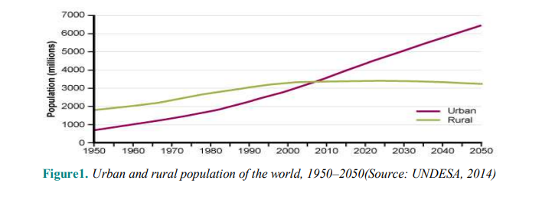
Urbanisation
Urbanization is the steady increase in the number of people living in cities or urban centers.
  Urbanization: share of population that live in urb areas.
  Urban Growth: refers to the overall growth in the population that lives in cities.
The definition of what qualifies a town as an urban centre differs from one country to another depending on the population criteria used.
It is predicted that the world‘s urban population will rise from the current 58 percent to 75 percent by 2050.

Slide 3
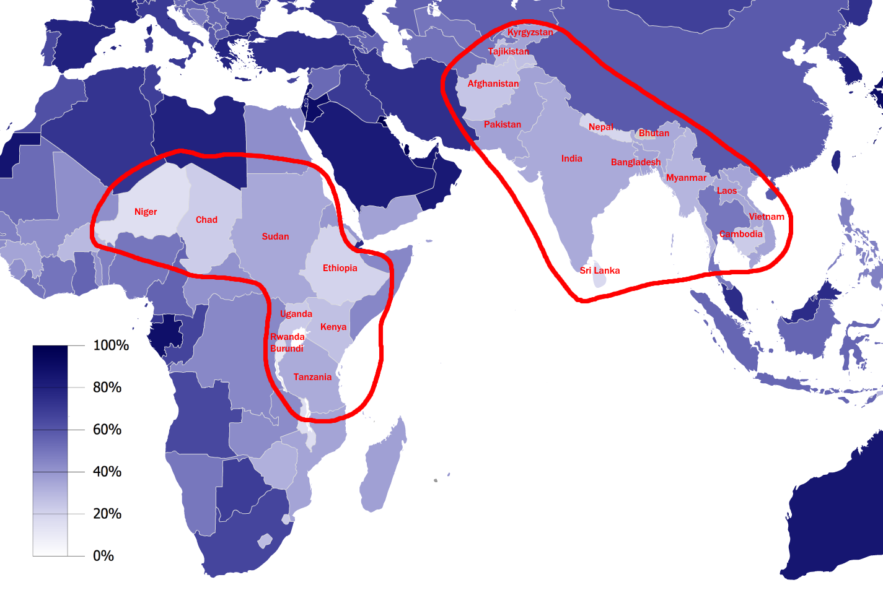
Urbanisation

Slide 4
Scientific Theories of Urbanization
A) The Theory of Self-Generated Urbanisation
B) Modernization Theory
C) Dependency/World-System Theory
D) Theory of Urban Bias
Van den Berg et al. - A Study od Growth and Decline → 4 phases of urbanization: a) Urbanization
b) Suburbanization
c) Deurbanization x reurbanization

Slide 5
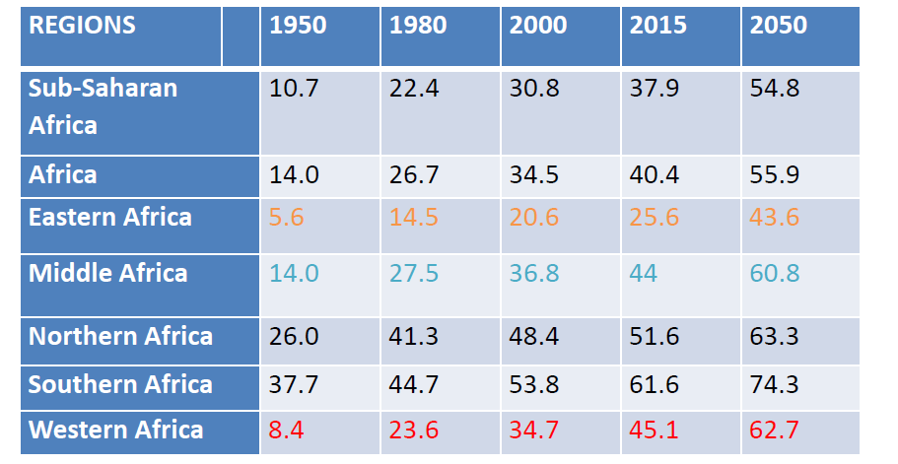
Urbanisation in Africa

Slide 6
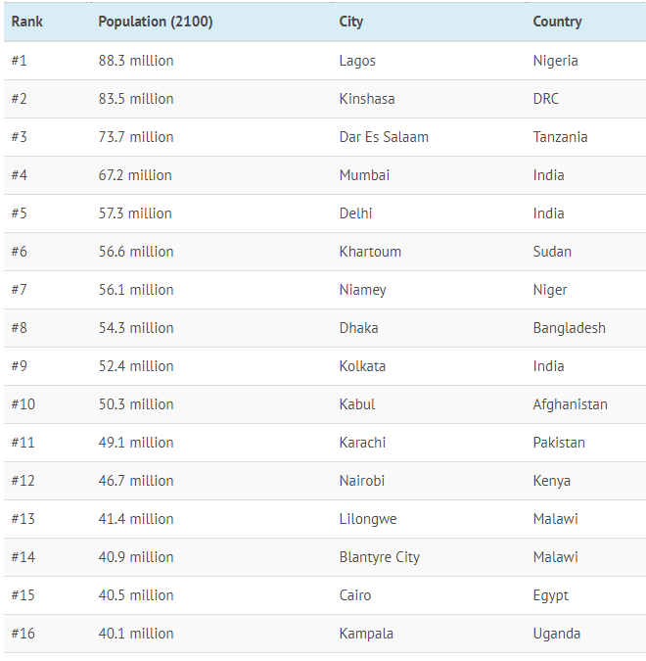
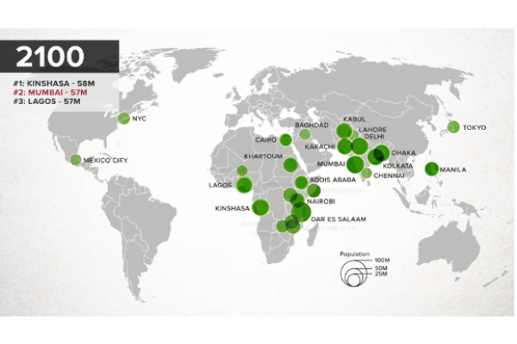
African Megacities
A megacity is a very large city, typically with a population of more than 10 million people.
A population density of 2,000 per square kilometer.

Slide 7
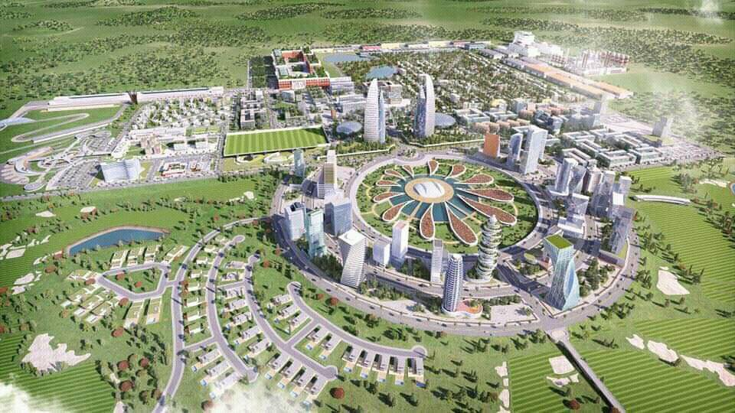
New Trend - Purpose-Built National Capitals?
Overpopulation vs. Conflict
Case of Nigeria (1991), Tanzania (1996), Ivory Coast (1983), and Burundi (2018)
In progress: South Sudan (2011), Egypt (2015), Equatorial Guinea (2015)

Slide 8
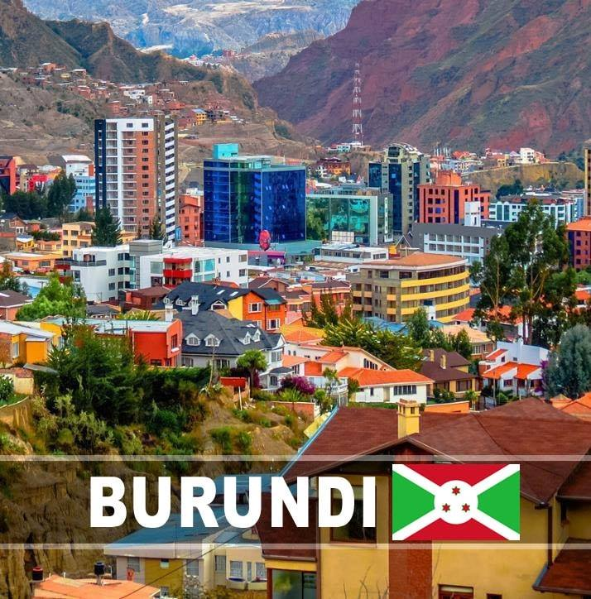
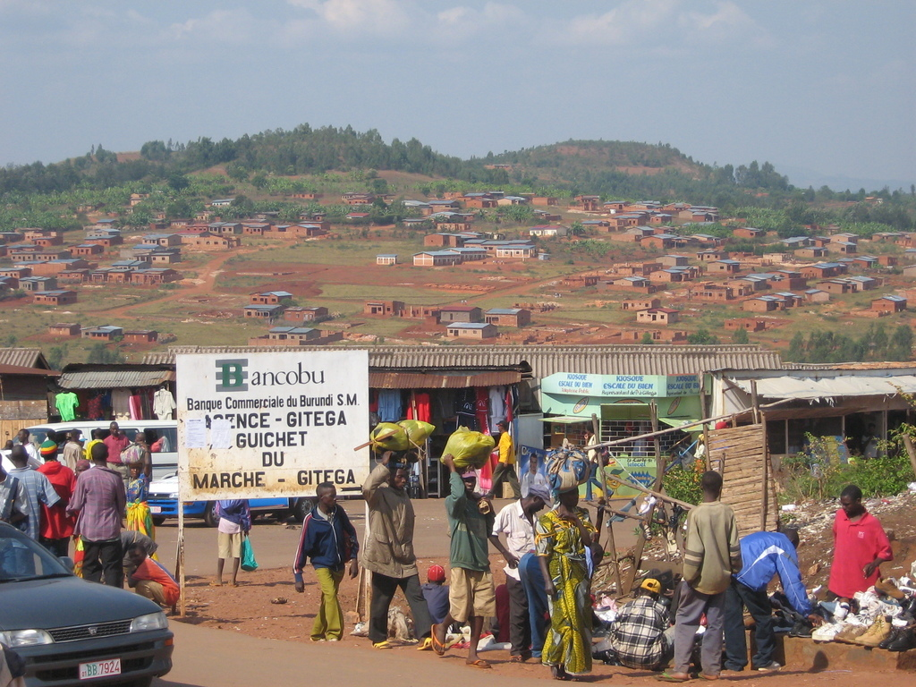
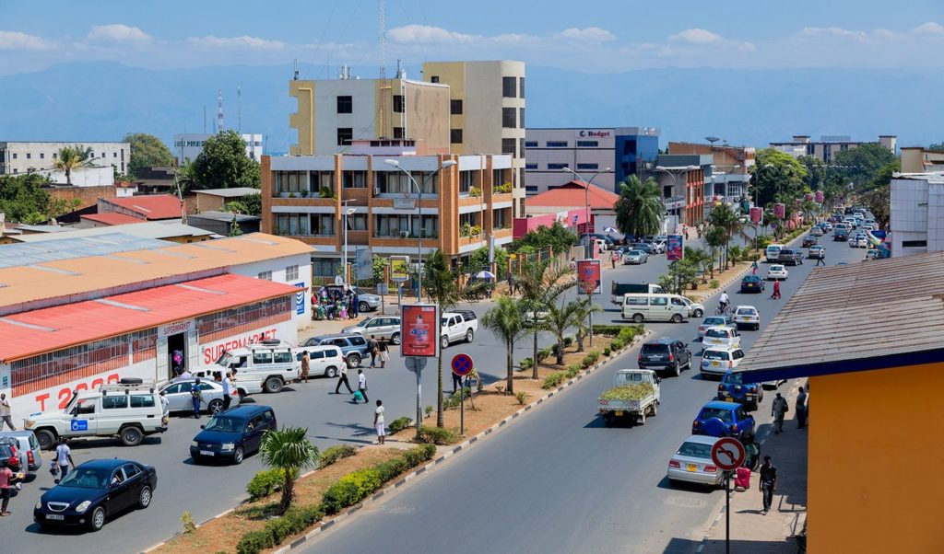
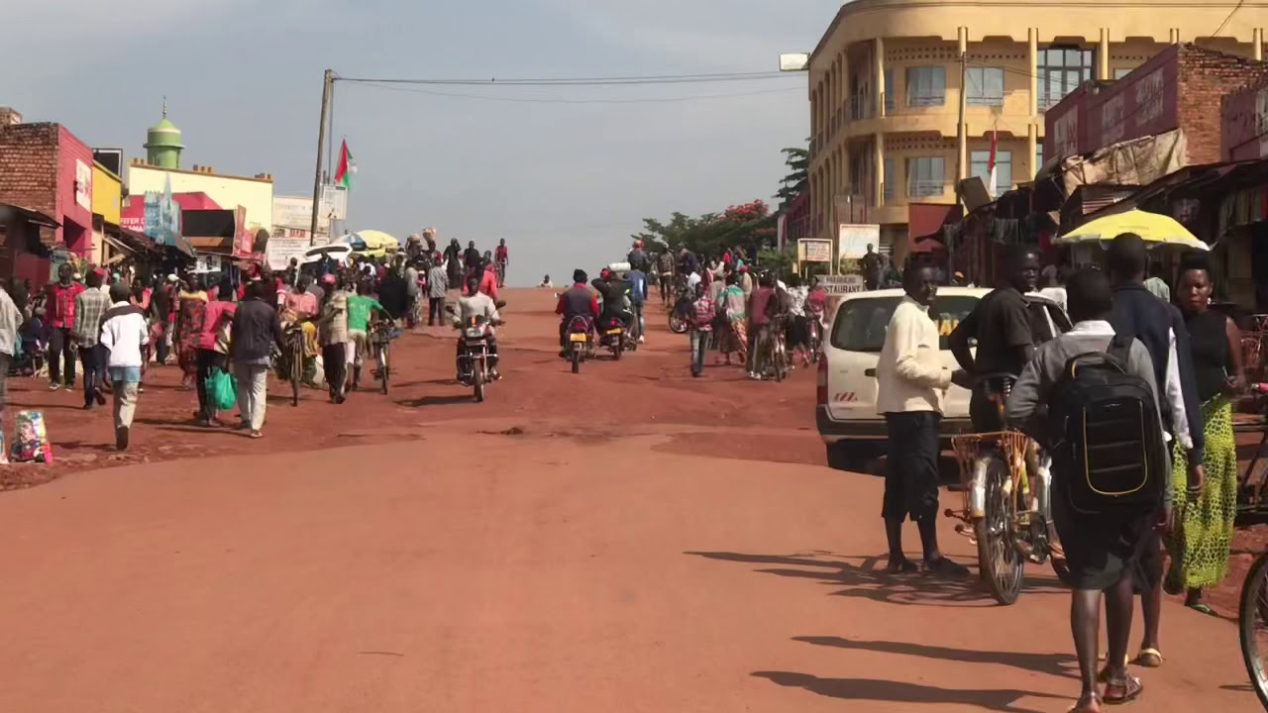
Bujumbura vs.
Gitega

Slide 9
Negative Effects of Urbanization in Africa
Economic Dimension
Severe shortage of affordable housing in areas
Household mortgage debt
Increasing unemployment
Economic losses in tourism areas due to degraded landscape scenery
A higher dependence on imported food
Higher infrastructure and public service costs, such as water supply, sanitation, electricity, public transport, waste management, policing and other services
b) Planning Laws and Policy Dimensions
Lack of public transport, poorer connectivity, traffic congestion
Unplanned growth and un-coordinated development
Unequal distribution of public amenities
Formation of dormitory towns (makes provision of services and infrastructure difficult and costly)

Slide 10
Negative Effects of Urbanization in Africa
c) Environmental Dimension
Loss of vegetation (Habitat loss for fauna and flora or irreversible damage to local ecosystems) and biodiversity
Increased (air, noise, light) pollution, water pollution and alteration of the hydrological properties of the water
Loss of productive agricultural land leading to higher dependence on imported food
Energy and climate change (due to higher energy consumption and higher greenhouse gas emissions per individual)
Environmental impacts through transformation, degradation and fragmentation of urban areas and change in perception of the landscape
d) Social Dimension
Social effects such poverty, lack of opportunities, psychological problems, alcoholism, drugs, crime, violence and other irregular behaviors, limiting the quality of life, reduced community ties, missing cultural identity, loss of rural heritage.
Higher costs for transport
Mobility issues such as traffic congestion
Reduction in social interaction
Car dependency
Public health issues
A reduction in food production and self-sufficiency

Slide 11
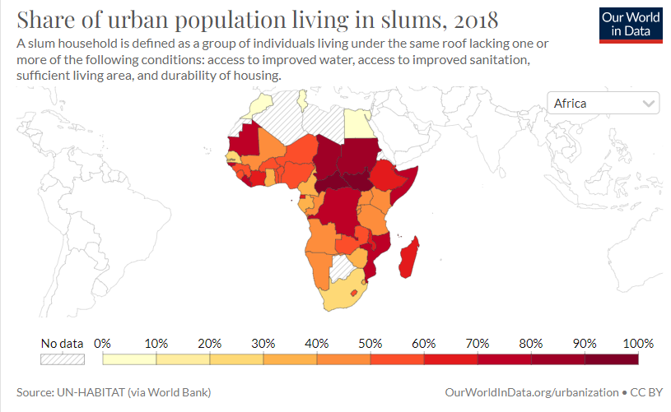
Slumization
„The United Nations Human Settlements Programme (UN-Habitat) defines a slum as an urban area with lack of basic services (sanitation, potable water, electricity), substandard housing, overcrowding, unhealthy and hazardous locations, insecure tenure, and social exclusion.“

Slide 12
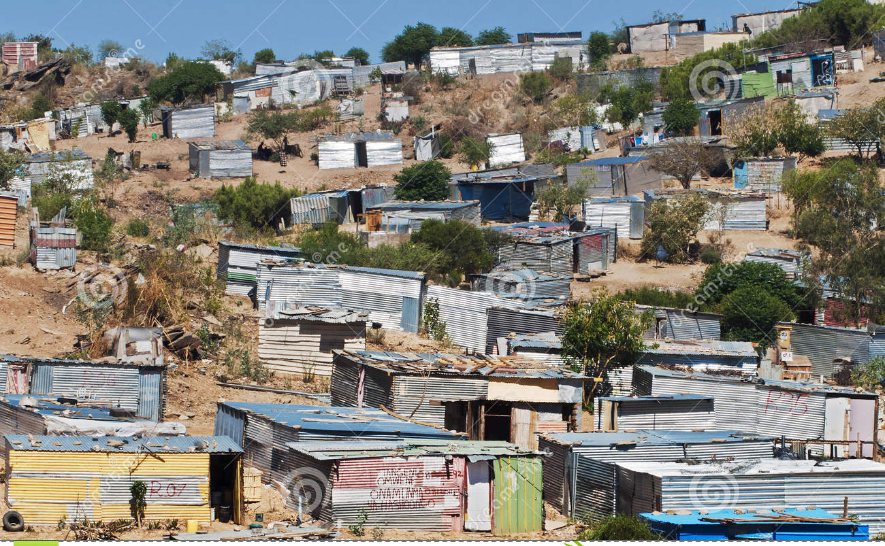
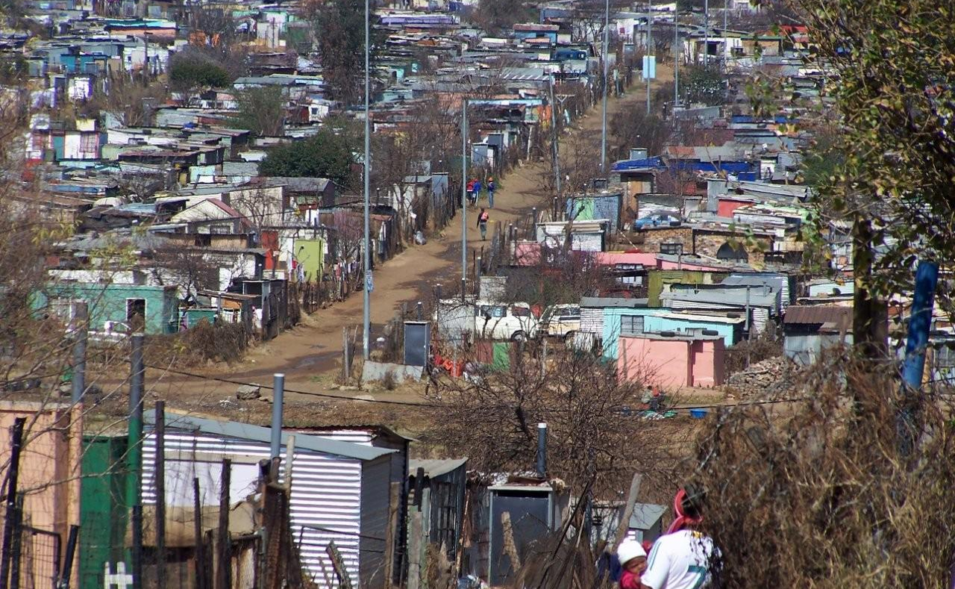
Slums in SA and Namibia
https://en.wikipedia.org/wiki/List_of_slums_in_South_Africa

Slide 13
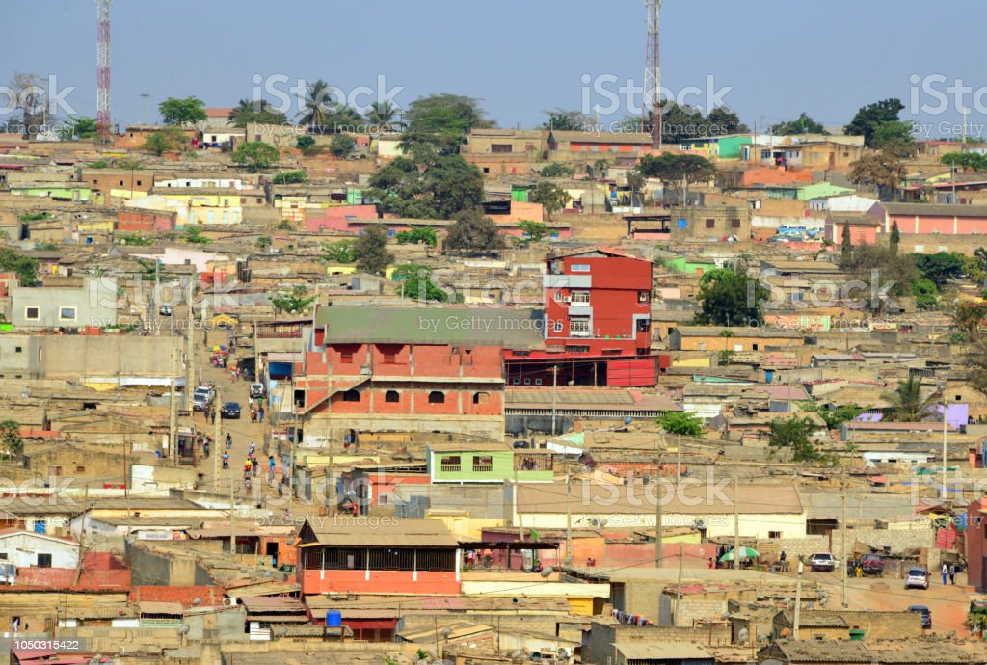
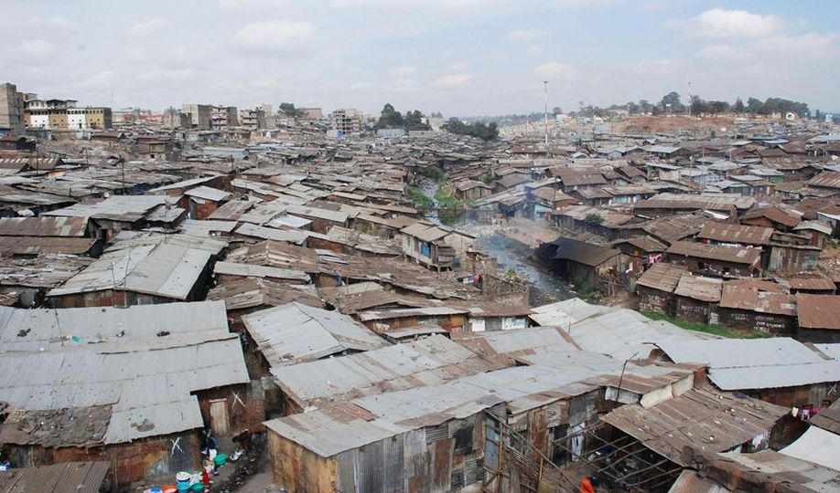
Slums in Angola and Zambia

Slide 14
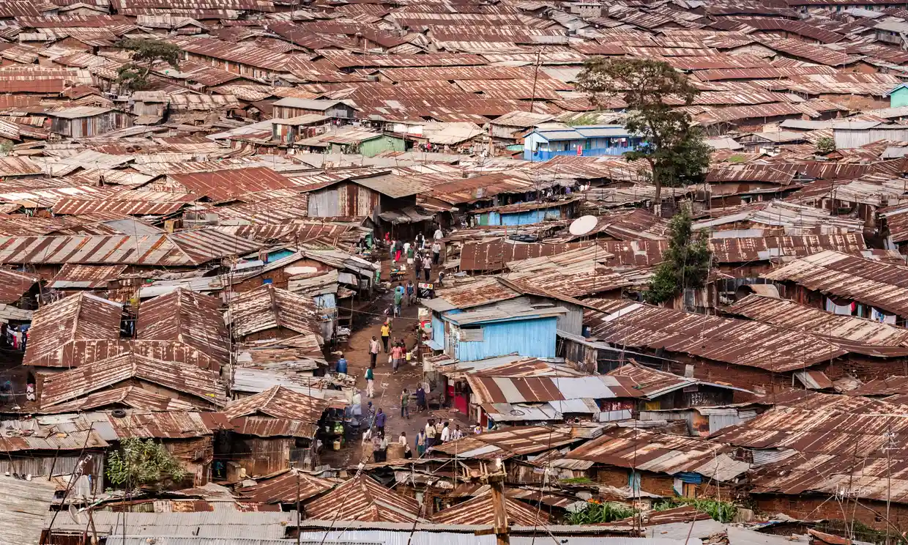
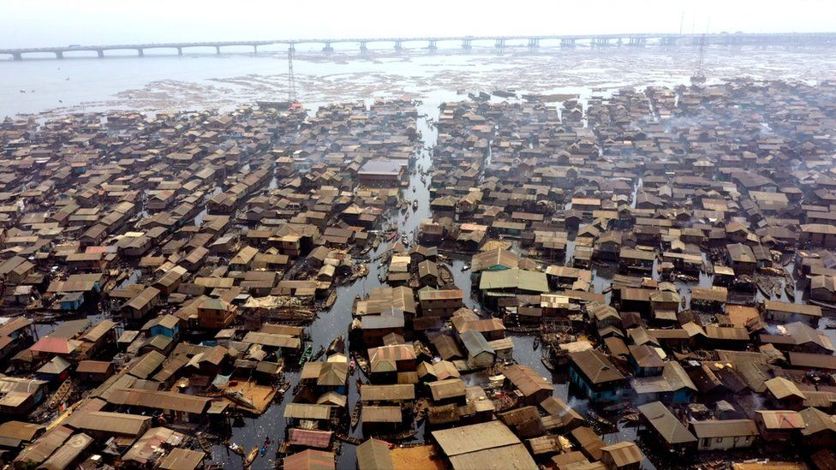
Slums in Kenya and Nigeria

Slide 15
Land Issues Among Population
White vs. Black people
  Land reforms in SA – 1996 (87% owned by White), 2012 (67% owned by White), 1997 White Paper on Land Reform, 2011 Green Paper on Land Reform, since 2017 attempts of Land Expropriation without Compensation (LEWC).
  The number of farmers of European descent had decreased by one third since 1997. 2001 - Committee of Inquiry into Farm Attacks.
  Creation of private armed patrols - „Farmwatch“
  Protests in Bloemfontein 2017, murder of Klapmuts farmer Joubert Conradie -#BlackMonday convoy, Violence in Senekal 2020.
  Land reforms in Namibia - "Willing buyer, willing seller" principle applies, Land Reform Act of 1995 – three pillars, 2004 land value tax.
  Land reforms in Zimbabwe – Lancaster House Agreement 1980, Zimbabwean Land Acquisition Act of 1992, 2005 – Constitutional amendment Fast Track - Zimbabwe National Liberation War Veterans Association (ZNLWVA).
Farmer vs. Pastoral conflicts
  Fulani in the Sahel
  Laikipia plateau, Turkana, etc.
  Agogo conflict

Slide 16
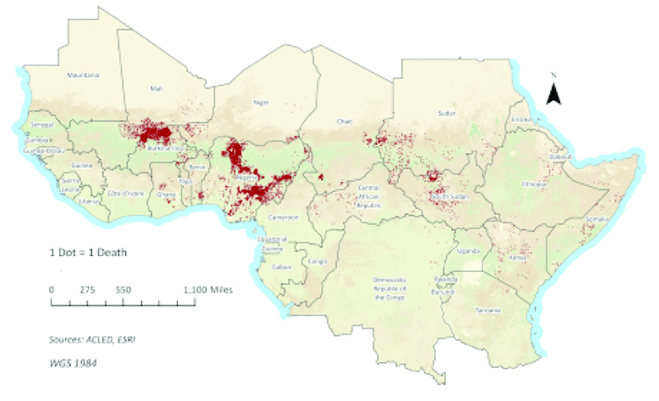
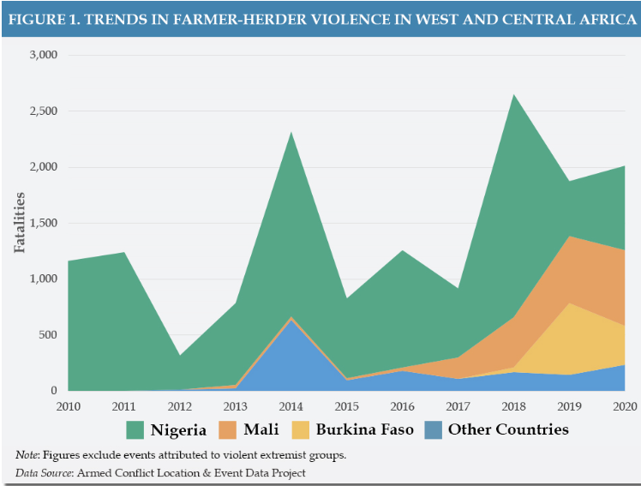
Land Issues Among Population

Slide 17
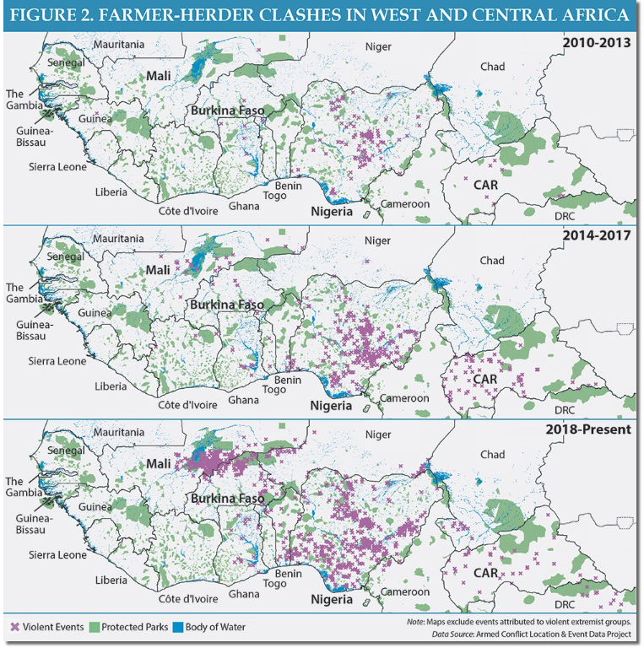
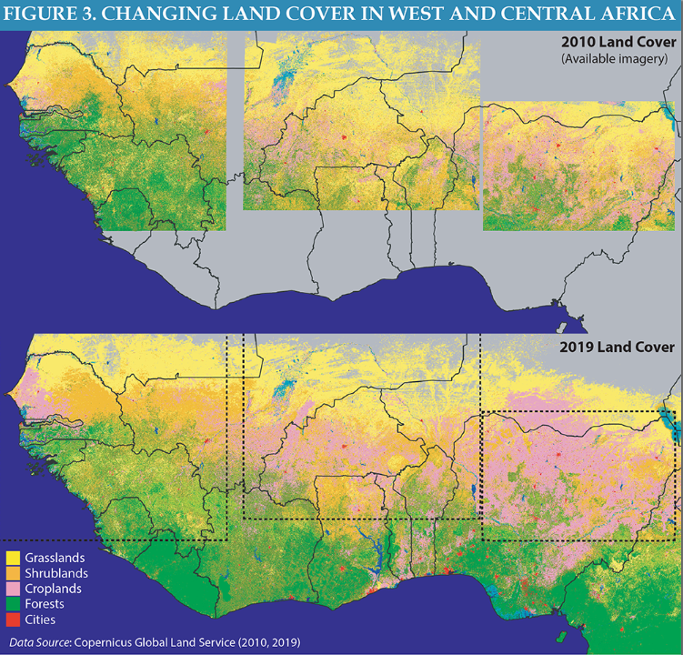
Land Issues Among Population

Slide 18
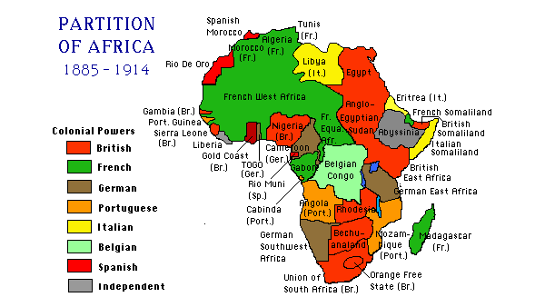
Territorial Disputes among States
https://www.youtube.com/watch?v=0xxaX4xlWE4

Slide 19
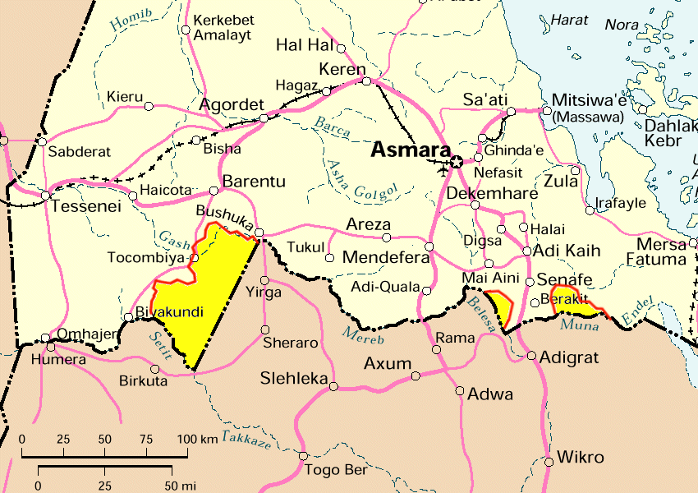
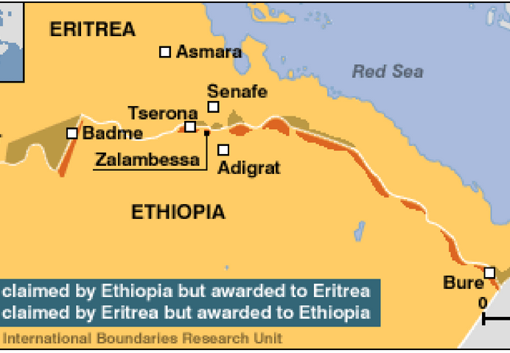
Eritrean-Ethiopian War

Slide 20
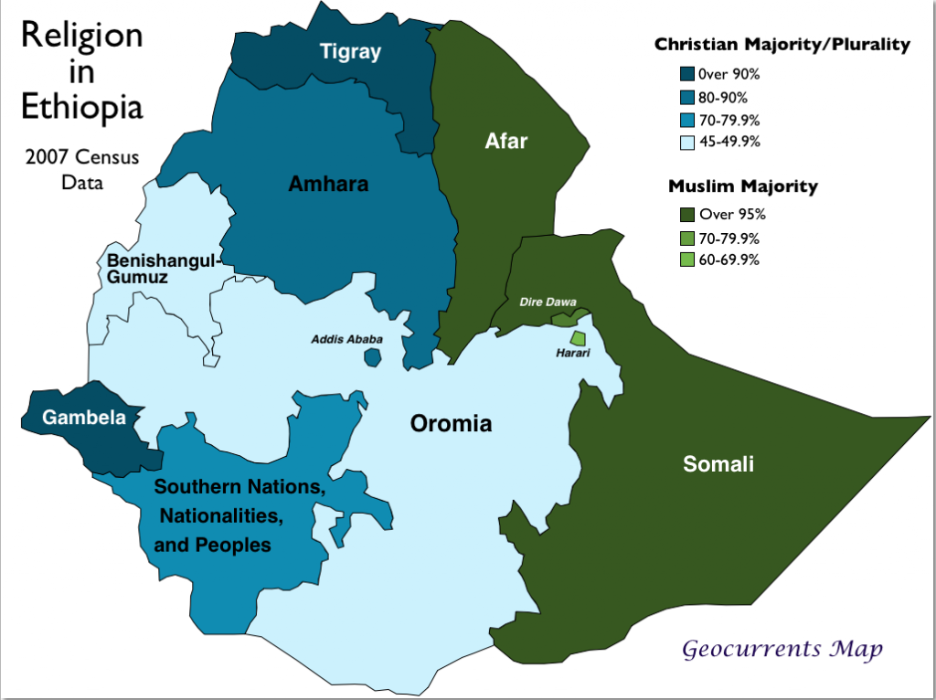
Separatism
Autonomism - territorial autonomy within the state (certain degree of self-governance and independence within a larger political entity).
Secessionism – obtaining an independent status for a certain part of the territory
Seperatism – in general term for any independence/separation; specifically: secession of several territories and union in a newly created territory with a certain status
Irredentism - incorporation of a part of a territory into another existing entity
Case Study of Ogaden

Slide 21
Thank you for your attention

