Slide 1
Weakening of the state
Lucie Konečná
GLCb2026 Africas Contemporary Security Challenges
27/3/2024

Slide 2
State Components and State Types
The state as a person of international law should possess the following qualifications:
  a ) a permanent population;
  b ) a defined territory;
  c ) government;
  d) capacity to enter into relations with the other states
(Convention on Rights and Duties of States 1933)
Typology of states:
1. Superpowers
2. (Regional) Powers
3. „Normal“ states
4. Microstates
5. Dependent states and territories
6. Failed states

Slide 3
Position of States in the International System/Polarity
Polarity expresses the number of autonomous centers of power and is a function of the distribution of power among only the most important actors
1. Unipolarity
2. Bipolarity
3. Tripolarity
4. Multipolarity
5. Hyperpolarity (total symmetric desintegration of power)
6. „Zero-polarity“ (total cooperation)

Slide 4
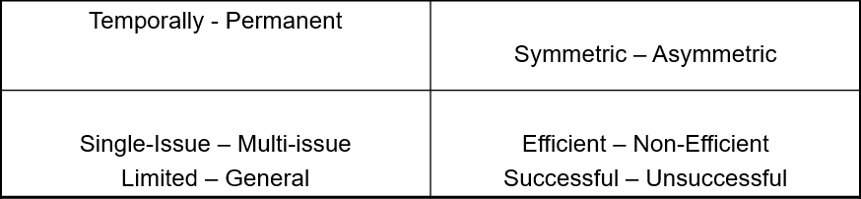
Position of States in the International System/Alliance
Security alliance is „formal agreement between two or more actors (usually states) to cooperate together on perceived mutual security issues. By allying themselves together it is anticipated that security will be increased in one, some or all of the following dimensions:
By joining an alliance system of deterrence will be established or strengthened;
By joining an alliance a defence pact will operate in the event of war;
By joining an alliance some or all the actors will be precluded from joining other alliances“ (Evans, Newnham 1998: 15).

Slide 5

Position of States in the International System/ Balancing and Bandwagoning
Balancing is more common than bandwagoning.
The stronger the state, the greater its tendency to balance. Weak state will balance against other weak states but may bandwagon when threatened by great powers.
The greater the probability of allied support, the greater the tendency to balance. When adequate allied support is certain, however, the tendency for free-riding or buck-passing increases.
The more unalterably aggressive a state is perceived to be, the greater the tendency for other to balance against it.
In wartime, the closer one side is to victory, the greater the tendency for other to bandwagon with it (Walt 2009: 102)

Slide 6
Strategies for Ensuring Security
Schroeder (1994): „Do all states, or virtually all, or all that really count, actually resort to self-help? → in the majority of instances, they have NOT!
four possible strategies
  balancing - as a form of self-help
  bandwagoning - joining the stronger side for the sake of protection and payoffs,
  transcending - to solve the problem, end the threat, and prevent its recurrence through some institutional arrangement
  hiding from threats - ignoring the threat / declaring neutrality / withdraw into isolation / assuming a purely defensive position…
the prevalence of balancing in international politics not backed up by evidence

Slide 7
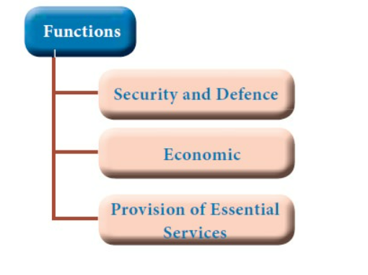
Functions of the State
The concept of the state emerged from a social contract theory, where inhabitants agreed to delegate certain rights and powers to a governing body in exchange for protection and the facilitation of societal order. This mutual agreement forms the basis of the state's authority and its responsibilities towards its citizens.
The only legitimate monopoly on violence.
Basic functions according to Zartman:
a) state as a sovereign authority (law and order)
b) state as an institution (good governance)
c) state as a guarantor of security (domestic peace)
Robert I. Rotberg: state is an instrument for providing political goods to citizens. Three Dimensions:
          Political (e.g. effective rule of law, political freedom)
          Security (state's monopoly on the use of violence)
          Economic (economic opportunities, education, etc.)

Slide 8
Reasons for Weakening and Collapse
„The collapse of the state occurs in a situation where the state is no longer able to provide its citizens with positive political goods and gradually loses its legitimacy in the eyes of citizens.“ (Rotberg 2002)
Rotberg - so-called Indicators of Failure:
a) Political Indicators (non-functioning democracy, subordination of legislation and judiciary to the executive, only privileged groups can use all state services, etc.)
b) Economic Indicators (declining income of the population, rising unemployment, poor education and health system experiencing deficiencies (medicines, textbooks), lack of fuel, corruption, etc.
c) Security Indicators/Level of violence (increasing levels of violence due to skirmishes, hostilities or civil war; decreasing level of security; rising crime rates and civilian casualties in conflicts)
Daniel C. Esty - three indicators, their fulfillment leads to collapse: closed domestic market, high infant mortality rate and undemocratic establishment.

Slide 9
Reasons for Weakening and Collapse
Zartman's so-called typical collapse scenario in Africa:
1. long-term ruling regime unable to meet the needs of different groups within society
2. newly dried up resources (reasons either exogenous or through internal waste and corruption)
3. social and ethnic groups feel neglected
4. atmosphere of discontent and opposition speaks out against the regime -> intensification of repression
5. sometimes a military regime is imposed; accompanied by martial law and escalating repressions
6. the final stage of the collapse of the state
The final stage of collapse is typically characterized by: central government loses its power base, power devolves to the peripheries, government malfunctions by avoiding necessary but difficult choices, government practice only defensive politics, centre loses control over its own state agents.

Slide 10
Typology According to Rotberg
Strong States – provide all services, have a good GDP, Human Development Index, rule of law prevails, courts are independent, ensure political and civil liberties, low level of crime, etc.
Weak States – mostly have linguistic, religious, or ethnic tensions (not violent), crime is rising, infrastructure is poor, GDP and the economy is declining or low, high levels of corruption which continue to grow, etc.
Failing States – transitional phase, the beginning of violence across various armed factions (the deterioration of other indicators such as the drop in GDP, the increasing level of corruption, the growing crime rate etc.)
Failed States – various armed factions fighting for power, high levels of violence and crime, huge levels of corruption, destroyed infrastructure, politicized military, declining GDP, economic opportunities only for the privileged, etc.
Collapsed States – an extreme version of failed state (vacuum of authority, services are mediated privately, some not at all, the rule of the strong, not of law, territory is divided among VNSAs,

Slide 11
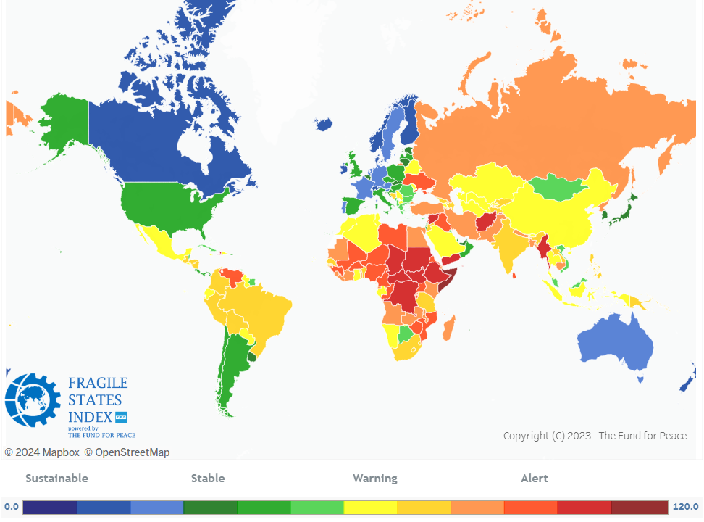
Fund for Peace – Fragile State Index

Slide 12
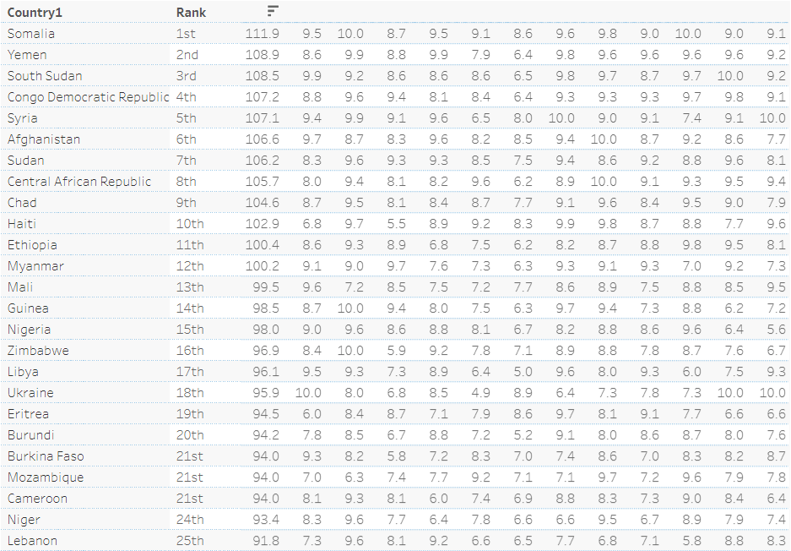
Fund for Peace – Fragile State Index

Slide 13
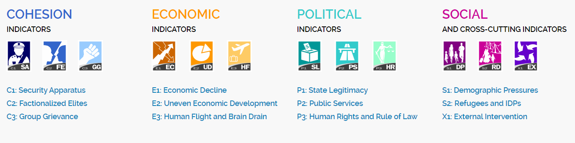
Fund for Peace – Fragile State Index

Slide 14
Characteristics of Failed/Collapsed States
Characteristic signs according to the UN General Assembly:
Inability of the central government to control state territory, fighting over natural resources between the central government and local groups
Loss of the authority of state institutions, the power struggle between the central government and other groups (militias, state army, local groups, religious groups)
Dysfunctional economy, high inflation, growth of the shadow economy, increasing national debt, currency devaluation
Increase in illegal emigrants
Loss of citizens' influence on the functioning of the state, unbalanced relationship between citizens and the state
Crime, emergence of terrorist training camps, drug trafficking
Poverty, hunger, absent or dysfunctional social systems

Slide 15
Typology of Failed States
Jean-Germain Gros – „failed states are those states where "public authorities are no longer able or willing to carry out their purpose, i.e., in Hobbes's terms, the social contract, which nowadays involves more than the preservation of peace between parts of society and their interests" (Gros 1996: 456-457)
Five types of failed states:
a) Anarchic state
b) Phantom/mirage state
c) Anaemic state
d) Captured state
e) Aborted state

Slide 16
How to Approach Collapsed States?
Solutions, the UN Approach According to J. Hamre and G. Sullivan:
Do nothing
Isolate failed/collapsed states
Divide into small parts
Integrate into a larger entity
Establish international authority
Provide neighbourhood supervision
Help one side of a conflict
International response through intervention or other measures

Slide 17
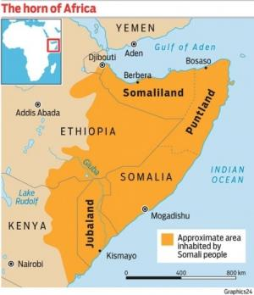
Quasi States and de Facto States
A state that has internal sovereignty but lacks external sovereignty
Jochen A. Frowein – De Facto State
De facto state, para-state, unrecognized state, empirical statehood, quasi-state
Entities that have the external attributes of the state (state symbols, institutions, economy, etc.), but lack the defining political characteristics of the state - external sovereignty - international recognition.
Scott Pegg - Quasi state ≠ De Facto State
Case of Somaliland

Slide 18
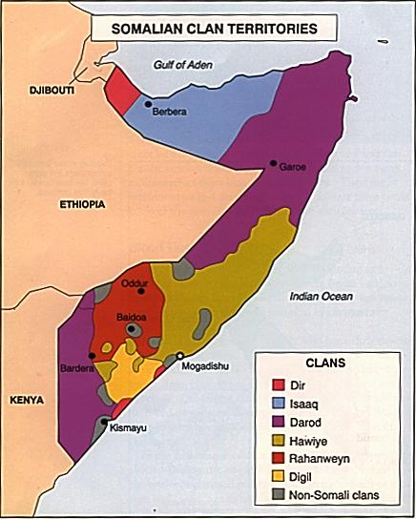
Case Study of Somalia
Hussein Adam - the predominance of internal factors over external ones:
Barre's dictatorial government
Clanism as an ideology - favoring the Darod
Repression of educated elites
Persecution, brutality, and politics of divide and conquer
Negative campaign against the north
Foreign aid - the end of the Cold War
The different colonial history, the independence of Djibouti, the dispersion of Somalis across several states, the overall underdevelopment of the country, the climate – extreme droughts.

Slide 19
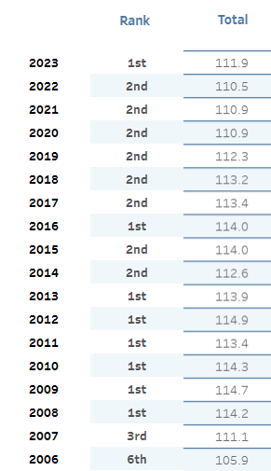
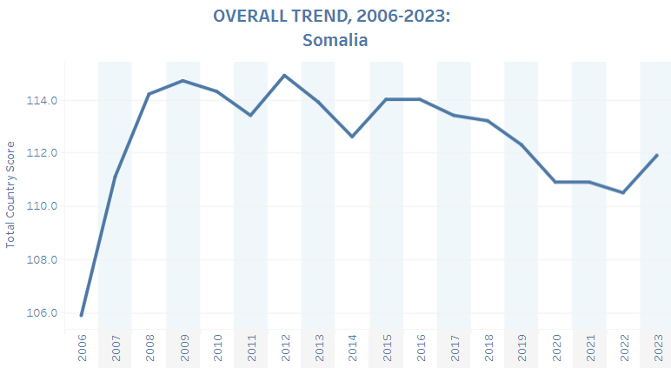
Case Study of Somalia

Slide 20
Thank you for your attention

