Slide 1
Visual culture and practices
Class 5. Embodied vision, representation and in/visibility 25.03.2024

Slide 2
Embodied vision, representation and in/visibility
Questions textS Brighenti & Piper?
Visibility as a field
Passing, Visibility and representation
Self-representation
Summary

Slide 3
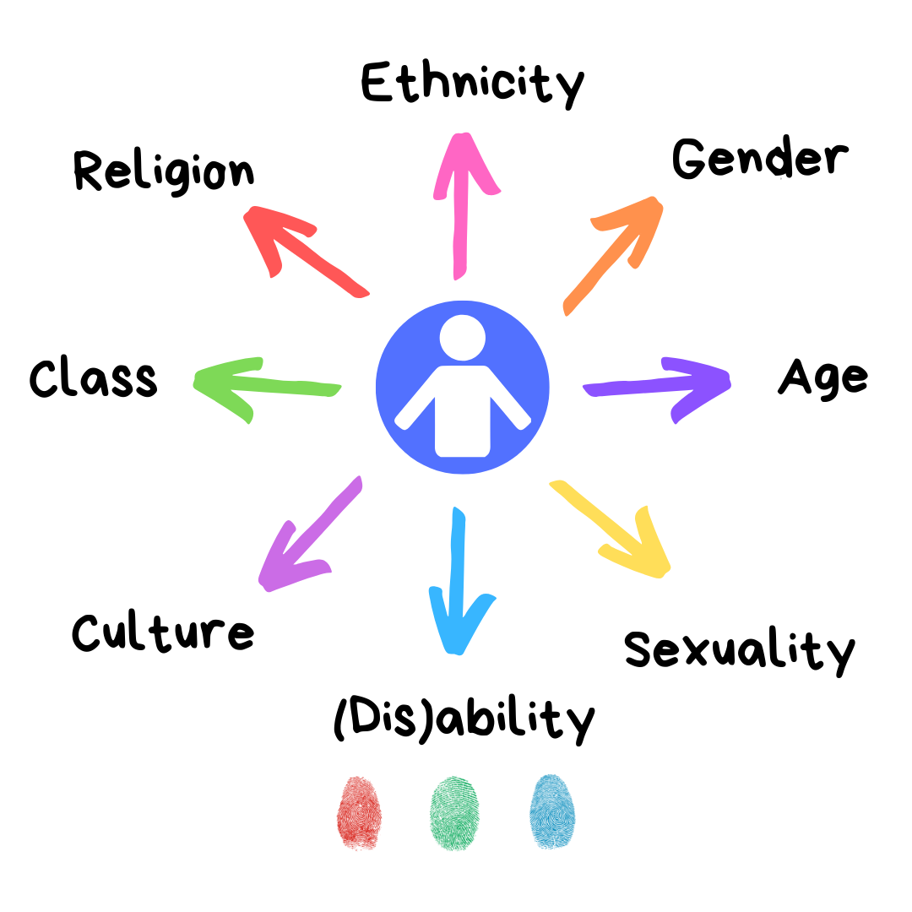
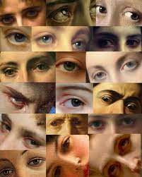
2. Visibility as a field
Visibility as a ‘new’ social science category
Gillian Rose: ‘Images can picture social power relations’, images don’t just illustrate these power relations, they also construct and depict social difference
Visibility and link with power: tension of recognition/empowerment and control/surveillance

Slide 4
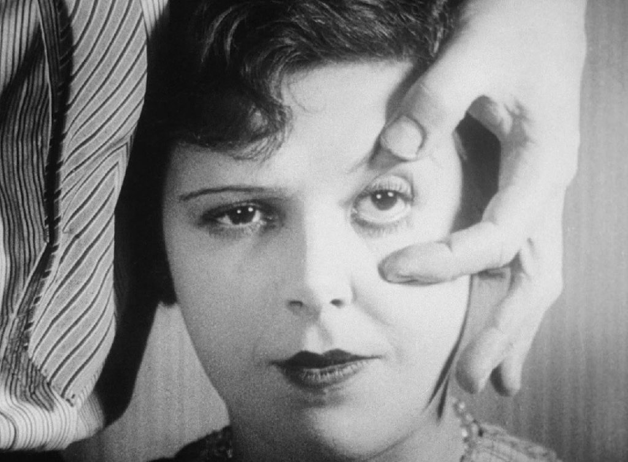
2. Visibility as a field
Visibility is a complex social phenomenon that ‘lies at the intersection of the two domains of aesthetics (relations of perception) and politics (relations of power) (Brighenti 2007: 324).
Visibility as a field: contradictions, tensions, contexts (‘ambivalence of visibility and its effects’)
‘Social effects of visibility depend on who is more visible in which site’ (Brighenti 2007: 331) and ‘depends on which subjects act in which places’ (ibid.: 335)
Luis Buñuel, un Chien Andalou (1929)

Slide 5
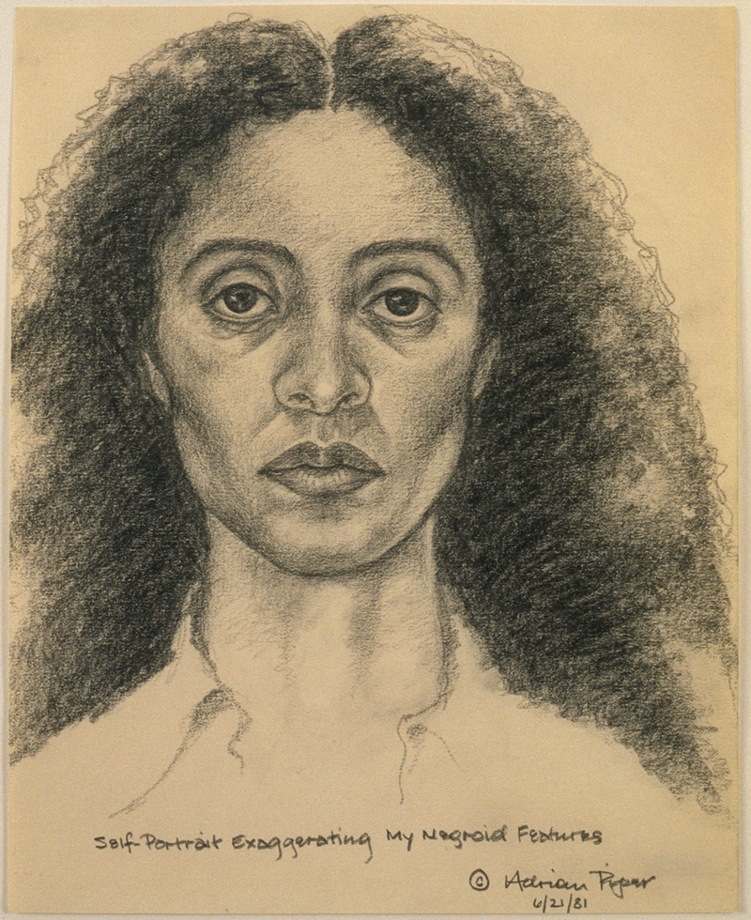
3. Passing, visibility and representation
Racial passing, in/visibility, (acccess to) privilege and social status, pride and shame
‘Finally, there was the groundless shame for the inadvertent impostor, exposed to public ridicule or accusation. For this kind of shame, you don’t actually need to have done anything wrong. All you need to do is care about others’ image of you, and fail in your actions to reinforce their positive image of themselves. Their ridicule and accusations then function to both disown and degrade you from their status, to mark you not as having done something wrong but as being wrong’ (Piper 1999: 354).
Adrian Piper, Self Portrait (1981)

Slide 6
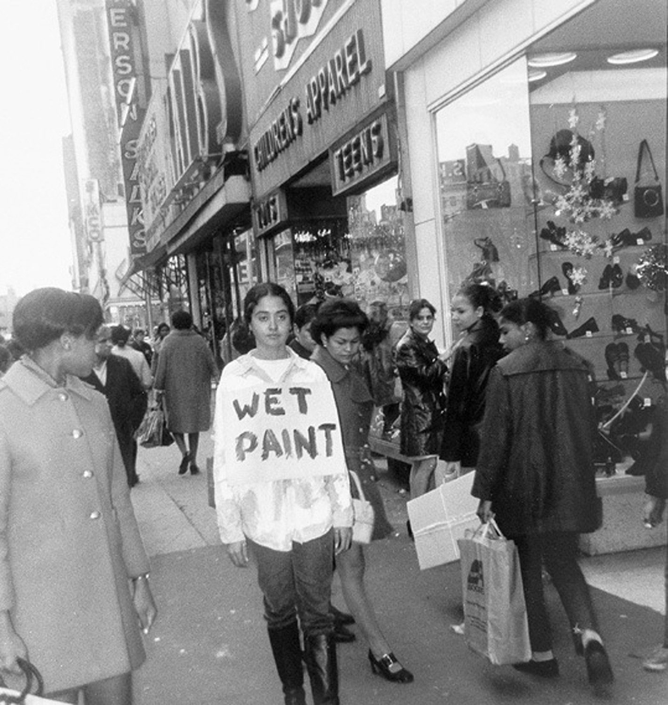
3. Passing, visibility and representation
Other people’s image (and imagination) of you ⬄ recognition vs control, visibility and its social effect dependent on subjects and places involved
‘Passing in order to get the benefits you know you deserve may seem the only way to defy the system’ (access to social status and privileges)
Passing: ambiguity of “real” self and the person society perceives you to be
Adrian Piper, Catalysis III (performance, 1970)

Slide 7
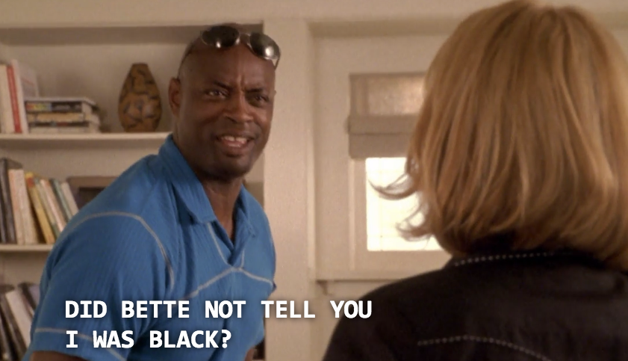
3. Passing, visibility and representation
L word S1E9 (2004) – intersectionality and “outing”
https://www.youtube.com/watch?v=oZe7FVg4t78&list=PLqfDkucG0VrQeann3UVOK2auYzMAr37Gc&index=11
https://www.youtube.com/watch?v=4eKOs-KOHy0&list=PLqfDkucG0VrQeann3UVOK2auYzMAr37Gc&index=12

Slide 8
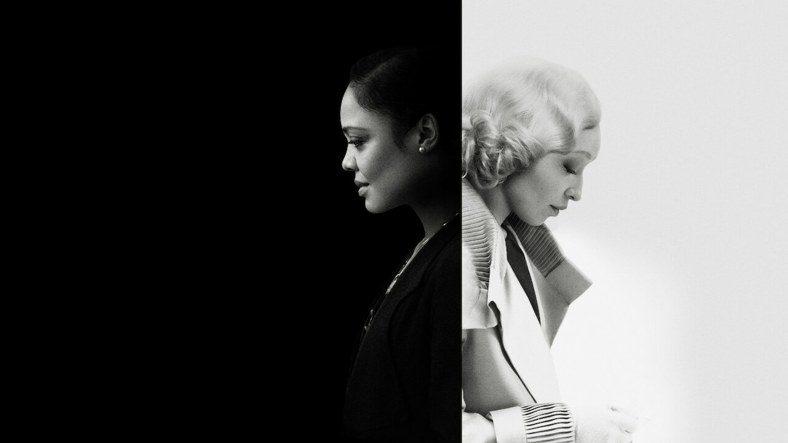
3. Passing, visibility and representation
Passing (2021, Rebecca Hall), adaptation of 1929 novel “Passing” by Nella Larsen
https://www.youtube.com/watch?v=trwq3CNCMkU

Slide 9
3. Passing, visibility and representation
Invisibility and (mass) media representation: film, TV series, online culture, advertisement (paintings, theater, ...)
(Self)representation: who is in charge of (visually) representating a certain individual/group of a particular identity category and/or background (cf insider/outsider debate sociology and anthropology)
Sensible and diverse representation: the opposite of stereotypical, violent and one-sided screen representations (voyeurism, exoticism, orientalism, racism, xenophobia, sexism, homophobia, transphobia; “flat” characters versus fully developed protagonists and plot development)

Slide 10
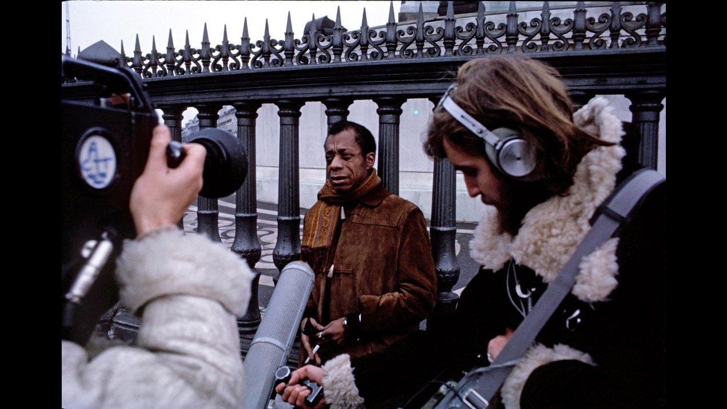
3. Passing, visibility and representation
James Baldwin (American writer and civil rights activist)
Meeting the Man: James Baldwin in Paris (1972, Terence Dixon)
https://mubi.com/en/cz/films/meeting-the-man-james-baldwin-in-paris

Slide 11
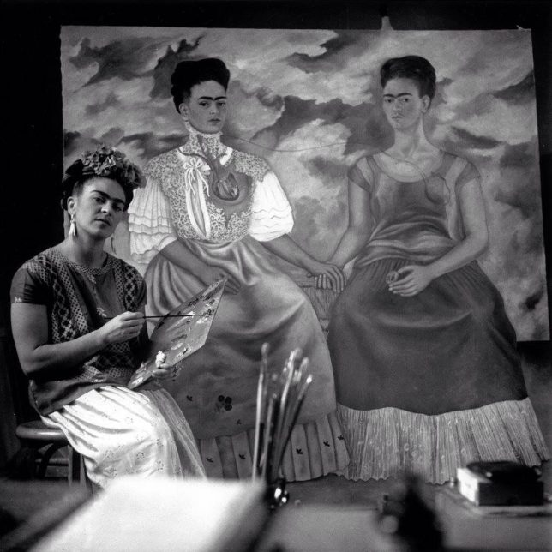
4. self-representation
Media visibility and (self)representation: ‘empowerment’, self-determination and ownership
Self-representation and casting of insider actors in ‘minority’ roles (marginalized, minoritized) – against blackface history and violent representations of BIPOC and LGBTQIA* identities
https://www.youtube.com/watch?v=pqlD-eZm1ck&list=PLqfDkucG0VrQeann3UVOK2auYzMAr37Gc&index=16
Frida Kahlo, The Two Fridas (1939)

Slide 12
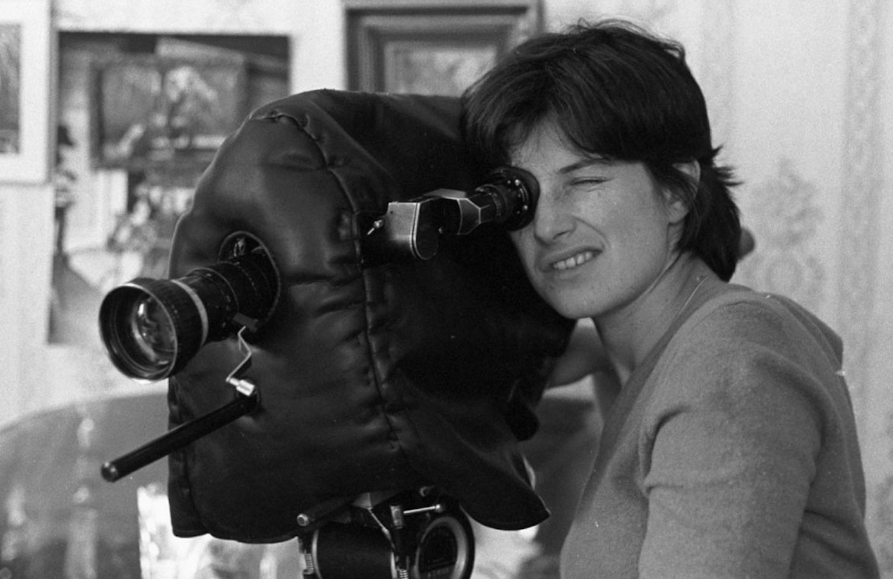
4. self-representation
Feminist cinema 1960s-1970s: female filmmakers and female subjectivity as main topic, away from the ‘male gaze’
https://www.youtube.com/watch?v=4VWEQc843YM
Chantal Akerman, News from Home (1976)

Slide 13
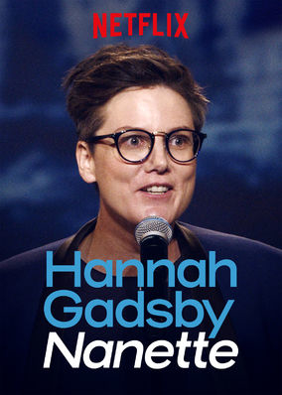
4. self-representation
Hannah Gadsby: queer neurodivergent (autistic + ADHD) comedian, writer and actor
Nanette (2018): issues of homophobia, xenophobia, sexism and gendered violence; critique on systemic violence and conventions of self-depreciation in the field and genre of stand-up comedy
https://www.youtube.com/watch?v=5aE29fiatQ0

Slide 14
Summary
Visibility as a field: contradictions and tensions, social effects dependent on subjects and sites
Media representations and visibility: passing and privilege
(Self)representation as layered notion in (visual) media contexts

Slide 15
Next class
8/4: no class, self study!
Read text Mitchell and watchWays of Seeing ep.2 (John Berger/BBC, 1972) + The Biography of the Motion Picture Camera (Les Films du Compas/ Roger Leenhardt, 1947)

Slide 16
Next class
15/4 : visual research methods I: film analysis
Mulvey L (1975) Visual Pleasure and Narrative Cinema. Screen 16(3): 6-18.
Rose G (2023) Compositional Interpretation: looking with a ‘good eye’. In: Rose G (2023) Visual methodologies. An Introduction to Researching with Visual Materials, fifth edition, p.117-141. Los Angeles/London/New Delhi: SAGE.
Optional
Sobchack V (1990). The active eye: A phenomenology of cinematic vision. Quarterly review of film and video 12(3): 21-36.

