Slide 2
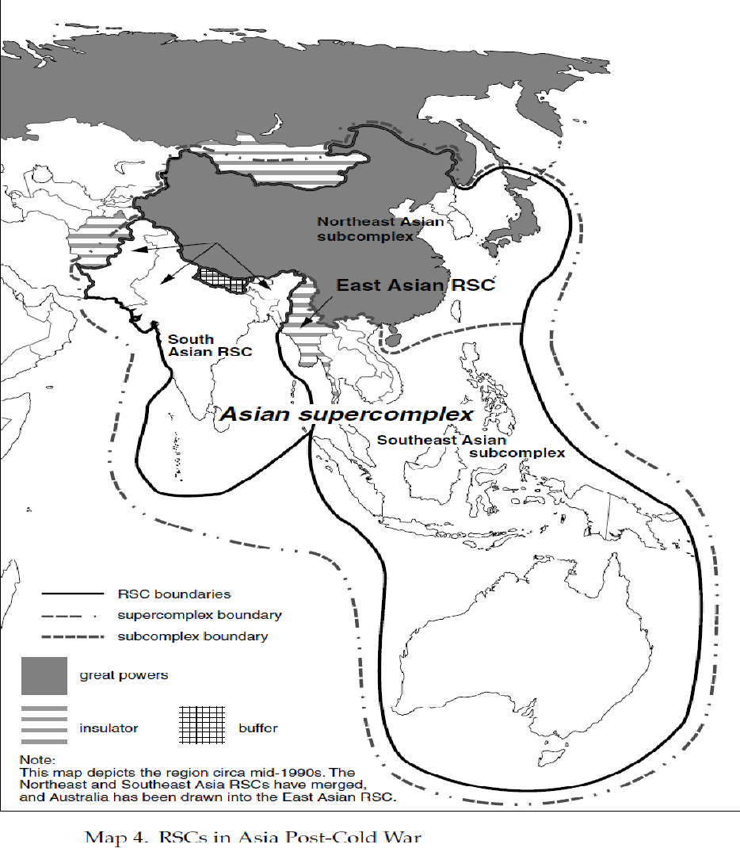
Asian RSC and the possible Asian supercomplex

Slide 3
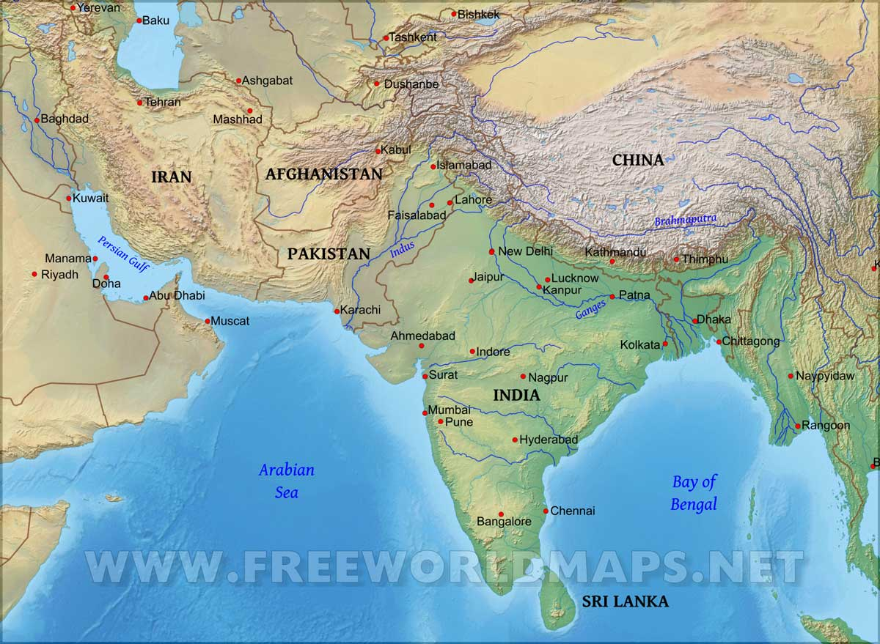

Slide 5
Regional Geopolitics (II): South Asia RSC
The region is insulated from the South-East Asian RSC by Burma from the East, while Afghanistan has also worked as an insulator from either the Middle-East, or from Central Asia after the Cold War. In addition, Iran could also be seen as an insulator from the Middle-East:
When observing the way security dynamics have been evolving in the region of South Asia, it is fairly clear that these have not been linked to dynamics from neighbouring regions. That is, as we will see below, neighbouring regions have influenced on the region and have participated in these dynamics, indeed. However, the nature of the regional dynamics stems mostly from features this region assumed from the very beginning of its formation.
As we see at the beginning of this slide, geography is determinant to understand why this region forms a particular RSC. However, we have not mentioned what is the most formidable insulator, and which is precisely the one that insulates South Asia from the East Asian RSC, arguably the one that can have a stronger influence. We are talking, of course, of the Himalayas, which we already had the occasion to see at the beginning of the course.
It must be said that this geographical insulator might have been reinforced if an independent Tibet had constituted as a strong political insulator. However, this never came to happen, for the country was annexed by China in 1951. This means that China would soon be able to project its power over this geographical insulator and constitute a vital inter-regional vector of influence on the South-Asian RSC, especially given the fact that China is classified as a great power. The potential for a conflictual securitization between India and China soon took a more concrete shape due to border disputes between both countries, as both India and China went to war in 1962. As a result of this war, China occupied the Indian territory of Aksai Chin.

Slide 6
Regional Geopolitics (II): South Asia RSC
The South Asian RSC saw the light in 1947 as a result of decolonization and it soon started as a conflict formation when India and Pakistan were separated amidst bloody civil strife. This is a RSC which represents a standard complex of bipolar character, reinforced by the nuclear status of both regional powers: India and Pakistan. The fateful role of human geography was here capital to understand how the region formed:
Long before British colonization, the Indian subcontinent was divided into several Hindu kingdoms in the Southern part, while most of the North of current India and all current Pakistan was ruled by the Mogul Empire, whose official religion was Islam. Mogul-based elites acquired great power during the British colonization. Then, eventually, when Indian nationalism, mostly based on the majority religion of the population, Hinduism, started taking shape, the stage was set for a confrontation between Hinduism and Islam. As a response to Hindu nationalism, Islam-based alternative nationalism developed in opposition. Hence, with the development of parallel nationalist movements, the basis was being established for the latter foundation of two different countries: India and Pakistan.
At the end of WWII, The UK took the decision that rule of the sub-Indian continent was no longer viable in the face of general opposition and that independence should be granted. However, the UK had now to deal with the intractable situation of two competing nationalisms, as seen above. As the minority of the Muslim population was mostly concentrated in nowadays Pakistan and Bangladesh, a partition plan was agreed so that a Muslim and Hindu state would succeed the former colonial rule. However, this clear-cut division resulted in a fateful territorial trap, as Muslim and Hindu minorities remained in the two new states. Thus, disagreements concerning this partition led to a brutal civil war that started in 1947 (date of both India and Pakistan´s independence) to 1948. Two regional powers were born in a context of enmity and ethnic cleansing: minorities were chased from their homes and forced to take shelter in a new homeland. For example, Pakistan was mostly freed of its Hindu minority, which had to resettle in India, whereas the same process happened in India, where since independence a 10% of Muslim remain, representing a lesser percentage than before partition. Both states would compete against each other and create a certain balance of power.

Slide 7
Regional Geopolitics (II): South Asia RSC
Compounding this problem, an especially sore point was inherited from this chaotic process of independence: the status of the region of Kashmir. In fact, in the midst of the civil unrest going on in each country (see above), a direct war erupted between India and Pakistan for the control of this contested region. The key to the problem, leading to what is officially known as the first India-Pakistan war, lasting from 1947 to 1948, took its roots again in human geography and territorial traps: the prince of Kashmir, a Hindu monarch ruling over a Muslim majority, wisely decided not to join either Pakistan or India, contrary to all other princes, who tended to join the country representing their subjects´ faith. However, Pakistan attacked Kashmir and the prince then decided to join India so that it could secure its territorial integrity. A ceasefire was agreed on under the auspices of the United Nations in 1948 which separated the region, with one side annexed to Pakistan and the other ruled from India. In addition, as already mentioned above, a third part, Aksai Chin, was annexed in 1962 by China.
The second war between India and Pakistan took place in 1965 and was motivated by the same dispute concerning Kashmir. In this war, Pakistan´s attempt at reuniting the whole region under its sovereignty failed in the face of Indian opposition, whose bigger power enabled her to maintain the status quo. This was, hence a useless and inconsequential war.
However, there would soon be a third India-Pakistan war, this time with bigger consequences. The war happened in 1971 and the focus was not this time Kashmir, but what was then known as Eastern Pakistan (and historically, Eastern Bengal), that is, what is nowadays known as Bangladesh. The region in question joined Pakistan in 1947 due to the fact its population was Muslim. Hence, one might be tempted to think that human and political geography matched perfectly. However, this was not fully the case, as the picture is more complex. Despite sharing the same religion, human geography shows us key cultural and linguistic differences. That is the reason Eastern Pakistan demanded autonomy first and when denied, opted for independence. In the midst of a brutal military repression, India jumped on the occasion and invaded the territory in support of the independence movement. Thus, independence was achieved through India´s help and the new state of Bangladesh was born.

Slide 8
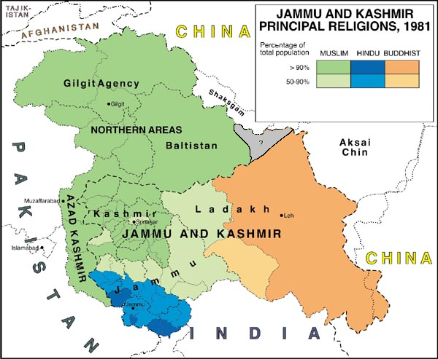

Slide 9
Regional Geopolitics (II): South Asia RSC
To complete the picture of the region, with the overwhelming presence of India and Pakistan, the two regional powers, we need to add, in addition to Bangladesh, as seen above, other small countries such as Nepal, Bhutan, Sri Lanka and the Maldives:
The particularity of the South Asian SRC is the huge imbalance between minor countries and the two regional powers. As the former are too small to influence India-Pakistan rivalry they have simply not tended to side with any of them, thus, at the same time, avoiding reprisals from any of them as a punishment for their alignment.
In principle, the overwhelming presence of India, with its huge size and population, and neighbouring to each of these minor countries, gives it an edge compared to Pakistan, more marginal both given its limited weight and its more marginal geographical position. This could have been the basis for a process of regional integration centred in India. In fact, such a dynamic of integration has happened with the creation of the South Asian Association for Regional Cooperation (SAARC).
The SAARC includes all countries of the region, even Pakistan, despite its hostile relations to India, as well as Afghanistan. Created in 1985, however, the organization has not been very successful in its process of integration: one important element is based on the physical geography, as a map will easily tell you that these countries are isolated from each other. Geographical continuity being small, no coalition of minor powers negotiate with India in equal conditions and have therefore strong incentives not to negotiate in too unequal terms with India.
But if this was not sufficient, all these countries tend to have a very weak structure. This can often result in protracted civil turmoil, as it was, for a long time, the case in Nepal, trying to cope with a strong communist insurgency and Sri Lanka, where for decades, the central government was opposed to the Tamil rebellion. A similar problem as bedevilled the Maldives:
It is interesting to focus on the particular case of Sri Lanka, given its interesting human geography and how it has impacted. The majority of the population is Singhalese, whereas a sizeable minority are of another ethnic group: Tamil. Rather than being predisposed to enmity, this human geography was reshaped by how colonial powers (the United kingdom) ruled the island, as they favoured the Tamil, affording them better access to education. When independence came, the Singhalese majority ruled in such a way as the Tamil minority felt discriminated, eventually leading to long-protracted insurgency, which lasted around 30 years until it was eventually crushed.

Slide 10
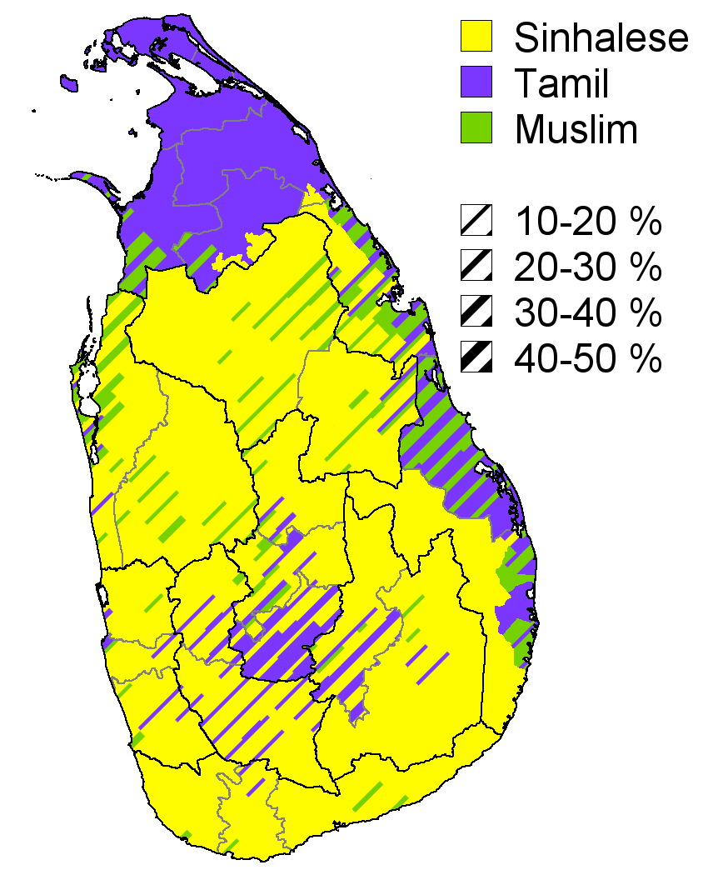

Slide 11
Regional Geopolitics (II): South Asia RSC
We have already had a general outlook of this region as for the countries that compose it, its fraught birth and the fact it is mostly determined in its power dynamics by the overwhelming presence of two regional powers.
When it comes to the relation it maintained with other great powers and superpowers at the global level, it must be highlighted this region did not have a big influence on the global level. However, the contrary cannot be stated. The global level strongly penetrated the region during the Cold War and came to reinforce the power dynamics inherent to the region:
From its beginning, India took a course of economic development strongly focused on state intervention in the economy in order to develop the country. This in itself brought India close to the Soviet Union while it detached itself from former colonial powers such as the United Kingdom and cultivated a strong distrust of US promoted capitalism. Hence, both Moscow and Delhi started developing a strong pattern of cooperation starting from the 50s.
As a result, the US soon turned to Pakistan, a more conservative power and as we have seen, strongly opposed to India since its independence in order to contain any reinforcement of the India-USSR axis.
As the regional antagonism between India and Pakistan was reinforced by the global rivalry between the US and the Soviet Union, the inter-regional level introduced an added level of complexity. Here, we need to focus on China, which as we saw, clashed with India in 1962. On the background of this enmity, came the Sino-Soviet split that unfolded throughout the decade of the 60s and which eventually led to China´s rapprochement to the US in the 70s. This led to China´s increased opposition to India, as a country close to the Soviet Union and to maintain close relations to Pakistan, enemy of India and hence, suitable ally to Beijing.
However, it must be said that India´s cooperation with the Soviet Union did not translate into a full-fledged alliance between Moscow and Delhi. Far from it, India tried to maintain its autonomy and was a key inspirer of the movement of non-aligned countries that endeavoured to strike a middle course between two antagonistic blocs.

Slide 12
Regional Geopolitics (II): South Asia RSC
The tensions derived from the penetration of the global level into the region came to its peak with the USSR intervention in Afghanistan:
For its geographical position, Afghanistan, is a country hard to assign to any particular RSC, rather working as an insulator.
However, in 1978, a coup d´état overthrew the monarchy and installed a military-backed communist regime. This regime was from the very beginning plagued by internal tensions between different factions, eventually leading to the Soviet Union´s intervention in favour of its preferred faction in 1979. Thus, started a war between the Soviet army and anti-Soviet insurgency.
This Soviet intervention provoked a geopolitical storm where dynamics from three different levels played out:
First, obviously, the global level: although the Soviet Union intended a limited intervention to “put order” in Afghanistan, the United States feared that this was a first step in an attempt to take hold of the whole Middle-East and endanger US influence in a vital and resourceful (oil) region.
Second, as should be logical, the regional level itself: given the power configuration of the region and the set of alignments and alliances that had been establishing since the birth of the South Asia RSC, Pakistan soon stepped in to counter Soviet influence in Afghanistan, a country Islamabad easily saw as its vital backyard. Thus, Pakistan and the US coordinated their efforts to support the anti-Soviet insurgency.
But third, the inter-regional level also made its appearance, as key powers in the Middle-East stepped in to support this insurgency. Obviously, we are referring to Saudi Arabia, which generously funded the anti-Soviet insurgency.
This combined effort eventually led to the defeat and withdrawal in 1989 of the Soviet Union. But as we may have easily imagined, the nature of the anti-Soviet insurgency was strongly Islamist, given the nature of both Pakistan and Saudi Arabia´s regimes! The core of future Al-Qaeda was formed in this war during the 80s. Political agency penetrated into Afghanistan with what was earlier an alien ideology, extremist Islamism, which would give birth to the Taliban movement. This political element would soon have an explosive combination with the fraught human geography of Afghanistan, as we will see below.

Slide 13
Regional Geopolitics (II): South Asia RSC
The transition from the Cold War did not bring about substantial changes, as global penetration had reinforced the patterns of rivalry rather than changing them:
In the regional level The India-Pakistan rivalry prevailed and has not disappeared since then. We need to remember that this rivalry did not originate from outside of the region and that had its roots exclusively in regional dynamics that have not disappeared. In fact, we can spot two instances when their mutual relations clearly worsened:
In 1998 both India and Pakistan, who had developed nuclear capacity in the late 70s, staged a series of nuclear tests that announced their official entry into the club of nuclear powers and made the rivalry more vicious between two, now nuclear countries. Just a year later, in 1999 both countries clashed again in the long-disputed region of Kashmir, in the city of Kargil, by the line of cease-fire, in what did not escalate further from an inconsequential war.
Then, in 2019, a suicide bombing in India-controlled Kashmir, perpetrated by an Islamist group, Jaish-e-Muhammad (JEM), with close links to Pakistan´s secret services, prompted India to launch an unprecedented since 1971 aerial bombing in Pakistan. The goal was to hit JEM facilities as a reprisal for the latest attack. This event, did not escalate further, but (as you can see in the Economist article in Alud “India and Pakistan: on perilous ground”) exemplified two domestic elements that in both India and Pakistan predispose both countries to hostile dynamics of this nature:
In the first place, let us return to human geography and the way political agency deals with this human geography. Despite ethnic cleansing at the moment of independence, India still has a 10% of its population which is Muslim. In addition, of course, we need to take into account the rule over Muslims in the explosive region of Kashmir. This reality persists in the face of a Hindu nationalist turn in India under the rule of its leader Narendra Modi. Harsh domestic policies against Muslims increase the likelihood of Islamist terrorist attacks, the likelihood of Pakistan´s support and the likelihood too, of harsher reprisals from the side of India as it happened in this case.
In the second place, turning to Pakistan, Islam remains a strong element of Pakistani nationalism and thus predisposes the country to similar aggressive chauvinistic rhetoric as often comes from India. Compounding the whole picture, Pakistan has been financing and sheltering powerful Islamist groups (see the example of Afghanistan above), many of them which have often turned against Pakistani authorities themselves and which need to be kept as an asset, either to maintain pressure on Kashmir and influence in Afghanistan or to satisfy most radical nationalist sectors in the country.

Slide 14
Regional Geopolitics (II): South Asia RSC
Turning now to the interregional level, a big change that the Cold War brought about was the disappearance of the Soviet Union and its “substitution” by the Russian Federation. From a former super-power, we now have a great power, with lesser influence on the region, but which has maintained previous patterns of cooperation inherited from the Cold War. Hence India maintains a cooperative relation with the Russian Federation, even if the heir to the USSR is not strong enough as to change the balance of power in any meaningful way. Military cooperation has remained strong to date, with the Russian Federation being a key supplier of India and Delhi made its best to stay aloof from the Western strong positioning in support of Ukraine, under attack from the Russian Federation, and maintaining economic relations.
If we remain in the interregional level, of course, the contrast of a decaying Russia is an increasingly powerful China. As it is the case of regional dynamics, Sino-Indian tensions have survived the cold war and China´s growth can only worsen their mutual hostility. In fact, a recent flare-up led to the worst border clashes since their war in 1962 relations (See in the Economist article in Alud “Ice and Fire: India´s border with China”). However, Sino-Indian relations remain ambiguous, despite the increasing distrust. Surprising as this may sound, some patterns of cooperation exist. This can be understood by the pragmatic nature of India´s foreign policy, inherited from the philosophy of non-alignment and distrust of the West. Thus, India and China often coincide in opposition to the West when it comes to issues of economic development and in opposition to the liberal economic agenda coming so often promoted in he West. Pragmatism also leads Delhi to appreciate economic opportunities of maintaining trade with China. Economic opportunities offered by the huge Indian market are something that China appreciates too (Read some interesting points in the Economist, in Alud “Still frosty: China-India relations” and even more “Asia´s biggest beasts”, which very thoroughly explains the difficult China-India-US triangle).

Slide 15
Regional Geopolitics (II): South Asia RSC
Then, of course, the global level is overwhelmingly characterized during this period by the prevalence of the US as the lone superpower:
The United States maintained themselves initially aloof from the Indian sub-continent and when both India and Pakistan became nuclear powers, its assumed responsibility as a status-quo guarantor positioned against nuclear proliferation led to opposition to both countries nuclear programmes.
However, more immediate geopolitical imperatives forced the US to a rapprochement to both countries, which in fact, put Washington in a dilemma:
Cooperation with Pakistan had been strong in Afghanistan during the cold war. However, since the Taliban ruled the country from 1996 onwards, they provided a shelter to Al-Qaeda, precisely the terrorist group that staged the terrorist attacks of 11-S in 2001. Despite the US intervention and their toppling of the Taliban regime, Pakistan always maintained secret links with them. However, playing a double game (Just remember Al Qaeda´s leader, Osama Ben-Laden himself, was hidden in Pakistan before being killed by the US in 2011!), it became a vital rear base for the US during all the years they fought for Afghanistan´s stabilisation. This symbiotic relationship was maintained until US troops finally abandoned the country and the Taliban came back to power in 2021.
If the double game Pakistan was playing forced the US in a difficult dilemma already, the reinforcement of links with Pakistan posed another one, this time in relation to India. As rivalry with China increased, the United States favoured using India as a counterweight. Example thereof was the signature in 2005 of the ten-year U.S.-India Defence Framework Agreement (renewed). However, US support to Pakistan has represented to date an important brake to better US-India relations, for as we very well know, Pakistan remains a sworn enemy of India!

Slide 16
Regional Geopolitics (II): South Asia RSC
As a corollary to what we have explained above, a short mention of Afghanistan´s microcosmos, which Buzan & Waever define as a Mini-system, is necessary:
From the withdrawal of the Soviet Union in 1989:
The country was mired in a devastating civil war between warlords that only ended in 1996 with the Taliban takeover.
Pockets of resistance to the Taliban were key for a counter-reaction to the Taliban in 2001, when they managed to push back against the crumbling regime of the Taliban.
However, the Taliban resisted throughout the period where US-backed governments were ruling, until they, as we earlier saw, managed to come back to power in 2021.
This country´s tragedy is that it has been engulfed in a never ending cycle of violence since 1979!
Afghanistan has a complex physical geography that has made control of the territory all the more difficult by external powers and also, during periods of internal strife, by rival ethnic groups. For, in addition, the country as a complex human geography, key for understanding the countries brutal instability:
The main ethnic group of Afghanistan, the Pashtun, represents the main support to the Taliban. Taliban religious schools (madrasas) mushroomed during the 80s in Pakistan, precisely in what are known as tribal zones, where a large Pashtun population lives! Yes, the Pashtun homeland is divided between Pakistan and Afghanistan (another territorial trap), but as long as Pakistan has supported Islamist militias such as a the Taliban, Islamabad´s political agency has enabled its rival zones to remain as the breeding ground of the nascent Taliban movement in the 80s, and as a shelter during the 00s and a springboard to fight back against the US.
Another key ethnic group, the Tajik, which represents the majority in the neighbouring Tajikistan, constituted the main pocket of resistance from 1996 to 2001 against the Pashtun-based Taliban.
Then, we find other minorities, such as Turkmen, Uzbek, Balochs, Nuristanis, Aimaks and Hazaras. The latter are Shiia, opposed to a majority Sunni country. This additional element of human geography is explosive, as the Sunni Taliban have brutally treated this minority.

Slide 17
Regional Geopolitics (II): South Asia RSC
Human geography has interacted with the external environment. As you may imagine, in the first half of the 90s, Uzbekistan and Tajikistan supported their ethnic brethren, while Iran was close to Hazaras, Shiia, as the majority in Iran and as the ruling regime of the Ayathollas since 1979-80. Obviously, Pakistan, as we have mentioned several times already, supported the Pashtun and Sunni Talibans.
However, this did not eventually lead to a generalized entry of other powers into the fray, turning ethnic/religious divides in Afghanistan into a maelstrom soaking in inter-state dynamics from other regions: Uzbekistan, Turkmenistan, Tajikistan and Iran have stayed aloof, enabling Afghanistan´s Mini-system to remain mostly as an insulator between the three RSC of South Asia, Middle-East and Post-Soviet Space.
The exceptions, where international intervention have been conspicuous, have been the result of more general global, inter-regional or regional dynamics from the South Asia RSC. The United States intervention was determined by the war on terrorism while the previous Soviet intervention was based on the need to support a friendly regime. Pakistan´s deep involvement has been a result, 1/first, of the need to contain Soviet influence (let us not forget Moscow´s close relations with Delhi) and 2/ second, to avoid India´s influence in Afghanistan and a possible encirclement, even though India´s support to US-supported administrations from 2001 to 2021 has arguably been very modest.

Slide 18
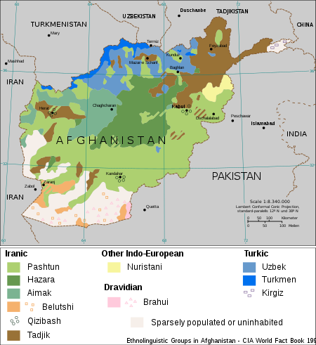

Slide 19
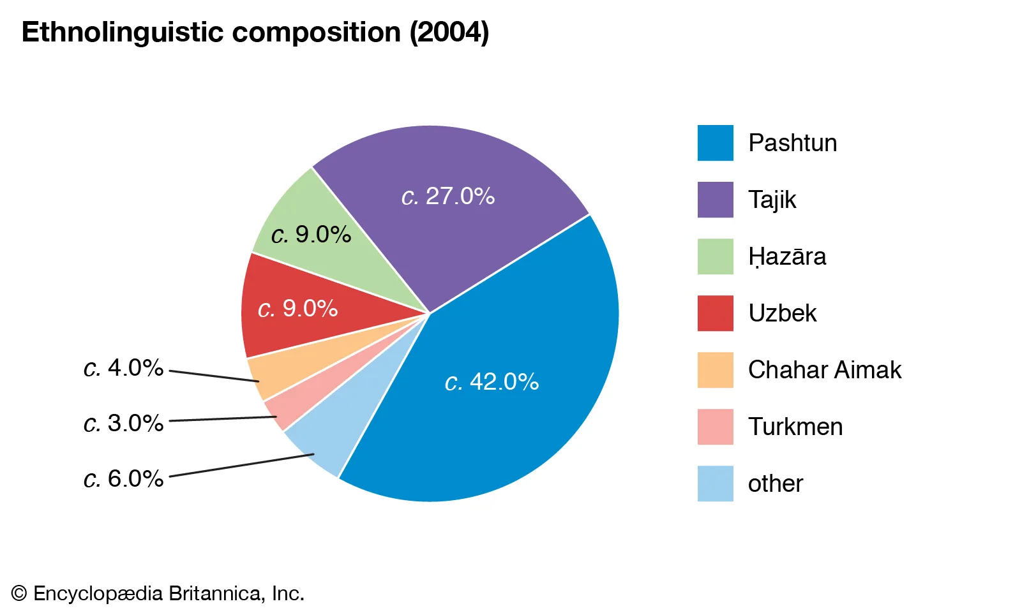

Slide 20
Regional Geopolitics (II): South Asia RSC
How may the South Asian RSC evolve? The two authors talk of three possibilities:
The first possibility would be if the region underwent an internal transformation: starting from the fact that so far only Pakistan and India “count” as the two poles of the region. Therefore, the most plausible possibility of an internal transformation would be if the power differential between India and Pakistan further increased in favour of the former, given its far more superior resources and that in parallel, the latter saw itself diminished by internal problems. Pakistan has internal limitations as for how it can control internal constituencies (autonomy of the military and security services) and for whether it can rein in sub-state actors such as Islamist radical groups. Internal turmoil could eventually degenerate into chaos within Pakistan.
A second possibility, arguably the most plausible one is that the region undergoes external transformation: given the fact that India is a close neighbour to China, a great power, rivalry between the two countries could lead to the South Asian RSC merging with the East Asian RSC. As their interaction is strong enough so that we may talk of an Asian Supercomplex, a full merging of both the South Asian RSC and the East Asian RSC would happen if China´s penetration into South Asia increased (see, as an example The Economist in “Storm in a Port”) and if India became involved in security dynamics of the neighbouring region (the high disparity between India and China in military power could nevertheless be complemented by the US siding with India against China).
China´s economic penetration has increased, indeed, through its massive economic investments (One-Belt One-Road, or New Silk Road) and this has increased influence in countries such as Sri-Lanka or, more importantly, Pakistan. This has not reached the level yet so as to upset power balances and neither does there seem to be a master plan from the side of China to use its investments in order to gain full control of its partners in the South Asian region and China is genuinely worried about debt piling-up in partner countries and eventually suffering from defaults (See “Party´s Over”).
As for India´s involvement into East-Asian security dynamics, we will mention this in the next session.
Then, a third possibility, external transformation again, is even less likely. Such transformation would happen if the South Asian RSC and the Middle-East RSC started intensifying their interregional interaction, eventually leading to a merging of both regions. Traditionally, it has been thought that Israel would intensify its relations with India, and Pakistan come closer to the Muslim/Arab countries. Security cooperation exists between India and Israel and their relations have recently expanded. However, neither India nor Israel have aligned with each other to oppose each other´s enemies. As for Pakistan, it traditionally has maintained strong relations with Saudi Arabia (see below, “Caught in the middle”), especially in the field of intelligence. This potential vector is impaired by Saudi Arabia´s mistrust of Pakistan´s closeness to countries, such as Turkey, which Saudis dislike and has even refused to align with Pakistan in matters so dear to Islamabad as the problem of Kashmir is.

