Slide 1
Regional Geopolitics (V): South America

Slide 2
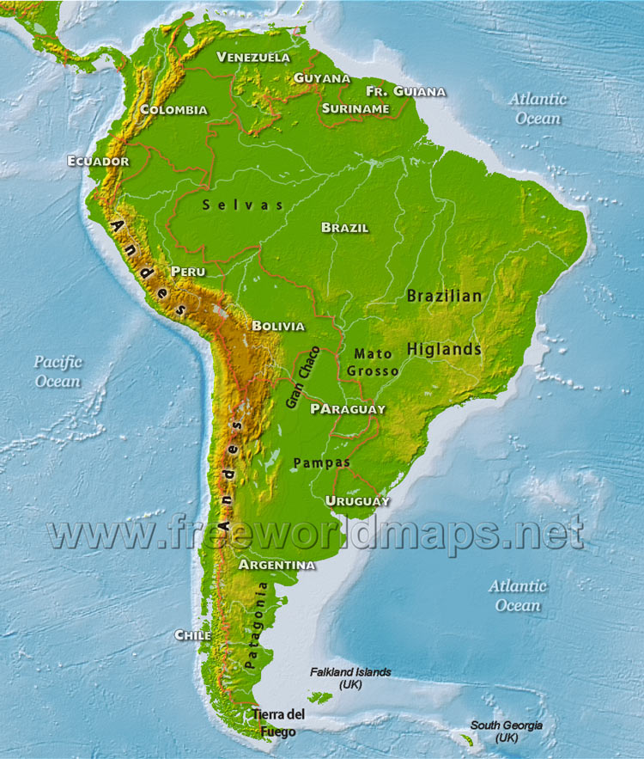

Slide 3
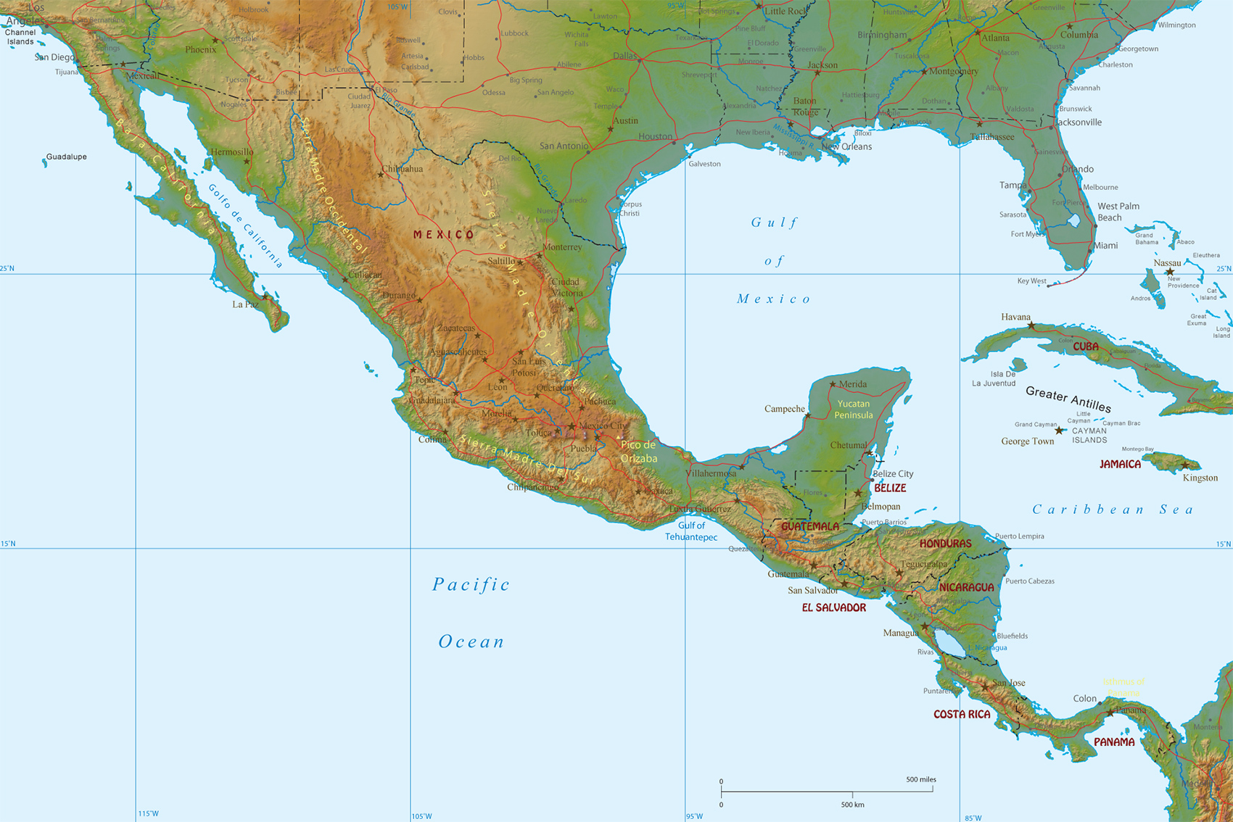

Slide 4
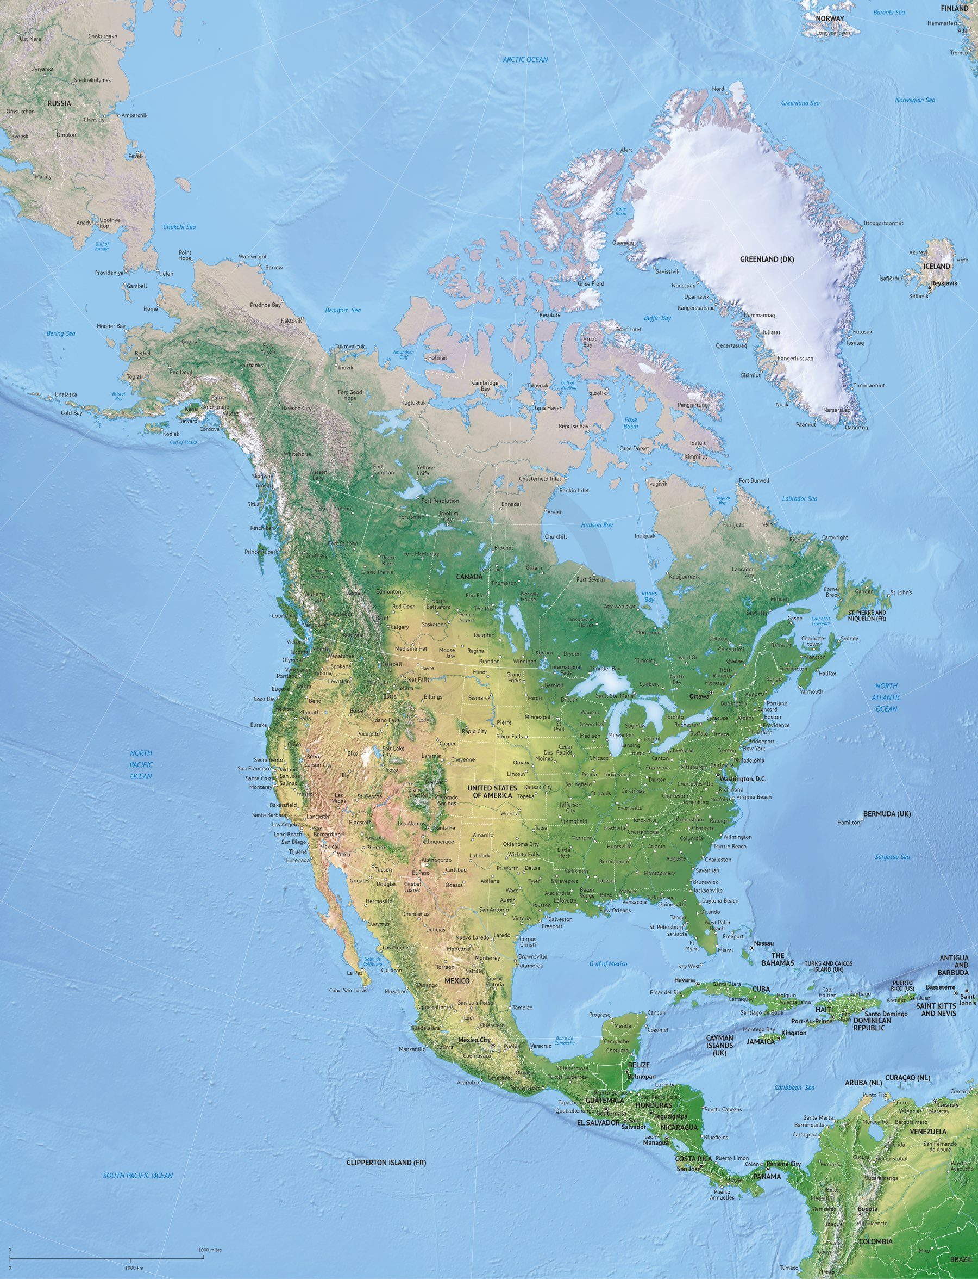

Slide 5
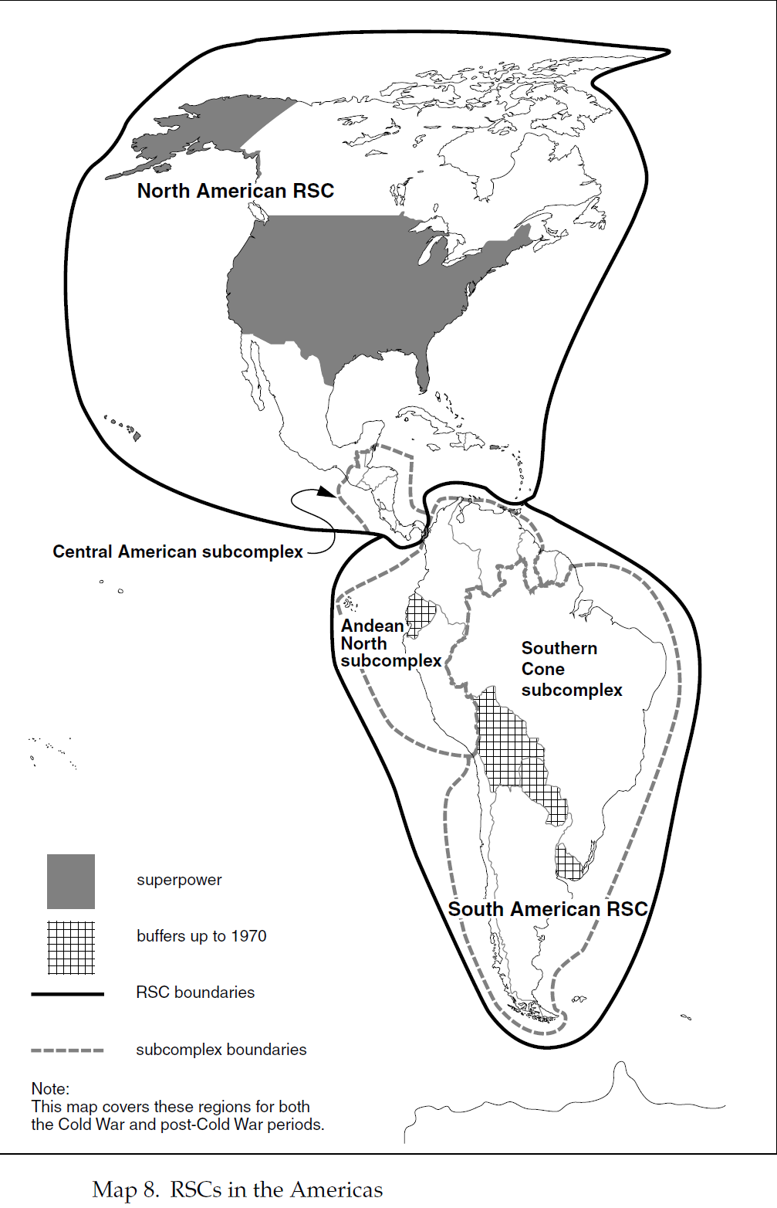

Slide 6
Regional Geopolitics (V): South America (I)
South America is considered by our two authors as an under-conflictual anomaly due to the seemingly low degree of inter-state conflicts both in their recurrence and in the limited character of many of those which occurred. This has led to a region which is in security terms largely unstructured.
In great part, this may be explained by the geography of the continent:
  Big mountainous reliefs cover the continent from Mexico to Patagonia: the former Spanish colonial Empire covered this territory and this arguably provoked both: 1/ post-colonial division and 2/ difficult contact between countries, many of which represent a vertical succession of different states. Paradoxically, while provoking border disputes, borders have remained lowly defended in areas usually lowly populated.
  The Central American “bottle-neck” separates Mexico from the rest of Latin America, while being funnelled towards the North American Region and therefore, under the overwhelming influence of the United States.
  Atomized geographical panorama in the Caribbean: marginality of the lesser Antilles and extreme securitization between the US and the Great Antilles (US vs. Cuba).
  The huge basin of the Amazonas: most of the territory belongs to Brazil, the former Portuguese colony, and which gained independence maintaining territorial integrity. The tropical climate shapes a region covered by the dense forest of the Amazonas, which strongly insulates Brazil from countries like Venezuela, Colombia, Perú and Bolivia.
The domestic level does not provide the same picture as in Africa:
  We do not witness the same level of weakness and state failure as in the African continent or the Middle-East. Most of the states are sufficiently strong and own armies capable of projecting their strength beyond their borders.
  However, it is nevertheless true that many of these countries have gone through intense civil wars that have contributed to the retrenchment in domestic affairs: independence wars, Mexico´s revolution in the early 20th century, Colombia´s violencia in the 50s, guerrilla insurgencies in Colombia and Peru, etc.
  Sub-state phenomena are very relevant when it comes to the existence of drug cartels that have turned into the main security issue for many of these countries: in the case of Colombia, this factor has merged with the armed groups operating, as drug has become the main financial source for the FARC and the ELN. In Central America, after brutal civil wars in the decade of the 80s, drug cartels and criminal groups have become powerful enough as to challenge governments, in what is the closest we find to the pattern of state failure in the continent. The case of Mexico is singular, as we are talking of a regional economic power which nevertheless has come to grips with a long, protracted and counter-producing war on drugs since 2006.

Slide 7
Regional Geopolitics (V): South America (II)
When it comes to the inter-regional level, it is impossible to miss the overwhelming influence of the United States:
  The United States expanded at the expense of Mexico only in North America proper, but gradually established a sphere of influence over Latin America in parallel to its increasing economic and military clout during the 19th century and into the 20th century, substituting the United Kingdom as the neo-colonial power in the region.
  The increasing importance of the Asian region with the integration of a Pacific economic area through projects of integration between both shores is a latest development that should not be overlooked.
The global level:
  It was obvious with Spanish, Portuguese, Dutch, French and British colonialism. However, it would take a new shape during the 19th century with the economic primacy of the United Kingdom, in what many would distinguish a neo-colonial pattern of domination.
  While the US would arguably assume its role later, the US presence would soon become enmeshed with Cold War geopolitics, so the ideological penetration and influence of the Soviet Union would influence politics and security dynamics during several decades.
  Vital role of the International Monetary Fund (IMF) managing debt crisis in the continent. This institution started assuming a strong and controversial role since the 80s debt crises in such countries as Mexico, Peru, Chile, Brazil and Argentina. This latest country is again engulfed in an economic crisis which has invited the IMF´s intervention.

Slide 8
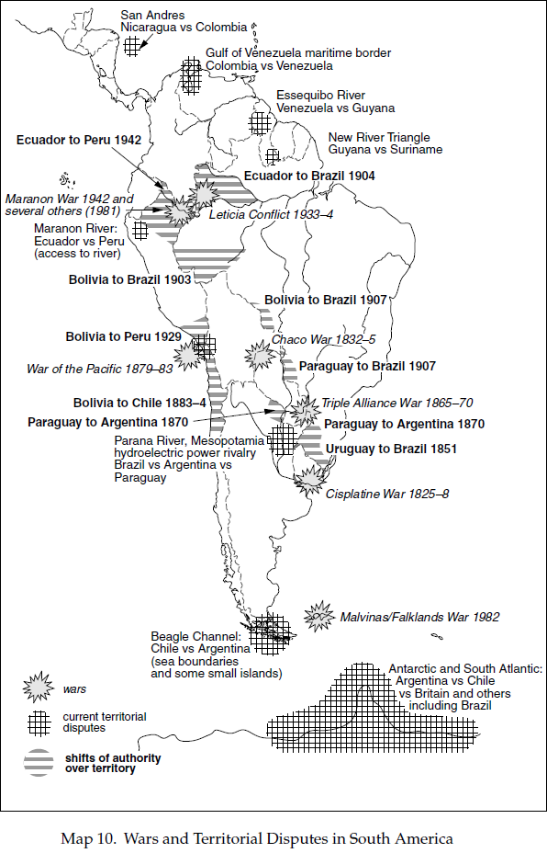

Slide 9
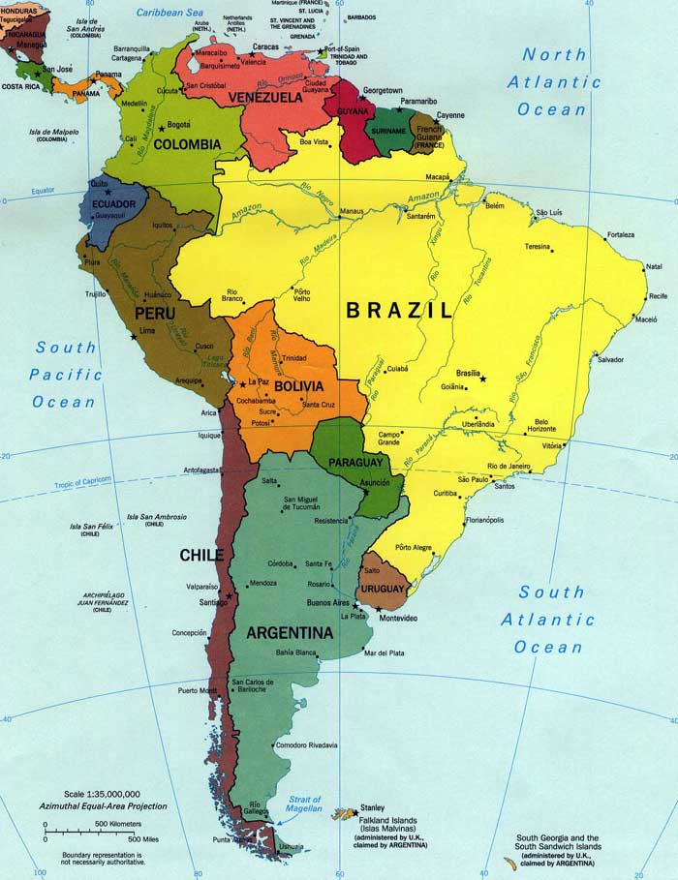

Slide 10
Regional Geopolitics (V): South America (III): patterns of conflict
Regional level: The general pattern is of under-conflictual relations between neighbours:
  There were several wars in the 19th century, some of which, as the Triple Alliance War from 1865-70 pitting Paraguay against Brazil, Uruguay and Argentina, were devastating.
  However, during most of the 20th century, inter-state warfare has been conspicuous for its low recurrence. Apart from the geographical factors mentioned already, the presence of Brazil as hegemonic stabilizer might provide a complementary explanation.
The South-American region is divided, as it often happens in other regions, in sub-regional complexes where we can identify different patterns of conflict:
  Argentina vs. Brazil: even if geography could defuse tension (both had wide expanses for expansion), they were nevertheless the economically most powerful actors in the region. While Brazil feared encirclement by Spanish America, Argentina feared the weight of its massive Northern neighbour. This is the only dyad that tried to develop nuclear programs.
  The “string”: Argentina, Chile, Bolivia, Perú, Ecuador, Colombia, Venezuela: bilateral border disputes:
    Chile-Argentina: almost went to war in 1978 for islands off Tierra de Fuego.
    Chile-Bolivia: 1879-1883 War of the Pacific where Bolivia lost access to the sea.
    Chile-Perú: latent scars from the War of the Pacific of scarce relevance.
    Perú-Ecuador: war of 1942 and military incidents in 1981 and 1995 over the Marañón border.
    Colombia-Venezuela: border dispute over the Gulf of Coquivacoa.
    Venezuela-Guayana: the former claims as much as five eights of the latter´s territory.
  Ecuador, Bolivia, Uruguay and Paraguay have often played a role as buffer states.
Potential patterns of alliance as Peru-Argentina vs. Brazil-Chile never assumed real entity so the South American RSC integrated very weakly regarding potential securitization.

Slide 11
Regional Geopolitics (V): South America (IV): Regional sub-complexes
In spite of this low security integration, we may talk of certain regional sub-complexes:
  Southern Cone: this would involve the interconnected rivalries between Argentina, Brazil and Chile with a string of buffer states formed by Bolivia, Paraguay and Uruguay. This lowly securitized region evolved into a security community through the formation of Mercosur.
  Andean North: this sub-complex would be formed by Perú, Ecuador, Colombia, Venezuela, and Guayana. Rivalries do not seem to have been overcome, especially aggravated by trans-border phenomena as guerrillas and drug traffic. An intergovernmental organisation was created with the Comunidad Andina de Naciones (CAN). The role of this organisation has remained limited.
Inter-regional / global level:
  As it has already been mentioned, the inter-regional level has traditionally mostly meant US penetration into the region, as a substitute of the United Kingdom. Apart from French intervention in Mexico in the 19th century (1861-67) and the Argentina-UK war over the Falkland Islands (1983), the US role in the continent would be overwhelming and exclusive.
  It must be said that during the Cold War period the inter-regional level mostly merged with the global level, as most US interventions followed the code of US-USSR rivalry that unfolded between both superpowers at a fully global level.
  US penetration into the Southern American Region never really had a translation in patterns of military alliances: In the first place, all South American nations did not add up enough military clout as to really offer a substantial balance against the US. In the second place, the US itself has been rather interested in avoiding the establishment of regimes that would prompt the region to lean to the Soviet camp (global level) or else, threaten US economic interests in the region.
  The deepest involvement of the US in the region comes arguably in the more vulnerable Central America and against the formidably resilient Cuban regime.
  Last but not least, the US has been key in the creation under US sponsorship: of the Organization of American States (OAS) in 1948 but which had had its first precedent the late 19th century. With the OAS, we could arguably talk of a weak regional super-complex integration (North + South America).

Slide 12
Regional Geopolitics (V): South America (V): Post-Cold War changes
Latin America is probably one of the regions for which the end of the Cold War meant less. However, changes have nevertheless taken place which are worth mentioning:
  Domestic level: democratisation took hold and the classic pendulum swung from radical regimes to military juntas seemed to disappear. A general tendency to liberalise economies and to support pro-market policies also seemed to take hold. However, sight must not be lost of the criticism of capitalism and IMF intervention: this prompted the birth of a new generation of leftist movements, chief among which was Hugo Chavez´s Venezuela. This, known as the “rose wave” initially retreated, especially given the dismal economic and political situation in Venezuela.
  Regional level: increasing separation of the two sub-complexes but at the same time, a region level process of integration through the security community formed by Unasur:
    Southern Cone Sub-complex: 1/Argentina-Brazil rapprochement; 2/ Regional integration through Mercosur; 3/ Resolution of border disputes.
    Andean North Sub-complex: patterns of conflict remained in the region, mostly provoked by sub-state guerrillas strongly financed by drug traffic: the paradigmatic case here is Colombia.
    UNASUR was founded in 2004 and it includes all countries belonging to the South American continent. It represents an interesting instrument of integration and desecuritization at the regional level. Its intervention in 2008 in Bolivia defused a political crisis that could have destabilized the whole country in its political integrity. This forum may become a tool for diplomatic power diffusion of Brazil. However, with the election of Jair Bolsonaro as President of Brazil, a rapprochement with the US was considered by analysts; this might bring about changes in both Brazil´s aspirations for leadership (domestic retrenchment rather aggressive position towards leftist regimes) and further influence of the US. It is to be seen whether the return of Lula will increase Brazil´s international profile as in the past.
  Interregional level: It is again the United States which holds the most relevant role, both on the side of securitization (war on drugs) and the side of economic integration (Free Trade Area of the Americas (FTAA) whose goal is to cover all the continent). Asia is assuming an increasing role, with China becoming a large consumer of raw materials from the continent and with economic integration through the Trans-Pacific Partnership (TPP). Since the US withdrew from the projected TTP, the rest of the countries have forged ahead with the now known as Comprehensive and Progressive Trans-Pacific Partnership (CPTTP).

