Slide 1
Memory Wars
Russia, Estonia, Czech Republiiic

Slide 2
Housekeeping
Topics today
Uploaded Slides for Monday and Tuesday
Added a couple of readings to syllabus—Just if you want to write about memory wars.

Slide 3
Today:
Memory Wars: Theory
  Ontological Security
    Linking the individual to the state
  Conflict-Supporting Narratives
  Persistent Victimhood
  Securitization
  Mnemonic Security Dilemmas
Securitiziing the Russian Narratiive
Memory Wars in Central and Eastern Europe
TOMORROW: Ukraine

Slide 4
Review :
Ontological Security: Sovereign states are willing to suffer political, military and economic harm if necessary to maintain identity
Why? Identity is a key source of legitimacy, but also framework for decision making
Narratives/memories are key foundation to identities: identify what state role is in international context, how it got there
Institutionalized memory narratives as sources of state/national identity

Slide 5
Three Post Cold War Narratives in Europe
The “Western Narrative”—
  Search for identity after cold war and EU expansion: Peace, Human Rights
  “Negative” Narrative emphasizes World War II over Nazism and Holocaust
The Central and Eastern Narrative—
  Creating or reframing a national identity
  World War II not a victory but dual occupation
  Focus on Stalinism as communist regime
  Holocaust not uniquely important
TODAY: Continue on this point, then the Russian narrative, then look at memory wars between Russia and Estonia and Russia and Czechia

Slide 6
Memory Wars: Theoretical Concepts:
Ontological Security
Ontological Security
Zarakol: “Ontological Security (Zarakol, 6): ”Ontological security first and formost entails having a consistent sense of self and having that self affirmed by others.
What does it mean for a state?
  Collective Identity and Narrative Engagement
  Individual sense of self within community depends on external role
  So the ontological insecurity confronts individuals as part of collective

Slide 7
Memory Wars: Theoretical Concepts
Conflictive Narratives and Persistent Victimhookd
Content: Causes of Conflict, its nature, image of rival, what needed to win
Functions: Justifies conflict, delineates dangers, delegitimizes opponents, creates glorified image of in-group, in-group as victim, patriotism, unity, desire to live in peace
Social function: Prepares people for privations of conflict, Provides explanation, certainty; prepares for violent acts against rival, mobilizes in-group; gain international support

Slide 8
Victimization
Victimization
Individual
Injury occurs, perceived to be unjust
Recognized by others
Investment in victim status
Collective aspect of victimization
Become a part of community of memory
Institutionalization

Slide 9
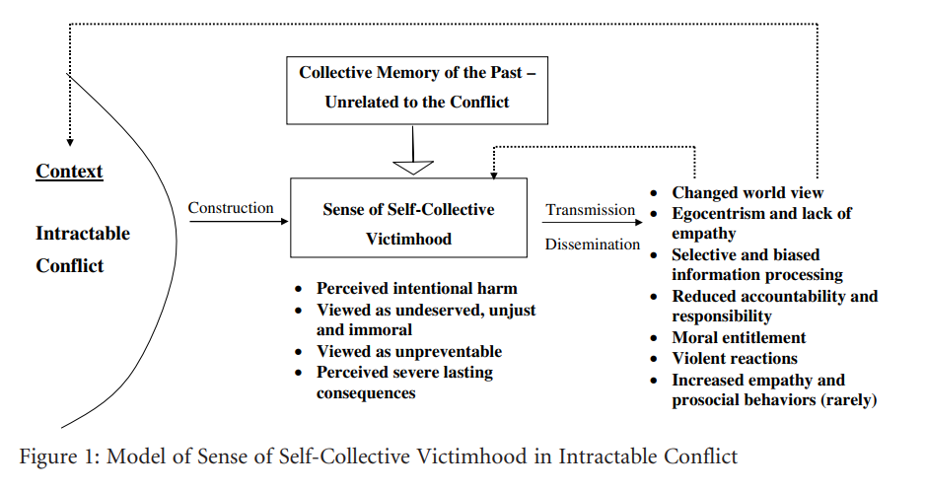

Slide 10
Memory War Theory: Securitization
Securitization (Gustafson, 74):“means to present an issue as urgent and existential, as so important that it should not be exposed to the normal haggling of politics but should be dealt with decisively by top leaders prior to other issues” (Buzan et al., 1998, p. 29).
  Depoliticize something is to place it unpolitical, not open for discussion
  Politicize means to bring it up to public debate, procedural issues on how to decide
  Beyond Politics

Slide 11
Memory Wars: Theoretical Conflicts: Mnemonic Security Dilemma
Two sides have contradictory narratives, such that efforts to assert narrative of one side to improve ontological security necessarily threatens ontological secuirity of the other

Slide 12
RUSSIA: Key Events
Conversion to Orthodox Christianity (988)
Vassalage to Mongol Horde (1247-1380)
1400s: “The Third Rome” after 1453
Not fully part of international society until Peter I
Napoleonic Invasion of 1812
Crimean War 1856
World War I and the Bolshevik Revolution
Stalin’s Revolution from Above
The Collapse of the USSR and the 1990s

Slide 13
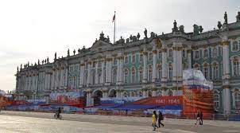
Persistent elements of Russian national Identity
The role of the state (at least since peter the great)
  GREAT POWER
  The tie with Orthodoxy
Feeling of relative weakness and backwardness towards Europe
  Change from above
  Peter the Great Tries to Copy Europe
  Also seen as threat
A struggle between Russian and European Identity
  Westernizers and Slavophiles
  What does Europe represent?
  What does Russia represent?

Slide 14
RUSSIA’S ONTOLOGICAL INSECURITY
SEEKING GREATNESS, NEVER A FULL MEMBER OF THE CLUB
Sergei Lavrov, 2016:
“There are different opinions, and doubts too, as to whether Russia assesses the international situation and its position in the world soberly enough. This is an echo of never-ending disputes between pro-Western liberals and the advocates of one’s own unique path. There are also people, both inside and outside the country, who believe that Russia is doomed to constantly fall behind and catch up, or adapt to the rules invented by others, and therefore cannot claim a rightful role in international affairs."

Slide 15
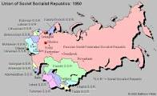
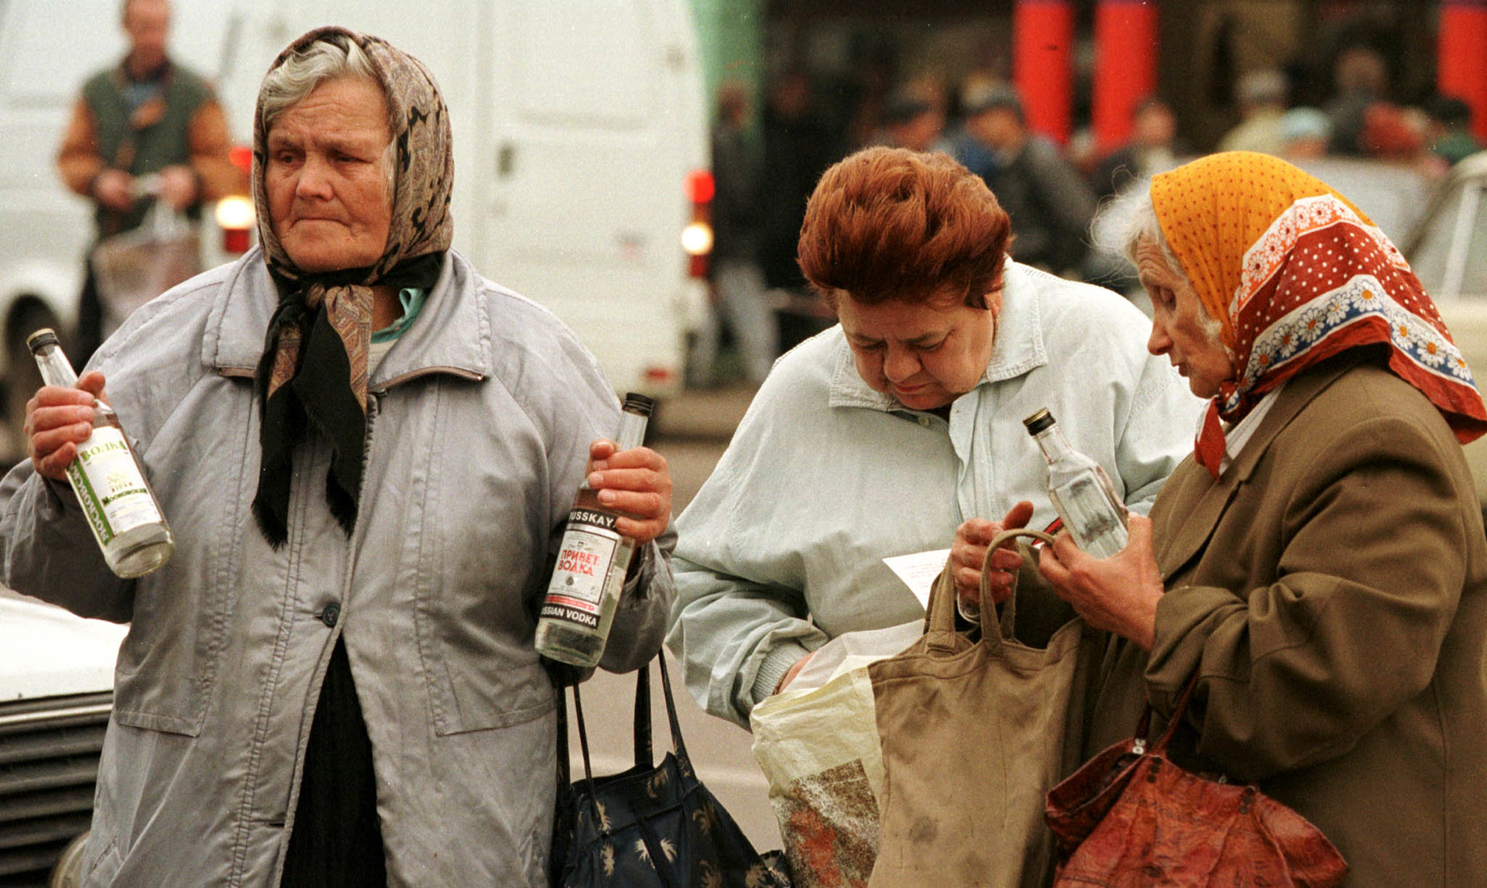
Russia After Soviet Collapse:
Debate over National Identity Particularly Important
A New State: New Borders;
14 New Neighbors
A Superpower in Decline
New Demographics:
51% Ethnic Russians in USSR
81% Ethnic Russians in Russia
Millions of Ethnic Russians in
former Soviet Republics
Political, Economic, Social Upheaval

Slide 16
Putin’s Entry
The productive and constructive work that our Fatherland needs is
impossible in a society finding itself in a condition of factionalism,
domestic disunity.… In the past century Russia twice found itself
in such conditions: after October 1917 and in the ’90s.… A strong
[krepkoe] state is not an anomaly for Russian citizens [rossiiane],
not something they have to struggle with, but, on the contrary, a
source and guarantor of order, the initiator and prime moving force
in any transition.
Conclusion: Russia needs a strong state and a power vertical
    Guarantor against internal chaos, external invasion

Slide 17
Putin’s Chosen Narrative for Russia
The Chosen Trauma—the 1990s
  The weakness of the state
  Anarchy, economic despair, factionalism
  Global Humiliation
The Chosen Victory—The Great Patriotic War

Slide 18
The Great Patriotic War
A Time of Great Suffering
A Time of Great Unity—Divisions between classes, ideology lessened
A Time of Great Victory
  Soviet Union arises as a great power, influence extends from Vladivostok and Pyongyang to Prague and Berlin
  USSR saves European civilization
The Soviet Legacy from the 1970s
  The Soviet Union gives up on communism, looks back
  Creates an infrastructure of memory Putin can use
  Differences: Not so much Soviet victory but Russian victory
    Not so much a warning against war, a call for preparedness, but rather a trope of Russian Greatness

Slide 19
The Evolution of Vladimir Putin
    2000-2003: Managed Democracy: Russia is part of European Civilization, but not yet ready for normal democracy
    2005-2009: Sovereign Democracy: Russia is part of European Civilization, but will always be different, respecting Russian history and culture
    An attempt to keep together three strands in Russian elites:
      Urban economic liberals, the Orthodox Church, the state builders in secret services, military, regional leadership, etc.

Slide 20
The Kremlin’s “Civilizational” Narrative
Massive Demonstrations in Moscow in 2011-12
  Putin very afraid
  Jettisons urban liberal idea for Russian nationalism
  Relies more heavily on statists, Orthodox Church
    Ecosystems of influence
One –Thousand Year History
  Russia Empire is separate from Europe: Multiethnic under Russian leadership
  Lenin: Represents betrayal of Russian state
The Redemption in the Great Patriotic War
  And a curiously ambiguous attitude on Stalin

Slide 21
Putin’s Speech at the Wall of Sorrows Monument, Moscow, October 30, 2017
It is very important that we all and future generations – this is of great significance – know about, and remember this tragic period in our history when entire social groups and entire peoples were cruelly persecuted, including workers, peasants, engineers, military commanders, clergy, government employees, scientists and cultural figures.
Neither talent, nor services to the Motherland, nor sincere devotion to it could help avoid repression, because unwarranted and absolutely absurd charges could be brought against anyone. Millions of people were declared ‘enemies of the people’, shot or mutilated, or suffered in prisons, labour camps or exile.
This terrifying past cannot be deleted from national memory or, all the more so, be justified by any references to the so-called best interests of the people.
The history of our country, like that of any other country, has plenty of difficult and controversial stages. People argue about them, discuss them, offering different approaches to explaining various events.

Slide 22
Putin’s Speech at the “Wall of Sorrows”
October 30,2017
In closing, I would like to ask Ms Natalia Solzhenitsyna permission to quote her, ”To know, to remember, to condemn. And only then to forgive.“ I fully agree with these words.
Indeed, we and our descendants must remember the tragedy of repression and what caused it. However, this does not mean settling scores. We cannot push society to a dangerous line of confrontation yet again.
Now, it is important for all of us to build on the values of trust and stability. Only on this basis will we be able to achieve the goals of our society and our country, which is one for us all.

Slide 23
Securitization
  Russia: Securitizes memory
      Russian historical society is head of foreign intelligence
      Believes in “hybrid warfare”
      Threat to foundational beliefs threat to regime as a whole
      Making laws makes it worse, because state recognizes it as important

Slide 24
Memory Wars
Russian Securitization
Central and Eastern Europe efforts to build nation with chosen trauma of repression under Soviet rule
Mnemonic Security Dilemma
  The attempt by one regime to shore up its narrative is threat to ontological security of another
Two different visions of how urban spaces should work

Slide 25
Estonia: 2007
Specific Sources of Tension
  Double Occupation
    The Nazis
    4300 Jews in Estonia before war, 75% flee to Russia, about 1000 Estonian Jews killed
    6000 Estonians and 1000 Ethnic Russians
    The Soviets
    20,000 deported arrested or executed in 1941
  Large Russian-speaking population
  Efforts by Estonians to limit citizenship through language, etc.

Slide 26
The Bronze Soldier in Estonia
Monument and Cemetery to Fallen Soviet Soldiers on “Liberators’ Square” in central Talinn
  Had been site of controversy after 1991, attempt by city to remove it
  Election of nationalist party to power
April, 2007: Statue relocated to cemetery outside the center
Graves also moved
Riots over two nights in Talinn
Estonian Embassy besieged,
Ambassador attached
Site of annual demonstrations
April, 2022: Statue vandalized

Slide 27
Securitization on Both Sides
Estonia—Right-wing emphasizes National boundaries—language, etc.
Response to National Identity Issues mentioned before
Presence of Russians seen as potential threat
Proponents of move assume Russians in Estonia the same
Russians—See it as evidence that second-class citizens
Partly true, partly also sense of entitlement
Putin’s Narrative--A denial of Putin’s narrative’s identity of Soviet soldiers as heroes
A desire to claim symbolic state on Estonian territory

Slide 28
The Statue Wars in Prague: 2019-2020
June 2019: Russia passes law naming soldiers in 1968 “war veterans”
Konev Statue Removed in April, 2020
Head of Řeporyje district announces construction of memorial to members of General Andrei Vlasov’s RLA who participate in Prague Uprising
Mayor Zdeněk Hřib enables square of Russian Embassy to be renamed “Boris Nemtsov Square”
Hřib also invites Beijing’s displeasure with gestures recognizing Taiwan autonomy

Slide 29
THE RESPONSE
RUSSIA:
Accusations that Czechs broke 1993 Friendship Agreement
April 7: Duma passes law criminalizing desecration of monuments to Soviet soldiers
Criminal Investigation of Hřib and Kolár
Czech National Government:
Pro-Russian President Miloš Zeman supports Russia’s objections in principle, calls the removal “underhanded” and ”morally unjust”
Czech Ministries support legality of removal and criticize Russian interference in internal affairs
Even Zeman critiques Russia’s overreaction to “stupid actions of otherwise insignificant politicians!

