Slide 1
MEMORY WARS IN EASTERN AND CENTRAL EUROPE

Slide 2
What are the goals?
Memory Wars: What are they? (The relation between memory and identity)
Why are they important?
Political Significance, both nationally and internationally
Insight into different societies of the region and why they clash
What do they say about the theory and practice of international politics?
Start with constructivist theory of international politics
Examine also the idea of ontological security
Discussions about the politics of memory

Slide 3
Introductions
James Richter
Education
2. Employment
3. Research Interests
Memory is new, and I am interested in your ideas
4. Other Interests
Who are you?

Slide 4
Course Information
Four Answers to Daily Question: Homework Vaults
Choose Topic for 5-page paper by Friday, May 23.
If you send rough drafts, I will look at them

Slide 5
General Introductions
Questions for me?
Perhaps about US politics?

Slide 6
Part I and II: The Theoretical background
Theories of International Politics: Realism vrs. Constructivism
Theories of Identity, Memory and Narrative
The Politics of Memory

Slide 7
Realism VRS. Constructivism
Key Actors: Sovereign States
Structure of System: Anarchic
Security is Scarce: Zero-sum
Key Motivation of States: Self-Help
States are Rational Actors
Distribution of power is key variable

Slide 8
ISSUES WITH REALISM?
How do you decide what the national interest is?
How can you tell between competing notions of national interest?
What makes the EU possible?
Why does Putin make a mistake?

Slide 9
First Step: Constructivist Notions of Identity and Interests
The social world is constructed: Many things we take for granted have no physical reality, but are “real” because of persistent patterns of social relations
Individuals confront, understand constructions as “real”, identity shaped by interaction with that structure
Nationality
If individual challenges that social reality, often considered weird, insane, criminal—Soviet dissidents
The structure and agent are mutually constitutive
The social structure reproduced by the actions of agents
The social structure appears as fact as individual that shapes identity

Slide 10
IDENTITY: What is it?
Personal Identity: (from Wikipedia). This refers to your individual perception of the qualities, personality, values, aspirations and codes of conduct that define who you are in relation to the outside world.
Social Identity: This refers to the social categories you belong to—including memberships in groups and social roles you perform—along with the social expectations generally assigned to this identity. This includes things like nationality, race, ethnicity, gender, class, occupation, and others. Such identities can be chosen, such as occupation, or imposed, such as often occurs with ethnic identity. Individuals can feel different ways about what each category means, and respond to expectations in different ways. The latter can be tricky, however.

Slide 11
IDENTITY PROVIDES Security
Cognitively: It reduces uncertainty:
Helps sift through barrage of incoming perceptions
Gives you a range of possible behaviors
Gives you range of expectations of how others will
respond
Emotionally: Provides permanence, stability, a sense of self
WHAT ARE IDENTITY CRISES? When old rules don’t work. Some students feel an identity crisis when you they first arrive, because no one knows you, you don’t know how to act, etc.
Could also occur if your earlier ideas about self disproved

Slide 12
IDENTITY: WHERE DOES IT COME FROM?
One’s identity emerges from accumulated interpretations of one’s interactions with others.
Human beings are social animals and depend on others to survive, beginning in infancy with parents and other caregivers.
You take up cues from others’ responses, esp. others who are important to you.
But the definition emphasizes interpretation. Identity is not merely passive, but also active.
EX. If you say thank you as a young child and your parents praise you for being polite, you will probably want to do that more, and you may expect others to be pleased when you do so as well.
Over time, get an instinct about how to respond in different situations and different people. You don’t act around me as you would each other or your parents, because you understand it’s not the same sort of relation

Slide 13
IDENTITY: More ABOUT What IT IS?
Identity is Multifaceted, Situational and Dynamic
Multifaceted: People have many sides, and play many different roles in life. You may be an American, a woman, a college student, an activist and a rugby player all at the same time.
Situational: Different identities become more salient in different contexts. If you go to a foreign country, your nationality often becomes more salient. Similarly, you focus more on different aspects of others’ identity In different circumstances.
Dynamic: Identity never complete, never static. The roles you play and your conception of these roles change over time. And there is more or less room for choice.

Slide 14
Collective Identity
DEFINITION: A collective identity occurs when a group—a nation, an ethnic group, a religious group—self-consciously defines itself as a community with a common past and a common future.
COLLECTIVE IDENTITIES ARE SOCIAL CONSTRUCTIONS:
They exist and have meaning only insofar as society grants them that meaning.
The “nation” as an imagined community

Slide 15
Can a State Have an “Identity”?
What is the state? How does it gain sense of reality sufficient for people to risk their lives to defend it? Why is not amorphous collection of offices, bureaus, building, etc. What makes it cohere? What makes it legitimate?
Is it simply the source of military protection? Is it simply collection of interests? Is it locus of identity?
Identity helps to coordinate to actions
Creates basis to decide what is appropriate policy
In modern world, state legitimated as representative of people
Sovereignty resides in the people
If persuade others to accept national identity, national interest
Key aspect of legitimacy
But many identities in any individual, many individuals in any state

Slide 16
How does state identity get embedded in institutions?
State as an organization
Identity as domestic legitimation
Organizations created to perform particular tasks
These organizations, tasks, must be justified in terms of identity and interests
These institutions have staying power
Individual actors invested in the tasks of these institutions
New recruits, those who are promoted should accept tasks of those institutions
Those who populate institutions will defend ideas that justify them
But may define identity in different ways:
Educators may define US identity different from military

Slide 17
Why is Constructivism important? Realism Plus
1. Realism does not problematize sovereign state system
Constructivism argues sovereign state system a construction,
which can be deconstructed
2. Realism believes competition and conflict a natural result of anarchic s structure
Constructivism believes that competition aspect is constructed, can
be changed
Realism argues ”national interest” logical result of state’s power capability and its geography relative to other states
Constructivism believe ”national interest” product of norms, national identity and history, as well as power relations within countries

Slide 18
Ontological Security
”Ontological security first and foremost entails having a consistent sense of self and having that sense affirmed by others.” (Zarakol)
Individuals, states and other groups act not only in interests of physical and economic interests, but also willing to accept significant harm to these interests in order to protect that sense of self (Mitzen. ,Steele, Kinnvall)
Mnemonic Security: “the idea that distinct understandings of the past should be fixed in public remembrance and consciousness in order to buttress an actor’s stable sense of self “(Malksoo)
Challenge to fixed narrative represents a challenge to sense of self that requires a remedy
The question: does identity come primarily from within or from without?

Slide 19
Identity: Bridging the individual to the state

Slide 20
Back To realism: How Does Power Fit into this?

Slide 21
BREAK

Slide 22
The Role of Memory
MEMORY FORMS IDENTITY, AND VICE-VERSA
Memory as such not very coherent, accurate
Active Recollection, reflection and integration
Constructing the narrative, self-biography
Select what is important, what is not
Influenced by identity
May try to justify, explain things that were uncomfortable, or contradictory
Provides a sense of continuity: you are a being with past, present, future
Narrative helps explain the present
Provides framework for decision-making
As identity changes, interpretation of past can also change

Slide 23
The Role of Memory
MEMORY FORMS IDENTITY, AND VICE-VERSA
Recollection, reflection and integration
Constructing the narrative, self-biography
Select what is important, what is not
Influenced by identity (can make up things)
May try to justify, explain things that were uncomfortable, or contradictory
Narrative helps explain the present
Provides framework for decision-making

Slide 24
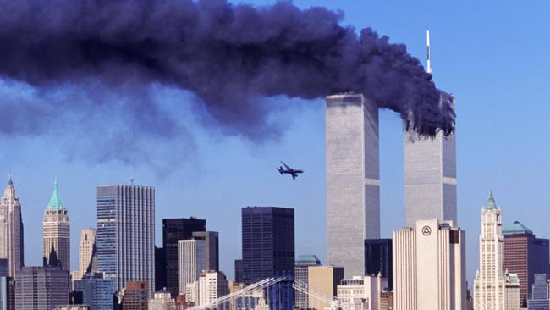
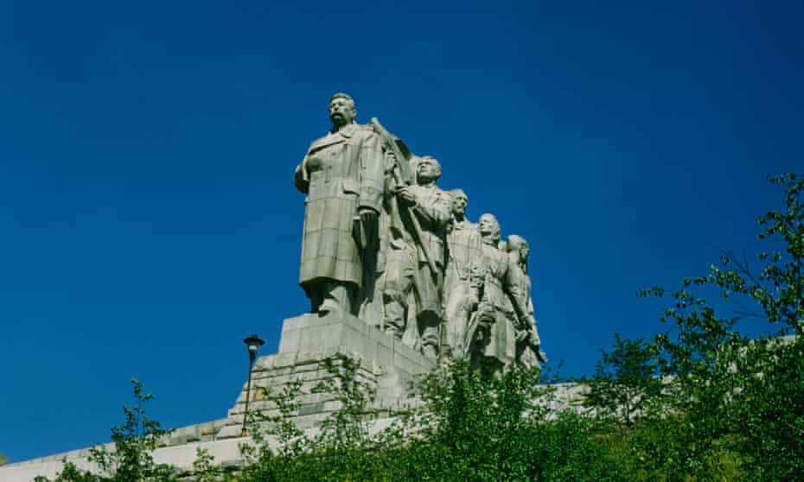
COLLECTIVE MEMORY: Assman
COLLECTIVE MEMORIES
They are a shared sense of a past event with a group
Memories are shared even though not everyone actually experienced that event, such as 9/11.
These memories then are shaped into a collective narrative.
Creates the boundaries of the group
They offer also an explanation of where the group comes from, why it is where it is, and it’s future may be.

Slide 25
Examples from the class

Slide 26
Different Forms of Memory: Assman
COMMUNICATIVE MEMORY: Passed down through stories. How long does it last?
PUBLIC MEMORY: “the official memory strategies propagated by holders and competitors of state power, as well as the cultural memory propagated within the public sphere, such as media, movies, memorials.” (Bernhard and Kubik). Institutionalized. Exists independent of stories
OFFICIAL MEMORY: Narrative propagated by state agents.
How different can it be?
MEMORY CULTURE : “frames of historical reference” within communities “who share a critical mass of content, patterns of interpretation and rituals of collective memory.”
THE DIFFERENCE BETWEEN MEMORY AND HISTORY

Slide 27
Examples:
A movie
A facebook page
A speech by the foreign minister
Your great-grandfather’s birth certificate
A newspaper in Germany
A letter written by your father’s grandfather
A “memory law”
A monument
The disjunction between communicative memory and public memory culture

Slide 28
Collective Narratives and the Nation: The Nation as an ”Imagined Community”
The nation as the principle legitimate political unit in world politics
But it also has no physical existence.
We cannot see the nation.
The boundaries of nations are fuzzy (and your definition of who is an “American” and mine may differ, and may not differ).
It is ”imagined” in that it exists only in the collective imagination of its members and people who are not its members, and therefore act as if it exists in reality.
We help to make it seem real with symbols like the flag, like the national anthem, like the Jan Hus momument, etc.
The nation is “imagined” but not “imaginary.” It has huge consequences in world politics. It can mobilize enormous human and material resources, sometimes to improve life, sometime to destroy it.
”Banal” or “Everyday Nationalism”

Slide 29
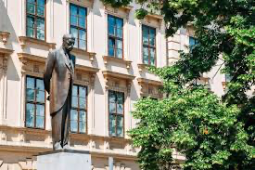
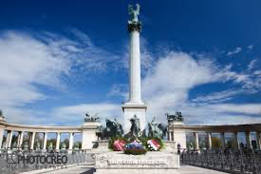

Slide 30
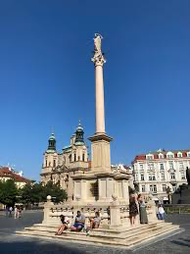
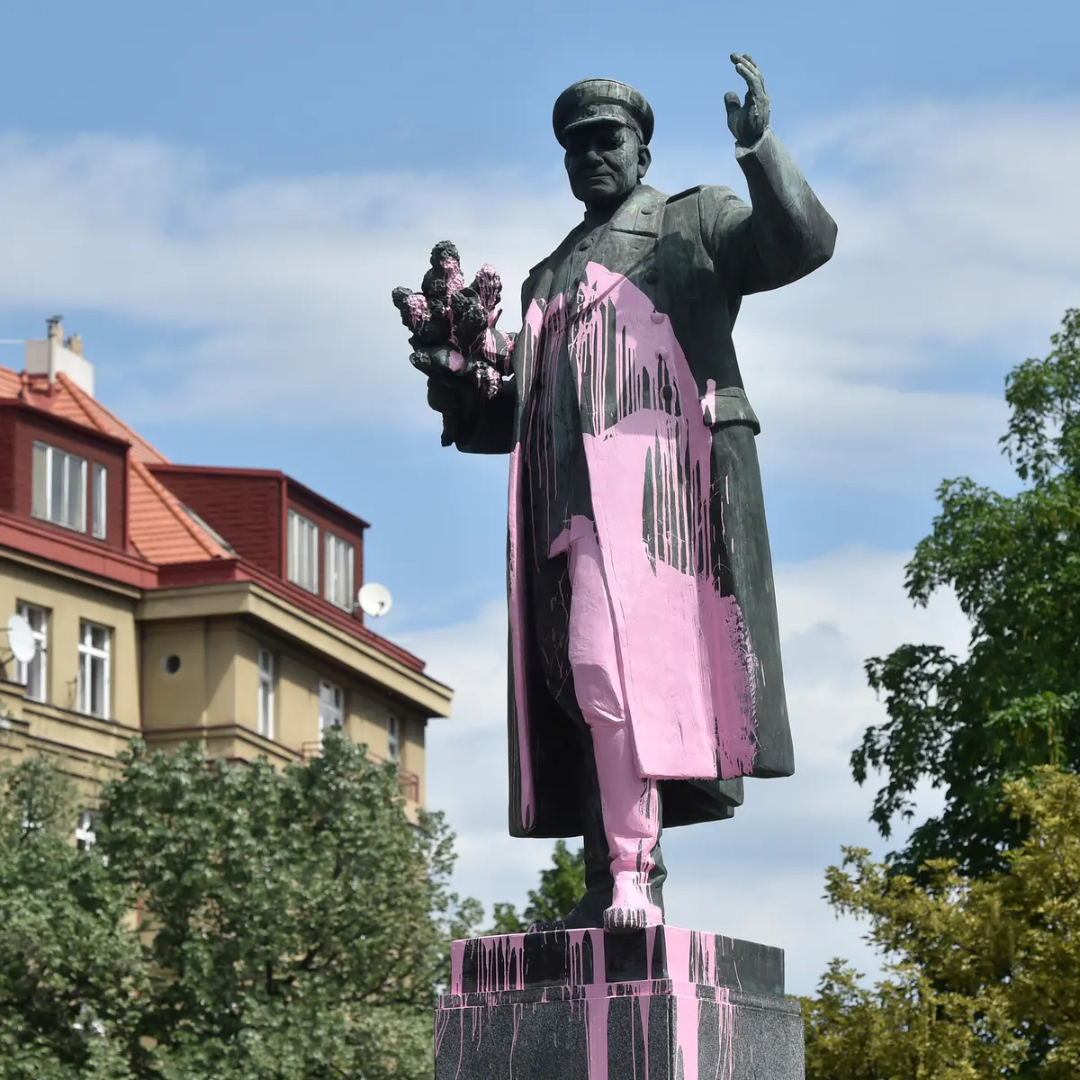
THE ELEMENTS OF A ”NATIONAL” COLLECTIVE NARRATIVE
A founding myth
Shared source
A sense of boundaries: who belongs to the state identity: who does the state serve?
Glorious Victories, Collective Traumas
Heroes and Villains
Friends and Enemies
What future is looking for?
Recent Changes in
Prague Monuments

Slide 31
The Political Work Of Narrative
Hammack: The meaning individuals make through narrative is not simply personal or idiosyncratic but rather political in nature, for it always possesses implications for a particular configuration of social categories and, hence, social competition.
EX. A society of x’s and y’s
Identifies and reinforces collective identity as something lasting, natural: Founding myth
Defines and defends the the ”symbolic boundaries” of the community
Removes or explains contradictions in history that could divide community
Explains and legitimates political structures and actions
Explains and legitimations position within international environment
Removes, Explains or Justifies negative events
Creates framework to explain, justify current actions
Discourages dissent
Creates Scapegoats

Slide 32
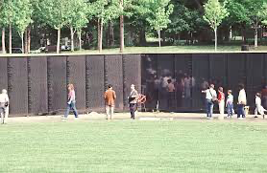
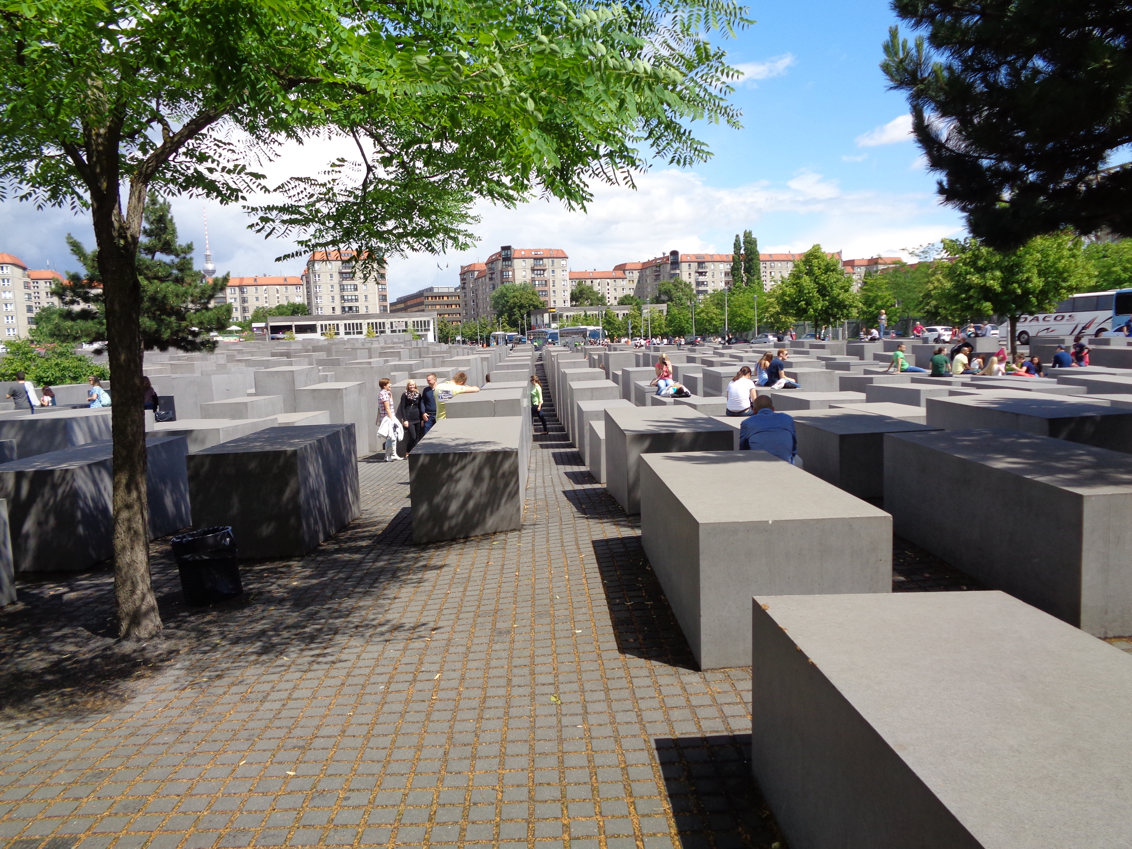
What about ”dark pasts”?
Denial—but perhaps not forever
Foot-dragging—but perhaps not forever
Victim and Perpetrator?
Reconciliation
Reparations

Slide 33
The Politics of Memory
National Identity Informs National interest
Collective memory informs national identity
Collective consists of many different identities, memory
The Memory that gains prominence has power
Which memory is prominent? Depends in part on power and politics
Politics of memory comprises public activity of various social institutions and actors aimed at the promotion of specific interpretations of a collective past and establishment of an appropriate sociocultural infrastructure of remembrance, school curricula, and, sometimes, special legislation.

Slide 34
Mnemonic Regimes
The Definition of a “Memory Regime”
The concept of "memory regime" in this study refers to a set of cultural and institutional practices that are designed to publicly commemorate and/or remembera single event, a relatively clearly delineated and interrelated set of events, ora distinguishable past process. We are particularly interested in official memory regimes, that is, memory regimes whose formulation and propagation involve the intensive participation of state institutions and/or political society (the authoritie sand major political actors such as parties, who are organized to hold and contest state power)…. The whole set of official regimes existing in a given country in a givenperiod can be called the official field of (collective or historical) memory.
TYPES OF MEMORY REGIMES
FRACTURED
UNIFIED
PILLARIZED

