Slide 1
Memory Wars
Part I: Poland and Russia
Part II: Ukraine and Russia Before the Invasion

Slide 2
Outline
Abstract- 200 words
Contains question
Why it is important
How you are going to approach the question
What is you conclusion
Introduction: Quick background, question, importance, argument
Background: Explain a little about the event and the case
Discussion of which concepts from the literature you are using for analysis
The analysis
Conclusion

Slide 3
The Importance of Paragraphs
One Paragraph One Idea
Topic Sentence Presents Idea
The rest of the Paragraph Develops It
Don’t make paragraphs too long

Slide 4
Review: When do memory wars occur?
Opposing or Mutually Exclusive Memories
Ontological Insecurity
Rise of Warrior narrative(s)
Securitization of Memory
Mnemonic Security Dilemma

Slide 5
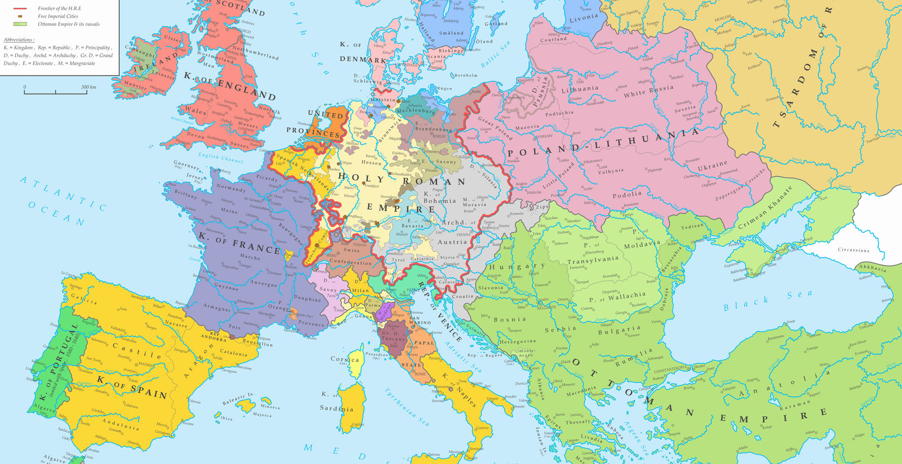
The Polish Narrative: Poland-Lithuania in 1648

Slide 6
Partition
Partitioned in Late 1700s—Between Three Empires
Rise of Nationalism—Identity Defined in Part by Nobility
Emphasis on Catholic Church

Slide 7
Interwar
Independence and the Defeat of the Bolsheviks
Constitutional Beginnings Degrade into:
Right-Wing Nationalist Authoritarianism
Legal Discrimination against Jews and
Ukrainians

Slide 8
The War Experience
Divided by Germany and Soviet Union
Elites murdered under both regimes--Katyn
Deportations in East and West
Atrocities not seen in France, Denmark, Holland, Belgium,
General Plan Ost
The Holocaust

Slide 9
Polish Traditions of Resistance
Against Prussia, Russia
1794, 1830, 1863
Against the Nazis
Home Army
Ghetto Uprising,
Warsaw Uprising
Against the Communists
1956, 1968, 1970, 1976
Solidarity, 1980

Slide 10
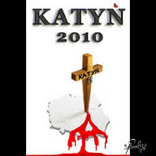
The Polish Martyr Narrative Among Post-Communist Right
POLAND AS VICTIM
POLAND AS SACRED: The Christ of Nations
SACRIFICE IS ENNOBLING

Slide 11
Polish-Russian Divide
Molotov-Ribbentrop Pact and The Secret Protocol—1939
The Polish Account:
Soviet Union and Nazi Germany divide Poland
Aggression by Totalitarian countries
Soviet Union just as bad as Nazis
Russian regime account:
Defensive Action by Stalin after West rejected cooperation
West abandoned Czechoslovakia, tried to push war eastward
Poland not innocent: anti-Semitism, taking part of Czechoslovakia as well
Katyn- The Murder of 20,000 Polish Officers, Elites
Soviets blame Germans
Persist in lie until 1989
Poles say attempt at decapitating Polish society
Katyn 2010
Several attempts at reconciliation, all failed

Slide 12
The 2019 Dispute
The European Parliament Resolution:
“The European Parliament…”
1. Recalls that, as enshrined in Article 2 of the TEU, the Union is founded on the values of respect for human dignity, freedom, democracy, equality, the rule of law and respect for human rights, including the rights of persons belonging to minorities; recalls that these values are common to all Member States;
2. Stresses that the Second World War, the most devastating war in Europe’s history, was started as an immediate result of the notorious Nazi-Soviet Treaty on Non-Aggression of 23 August 1939, also known as the Molotov-Ribbentrop Pact, and its secret protocols, whereby two totalitarian regimes that shared the goal of world conquest divided Europe into two zones of influence;
3. Recalls that the Nazi and communist regimes carried out mass murders, genocide and deportations and caused a loss of life and freedom in the 20th century on a scale unseen in human history, and recalls the horrific crime of the Holocaust perpetrated by the Nazi regime; condemns in the strongest terms the acts of aggression, crimes against humanity and mass human rights violations perpetrated by the Nazi, communist and other totalitarian regimes;

Slide 13
Putin’s Response
I believe that such ‘paperwork’ – for I cannot call this resolution a document – which is clearly intended to provoke a scandal, is fraught with real and dangerous threats. Indeed, it was adopted by a highly respectable institution. And what did it show? Regrettably, it revealed a deliberate policy aimed at destroying the post-war world order whose creation was a matter of honour and responsibility for the countries a number of representatives of which voted today in favour of this deceitful resolution. …And those who deliberately put this consensus into question undermine the foundations of the entire post-war Europe.

Slide 14
The creation of the modern system of international relations is one of the major outcomes of World War II. Even the most insurmountable contradictions – geopolitical, ideological, economic – do not prevent us from finding forms of peaceful coexistence and interaction, if there is the desire and will to do so. Today the world is going through quite a turbulent time. Everything is changing, from the global balance of power and influence to the social, economic and technological foundations of societies, nations and even continents. In the past epochs, shifts of such magnitude have almost never happened without major military conflicts. Without a power struggle to build a new global hierarchy. Thanks to the wisdom and farsightedness of the political figures of the Allied Powers, it was possible to create a system that has restrained from extreme manifestations of such objective competition, historically inherent in the world development.

Slide 16
The Entangled Memory Seeing Through An Imperial Lens The Little Brother Who Came Back
Shared Founding: Kyivan Rus’--Vikings
Vladimir (Volodymyr) the Great—Conversion to Christianity 988
The Separation: 13-17th Centuries
The Cossacks
1654: Bohdan Khmelnitsky and the Treaty of Pereyaslav
Late 18th Century: The Partition of Poland and
the First Annexation of Crimea
Most of Ukraine Becomes Part of Russia,
but Western Ukraine part of Austria
Russification in Russia and the Soviet Union
The Experience of World War II

Slide 17
Ukraine’s Differentiation from Russia
**After Collapse of Kyivan Rus’: ”Ukrainians” Under Lithuania and Poland until 1600s: Conversion to Eastern Rite Catholicism
Cossacks: The Battle of Poltava: Cossacks Realign with Poland
**Ukrainian Nationalism in early 1800s: Taras Shevchenko
**Nationalism in Western Ukraine: Stepan Bandera
Ukrainian People’s Republic, 1918-1920
**The Holodomor and the Purge of Ukrainian Political and Cultural Elite
Ukrainian National Resistance Before, During and After WWII
Stepan Bandera

Slide 18
TWO UKRAINES? EAST VRS. WEST
Two Approaches to Ukrainian populations
Russian Empire: Ukraine = “Little Russians”
Russification, No Mass Education
Austro-Hungarian Empire—Mass Education In Local Languages
In Western Ukraine: Poles Dominate Cities, Ukrainians more rural
The Interwar Period
Soviet Ukraine
Polish Ukraine

Slide 19
The Twentieth Century
World War I and Russian Civil War
Groups of Ukrainian nationalists sided with Poles against Bolsheviks
But Poles did not want to recognize Ukrainian independence either
The Early Soviet Ukraine Polish Galicia
SSR in 1922 Poles dominant
1920s Korenizatsia Discrimination
Stalin
1930s. Collectivization
Campaign against ”bourgeois nationalists” Mid-Late1930s: Discrimination
Russification Violent Nationalist Movements
Russians sent to work in E. Ukr, Stepan Bandera; Roman Shukhevych
The War—Germans invade; Stories that Ukr. 1939—Soviets invade, Bandera joins Nazis
1941. Germans invade, Bandera goes to camps
Soviets come back Nationalist groups often work with Nazis
1944. Civil war: Poles-Ukrainians
1945. Sovietization
Post-Stalin:
Assimilation, Russian is key language

Slide 20
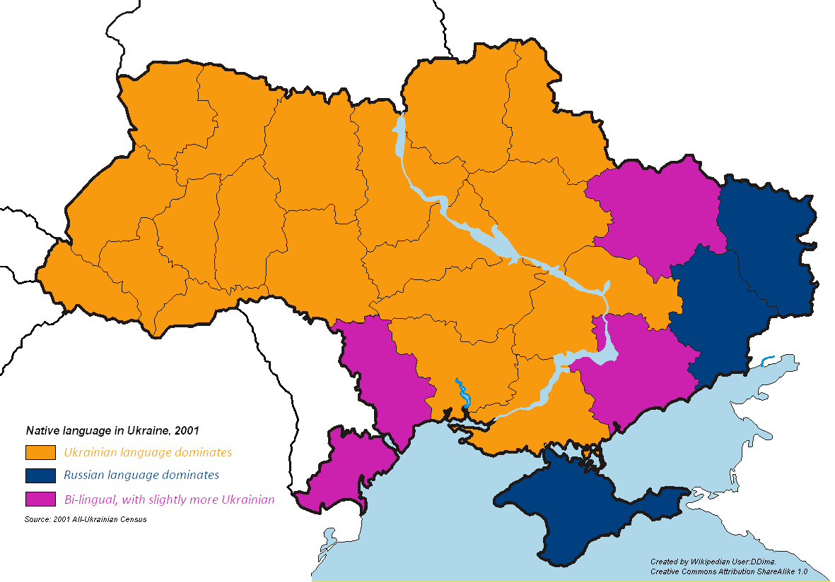

Slide 21
Independent Ukraine
1987-1991: Ukrainian Nationalist Movement in West, then spreads
1991: Yuriy Kravchenko, Former head of secret police and First Party Secretary, becomes First President.
Referendum: More than 90% for independence
Kravchenko’s and Kuchma’s Presidency (1991-2004)
Fairly superficial reforms
Patronal networks tied to Russian economy
Recognizes nationalism, but downplays differences, looks to future
2004. The Orange Revolution
Yushchenko—Ukrainian Nationalist
Yanukovich-Embedded in oligarchic networks with Russia
2010 Yanukovich wins-fair Elections
2014: Partnership with EU or membership in Russia’s Eurasian Economic Union
Maidan protests
Corruption a Key Issue
In a truncated Ukraine, Russian interests diminish in power

Slide 22
Ukrainian Identity: Before and After 2014
Join European Union or Eurasian Economic Union?
2013: 42% for EU, 37% for EAEU
2016: 47% for EU, 16% for EAEU
Positive Attitudes towards Russia?
February 2014: 78% Positive; May 2015: 30% Positive
Independence Referendum?
2011: 61% for independence; but in East only 53% and in South only 37%
2016: 87% for independence including 71% in East and 78% in South
HOLODOMOR A GENOCIDE? 2010- 60% said yes; 2017- 80%
Bandera and others? May 2012—21%; 2013—31%

Slide 23
Ukrainian Memory and Other Laws
2015: Four Decommunization Laws
Remembering Victory over Nazism:
Great Patriotic War to World War II;
Prohibits “falsification of the history of World War II”
Condemning Nazist and Communist Totalitarianism and Symbols
Renaming streets, taking down statues, etc.
Recognition of Fighters of Independence: More Controversial
Also upsets Poles
2019: De-Russification Laws
The 2012 Law-Ukrainian state language but regions can declare Russian a minority
language and use in governmental business, schools
2019 limits use of Russian throughout public life, including education and the media
Restrictions of Russian books sold in Ukraine
Restrictions of Russian movies, television available in Ukraine

Slide 24
Putin Denies Existence of Ukrainian Nation
It should be noted that Ukraine actually never had stable traditions of real statehood. And, therefore, in 1991 it opted for mindlessly emulating foreign models, which have no relation to history or Ukrainian realities.
I will start with the fact that modern Ukraine was entirely created by Russia or, to be more precise, by Bolshevik, Communist Russia. This process started practically right after the 1917 revolution, and Lenin and his associates did it in a way that was extremely harsh on Russia – by separating, severing what is historically Russian land. Nobody asked the millions of people living there what they thought.
Lenin … suggested making concessions to the nationalists, whom he called “independents” at that time. Lenin’s ideas of what amounted in essence to a confederative state arrangement and a slogan about the right of nations to self-determination, up to secession, were laid in the foundation of Soviet statehood.
If Ukraine does not exist but is part of Russia, then all people who fight for Ukrainian independence are Nazis like Bandera

Slide 25
Debates Over Different Laws
CRITIQUES
Expensive
Freedom of speech
Human Rights
DEFENSE
National Security
Russia’s Hybrid War
Possibility of infiltration, subversion
Economic Development
Russia has a huge market, can produce books, movies, etc on a larger scale
Decolonization—Persistent efforts of Russification have to be undone

