Slide 1
Proportional and Mixed Systems
PMCb1012 Elections and campaigning

Slide 2
Elections
A necessary but not a sufficient condition for democracies
Various benefits:
Accountability
Representation
Legitimacy
A peaceful transfer of power (unlike a military coup)
Civic mobilization
Only free and fair elections fulfil this role

Slide 3
Proportional Representation (PR) Systems
Main aim - distribution of seats resembles the proportion of votes
Multi-member constituencies
Two main categories:
List proportional representation
Single transferrable vote

Slide 4
Ideal proportionality

Slide 5
The reality might be quite different

Slide 6
List Proportional Representation
Parties create lists of their candidates for each constituency
Voters have a single vote given to one political party
Some systems allow support some candidates within the party list
A unique set of several features:
1) Number and size of constituencies
2) Allocation formula
3) Threshold
Their specific rules have key impact on true proportionality

Slide 7
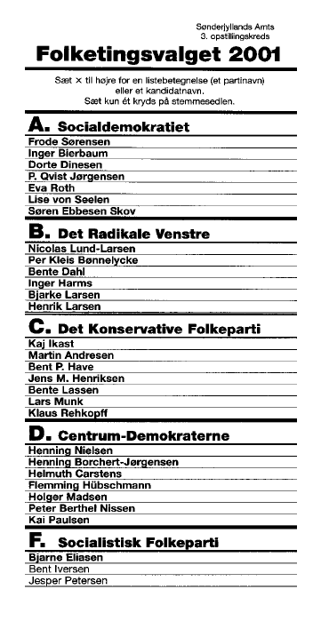
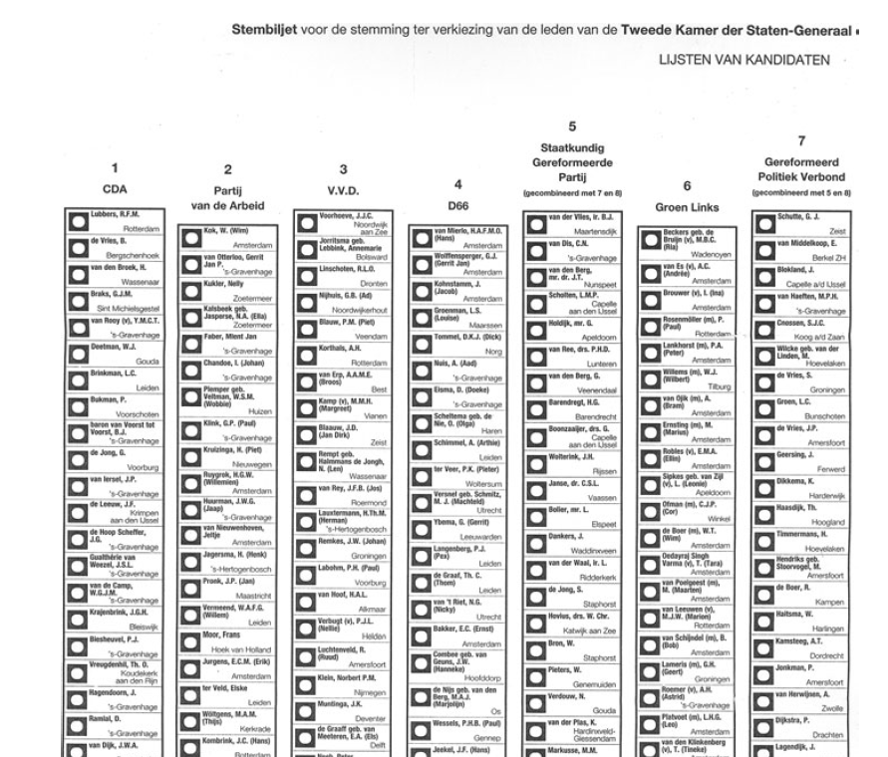

Slide 8
1) Constituencies
Always multi-member constituencies (>1 seat)
Two options:
Countries divided into various constituencies – most countries
A single nationwide constituency – Netherlands, Slovakia
Size of constituency (number of seats) is critical
The main rule:
The smaller are the constituencies, the better for large parties

Slide 11
2) Allocation Formula
A mathematical transformation of votes to seats
Various ways
Quotas
Divisors
Also impacts the final proportionality

Slide 12
Quota
A set number of votes needed for one seat
A party receives a seat for each time its votes pass the quota
Most simple example – the Hare quota
Number of all valid votes / number of seats
If we have 1,000 votes and 20 seats then the quota is:
1,000 / 20 = 50 votes
→ parties receive a seat for each acquired 50 votes

Slide 13
Party | Votes | Quota | Seats 1 | Remaining votes | Seats 2 | Seats final
A | 415 | 1,000 / 20 = 50 | 8 | 15 |  | 8
B | 340 |  | 6 | 40 | 1 | 7
C | 165 |  | 3 | 15 |  | 3
D | 80 |  | 1 | 30 | 1 | 2
 | 1,000 |  | 18 |  | 2

Slide 14
Divisor
Alternative to quota
Votes of parties are divided by a series of growing numbers
Seats are distributed based on results of division
D’Hondt divisor: 1,2,3,4,5,6,7,…

Slide 15
Example
20/20
4 parties
20 seats to distribute
Party | Votes | Votes divided by
Party | Votes | 1 | 2 | 3 | 4 | 5 | 6 | 7 | 8 | 9 | 10
A | 415 | 415 | 208 | 138 | 104 | 83 | 69 | 59 | 52 | 46 | 42
B | 340 | 340 | 170 | 113 | 85 | 68 | 57 | 49 | 43 | 38 | 34
C | 165 | 165 | 83 | 55 | 41 | 33 | 28 | 24 | 21 | 18 | 17
D | 80 | 80 | 40 | 27 | 20 | 16 | 13 | 11 | 10 | 9 | 8

Slide 16
Now only 11 seats
Party | Votes | Votes divided by
Party | Votes | 1 | 2 | 3 | 4 | 5 | 6 | 7 | 8 | 9 | 10
A | 415 | 415 | 208 | 138 | 104 | 83 | 69 | 59 | 52 | 46 | 42
B | 340 | 340 | 170 | 113 | 85 | 68 | 57 | 49 | 43 | 38 | 34
C | 165 | 165 | 83 | 55 | 41 | 33 | 28 | 24 | 21 | 18 | 17
D | 80 | 80 | 40 | 27 | 20 | 16 | 13 | 11 | 10 | 9 | 8

Slide 17
And now only 4 seats
Party | Votes | Votes divided by
Party | Votes | 1 | 2 | 3 | 4 | 5 | 6 | 7 | 8 | 9 | 10
A | 415 | 415 | 208 | 138 | 104 | 83 | 69 | 59 | 52 | 46 | 42
B | 340 | 340 | 170 | 113 | 85 | 68 | 57 | 49 | 43 | 38 | 34
C | 165 | 165 | 83 | 55 | 41 | 33 | 28 | 24 | 21 | 18 | 17
D | 80 | 80 | 40 | 27 | 20 | 16 | 13 | 11 | 10 | 9 | 8

Slide 18
Why size of constituencies matters
Party | Votes | Votes % | 4 seats | 11 seats | 20 seats
A | 415 | 41.5 | 2 | 5 | 9
B | 340 | 34.0 | 2 | 4 | 7
C | 165 | 16.5 | 0 | 2 | 3
D | 80 | 8.0 | 0 | 0 | 1

Slide 19
You can also switch the divisor (example with 11 seats)
Party | Votes | Imperiali - votes divided by
Party | Votes | 2 | 3 | 4 | 5 | 6 | 7 | 8
A | 415 | 208 | 138 | 104 | 83 | 69 | 59 | 52
B | 340 | 170 | 113 | 85 | 68 | 57 | 49 | 43
C | 165 | 83 | 55 | 41 | 33 | 28 | 24 | 21
D | 80 | 40 | 27 | 20 | 16 | 13 | 11 | 10
Party | Votes | Saint-Laguë - votes divided by
Party | Votes | 1 | 3 | 5 | 7 | 9 | 11 | 13
A | 415 | 415 | 138 | 83 | 59 | 46 | 38 | 32
B | 340 | 340 | 113 | 68 | 49 | 38 | 31 | 26
C | 165 | 165 | 55 | 33 | 24 | 18 | 15 | 13
D | 80 | 80 | 27 | 16 | 11 | 9 | 7 | 6

Slide 20
3) Threshold
A minimum percentage of votes a party must pass to obtain seats
Typically around 5%
National v. regional
Impact on:
Level of fragmentation of elected bodies (parliaments, assemblies)
Stability of governments
Level of political representation

Slide 21
Details are essential
Proportional representation is only a general term
Necessary to know the specific features
Real outcomes might not be that proportional
Are some proportional systems truly proportional?

Slide 22
Impact of PR systems
Representation of various interests (and parties)
Reduced waste of votes
Allow survival of minority parties
Lower candidates’ accountability
Coalition governments

Slide 23
Country | Number of parties | Strongest party | Government
Austria | 5 | 31,5 | Coalition
Belgium | 12 | 16,0 | Coalition
Bulgaria | 6 | 25,4 | Coalition
Croatia | 8 | 37,3 | Coalition
Czech Republic | 4 (7) | 27,8 | Coalition
Denmark | 12 | 27,5 | Coalition
Estonia | 6 | 28,9 | Coalition
Finland | 10 | 20,8 | Coalition
Greece | 8 | 40,6 | Single party
Latvia | 7 | 19,2 | Coalition
Luxembourg | 7 | 29,2 | Coalition
Netherlands | 15 | 23,5 | Coalition
Poland | 5 (17) | 29,1 | Coalition
Portugal | 10 | 41,4 | Single party
Romania | 5 | 28,9 | Coalition
Slovakia | 7 | 23,0 | Coalition
Slovenia | 5 | 34,5 | Coalition
Spain | 11 | 33,1 | Coalition
Sweden | 8 | 30,3 | Coalition

Slide 24
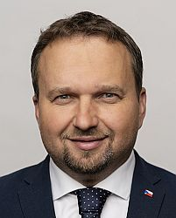

Slide 25
Mixed Systems
Systems based on (at least) two tiers:
Nominal - Majority/Plurality mechanism
List – Proportional representation
Share of seats assigned to each tier:
Equal distribution – nominal tier 50%, list tier 50%
Prevalence of one tier – for instance nominal tier 75%, list tier 25%
Voters usually have two votes, one for each tier
The best of both worlds?

Slide 26
Example
Parliament has 200 seats
Nominal tier (100 seats):
Country divided into 100 single-member districts
FPTP rules
List tier (100 seats):
Country divided into 10 multi-member districts (8-12 seats each)
List PR system

Slide 27
Nominal tier List tier
1 | 1 | 1 | 1 | 1 | 1 | 1 | 1 | 1 | 1
1 | 1 | 1 | 1 | 1 | 1 | 1 | 1 | 1 | 1
1 | 1 | 1 | 1 | 1 | 1 | 1 | 1 | 1 | 1
1 | 1 | 1 | 1 | 1 | 1 | 1 | 1 | 1 | 1
1 | 1 | 1 | 1 | 1 | 1 | 1 | 1 | 1 | 1
1 | 1 | 1 | 1 | 1 | 1 | 1 | 1 | 1 | 1
1 | 1 | 1 | 1 | 1 | 1 | 1 | 1 | 1 | 1
1 | 1 | 1 | 1 | 1 | 1 | 1 | 1 | 1 | 1
1 | 1 | 1 | 1 | 1 | 1 | 1 | 1 | 1 | 1
1 | 1 | 1 | 1 | 1 | 1 | 1 | 1 | 1 | 1
8 | 9 | 1 | 10 | 1
1 | 1 | 1 | 12 | 10
1 | 12 | 1 | 1 | 1
11 | 1 | 1 | 1 | 1
1 | 1 | 1 | 9 | 1
 | 1 | 1 | 1
9 | 1 |  | 1 | 1
1 | 1 | 10 | 1 | 1

Slide 28
Linkage Between the Tiers
Critical for effects of mixed systems
Parallel system:
The tiers work completely independently
Seat distribution is separated for to tiers
Basically two different electoral systems existing next to each other
Compensatory system:
Existing linkage between the tiers
Typically some sort of compensation to lower advantage of large parties
List tier used as a protection of small parties

Slide 29
Lithuania (Parallel)
Lithuanian parliament Seimas (141 members)
Nominal tier:
71 seats in single-member districts
Majoritarian run-off system
List tier:
70 seats in one nationwide constituency
List PR system

Slide 30
Lithuanian 2020 election
Party | List tier |  | Nominal 1 |  | Nominal 2 |  | Total seats
 | Votes % | Seats | Votes % | Seats | Votes % | Seats
TS-LKD | 25.8 | 23 | 24.2 | 1 | 40.2 | 26 | 50
LVZS | 18.1 | 16 | 15.2 | 0 | 23.6 | 16 | 32
DP | 9.8 | 9 | 7.9 | 0 | 0.9 | 1 | 10
LSDP | 9.6 | 8 | 11.8 | 0 | 8.5 | 5 | 13
LP | 9.5 | 8 | 6.5 | 0 | 8.1 | 3 | 11
LRLS | 7.0 | 6 | 9.3 | 0 | 6.9 | 7 | 13
Others | 20.2 | 0 | 25.1 | 2 | 11.8 | 10 | 12

Slide 31
Italy 1994-2001 (Compensatory)
630 seats
475 seats in nominal tier (FPTP)
155 seats in list tier (PR)
Linkage (Scorporo):
Penalty for large parties winning in the nominal tier
Each victory in nominal tier leads to penalty in list tier
Penalty = votes needed for the victory in nominal tier
Huge disproportionality in favour of nominal tier

Slide 32
Scorporo - example
Candidate | Party | Votes
A | AAA | 50 000
B | BBB | 30 000
C | CCC | 15 000
D | DDD | 10 000
Penalty for party AAA:
Votes of the second best candidate +1 (votes needed for victory)
Party AAA will lose 30,001 votes in the list tier

Slide 33
It worked for a while (1994 election)
Alliance / Party | Nominal seats | PR votes % | PR seats | Seats
Polo Delle Libertá | 302 |  | 64 | 366
Forza Italia – CCD (FI-CCD) |  | 21,0 | 30
Alleanza Nazionale (AN) |  | 13,5 | 23
Lega Nord (LN) |  | 8,4 | 11
Alleanza Dei Progressisti | 164 |  | 49 | 213
Partito Dem. della Sinistra (PDS) |  | 20,4 | 38
Partito della Rif. Comunista (RF) |  | 6,1 | 11
Others | 9 | 16,6 | 42 | 50
Sum | 475 | - | 155 | 630

Slide 34
It worked for a while (1996 election)
Alliance / Party | Nominal seats | PR votes % | PR seats | Seats
L‘Ulivo | 247 |  | 38 | 285
Partito Dem. della Sinistra (PDS) |  | 21,1 | 26
Popolari-SVP-PRI-UD-Prodi |  | 6,8 | 4
Lista Dini |  | 4,3 | 8
Federazione dei Verdi |  | 2,5 | -
Polo Delle Libertá | 169 |  | 77 | 246
Forza Italia (FI) |  | 20,6 | 37
Alleanza Nazionale (AN) |  | 15,7 | 28
CCD-CDU |  | 5,8 | 12
Lega Nord | 39 | 10,1 | 20 | 59
Others | 20 | 8,8 | 20 | 40
Sum | 475 | - | 155 | 630

Slide 35
Failure of scorporo (2001 election)
Alliance / Party | Nominal seats | PR votes % | PR seats | Seats
Casa Delle Libertá | 282 | 49,6 | 86 | 368
Forza Italia (FI) |  | 29,4 | 62
Alleanza Nazionale (AN) |  | 12 | 24
L‘Ulivo | 189 | 34,9 | 58 | 247
Democratici di Sinistra (DS) |  | 16,6 | 31
La Margherita (DL) |  | 14,5 | 27
Partito D. R. Comunista (RF) | 4 | 5,5 | 11 | 15
Spolu | 475 | - | 155 | 630

Slide 36
How the system failed
Italian parties developed a strategy to avoid scorporo
Candidates in nominal tier with decoy partisan affiliation
Penalty accounted to these decoys (Abolizione scorporo, Paese nuevo)
Real parties faced no penalties
Formally compensatory → parallel in reality

Slide 37
Mixed Systems - Summary
Various configurations of the tiers
Allow more strategies to voters (ticket splitting)
Political scientists differ in their evaluation
Personal ties between voters and elected officials
Wasted votes, representation, governance
Best or worst of the both worlds?

