Slide 1
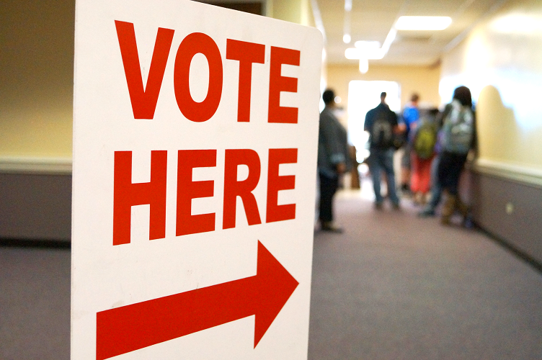
Voter Turnout
April 2, 2024

Slide 2
Voter behavior and decision making
Vote choice
Decision to vote
Why is voter turnout important??
Should there be high turnout?
Who it helps/hurts?

Slide 3
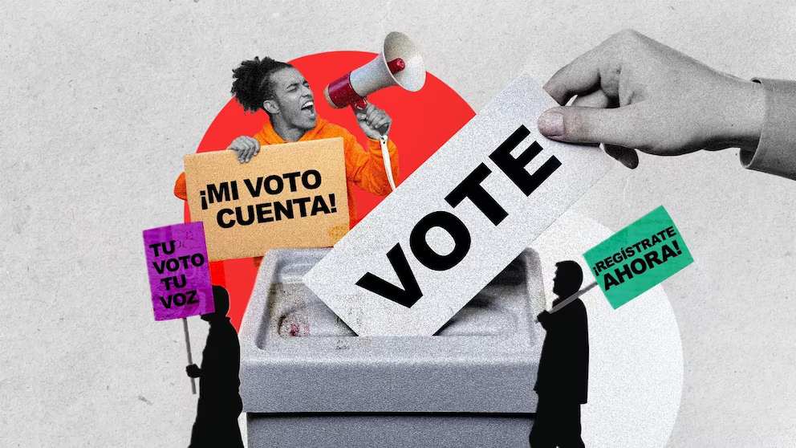
Voter turnout
Why voters vote?
Who is more/less likely to vote
What factors matter?

Slide 4


Why do you vote?
A. Downs: paradox of voting
Benefit of voting must exceed cost of voting
R $=PB−C$
Costs before the election
Cost of actual voting
While some people might vote instrumentally, rational choice does not explain voter turnout

Slide 5
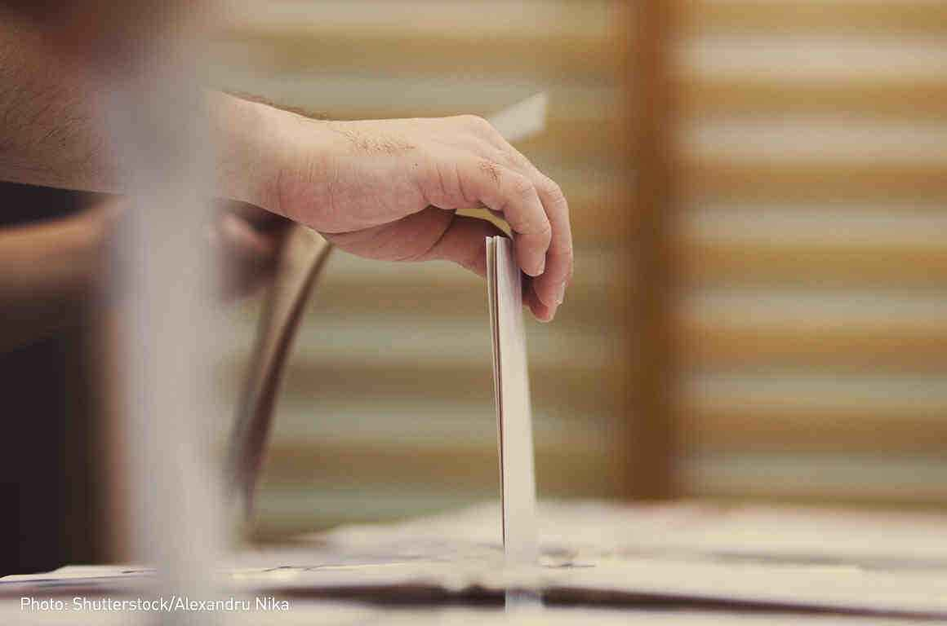
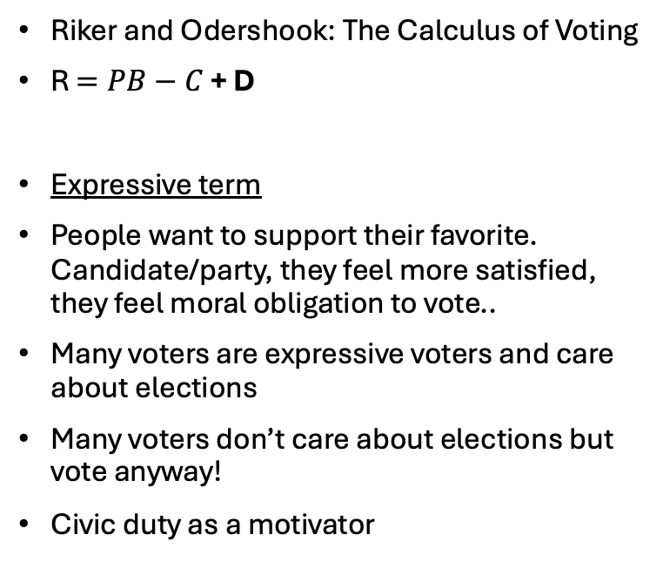
The D Term!
Riker and Odershook: The Calculus of Voting
R $=PB−C$+ D
Expressive term
People want to support their favorite. Candidate/party, they feel more satisfied, they feel moral obligation to vote..
Many voters are expressive voters and care about elections
Many voters don’t care about elections but vote anyway!
Civic duty as a motivator

Slide 6

Civic duty
Works for some voters as motivator
Voting compulsory in 29 democratic countries
In 8 constitutions: voting is a civic duty
2000 US presidential election: 71 % feeling of guilt when not voting
90% voters in Canada = vote as a civic duty (Blais et al. 2000)
80% in the UK (Clarke et al. 2004)
95% in Japan (2000)

Slide 7
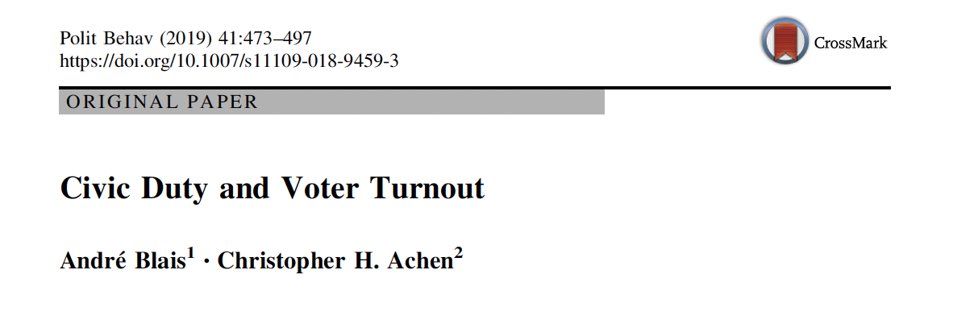
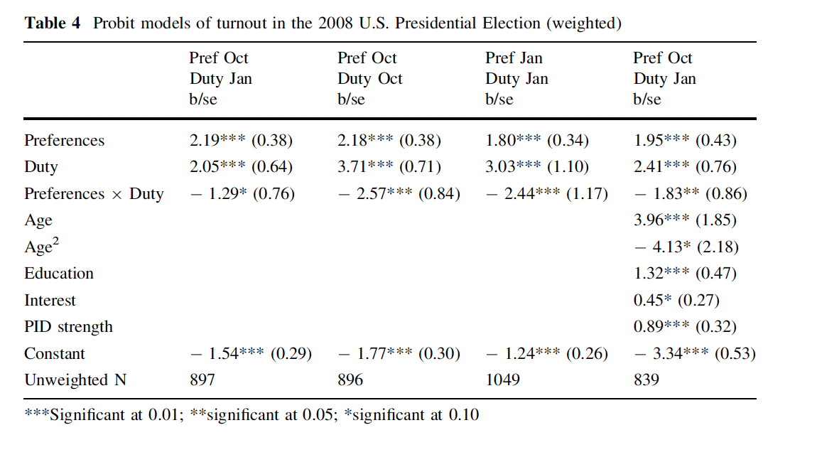
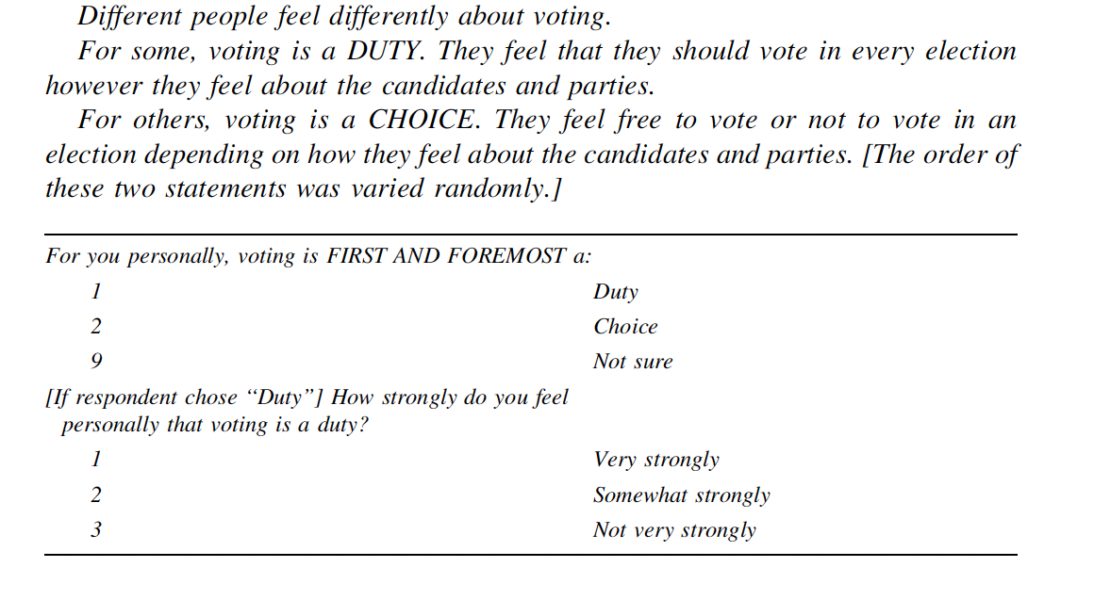
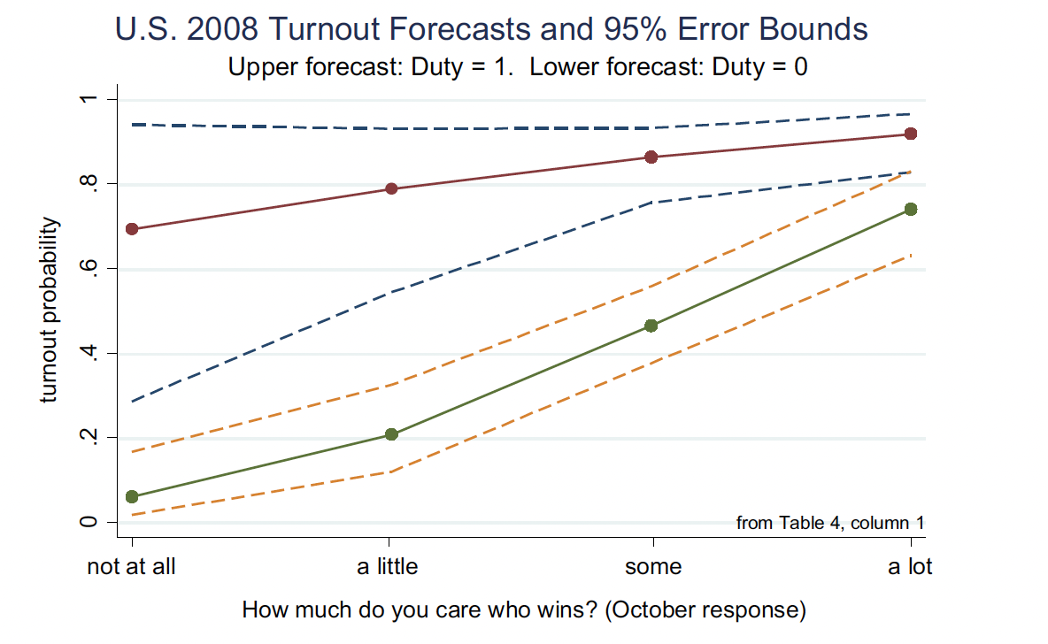

Slide 8
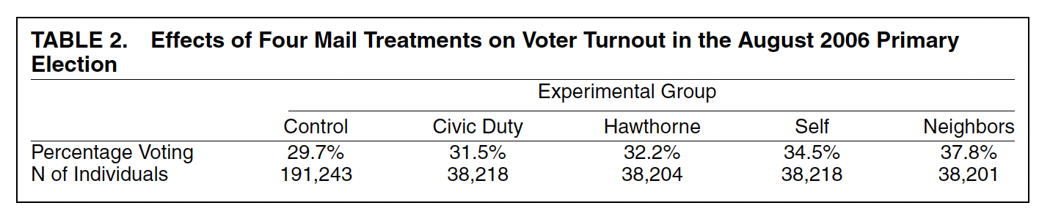
Experimenting with voter turnout
Can different messages increase voter turnout?
Gerber, Green, Larmier 2008: Social pressure to increase turnout?
Michigan primaries 2006, 180,002 households
Mailing one of the messages, turnout data from public records
CIVIC DUTY, Hawthrone effect, Self, Neighbors vs. Control group

Slide 9
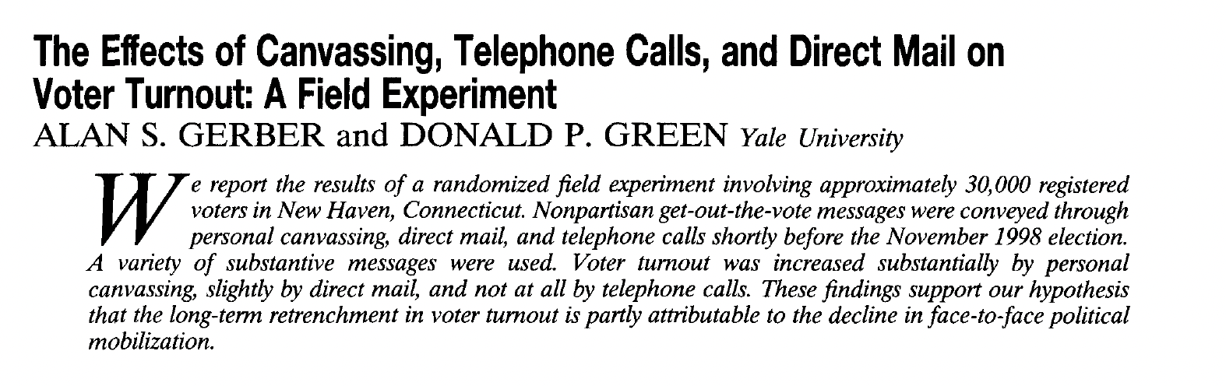
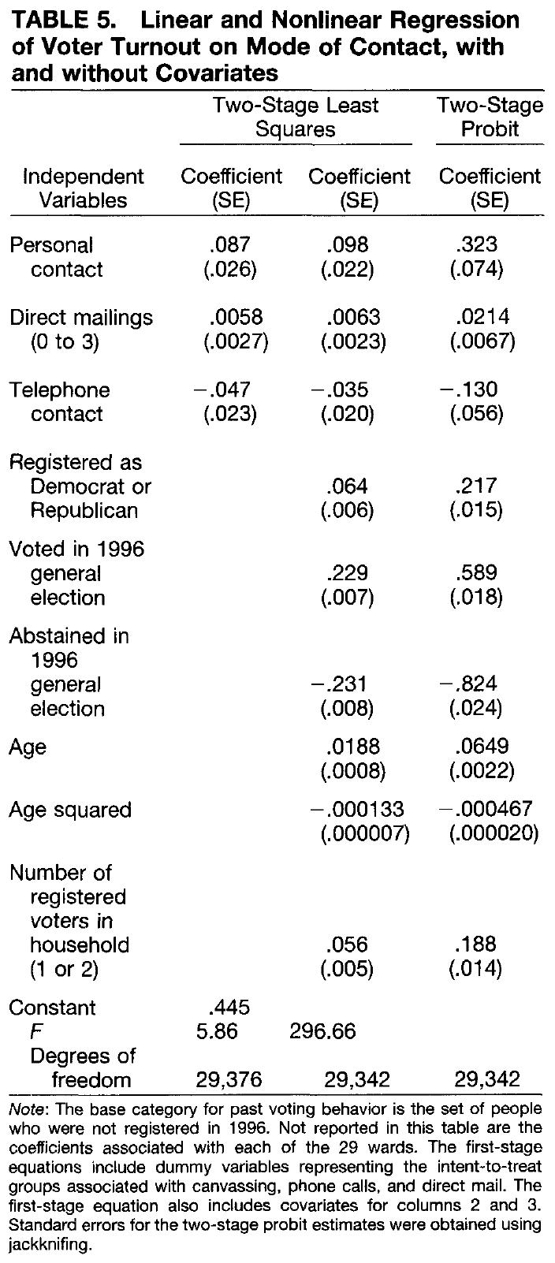
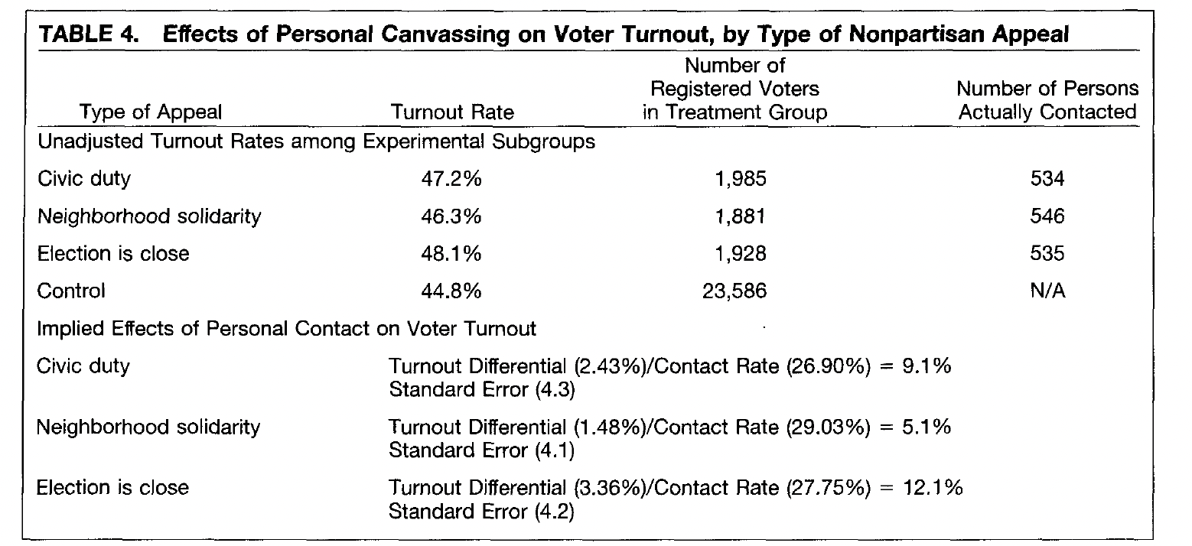
Communication channel
Large-scale study of GOTV
1998 election, New Haven

Slide 10
What other factors matter?
Focus on aggregate level and systems (country-level factors)
Focus of social characteristics

Slide 11
Aggregate level
In/equality and electoral turnout?
Some research confirms
Some does not
Role of operationalization
Wilford (2013)
Across 41 elections in 22 countries
Economic hardship = lower turnout among people of lower socioeconomic status

Slide 12
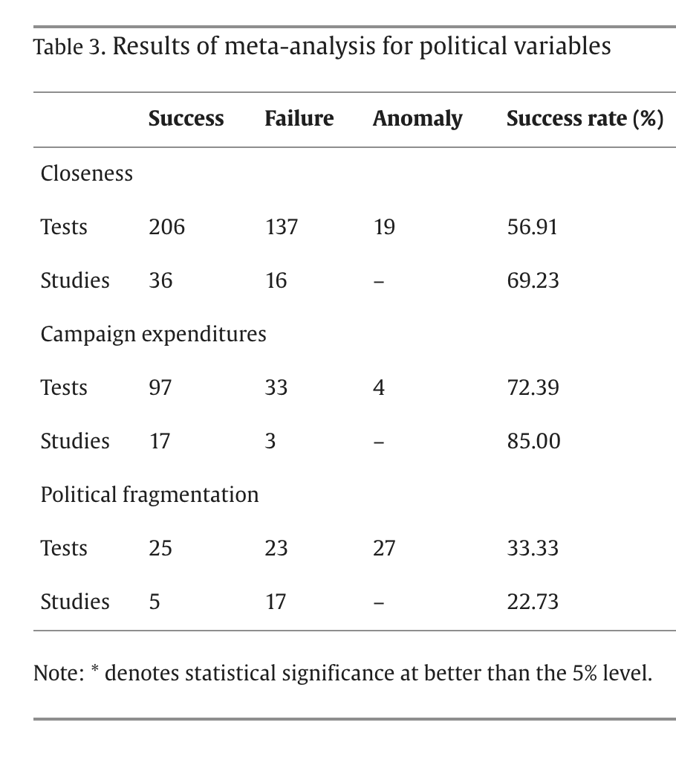
Political factors
(Geys 2006)
Closeness indicates competitiveness
  Increases probability of one‘s vote having effect
  More party mobilization in close districts
Campaign expenditure
  Increase information
  GOTV
Pol. Fragmentation
  Number of parties (inconclusive)

Slide 13
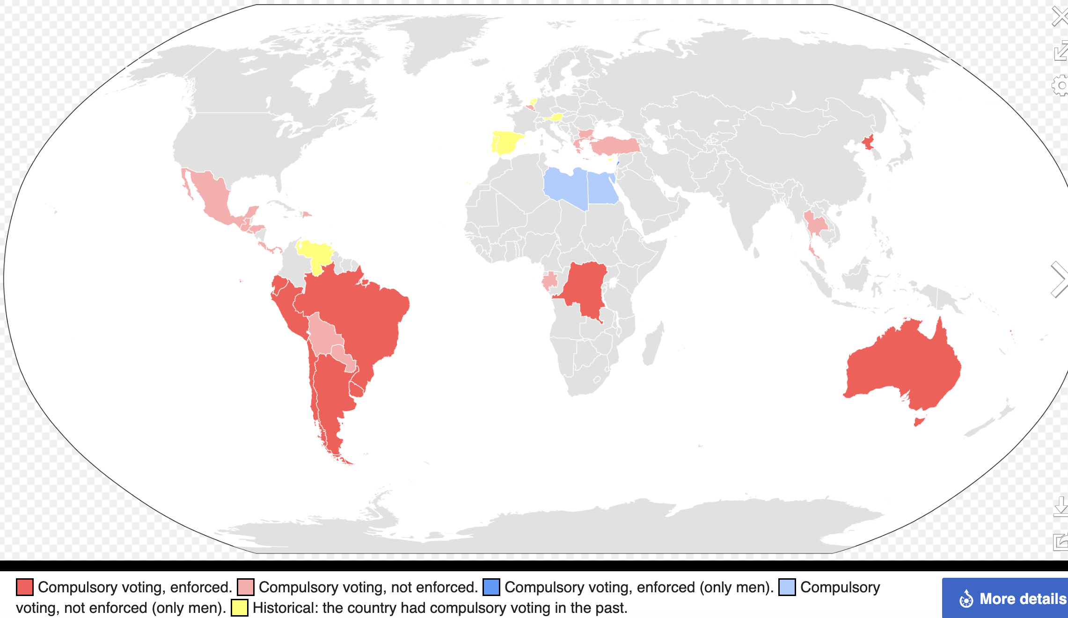
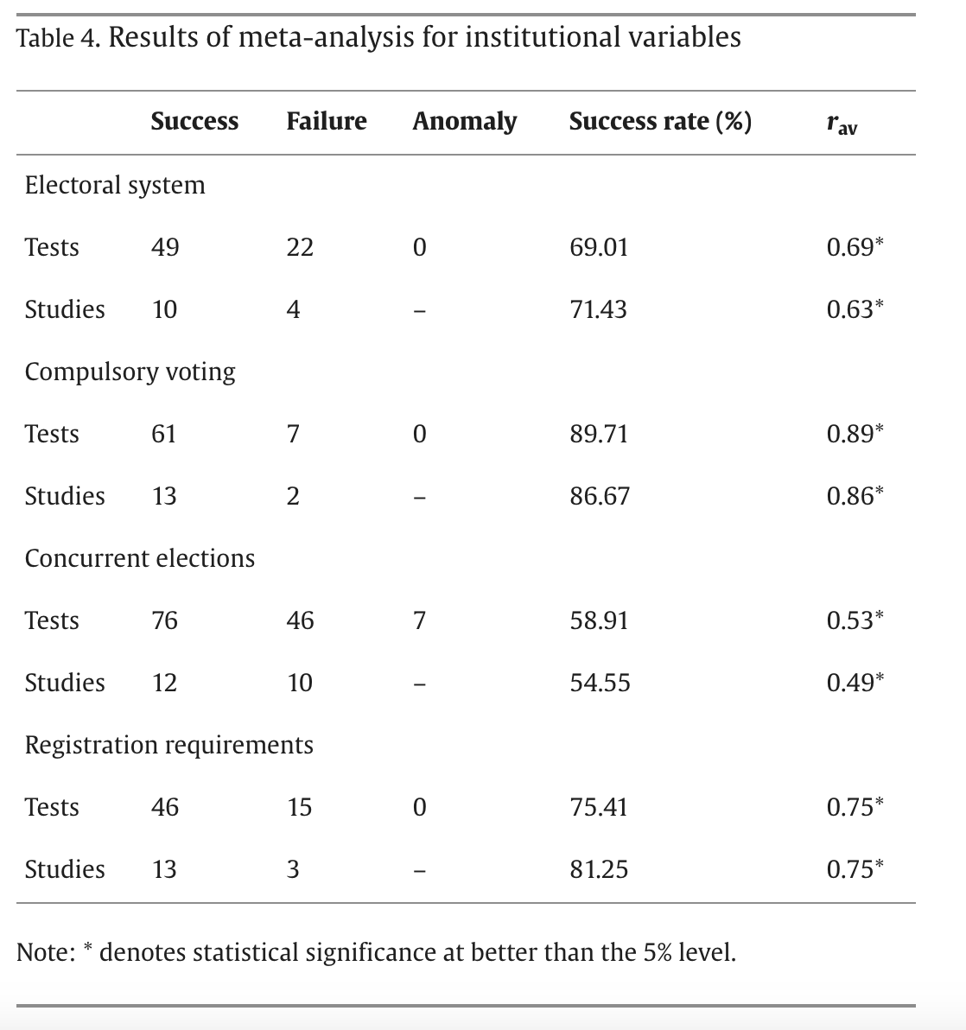
Institutional factors
PR systems = higher turnout rates
Compulsory voting is the strongest predictor
Concurrent elections increase turnout
Automatic registration increases turnout
Additional factor
“Order of the election”

Slide 14
Demographics and social groups
Very straightforward analysis
Measurement issues

Slide 15
Age
Low turnout among the youngest eligible voters
Steep increase in adulthood, gradual increase until sixities
Does turnout fall in old age?
Explanation
  Gradual clarification of interests
  Gradual internationalization of social norms
  Peer influence (other young people not voting too, low turnout context, low level of social cues, no expectations etc.)

Slide 16
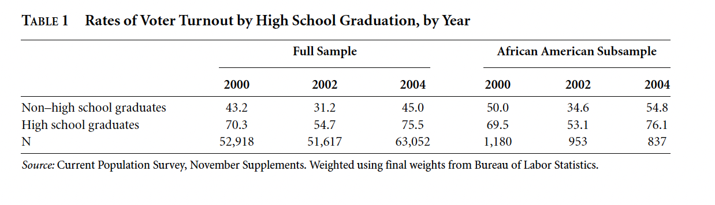
SES
Wide range of characteristics
Social class – various operationalizations (i.e. occupation – income and prestige) (modest to minimal effects
Income effects (mostly in the US)
Education – strong predictor but is there some other intevening variable?
  Is it an indicator of social class?
  Causal studies support the idea of direct effect of education on voter turnout

Slide 17
Gender
Women enfranchisement later then men
Traditional gender gap in voter turnout
Does it still apply?????

Slide 18
Summary
We should still ask normative questions about why people should(not) vote
Factors on individual (psychological, social) and systematic level (political, institutional, systemic factors)
Accumulation of much knowledge
Vast literature, feel free to study more!

Slide 19
Next step:
Your position paper!
Due next week!
Looking forward to learn more about your countries.

