Slide 1
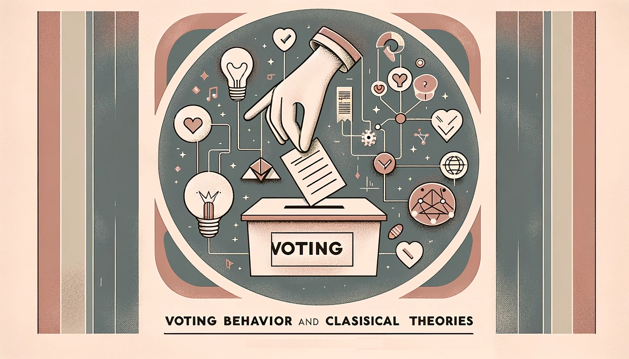
behavior
PMC
19 March 2024
PMCb1012 Spring 2024

Slide 2
Why do we study voting behavior?
Why is it a big deal?
Who should be interested?
How is voting related to democracy?
Are there any assumptions that we hold about voters?

Slide 4
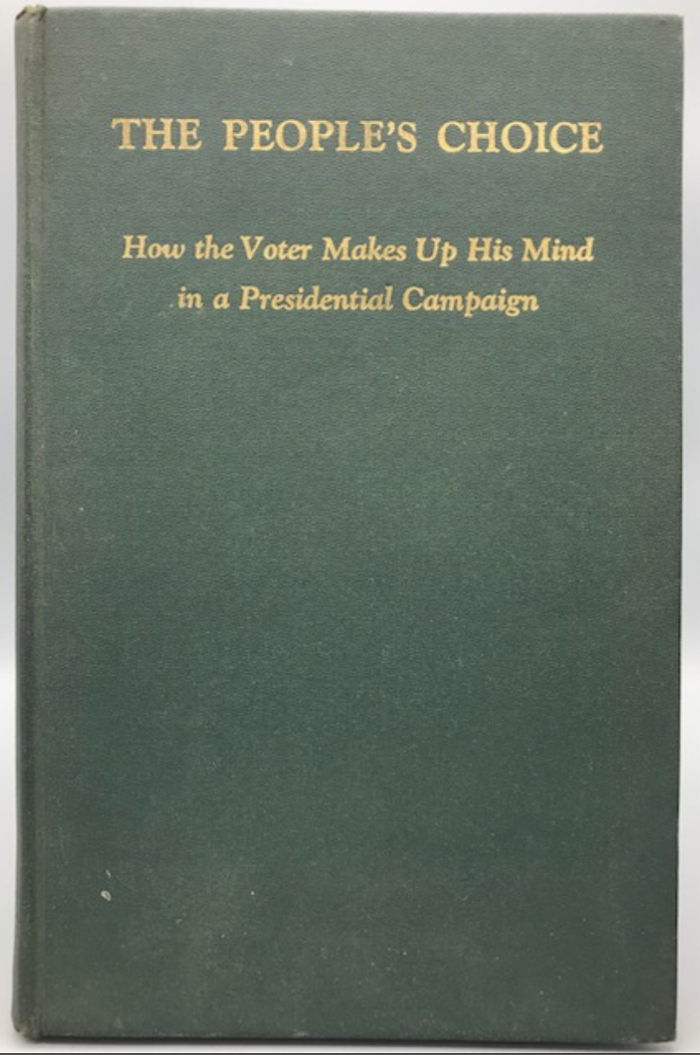
Sociological theory of voting
Lazarsfeld, Berelson & Gaudet 1944
Eire county, questionnaires
Mechanisms of voting decision
Panel (7 waves)
Hypothesis: personality and media
Not supported!
Main effects: social groups one belongs to

Slide 5
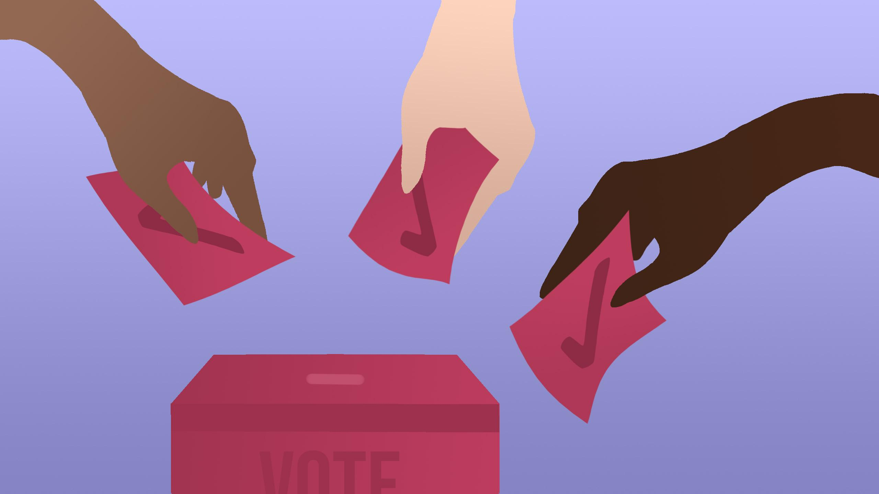
Sociological theories
Majority of voters voted according their original position
Strong correlation of social groups and voting
Index of Political Predisposition: socio-economic status, religion, area of residence
„ a person thinks, politically, as he is, socially. Social characteristics determine political preference.“
Undecided, switching voters = pressures from community
Camaign effect: activation, reinforcement (53%), conversion (8%)
Personal contact, two-step-flow
“In a way, the content of this chapter can be summarized by saying that people vote, not only with their social group, but also for it”

Slide 6
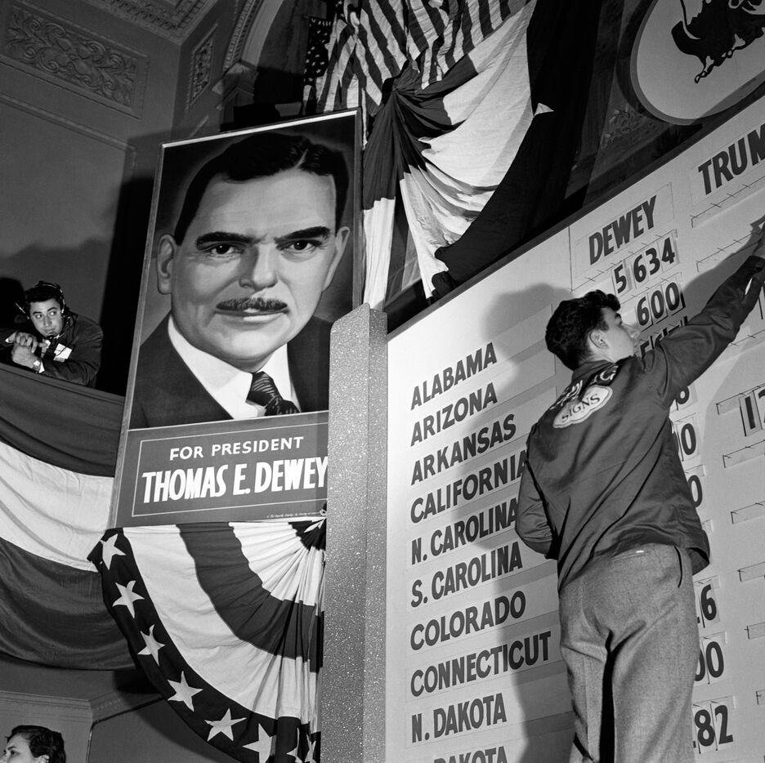
Voting (1954)
1943 election, Elmira study
Differentiation, transmission, contact
Predispositions: socio-economic status, race, religion, area of residence
Crosspressure
Subjects who move away will eventually return
To the “natural” position of their soc. group (reactivation)
How does their findings fit the democratic theory?

Slide 7
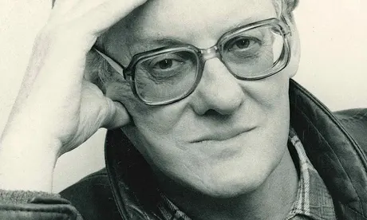
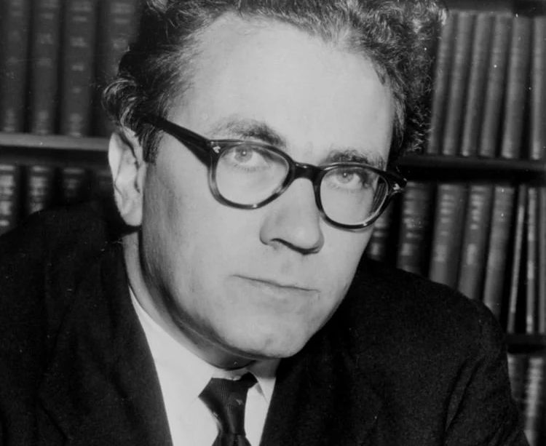
Cleavage theory (Rokkan and Lipset 1967)
Macro-sociological explanation
Society segmented into groups based on cleavages
Deep conflicts in societies that materialize in political parties
Alignment of one‘s identities with the social group represented by a party
Cleavages defined by national revolutions and industrial revolution
State vs. Church and Center vs. Periphery
Urban vs. Rural and Capital vs. Labor
Party systems frozen (1920s-1960s)

Slide 8
Cleavages and voting
Social predisposition to vote for parties (socialists, conservatives or liberals, Christian democrats, conservatives, regional parties etc.)
But what is a cleavage?!!!
Social structure
Psychology
Organizational aspect
Debates: Is there a decline of cleavage voting? Can cleavages change?

Slide 9
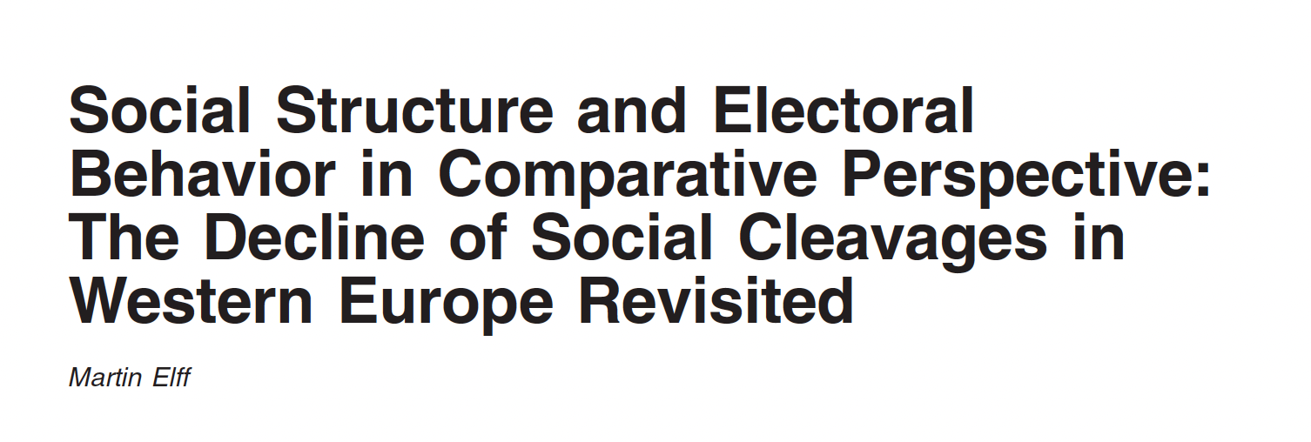
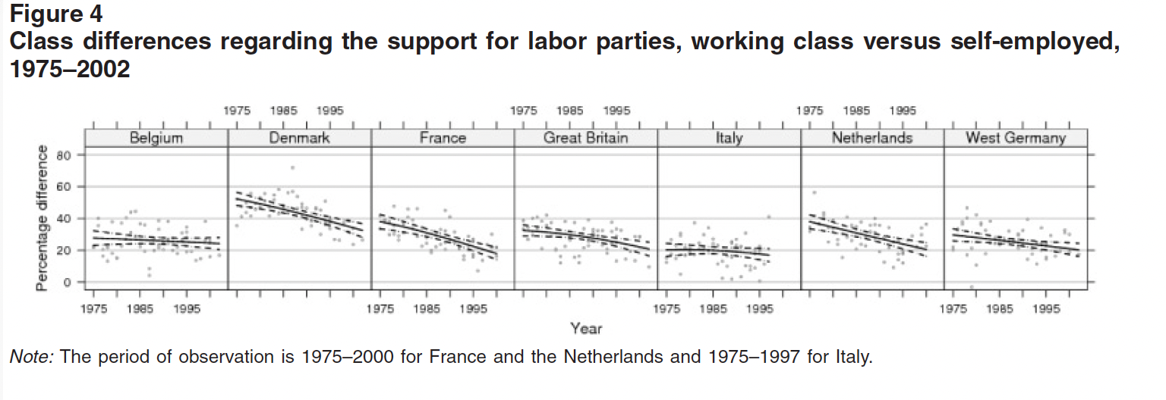
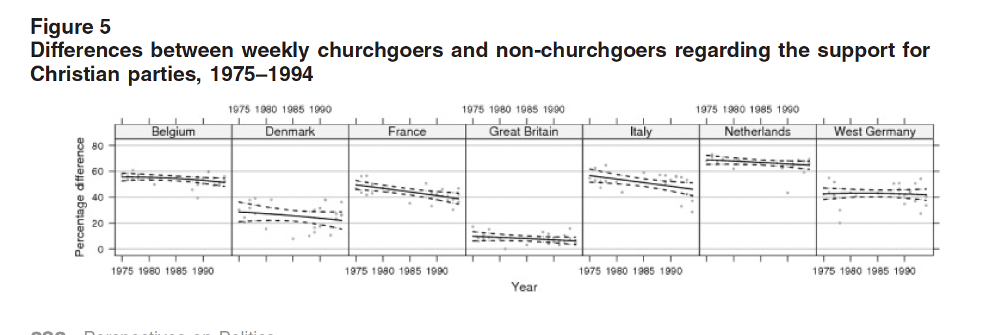
Decline of claas based and religious voting in W. Europe 1975-2002?
Not clearly, heterogenous
Most visible in France and Denmark
New issues adopted by parties

Slide 10
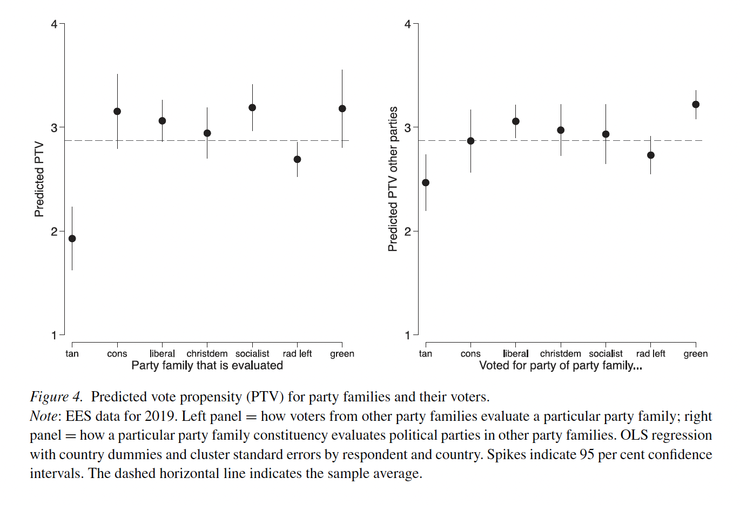
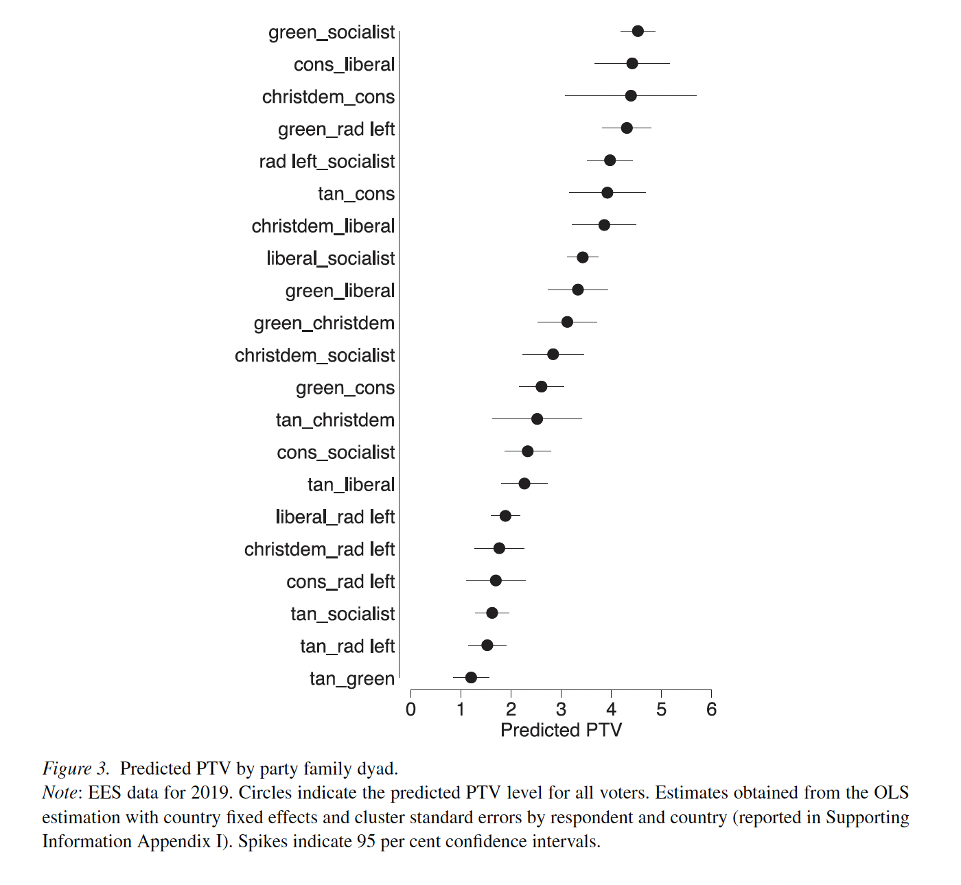
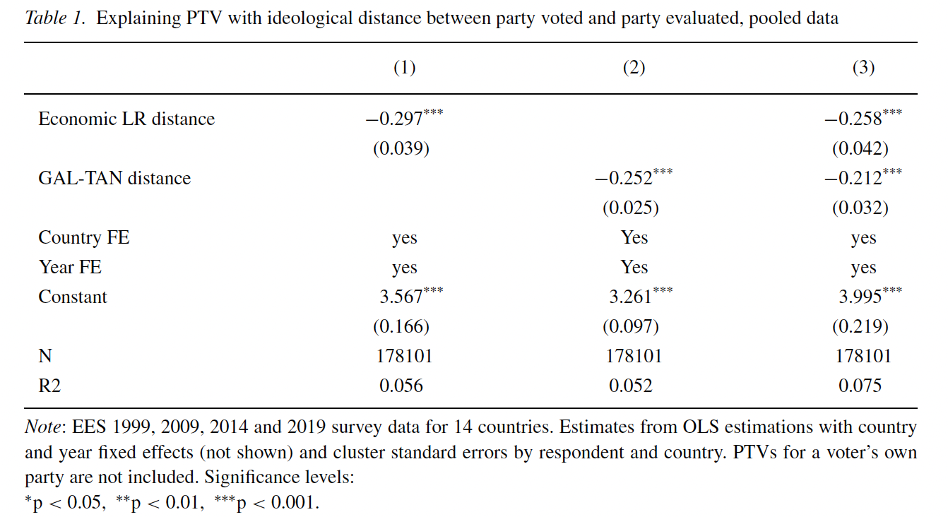

Slide 12
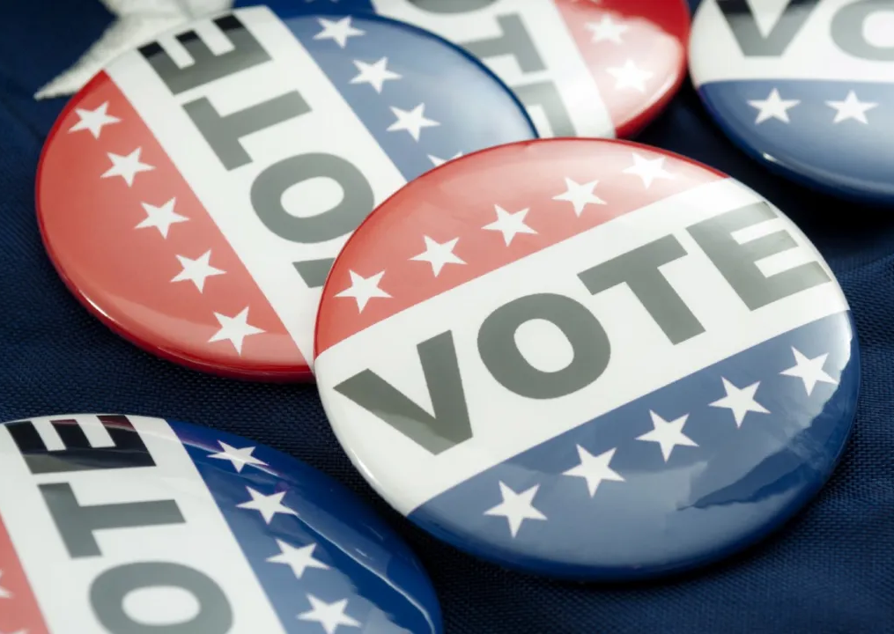
Psychological model of voting
Michigan (1948, 52, 56) Survey Research Center -> Center of Political Studies (ANES)
Campbell, Converse, Miller, Stokes (1960) The American Voter
Political partisanship, party ID
Psychological, affective affinity, stable, long-lasting
Not the same as vote choice!
Socialization processes
“Generally speaking, do you think of yourself as a Republican, a Democrat, an Independent, or what?”
“Would you call yourself a strong (Republican, Democrat) or a not very strong (Republican, Democrat)?”
Perceptual filter

Slide 13
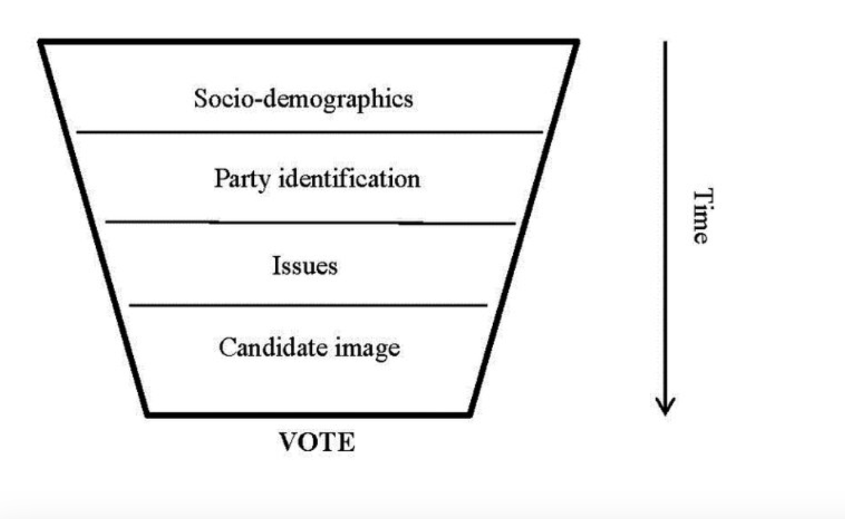
Funnel of causality
Distal factors
Proximal factors

Slide 14
Criticism: proximal over distal factors?
Why some voters switch votes?
How to explain voting for another party?
Role of proximal factors
Evaluation of parties/candidates in every elections
Parties as a cue not identity

Slide 16
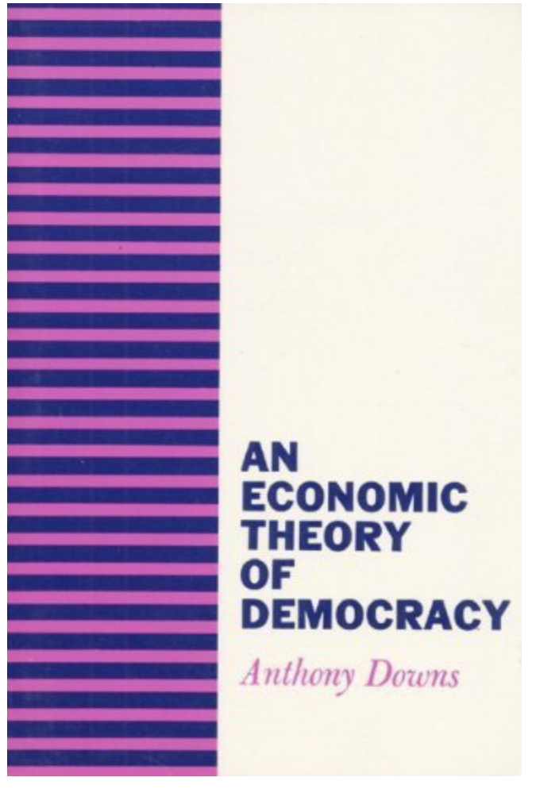
Rational choice theory
Anthony Downs (1957) Economic Theory of Democracy
Analogy between market and politics
Voters as consumers and political actors as enterprises
Assumption of rationality
Self-interest, maximization of utility
Rationality? Logics? Information?
Goal of parties: win elections
Goal of voters: government of the party closet to them

Slide 17
Rational theory of voting
Consistency
Preferences ordered A>B>C
Rational subjects compare them
How do voters calculate the expected value??
Consistency of parties (ideology)
Uncertainty
If parties maximize votes, how come they are not the same?
Various social groups with various interests
One dominant vs niche parties
Spatial representation

Slide 18
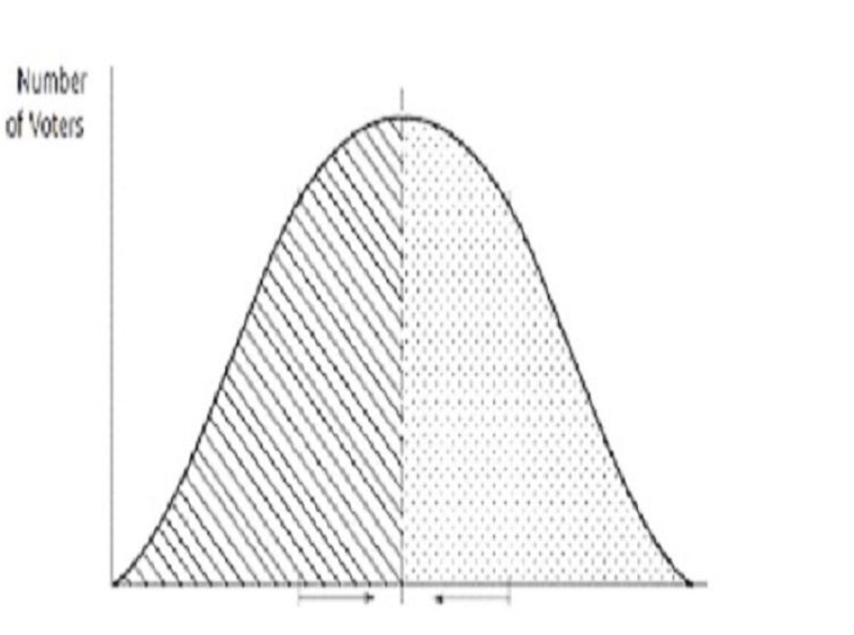
Spatial representation
Politics as a political space
Role of policy but in left-right dimension
Parties place themselves where they can maximize votes
Hotteling‘s economic theory applied to politics (icecream stands)
Parties follow voter distribution (modes of voters)
Median voter theorem
In two-party systém parites gravtate to the center

Slide 19
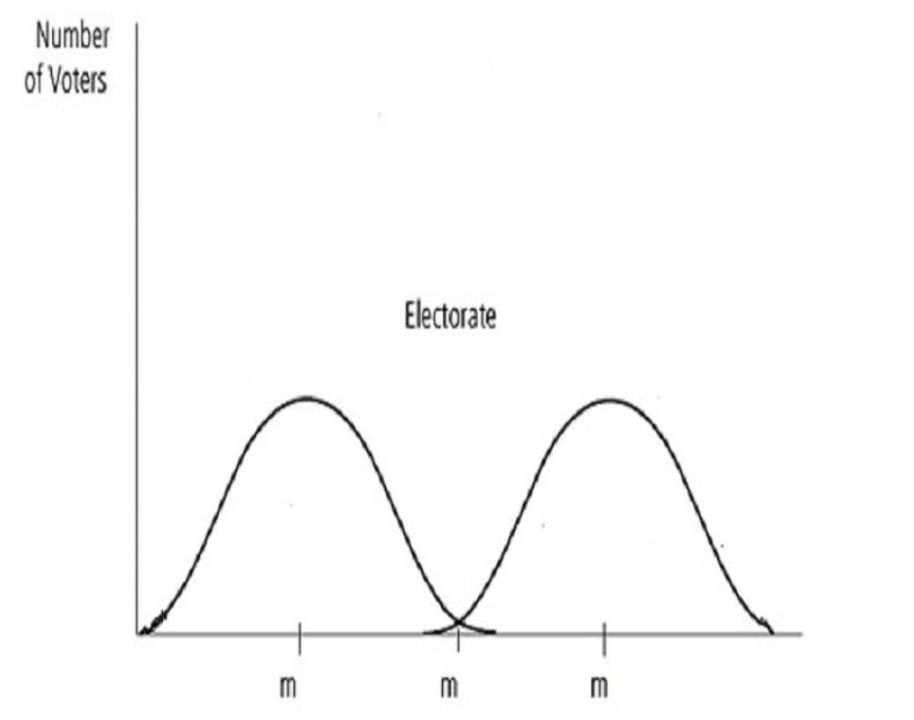
Spatial representation
But what if there are two modes?

Slide 20
Strategic vote
Voting – belief in effectiveness of such act
How rational is it to vote???
What if the party which brings you biggest utility has no chances of winning?
Risk of victory of the party considered undesirable
How big is the risk and how much my vote matters?

Slide 21
Criticism
Blais (2000)
“unfortunately for the theory, many people do vote. In fact, a clear majority vote in the most important elections, where the numbers of voters is extremely large and the probability of casting a decisive vote is minuscule” (p. 2).
Green, Shapiro (1994). Criticize the method (theory not based on evidence)
Do voters possess information to make rational choices?

Slide 22
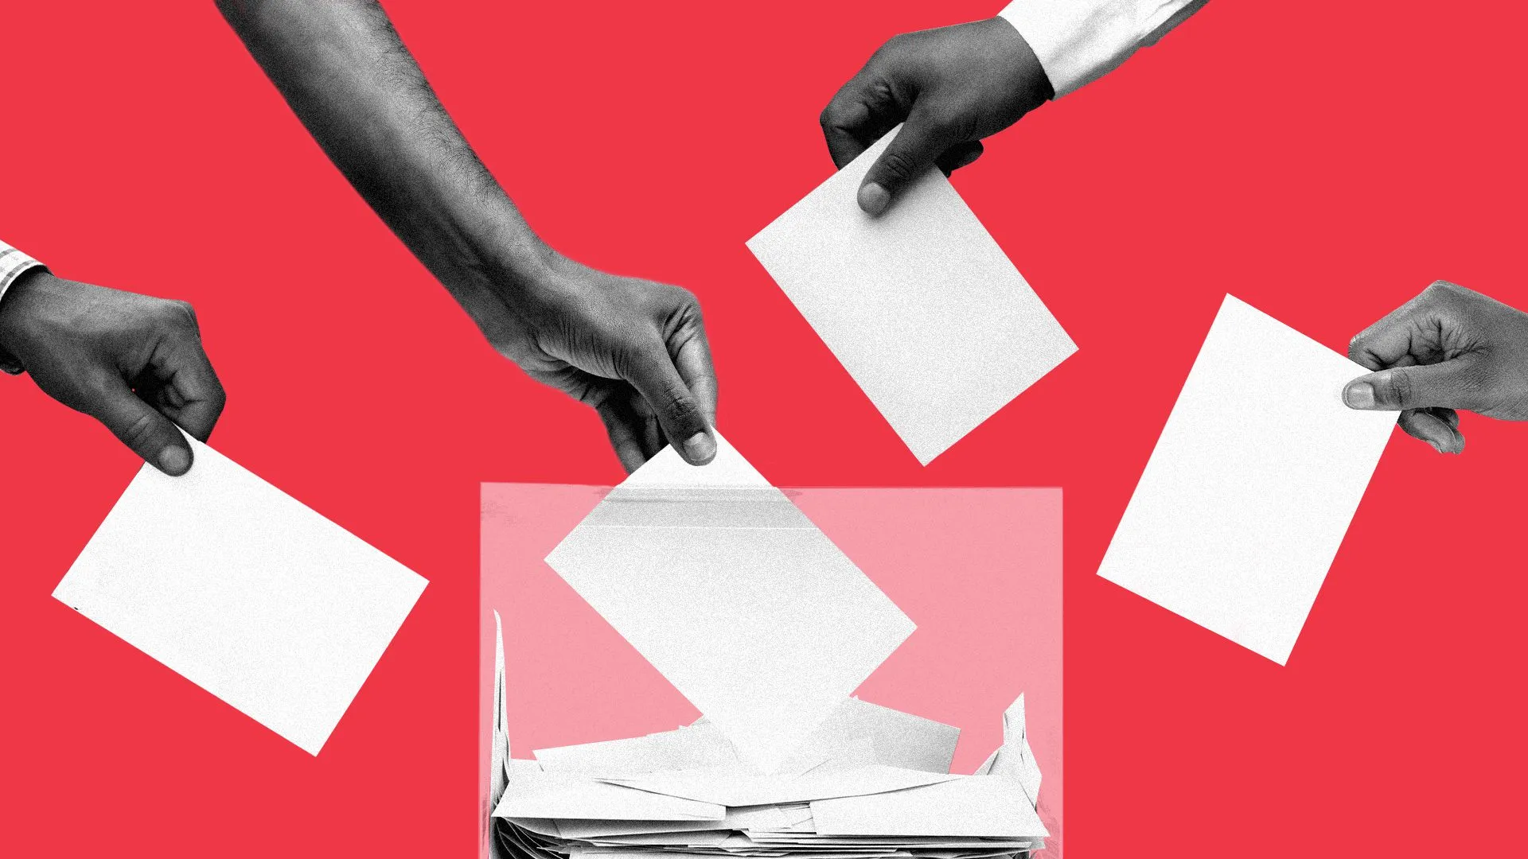
The classical approaches
Sociological
Psychological
Economic
Complement each other
What are the weaknesses of each one of them?
Do the others explain it better?

Slide 23
What do you think?

