Slide 1
Pork Barrel Logic of Real Politics
PMCb1113 Money and Politics

Slide 2
Many Faces of Pork Barrel Politics
Context dependency
What are the main aims?
What are the procedures?
In other words, why and how is pork barrel politics performed

Slide 3
The Flag of Georgia

Slide 4
Georgia
Power division in USA
State level framework resembles the federal level
Strong role of governors in pursuing legislative agenda
State legislature typically follows the ideas of governor
This works especially when the same party has the governor and controls the majority in House and Senate

Slide 5
Georgia
To follow the governor is comfortable when the agenda fits the public opinion
But what happens when the governor pursues an agenda that is sharply in contrast to the will of voters?
Dilemma for members of the legislature from constituencies where voters disagree with such agenda

Slide 6
Georgia
Dominance of governors over General Assembly
Very long tradition of Democratic governors
Roy Barnes (elected in 1998):
125 years of Democrats in office
Showed strong position over General Assembly
94 per cent acceptance of his agenda in the assembly

Slide 7
The Flag of Georgia
Georgia adopted a new flag in 1956 including the St. Andrew’s cross (a reminiscence on the Confederation)
Several initiatives to drop the cross from the flag
2001 – Governor Barnes initiated a change of the flag and adoption of a new one without the Confederate battle cross

Slide 8
A highly polarizing agenda
No middle ground
African Americans:
Dominantly voting for Democrats
More than 75 per cent for the change of the flag
White population:
Democrats – 21 per cent for the change and 58 for keeping the flag
Republicans – two thirds for keeping the flag

Slide 9
General Assembly
House:
102 Dem (66 W, 36 AfAm) - 74 Rep
Senate:
32 Dem (21 W, 11 AfAm) - 24 Rep
True dilemma for part of Democrats – supporting the change of flag and risking a political suicide
Governor Barnes forced to seek support across party lines

Slide 10
How to Secure Votes?
Carrot and stick
Inducements:
Positive – help in campaign, fundraising, media influence
Negative – loss of offices, redistricting of constituencies
Negative inducements mostly applicable only on members of own party (opposition does not hold offices)

Slide 11
Solution for Barnes
Additional funding for new classrooms in 2001 budget worth 562 mil. USD
Main tool in persuading members of assembly to support the agenda
Time restraints allowed to effectively use pork to affect the vote in Senate

Slide 12
The Effect of Pork (Bullock and Hood 2005)

Slide 13
Aftermath
General Assembly voted for the change of the flag
In the upcoming election Barnes lost to his Republican challenger Sonny Perdue
First Republican governor of Georgia since 1872
Referendum in 2004 supported a modified version of the flag (73 per cent voters for the flag)

Slide 14
The Flag of Georgia

Slide 15
The Flag of Georgia
What was the aim of pork barrel politics?
What was the procedure?

Slide 16
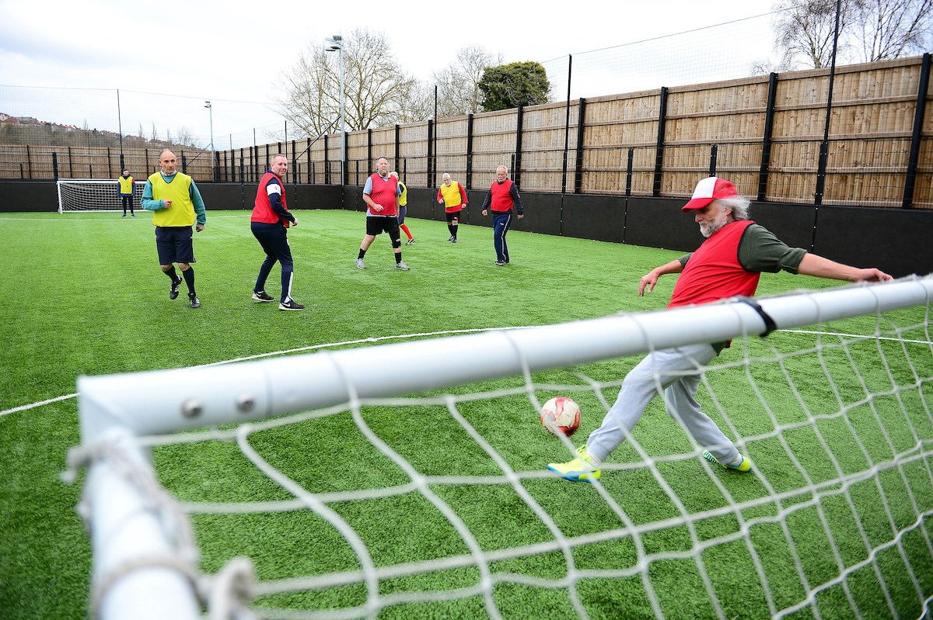
Sports Grants

Slide 17
Sports Grants in Slovakia
In 2015 a single-party government in Slovakia launched a Support of Sport Development (SoSD) funding program
Grants for establishment of sport facilities for (at least) football and volleyball
A total of 4 million EUR
Expected support of 40 thousand EUR for each facility

Slide 18
SoSD program – basic rules
Official aim to provide support for sport facilities for young people
Organization:
Directly organized by national government
Executive management by governmental representative and also a gov MP
Selection committee (members appointed by the government)
Who could apply:
Municipalities, regions, civic associations, foundations, Church, schools etc.
A formal request required

Slide 19
SoSD program – the selection process
Officially an anonymous evaluation of requests
Criteria (each score 0 – 5 points):
Relevancy of the project and its aims
Quality and excellence
Tradition and continuity
Sporting and societal importance
Target groups
Feasibility of the budget
Each request could score up to 30 points

Slide 20
SoSD program – results
524 municipalities filed a formal request for grants
95 (out of 100) grants given to municipalities
429 requests from municipalities refused (due to low score)
Mean success rate of 18 per cent

Slide 21
SoSD program – political background
Mayors as highest municipal representatives
Directly elected for four years (FPTP)
Partisan background of mayors:
GOV – nominated only by gov party
MIX – nominated by gov party and opp parties
OPP – nominated only by opp parties
IND – independent candidate
Any impact on the distribution?

Slide 22
 | Unsuccessful requests (N = 429) | Successful requests (N = 95) | Total requests (N = 524)
Mayor GOV | 97 (74.0 %) | 34 (26.0 %) | 131
Mayor MIX | 40 (62.3 %) | 24 (37.5 %) | 64
Mayor IND | 189 (84.8 %) | 34 (15.2 %) | 223
Mayor OPP | 103 (97.1 %) | 3 (2.9 %) | 106

Slide 24
SoSD program
What was the aim of pork barrel politics?
What was the procedure?

Slide 25
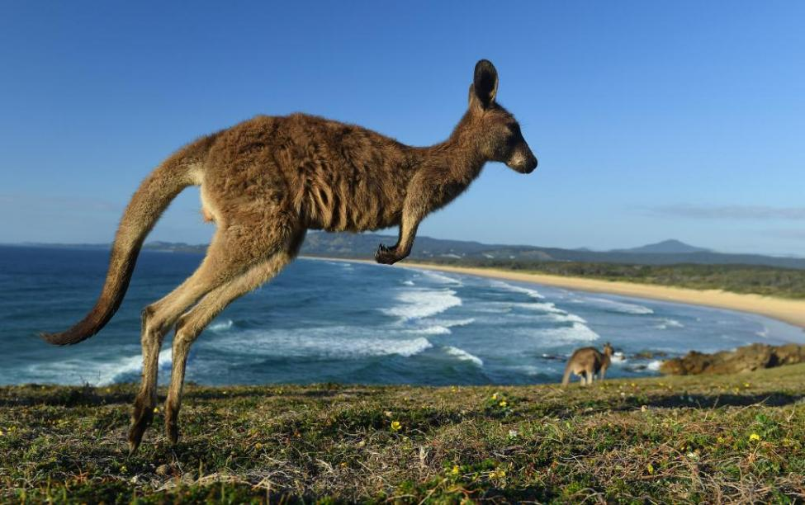
Sports Grants in Australia

Slide 26
Political Background of Australia
Parliamentary democracy
Three party system – ALP vs. National/Liberal coalition
Strong parties and partisan loyalty
‘European’ incentives for pork barrel politics – collective centralized goals over individual interests of representatives

Slide 27
Sports Grants in Australia
The Community Recreational and Sporting Facilities Program (CRSFP)
Established in 1988 by Labor government (ALP)
Distribution of money in four waves
Total of 1,447 grants worth more than 60 mil. AUS dollars
Two waves realized before federal elections in 1990 and 1993
Opportunity for pork barrel politics

Slide 28
CRFSP - rules
The program aimed at supporting local area projects especially in weaker socioeconomic environment (high unemployment)
Organized by Ministry of Sport
Criteria:
Population distribution, availability of sporting facilities in region
Project size, speed of implementation, employment potential
Impact on priority groups and disadvantaged groups (youth, rural areas, Aboriginal communities, high unemployment, high share of migrants)

Slide 29
CRFSP – Distribution of Grants
Overrepresentation of grants awarded to ALP held districts:
1990 – ALP held 52.7 % of districts and gained 70 % of resources
1993 – ALP held 54.4 % of districts and gained 67 % of resources
Mean sum of grants awarded to ALP districts around twice the size the grants awarded to Coalition districts
The question of marginal seats

Slide 32
Aftermath
In 1993 the Auditor-General made an audit with important findings
Audit showed that Ministry of Sport was unable to explain part of the grants
Minister Kelly resigned but refused any pork barrel practices
ALP defended the distribution by claiming that targeted localities fit the characteristics of regions with higher ALP support

Slide 33
Grants in Canada
Similar story as in Australia
Analyzed grants:
Regional grants in Canada in 1988-2001
42 thousand grants
Each year grants worth several hundred millions CAD
Confirmed marginal seat theory and special attention given to high ranked officials and new MPs

Slide 34
Per Capita Spending (Milligan and Smart 2005)

Slide 35
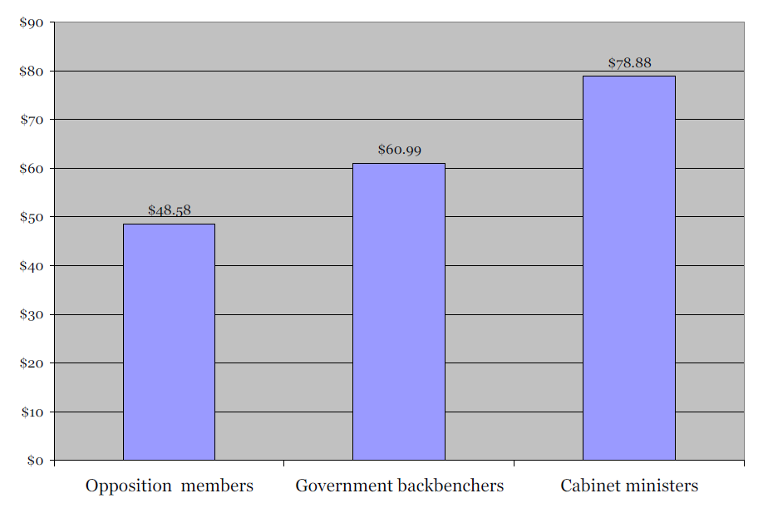
Per Capita Spending (Milligan and Smart 2005)

Slide 36
Grants in Australia and Canada
What was the aim of pork barrel politics?
What was the procedure?

Slide 37
Local Favoritism in Norway

Slide 38
Main theories of Pork Barrel Politics
Main motives of pork barrel politics lie in reelection of elected representatives
Electoral systems produce various incentives to realize pork barrel spending
What if the electoral rules do not contain such incentives?
Norway as an example (Fiva and Halse 2016)

Slide 39
Regional Government in Norway
Unitary state with three gov levels (national, regional, local)
Regions as a strong player in terms of GDP and employment
Regional councils of 35-85 members who elect the governor
Governor is almost always the top candidate of majority party

Slide 40
Electoral System to Regions in Norway
Proportional representation
Each region represents a single electoral district
1975 – 1999 – closed list system
Since 2003 – flexible lists but without any real effect
Who gets a seat completely depends on votes for parties
Voters can not reward individual candidates

Slide 41
Grants in Norway
Analysis of 1976 – 2011 found that members of regional councils provide more money to their hometowns
Why would they do that?
1. sympathy for their hometowns
2. they expect something (electoral support) in return
Career paths in Norwegian politics support the former option

Slide 42
How Many Types of Pork Barrel Politics?
Flag of Georgia – carrot and stick (compensation)
Sport grants in Slovakia – support for allies, punishment for rivals
Sport grants in Australia – marginal seat (collective victory)
Regional grants in Canada – marginal seat, high rank officials
Local grants in Norway – hometown favoritism without electoral interests

