Slide 1
Incidence of Pork Barrel Politics and its Consequences
PMCb1113 Money and Politics

Slide 2
National, Regional or Worldwide?
A complex phenomenon in a complex world
Various political systems with different institutional framework
Different currencies
But the same human nature

Slide 3
Spread of Research
Initial dominance of research in USA
Pork Barrel Politics as an ‘American phenomenon’
Change in recent decades
Factors: new data, new approaches, comparative research aims

Slide 4
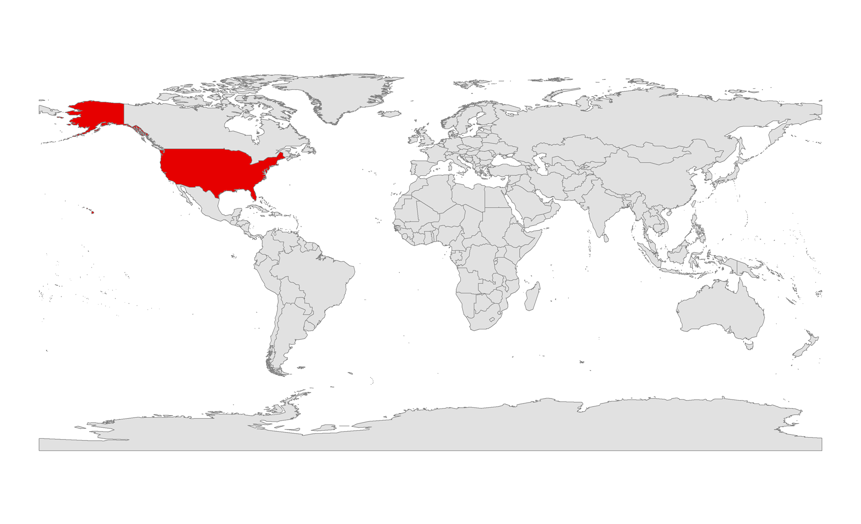
Once in 20th Century

Slide 5
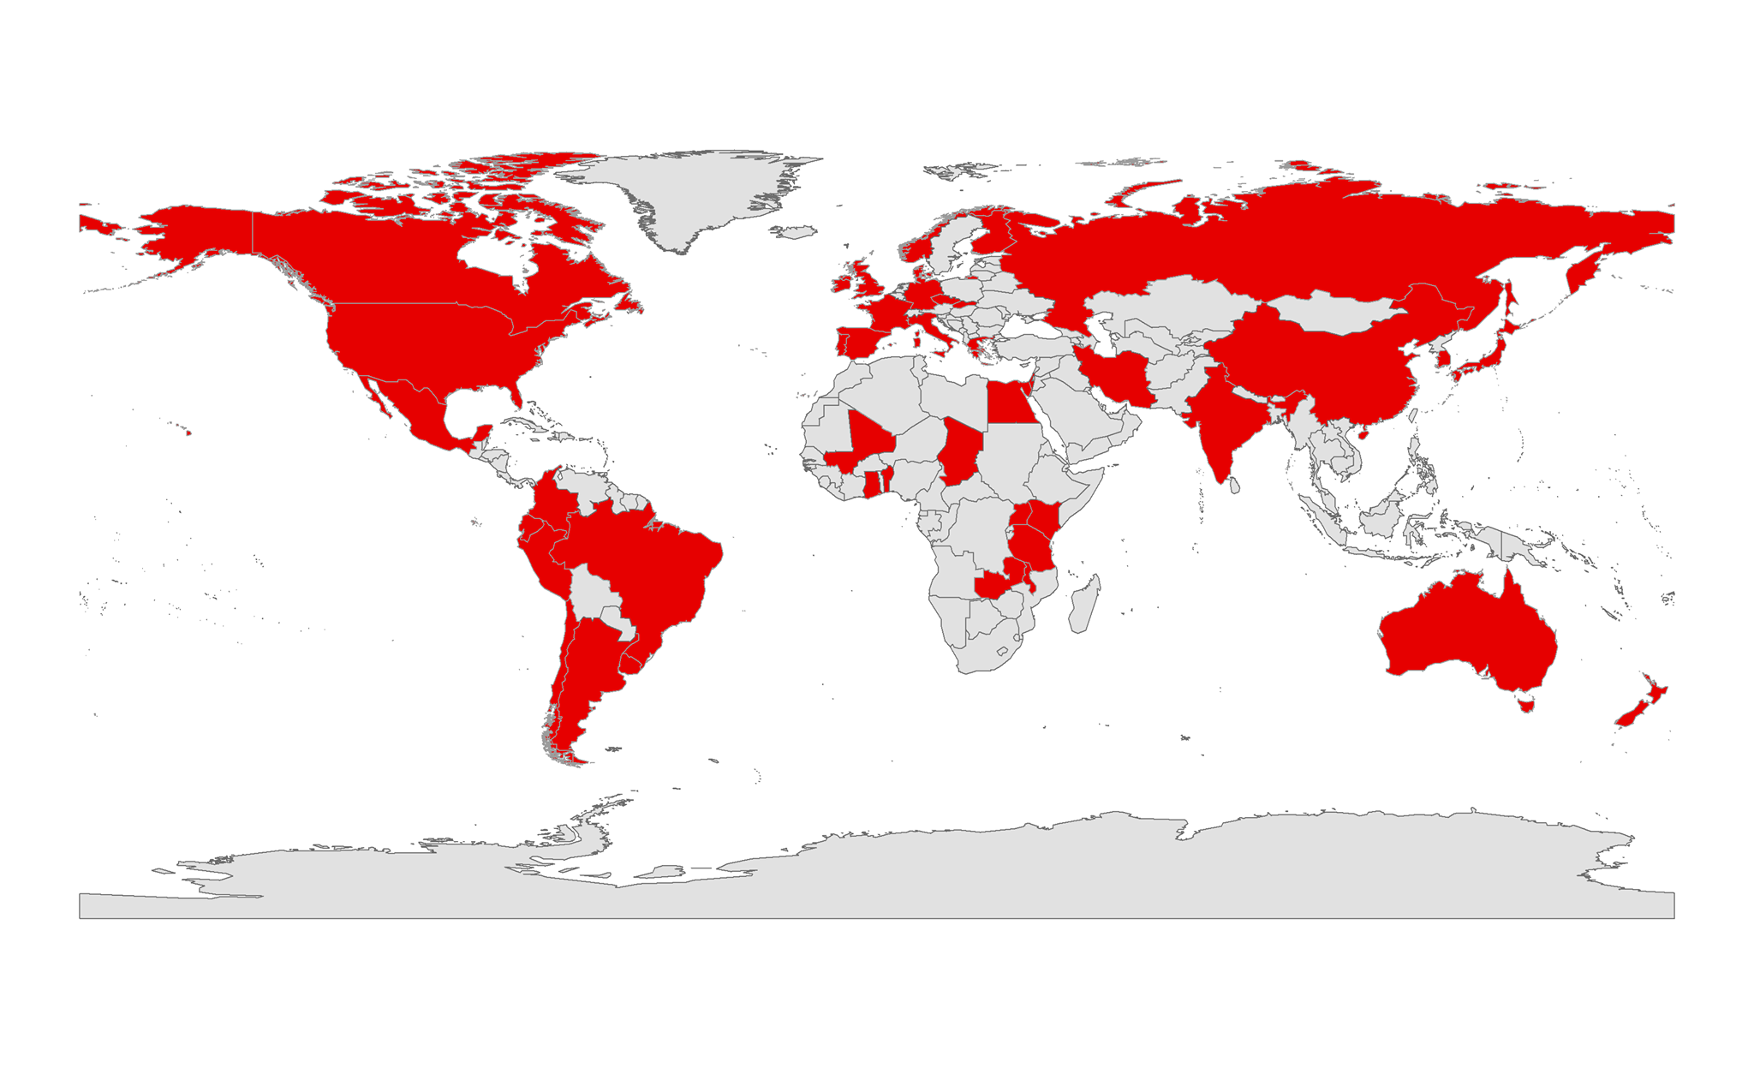
And now

Slide 6
Consequences of Pork Barrel Politics
Important questions
Is the distribution of public money based on political interests meaningful?
Does it lead to expected outcomes?
Or is it just a waste of time (and money)?
Consequences depend on type of pork barrel politics

Slide 7
Bill Clinton and NAFTA
NAFTA (North American Free Trade Agreement)
Aim of president Clinton to pursue this agenda in Congress in 1993
Important case of pork barrel politics with crucial consequences
Congress approved NAFTA in November 1993

Slide 8
Background
Clinton as a president who used pork barrel politics before
Tradition established by previous presidents (Roosevelt, Reagan etc.)
Exception – Jimmy Carter
Members of Congress often expect something in return by default

Slide 9
Background
Strong opposition against NAFTA:
Trade unions (lower wages, export of jobs abroad)
Environmentalists (lower environmental limits)
Split in Democratic party:
Initiative to delay the whole NAFTA project
Republicans leaning more to support NAFTA:
Previous term of George Bush
Free trade as a value

Slide 10
Pork Barrel Politics and NAFTA
Negotiations and proclaimed compromises without substantial effect
Pork barrel politics as the only choice:
Massive launch of deals with members of Congress
Lasted until final day of vote in Congress
Various deals:
Guarantees for agricultural sector in Florida
Governmental purchases of airplanes from Texas
Promise to block subsidized wheat from Canada
Money on customs agents (textile) one day before the vote

Slide 11
Vote in Congress
Perspective of a clear defeat in October 1993
November 1993 – 234 : 200 in favor of NAFTA
Impact of pork barrel politics?

Slide 12
Vote in House on NAFTA
Vote on NAFTA | Members who did not receive benefit | Members who received benefit
Yes | 47.5 | 84.2
No | 52.5 | 15.8
Total | 100.0 | 100.0

Slide 13
Probability of supporting NAFTA
 | Democrat | Republican
No benefit received | .275 | .688
Benefit received | .684 | .927
Change | .409 | .239

Slide 14
Bill Clinton and NAFTA
Main aim fulfilled - Congress approved NAFTA
Bringing home pork as a way how to increase support for NAFTA
Successfully applied on members of both parties
Pork barrel politics as a way of changing voting patterns of elected representatives

Slide 15
What About Voters?
Pork Barrel Politics as a vote-buying mechanism
The main logic:
1. grants are sent to a specific area
2. a representative of the area claims the credit
3. voters respond to income of public money and support the local representative
Does it work in reality?

Slide 16
Potential Limits (Bickers and Stein 1994)
Critical points:
Do all political representatives seek public money to same extent?
Do local representatives claim credit for pork despite their real role in securing the money?
Do all voters recognize income of money?
Do voters reward local representatives by supporting them in elections?

Slide 17
Potential Limits (Bickers and Stein 1994)
Critical points:
It depends on the amount of risk of losing in election
Yes, by all means (accounts for political representatives regardless of whether they played any role in securing the money)
No, it depends on the level of information and interest of people in politics
Yes, but it depends on their attitude to incumbent and on their knowledge

Slide 18
Does Pork Barrel Politics Affect Voters?
Every 100-dollar per capita increases the vote shares of candidates of the majority party in Canada by 1.5–2.5 % points (Evans 2006)
Each additional 100 dollars per capita to a district leads to a 2 % increase in the incumbent’s vote share in US House of Representatives elections (Levitt and Snyder 1997)
Indirect relationship (Klingensmith 2019):
Pork-barrel grants >> more fundraising >> higher vote share

Slide 19
Does Pork Barrel Politics Affect Voters?
Depends on the context
What might be important?
Pure fact of obtaining grants
Number of obtained grants
Timing of grants
Value of grants

Slide 20
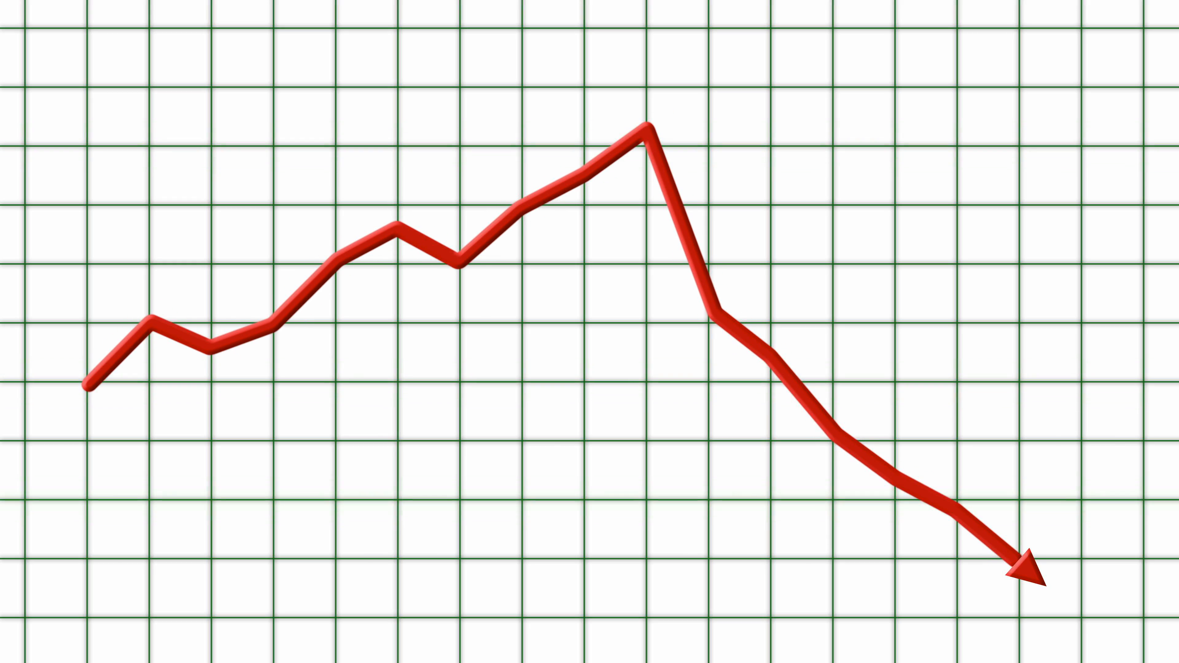
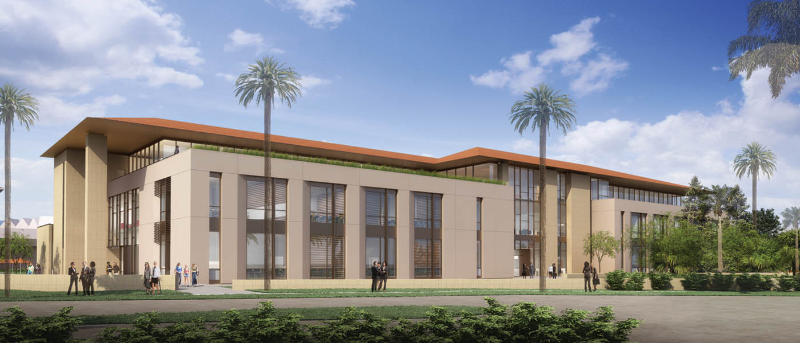
Touch of Grants

Slide 21
Impact of Grants on Local Elections
Case of Slovakia
Grants as a further benefit for local elected representatives – part of incumbency advantage
Mayors in Slovakia:
Highest municipal representatives
Directly elected for four years (FPTP)
High rate of reelection in general
Do grants affect the prospects of mayors when seeking reelection?

Slide 22
Impact of Grants on Local Elections
Local elections 2006-2018
Included municipalities:
Mayor in office during the whole term
Mayor runs in election (seeks reelection)
Mayor has at least one challenger (competitive election)
More than 7,300 competitive local elections
More than 9,700 grants

Slide 23
Findings
In general, grants are helpful for local incumbents but only to some extent
Likelihood of reelection increases with:
More awarded grants
Grants awarded in the end of term
The picture is however more complex

Slide 24
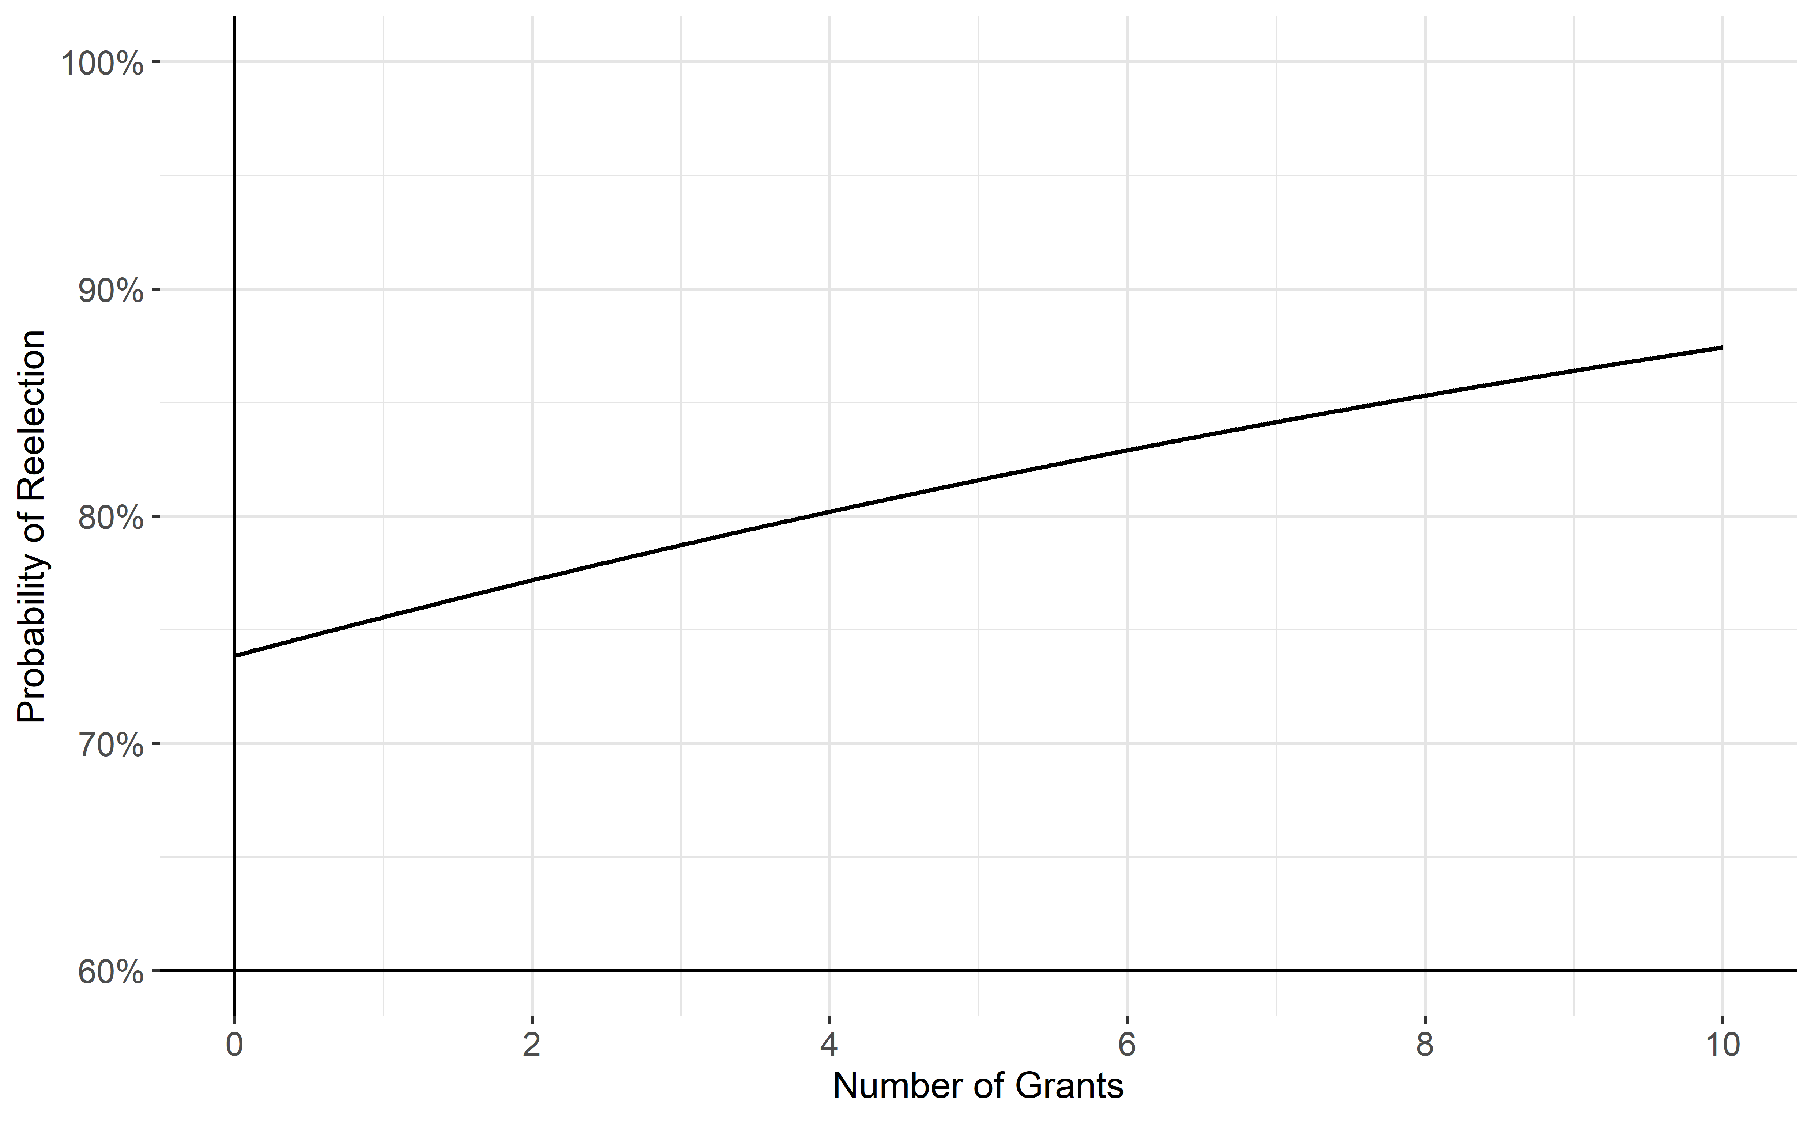

Slide 25
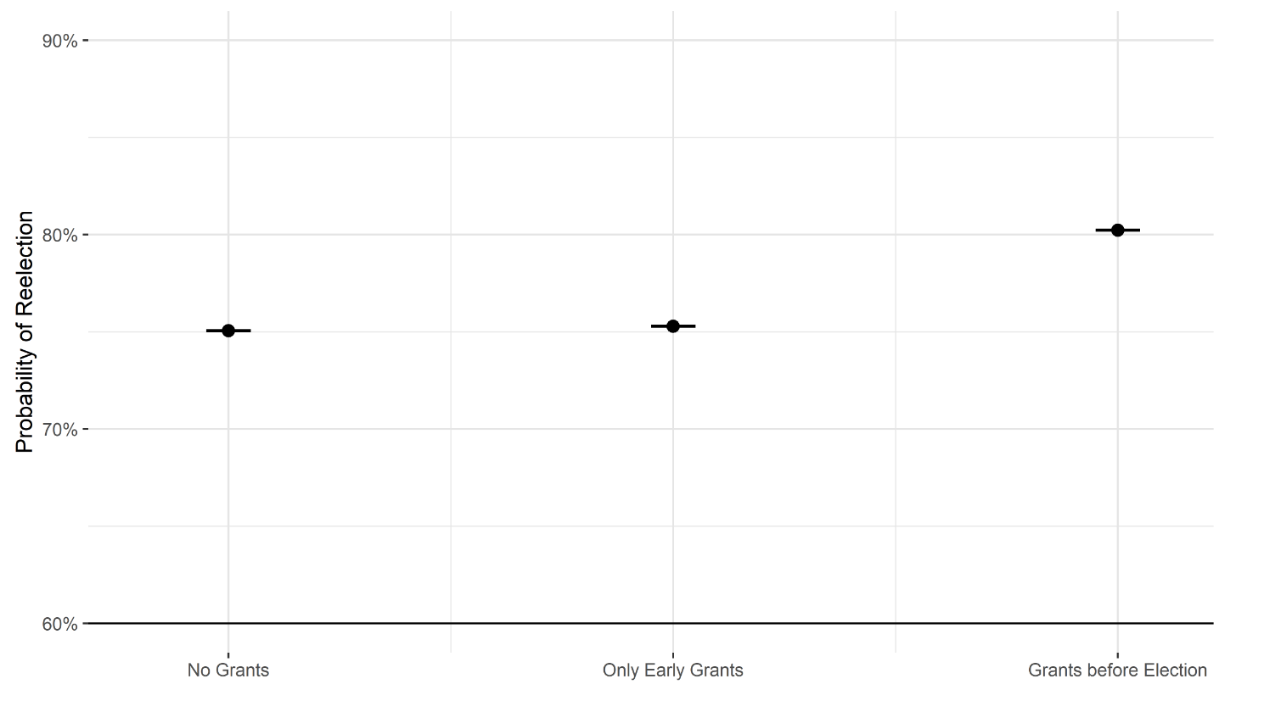

Slide 26
Any Difference?

Slide 27
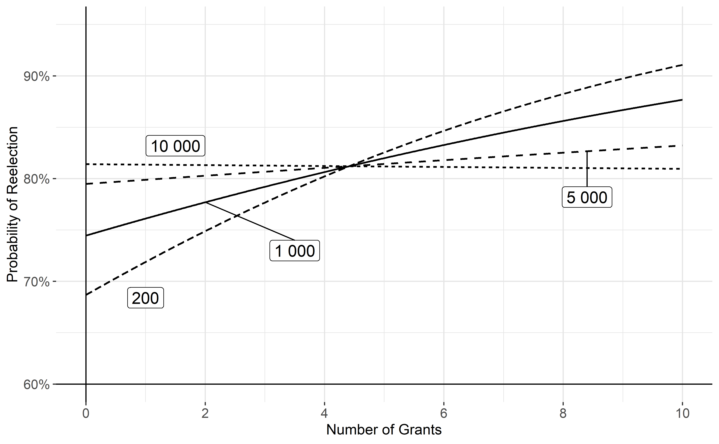

Slide 28
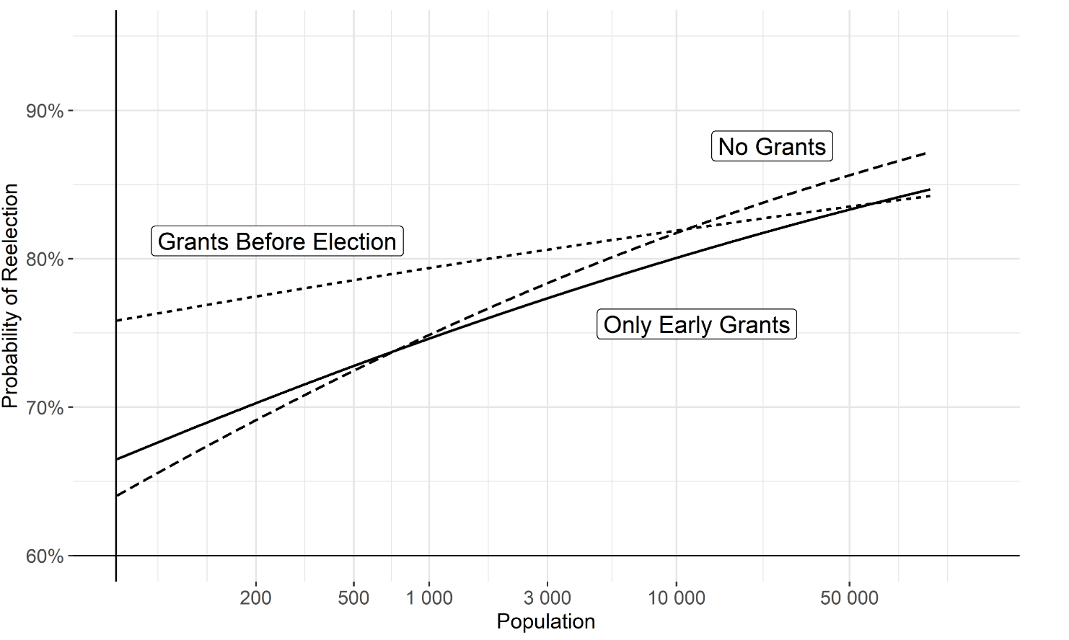

Slide 29
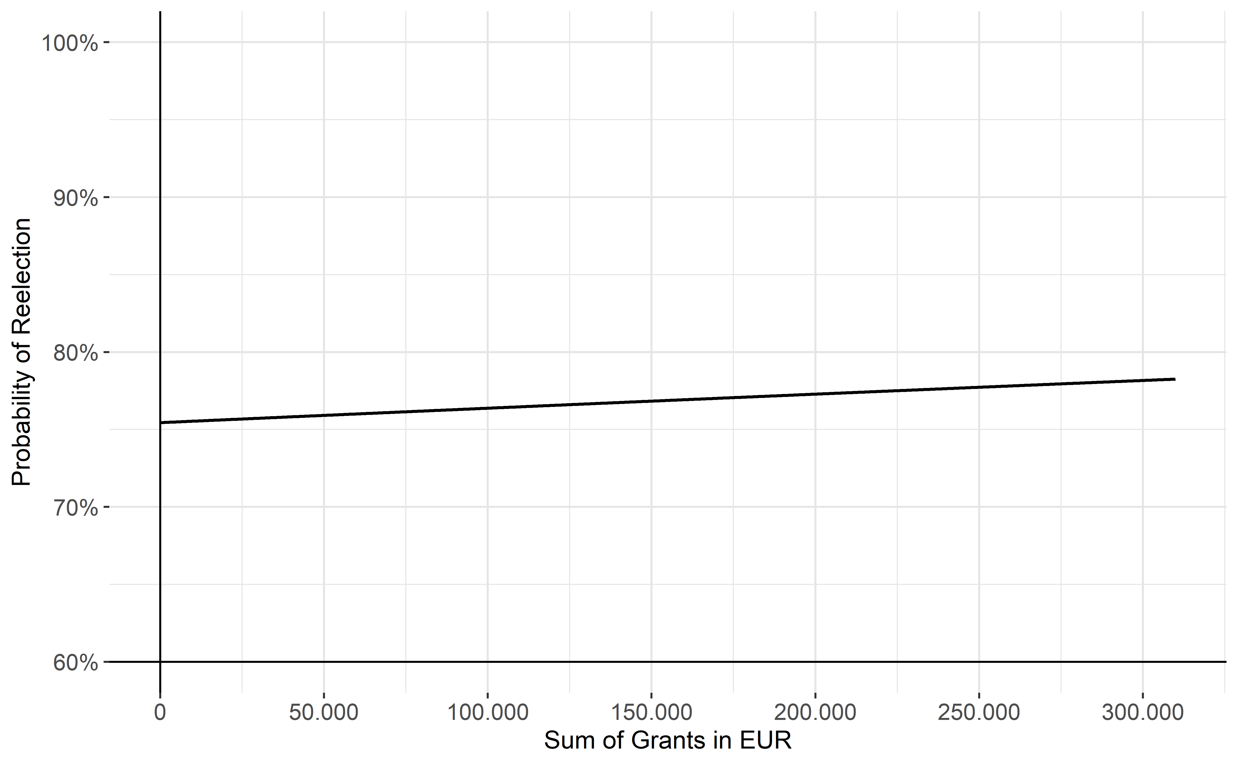

Slide 30
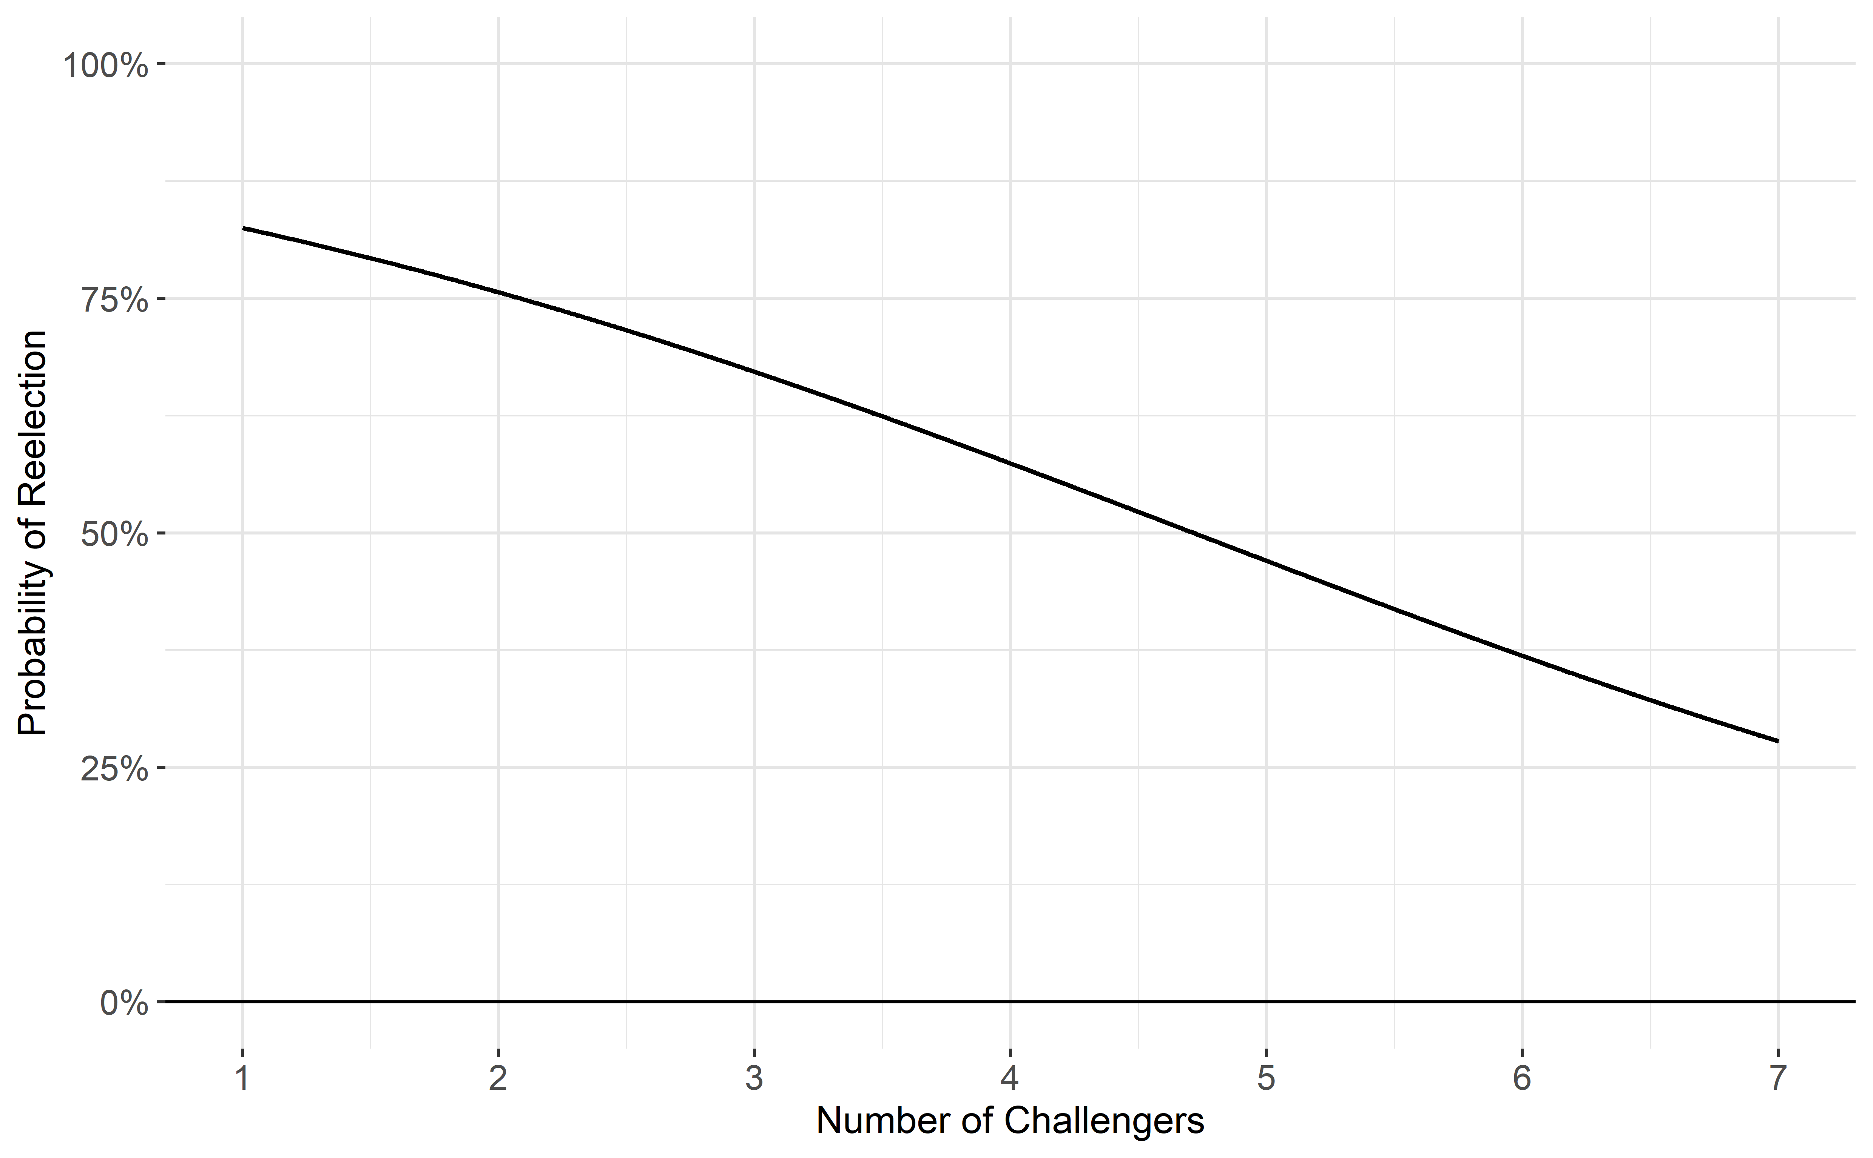

Slide 31
EP Elections and Incumbent Parties
Henceroth and Oganesyan (2019)
EU Structural Funds affect the results of EP elections
Analysis of nine EU countries on regional level
Higher amount of SIF provided more support to gov parties

