Slide 1
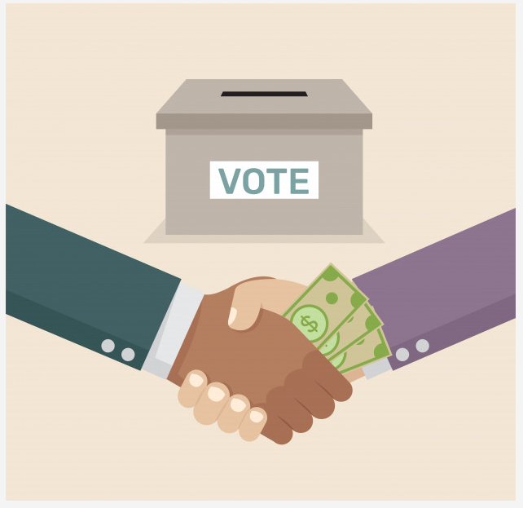
Voters’ Perception of Pork Barrel Politics _
PMCb1113 Money and Politics

Slide 2
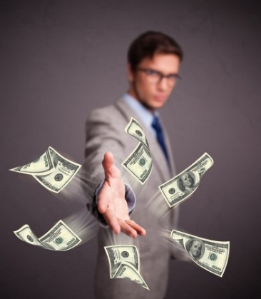
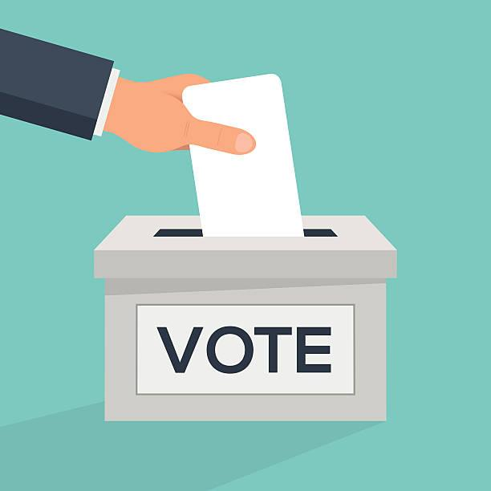
Voters’ perception of pork-barrel - THEORY
Classical notion - politicians need to make favourable decisions in order to please their constituents and secure re-election (Downs 1957, Schumpeter 1943)
Social psychology “Procedural fairness theory” (Allen & Birch, 2014; Hibbing & Theiss-Morse, 2002, 2008)
People care about how decisions are made
Basic principle – process should be fair (to maintain the trust and support from voters)
Personal motives can harm political trust – people less inclined to trust and vote
In politics: politicians/decision-makers should be impartial (without personal interests in the outcome)
Challenge:
To please potential voters (favourable policies)
and remain fair and impartial

Slide 3
Voters’ perception of pork-barrel – THEORY vs. PRACTICE
Intentional distribution of public resources
Politicians seek reelection
Influence of (local) electoral behavior
Downs, 1957
Mayhew, 1974
Popkin, 1991
Schumpeter, 1943
Kitschelt, 2000
Kitschelt & Wilkinson, 2007
Stokes, 2005
Stokes et al., 2013
Costa-I-Font et al., 2003
Denemark, 2000, 2014
Milligan & Smart, 2005

Slide 4
Voters’ perception of pork-barrel – THEORY vs. PRACTICE
Trust
Vote for decision-maker (?)
Voters
Support
Intentional/Unfair/Partial distribution of resources

Slide 5
Motivation for research
„Pork-barrel“ – unfair/impartial allocation of public finances – tool for securing votes/reelection
UNFAIR = BAD
UNFAIR + BENEFIT = ??
How voters perceive this inherently unfair effort to ensure their votes in case they can benefit from it?
(Are openly expressed „pork-barrel“ efforts efficient for politicians?)

Slide 6
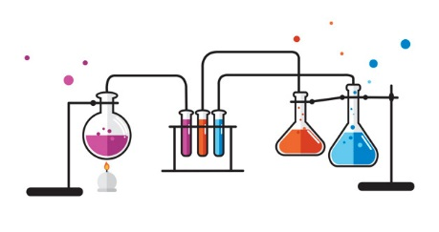
Best way to study voters (and perception?)
EXPERIMENT

Slide 7
Experiment (in political science)
Why/when do we need experiment?
How?
Randomization
Standardization
Placebo effect (medicine)
BIAS
(independent variables)
(dependent variables)

Slide 8
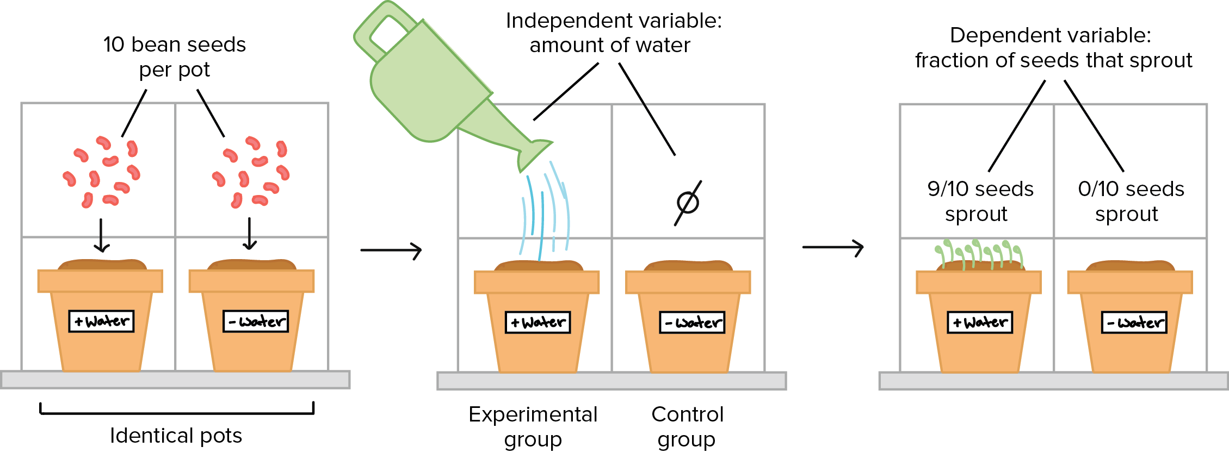
Experiment (in political science)
Randomization
Assignment of subjects into experimental conditions (groups) – difference in experimental manipulation
Random assignment → even distribution of unseen factors → reduction of biases
No systematic differences in subjects (and between groups)
source: khanacademy.org

Slide 9
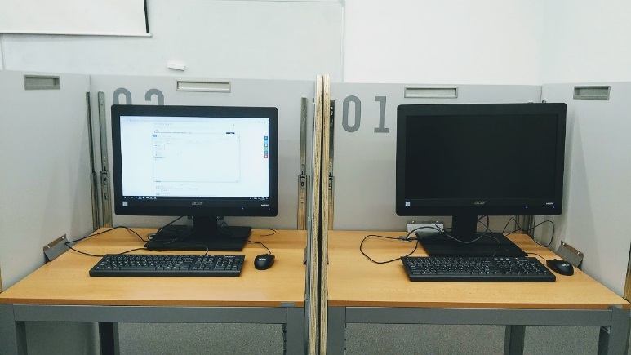
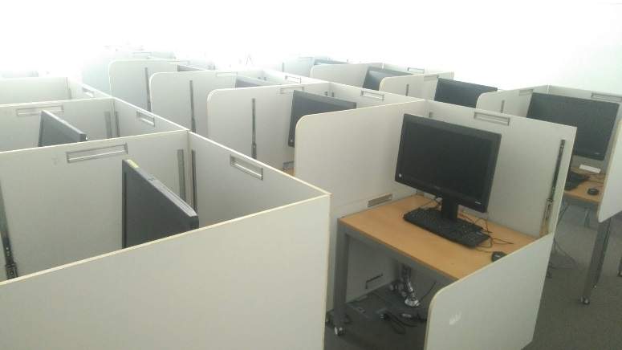
Experiment (in political science)
Standardization
To ensure the same procedures and measures apply for all subjects (respondents)
All experimental sessions administered in the same way
Laboratory experiments (controlled environment)
Only values of independent variable can be (and have to be) manipulated

Slide 10
Pork-barrel in lab

Slide 11
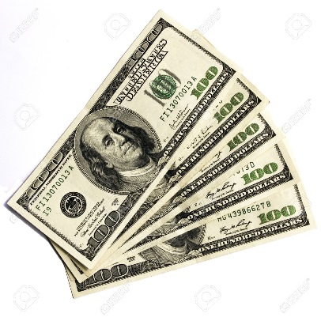
US Congresspersons
Braidwood (2015) Desirable pork: do voters reward for earmark acquisition?
money for the district
(pork-barrel projects/earmarks)
appreciation from constituents
More grateful constituents v. general public opposes pork-barrel spending
Braidwood: explain this discrepancy
Experimental data

Slide 12
Braidwood (2015) Desirable pork: do voters reward for earmark acquisition?
Scholars: pork-barrel politics make elections more safe (higher voters‘ evaluation)
Theory: voters must be able to successfully connect actions of elected officials to specific benefit – requires knowledge of the voters (Popkin 1991)
Evidence: citizens are uninformed about spending (and politics)
Braidwood first to directly measure connection between pork-barrel politics and opinions
Assumption: despite the “pork” is disliked in aggregate, can particular benefits increase politician‘s support?
Personal economic well being (new roads, schools, ... ) – key factor in the candidate assessments

Slide 13
Braidwood (2015) Desirable pork: do voters reward for earmark acquisition?
Hypotheses:
Information about money secured for the local benefit will increase favorable evaluations of responsible member of Congress
Information about personally relevant local benefit will increase evaluations of responsible member of Congress
People like local projects, especially those devoted to the issues that are personally important to them

Slide 14
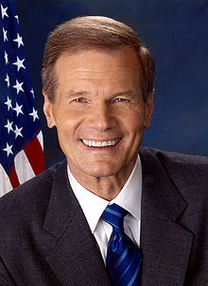
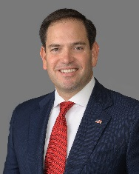
Braidwood (2015) Desirable pork: do voters reward for earmark acquisition?
Experiment
Survey-based lab experiment
Subjects: Amazon’s Mechanical Turk (Florida residents to ensure direct connection between MC and voters)
5 groups (5 experimental conditions):
Bill Nelson - general
Bill Nelson - education
Control group – no text
Marco Rubio - general
Marco Rubio - military

Slide 15
Braidwood (2015) Desirable pork: do voters reward for earmark acquisition?
Experiment
Follow-up questionnaire
Dependent variable: support for the MC
Measure issue saliency
Comparison of MCs evaluation

Slide 16
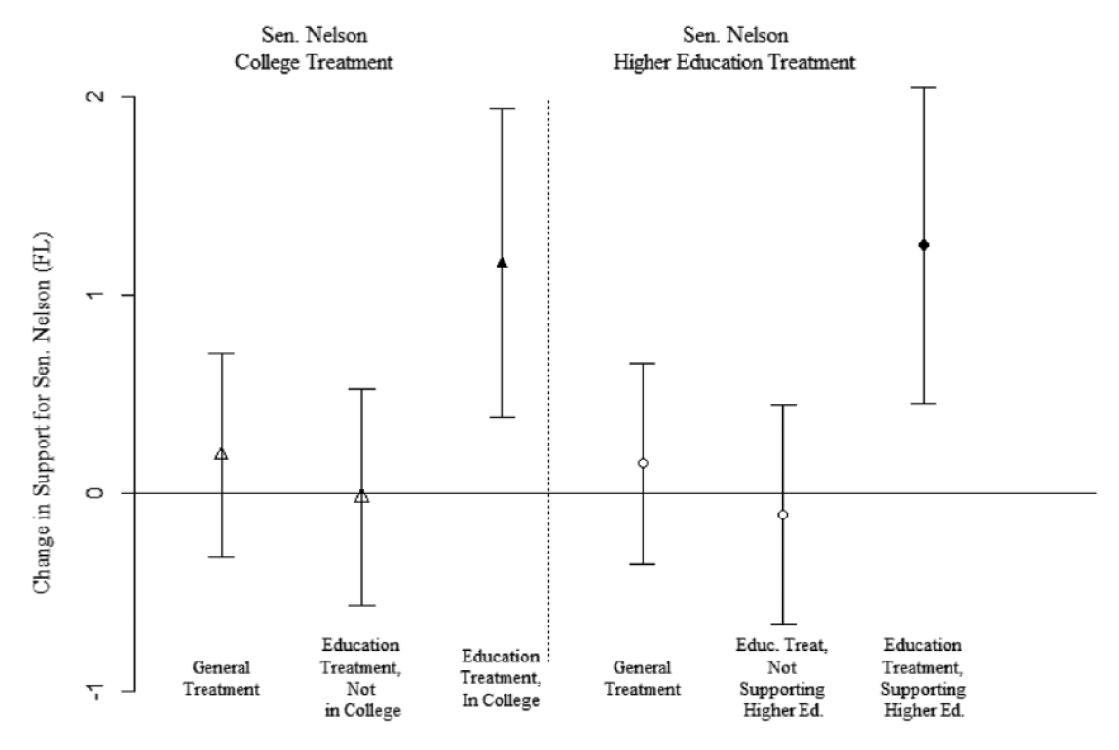
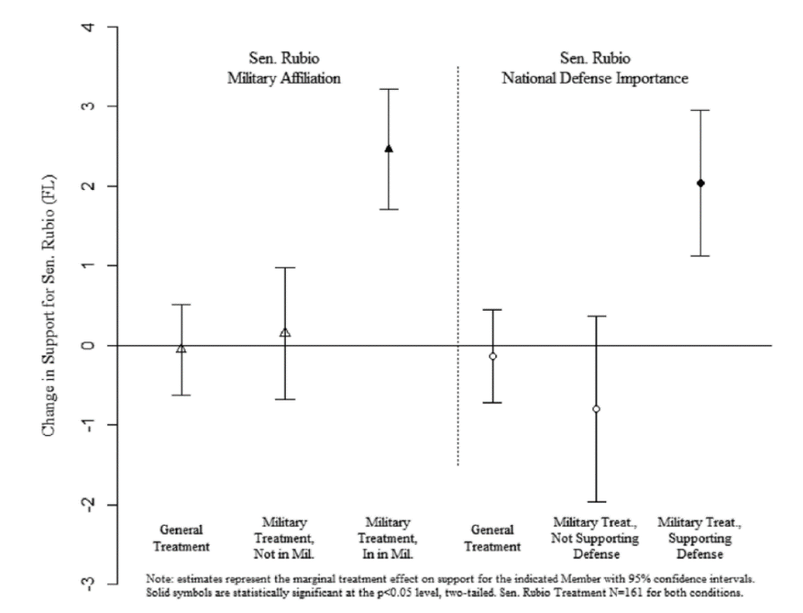
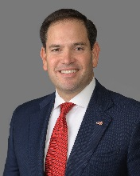
Braidwood (2015) Desirable pork: do voters reward for earmark acquisition?
Results
education as important issue
students
in army
national defense as important issue

Slide 17
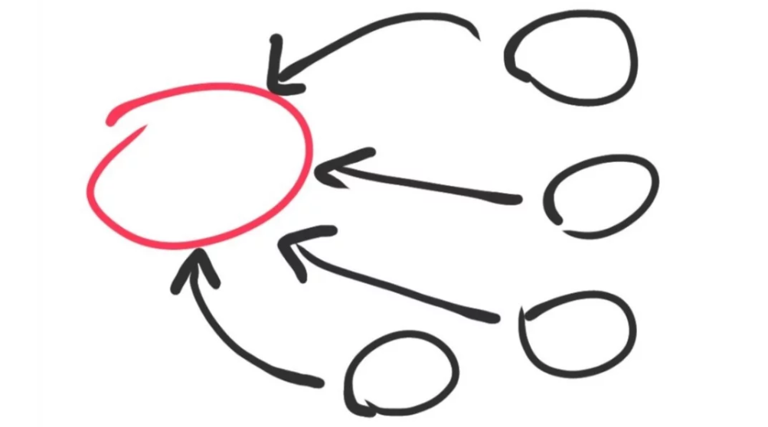
Braidwood (2015) Desirable pork: do voters reward for earmark acquisition?
Results
Exposure to the general treatment did not affect assessment of congressmen
Higher saliency of the issue increases positive evaluation of congressmen
CONCLUSION
Earmarks/pork-barrel politics may help politicians
CONDITION!
Issue/project must be individually relevant to the recipient/voter

Slide 18
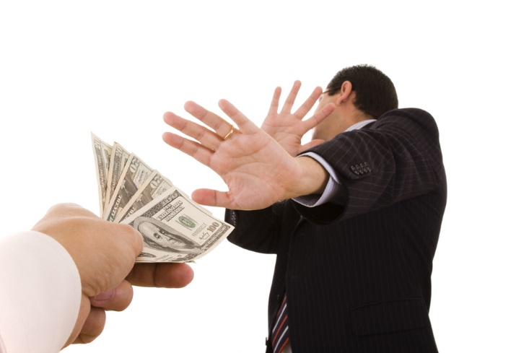
Boggild (2016) How Politicians’ Reelection Efforts Can Reduce Public Trust, Electoral Support, and Policy Approval
Experiment in Denmark
Based on Procedural fairness theory (attention of voters to both outcomes and fairness of procedure)
Assumption: people respond negatively to the reelection effort of politicians EVEN when such efforts are targeted at themselves (and provide them with favorable outcomes)
Impartiality/fairness = central determinant of vote choice (?)

Slide 19
Boggild (2016) How Politicians’ Reelection Efforts Can Reduce Public Trust, Electoral Support, and Policy Approval
Hypotheses:
Citizens will be less inclined to trust a political decision-maker who adopts a political decision motivated by winning reelection.
Citizens will be less inclined to vote for a political decision-maker who adopts a political decision motivated by winning reelection.
Citizens will be less inclined to support a political decision adopted by a political decision-maker motivated by winning reelection.

Slide 20
Boggild (2016) How Politicians’ Reelection Efforts Can Reduce Public Trust, Electoral Support, and Policy Approval
Study 1
Survey-based experiment
Between subject design
2 x 2 factorial design (2 independent variables)
Decision maker impartiality
Outcome favorability
Paper and pencil
Subjects: Danish medical students (N = 154)
4 groups/experimental conditions

Slide 21
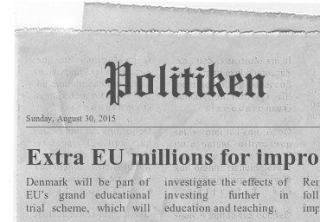
Boggild (2016) How Politicians’ Reelection Efforts Can Reduce Public Trust, Electoral Support, and Policy Approval
Treatment:
Made-up newspaper article in Politiken describing fictitious policy initiative at the EU level (article described how were participating countries chosen to the new educational grant scheme)
 | Impartial decision-maker | Partial decision-maker
Favourable | Decision maker: Danish Distribution: random (money goes to Denmark) | Decision maker: Danish Distribution: partial (money goes to Denmark)
Unfavourable | Decision maker: Belgian Distribution: random (money goes to Belgium) | Decision maker: Belgian Distribution: partial (money goes to Belgium)

Slide 22
Boggild (2016) How Politicians’ Reelection Efforts Can Reduce Public Trust, Electoral Support, and Policy Approval
Follow-up questionnaire
Measurement of dependent variables:
Trust in decision-maker
Inclination to vote for decision-maker
Support for decision (money distribution)
Questions with 0-10 scale

Slide 23
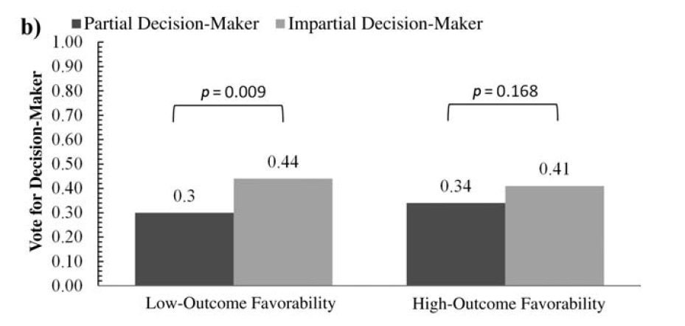
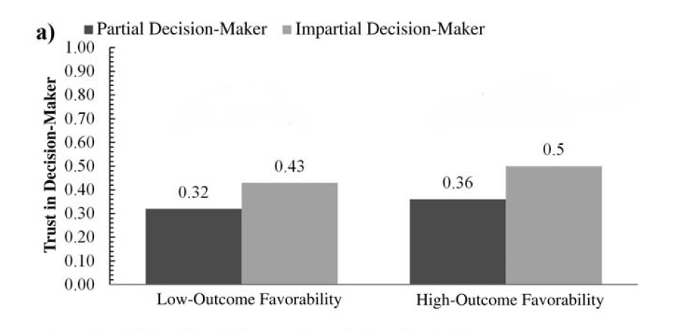
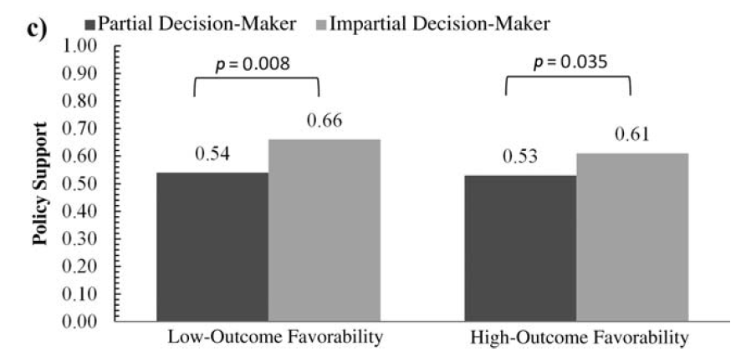
Boggild (2016) How Politicians’ Reelection Efforts Can Reduce Public Trust, Electoral Support, and Policy Approval
Results:
money goes to another country (Belgium)
money goes to participant’s home country (Denmark)
partial (intentional/unfair) distribution
impartial (fair/random) distribution

Slide 24
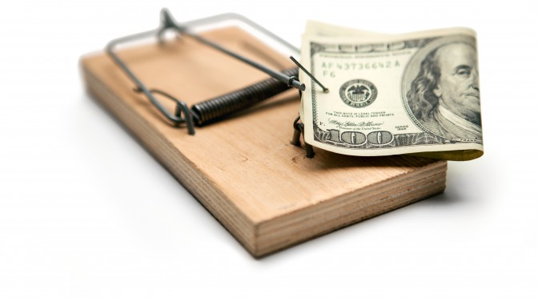
Boggild (2016) How Politicians’ Reelection Efforts Can Reduce Public Trust, Electoral Support, and Policy Approval
Results:
Reelection efforts of politicians can depress public trust, inclination to vote and support of the political decision
Effect persists even when people can benefit from such efforts
(Procedural) fairness matters

Slide 25
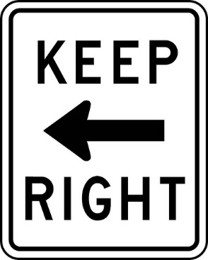
What we know so far?
Existing findings limited and contradictory
Experimental studies:
USA – subjects who benefited from redistribution (aimed to please the voters) appreciated such decision (Braidwood 2015)
Denmark – subjects responded to reelection efforts of politicians (impartial redistribution of public finances) with lower level of trust and reduced willingness to vote even when they can benefit from redistribution (Bøggild 2016)
Appears that voters can perceive pork-barrel strategies both in positive and negative way

Slide 26
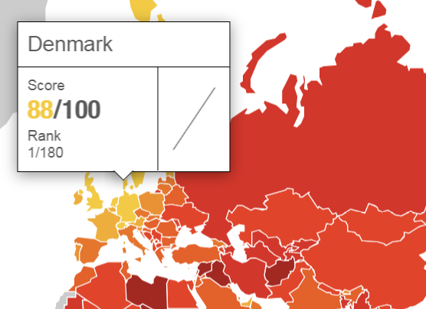
Contextually conditioned effect?
Corruption Perceptions Index (CPI) – „perceived levels of corruption“ – defined as „the misuse of public power for private benefit“
Denmark vs. CE countries

Slide 27
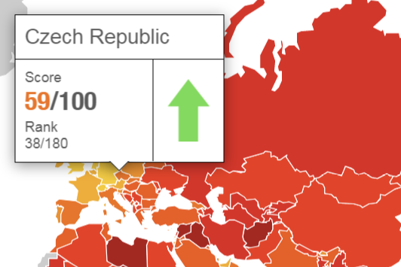
Contextually conditioned effect?
Corruption Perceptions Index (CPI) – „perceived levels of corruption“ – defined as „the misuse of public power for private benefit“
Denmark vs. CE countries

Slide 28
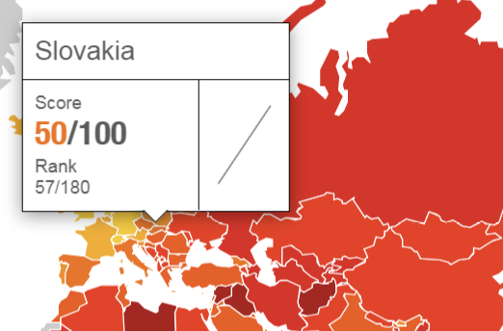
Contextually conditioned effect?
Corruption Perceptions Index (CPI) – „perceived levels of corruption“ – defined as „the misuse of public power for private benefit“
Denmark vs. CE countries

Slide 29
Tóth, Nemčok, Spáč (2021) I Don't Like It Unless It's for Me: Perceptions of Pork-Barrel Politics in Central and Eastern Europe
Project „Distributive Politics in Central Europe“ – study of pork-barrel politics in CE (patterns of distribution, strategies, factors influencing distributive politics etc.)
Experimental part – better understanding of psychological mechanisms behind distribution of subsidies
Series of survey experiments (manipulation based on Boggild‘s (2016) study) - replication
Pilot study: summer 2018 – non representative sample of 87 subjects (survey distributed via social networks) – goal: test the design and manipulation
1st study: 2018 – Slovakia – representative sample of 700 subjects
2nd study: 2019 – Czech republic - representative sample of 1025 subjects – goal: replicate findings from 1st study

Slide 30
Tóth, Nemčok, Spáč (2021) I Don't Like It Unless It's for Me: Perceptions of Pork-Barrel Politics in Central and Eastern Europe
Trust in decision-maker
Benefit
Willingness to vote for decision-maker
Fairness
Support for the policy

Slide 31
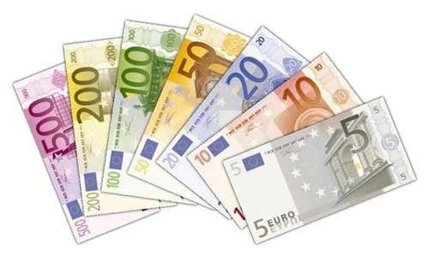
Tóth, Nemčok, Spáč (2021) I Don't Like It Unless It's for Me: Perceptions of Pork-Barrel Politics in Central and Eastern Europe
Experimental design:
Experimental manipulation: newspaper article describing the way how money from made-up trial European health care grant scheme were distributed among several EU members
4 scenarios/versions: differences:
Benefit from distribution - origin of the politician (decision-maker responsible for the distribution of the money)
Slovak/Hungarian
Czech/German
Fairness of such distribution
random draw
intentional (secure votes in upcoming elections)
Participants randomly assigned to each condition

Slide 32
Tóth, Nemčok, Spáč (2021) I Don't Like It Unless It's for Me: Perceptions of Pork-Barrel Politics in Central and Eastern Europe
 | Slovakia |  |  | Czech Republic
 | Fair distribution | Unfair distribution |  | Fair distribution | Unfair distribution
Benefit | Decision-maker: Slovak N = 186 | Decision-maker: Slovak N = 174 |  | Decision-maker: Czech N = 269 | Decision-maker: Czech N = 256
No benefit | Decision-maker: Hungarian N = 171 | Decision-maker: Hungarian N = 169 |  | Decision-maker: German N = 241 | Decision-maker: German N = 259
Total | 700 participants |  |  | 1,025 participants

Slide 33
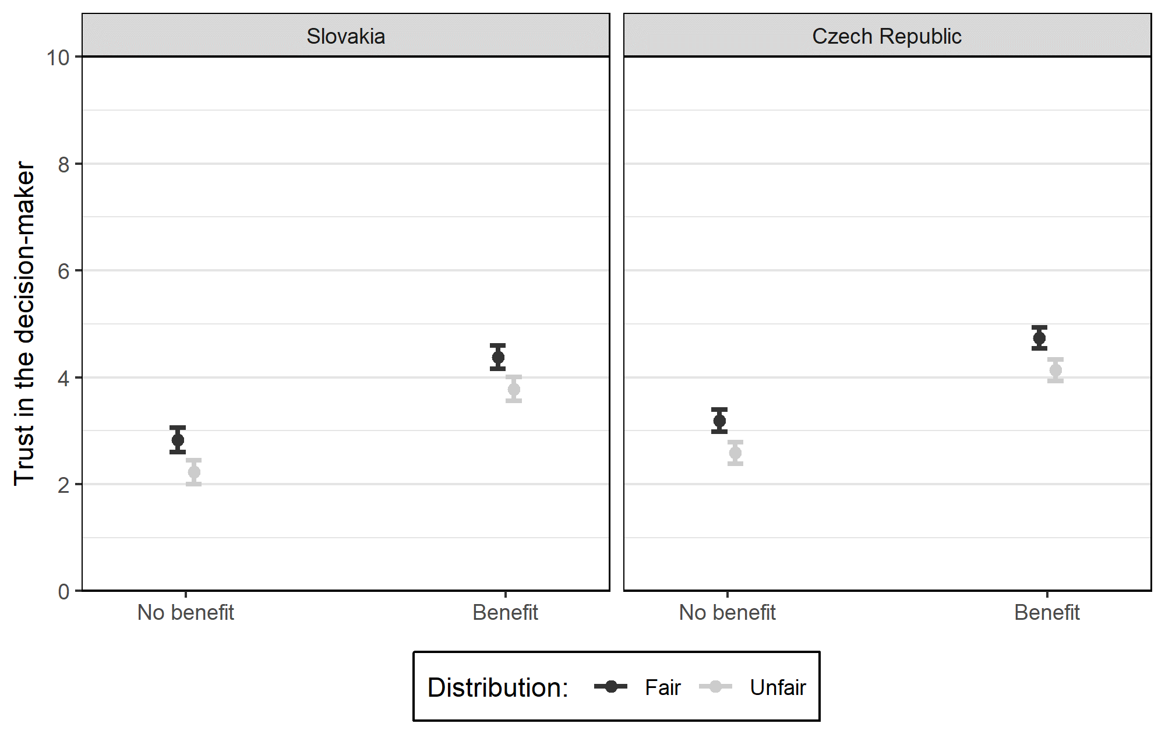
Tóth, Nemčok, Spáč (2021) I Don't Like It Unless It's for Me: Perceptions of Pork-Barrel Politics in Central and Eastern Europe
Results
Trust in decision-maker
Benefit + Fair
Benefit + Unfair

Slide 34
Tóth, Nemčok, Spáč (2021) I Don't Like It Unless It's for Me: Perceptions of Pork-Barrel Politics in Central and Eastern Europe
Results
Trust in decision-maker
No benefit + Fair
Benefit + Unfair

Slide 35
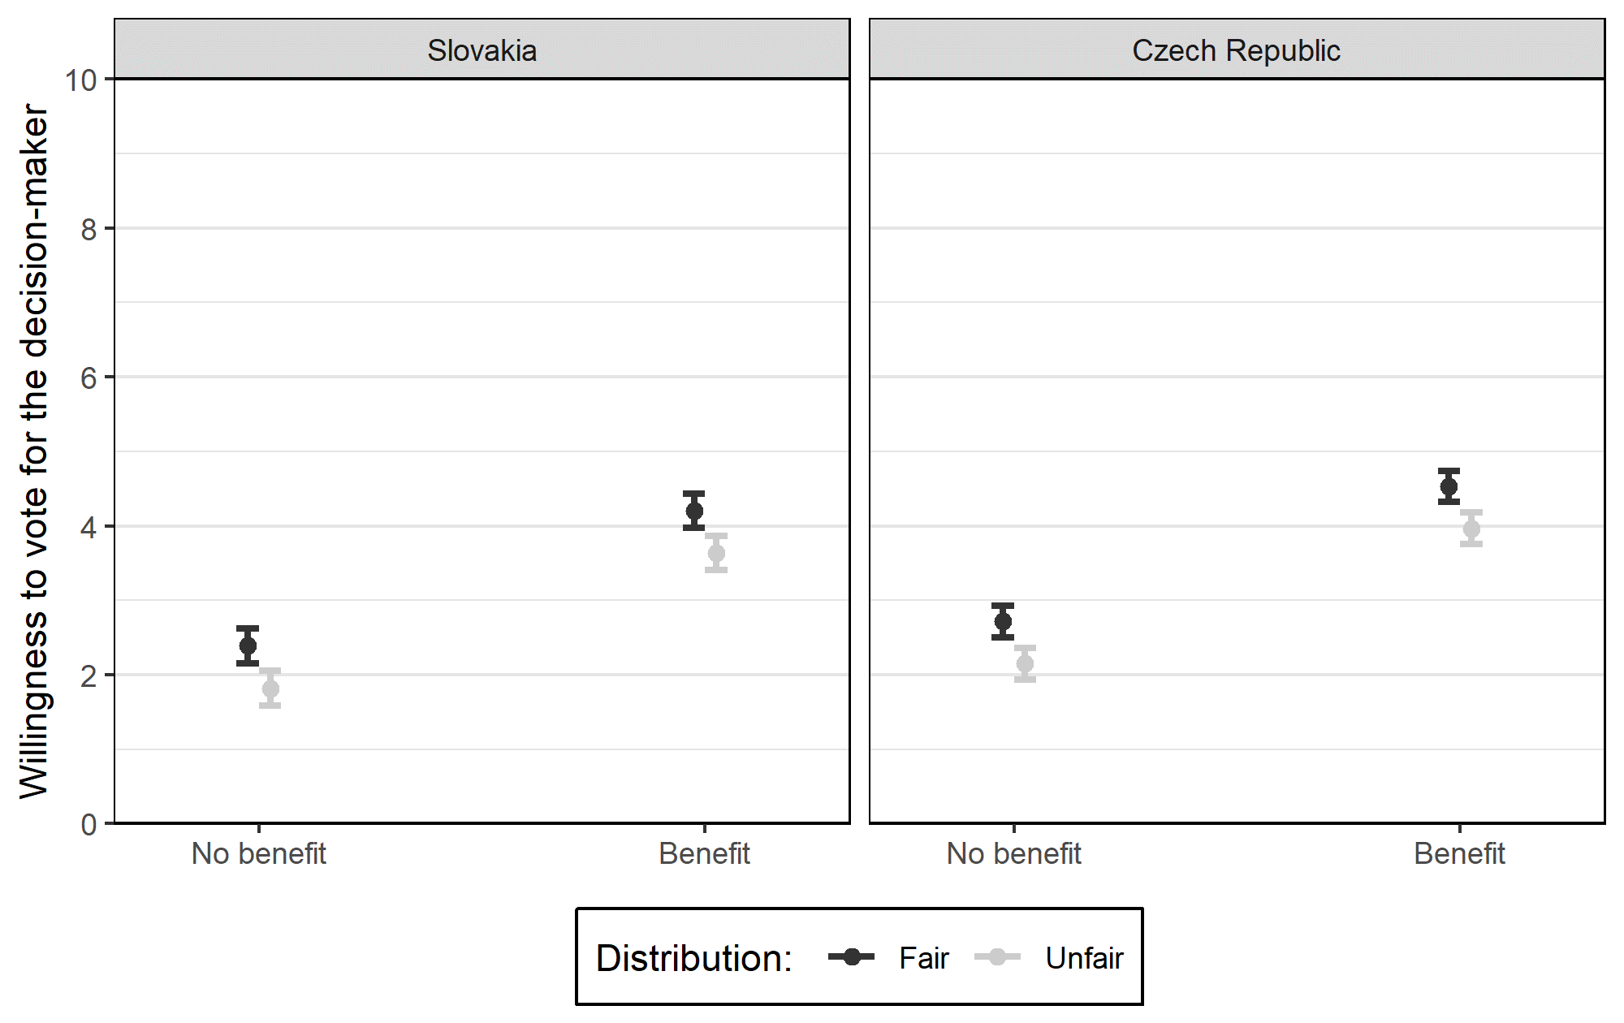
Tóth, Nemčok, Spáč (2021) I Don't Like It Unless It's for Me: Perceptions of Pork-Barrel Politics in Central and Eastern Europe
Results
Willingness to vote

Slide 36
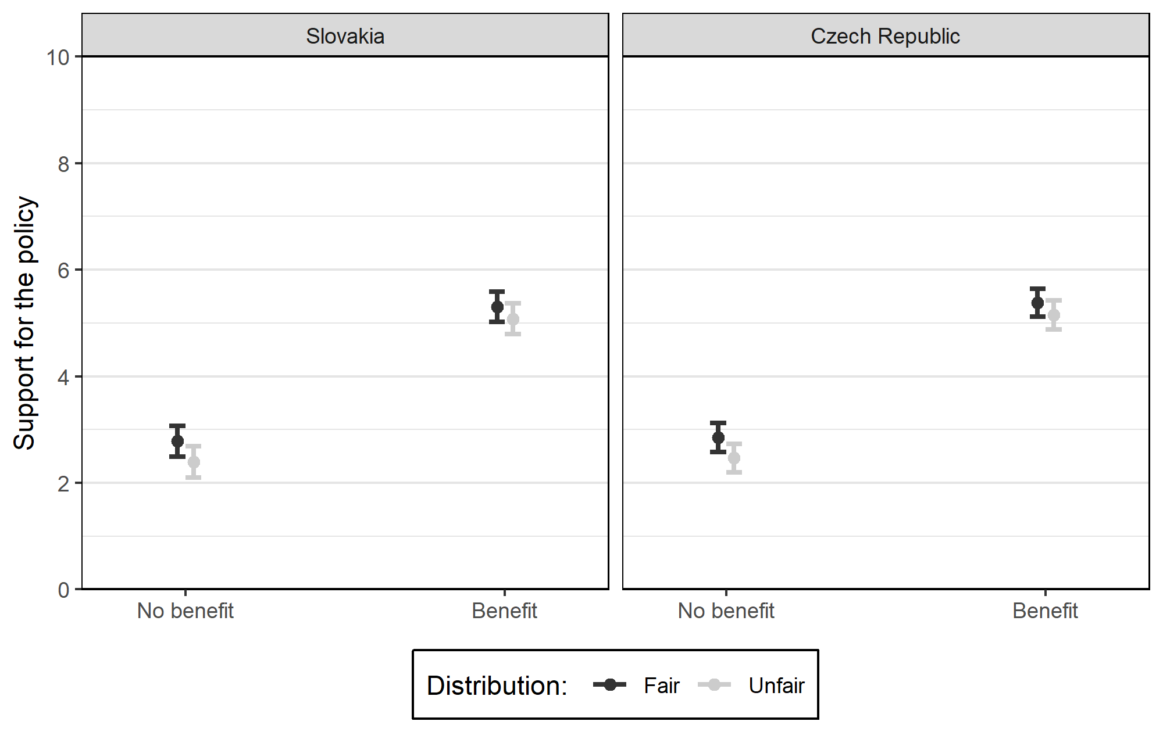
Tóth, Nemčok, Spáč (2021) I Don't Like It Unless It's for Me: Perceptions of Pork-Barrel Politics in Central and Eastern Europe
Results
Support for the policy

Slide 37
Tóth, Nemčok, Spáč (2021) I Don't Like It Unless It's for Me: Perceptions of Pork-Barrel Politics in Central and Eastern Europe
Conclusion:
Subjects showed higher trust (and willingness to vote) to politician, who selected countries for funding on the fair basis (random selection)
At the same time, they appreciated more if their country benefits from the funding program
In contrast to Danish study (Boggild 2016), results indicate that people in Slovakia and Czech Republic are willing to forgive „corruption“ (unfairness) providing they benefit from it
Reasons – context, characteristics of the sample (students v. population sample)
Main result: Benefits beat fairness

