Slide 1
Populism: definition and theoretical approaches
POLb1111 Populism and political parties

Slide 2
Aims of the lecture
Explain the core features of populism as a distinctive concept
Briefly introduce different approaches to the study of populism
Define different types of populism

Slide 3

The main thesis is that…
…populism is like arancini.

Slide 4

Problems with populism
Canovan (1999): ‘contested concept’
Stanley (2008): vague term retaining an ‘awkward conceptual slipperiness’
Taggart (2000): ‘chameleonic nature’

Slide 5
Problems with populism
- Popular perception of populism (unrealistic promises, irresponsible policies, demagoguery, spending, socialist policies, xenophobia…)
- Negative political label
- Terminological mess: protest parties, challenger parties, anti-party parties, anti-mainstream parties, anti-political establishment parties, anti-establishment reform parties, discontent parties, neopopulism/ new populism, anti-corruption parties, national populist parties…

Slide 6

Popular perception of populism
Stretching of the term
All politicians are populists (from time to time)
Content – unrealistic promises, irresponsible policies, demagoguery, spending, socialist policies, xenophobia…
See Bale, Taggart, van Kessel. 2011: “Thrown around with abandon? Popular understandings of populism as conveyed by the print media: a UK case study.” Acta Politica 46 (2).
Populism as a label in political fight

Slide 7
Three waves of populism
Empirical diversity of populism (Pauwels 2014)
19th century populism – the People`s Party in the USA, „narodniky“ in Russia (Canovan 1981, Taggart 2000)
Latin American populism – Peron, Chávez, De la Torre…
New populism – radical right-wing or radical left parties in Europe
  (+ exclusively/centrist populist parties)
Case driven definitions (agrarian populism until the 1970s, RRP in Western Europe)

Slide 8
POPULISM AS AN IDEOLOGY
Ideology:
total, closed and cohesive view of human beings in society / a systematic body of concepts / a comprehensive normative vision / the integrated assertions, theories and aims that constitute a sociopolitical program
Is populism an ideology?
Populism is usually not regarded as a full-blown ideology (such as socialism, liberalism etc.)

Slide 9

POPULISM AS A THIN-CENTERED IDEOLOGY
Cas Mudde (2004, 2007):
“populism as an ideology that considers society to be ultimately separated into two homogeneous and antagonistic groups, ‘the pure people’ versus ‘the corrupt elite’, and which argues that politics should be an expression of the volonté générale (general will) of the people”
thin-centered ideology – does not cover all aspects of life, only specific political questions
can be combined with other thin-centered of full blown ideologies – ‘a receptive partner for full ideologies’ (Stanley 2008), ‘colourless’(Jagers, Walgrave, 2007) – East-Central European experience, M5S
Stanley, B. (2008). „The thin ideology of populism.“ Journal of Political Ideologies, 13(1), 95-110.

Slide 10
ANALYTICAL CORE OF POPULISM
Deconstruction of the definition (Rooduijn 2016, see also Deiwiks 2009, Stanley 2008, Muller 2016):
Muller (2016): moralistic imagination of politics
The people as a homogeneous group – the people and the elite
Denigration of the elites
The antagonistic relationship between the elites and the people
The idea of (restoration) of popular sovereignty

Slide 11
Political elites
People
Populists

Slide 12
THE ‘ PURE PEOPLE’ AS A HOMOGENEOUS GROUP
Crucial importance for populism
Refusal of division of society into different groups (antipluralist – next lecture)
How is the people defined – an empty signifier?
Purity as the most single important characteristic of the people
Taggart: heartland, idealized conception of the community

Slide 13
Class task!!!
Imagine you are a populist leader coming from:
The United States
Italy
Poland
Czech Republic
The United Kingdom

Slide 14
How would you define the „pure people“ or a member of your heartland?

Slide 15

1 bonus point! (5 minutes to complete the task)

Slide 16
THE ‘ PURE PEOPLE’ AS A HOMOGENEOUS GROUP
Culturally/politically determined content of the “people”
As the sovereign – demos, against principles of liberal and representative democracy
As a nation – ethnos, populism = nationalism (?), vs. foreigners, immigrants etc.
As a class – ‘working people’, the ‘99 per cent’ vs. ‘the rich’, the ‘1 per cent’, exploitation the lower class
BUT related to the host ideology (see later)

Slide 17

Political elites
People
Populists

Slide 18
DENIGRATION OF THE ELITES
Establishment/elites as a collective, monolithic entity
Criticism targeting all the established actors
Political parties, businessmen, ‘the rich’, oligarchy, the ‘1 per cent’, ‘champaigne/drinkers’, “latte-drinking, sushi-eating, Volvo-driving, New York Times-reading, Hollywood-loving” liberal elites …
Particular interests which are in opposition to the interests of the people
Sabotaging the interests and democratic rights of the people
Beyond the usual opposition

Slide 19
Class task!!!
Imagine you are a populist leader coming from:
The United States
Italy
Poland
Czech Republic
The United Kingdom

Slide 20
How would you define the elites (and why)?

Slide 21
1 bonus point! (5 minutes to complete the task)

Slide 22
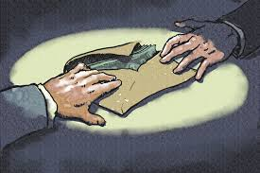
Political elites
People
Populists

Slide 23

Political elites
People
Populists

Slide 24
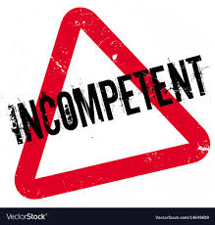
Political elites
People
Populists

Slide 25
The antagonistic relationship between the people and the elite
Manichaean view (moral dimension, normative outlook)
The good (‘pure’) people and the bad elite
People betrayed by the corrupt elite
Alienation of the elite, people exploited by the elite
P. speak in the name of the ‘oppressed people’
The chief social divide between the governing and the governed – denial of the old cleavages
Aggresive and/or mocking rhetoric (‘political class’, ‘dinosaurs’, ‘robber barons’, ‘thieves’, ‘oligarchy’, ‘godfathers’…)
Emphasis on the proclaimed crisis (elites blamed for it) - political, cultural, social, economic

Slide 26
Political elites
People
Populists

Slide 27
THE IDEA OF POPULAR SOVEREIGNTY
Sovereignty taken away from the people by the elite - against the representative democracy (next lecture)
Often proponents of direct democracy (not a defining characteristic of p.)
Renewal of the ‘distorted’ relationship between the elites and the people
People are fully formed and self-aware (no need for incompetent political elites)
‘common sense’ as the leading principle (‘votes for us are votes for common sense’ – R. John (VV))
All representatives have to do is to listen to the vox populi

Slide 28

Political elites
People
Populists

Slide 29
Types of populism

Slide 30
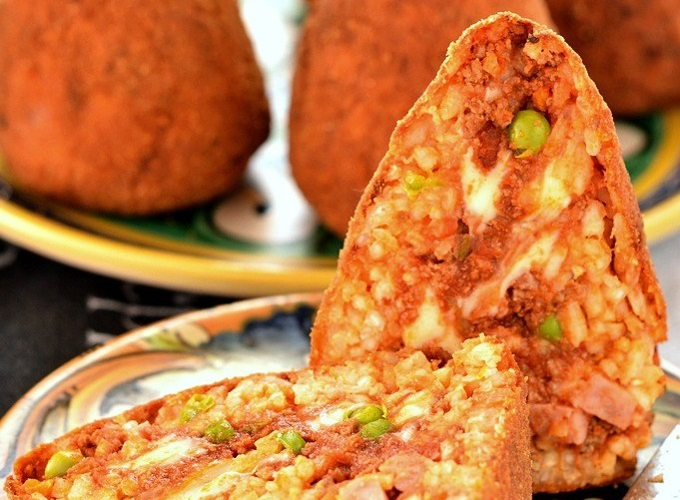
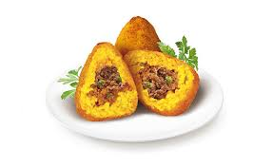

thin-centered ideology (Freeden 1996)
Goes together with other thin-centered of full blown ideologies:
Populist radical right (Lega, National Rally, Bolsonaro)
Populist radical left (Podemos, Syriza)
Centrist populist parties (ANO, M5S)

Slide 31
Typology of populism (based on Pauwels 2014; Havlík, Stanley 2015; modified)
 | Social populism | Radical right-wing populism | Neoliberal populism | Non-ideological populism
Construction of the people | Working class, the opressed, 99%, the exploited | (Pure) nation, ethnos | Hard-working taxpayers, entrepreneurs | Ordinary people, citizens
Depiction of the elites/enemies | Capitalists, imperialists, bankers, exploiters | Immigrants, foreigners, multiculturalism, feminism | Bureaucratic elites/states, interventionist state | Corrupt incompetent politicians
Host ideology | Socialism | Nativism | Economic liberalism | Not clear
Examples | PDS, Syriza, SP | NF, VB, Ataka | LPF, ALP, ANO (SVK) | ANO (CZ), NDSV, M5S

Slide 32
Populism
Authoritarianism
Nativism
PRR

Slide 33
Nativism
The key concept is nationalism
A political doctrine based on the congruence on the cultural and the political unit, i.e. on the nation and the state
Internal homogenization + external exclusiveness as tools
How to distinguish between moderate and radical nationalism?
Nativism = „An ideology, which holds that states should be inhabited exclusively by members of the native group (“the nation”) and that nonnative elements (persons and ideas) are fundamentally threatening to the homogenous nation-state.“ (Mudde 2007: 19)
  = combination of nationalism and xenophobia
  Different construct of native(ness) – racist, cultural, religious…

Slide 34
Economy
Not of the primary importance for populist radical right
Winning formula – free market economic policies combined with xenophobia and social-cultural conservatism (Kitschelt and McGann)
The empirical evidence provides a more mixed picture
Protectionism determined by nativism (critical approach to international market)
Welfare chauvinism – social benefits guaranteed only for natives

Slide 35
Populism and radical left
„chameleonic“ nature of populism open to appeal from different parts of the ideological spectrum
Combination of left-ideologies with populism relatively new – European populism almost exclusively tied to radical right politics (X the 19th centure populism in USA, Latin American experience)
1990s – atmosphere critical to the prevailing economic (neo)liberalism + the fall of communism in CEE (losers of transition)
The ideological background of radical left populism = populism + democratic socialism

Slide 36
Democratic socialism as a host ideology
„A democratic ideology between revolution and reform“ (Pauwels 2014)
Reformism of social democratic parties criticized – abandonment of the working class (centrism, a power-seeking strategy)
Revolutionary ideas of communism (overthrowing of democracy and capitalism) rejected
On the left from social democracy but seeking to transform the system
The crucial importance of issues related to the economic dimension of political competition (X RRP) – welfare-state, redistribution, public ownership, (socioeconomic) equality
The new left issues (feminism, environmentalism)
Conflict of pop. and demsoc.:
  minority status of the working class and „common sense“ (vox populi) vs educative activities of the „vanguard of the proletariat“

Slide 37
Populism of radical left
“populism as a thin-centered ideology that considers society to be ultimately separated into two homogeneous and antagonistic groups, ‘the pure people’ versus ‘the corrupt elite’, and which argues that politics should be an expression of the volonté générale (general will) of the people” (Mudde, 2007)
Who are the people?
  The ordinary hard-working people
Who is the enemy?
  The (neoliberal) political and economic elites, a bourgeois class
  Social democratic parties – traitors of the interest of the working class, i.e. RLP presenting themselves as „purifiers“
  External enemies – imperialists (USA, EU)
Exploitation of the working class by the elites – a Manichean view (intensity of the conflict)

Slide 38
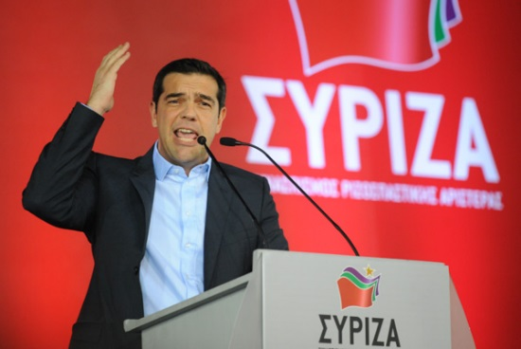

Slide 39


Slide 40
New/centrist populism
Emergence in CEE in the late 1990s
Arisen from the dissatisfaction to political elites and anti-political/anti-party sentiments
The lack of a coherent host ideology
The key issue is corruption, otherwise modest profile (AERPs – Hanley, Sikk) lacking radicalism of PRR or PRL
Politics presented by a grubby business performed by incompetent and selfish politicians
Offer of a “third way”, “non-ideological solutions”, “common sense”…
The people – citizens, ordinary people
Very flexible in terms of attitudes to other issues

Slide 41
Conclusion
populism as a contested concept X agreement on the analytical/definitional core: the people and the elite as homogeneous groups, antagonistic (and essentially moralistic) relationship between the two, popular sovereignty
Populism and democracy (next lecture)
Populism and demagoguery and/or opportunism
Vague use of the term in the media/popular discourse X a precisely defined in political science (and in this course)
Populism usually combined with other ideologies that fill the “emptiness” of populism
The omnipresent moralistic antagonism between the people and the elites varies in its specific context

Slide 42
Thank you for your attention.

