Slide 1
Populism: definition and theoretical approaches
POLb1111 Populism and political parties

Slide 2
Aims of the lecture
Explain the core features of populism as a distinctive concept
Briefly introduce different approaches to the study of populism
Define different types of populism

Slide 3

The main thesis is that…
…populism is like arancini.

Slide 4

Problems with populism
Canovan (1999): ‘contested concept’
Stanley (2008): vague term retaining an ‘awkward conceptual slipperiness’
Taggart (2000): ‘chameleonic nature’

Slide 5
Problems with populism
- Popular perception of populism (unrealistic promises, irresponsible policies, demagoguery, spending, socialist policies, xenophobia…)
- Negative political label
- Terminological mess: protest parties, challenger parties, anti-party parties, anti-mainstream parties, anti-political establishment parties, anti-establishment reform parties, discontent parties, neopopulism/ new populism, anti-corruption parties, national populist parties…

Slide 6

Popular perception of populism
Stretching of the term
All politicians are populists (from time to time)
Content – unrealistic promises, irresponsible policies, demagoguery, spending, socialist policies, xenophobia…
See Bale, Taggart, van Kessel. 2011: “Thrown around with abandon? Popular understandings of populism as conveyed by the print media: a UK case study.” Acta Politica 46 (2).
Populism as a label in political fight

Slide 7
Three waves of populism
Empirical diversity of populism (Pauwels 2014)
19th century populism – the People`s Party in the USA, „narodniky“ in Russia (Canovan 1981, Taggart 2000)
Latin American populism – Peron, Chávez, De la Torre…
New populism – radical right-wing or radical left parties in Europe
  (+ exclusively/centrist populist parties)
Case driven definitions (agrarian populism until the 1970s, RRP in Western Europe)

Slide 8
POPULISM AS AN IDEOLOGY
Ideology:
total, closed and cohesive view of human beings in society / a systematic body of concepts / a comprehensive normative vision / the integrated assertions, theories and aims that constitute a sociopolitical program
Is populism an ideology?
Populism is usually not regarded as a full-blown ideology (such as socialism, liberalism etc.)

Slide 9

POPULISM AS A THIN-CENTERED IDEOLOGY
Cas Mudde (2004, 2007):
“populism as an ideology that considers society to be ultimately separated into two homogeneous and antagonistic groups, ‘the pure people’ versus ‘the corrupt elite’, and which argues that politics should be an expression of the volonté générale (general will) of the people”
thin-centered ideology – does not cover all aspects of life, only specific political questions
can be combined with other thin-centered of full blown ideologies – ‘a receptive partner for full ideologies’ (Stanley 2008), ‘colourless’(Jagers, Walgrave, 2007) – East-Central European experience, M5S
Stanley, B. (2008). „The thin ideology of populism.“ Journal of Political Ideologies, 13(1), 95-110.

Slide 10
ANALYTICAL CORE OF POPULISM
Deconstruction of the definition (Rooduijn 2016, see also Deiwiks 2009, Stanley 2008, Muller 2016):
Muller (2016): moralistic imagination of politics
The people as a homogeneous group – the people and the elite
Denigration of the elites
The antagonistic relationship between the elites and the people
The idea of (restoration) of popular sovereignty

Slide 11
Political elites
People
Populists

Slide 12
THE ‘ PURE PEOPLE’ AS A HOMOGENEOUS GROUP
Crucial importance for populism
Refusal of division of society into different groups (antipluralist – next lecture)
How is the people defined – an empty signifier?
Purity as the most single important characteristic of the people
Taggart: heartland, idealized conception of the community

Slide 13
Class task!!!
Imagine you are a populist leader coming from:
The United States
Italy
Poland
Czech Republic
The United Kingdom

Slide 14
How would you define the „pure people“ or a member of your heartland?

Slide 15

1 bonus point! (5 minutes to complete the task)

Slide 16
THE ‘ PURE PEOPLE’ AS A HOMOGENEOUS GROUP
Culturally/politically determined content of the “people”
As the sovereign – demos, against principles of liberal and representative democracy
As a nation – ethnos, populism = nationalism (?), vs. foreigners, immigrants etc.
As a class – ‘working people’, the ‘99 per cent’ vs. ‘the rich’, the ‘1 per cent’, exploitation the lower class
BUT related to the host ideology (see later)

Slide 17

Political elites
People
Populists

Slide 18
DENIGRATION OF THE ELITES
Establishment/elites as a collective, monolithic entity
Criticism targeting all the established actors
Political parties, businessmen, ‘the rich’, oligarchy, the ‘1 per cent’, ‘champaigne/drinkers’, “latte-drinking, sushi-eating, Volvo-driving, New York Times-reading, Hollywood-loving” liberal elites …
Particular interests which are in opposition to the interests of the people
Sabotaging the interests and democratic rights of the people
Beyond the usual opposition

Slide 19
Class task!!!
Imagine you are a populist leader coming from:
The United States
Italy
Poland
Czech Republic
The United Kingdom

Slide 20
How would you define the elites (and why)?

Slide 21
1 bonus point! (5 minutes to complete the task)

Slide 22
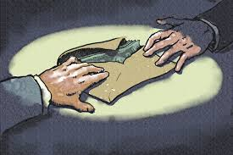
Political elites
People
Populists

Slide 23
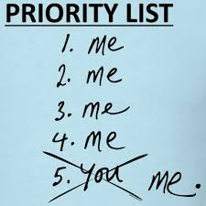
Political elites
People
Populists

Slide 24
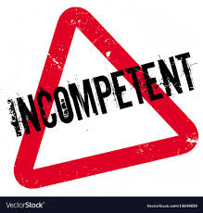
Political elites
People
Populists

Slide 25
The antagonistic relationship between the people and the elite
Manichaean view (moral dimension, normative outlook)
The good (‘pure’) people and the bad elite
People betrayed by the corrupt elite
Alienation of the elite, people exploited by the elite
P. speak in the name of the ‘oppressed people’
The chief social divide between the governing and the governed – denial of the old cleavages
Aggresive and/or mocking rhetoric (‘political class’, ‘dinosaurs’, ‘robber barons’, ‘thieves’, ‘oligarchy’, ‘godfathers’…)
Emphasis on the proclaimed crisis (elites blamed for it) - political, cultural, social, economic

Slide 26
Political elites
People
Populists

Slide 27
THE IDEA OF POPULAR SOVEREIGNTY
Sovereignty taken away from the people by the elite - against the representative democracy (next lecture)
Often proponents of direct democracy (not a defining characteristic of p.)
Renewal of the ‘distorted’ relationship between the elites and the people
People are fully formed and self-aware (no need for incompetent political elites)
‘common sense’ as the leading principle (‘votes for us are votes for common sense’ – R. John (VV))
All representatives have to do is to listen to the vox populi

Slide 28

Political elites
People
Populists

Slide 29
Types of populism

Slide 30
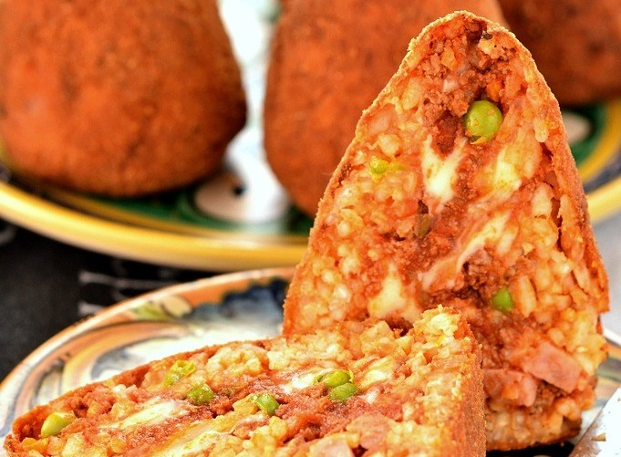
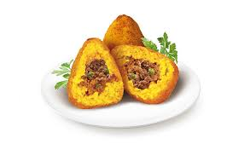

thin-centered ideology (Freeden 1996)
Goes together with other thin-centered of full blown ideologies:
Populist radical right (Lega, National Rally, Bolsonaro)
Populist radical left (Podemos, Syriza)
Centrist populist parties (ANO, M5S)

Slide 31
Typology of populism (based on Pauwels 2014; Havlík, Stanley 2015; modified)
 | Social populism | Radical right-wing populism | Neoliberal populism | Non-ideological populism
Construction of the people | Working class, the opressed, 99%, the exploited | (Pure) nation, ethnos | Hard-working taxpayers, entrepreneurs | Ordinary people, citizens
Depiction of the elites/enemies | Capitalists, imperialists, bankers, exploiters | Immigrants, foreigners, multiculturalism, feminism | Bureaucratic elites/states, interventionist state | Corrupt incompetent politicians
Host ideology | Socialism | Nativism | Economic liberalism | Not clear
Examples | PDS, Syriza, SP | NF, VB, Ataka | LPF, ALP, ANO (SVK) | ANO (CZ), NDSV, M5S

Slide 32
Populism and democracy

Slide 33
Main questions
What is the relationship of populism and democracy?
Is populism dangerous to democracy?

Slide 34
Outline
The two faces of democracy
Populism – threat or corrective to democracy?

Slide 35
What is democracy?

Slide 36
Democracy
Popular sovereignty
Majority rule
Schumpeter (1949: 250): ‘institutional arrangement for arriving at political decisions in which individuals acquire the power to decide by means of a competitive struggle for the people’s vote’; representative democracy, a method of selection of rulers, free and fair elections

Slide 37
Populism
“populism as a thin-centered ideology that considers society to be ultimately separated into two homogeneous and antagonistic groups, ‘the pure people’ versus ‘the corrupt elite’, and which argues that politics should be an expression of the volonté générale (general will) of the people” (Mudde, 2007)
Populism supports popular sovereignty and majority rule

Slide 38
Populism and democracy - discussion
Why so much discussion on the relationship between populism and democracy?
Is populism dangerous to democracy? Why?

Slide 39
Democracy
Popular sovereignty
Majority rule
Schumpeter (1949: 250): ‘institutional arrangement for arriving at political decisions in which individuals acquire the power to decide by means of a competitive struggle for the people’s vote’; representative democracy, a method of selection of rulers, free and fair elections
Most contemporary democracies are liberal (vs. procedural approach to democracy)

Slide 40
What makes a democracy to be a liberal one?

Slide 41
Key features of liberal democracy
Free and fair elections
Popular sovereignty
Majority rule
+
Checks and balances and the constitutional protection of minority rights

Slide 42
Two faces of democracy

Slide 43
Two faces of democracy
Canovan (1999) – two faces of democracy:
  Redemptive face – ‘salvation through politics’, direct exercise of power
  Pragmatic face – ‘ballots, not bullets’, a way of peaceful resolution of conflicts, a form of government, and institutions and rules
C. Mouffe – a liberal/constitutional pillar & democratic pillar
Ideal of democracy vs. Real functioning – permanent internal tension between the two faces of democracy
Populist appeal refers (only) to the redemptive face of democracy vs. principles of liberal democracy

Slide 44
Democratic tension as a breeding ground for populism
„A broad tendency that is always latent to some degree in modern democracies“ (Plattner, 2010)
„If it becomes clear that those involved see in democracy nothing but horsetrading, they, and eventually the system itself, are liable to lose their legitimacy. When too great a gap opens up between haloed democracy and the grubby business of politics, populists tend to move on to the vacant territory, promising in place of the dirty world of party monoevring the shining ideal of democracy renewed.“ (Canovan 1999: 11).
Populism as a ‘shadow of democracy’, democracy/political crisis as a (possible explanation of the rise of populism x different kind of populisms)

Slide 45
Populism as a threat to democracy I.
Democracy seen by populist only as the ‘power of the people’ – reductionist definition of democracy (Mény, Surel, 2002)
‘democratic illiberalism’ (Pappas, 2012)
‘pure populist democracy vs. the practice of constitutional democracy’ (Abts, Rummens, 2007)
‘little patience with liberalism`s emphasis on procedural niceties and protections for individual rights’ (Plattner, 2010)
Populism is not against democracy per se, but against the principles of liberal democracy

Slide 46
Populism as a threat to democracy II.
Negative effects on different aspects of democracy:
Position of individuals and social groups
Rejection of the unified-in-diversity vision of society
Circumvention of minority rights in the name of majority rule/majority rights
Ignorance of constitutional guarantees for the individual rights of citizens
Attitudes to NGOs, media, academia
Pluralism at stake with populism

Slide 47
Populism as a threat to democracy III.
2. Institutions and rules of liberal democracy
System of ‘checks and balances’, a complex model of bargaining, compromises in contrast with populist vision of democracy
Delegitimization of institutions necessary for ‘good governance’
‘Solutions’:
  By-passing of representative principles of liberal democracy by promotion of elements of direct democracy
  Limitation of separaration of powers, weakening of ‘pluralist’ institutions (parliaments, opposition rights, discussion, constitutional courts…)
  Delegimisation of elected bodies, replacing by ‘non-political’ principles
  Effectivity instead of procedural checks

Slide 48
Populism as a threat to democracy IV.
3. Effectiveness of political processes
Indirect effect related mostly to democracy support
Limited coalition potential of populist parties – formation of ideologically non-connected coalitions (a new political cleavage - Greece) – convergence of political space – growing dissatisfaction with democracy (lack of representativeness)
Formation of ‘populist democracies’ (Pappas) – reaction to success of populist rhetoric, populist inflation
Populists in government – ‘mainstreamization’, lack of trust, ‘spiral of discontent’ – clash of a programme of redemptive democracy and the practice of pragmatic democracy
Drop of legitimity of standard institutions of liberal democracy (intentional delegimisation – framing and cueing)

Slide 49
Populism as a corrective to democracy
Populist success as a litmus paper of pragmatism of democracy
Corrective function of populism (Mudde, Rovira Kaltwasser, 2012)
Mostly related to the inclusionist face of populism:
Representation of ‘silent majority’
Mobilization and representation of excluded sections of population (issues important for this part of society but neglected by political representation)
Increase of democratic accountability – new issues in the political agenda
‘Democratisation of democracy’ – related to mobilization, revitalization/intensification of political conflicts

Slide 50
Conclusion
Populism based on basic principles of democracy (the essence of populism is democratic)
Different faces of democracy: idea/practice of democracy – liberal democracy
Three faces of populism:
Latent and permanent danger to liberal democracy
Possible corrective to liberal democracy
Litmus paper of functioning of democracy (demand)
Empirical investigation needed, case studies (presentations?)

Slide 51
Thank you for your attention.

