Slide 1
Foreign Policy of the Russian Federation in last two decades
Masaryk University
Faculty of Social Studies
Department of Political Science
From the Reaction to the Color Revolutions to the War in Ukraine
PhD Candidate in Political Science
Andrei Kalavur (Andrej Kallaur)
Brno, 2024

Slide 2
Overview
Introduction
Russian Foreign Policy Concept
Relations with Post-Soviet States
«Grey Zone» Concept
«Authoritarian International»
«2014 Eastern Turn»
Full-Scale War in Ukraine
Relations with the United States and the EU
Perception of Russian Foreign Policy by the Russians
Conclusions
Bibliography

Slide 3
Introduction
The foreign policy of the Russian Federation under the presidencies of Vladimir Putin (2000-2008; since 2012) and Dmitry Medvedev (2008-2012) pursues the main goal: to restore the status of Russia as a ‘great power’ in the global arena [Gromyko, 2018; Trenin, 2020].
The stages of the foreign policy:
1) cooperative relations (2000-2014);
2) competition or confrontation (since 2014) [Trenin, 2016].
The «secret room» of Putin, Kremlin [Russia 1, 2020].

Slide 4
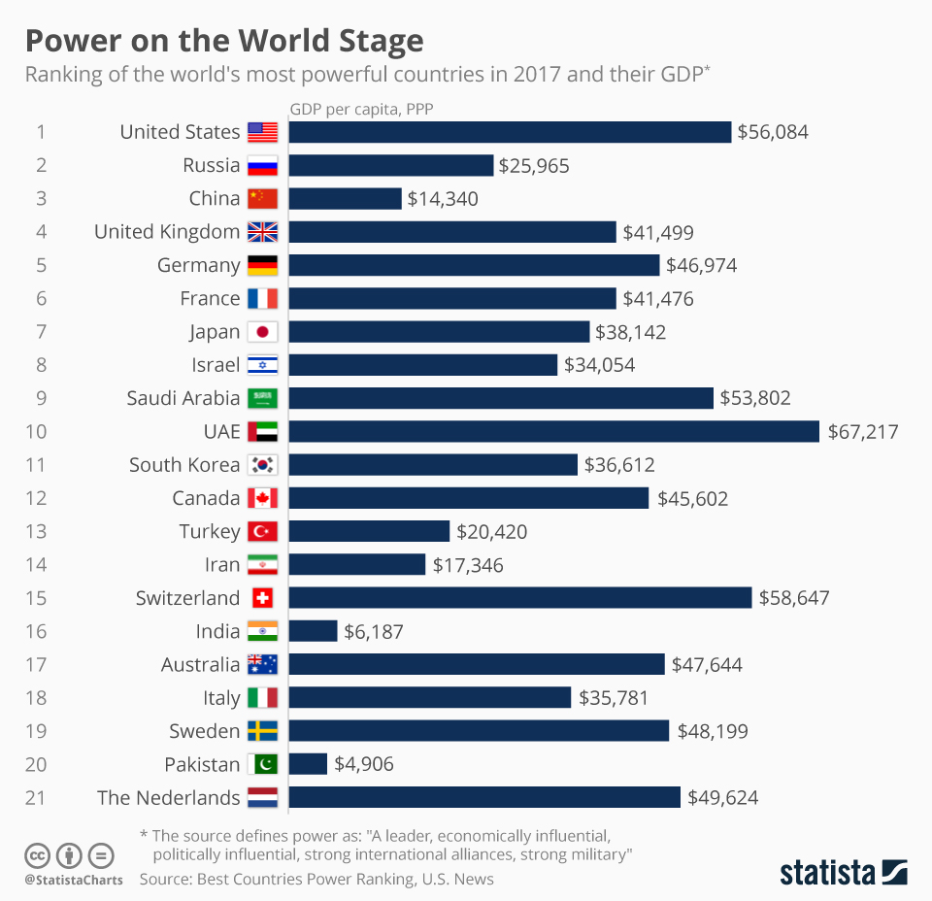
Introduction
Russian foreign policy is based on «national interest» and «realpolitik» [Gromyko, 2018].
The asymmetry between the economic development (relatively weak) and activities on the world arena are observed (relatively high).
2017 US News Power Ranking considered political and economic influence, military alliances and the strength of the army [Statista, 2017].

Slide 5
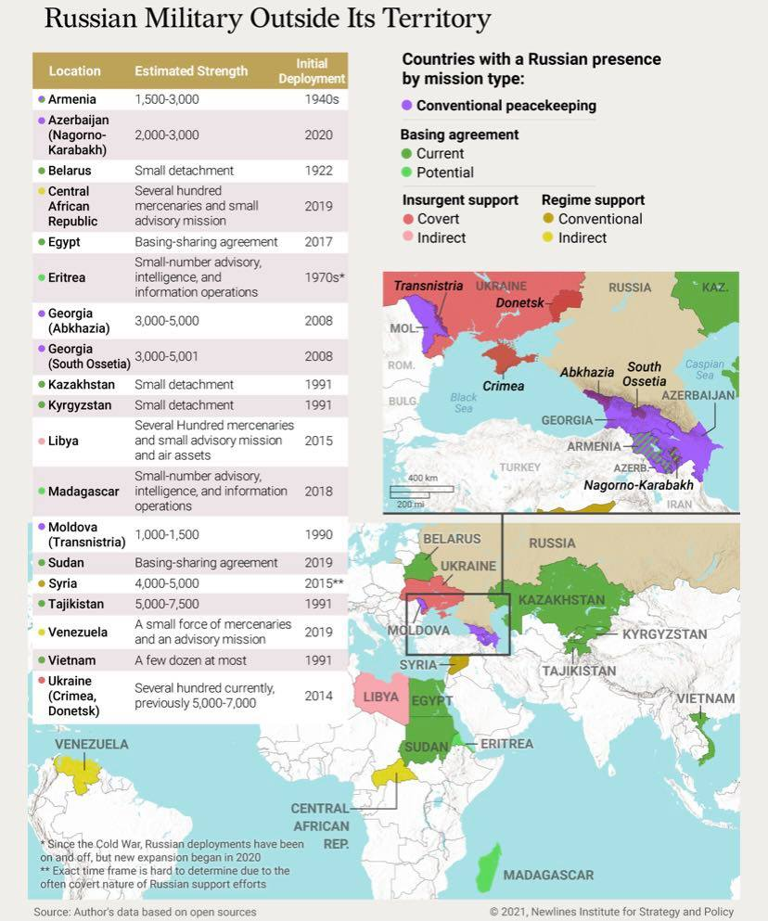
Introduction
«The tactics of the Russian foreign policy is not to dominate its opponents but to keep them off balance by applying diplomatic, economic, military, and political pressure» [Hawn, 2021]. Even the goals of so-called “Special military operation in Ukraine” as ’denazification’, ‘demilitarization’ and ‘neutral status of Ukraine’ are proclaimed by officials [Putin, 2023].
Source: Newlines Institute for Strategy and Policy, 2021, newlinesinstitute.org/russia/russias-extraterritorial-military-deployments/?fbclid=IwAR057KpG9CYg7yR0tRZM8etoEVICPffn-f4CYALb3vy699nNjqbIGgjIXfI.

Slide 6
Russian Foreign Policy Concept
The latest variation of the Concept was approved by the President of the Russian Federation Vladimir Putin in 2023. The concept is rooted in his famous «Munich speech» (Munich Security Conference, 2007).
Foreign Policy Official Priorities (excerpts):
Rejection of the hegemony in international affairs.
The supremacy of international law in regulating international relations.
Diversity of civilizations and models of society.
Eliminating the dominance of the United States and other unfriendly states in world affairs.
Neutralizing the policy of imposing pseudo-humanistic and other neoliberal ideological guidelines leading to the loss of sustainable traditional spiritual values and moral attitudes.
Restoration of the role of the UN as a central coordinating mechanism.
Source: Ministry of Foreign Affairs, 2023, www.mid.ru/ru/detail-material-page/1860586/.
Munich speech 2007 (from 5.35 min): youtube.com/watch?v=hQ58Yv6kP44.

Slide 7
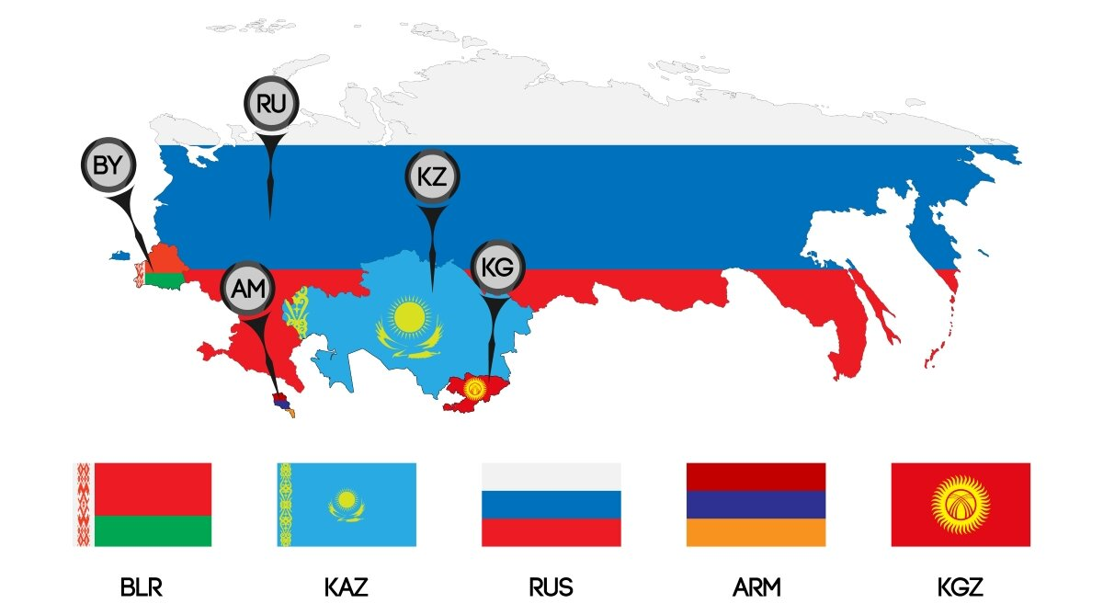
Relations with Post-Soviet States
The Russian Federation develops cooperation with the Republic of Belarus within the Union State, with Armenia, Belarus, Kazakhstan and Kyrgyz Republic within the Eurasian Economic Union (EAEU), etc.
«Russia’s partner members, including the closest – Belarus and Kazakhstan – are extremely anxious when it comes to the preservation of their sovereignty» [Trenin, 2020].

Slide 8
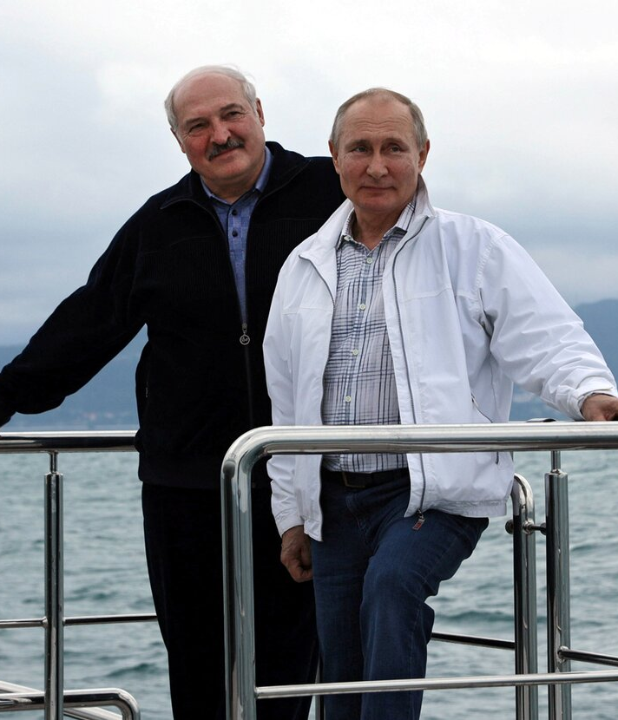
The Union State
The closest ally of Putin is A. Lukashenka’s regime in Belarus.
The Union was established in 1999 as a supranational organization.
In practice, from one side, the Kremlin was ready to send special forces and support A. Lukashenka in 2020. On the other side, Belarusian regime provided the territory for Russian full-scale invasion in Ukraine in 2022.
Photo: meeting of A. Lukashenka and V. Putin in Sochi, May 2021 [Press-agency of the President of the Russian Federation].

Slide 9
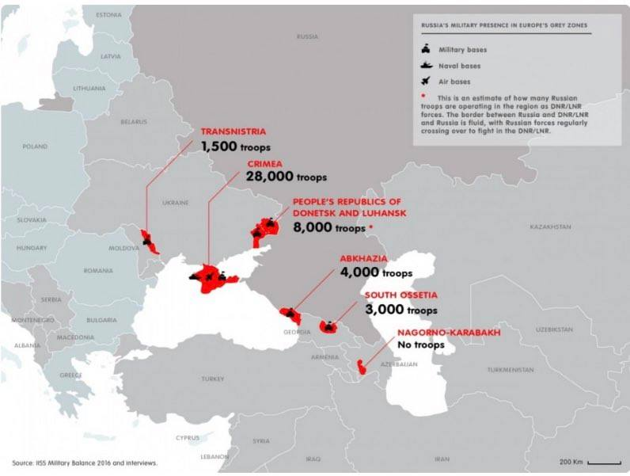
The «Grey Zone» Concept: before 2022
2003 «Rose Revolution» in Georgia (European and Euro-Atlantic integration as a main priority declared by the United National Movement and N. Saakashvili).
2004 «Orange Revolution» (victory of pro-European candidate V. Yushchenko after re-run elections in 2004) and 2014 «Euromaidan» in Ukraine (removal of V. Yanukovych and declaration of European and Euro-Atlantic integration).
«The ”grey zones” are obstacles for Georgia and Ukraine to become members of NATO and move closer to the EU» (Pugsley & Wesslau, 2016).
‘zones’ divert resources and attention from much-needed reform;
represent security risk as the threat of further Russian incursions.
Source: Pugsley & Wesslau (2016) Russia in the grey zones.

Slide 10
The «Grey Zone» Concept: before 2022
The steps of the application of «grey zone» were as follows: recognition of Abkhazia and South Ossetia as independent states and maintenance of military presence in both, annexation and integration of Crimea, war in Donbass (Pugsley & Wesslau, 2016)
Russian Troops Still Advancing in Georgia. Source: Al Jazzera English. The link: youtube.com/watch?fbclid=IwAR3rosDMXqogwhjK4ILXzdUcOPcIR5cKDQGW05K3lnUjDwiyCCnNd-HeoPU&v=p1P1nKt5zB4&feature=youtu.be.
Russian Troops Enter Crimea Airbase. Source: Al Jazeera English. The link: youtube.com/watch?fbclid=IwAR3BINCGI9uOZeoRt6VIfklYKqnvTqXiHNuCXLxTM69LZVHsuFi8g9POLv8&v=EZzwv2byV6c&feature=youtu.be.

Slide 11
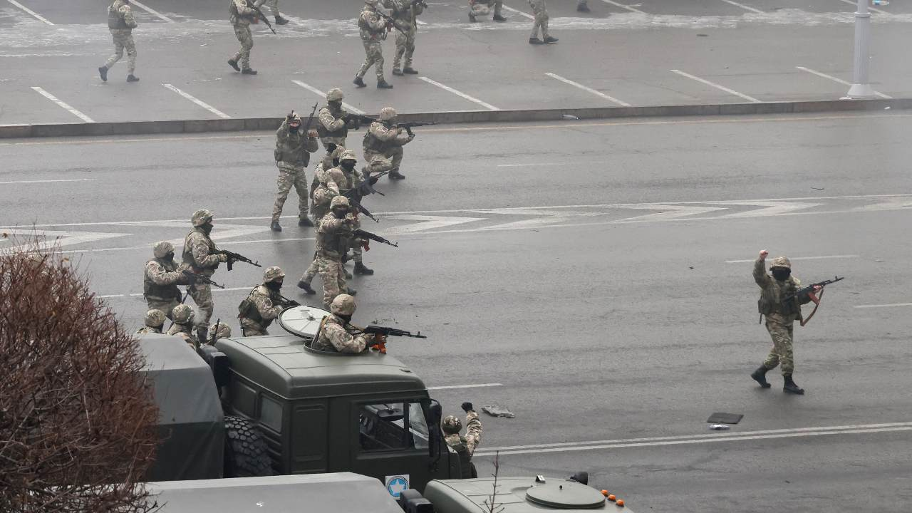
The «Authoritarian International»
«This resulted in the coordination of the efforts to create a sort of collective against the further spread of regime change and unwelcome international influences that could be conducive to promoting it. This collective defense may be named an “authoritarian international”» [Silitski 2010].
The Collective Security Treaty Organization (CSTO) is a military alliance consisting of six post-Soviet states: Armenia, Belarus, Kazakhstan, Kyrgyzstan, Russia, and Tajikistan, formed in 2002.
2022 Case: www.youtube.com/watch?v=RVzLbpM5dV8.
CSTO in Kazakhstan 2022, operation against protests (Russian, Belarusian, Armenian, Kyrgyz, Tajik special forces were sent to protect the regime of Tokaev).
Source: cepa.org/article/russias-warsaw-pact-lite-deploys-to-crush-dissent/.

Slide 12
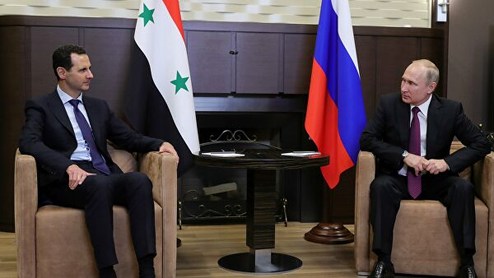
The «2014 Eastern Turn»
Non-recognition of Russia as one of the leading states, enlargement of NATO, ‘color revolutions’ are typically considered by the Russia as the causes of a new stage in their foreign policy [Trenin, 2009].
The «Eastern turn» began since 2014: intensification of cooperation within Shanghai Cooperation Organization, BRICS and RIC (Russia, India, China), army support of the regime of Assad in Syria 2015.
«Moscow occupied a unique position as a player that was capable of maintaining productive contacts with all the significant forces in the region (means in the Middle East)» [Trenin, 2020].
The meeting of Assad and Putin. RIA Novosti, 2020.

Slide 13
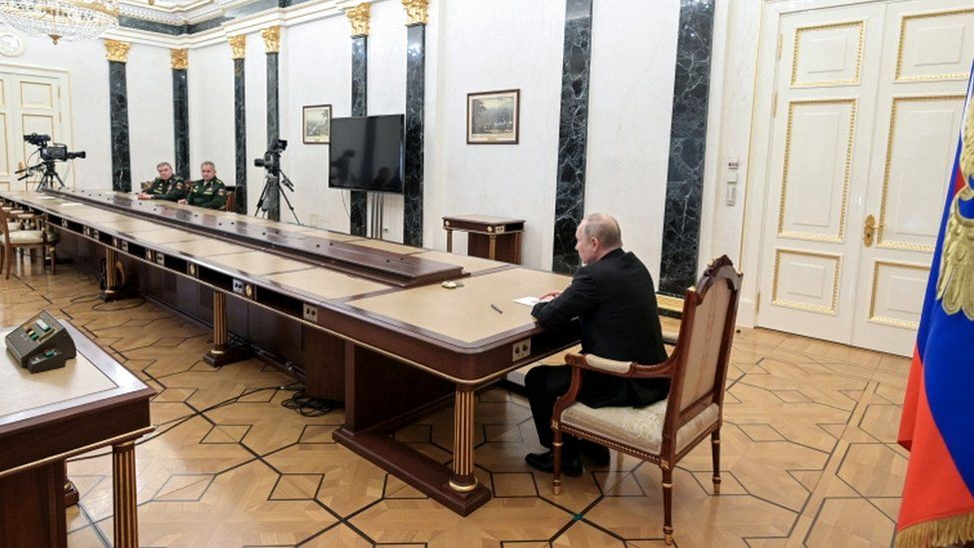
The War in Ukraine. Preconditions
Article by Vladimir Putin «On the Historical Unity of Russians and Ukrainians»: «Step by step, Ukraine was dragged into a dangerous geopolitical game aimed at turning Ukraine into a barrier between Europe and Russia, a springboard against Russia»
(July 2021, en.kremlin.ru/events/president/news/66181).
V. Putin, V. Gerasimov and S. Shoigu meeting (kremlin.ru, 27 February 2022).

Slide 14
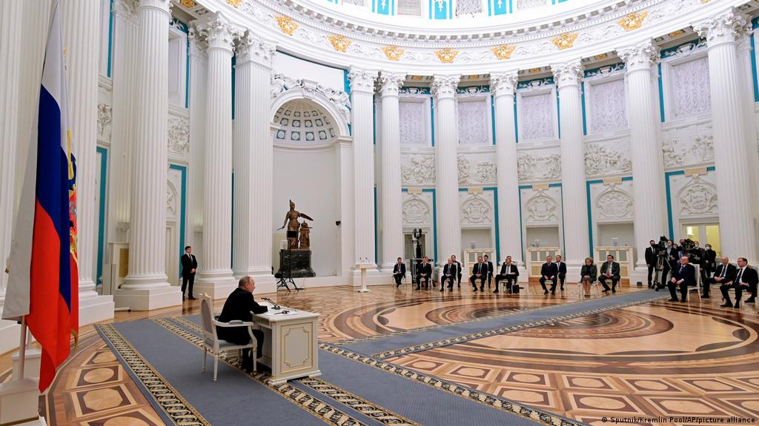
The War in Ukraine. Preconditions
V. Putin held a meeting of the Russian Federation Security Council at the Kremlin: «I have said many times before, if Russia faces the threat of Ukraine being accepted into the North Atlantic Alliance, NATO, the threat against our country will increase because of Article 5 of the North Atlantic Treaty» (February 2022, en.kremlin.ru/events/president/news/67825).
The short video by Guardian (22 February 2022): www.youtube.com/watch?v=o9A-u8EoWcI.

Slide 15
The Full-Scale War in Ukraine
The Kremlin pursues, as Russian officials stated, «to demilitarize and de-Nazify the country» (TASS, 8 April 2022) and «protect the people» in Donbass (Putin, 24 February 2022).
The Institute for the Study of War (12 April 2014): “Russian forces recently made confirmed advances near Avdiivka and Donetsk City“, www.understandingwar.org/backgrounder/russian-offensive-campaign-assessment-april-12-2024.

Slide 16
Relations with the US and the EU
The relations between Russia and USA could be considered as «new cold war» (Lo, 2018), to the same extent tension between Russia and the EU is high. Relations are under the (counter) sanctions, which were implemented in response to the annexation of Crimea and intensified during the war in Ukraine.
EU Economic Sanctions. Source: Council of the European Union, 2021.

Slide 17
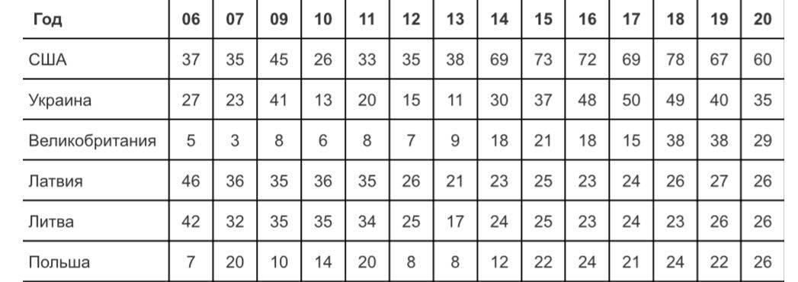
Perception of Russian foreign policy by the Russians
According to the Levada center, 59% of respondents are for peaceful and secure international relations, while 49% are for restoring Russian prestige as one of the most influential states (Levada, 2017). 16% of respondents supported Putin’s foreign policy in 2018 (Levada, 2018).
The ‘enemies’ of Russia in % by the respondents (Levada, 2020).

Slide 18
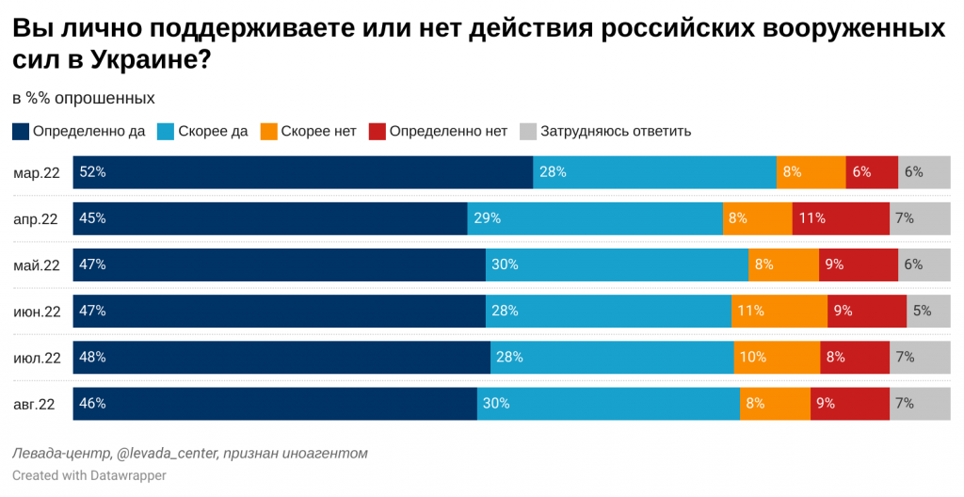
Perception of Russian foreign policy by the Russians
Levada center (August 2022): “Do you personally support or do not Russian special forces operation in Ukraine?“ (“definetely yes‘“ – from 52 to 46% in 2022).

Slide 19
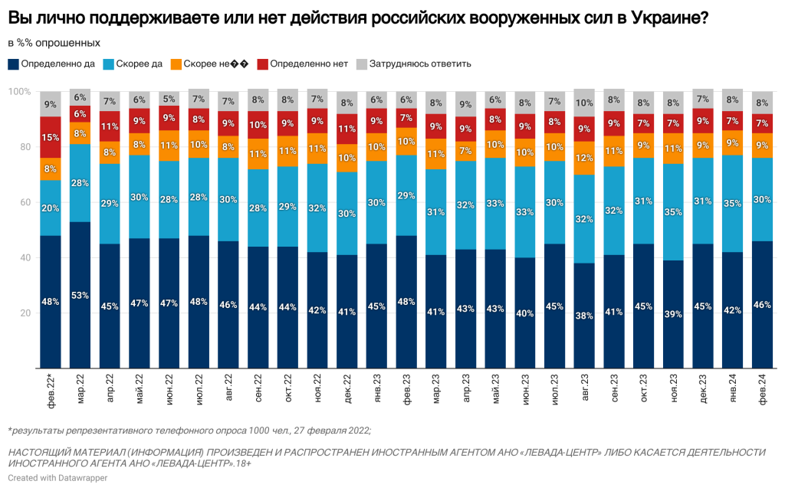
Perception of Russian foreign policy by the Russians
Levada center (March 2024): “Do you personally support or do not Russian special forces operation in Ukraine?“ (“definetely yes‘“ – from 53 to 38% in 2022-2024).
Source: www.levada.ru/2024/03/05/konflikt-s-ukrainoj-massovye-otsenki-fevralya-2024-goda/.

Slide 20
Conclusions
The main goal of the Russian foreign policy is to restore the status of Russia as a great power in the global arena. This is supported by the citizens.
Since 2014 Russian foreign policy turned to “east” because of the Western sanctions in response to the Crimea annexation, etc. Moscow occupied a unique position in the region after successful Syrian operation in the Middle East.
Russia does not have enough economic conditions to dominate its opponents but keep them off balance by applying any kind of pressure (establishing «grey zones», for instance).

Slide 21
Bibliography
Gromyko, A. (2018) The Fourth of The Century of Russian Foreign Policy. http://sov-europe.ru/images/pdf/2018/3-2018/Gromyko-3-2018.pdf (In Russian)
Trenin, D. (2020). 20 Years of Vladimir Putin: How Russian Foreign Policy Has Changed. https://carnegie.ru/2019/08/28/20-years-of-vladimir-putin-how-russian-foreign-policy-has-changed-pub-79742
Trenin, D. (2016) A Five-Year Outlook for Russian Foreign Policy: Demands, Drivers, and Influences. https://carnegie.ru/2016/03/18/five-year-outlook-for-russian-foreign-policy-demands-drivers-and-influences-pub-63075
Trenin, D. (2009) Russia in the CIS: Field of Interest, not a Sphere of Influence. https://carnegieendowment.org/files/ProEtContra_5-6_82-97.pdf
Hawn, J. (2021) Russia’s Extraterritorial Military Deployments. https://newlinesinstitute.org/russia/russias-extraterritorial-military-deployments/?fbclid=IwAR057KpG9CYg7yR0tRZM8etoEVICPffn-f4CYALb3vy699nNjqbIGgjIXfI
Pugsley, S. & Wesslau, F. (2016) Russia in the Grey Zones. https://ecfr.eu/special/russia_in_the_grey_zones/

