Slide 1
Toni Morrison a epistemologie rasy
Sociologie literatury
FSS MUNI
Františka Schormová
25.4.2024

Slide 2
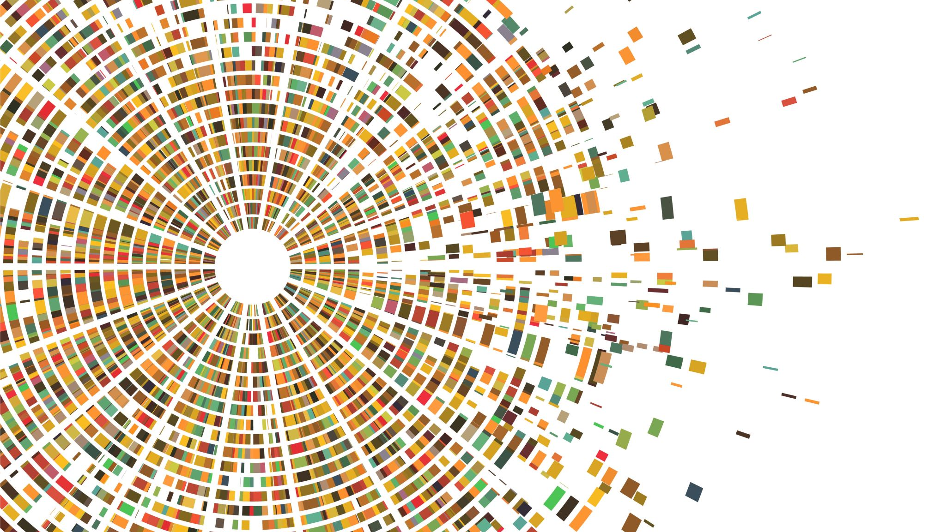
úvodní kolečko

Slide 3
Jak je rasa konstruována v textu?
Jak se bavit o těchto tématech z české perspektivy? Překlad a pozicionalita.

Slide 4
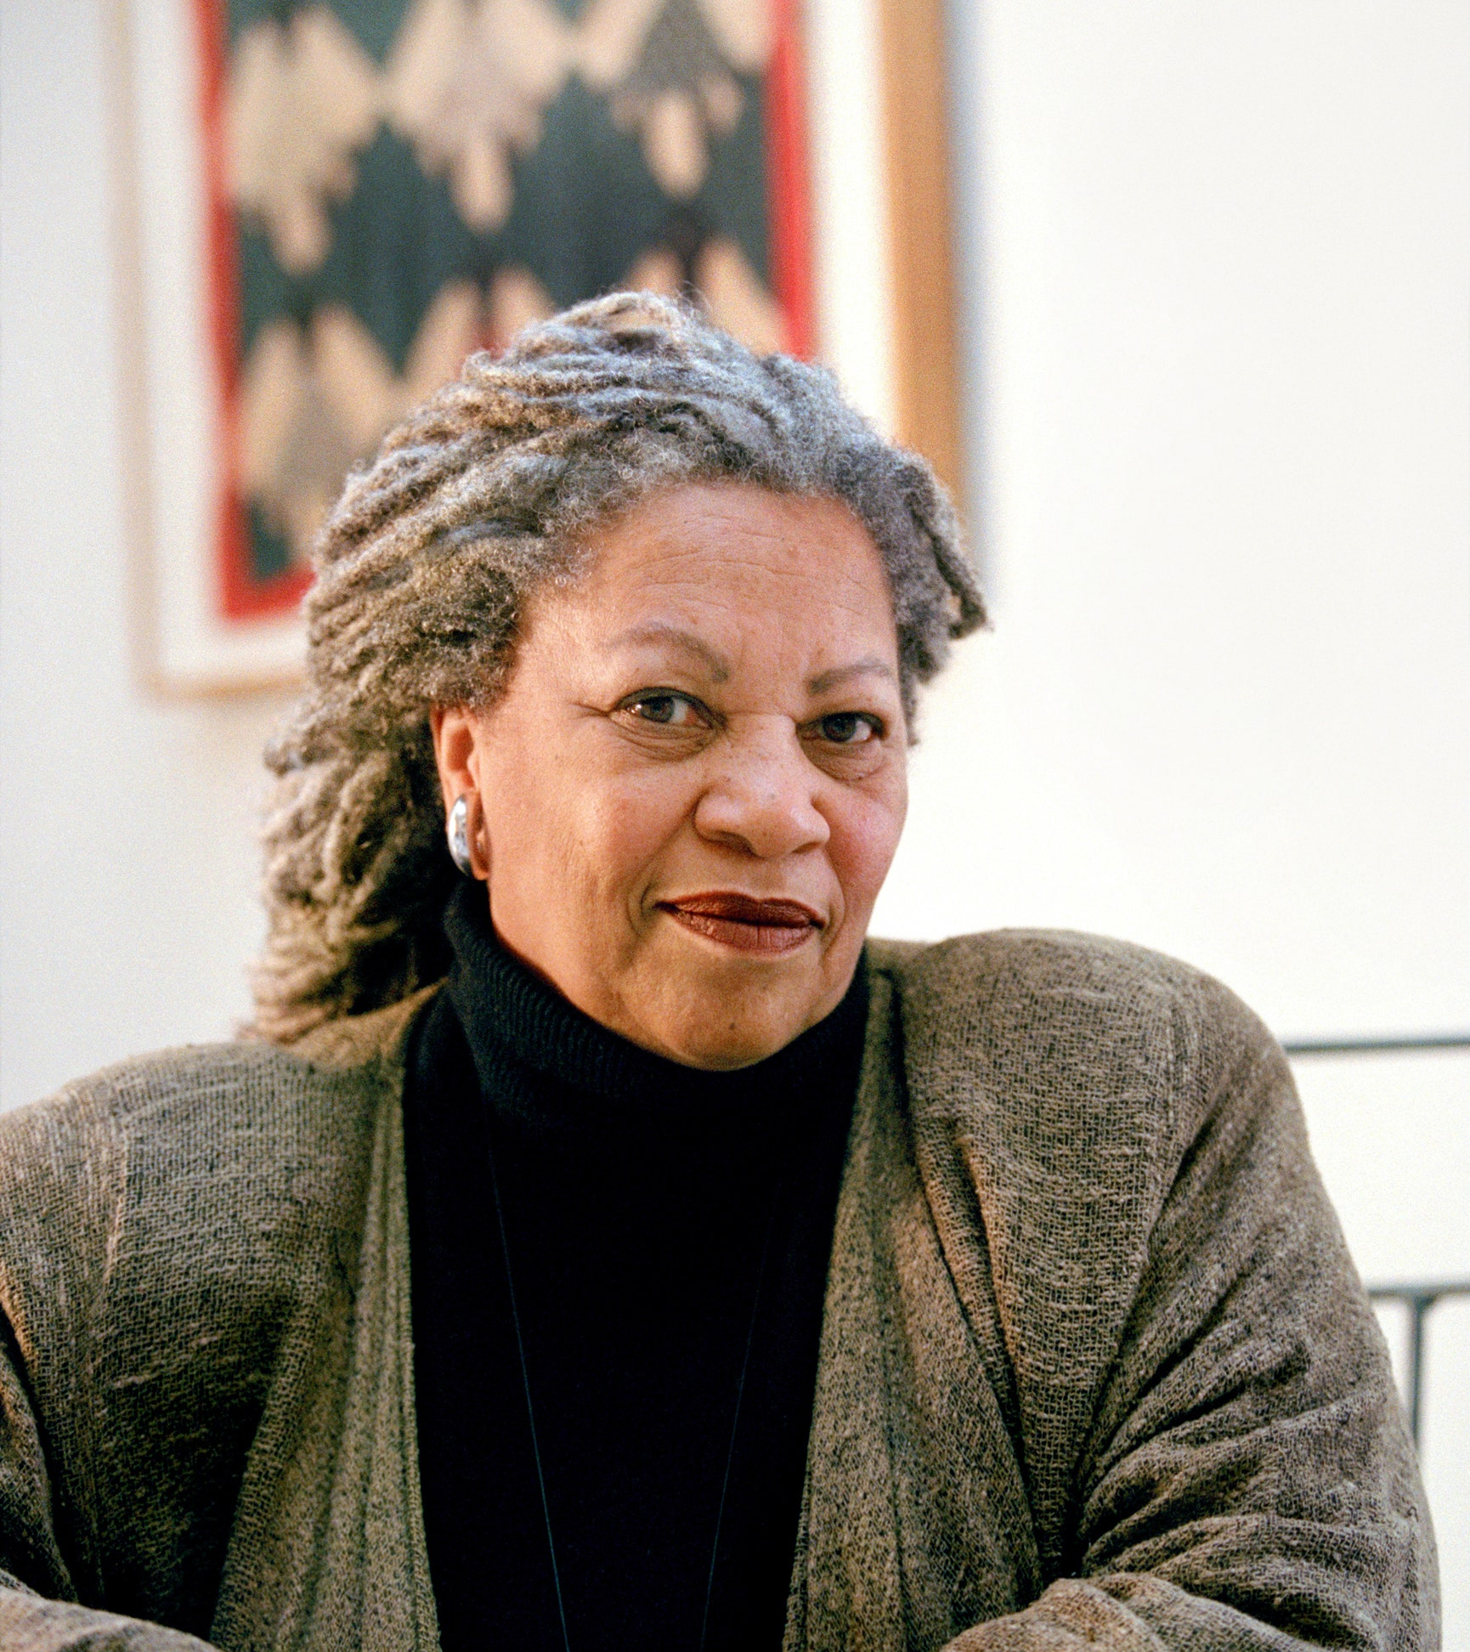
Toni Morrison 1931-2019
tematika rasismu v USA a zkušenosti Afroameričanů, včetně historické zkušenosti a mezigeneračního traumatu a paměti
držitelka cen včetně Pulitzerovy ceny za Beloved (1987) a Nobelovy ceny za literaturu (1993)
další romány: The Bluest Eye (1970), Sula (1974), Song of Solomon (1977), Tar Baby (1981), Jazz (1992), Paradise (1998), Love (2003), Mercy (2008)
Literární vlivy: Tostoj, Austen, Wright, „slave narratives“: Douglas, Jacobs

Slide 5
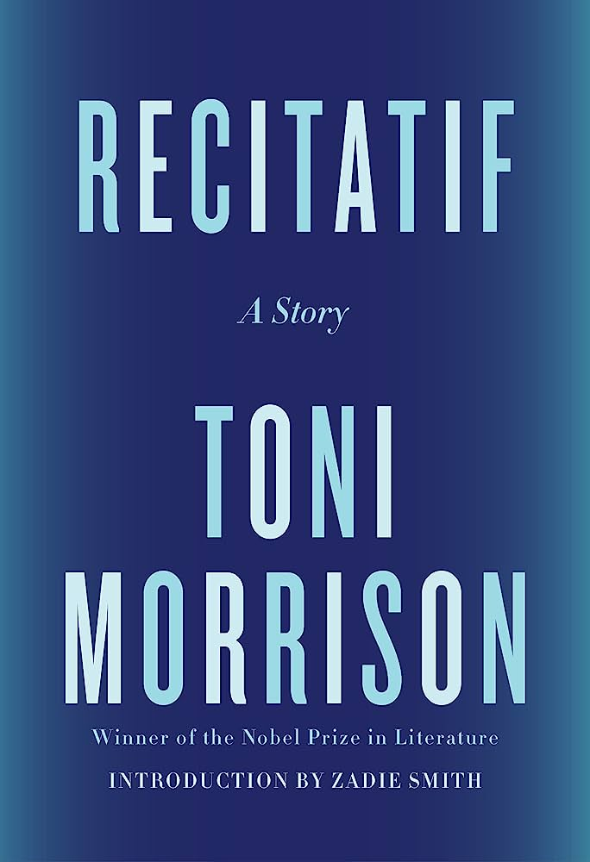
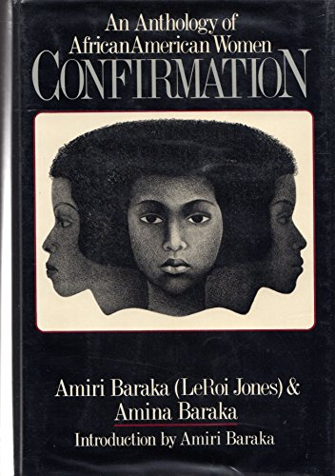
Recitatif
jediná povídka Toni Morrison
původně publikovaná v roce 1983
znovu vydaná roku 2022, úvod napsala britská autorka Zadie Smith

Slide 6
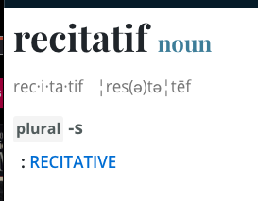
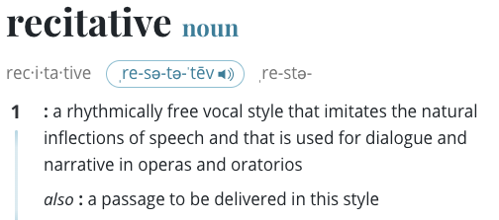
Název
Recitatif

Slide 7
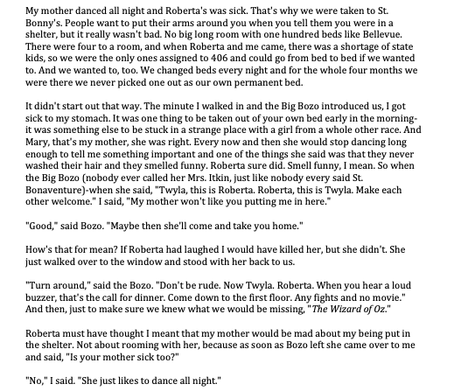
Recitatif
Jak? (vypravěč, stavba narativu)
Kde?
Kdy?
Co? (děj)
Kdo? (postavy)

Slide 8
Kdo?
Reflexe procesu čtení ve skupinách

Slide 9
Experiment na UHK
Religion
Names
Hair
Social status
Health
Education
Politics
Money
Culture
Food
Family
Pride
Geography
Music
Physical description
Free time
4 skupiny: 15, 8, 14, 10
2021, 2022
Seřazeno od nejčastějšího
po nejméně častý

Slide 10
Purple: this is about an African American person
Blue: this is about a white American person
Green: both opinions were expressed
My mother danced all night and Roberta's was sick. That's why we were taken to St. Bonny's. People want to put their arms around you when you tell them you were in a shelter, but it really wasn't bad. No big long room with one hundred beds like Bellevue. There were four to a room, and when Roberta and me came, there was a shortage of state kids, so we were the only ones assigned to 406 and could go from bed to bed if we wanted to. And we wanted to, too. We changed beds every night and for the whole four months we were there we never picked one out as our own permanent bed.
It didn't start out that way. The minute I walked in and the Big Bozo introduced us, I got sick to my stomach. It was one thing to be taken out of your own bed early in the morning-it was something else to be stuck in a strange place with a girl from a whole other race.
The food was good, though. At least I thought so. Roberta hated it and left whole pieces of things on her plate: Spam, Salisbury steak-even jello with fruit cocktail in it, and she didn't care if I ate what she wouldn't. Mary's idea of supper was popcorn and a can of Yoo-Hoo. Hot mashed potatoes and two weenies was like Thanksgiving for me.
I felt a tap on my shoulder, turned, and saw Roberta smiling. I smiled back, but not too much lest somebody think this visit was the biggest thing that ever happened in my life. Then Roberta said, "Mother, I want you to meet my roommate, Twyla. And that's Twyla's mother."
I looked up it seemed for miles. She was big. Bigger than any man and on her chest was the biggest cross I'd ever seen. I swear it was six inches long each way. And in the crook of her arm was the biggest Bible ever made.
1. Markers often ascribed to both identities
2. Whiteness perceived as epistemologically hegemonic and normative
3. Assumptions based also on what we had covered so far in the course
1. We tend to ascribe identities as we read
2. “Recitatif” is not about racial difference but about how we perceive this difference in the text
3. These markers are unstable, socially constructed, sometimes arbitrary
“Removal of all racial codes from a narrative about two characters of different races for whom racial identity is crucial.“
Toni Morrison, Playing in the Dark: Whiteness and the Literary Imagination (Harvard UP, 1992), 17
Morrison dekonstruuje epistemologii bělošství: whiteness také rasová identita postihnutelná textovými prostředky
V povídce „Recitatif“ vzdoruje dekódování typickému pro studium literatury („I am so glad it wasn‘t my fault I could not figure it out.“)
Ve své studii čte kanonické americké autory a dívá se na to, jak zpracovávání blackness (černošství?) a na vznik amerického literárního kánonu v opozici k tomuto konceptu

Slide 11
Critical Race Theory
sociální koncepce a konstrukce rasy a etnicity
soustředí se na systémy (např. právo) spíše než individuální předsudky, rasismus jako systémový fenomén
intersekcionální
vidí rasu jako sociální konstrukt a dívá se na dějiny tohoto konstruování i právní a sociální implikace tohoto konstruktu
vznikla při hledání odpovědi na otázku, proč hnutí za občanská práva neznamenala konec rasové oprese v USA
zakládá se mj. na myšlenkách afroamerických intelektuálů a intelektuálek (Douglas, Du Bois, Truth, Crenshaw), feministickém hnutí a dalších hnutích
současné kontroverze v USA
and Distant Reading,” PMLA 135, no. 1 (January 2020): 59–73.

Slide 12
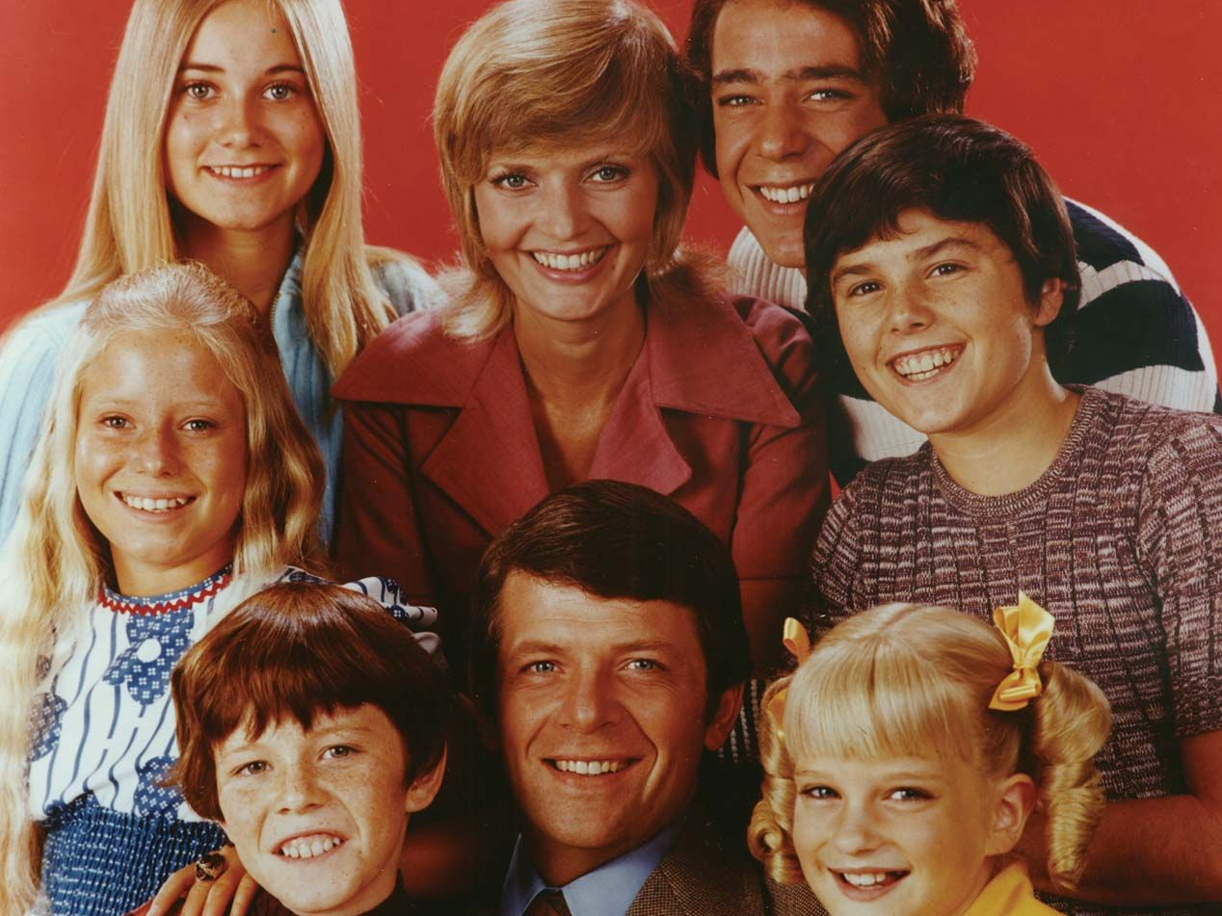
Recitatif
1. Sirotčinec
2. Restaurace – Howard Johnson’s – skandál, segregace (Komla Agbelt Gbedemah) v roce 1957, protesty až do začátku šedesátých let, později LGBTQ+ práva
3. Supermarket – Newburg, New York, historie rasových nepokojů
4. Protest – souvislosti s Brown vs Board of Education (1954), TV seriály
5. Kavárna

Slide 13
SKUPINOVÁ PRÁCE

Slide 14
What the hell happened to Maggie?
„It was the day before Maggie fell down“
„Maggie didn‘t fall. They knocked her down. Those girls pushed her down and tore her clothes“
„I wouldn‘t forget a thing like that. Would I?“
„You are the same little state kid who kicked a poor old black lady when she was down on the ground. You kicked a black lady.“
Twyla i Roberta – jasně dané identity, Maggie ambivalentní, postava která doslova nemůže mluvit sama za sebe a čtenářstvo se nikdy nedozví, co se s ní stalo.

Slide 15
Intersekcionalita
Jak se v textu projevují a jaký vztah mají různé typy znevýhodnění a identit?

Slide 16
Jak je rasa konstruována v textu?
– propletený systém referencí, který pracuje s naším dosavadním poznáním
– omezené množství příznakových lingvistických prostředků
Více k tématu: Richard Jean So and Edwin Roland, “Race and Distant Reading,” PMLA 135, no. 1 (January 2020): 59–73.
Jak se bavit o těchto tématech z české perspektivy?
– unikátní pozicionalita
– nemožnost jednoduchého překladu konceptů

Slide 17
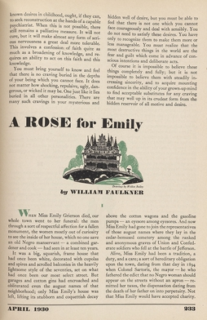
“It is increasingly the case that students in my Southern literature classes at Emory don’t always know who is ‘black’ and who is ‘white’ in William Faulkner’s work.“
Barbara Ladd, “Reading William Faulkner after the Civil Rights Era,” in William Faulkner in Context, ed. John T. Matthews (New York: Cambridge University Press, 2015), 207–15.

Slide 18
It is increasingly the case that students in my Southern literature classes at Emory don’t always know who is “black” and who is “white” in William Faulkner’s work. I recall, in particular, a conversation about “A Rose for Emily”, in which it became clear to me that the student – an African American student – thought the story was about an upper-class, town-bred, somewhat repressed African American woman. […]
He could have encountered this depiction of upper-class African American women from any number of African American texts and, as a student in a major Southern university in the early 21st century, he was quite familiar with African American literature as a category, certainly more familiar with African American literature than with “Southern” writing or William Faulkner. Anyway he was surprised to learn that most people have read Emily Grierson as “white.” […]
The fact is that black and white are not so easily distinguished in Faulkner’s work for many young readers, who do not necessarily operate on the assumption that a character whose race is unmentioned is “white. Given the increasingly multiracial, multiethnic population of our communities, why should they? Rather than to assume that these readers need only to be corrected and perhaps dosed with some history, we might, instead, want to accept the idea, at least provisionally, in order to see where it takes us, because the mistake (if that is what it is) does raise important questions about the future as well as the past of race in and beyond the United States and how we read Faulkner. […]
And in the twenty-first century classroom, the conjunction of a reading of “A Rose for Emily” in which an unmarked character, typically read as white, is read as African American alongside a deployment of identity politics around the political solidarity of “blackness” illuminates the complex contemporary world in which I and my student live.
Barbara Ladd, “Reading William Faulkner after the Civil Rights Era,” in William Faulkner in Context, ed. John T. Matthews (Cambridge University Press, 2015), 207–15.

Slide 19
Od epistemologie rasy ke způsobům vidění

Slide 20
You and your partner go to see the film The House We Live In. You ask your friend to pick up your child from school. On your way home your phone rings. Your neighbor tells you he is standing at his window watching a menacing black guy casing both your homes. The guy is walking back and forth talking to himself and seems disturbed.
You tell your neighbor that your friend, whom he has met, is babysitting. He says, no, it’s not him. He’s met your friend and this isn’t that nice young man. Anyway, he wants you to know, he’s called the police.
Your partner calls your friend and asks him if there’s a guy walking back and forth in front of your home. Your friend says that if anyone were outside he would see him because he is standing outside. You hear the sirens through the speakerphone.
Your friend is speaking to your neighbor when you arrive home. The four police cars are gone. Your neighbor has apologized to your friend and is now apologizing to you. Feeling somewhat responsible for the actions of your neighbor, you clumsily tell your friend that the next time he wants to talk on the phone he should just go in the backyard. He looks at you a long minute before saying he can speak on the phone wherever he wants. Yes, of course, you say. Yes, of course.
Claudia Rankine, “You and Your Partner,” Citizen: An American Lyric (Greywolf Press, 2015), 21.

Slide 21
Citizen in general, and this reflective, narrative page in particular, keep on panning out, breaking the frame, showing how around each domain, each picture, each idea of “you” and “I” there are larger, unacknowledged assumptions and systems in play, and not only about race.
It may be that poetry, or poetic language, wants to give us the right to speak “wherever,” to make us heard as if from everywhere and nowhere, as if superior to our mortal, frail, and socially classified bodies. But poetic language does not always get what it seems to want, does not always work as a poet intends. And even if we could write or read poetry that way (and it is by no means clear that we can), we cannot speak as if from nowhere, live as if disembodied, from day to day, as we pick up our kids, mow our lawns, or talk on our phones.
If your listeners cannot stop seeing you as a “menacing black man,” then everything you say will be connected, willy-nilly, to your blackness, or your manhood, or your potential menace, or the surprising absence of any of those things; nothing you say will not be racially marked. And if that is true for black speakers, for black bodies, why should it not be true for white speakers as well? If you have not seen a picture of me or heard my voice, how do you think I look? Do you think I am white, black, Taiwanese American, or all three? Male or female or both? What if you learned you were wrong?
Stephanie Burt, This Poem is You: 60 Contemporary American Poems and How to Read Them (Harvard UP, 2016), 353.

