Slide 1

2023-2024 Spring Term
Green transition from international and European perspective
Decarbonisation & Business
Lecture 3 │12 April 2024

Slide 2
Reporting climate-related information: TCFD

Slide 3
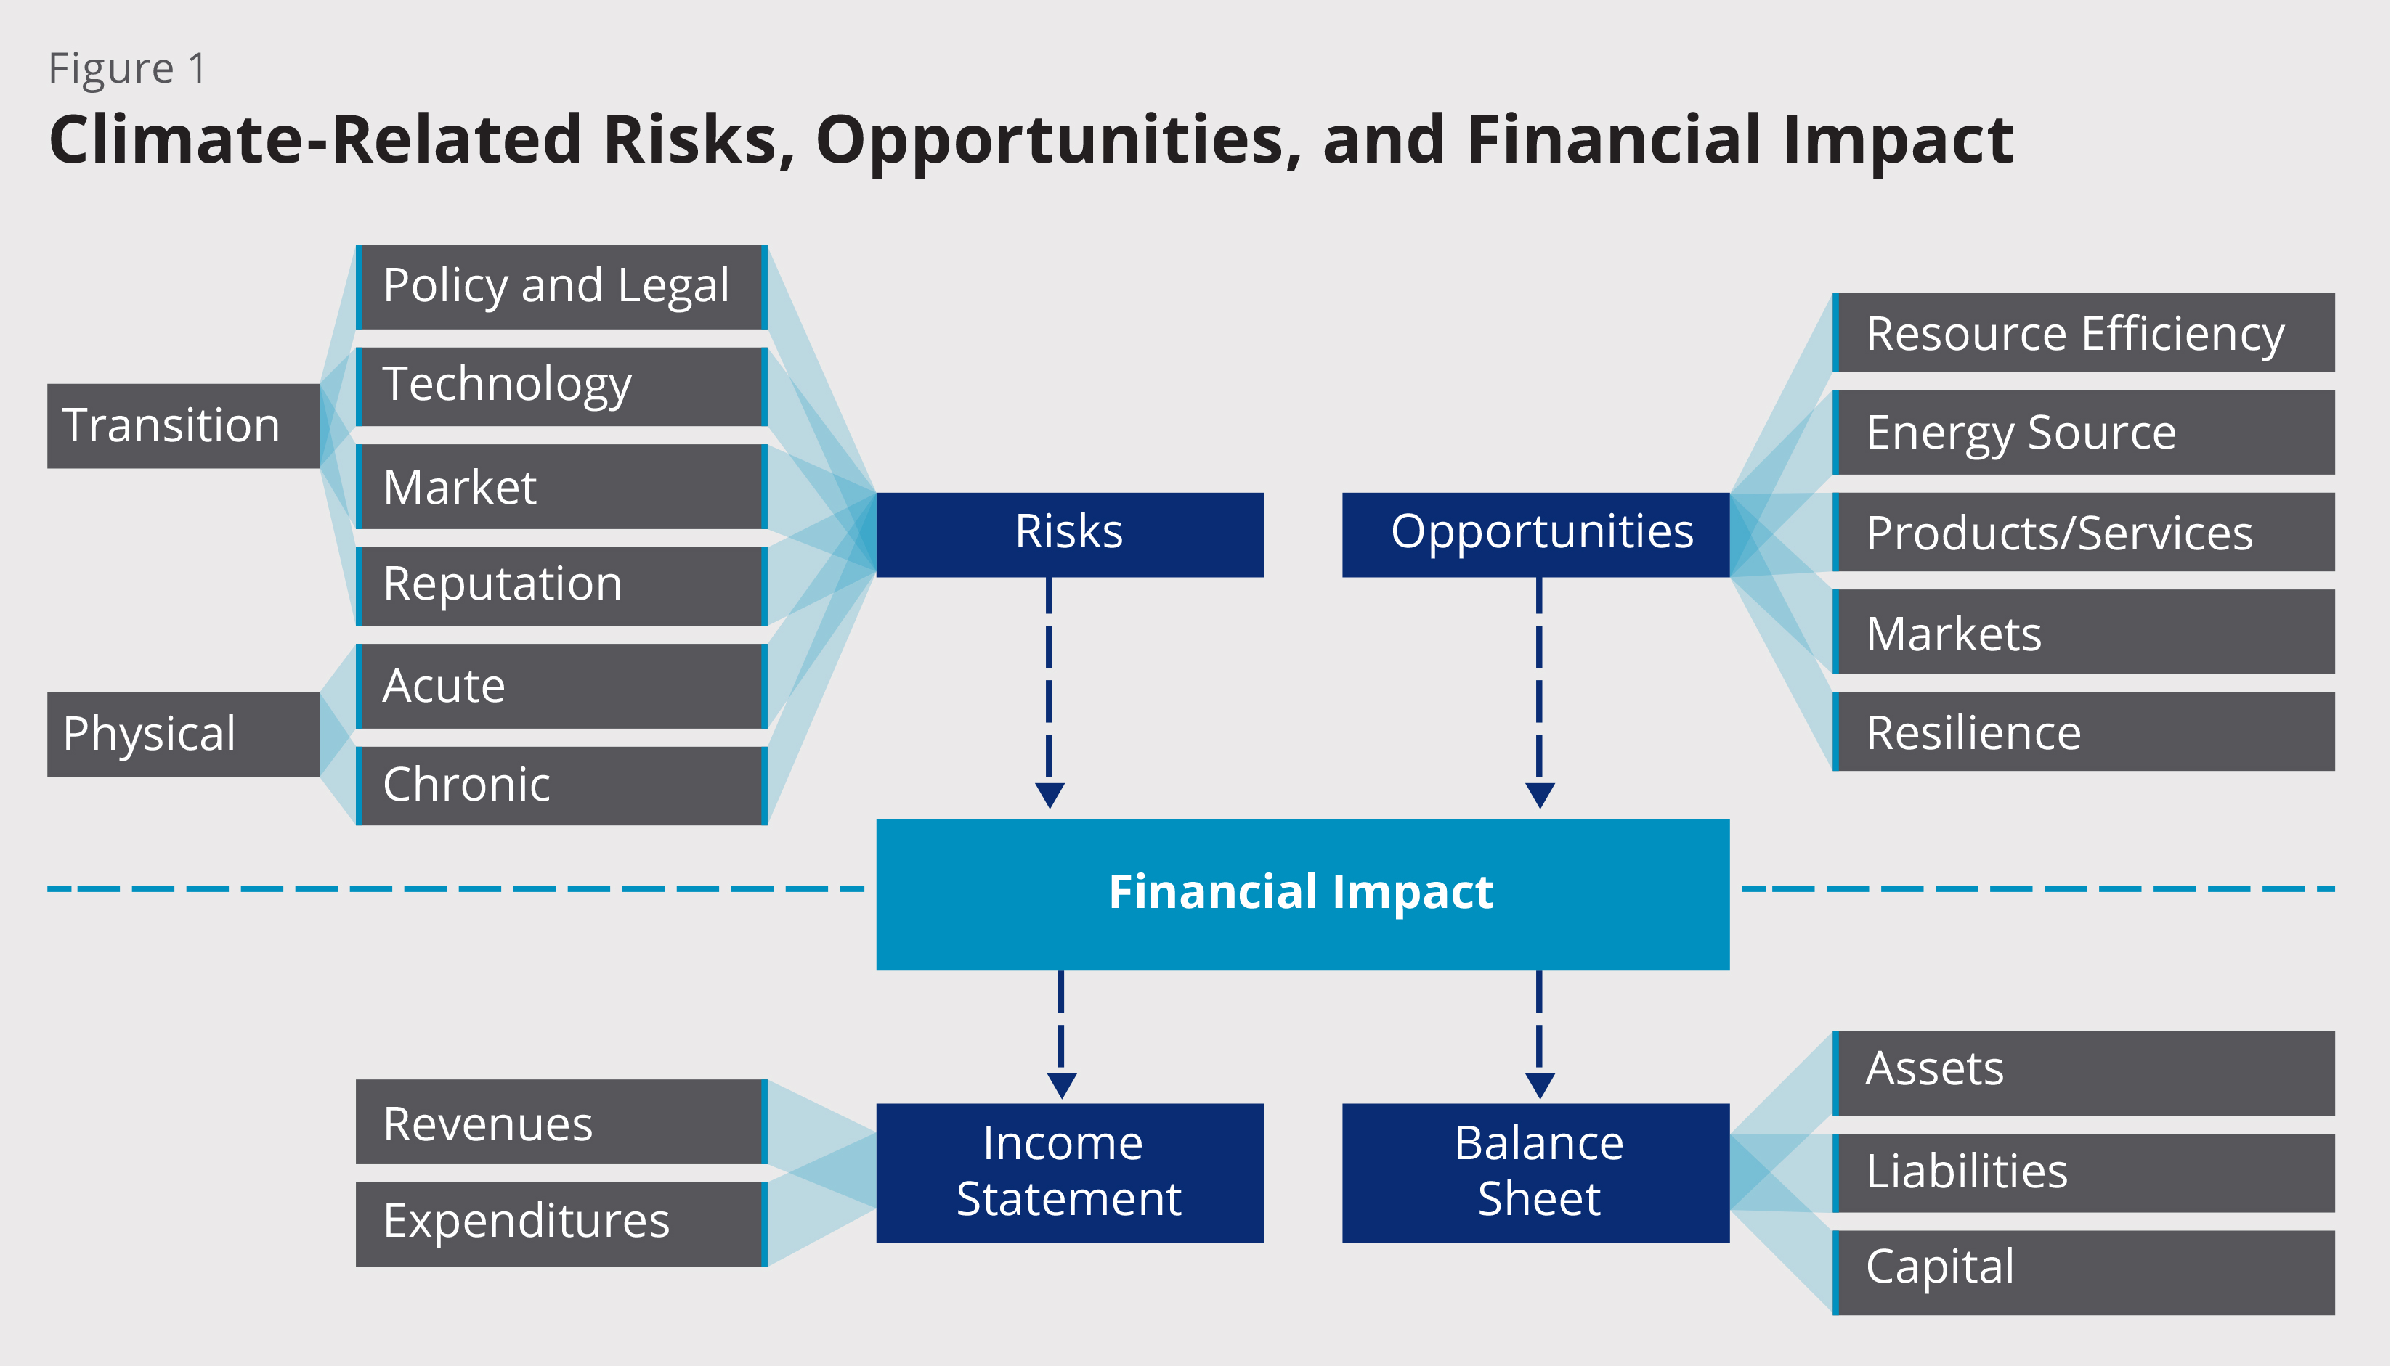
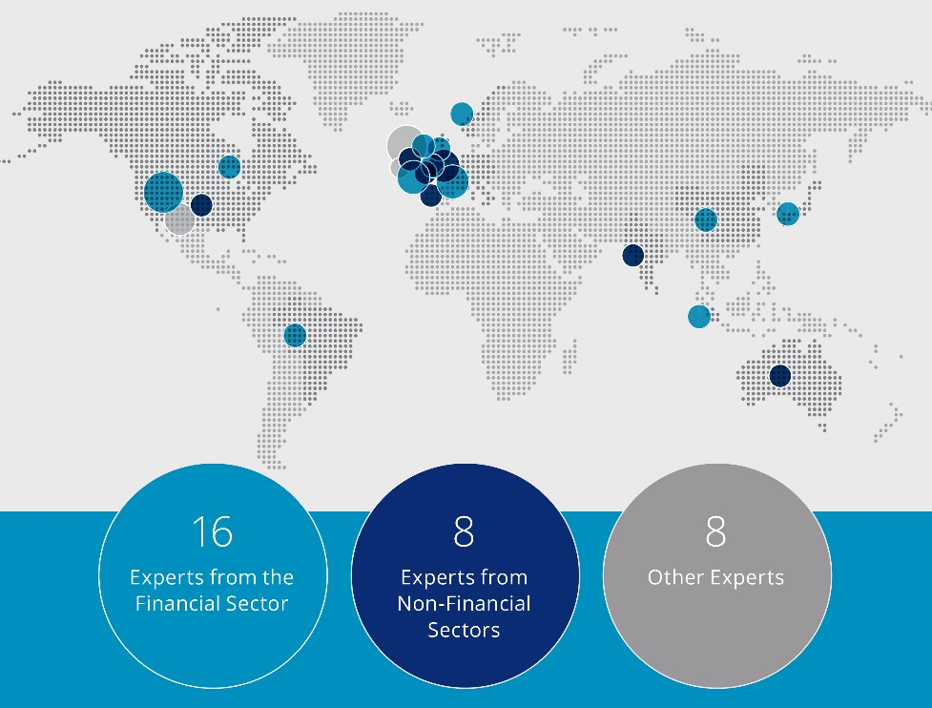
Introduction to TCFD recommendations
G20 Finance Ministers and Central Bank Governors asked the Financial Stability Board (FSB) to review how the financial sector can take into account of climate-related issues. The FSB established the Task Force on Climate-related Financial Disclosures (TCFD) to develop recommendations that:
could “promote more informed investment, credit, and insurance underwriting decisions”, and
in turn, “would enable stakeholders to understand better the concentrations of carbon-related assets in the financial sector and the financial system’s exposures to climate-related risks.”
The Task Force published recommendations (2017) to help address climate-related disclosure challenges faced by:
Issuers who generally have an obligation under existing law to disclose material info, but lack a coherent framework to do so for climate info,
Investors, lenders, and insurers who need decision-useful, climate-related info to make informed capital allocation and financial decisions
Industry Led and Geographically Diverse Task Force
  The Task Force’s 31 international members, led by Michael Bloomberg, include providers of capital, insurers, large non-financial companies, accounting and consulting firms, and credit rating agencies.
15
Notes:
A key objective of the Task Force’s work, as outlined by the FSB, is to develop more effective climate-related disclosures that
could “promote more informed investment, credit, and insurance underwriting decisions” and,
in turn, “would enable stakeholders to understand better the concentrations of carbon-related assets in the financial sector and the financial system’s exposures to climate-related risks.”
Our report sets out specific recommendations for voluntary disclosure to improve consistency, accessibility, clarity, and usefulness of climate-related financial reporting.
The Task Force brings a unique perspective to this work through its consensus-based and industry-led focus. The FSB chose extremely well in appointing Task Force members.
Michael Bloomberg, the founder of Bloomberg LP and former mayor of New York City, serves as chairman.
It is composed of 32 members, including four international vice-chairs, who are users and preparers of financial disclosures across a range of financial and non-financial sectors and industries. They are highly engaged and expert.

Slide 4
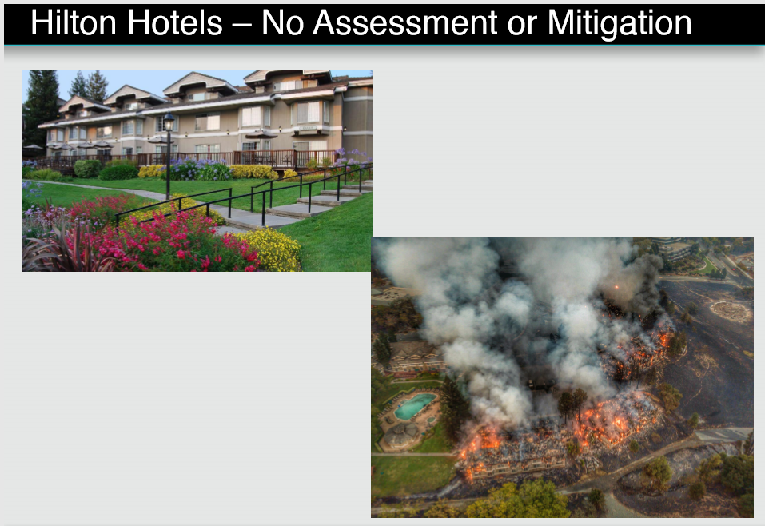
Focus on financial impact
RISKS
Transition | Policy and Legal Carbon pricing and reporting obligations Mandates on and regulation of existing products and services Exposure to litigation Technology Substitution of existing products and services with lower emissions options Unsuccessful investment in new technologies Market Changing customer behavior Uncertainty in market signals Increased cost of raw materials Reputation Shift in consumer preferences Increased stakeholder concern/negative feedback Stigmatization of sector
Physical | Acute: Extreme weather events Chronic: Changing weather patterns and rising mean temperature and sea levels
OPPORTUNITIES
Resource Efficiency | Use of more efficient modes of transport and production and distribution processes Use of recycling Move to more efficient buildings Reduced water usage and consumption
Energy Source | Use of lower-emission sources of energy Use of supportive policy incentives Use of new technologies Participation in carbon market
Products & Services | Development and/or expansion of low emission goods and services Development of climate adaptation and insurance risk solutions Development of new products or services through R&D and innovation
Markets | Access to new markets Use of public-sector incentives Access to new assets and locations needing insurance coverage
Resilience | Participation in renewable energy programs and adoption of energy-efficiency measures Resource substitutes/diversification
Strategic Planning
Risk Management
Financial Impact
Revenues
Income
Cash Flow
Balance
Assets
&
Liabilities
Expenditures
Statement
Statement
Sheet
Capital
& Financing

Slide 5
Disclosure Recommendations
The Task Force developed four widely-adoptable recommendations on climate-related financial disclosures that are applicable to organizations across sectors and jurisdictions.
The recommendations are structured around four thematic areas that represent core elements of how organizations operate:
Governance
The organization’s governance around climate-related risks and opportunities
Governance
Strategy
The actual and potential impacts of climate-related risks and opportunities on the organization’s businesses, strategy, and financial planning
Strategy
Risk
Management
Risk Management
The processes used by the organization to identify, assess, and manage climate-related risks
Metrics
and
Targets
Metrics and Targets
The metrics and targets used to assess and manage relevant climate-related risks and opportunities
Notes:
Using the common language of governance, strategy, risk management, and metrics and targets, the Task Force developed four widely-adoptable recommendations on climate-related financial disclosures that are applicable to organizations across sectors, around the world.
These are foundational recommendations that will permit the users of disclosure—investors, lenders, underwriters, and others—to understand how a company identifies its climate risk, manages it, incorporates it into its strategy and risk oversight process, and mitigates it.

Slide 6
Disclosure recommendations
The four recommendations are supported by specific disclosures organizations should include in financial filings or other reports to provide decision-useful information to investors and others.
Governance |  |  | Strategy |  |  | Risk Management |  |  | Metrics and Targets
Disclose the organization’s governance around climate-related risks and opportunities. |  |  | Disclose the actual and potential impacts of climate-related risks and opportunities on the organization’s businesses, strategy, and financial planning where such information is material. |  |  | Disclose how the organization identifies, assesses, and manages climate-related risks. |  |  | Disclose the metrics and targets used to assess and manage relevant climate-related risks and opportunities where such information is material.
Recommended Disclosures |  |  | Recommended Disclosures |  |  | Recommended Disclosures |  |  | Recommended Disclosures
a) | Describe the board’s oversight of climate-related risks and opportunities. |  | a) | Describe the climate-related risks and opportunities the organization has identified over the short, medium, and long term. |  | a) | Describe the organization’s processes for identifying and assessing climate-related risks. |  | a) | Disclose the metrics used by the organization to assess climate-related risks and opportunities in line with its strategy and risk management process.
b) | Describe management’s role in assessing and managing climate-related risks and opportunities. |  | b) | Describe the impact of climate-related risks and opportunities on the organization’s businesses, strategy, and financial planning. |  | b) | Describe the organization’s processes for managing climate-related risks. |  | b) | Disclose Scope 1, Scope 2, and, if appropriate, Scope 3 greenhouse gas (GHG) emissions, and the related risks.
 |  |  | c) | Describe the resilience of the organization’s strategy, taking into consideration different climate-related scenarios, including a 2°C or lower scenario. |  | c) | Describe how processes for identifying, assessing, and managing climate-related risks are integrated into the organization’s overall risk management. |  | c) | Describe the targets used by the organization to manage climate-related risks and opportunities and performance against targets.
Notes:
Each of the four overarching recommendations is supported by two to three specific disclosures that organizations can include in financial filings to provide decision-useful information about their climate-related risks and opportunities.
The recommendations solicit information that is primarily forward-looking, which reflects the Task Force’s desire to raise the bar on climate-related financial disclosures where appropriate and further develop the currently limited disclosure of financial risks posed by climate-related impacts.
The Task Force is hopeful that widespread adoption will help organizations better demonstrate responsibility and foresight in their consideration of climate issues to their investors and others.

Slide 7
Key elements of disclosure recommendations
Principle of Materiality
Materiality is a substantial likelihood that a reasonable investor would consider it important. The trigger areas could be legislation/regulation, international agreements, indirect consequences of regulations and businesses, and physical impacts.
The disclosures related to the Strategy and Metrics & Targets are subject to an assessment of materiality.
The disclosures related to the Governance and Risk Management are not subject to an assessment of materiality and should be provided because many investors want insight into the governance and risk management context in which organizations’ financial and operating results are achieved.
2°C Scenario
Provides a common reference point that is generally aligned with the objectives of the Paris Agreement.
Scenario Analysis Threshold
The Task Force established a threshold for organizations that should consider conducting more robust scenario analysis to assess the resilience of their strategies (those in the four non-financial groups with more than 1 billion USDeq in annual revenue).
Scenario Analysis
The Task Force encourages forward-looking information through scenario analysis—a useful tool for considering and enhancing resiliency and flexibility of strategic plans.
Many investors want to understand how resilient organizations’ strategies are to climate-related risks.
Recommended disclosure (c) under Strategy and the related guidance asks organizations to describe the resilience of their strategies, taking into consideration different climate-related scenarios, including a 2°C or lower scenario.

Slide 8
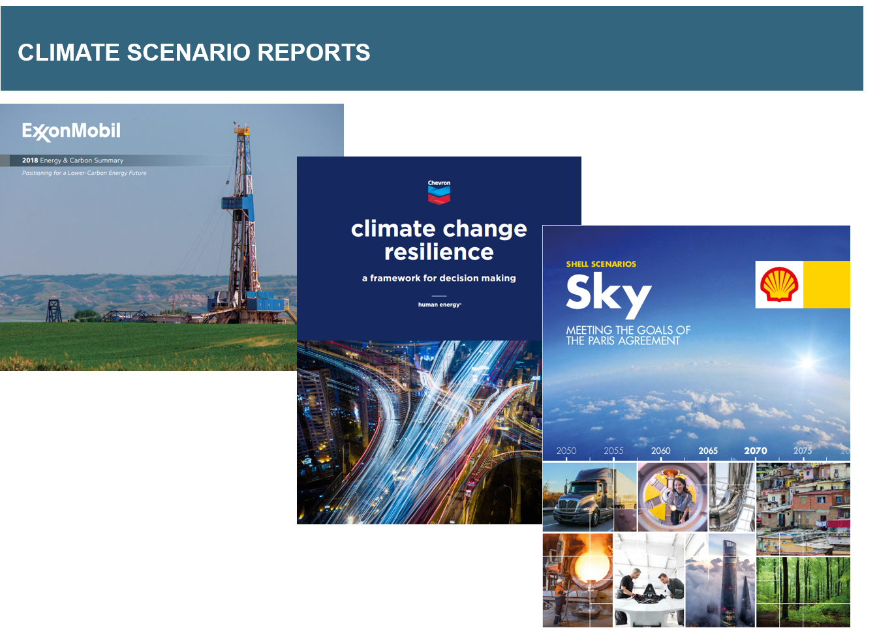
How did they balance voluntary reporting vs materiality considerations, given investor expectations?
At what point do the results of a scenario analysis become material?
How can a company talk about opportunities?
What about physical risks?

Slide 9
CASE STUDY 2: TCFD DISCLOSURE FOR METAL MINING COMPANY

Slide 10
GHG emissions from metal mining
Source: MineSpans, McKinsey Energy Insights

Slide 11
Copper and Molybdenum Mining Company
One of the 10 leading molybdenum producers in the world (Southern Caucasus)
EU is the main markets for company’s products, molybdenum and copper
Does not fall under EU CBAM or CSRD (yet!)
Strategic partners: Government (partial owner) and EBRD – financier – requires climate risks assessment and Paris-alignment

Slide 12
IFRS S1 (former TCFD) / EU CSRD requirements
Governance
Strategy
Risk management
Metrics and targets
 | Governance The organisation’s governance around climate-related risks
 | Strategy The actual and potential impacts of climate-related risks and opportunities on the organisation’s businesses, strategy, and financial planning
 | Risk management The processes used by the organisation to identify, assess, and manage climate-related risks
 | Metric and targets The metrics and targets used to assess and manage relevant climate-related risks and opportunities

Slide 13
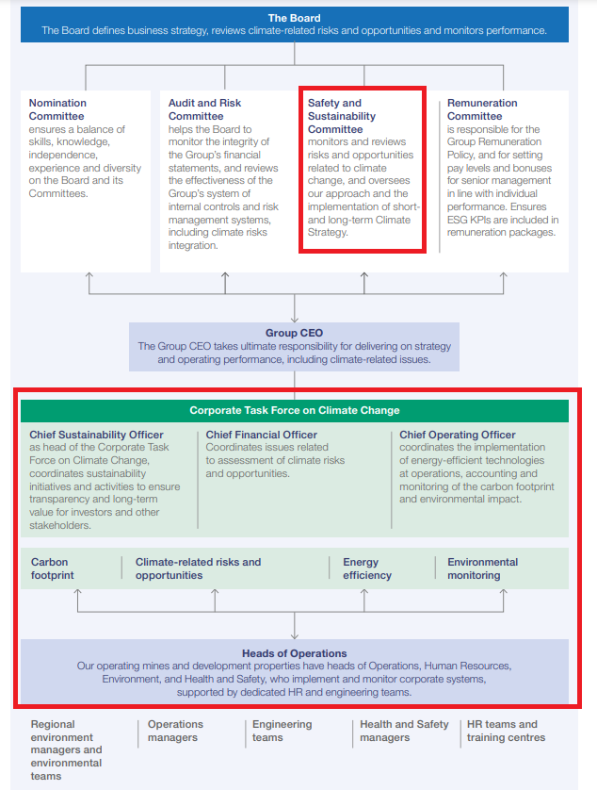
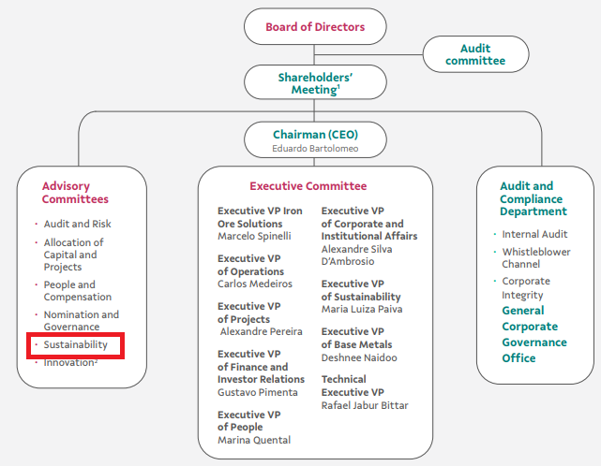
Governance
Example 2: Polymetal
Example 1: VALE S.A.

Slide 14
Assessment of risks and opportunities
TCFD recommends assessing climate-related issues and how they may affect an organisation’s businesses, strategy, and financial planning.
Risks
Opportunities
    Transition risks
      relate to changes in law and policies, technologies, the market, and reputation
    Physical risks
      relate to changes in climate that affect operations
    Opportunities
      climate change incentivizes the use of resources and energy in a more efficient way,
      accessing new markets with old and/or new products, changes in the demand for products, etc.
How the work was performed on assessing risks and opportunities for a mining company
    Benchmarking with risks and opportunities identified by selected peers (BHP Group, VALE S.A., Polymetal, KazMinerals)
    Analysis of studies and publications in the sector of copper and molybdenum mining
    Analysis of national regulatory requirements (existing and foreseen) of Armenia
    Conducting survey
    Conducting interviews

Slide 15
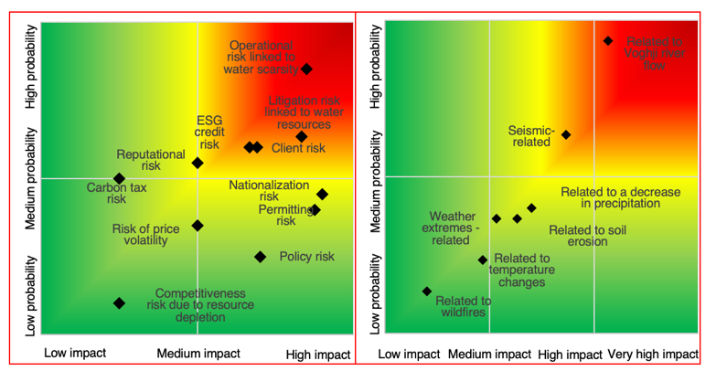
Risks
Transition risks
Operational risks
Our report
      Scored and positioned on the matrix 18 risks
Top 4 risks (top right square)
      Scarcity of water resources
      Litigation related to water
      Client risk: decarbonization strategy of clients increases demand for products with lower carbon footprint
      ESG credit risk
Notes:
Operational risk related to water scarcity - a reduced flow of i river poses a risk to production processes.
Litigation risk related to water - possible conflicts over water usage with local communities and agriculture.
Client risk - a risk of losing clients if not aligned with their decarbonization targets.
ESG risk - financing challenges due to stringent ESG requirements and a low ESG rating score.

Slide 16
Opportunities
Our report
      Scored 7 opportunities
Top 4 opportunities
      Cu and Mo demand expansion
      Synergy with the government to develop renewable energy
      Cost reduction linked to decarbonization activities
      International cooperation i.a. with China
Scoring of opportunities

Slide 17
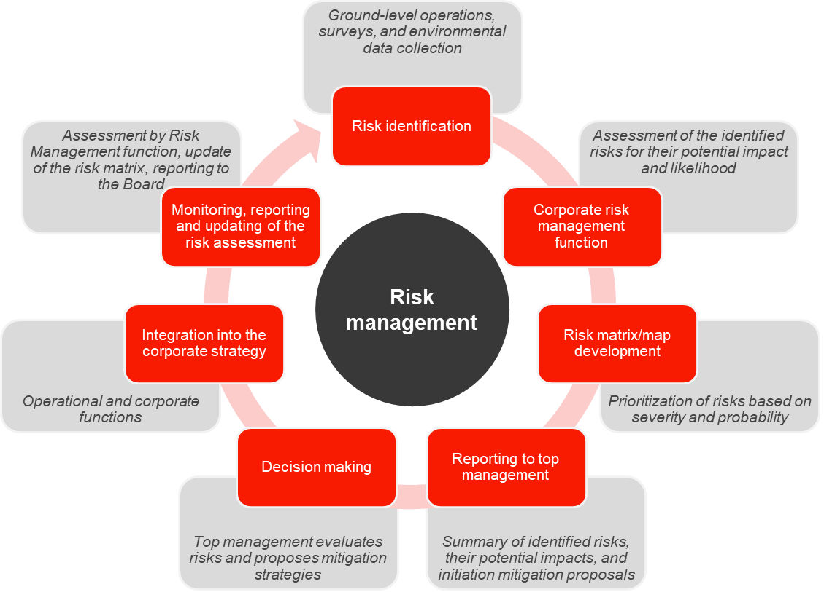
Risk management
TCFD recommends
  describe how processes for identifying, assessing, and managing climate-related risks are integrated into the organization’s overall risk management
TCFD advocates
  for an integrated approach to climate risk management urging businesses to embed climate risks into their broader risk management systems, ensuring long-term sustainability
      We recommend the following structure and process flow for the climate risk management ->

Slide 18
Metrics| Scope 1 and 2
Scope 1: 25% of Scope 1 + 2 emissions
Scope 2: 75% of Scope 1+2 emissions
Emissions associated with industrial transportation contribute the largest share to Scope 1.
Emissions associated with industrial processes (mostly energy workshop) contribute the largest share to category “Stationary fuel combustion”
Process-related emissions contribute the largest share to Scope 2.
Emissions of the processing plant contribute the largest share to category process-related emissions.

Slide 19
Metrics| Scope 3
> 70 % of Scope 1 + 2 +3 emissions
Top 3 categories in terms of emissions:
  energy consumption for processing of sold products,
  transportation of sold products, and
  emissions from the extraction, production and transportation of goods/ services purchased/ acquired by the company

Slide 20
Proposed decarbonisation targets
Scope 1 and 2 target
Additional commitments for the 2030 target, consistent with the SBTi guidelines may include:
Scope 3 target
Between 30% and 35% by 2030, compared to 2022 (corresponds to an emission decrease of 3.8%/yr. to 4.5%/yr.)
Between 8% and 20% by 2030 compared to 2022 (corresponds to an emission decrease of 1.0%/yr. to 2.5%/yr.)
Achieve 30% of EVs in passenger vehicles (Scope 1);
Achieve 30% renewable electricity consumption (Scope 2); and
Ensure 100% of strategic value chain partners have science-based decarb targets (Scope 3).
This level of ambitions is in line with and/ or ahead of the IEA Net Zero Scenario for the global industry, decarb benchmarks for the CU industry in ICA and IFC Scenarios, and the targets of its peers.
It also reflects the hard to abate nature of company’s activities related to production and processing of non-ferrous metals.
This level of ambitions is in line with and/ or ahead of the targets for national economy, decarb benchmarks for the Cu industry in the ICA scenario, and its peers's targets.

Slide 21
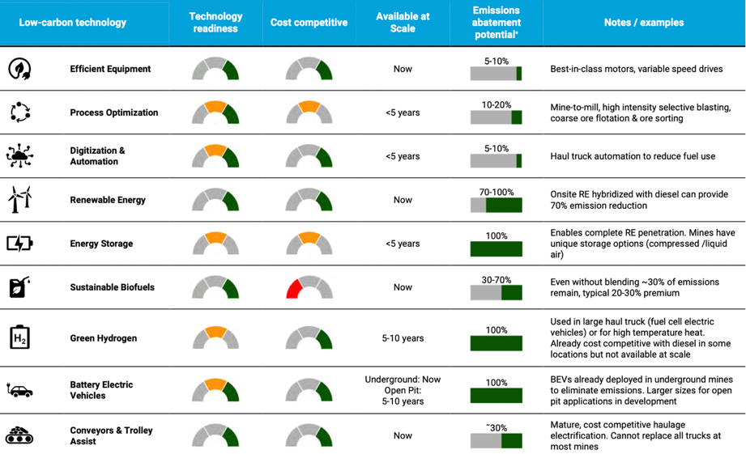
Decarbonisation levers | Scope 1 & 2
Three general decarbonisation levers are proposed (Scope 1 & 2):
energy and material efficiency,
switch to renewables/ intensified electrification,
decarbonisation of transport.
Breakdown of these levers and their technoeconomic assessment follows:
Source: IFC 2023. Net Zero Roadmap for Copper and Nickel

Slide 22
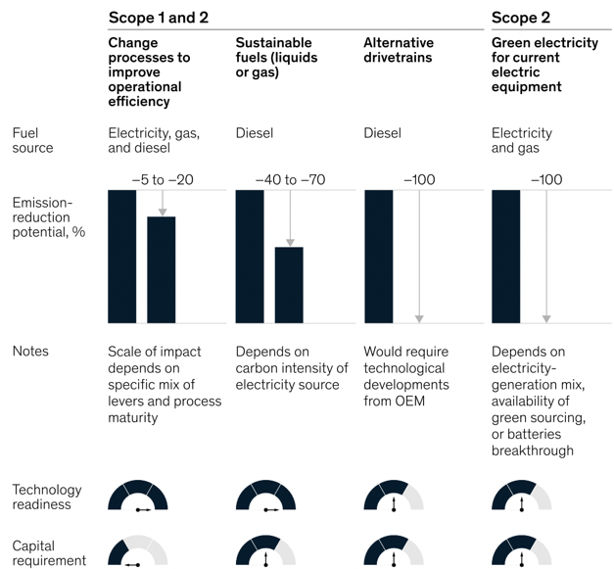
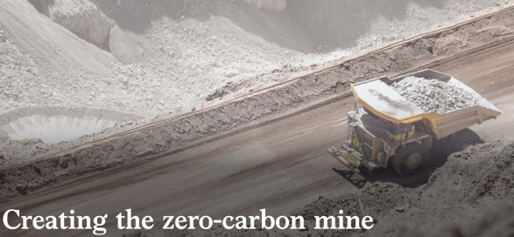
Decarbonisation levers | Scope 1 & 2
Source: McKinsey & Company: 2021, Creating the Zero Carbon Mine

Slide 23
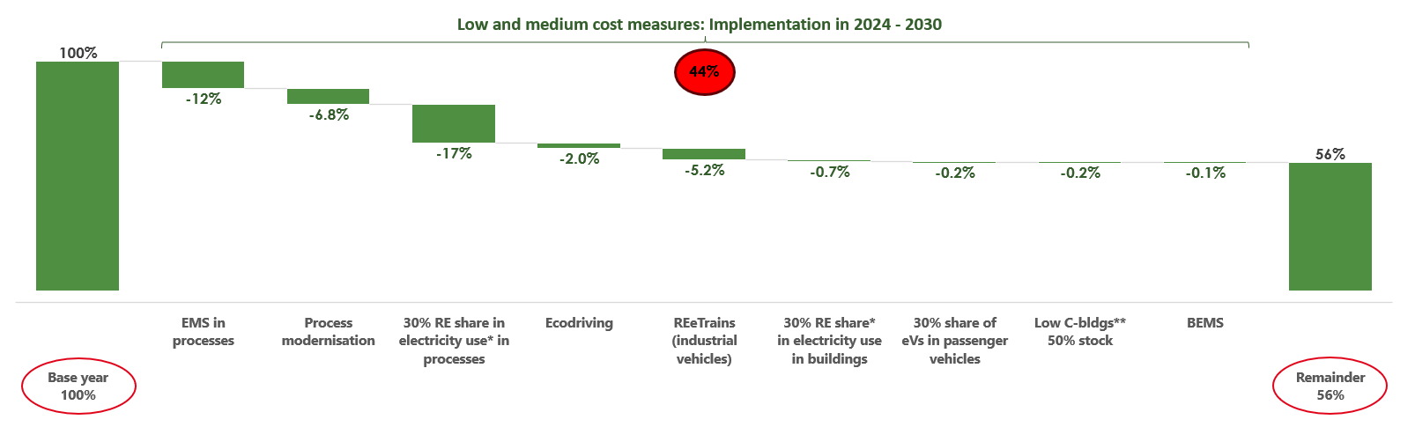
Decarbonization roadmap | 2024 - 2030 | Scope 1 & 2
Notes:
* Renewable electricity refers to either own renewable energy production with energy storage or the purchase of renewable electricity from external suppliers.
** Replacement or retrofits of existing buildings with/to very low energy- or carbon levels, integrating such concepts and options as nZEBs, deep retrofits, solar water heating, and others.

Slide 24
EU Corporate Sustainability Reporting
Directive (CSRD)

Slide 25
CSRD – Background information
  CSRD amends Directive 2013/34 (Accounting Directive “AD”), Directive 2004/109/EC (Transparency Directive “TD”), Directive 2006/43/EU (Audit Directive “AuD”), and Regulation (EU) No 537/2014 (Audit Regulation)
  CSRD revises and strengthens sustainability reporting requirements for companies introduced by Directive 2014/95 (Non-Financial Reporting Directive “NFRD”) into the Accounting Directive
  Key element of the EU Green Deal
  Objective: to put Sustainability Reporting in equal footing with Financial Reporting
  Publication in OJ in December 2022 (Directive 2022/2464)
  Transposition Deadline: 6 July 2024

Slide 26
CSRD – Key elements
Extension of NFRD scope of application
Strenghtening of NFRD reporting requirements
European Sustainability Reporting Standards
(ESRS)
Developed by EFRAG and adopted by COM as delegated acts
Digitalisation of sustainability reporting
XHTML format (+ marking-up of the information once digital taxonomy is adopted)
Assurance of sustainability reporting
limited assurance now, reasonable assurance at later stage

Slide 27
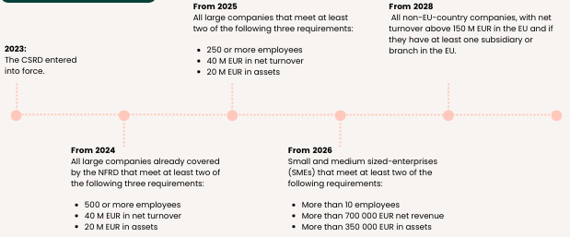
Scope & Schedule

Slide 28
European Sustainability Reporting Standards “ESRS”
Cross-cutting standards and standards for all sustainability topics
Sector-specific standards
Standards for listed SMEs
Standards for non-EU companies exceeding
EU turnover threshold
Adoption by
COM 30 June 2023
“ESRS”
(Art. 29b AD)
“ESRS
for SMEs”
(Art. 29c AD)
Adoption by COM 30 June 2024
“ESRS
for certain
non-EU companies”
(Art. 40b AD)

Slide 29
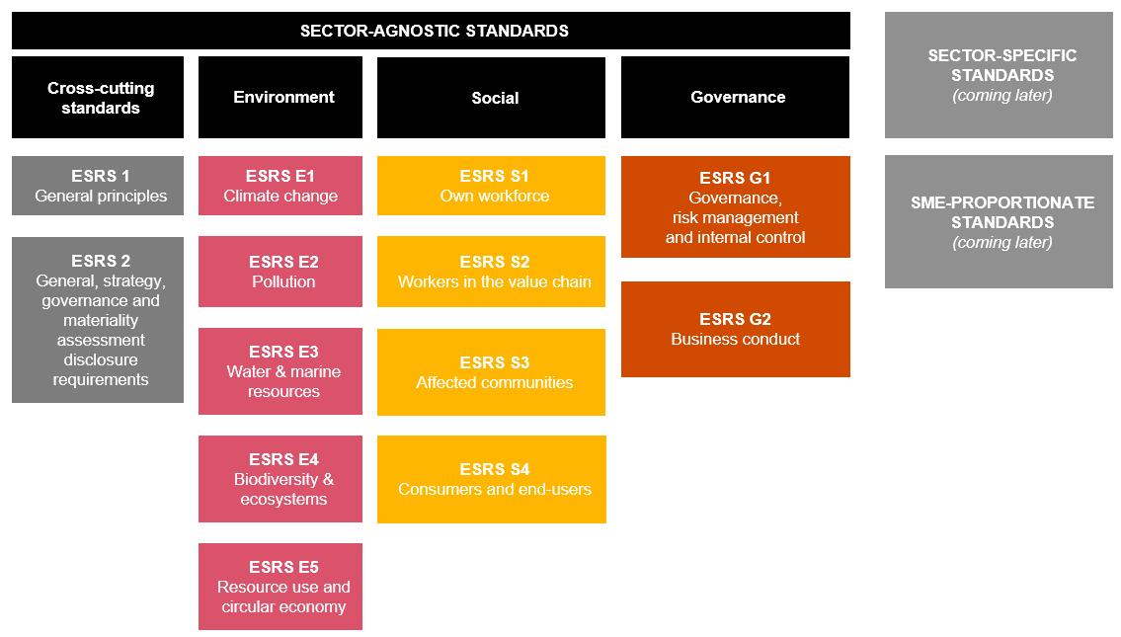
CSRD Reporting Standards
Source: PwC

Slide 30
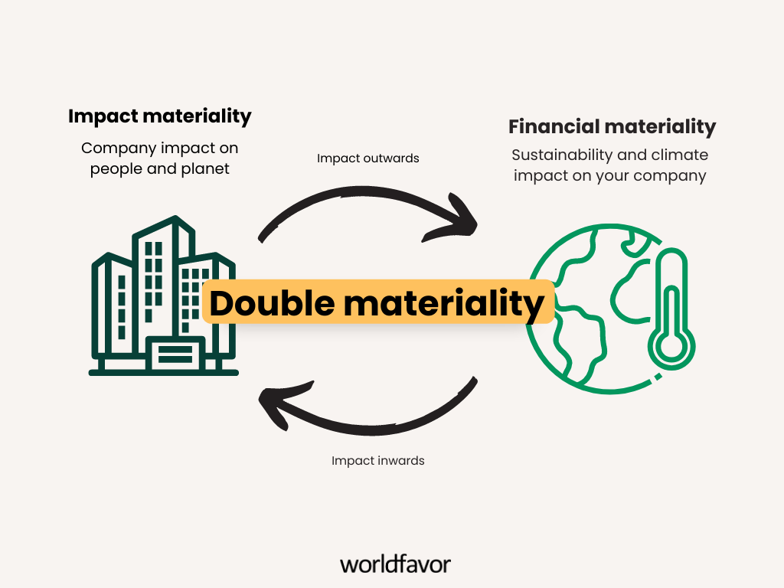
Double materiality

Slide 31
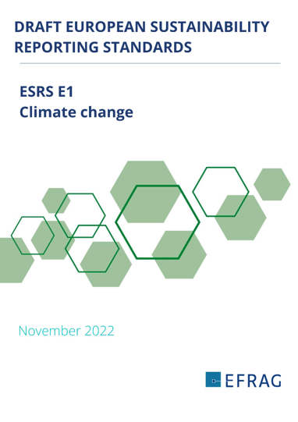
ESRS E1 Climate change

Slide 32
DR E1-1 – TRANSITION PLAN FOR CLIMATE CHANGE MITIGATION
“...the undertaking is expected to provide a high-level explanation of how it will adjust its strategy and business model to ensure compatibility with the transition to a sustainable economy and with the limiting of global warming to 1.5°C in line with the Paris Agreement (...) and the objective of achieving climate neutrality by 2050 with no or limited overshoot (...), and where applicable, its exposure to coal, and oil and gas- related activities.” (AR 1)
IF the undertaking does not have a transition plan in place, it shall indicate whether and, if so, when it will adopt a transition plan.

Slide 33
Impact, Risk and Opportunities (IRO) Management

Slide 34
IRO Management (cont)

Slide 35
DR E1-4 – TARGETS RELATED TO CLIMATE CHANGE MITIGATION AND ADAPTATION

Slide 36
METRICS AND TARGETS: ENERGY
Total energy consumption from non-renewable sources for high climate impact sectors :
Fuel consumption from coal and coal products;
Fuel consumption from crude oil and petroleum products;
Fuel consumption from natural gas;
Fuel consumption from other non-renewable sources;
Consumption from nuclear products; and
Consumption of purchased or acquired electricity, heat, steam, and cooling from non- renewable sources.
Total energy consumption from renewable sources disaggregated by:
Fuel consumption for renewable sources (including biomass, biogas, non-fossil fuel waste,
hydrogen from renewable sources, etc.);
Consumption of purchased or acquired electricity, heat, steam, and cooling from renewable sources; and
Consumption of self-generated non-fuel renewable energy.

Slide 37
METRICS AND TARGETS: GHG EMISSIONS

Slide 38
METRICS AND TARGETS (CONT)
E1-7 GHG REMOVALS AND GHG MITIGATION PROJECTS FINANCED THROUGH CARBON CREDITS
GHG removals and storage from own operations and upstream and downstream value chain it may have developed in metric tonnes of CO2eq; and
The amount of GHG emission reductions or removals from climate change mitigation projects outside its value chain it has financed through any purchase of carbon credits.
E1-8 INTERNAL CARBON PRICING
Disclose whether internal carbon pricing schemes are applied and, if so, how these support its decision making and incentivise the implementation of climate-related policies and targets, including:
The type of internal carbon pricing scheme, for example, the shadow prices applied for CapEX or research and development (R&D) investment decision making, internal carbon fees or internal carbon funds;
The specific scope of application of the carbon pricing schemes (activities, geographies, entities, etc.);
The carbon prices applied according to the type of scheme and critical assumptions made to determine the prices, including the source of the applied carbon prices and why they are deemed relevant; and
The current year approximate gross GHG emission volumes by Scopes 1, 2 and 3 in metric tonnes of CO2eq covered by these schemes, as well as their share of the undertaking’s overall GHG emissions for each respective Scope.

Slide 39
METRICS AND TARGETS: E1-9 POTENTIAL FINANCIAL EFFECTS FROM MATERIAL PHYSICAL AND TRANSITION RISKS AND POTENTIAL CLIMATE-RELATED OPPORTUNITIES
Potential financial effects from material physical risks;
Potential financial effects from material transition risks; and
Potential to pursue material climate-related opportunities.

Slide 40
Financial impact assessment

Slide 41

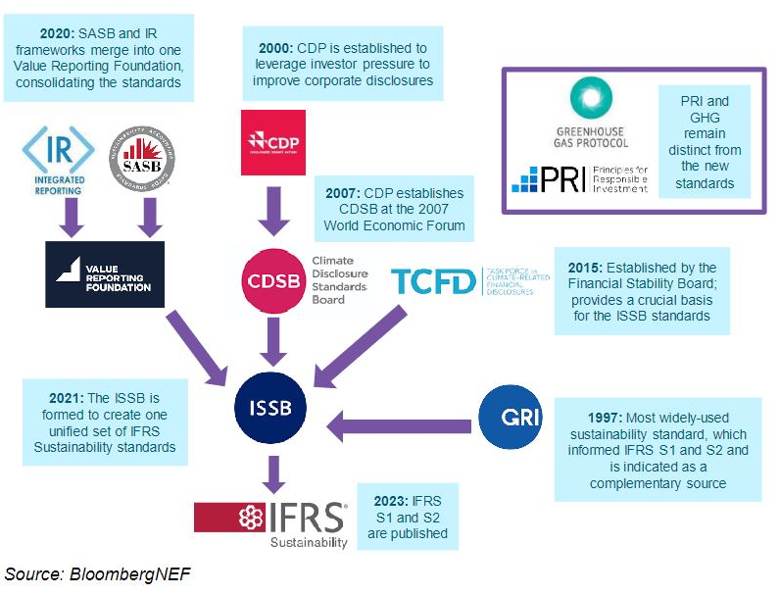

Slide 42


Overview of IFRS sustainability standards
 | The first two ISSB Standards
The International Sustainability Standards Board (ISSB) issued two IFRS Sustainability Disclosure Standards in June 2023 | IFRS S1 General Requirements for Disclosure of Sustainability-related Financial Information sets out the general requirements for a company to disclose info about its sustainability‐related risks and opportunities that is useful to investors in making decisions relating to providing resources to the company. The requirements in IFRS S1 also integrate the TCFD recommendations. | IFRS S2 Climate-related Disclosures sets out the requirements for a company to disclose info about its climate‐related risks/opportunities, while building on the requirements described in IFRS S1. IFRS S2 integrates the TCFD recommendations and requires the disclosure of info about both cross‐industry and industry‐specific climate‐related risks and opportunities. IFRS S2 is broadly consistent with the TCFD recommendations, but it requires more detailed info.
 | IFRS S1 and IFRS S2 are effective for annual reporting beginning on 1 January 2024. Companies are required to apply the two Standards together to assert compliance with IFRS Sustainability Disclosure Standards.
Notes:
IFRS S1 and IFRS S2 are effective for annual reporting beginning on 1 January 2024. Companies are required to apply the two Standards together to assert compliance with IFRS Sustainability Disclosure Standards. However, the ISSB has provided reliefs from some requirements in the first year a company applies the standards. For example, a company has the option to limit disclosures to information about climate‐related risks and opportunities in the first year that it applies IFRS S1 and IFRS S2.
Although all public and private companies can apply IFRS S1 and IFRS S2, the ISSB does not have the right to mandate the application of the Standards. Companies can voluntarily apply these Standards, and jurisdictional authorities can decide whether to require companies to apply them.

Slide 43

IFRS S2
A company applying IFRS S1 is required to apply IFRS S2 to identify and disclose material information about its climate‐related risks and opportunities.
IFRS S2 requires a company to disclose information about its governance, strategy and risk management, as well as metrics and targets, in relation to its climate‐related risks and opportunities.
Notes:
Many of the conceptual foundations and general requirements of IFRS S1 are adapted from
the IASB’s Conceptual Framework for Financial Reporting and
the IFRS Accounting Standards, including IAS 1 Presentation of Financial Statements and IAS 8 Accounting Policies, Changes in Accounting Estimates and Errors.
These foundations and requirements will be familiar to companies that prepare financial statements, particularly companies that prepare them in accordance with IFRS Accounting Standards.

Slide 44
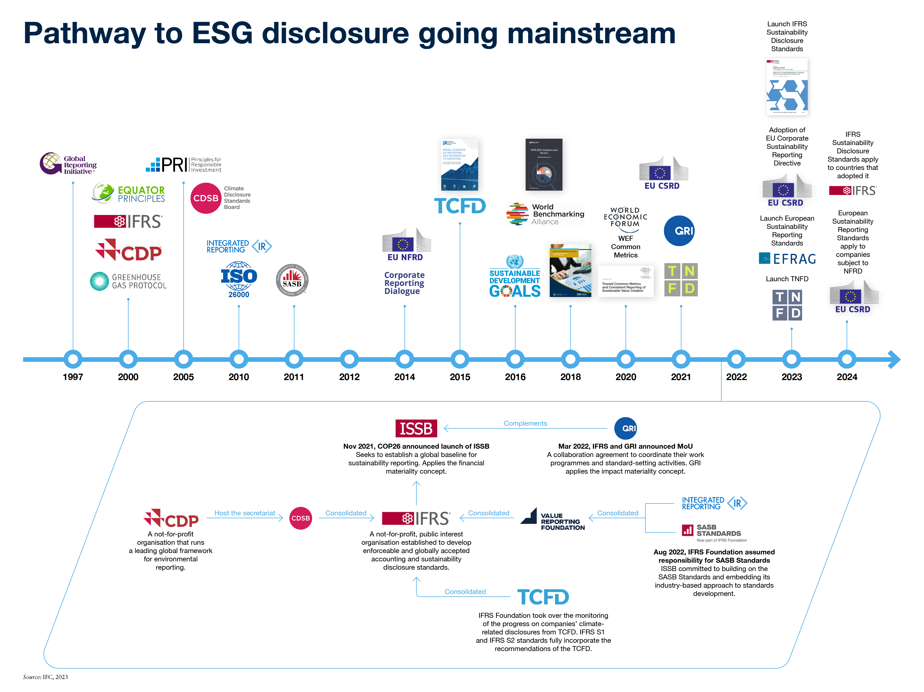

Slide 45

Key take-aways
Yesterday, we thought that the climate change challenge is the issue of the future. Today, the future has come, and the corporate world must respond to the challenge.
Should you need to understand climate risks and opportunities of corporations, including the financial industry firms, now you know where to search for their climate-related information
To read analyze the disclosure report, it is useful to rely on the respective standards, recommendations and guidelines

