Slide 1
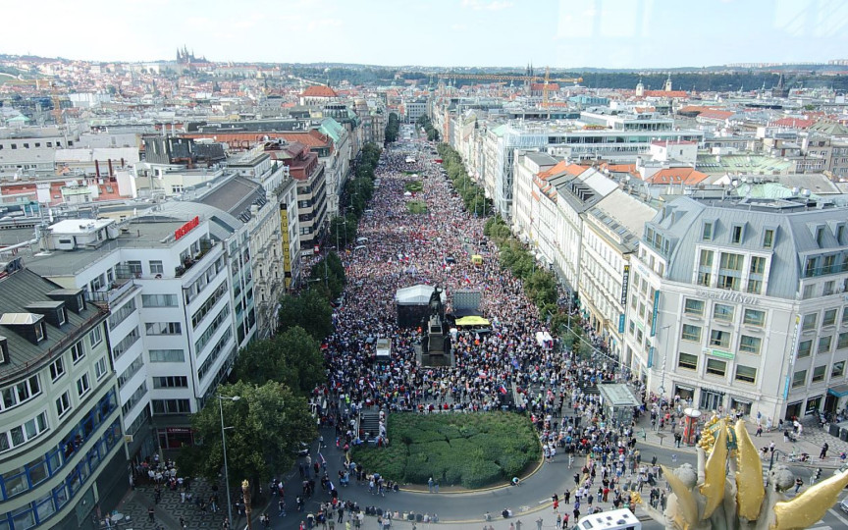
GLCb1014 Social Movements: Multidisciplinary Approach
Lecture 1: Introduction: conceptualizing social movements

Slide 2
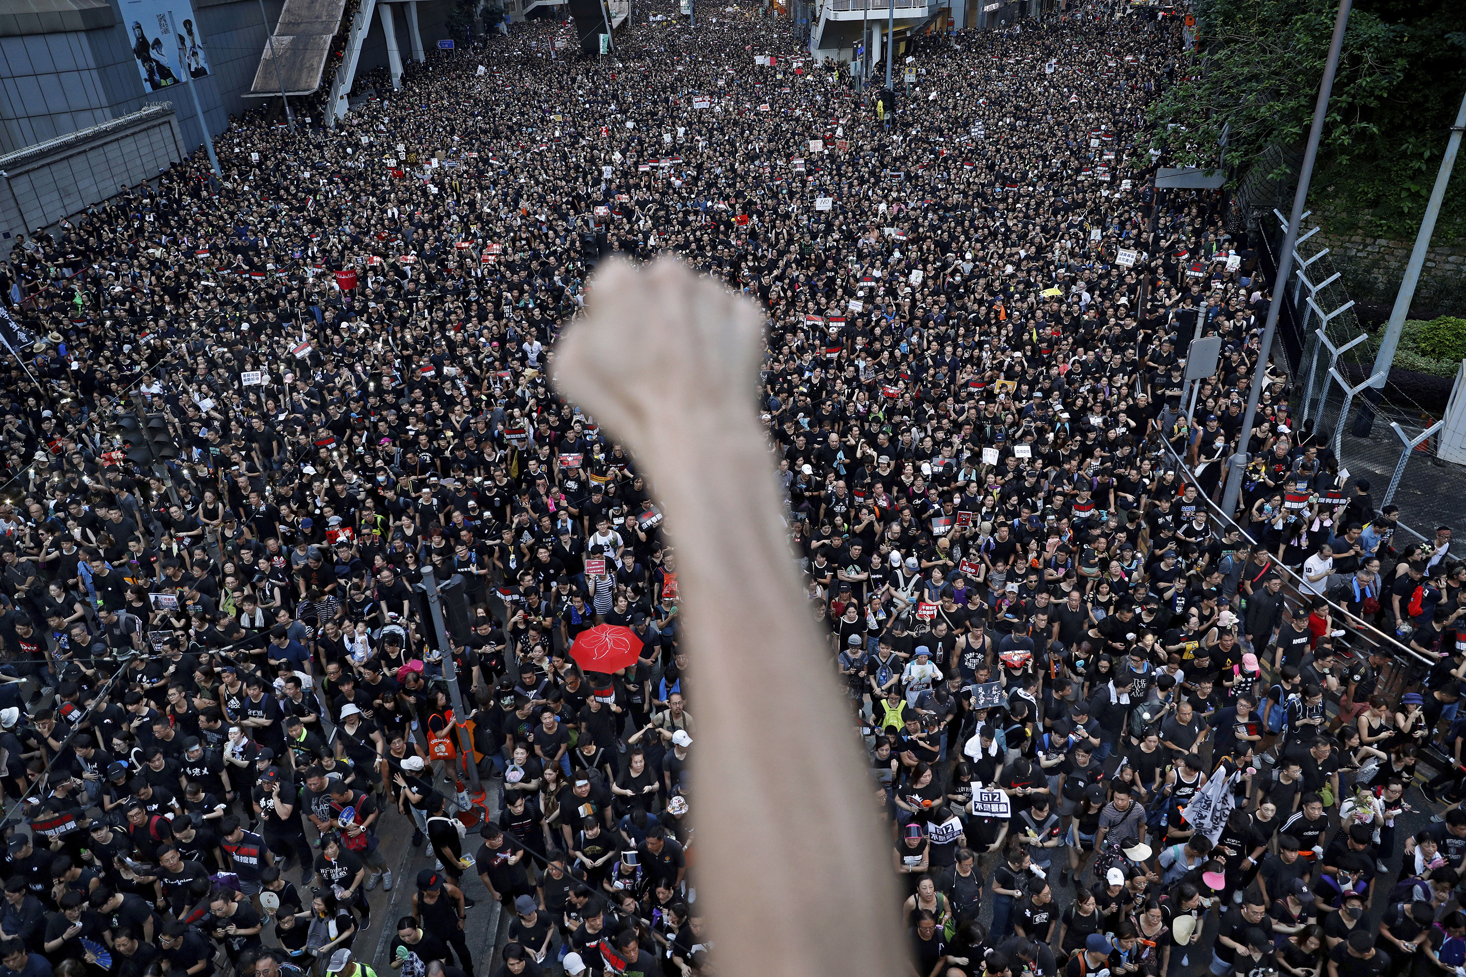
Social movements: a sociological concept
Broader social change/revolution?
Gathering in the street?
Demonstration?
Protest participation?
NIMBY mobilization?
GOOD guys?
Radicals?
Civil society?
Vs. political science (interest groups, advocacy groups)

Slide 3
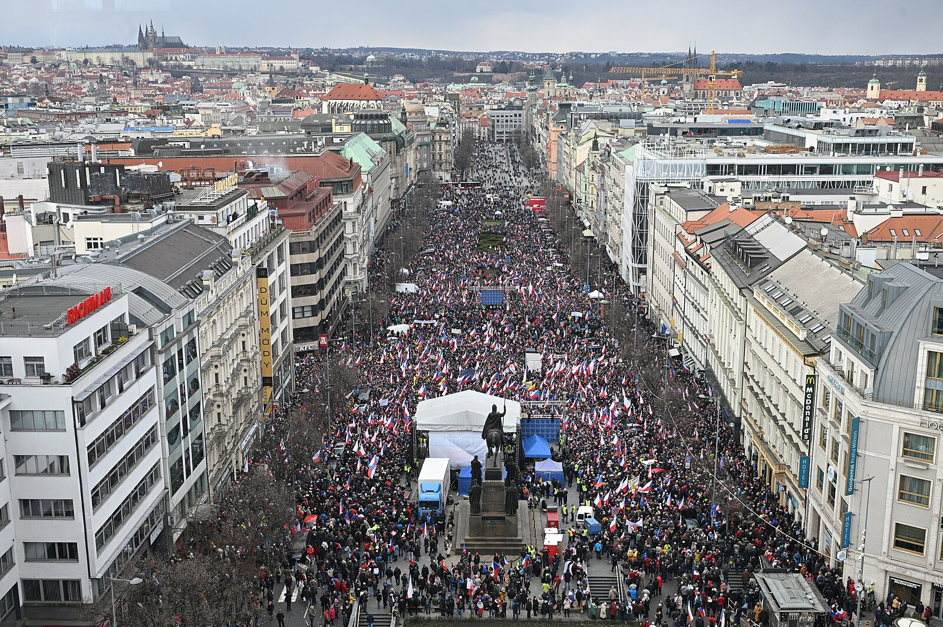
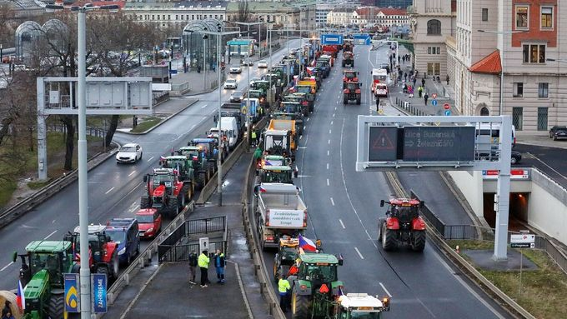
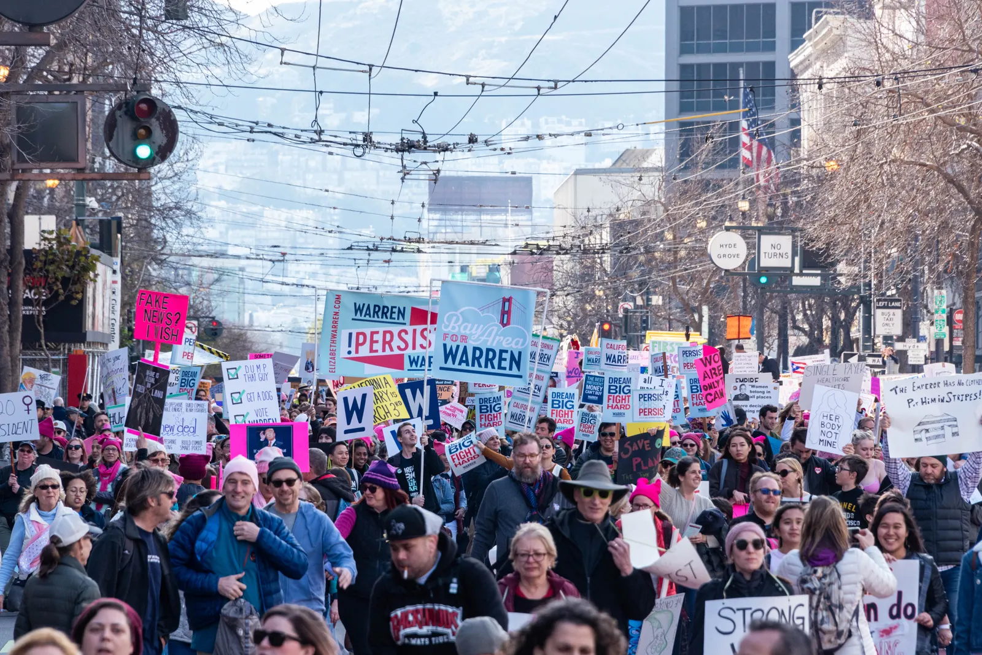
Classic conceptualization (Charles Tilly)
sustained, organized public effort making collective claims on target authorities (campaign)
employment of combinations from among the following forms of political action: creation of special-purpose associations and coalitions, public meetings, solemn processions, vigils, rallies, demonstrations, petition drives, statements to and in public media and pamphleteering (social movement repertoire)
participants’ concerted public representation of WUNC: worthiness, unity, numbers and commitment on the part of themselves and/or their constituencies

Slide 4
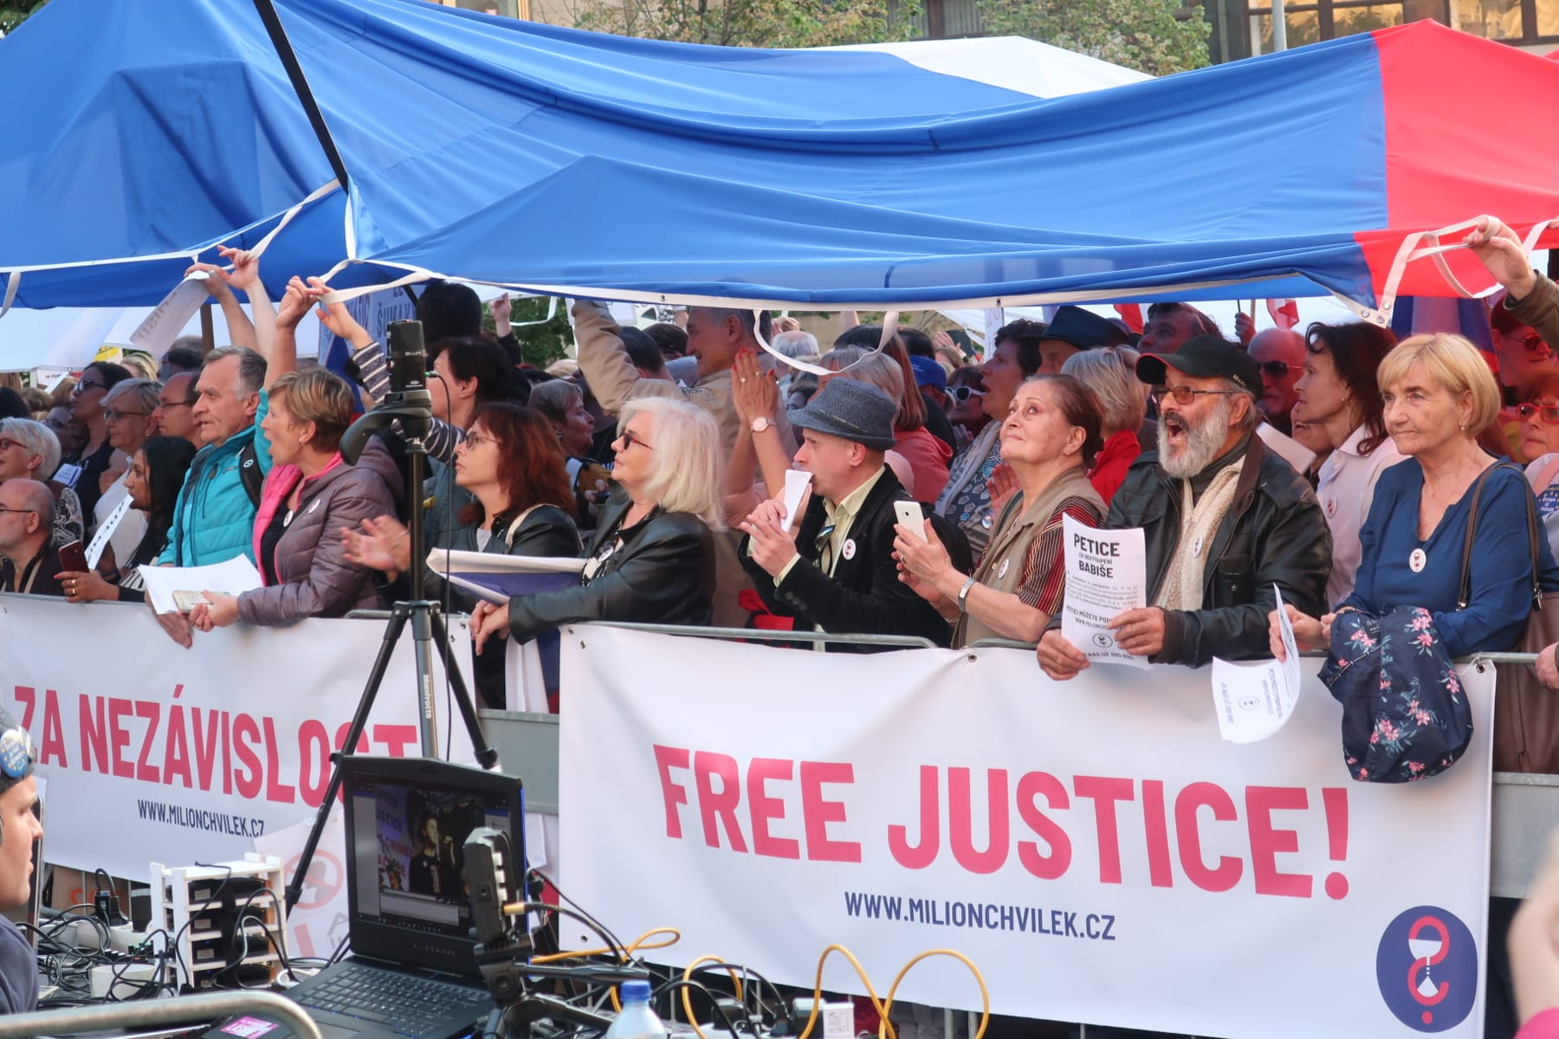
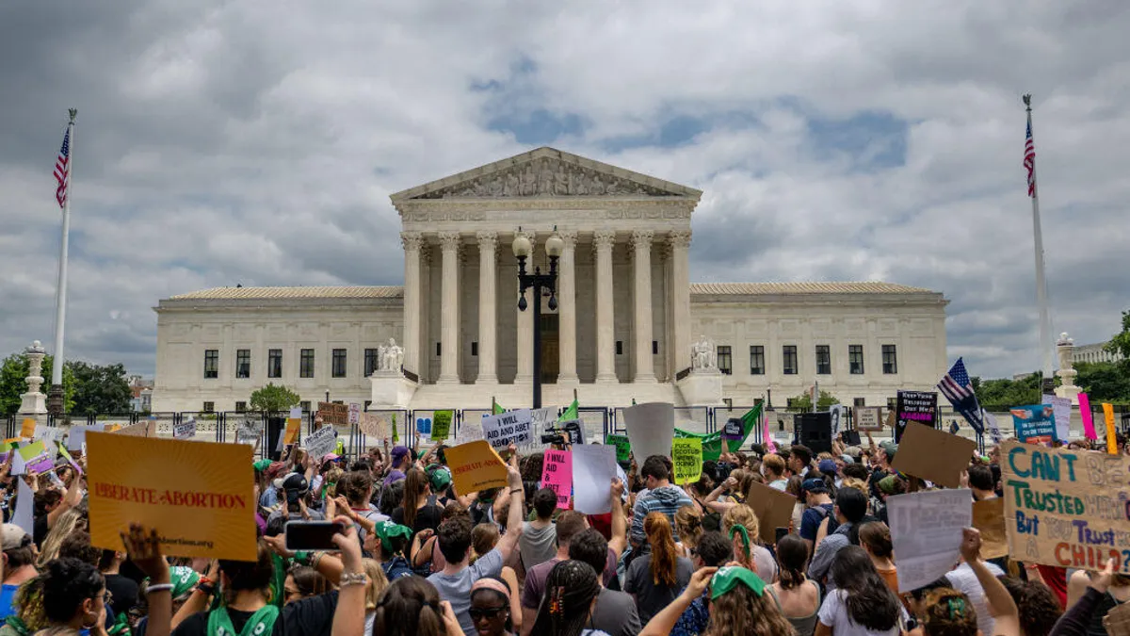
Standard conceptualization (Snow & Soule)
Challenging the structures/systems of authority (decision making - government, for-profit corporations, international organizations, local institutions) – directly or indirectly
Collective action (vs. Lobbyist, interest groups)
Activity outside existing institutional/organizational arrangements
Having organization
Having continuity

Slide 5
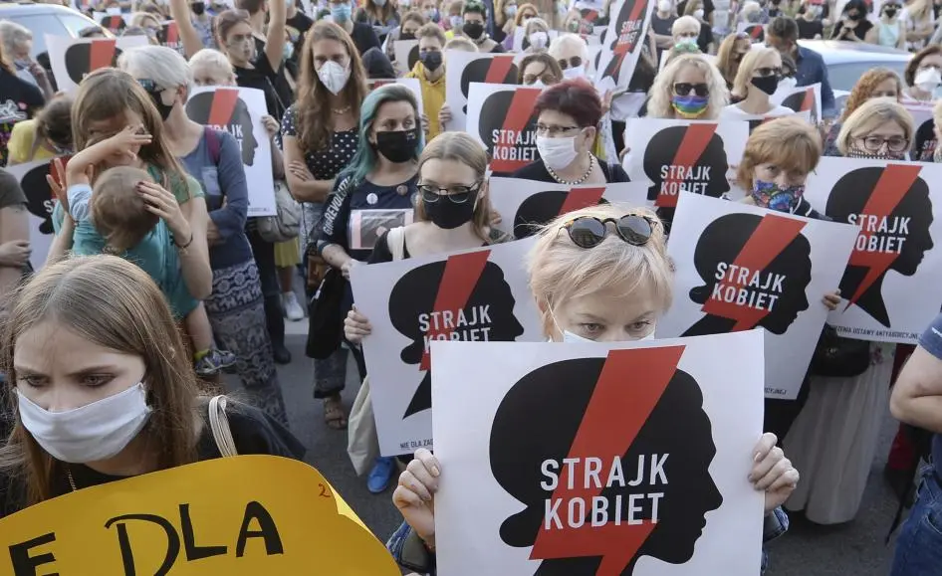
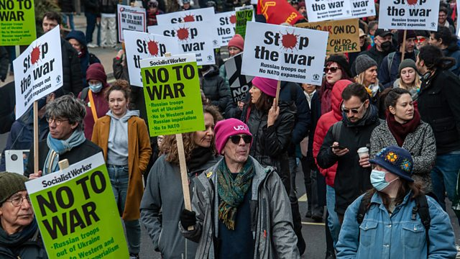
Social movements: a concept (Melucci, Diani)
Involvement in conflictual relations with clearly defined opponents
Linked by dense informal networks
Sharing distinct collective identity

Slide 6
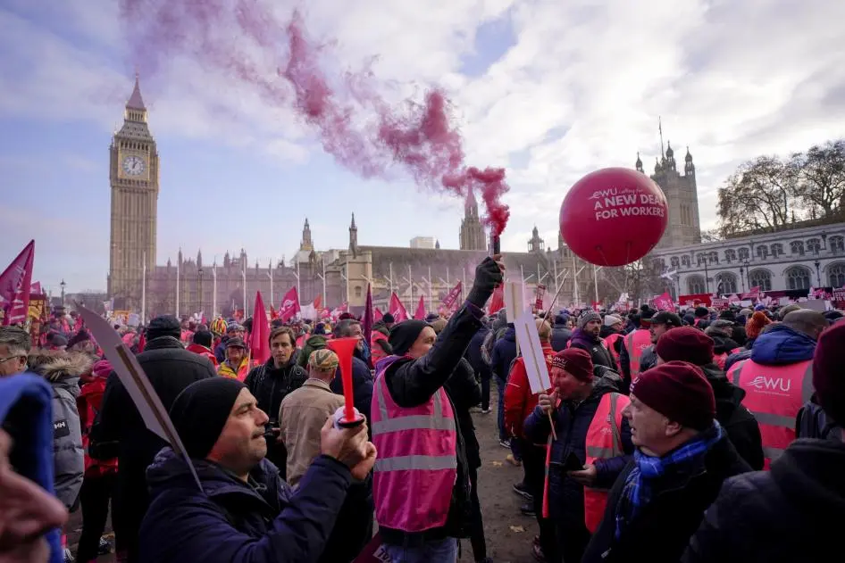
Relational re-conceptualization (Diani)
Object? Process? Representation?
Organization? Event? Network?
Sociology: a processual phenomenon, consisting of various mechanisms
Boundary de/activation
Resource sharing

Slide 7
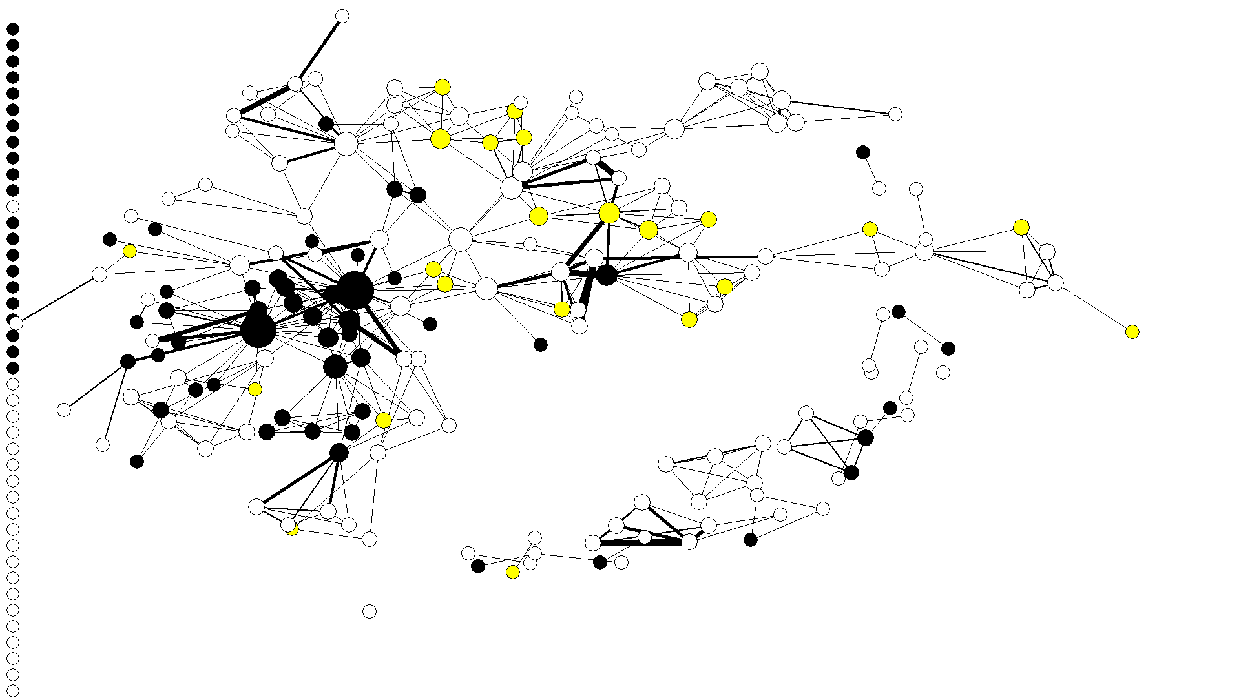
Processual, network-oriented concept

Slide 8
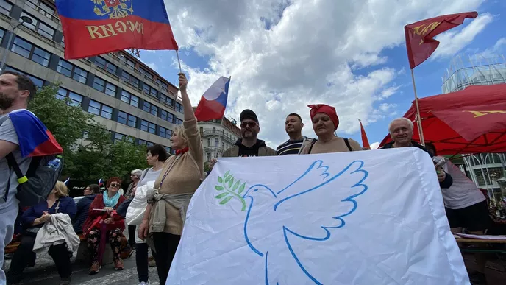
Social movements: different puzzles
How movements emerge? How it connected to social conflict?
What do movements culturally represent? How are problems identified as potential objects of collective action?
How values, interests and ideas turn into the collective action?
How particular contexts affect collective action?

Slide 9
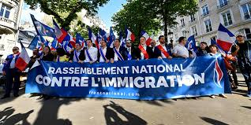
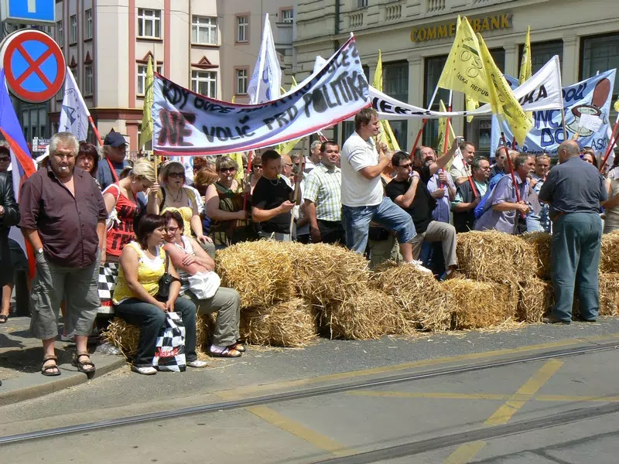
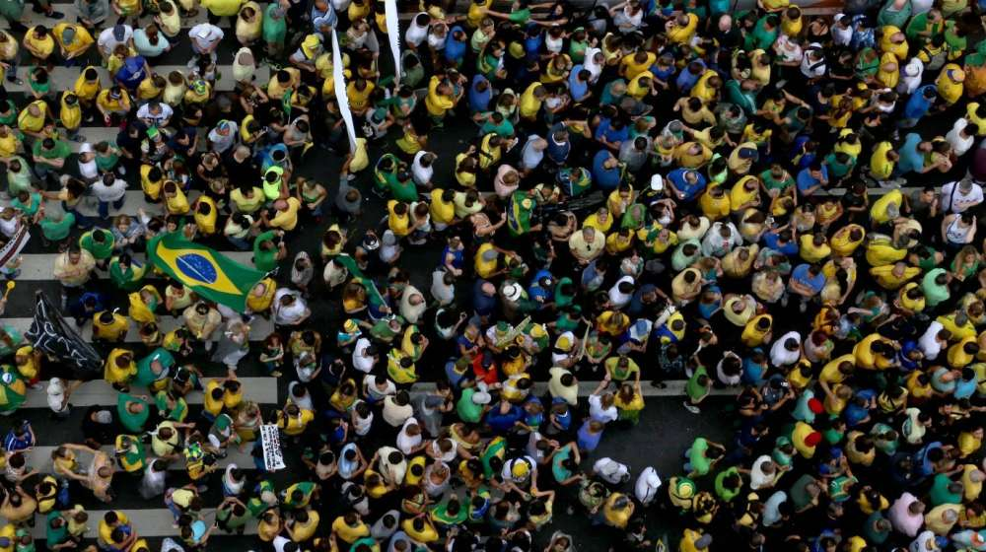
Recent mega-trends
Class transformation – new middle classes in capitalist societies after 1970s?
Decline of material struggles?
Rise of post-materialist movements?
New movements representing structural conflicts?
Examples: abortion rights, climate crisis, Great Recession…

