Slide 1
Climate change solutions
Global or local?

Slide 2
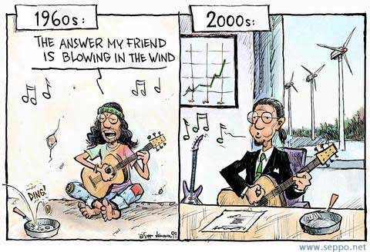
Problems for policy-makers
Uncertainty
Credibility: Tax take?
Impracticality: labour-intensive and thus costly on the public purse
Impersonality: what is our personal incentive?

Slide 3
Upstream or Downstream?
Upstream – with producers – is simpler, e.g. when the fossil fuel comes out of the ground
How can we be sure this will be passed on to consumers?
Downstream is complex and costly
But downstream – i.e. with consumers – does impose individuality responsibility
Downstream is also educational

Slide 4
Putting a price on carbon
Applying a price to emissions of greenhouse gases (GHGs), not just carbon dioxide (CO2 does make up 80% of GHGs)
Both carbon tax and cap-and-trade system are examples of carbon pricing
Polluter pays principle: stop treating the atmosphere as a free dumping ground
Including this cost gives an incentive for polluters to invest in using less energy and using cleaner energy (EE and RE): especially strong for heavy industry

Slide 5
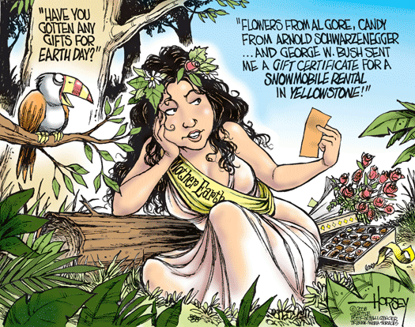
Nice and simple!
Estimate the cost of specific impacts of / adaptation to climate change over time
Aggregate across the world (weighting?)
Aggregate over the future (with some kind of discounting)

Slide 6
What is a carbon tax?
For most sources of GHG emissions, it is applied as a fuel tax, based on amount of fuel sold e.g. gasoline:
We know GHG emissions per litre of gasoline so convert the price per tonne into a price per litre ($10/tonne CO2 = 2.3 cents/litre of gas)
Apply to fuel wholesalers
Do this for tonnes of coal and cubic feet of nat. gas

Slide 7
EU Carbon Tax
Taxation is amongst the most jealously guarded areas of national sovereignty
Where carbon taxes have been implemented, even in relatively small homogenous regions such as carbon taxes introduced across Scandinavia from 1990-1992:
'The taxes differ considerably regarding rates, tax base and exemptions ....nominal rates are currently the highest for Danish Households. Sweden and Norway have the highest rates for industry, however, Norway applies the high rate to offshore oil and gas .. all four countries have [differing] special arrangements for energy-intensive companies’
Notes:
Mikael SkouAnderson (2004), 'Vikings and Virtues: a decade of CO2 taxation', Climate Policy Vol.4(1):13-24

Slide 8
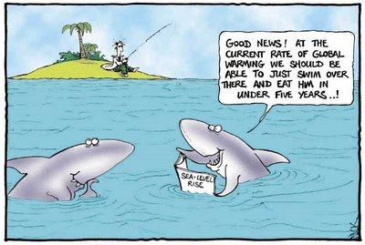
Carbon Tax: Advantages and disadvantages
Advantages
  Can be implemented quickly
  Industry and other fuel users know exactly the costs they face now and in near future
Disadvantages
  We are less sure of what emission reductions will result

Slide 9
Rationale for carbon trading
In the past there has been no market to trade and enforce environmental property rights (missing markets)
Creating incentives to reduce pollution
A cap is set on the emissions allowed
The cap creates the scarcity required for the market
At the end of each year installations are required to ensure they have enough allowances to account for their installation’s emissions.
Can be flexible to achieve the cap

Slide 10
Critique
Internally inconsistent: market failure requires more markets
How can we be sure that the market analogy will extend to a virtual good like the global atmosphere?
‘the problem lies with the whole economic process of business enterprise not some simple bilateral pollution problem which is a minor aberration of an otherwise perfect market system. Every product in the market place has embodied energy, is related to GHG emissions, and therefore has the “wrong” price.’

Slide 11
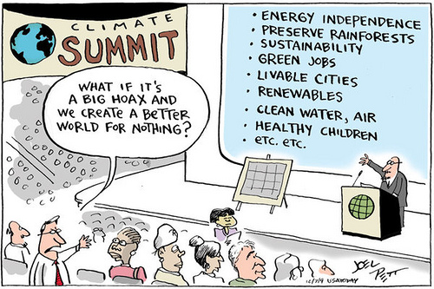
Who establishes the market—and sets the price?
Are we all equally powerful consumers?
How are we to establish the global limits? While negotiations stall emissions continue

Slide 12

EU-ETS: A Corporate Bonanza
Firms have charged consumers for emission rights they received for free
This has increased their profits. The WWF estimates that German utilities will make windfall profits of between €31-€64 billion to 2012 because of allowances.
It has also increased the cost of electricity to consumers and businesses
Bureaucratic expenses associated with National Allocation Plans, verification and compliance are being paid for by the public

Slide 13
EU-ETS: The big questions
Whose right is it to emit? Should it be given to an arbitrary group of companies, based on their past emissions? (“grandfathering”)
Should it be applied partially ‘downstream’
Should valuable permits worth €170 billion at issue be given away?
Should it cover only 43% of EU emissions?

Slide 14
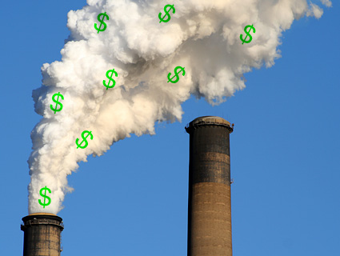
Questions

Slide 15
What Would an Effective Solution Include?
A firm and ‘scientifically based’ cap on emissions
A fair method for sharing the emissions – equality between and within countries?
Prevention of financial leaks by countries controlling reserve currencies
A soft landing for the inevitable end of a growth-driven global economy

Slide 16
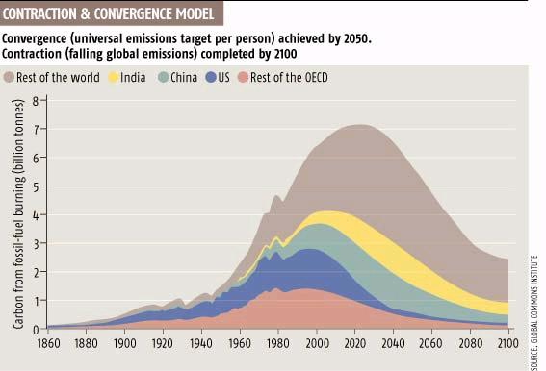
Contraction and Convergence
http://www.gci.org.uk/contconv/cc.html

Slide 17

Contraction and stabilisation at 450 ppmv
1
0
5
0
Atmospheric Concentrations
Business as Usual (BAU)
8
5
0
Stabilising atmospheric
concentrations with C&C
650
ppmv
450
250
Annual Emissions (BAU)
2
0
G
t
c
Contracting emissions with C&C
1
5
G
t
c
1
0
G
t
c
5
G
t
c
G
t
c
1
8
0
0
1
9
0
0
2
0
0
0
2
1
0
0
2
2
0
0
Notes:
Go to Flash 1

Slide 18
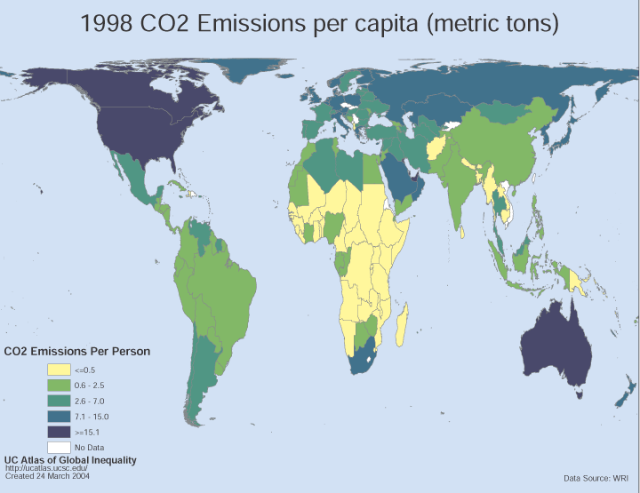
CO₂ Emissions Per Capita
Based on 1998 Data

Slide 19
Convergence by 2050
Per Capita Emissions
6
Annual
Per Capita
CO₂ Emissions
[tonnes
per capita
per annum]
Rest of World
4
India
2
China
Annex 1 (non-OECD)
0
OECD minus USA
Annual Gross
CO₂ Emissions
[Gigatonnes
per annum]
USA
10Gtc
Gross Emissions
5Gtc
1800
1900
2000
2100
2200

Slide 20
Support for C&C
Group of African Nations
India and China
5 of 7 British political parties
Over half of the MPs in parliament
David Miliband, Minister for the environment
European Parliament
C&C meets every objection raised by the US to Kyoto

Slide 21
Cap & Share
Issues entitlements for all the emissions allowed in a year under the EU’s Kyoto target or that set by its successor.
Gives equal entitlements to each EU resident
Recipients then sell their entitlements at the current market rate, via banks or post-offices
The entitlements are sold by the banks to companies producing or importing fossil fuels in the EU
Each importer or producer needs to buy enough permits to cover the eventual emissions from the fuels they sell.

Slide 22
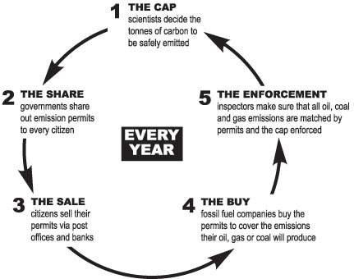

Slide 23
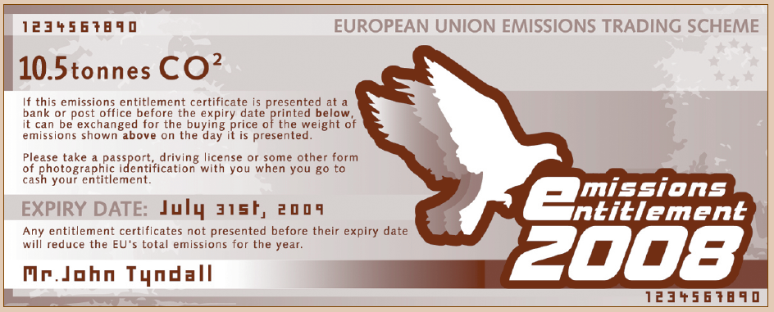
Cap & Share

Slide 24
Cap & Share
C&S acknowledges the right to pollute the global commons is a human right and responsibility
It compensates people via their emission entitlements for higher energy prices
It emphasizes and promotes the idea the climate security is a societal issue, not merely a commercial or political one.
All emissions, including transport and aviation can be included in C&S
Perverse incentives removed
It is far less prone to corruption
It allows more efficient implementation and should provoke fewer national squabbles

Slide 25
Personal carbon trading
Total emissions in the US: 20 t CO2 per capita
Non-personal: services, goods and infrastructure--11 t CO2 per capita
Personal: home energy and transport-- 9 t CO2 per capita
An equitable share to stabilize at 450 ppm – Mayer Hillman ~1 t CO2 per capita

Slide 26
Three key elements of personal carbon trading
􀂃 1- Setting the carbon budget
􀂃 2- Surrendering carbon units
􀂃 3- Allocating carbon units

Slide 27
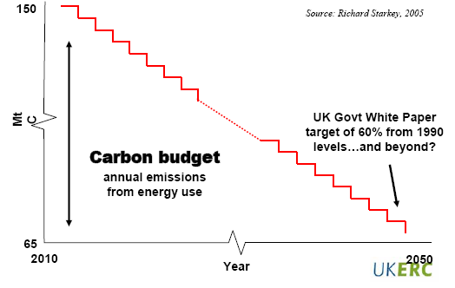
Setting a carbon budget

Slide 28
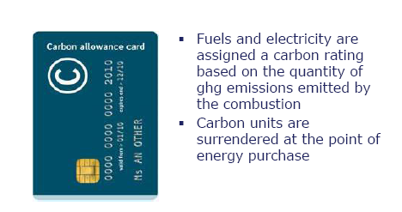
Surrendering carbon units

Slide 29
Allocating or acquiring carbon units
Individuals receive a free and equal per capita carbon allowance
Individuals exceeding their free allowance will have to buy additional carbon units from the market
Individuals having surplus carbon units will be able sell or save them

Slide 30
Why TEQs?
Equity: Everyone given an equal carbon share
Effectiveness: Guarantees carbon emission cuts
Efficiency: Takes advantage of the market

Slide 31
Making carbon a part of everyday life
􀂃 Smart bills
􀂃 Smart meters
􀂃 Smart receipts
􀂃 Enhanced petrol pumps
􀂃 Carbon-ometers
􀂃 Carbon responsibility in advertising
􀂃 Carbon labels
􀂃 Carbon promises
􀂃 Carbon-rated homes
􀂃 Carbon watchers

Slide 32
Questions
Which scheme would you favour if you were one of the following:
  CEO of an oil company
  A retired pensioner living in Brno
  A peasant in rural China
  An employee in a UK-based manufacturing company

