Slide 1

Consciousness
Michaela Porubanova PSY 270

Slide 2

.
“How it is that anything so remarkable as a state of consciousness comes about as a result of irritating nervous tissue, is just as unaccountable as the appearance of the Djin, when Aladdin rubbed his lamp.” (1866) T. H. Huxley

Slide 3
Introduction
Various stages of C (sleep to “full C”)
Various aspects of C: Experience of pain to self- awareness
Descartes- strict dualism
Cartesian theatre....existence of “seat” of C in brain
Daniel Dennet- contemporary opponent- no “seat” of C or time of C
William James- C as a process, not a structure (STM and attention
No study of C (during behaviorism)
90. – thriving of studying of C

Slide 4
William James
C: It is the taking possession by the mind, in clear and vivid form, of one out of what seem several simultaneously possible objects or trains of thought.” (1890)
Short term memory plus attention
One can control C using free will

Slide 5
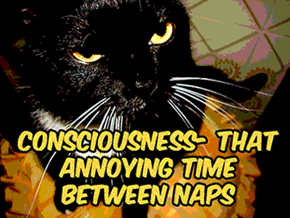
Think about….
Somebody has opened a door:
- 1, did you perceive consciously the person opening the door and then turned around?
- 2, did you turn around from a different reason without a conscious perception?

Slide 6
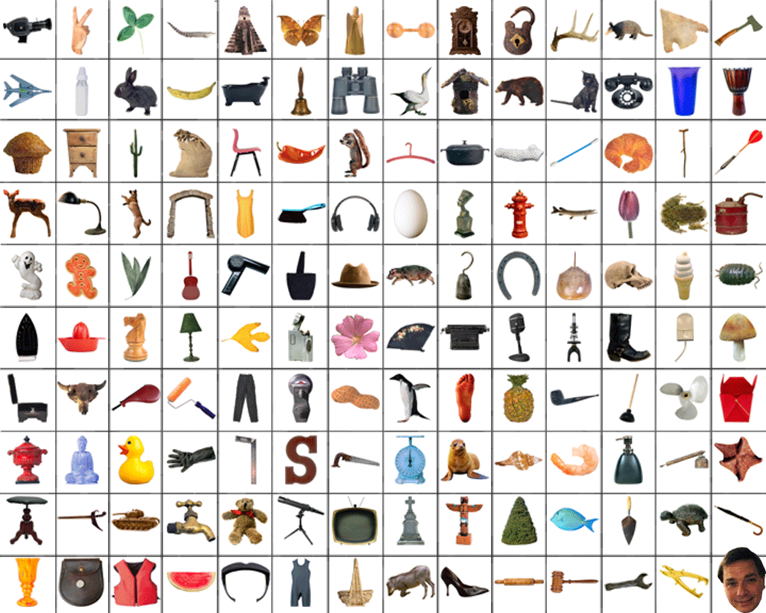
Content of consciousness
the perceptual world; inner speech and visual imagery; the fleeting present and its fading traces in immediate memory; bodily feelings like pleasure, pain, and excitement; surges of emotional feeling; autobiographical events when they are recalled; clear and immediate intentions, expectations and actions; explicit beliefs about oneself and the world; and concepts that are abstract but focal.

Slide 7
direct report
is one triggered by the conscious
visual experience of the observer; it can be a verbal report, or an action that is at least potentially
verbalizable, such as a volitional press of a button. In contrast, The two main types of indirect report are behavioral
indirect report
observer has no conscious visual experience, so that the response must be made via mechanisms
not triggered by conscious command. (Here, the entity "reporting" is not the conscious mind of
the observer, but rather, some other system.) (e.g., priming effects of stimuli not consciously seen by the observer) and physiological (e.g.,
differential activity of various brain regions).

Slide 8
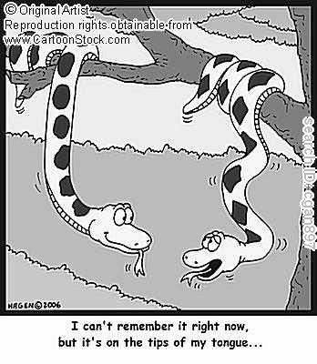
Consciousness- types
ACCESS
Information available,
or potentially available, for report
Tip-of-the-tongue states demonstrate access consciousness
PHENOMENAL
Current experience I have
Not necessarily reportable

Slide 9
Consciousness- approaches
1st person perspective
"what is it like to be a conscious being?“
Subjective quality of experience
Philosophy
Qualitative approach
3rd person perspective
Experiences of people in specific experimental conditions
Objective representation of experience
Verifiable reports of conscious experiences

Slide 10
Qualia
“subjective” approach
“what it is like” aspect of human experience
1, ineffable
2, intrinsic
3, directly apprehensible
4, private

Slide 11

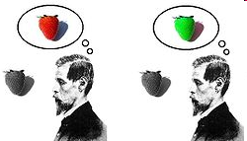
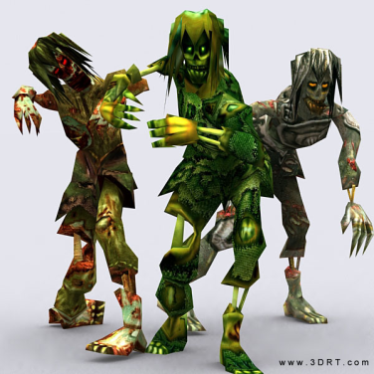
Arguments for qualia
What is it like to be a bat? (Thomas Nagel)
Inverse spectrum argument (John Locke)
Zombie argument

Slide 12
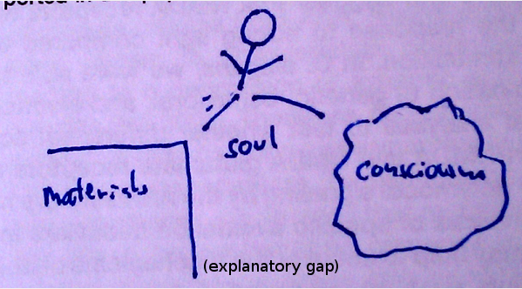

Arguments for qualia
Explanatory gap
Mary’s room

Slide 13
Experimental research of consciousness
Conscious versus unconscious experience
-reportability index
- ability to provide a proper response about the experience
- versus subliminal cortical activation- subliminal perception

Slide 14
Easy vs. hard problem of consciousness
The hard question: Why does anything feel like
anything at all?
How do we incorporate subjective experience into a
scientific picture?
Redness: what it feels like to see red

Slide 15
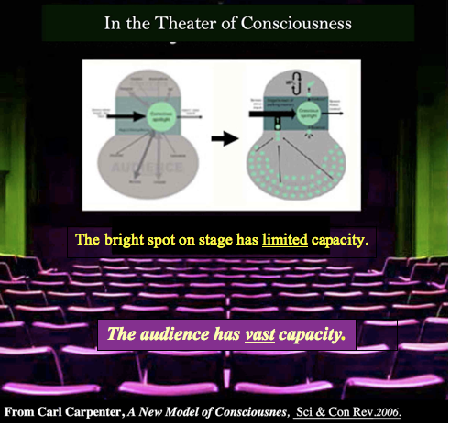
One Scientific Theory of Access
Consciousness: Baars- Global Workspace Theory

Slide 16
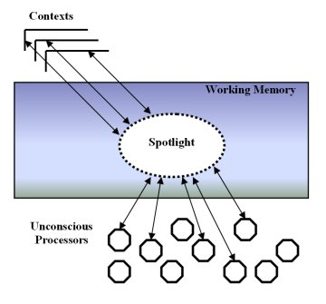
Baars- Global Workspace Theory
As in the theatre of consciousness
--- only the bright spot on stage is conscious
(because consciousness has very limited
capacity)
--- sensory inputs compete for access to the
conscious bright spot; so do output plans;
--- the "theater stage" equals to
Working Memory;
--- all other parts are unconscious, including
Long term memory, the automatic processes
of language, and events going on backstage.
(The capacity of unconsciousness is
enormous.)
Notes:
Baars uses the theater metaphor in order to give an intuitive idea of his theory of consciousness known as Global Workspace Theory.
Baars tell us about a “theater” in which the spotlight on the scene represents the focus of consciousness directed by attention. The complete scene corresponds to the working memory, which is the memory system that stores the conscious contents of the mind. The information retrieved under the spotlight is globally broadcasted throughout the theater to two different types of unconscious processors: the audience and the ones behind the scene. The latter are unconscious contextual systems that create the events taking place in the scene.
The spotlight metaphor is also used by Crick (1994) when he argues that the visual information processing in the brain takes place centered in a spotlight, whereas in other regions of the visual field the information is less processed or not processed at all.
The theater metaphor used by Baars is essentially opposed to other metaphor known as “Cartesian theater”. Even thought both ideas sound similar they are actually divergent. The idea of a Cartesian theater refers to the existence of a concrete point in the brain, the pineal gland, where Descartes thought the link to the soul was located (Finger, 1995). Theories that pretend to localize consciousness in a central concrete point of the brain are broadly rejected by scientific community. However, scientists are looking for the neural correlates of consciousness (NCC), although they are not believed to be in a concrete point, but formed from neural coalitions (Crick and Koch, 2003).
Coming back to the theater metaphor developed by Baars, it is important to remark that the scene is composed by the working memory. This is the place where the actors compete for the spotlight space of attention. When they get there, they appear as conscious contents of the mind. The selection of the spotlight position is to a great extend done behind the scene. Unconscious processors select the conscious contents (the play in the scene) using contexts and beliefs. Baars indicates that the “director” can take decisions in the field of working memory driven by goal accomplishment. The play director also works behind the scene; this means that usually we have no access to the reasons why we do things. This conception resembles to the ideas of other authors who argue that the conscious self confabulates in order to deduce the reasons why the subject perform the actions (Ronsenthal, 2000; Morin, 2002).
According to Baars, consciousness is the key to access to the vast domain of unconscious knowledge. Consciousness is used for rapid learning and accurate recognition. It also activates a great number of unconscious routines providing coordination and control. Conscious experiences activate unconscious contexts which help to interpret future conscious events. In sum, consciousness provides a framework for global access to the vast unconscious contents of the mind. It seems that recent advances using brain imaging techniques (fMRI, PET, etc.) confirm Baars’ hypothesis. (Baars, 2002, Baars et al. 2003). Anyhow, more neurological insight is needed to completely confirm Baars’ assumptions.

Slide 17
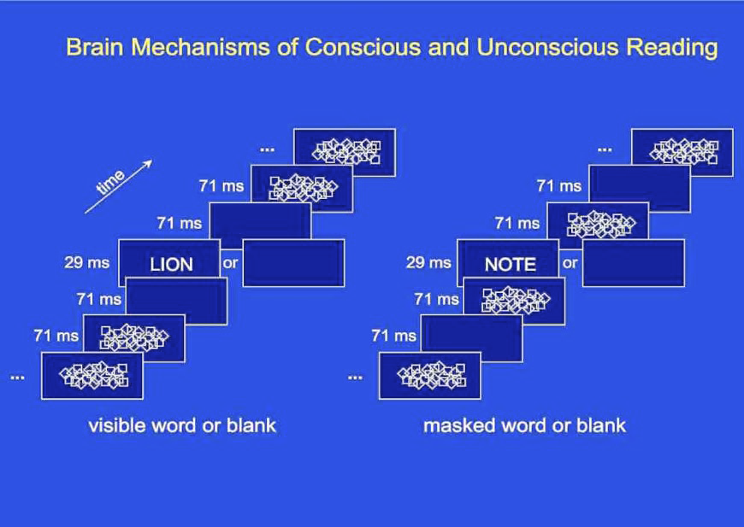
Baars- Global Workspace Theory

Slide 18
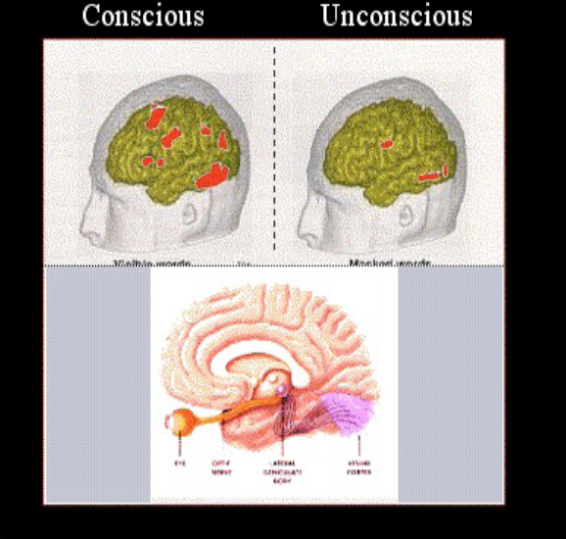
Baars- Global Workspace Theory

Slide 19
Consciousness disorders
Visual agnosia
Prosopagnosia
Neglect
Balint syndrome

Slide 20
Dennett’ s video
Dennett on TED
Prosopagnosia case study

