Slide 1
The Green Paradox of Thrift
Using the Economic Crisis to Move Towards a Sustainable Economy
Molly Scott Cato
Professor of Strategy and Sustainability
Roehampton Business School

Slide 2
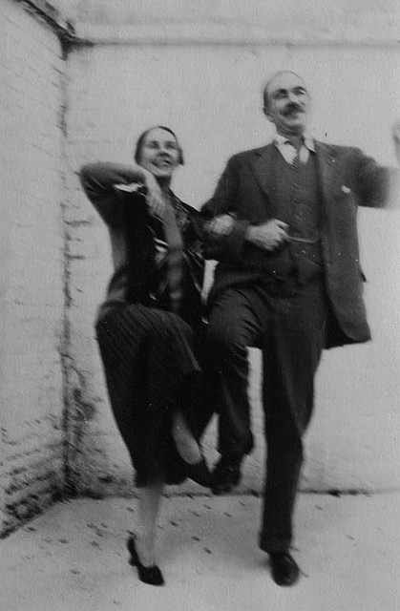
The Last Great Depression
Failure of aggregate demand
Repayment of debts
Failure of lending and borrowing
Recessionary spiral: ‘the death spiral’

Slide 5
The view from No. 10

Slide 6
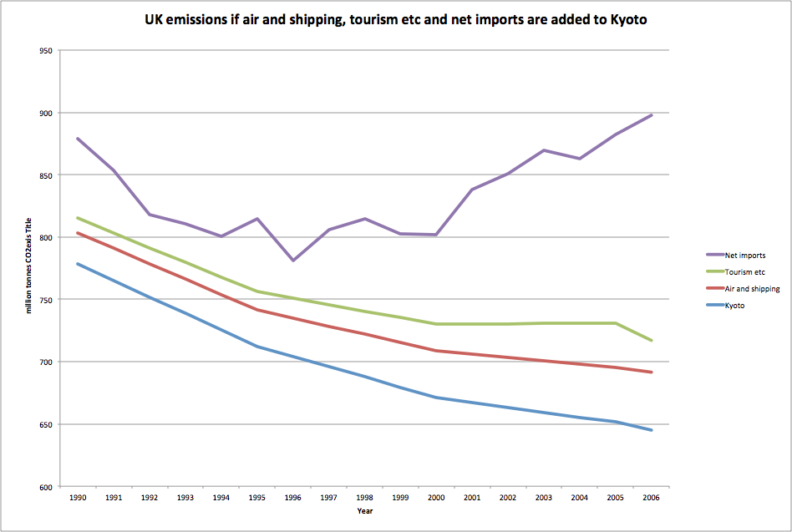
The full picture

Slide 7
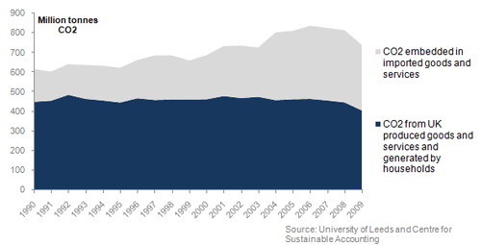
CO2 emissions associated with UK consumption 1990 to 2009 (Defra)

Slide 8
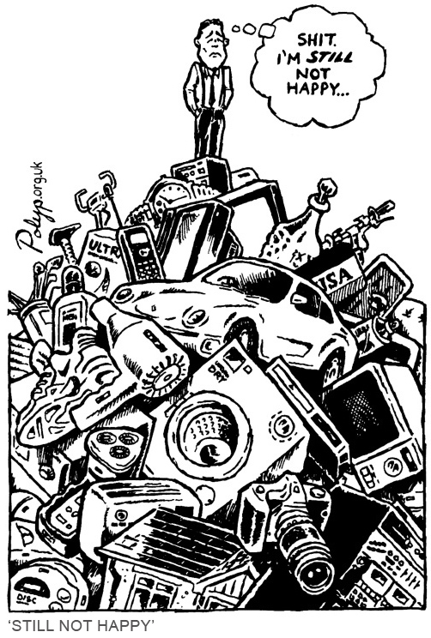
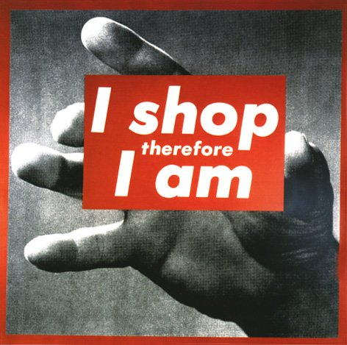

Slide 9
But perhaps a rest from growth isn’t such a bad thing . . .?
Notes:
Column ABMI in Office for National Statistics. (2011b, November 24). Second estimate of GDP time series dataset 2011 Q3. Retrieved March 1, 2012, from Office for National Statistics: http://www.ons.gov.uk/ons/rel/naa2/second-estimate-of-gdp/q3-2011/tsd-second-estimate-of-gdp-2011-q3.html

Slide 10
The Impossible Hamster
http://vimeo.com/8947526

Slide 11
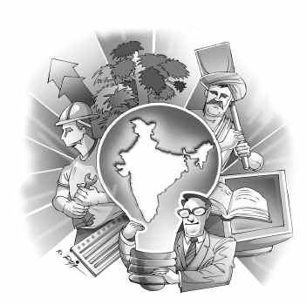
Questions
Why do economies grow?
Is it only capitalist economies that grow?
In your country is their such a persistent focus on growth?
Are the benefits of growth fairly shared?

Slide 12
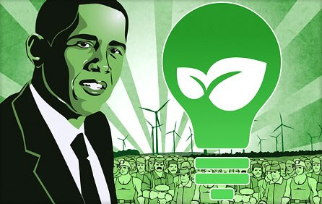
Can we have ‘green growth’?
‘Green growth can cut emissions, help insulate against oil price shocks and bolster the fast-growing market for green goods and services – providing jobs, growth and prosperity’.
Chris Huhne, Energy and Climate Change Secretary (DECC 2011)

Slide 13
Definitions I: OCED definition
Green growth is economic growth which does not impede on our natural capital (OECD 2011:4):
‘We need to make growth greener, to make our economic and environmental policies more compatible and even mutually-reinforcing. This is not just a matter of new technologies or new sources of renewable, safe energy. It is about how we all behave every day of our lives, what we eat, what we drink, what we recycle, re-use, repair, how we produce and how we consume.’
Notes:
OECD (2011) Towards Green Growth – A summary for policy makers, accessed online on 15-07-2011 on http://www.oecd.org/dataoecd/32/49/48012345.pdf

Slide 14
ILO definition
ILO’s definition says that all jobs which promote sustainable development are green jobs; points out that the definition includes, firstly, jobs which directly reduce consumption of energy and resources, protect ecosystems and biodiversity and minimize waste production and air pollution and, secondly, all jobs which reduce the environmental footprint; recognizes that, owing to the relative nature of the definition, the job potential cannot be definitively determined.
Notes:
UNEP, ILO, IOE, ITUC. (2008). Green Jobs: Towards Decent Work in a Sustainable, Low-Carbon World. Available: http://www.ilo.org/wcmsp5/groups/public/---dgreports/---dcomm/documents/publication/wcms_098503.pdf. Last accessed 8th Sep 2010.
Thanks for Shahla Khan for this research

Slide 15
Definitions II: UNEP
Green and decent?
‘In addition to quantities of jobs, there is a range of qualitative questions, relating to occupational profiles and work skills, wage levels, and the degree to which worker representation (unionization) and workplace involvement (empowerment) are advanced or not. To fully identify, adopt, and implement green opportunities in the workplace, the active involvement of workers and unions is essential.’
Notes:
"Green Jobs: Towards Decent Work in a Sustainable, Low-Carbon World." :

Slide 16
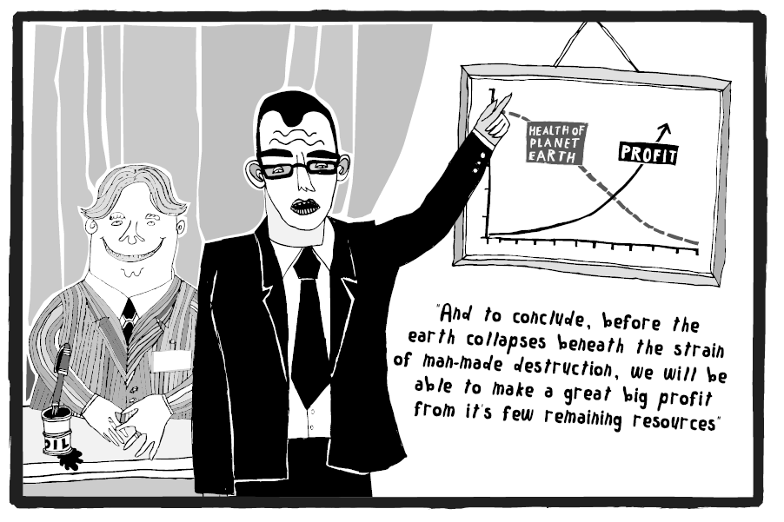

Slide 17
Definitions III: Shades of Green
 | Deep Green | Mid Green | Light Green
Mode | Proactive | integrative | reactive
Scope | long term | Intermediate term | short term
Nature | transforming | reforming | conforming
Objective | redefine growth | ‘ecologise’ growth | enhance growth
Operation | rejectionist | reinventionist | accommodationist
Aim | ecological sustainability | ecological modernity | sustainable development
Jobs | preserving nature | greening industry | remedying ecological decline
Notes:
Crowley K. (2009) “Jobs & Environment: the Double Dividend of Ecological Modernization”
International Journal of Social Economics, Vol 26, No. 7/8/9, pp. 1013-1026

Slide 18
Farewell to Thrift
‘the whole system of an increasing productivity, plus inflation, plus a rising standard of material living, plus high-pressure advertising and salesmanship, plus mass communications, plus cultural democracy and the creation of the mass mind, the mass man’
J. B. Priestley, 1955

Slide 19
Built-in obsolescence
Phoebus Cartel
World’s leading light-bulb manufacturers agreed to reduce the maximum life of a light-bulb to 1000 hours from the 2500 hours that Edison had already managed.
The oldest light-bulb in the world is still in place at the Livermore Fire Station in California: it is 110 years old.

Slide 20
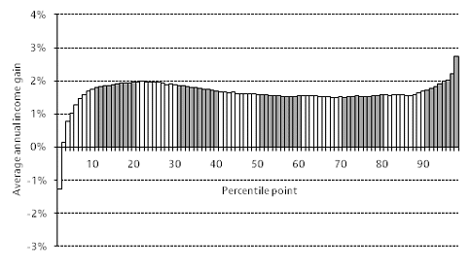
Growing Inequality

Slide 21
Climate change is a class issue
Notes:
'Mean average CO2 emissions are strongly correlated with income: households within the highest equivalised income decile have mean total CO2 emissions more than twice that of households within the lowest equivalised income decile. Emissions from private road travel and aviation account for a high proportion of this differential: aviation emissions of the highest income decile are more than six times that of the lowest income decile.'

Slide 22
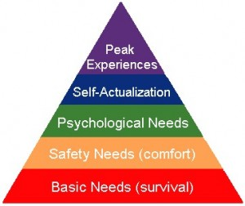
Max Neef needs matrix
Notes:
Globalised economy offers us ‘peak experiences’ but our basic needs remain unmet – security and safety. Consumption provides a diversion while continuing to leave basic needs unmet.

Slide 23
Ecological citizenship
‘environmentalism argues for a managerial approach to environmental problems, secure in the belief that they can be solved without fundamental changes in present values or patterns of production and consumption. … ecologism holds that a sustainable and fulfilling existence presupposes radical changes in our relationship with the non-human natural world, and in our mode of social and political life.’
‘there is a consensus over the need for active ecological citizenship because of the recognition that the transition to a sustainable society requires more than institutional restructuring; it also needs a transformation in the beliefs, attitudes and behaviour of individuals’
Notes:
Andy Dobson, Green Political Thought (2007)
Neil Carter, The Politics of the Environment (2007)

