Slide 1
Ethnicity and Ethnic conflict
Zinaida Shevchuk

Slide 2
The role of ethnicity
After the World War II: few new states were created through ethnic secession.
Iceland, Baltic states, Singapore and Bangladesh.
Africa and Asia – through decolonization – ethnicity was not decisive factor.

Slide 3
?
Is ethnicity a criterion for statehood?
Is it not the superior force of the ability of states in other regions to contain the aspirations and demands of their ethnically heterogeneous population?
Did not the Kurdish an Shi’s revolts in Iraq portend the dissolution of that state?
Is it not the role of the Indian and Sri Lankan governments that has prevented the secession of Sikh, Naga, Kashmiri, and Tamil populations?
Is the same true for Kurds in Iran, the Moro in Philippines, and the Uigurs and Tibetan in China?
In Africa, are there not other ethnic candidates for autonomy and secession?

Slide 4
?
What are the bases for ethnic nationalism?
What are the collective ties that must be ignited by political, economic and other forces, if demands for national recognition are to emerge?

Slide 5
Nature and power of ethnic nationalism – collective level of identity and community.
Ethnie or ethnic community.
Properties of such communities is the key to the explosive power of nationalism.

Slide 6
Ethnic identity
1. Name is important – sense of community.
Until 1960s “Islamized Slavs (Serbs and Croats), then Muslims.
A different community, whose myth of collective ancestry was traced back to the moment of conversion to Islam.

Slide 7
Ethnic Identity
2. Belief or myth of common ancestry vs. some genetic heritage.
Ethnicity is about belief in common origins.
Ethnie – “superfamily”

Slide 8
Ethnic Identity
3. Historical memories
- Ethnohistorical memories of the collectivity, sources of moral inspiration to its members, selective traditions, legends about their past.

Slide 9
Ethnic Identity
4. Shared culture
dress, food, music, crafts and architecture, as well as laws, customs and institutions.
Language and religion: separate pantheons and rituals as source of ethnic difference and conflict.

Slide 10
Ethnic Identity
5. Attachment to a specific territory and to a particular land.
- even if exiled
Crucial is not the possession of the homeland, but the sense of mutual belonging, even from afar.

Slide 11
Ethnic identity
6. Solidarity
-equal sense of ethnic belonging to the community.
Task of nationalism is to turn ethnic categories (collectively self-aware) into ethnic communities and ethnic communities into ethnic nations.

Slide 12
?
By what processes are ethnic identities transformed to ethnic communities and ethnic nation?

Slide 13
1. “Vernacular mobilization” – rediscovery by ethnic of traditions, customs, memories, symbols and language to wider strata of the designated population.
Elevating a formerly “low” oral culture and language to the status of a “high” literary culture.
Through the compilation of dictionaries, grammars, and philological treaties, ethnic elites have modernized and regenerated peasant languages and cultures.
Example: the Czech, Finnish and Ukrainian languages and cultures – initially peripheral and neglected.

Slide 14
2. “Cultural politicization” of the vernacular heritage.
Transform the ethnie into a would-be nation and treat community’s cultural heritage as a political resource.
Politicization of cultures linked to a living ethnic past and combined with an ethnohistorical tradition – explosive ethnonational energy that is frequently tapped by ethnic nationalism.

Slide 15
3. “Ethnic purification” – the process begins with return to a popular vernacular culture, which is used for political purposes, and injects a belief in the sanctity of that culture.
To preserve the culture, it must be kept unadulterated – it must be purged and purified.
It must be kept away from undesirable influences through the relegation, segregation, expulsion, deportation and even extermination of aliens.

Slide 16
The role of ethnicity
Anthony Smith
1. Ethnic category must be transformed to ethnic community.
2. Ethnic nationalism must have spread to the relevant area of the globe.
3. The ethnie must have produces a stratum of ethnic intellectuals and an intelligentsia that will apply the ideals of national self-determination to the ethnie.
Scholars have to identify the factors that can ignite ethnic differences and transform them into conflict between self-aware ethnies intent on national self-determination.

Slide 17
Stuart J. Kaufman – theory of ethnic conflict
Ethnic appeals may lead to violent escalation only if a group fears that its existence threatened.
What matters is the ability to evoke vertical escalation “our group is in danger”.
The next condition, is political opportunity. This consist of two elements,
first, there must be sufficient political space (weakening or state breakdown, or support from external power)
secondn, a territorial base (for successful mobilization, ethnic groups are either territorially concentrated in some region or they have a territorial base in neighboring country).

Slide 18
Stuart J. Kaufman – theory of ethnic conflict
Ethnic conflict involves three dynamics:
- mass hostility,
chauvinist political mobilization
a security dilemma.
The combination and interaction of those aspects creates the spiral of escalation, if the preconditions mentioned above are present.

Slide 19
Stuart J. Kaufman – theory of ethnic conflict
Causal chain of ethnic conflict is following: Three preconditions are necessary
1. Ethnic group’s interpretation of its history justifies hostility towards others and emphasizes the need to gain special status.
2. Fear of group extinction is strong at the time violence breaks out.
3. Ethnic group has a territorial base and the opportunity to mobilize.

Slide 20
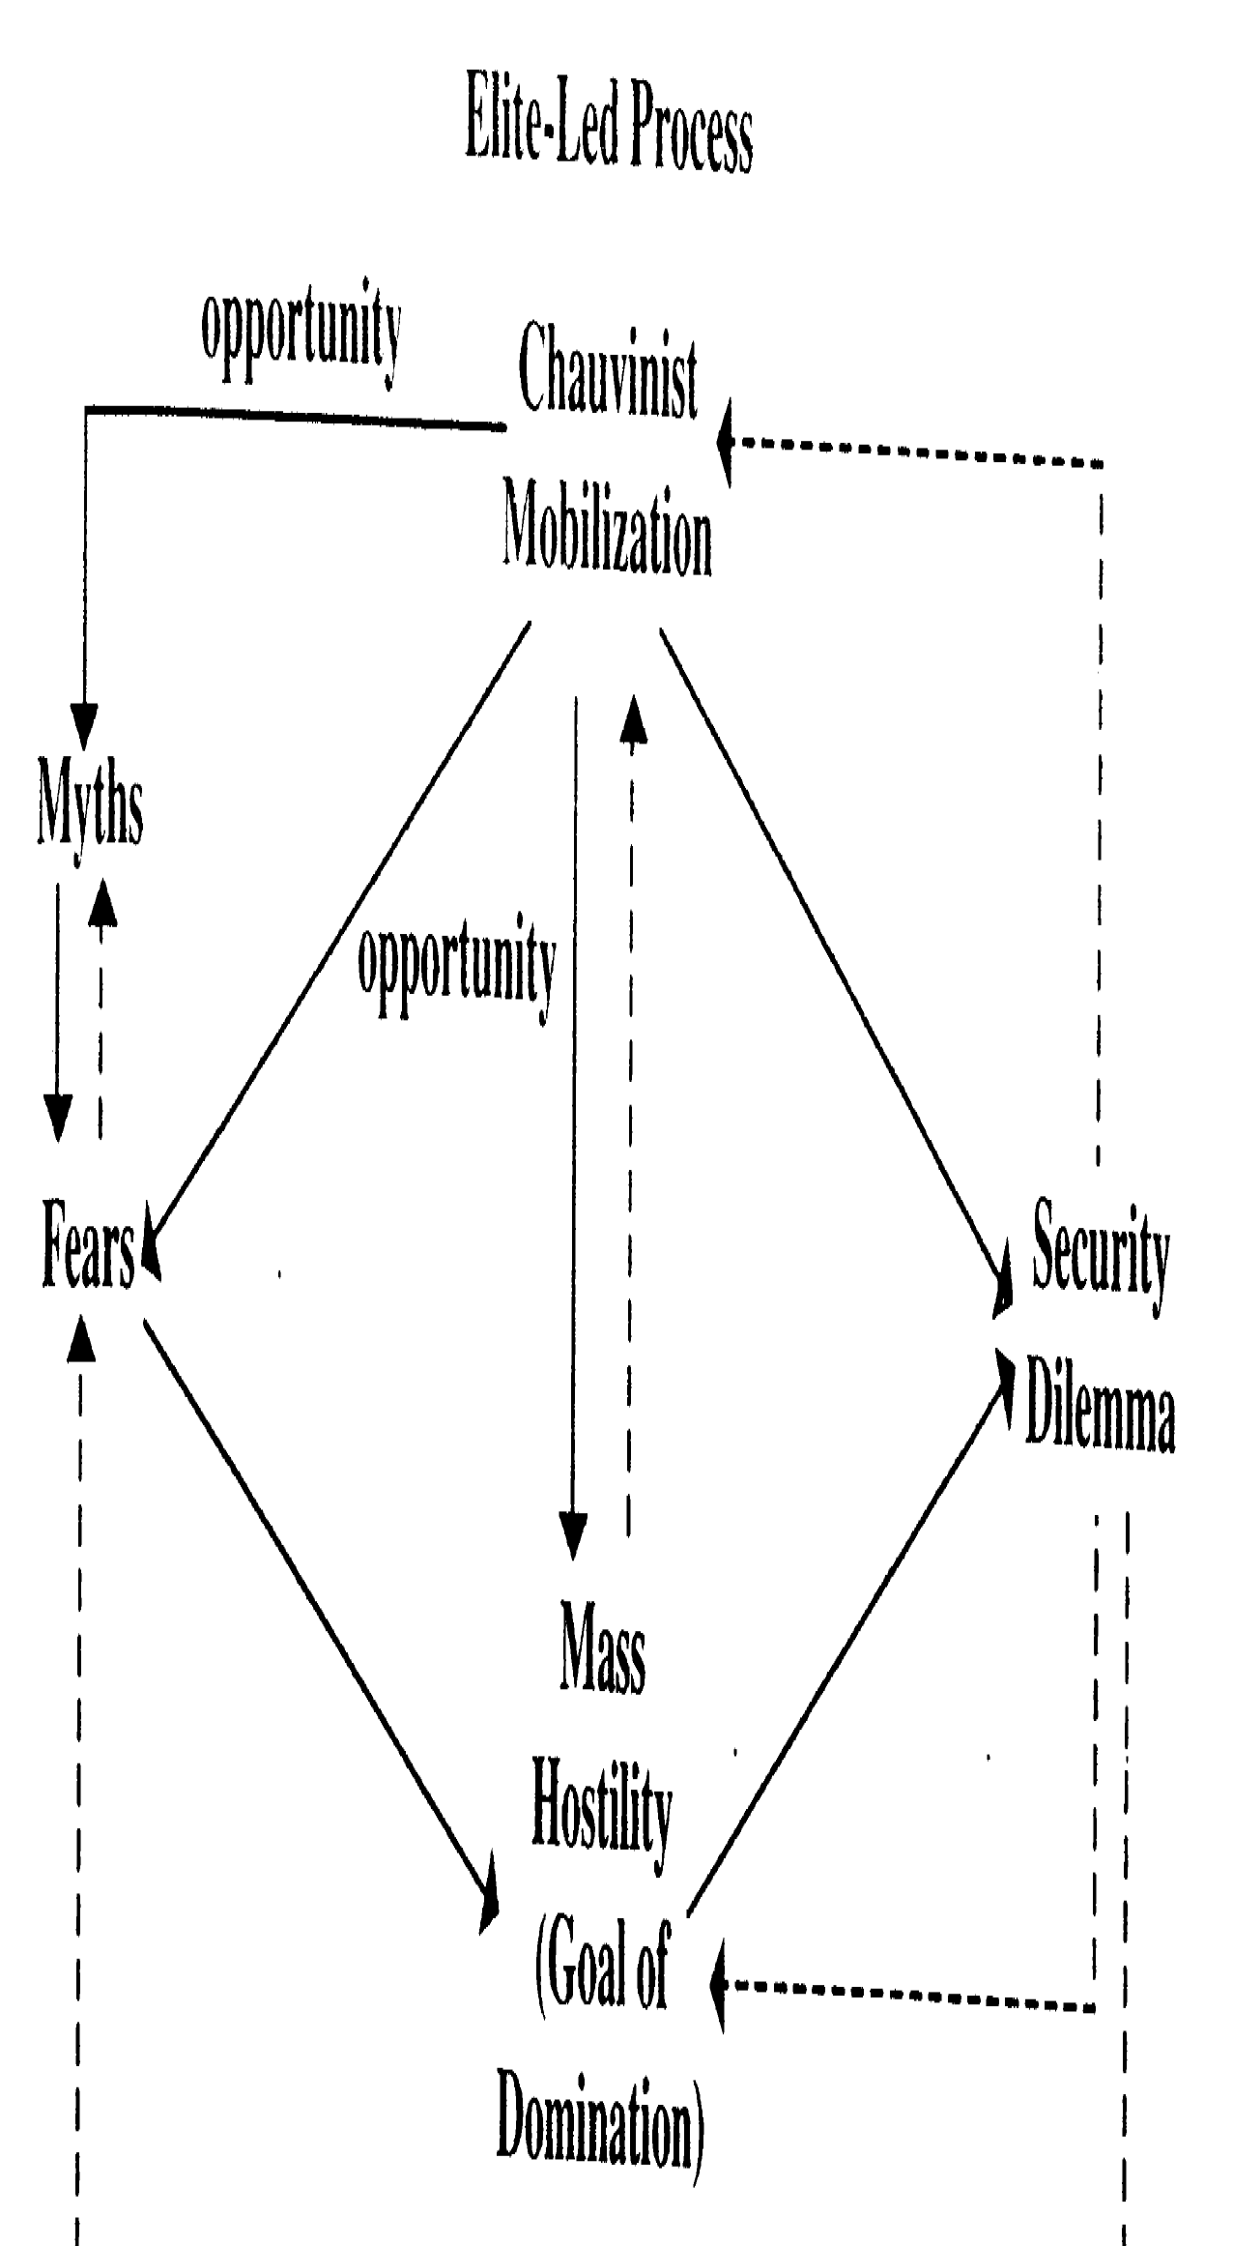

Slide 21
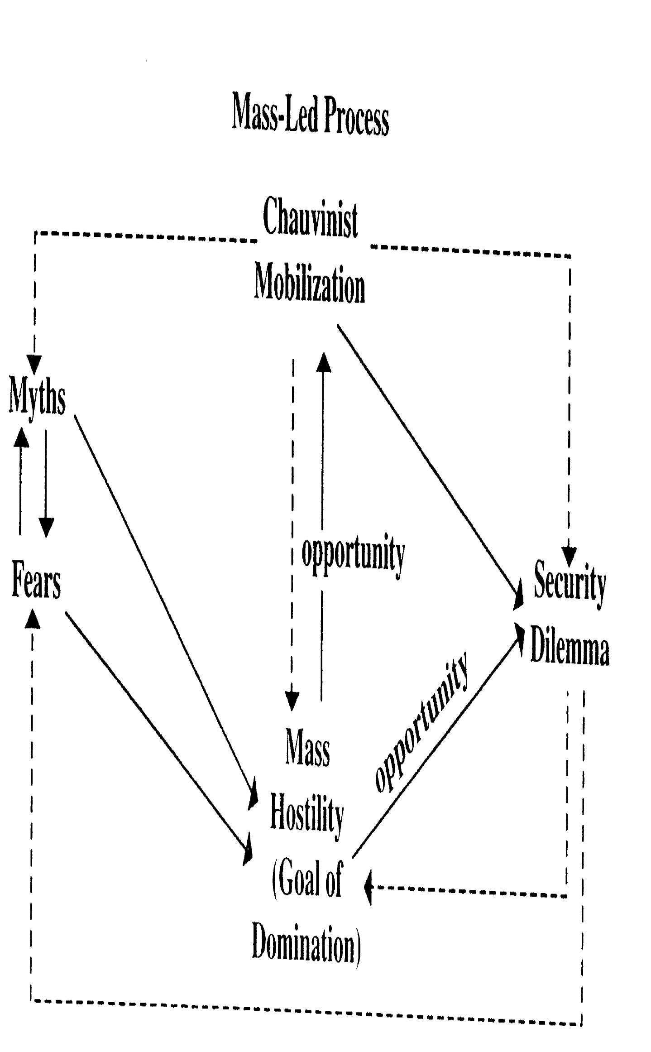

Slide 22
Stuart J. Kaufman – theory of ethnic conflict
Mechanisms:
Extreme hostility has a popular mass support. The probability of conflict increases with the ethnic group’s relative demographic size.
The ethnic group glorifies its history through a one sided interpretation of its own victories and blames losses on traitors or weak leaders. Nourishing calls for revenge contributed to creating organizational structures and culture of violence.
Elites uses ethnic appeals, promoting fear and mass hostility and mobilization for conflict.
A security dilemma arises, in which the hostile ax by the leadership on one side leads to the radicalization of the leadership on the other.

Slide 23
Conclusions
Ethnic symbolism – combines ancient hatreds, manipulative elites and economic rivalry.
Without perceived conflicts of interest, people have no reason to mobilize.
Without emotional commitment based on hostile feelings, they lack sufficient imputes to do so.
Without leadership, they typically lack the organization to act.

Slide 24
Ethnic conflict – military threat
Gap between ethnic group's inadequate capacity for collective action and acute threat to the group's military and economic security.
Ethnic conflict and military threats
„war made the state, and the state made war“ Charles Tilly.
Example: Nagorno-Karabakh – Mutalibov's government was changed by Abulfez Elchibey.

Slide 25
Ethnic conflict – economic threat
Rapid industrialization, introduction of market forces into nonmarket or regulated market economies and the disruption of local markets
Popular demand for state protection from the pain of adjusting to unregulated markets.
Incompatibility of mass-suffrage democracy with the adjustment shocks of laissez-faire economics.
Economic shock therapy is hard to sustain politically.

Slide 26
Ethnic conflict – political participation
Ethnic group claim that old elites are ineffective in meeting foreign threats and that a new, popular government is needed to pursue national interests more forcefully.
Transition to democracy is turbulent
„pre-democracies“ or at best „proto-democracies“ – high participation but low institutionalization that has intensified nationalist politics in the past.

Slide 27
Ethnic conflict – Ideology
Propaganda
Nationalistic version of history
Mythmaking
Exploit nationalist propaganda for state-building.

