Slide 1
Tapiola, Finland
Garden City

Slide 2
Cultural Aspects of Migration, Urbanity and Gender Department of Sociology, Faculty of Social Studies, Masaryk University
Maja Ahmić 390 452

Slide 3
Tapiola, Espoo Region, Finland

Slide 4
Where is it?
Tapiola is a district of Espoo on the south coast of Finland, and is one of the major urban centres of Espoo.
Espoo is statistically the second largest city in Finland with roughly 250 000 inhabitants and more pouring in all the time.
Espoo is a classic case of a community that evolves when the center city (Helsinki) spills over its limits and loses control over its suburban areas. Espoo developed along with Finland’s fast urbanization process after the Second World War.

Slide 5
The name origin
The name Tapiola is derived from Tapio, who is the forest god of Finnish mythology, especially as expressed in the Kalevala, the national epic of Finland.

Slide 6
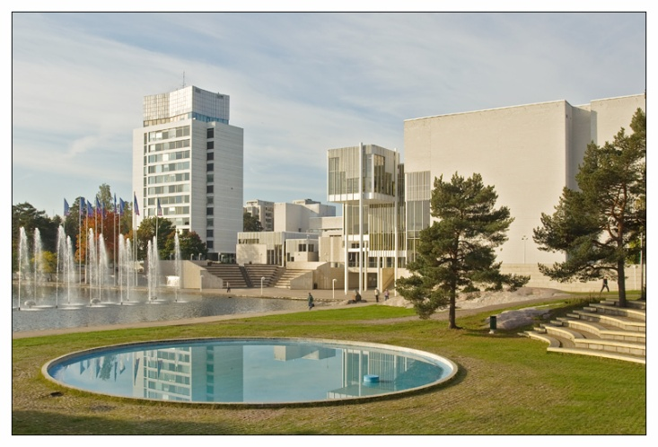
The year of construction
The construction of the city began in 1950's and the goal of constructing this garden city has been to establish balance between nature and its citizens.

Slide 7
The Aim of The Project
The aim of the Housing Foundation was to create a garden city which would be a microcosm of Finnish society: all social classes would live there and there would be different types of buildings, ranging from detached houses to terraced and multi-storey blocks.

Slide 8
The Slogan of the Project
“We do not want to build houses or dwellings but socially healthful surroundings for contemporary man and his family".
Tapiola provided a utopian vision of society and an alternative to what was seen at the time as an oppressive urban environment. In this sense, Tapiola was both an experiment and a model.“

Slide 9
The Housing Team
Team members were from a wide range of fields and included:
a building engineer,
a heating engineer,
two independent architects,
an electrical engineer,
a landscape gardener,
a domestic science expert,
a child welfare expert,
a sociologist,
and a housewife

Slide 10
Urbanity of Tapiola
The founder of Tapiola, Heikki von Hertzen, believed that it was not possible to create a satisfactory residential centre if the population density exceeds a certain figure.
Hertzen's vision for Tapiola, which was originally planned for an area of 600 acres, was to have only 26 residents per acre, and a total of 15,000 people.
The ground was divided into four neighbourhood units, separated by green belts, and in the middle was built a main shopping and cultural centre to meet the needs of 30,000 inhabitants (including those of surrounding districts) (Hertzen 1959).

Slide 11
Mini Map of Tapiola

Slide 12
An important feature of the Tapiola and garden cities is the development of a self-contained community. This meant that as many jobs as possible had to be provided – as many as could be at a distance of less than 10 km from Helsinki.

Slide 13
Features on which Tapiola was built were:
The starting point of planning is the individuality of man and closeness to nature, and the aesthetic value of nature and use of natural contours of the landscape are retained wherever possible.
Nature dominates, architecture is secondary. All buildings must harmonise with the natural setting
To be a working town, not a dormitory or nursery, providing as many jobs as possible to its inhabitants
The town should provide for a range of income levels – "a community of everyman, where the ordinary worker, successful businessman and university professor can live side-by-side"
Consistent placing of multi-story buildings with alternatively low housing, resulting in a feeling of spaciousness and variety

Slide 14
Practices and Services of Tapiola
The Tapiola commercial centre at night-time.
Finland's first shopping centre, was opened in Tapiola in 1968. The Tapiola centre has a large selection of services: department stores, book stores and groceries, a post office, banks, sports stores photography stores, barber's shops, and other small businesses. Public services include the Tapiola health centre, a library, an employment bureau, the Espoo magistrate and the Espoo tax bureau.

Slide 15
The Future Plannings

Slide 16
Espoo Region in Plans
Espoo’s goal is to create what could be referred to as an innovation city: s place where these different areas of life collide resulting in new ideas, ways of doing things, and prosperity.
Walking is encouraged, everything is bustling with life 24/7 and all solutions will be so environmentally sustainable that a global recognition is granted.
The bill is at least four to five billion Euros for all investments combined. The mission for city planning is to connect the dots and turn a new page is Espoo’s history.

