Slide 1
Transition Towns
Molly Scott Cato

Slide 2
Living Experimentally

Slide 3
A brief history . . .
Transition Towns launched in Totnes in September 2006
if we wait for the governments, it'll be too little, too late
if we act as individuals, it'll be too little
but if we act as communities, it might just be enough, just in time.
Transition Stroud launched in January 2007

Slide 4
Three key concepts
Resilience: ‘the property of a material to absorb energy when it is deformed elastically and then, upon unloading to have this energy recovered.’
Ecological citizenship: intrinsic and ethical motivations towards protecting the environment
Critique: the importance of political economy

Slide 5
Psychological aspects
‘Moving from probabilities to possibilities’
http://www.youtube.com/watch?v=0q90_phxAOk

Slide 6
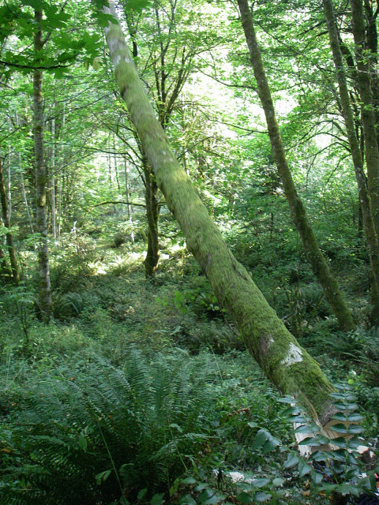
Taking a bioregional approach to land
„Nature is not a place to visit, it is home“ Gary Snyder

Slide 7
Reclaiming the local food economy

Slide 8
Stroud Community Agriculture

Slide 9
Apple day

Slide 10
Celebration!

Slide 11
Preservation

Slide 12
Close to zero food miles
Genuine ownership
Production not just consumption
Seasonality and concept of ‘share’
Annual cycle and community in festivals

Slide 13
Conviviality: Stroud Farmers’ Market

Slide 14
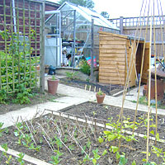
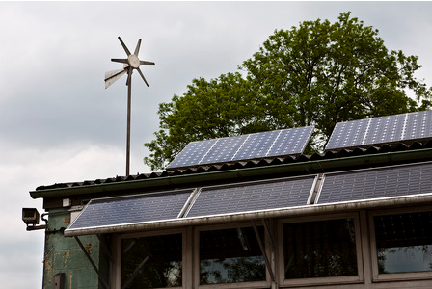
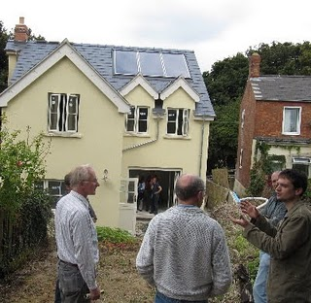
Open Homes and Gardens

Slide 15
The Seeds of a Greener Future?
Notes:
Flourishing within limits
A new consumption ethic
Re-embedding

