Slide 1
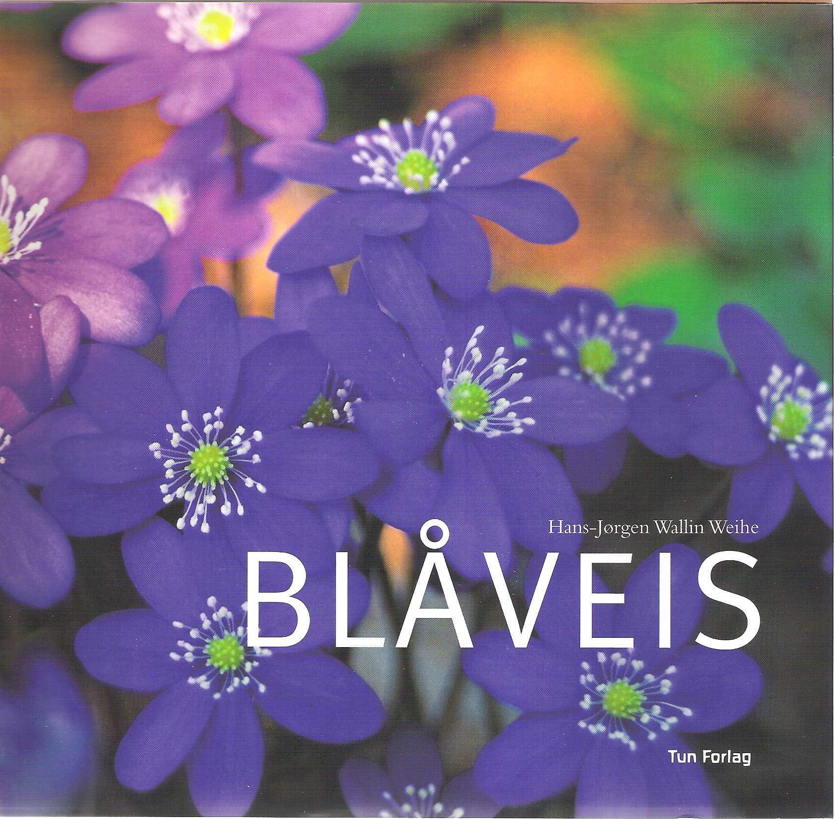
Notes:
The Blue Anemone Hepatica nobilis – The flower of resistance, survival and beauty. The Norwegian name means Blue (blå) and the type of flower wich is called ”veis”, which include a number of anemone flowers like the wood anemone. The anemones have been described in eraly historical botanical works back to the Greek time and means a flower moving in the wind.

Slide 2
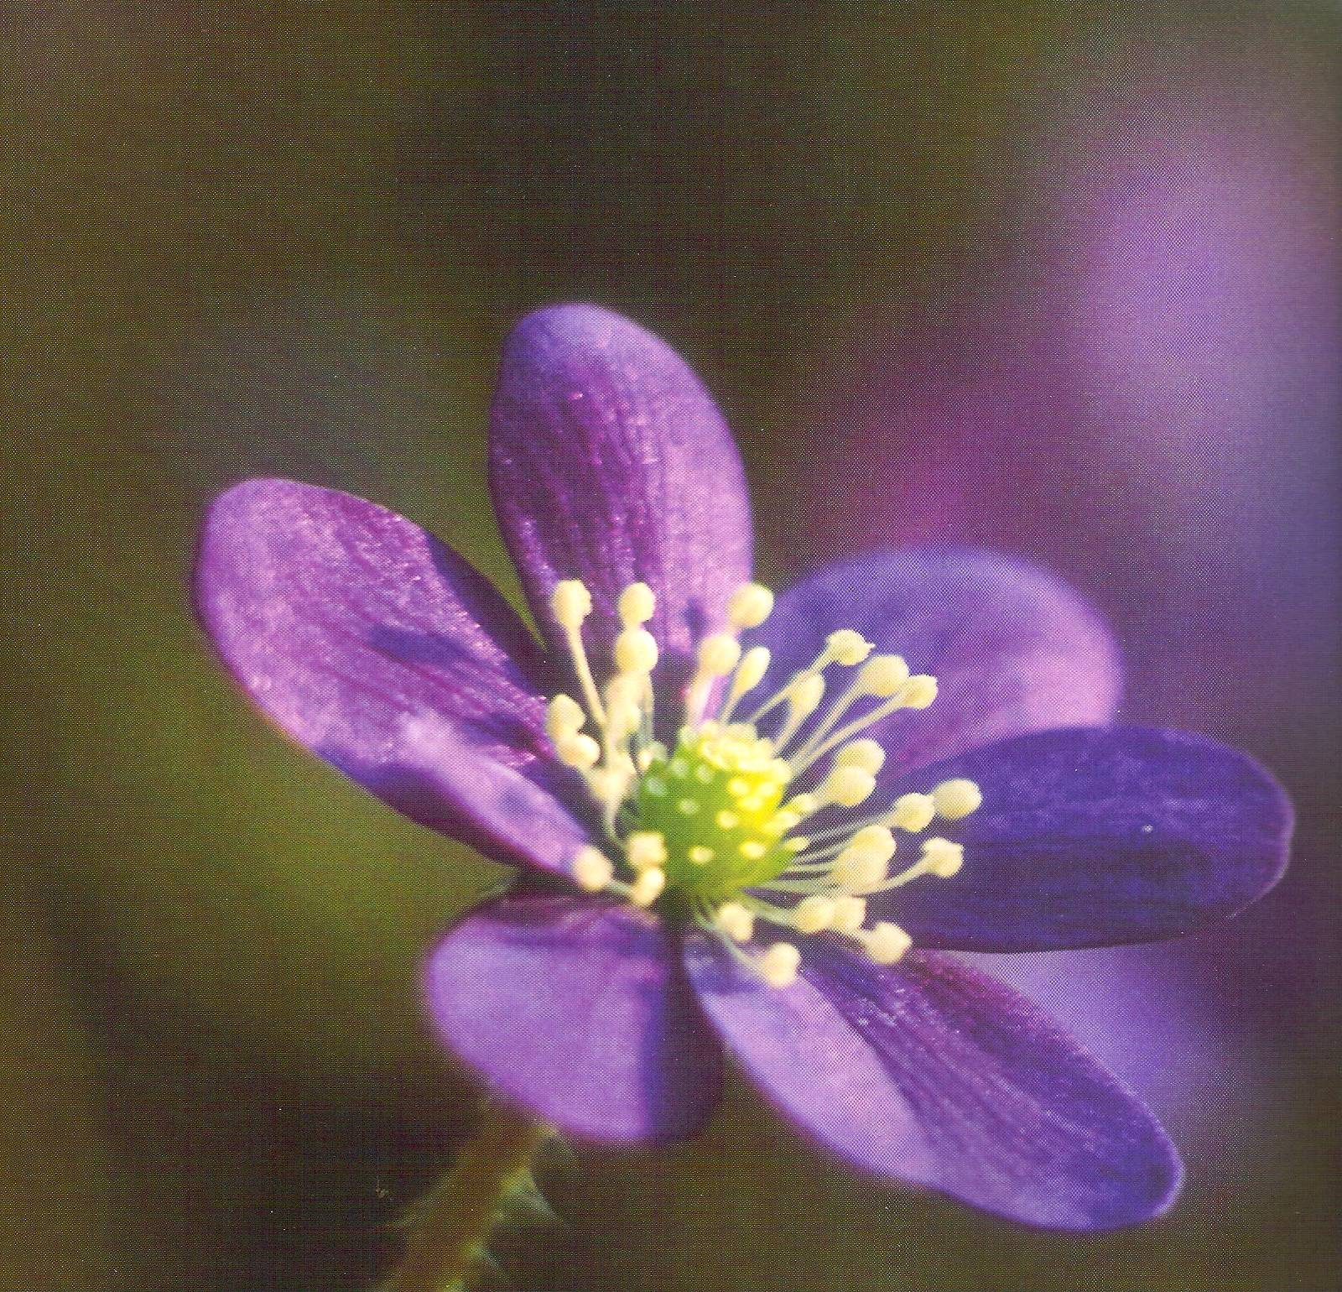
Notes:
A small spring flower blossoming before other flowers early in the spring often in places later covered with dense vegetation. In German the flower is called Hassel blume – since it is growing underneath the dense vegetation of hazel bushes.

Slide 3
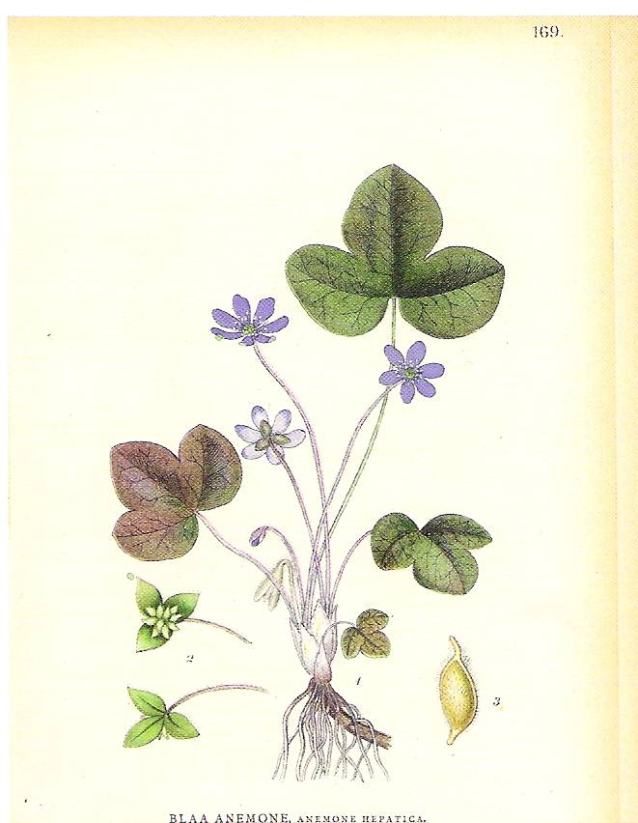
Notes:
An illustration from a botanical book from the early 1900s. The Latin name has later on been altered from Anemone Hepatica to Hepatica nobilis.

Slide 4
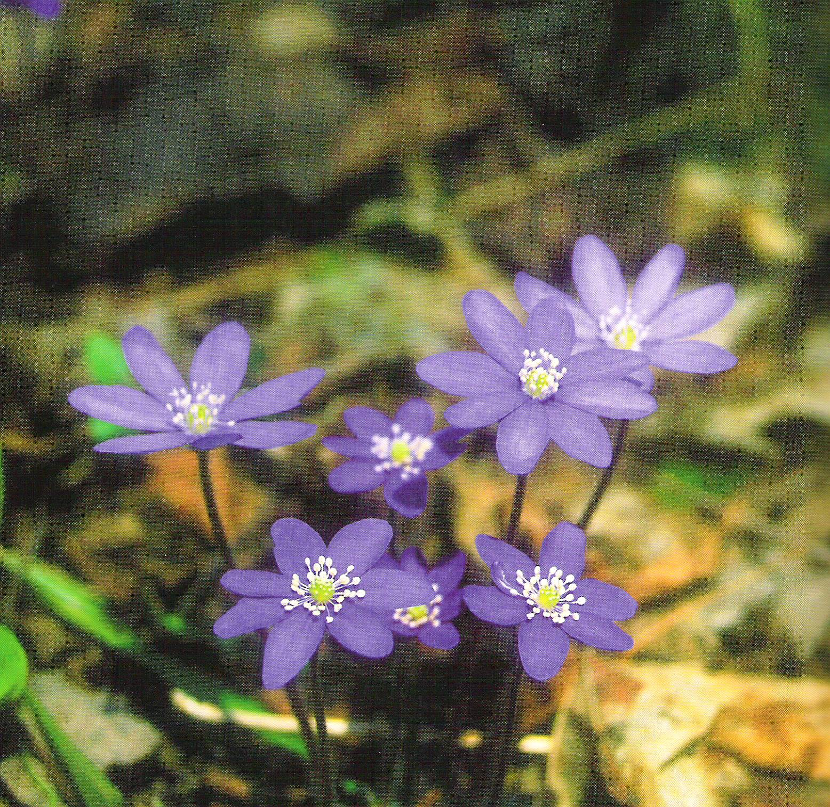
Notes:
Variations in the flowers (number of petals) of the blue anemone Hepatica nobilis

Slide 5
Notes:
Colour variations in the Blue anemone Hepatica nobilis (from white, to nearly red to the mots commonly found blue).

Slide 6
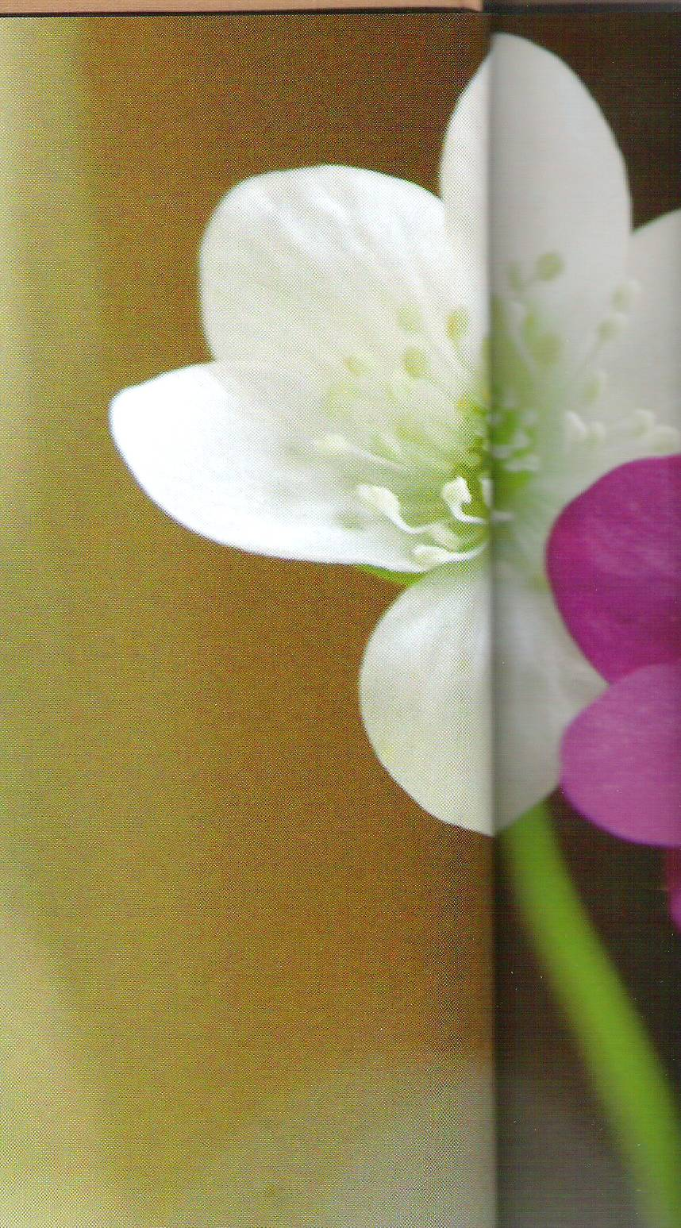
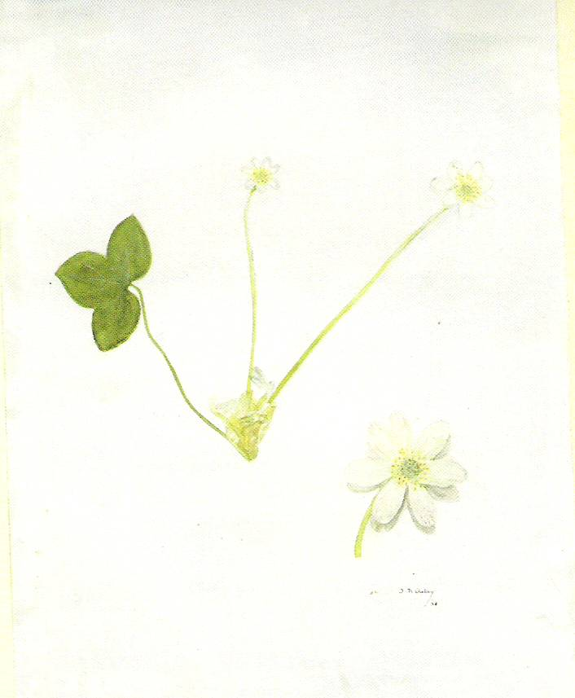
Notes:
The illustration is from a botanical thesis of the 1930s

Slide 7
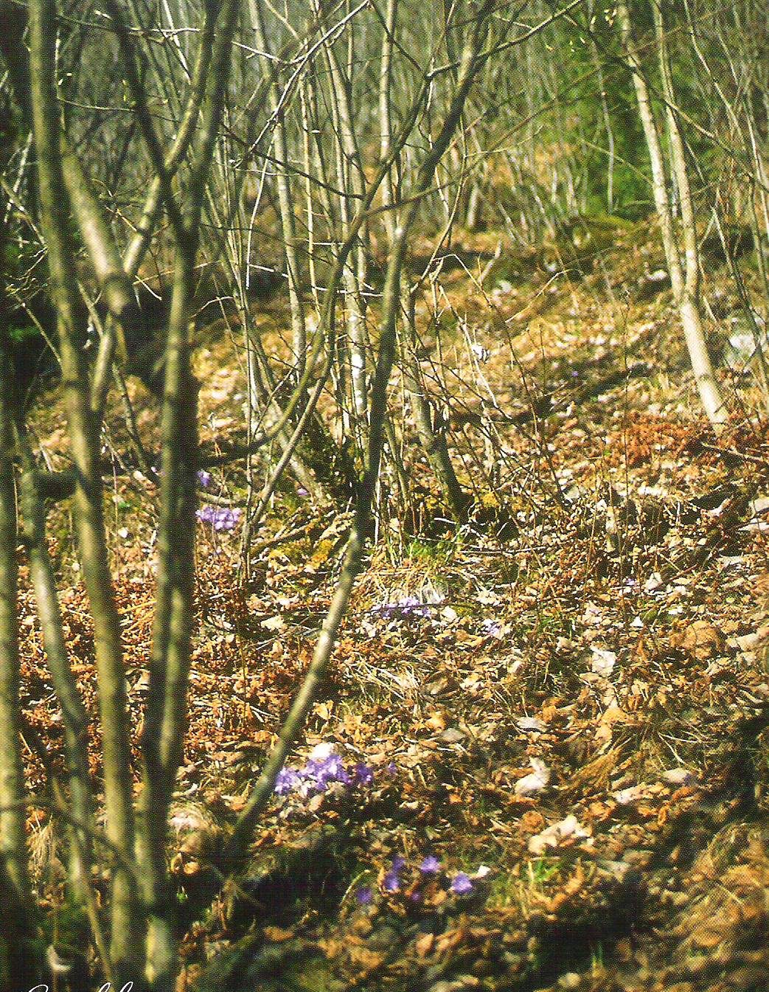
Notes:
Typical area of growth in abushy terrain with hazel bushes – later leaves on the bushes will make it difficult for plants to grow underneath.

Slide 8
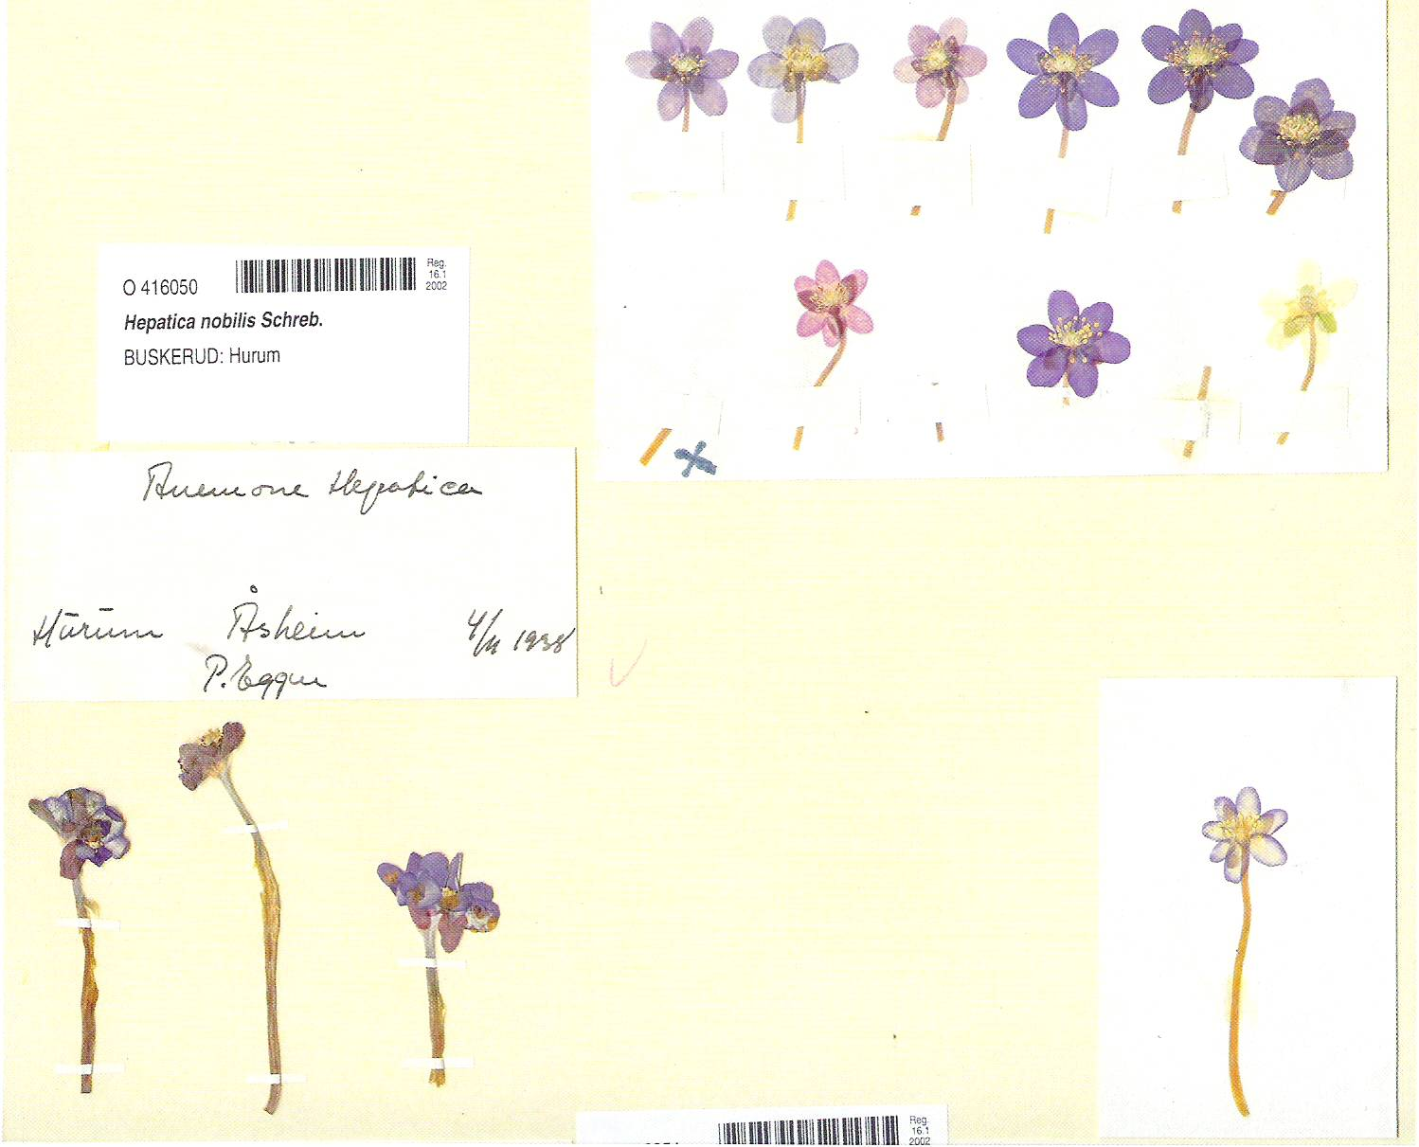
Notes:
Botanical reference samples from the collection of the botanical Museum in Oslo.

Slide 9
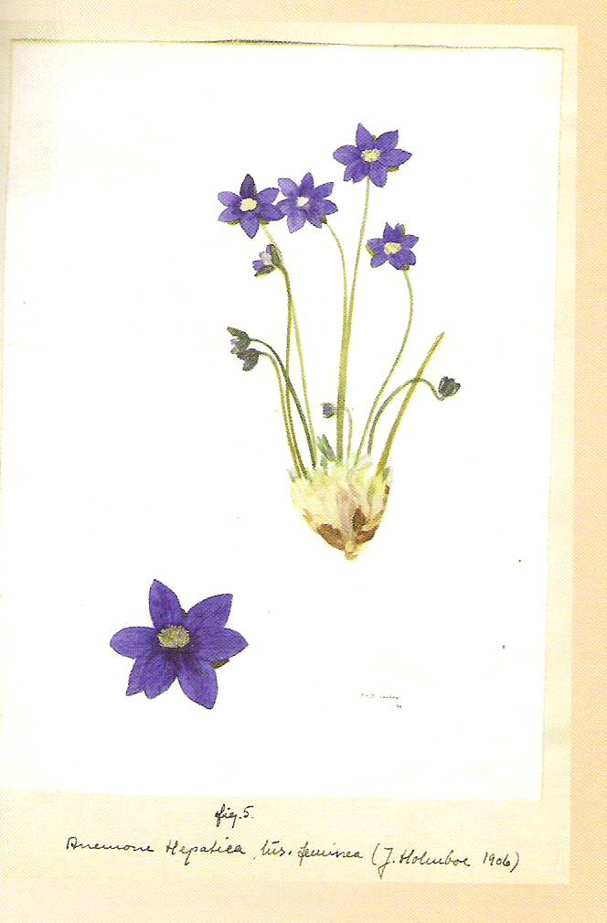
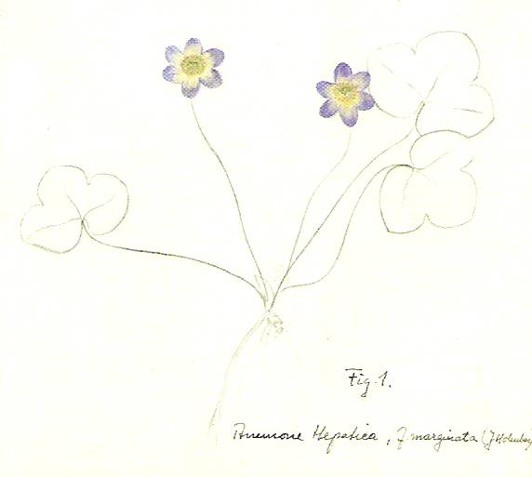
Notes:
Colour variations and differences in flowers

Slide 10
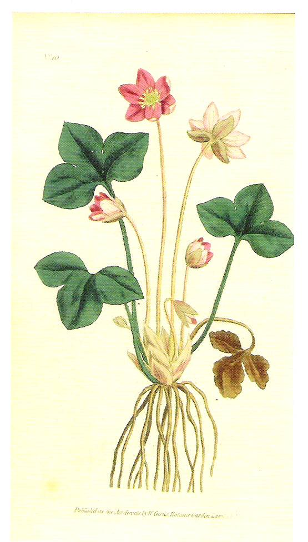
Notes:
The redish coloured blue anemone is somewhat of a mystery a highly sought after

Slide 11
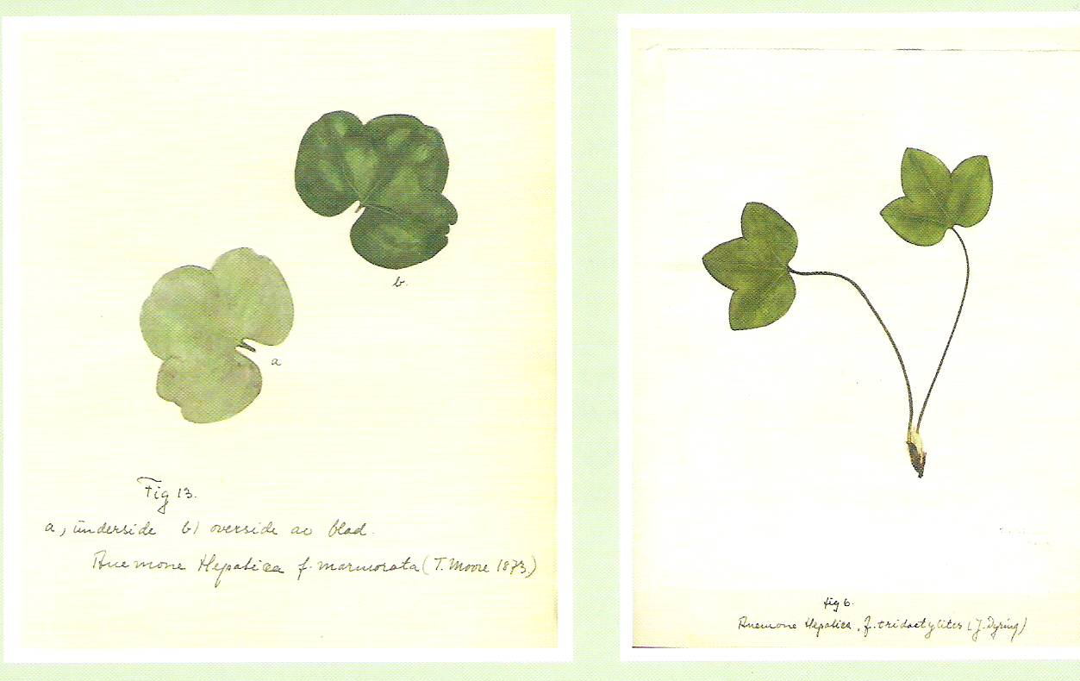
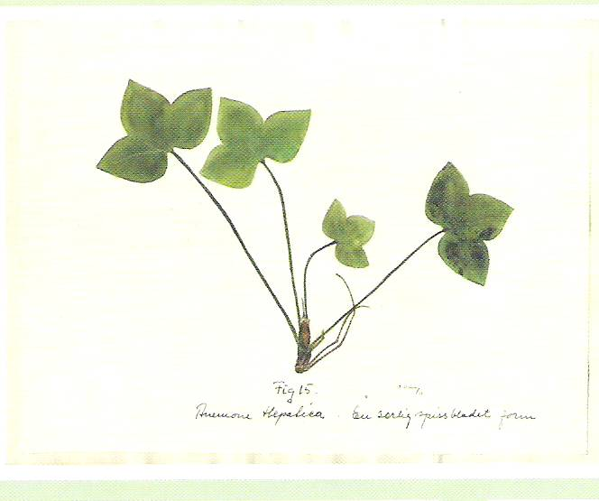
Notes:
Variations in the leaves of Hepatica nobilis

Slide 12
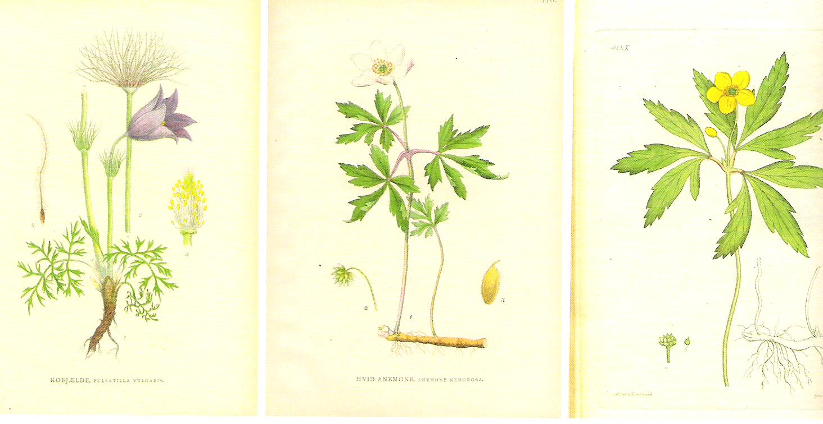
Notes:
Pulsatilla and anemones – earlier they were all classified in one family together with Hepatica nobilis

Slide 13
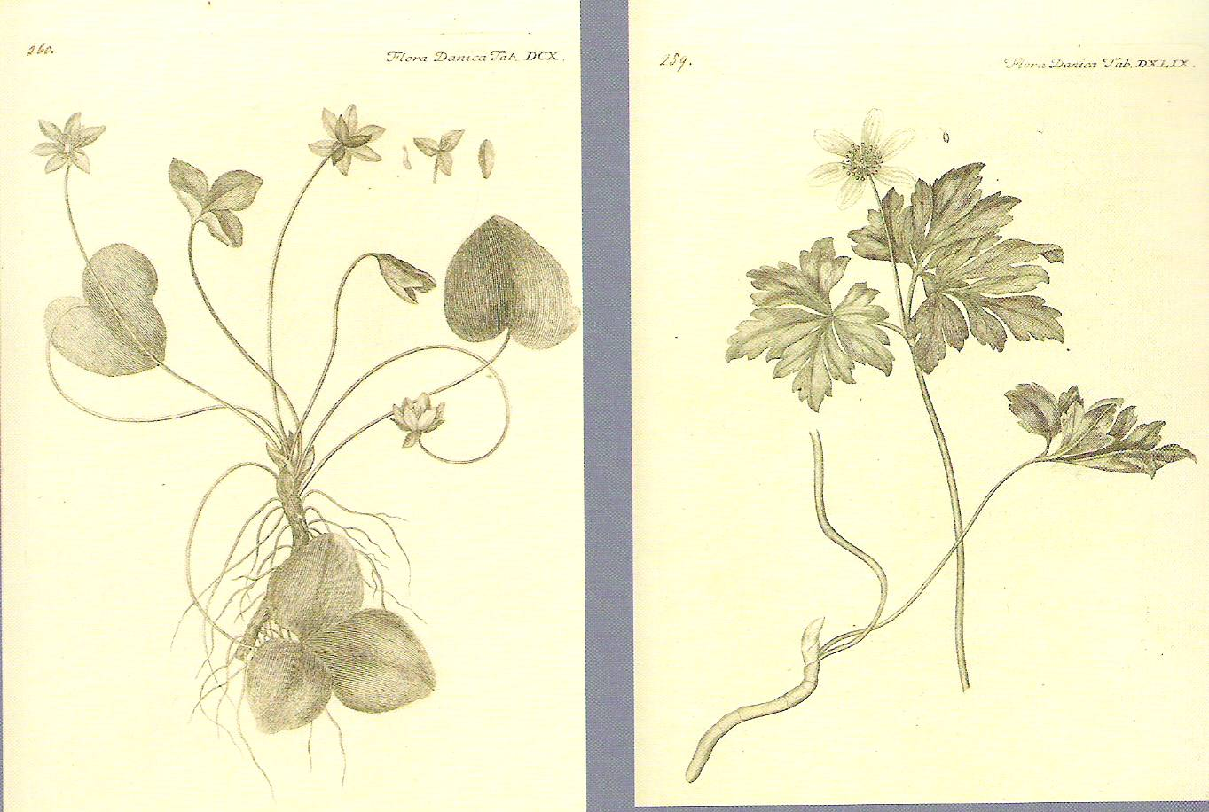

Slide 14
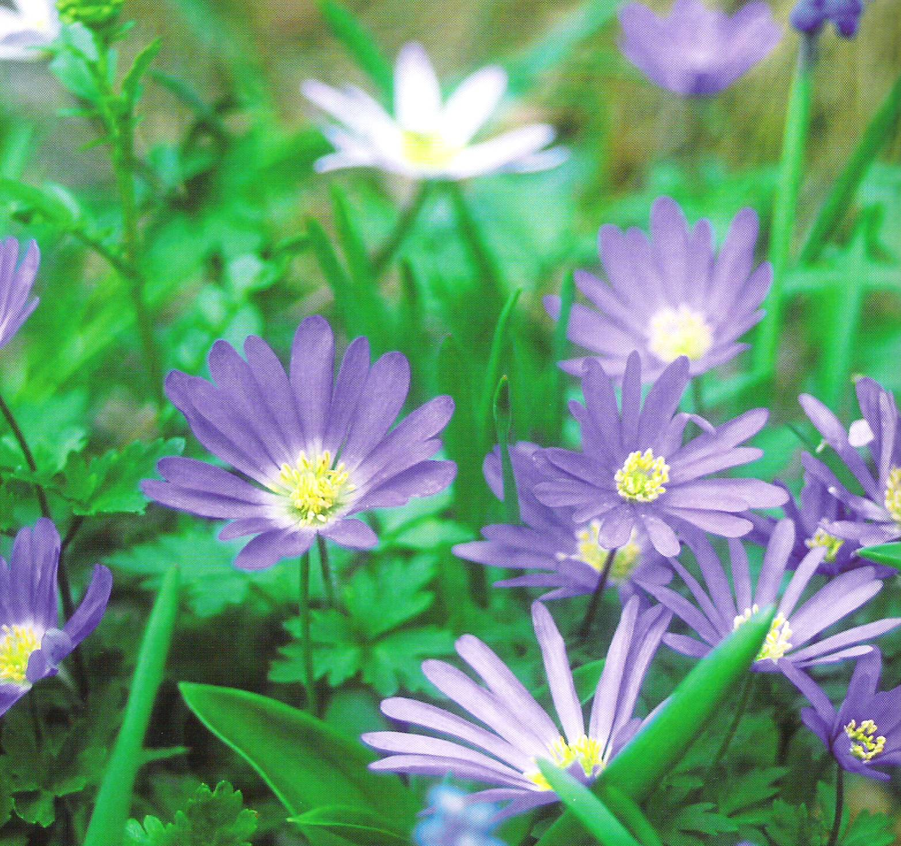
Notes:
Anemone of the Baltic

Slide 15
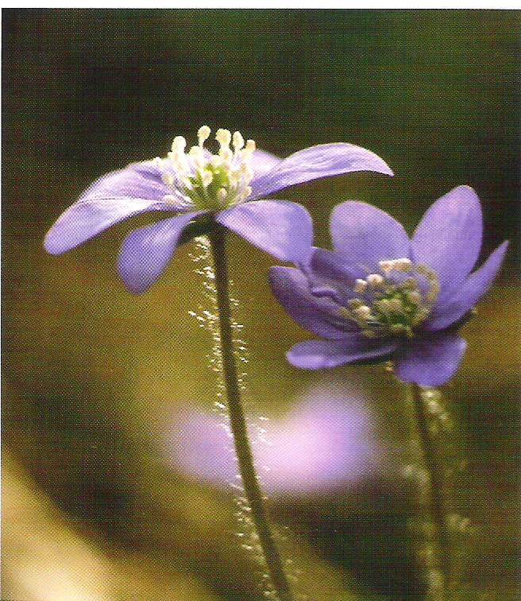
Notes:
The ”hairy” or ”pussy” flower. The hairs on the stem is typical of arctic flowers and give some protection against frost

Slide 16
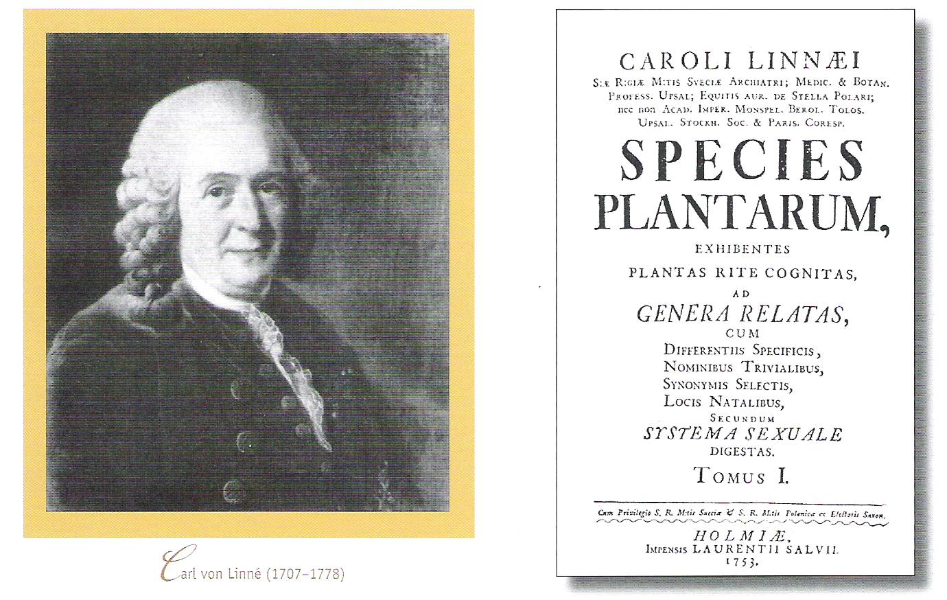
Notes:
The Swede Carl von Linné (1707 – 1778) made the modern system for classification of plants.

Slide 17
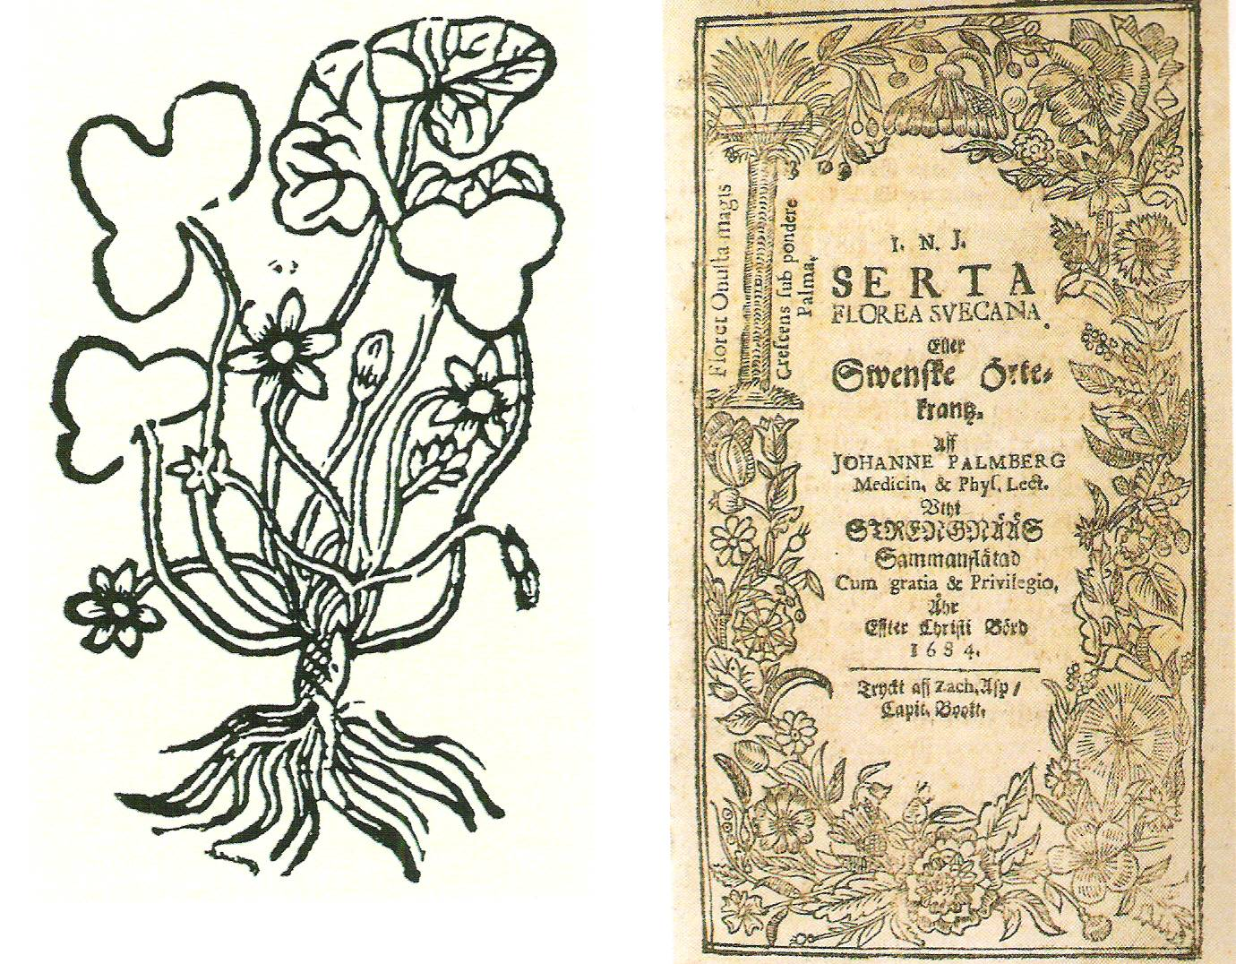
Notes:
Swedish botanical work from 1643 – at the time the flower hepatica was thought off as medical plant that could be used to treat liver diseases. The shape of the leaves resembles the shape of the human liver.

Slide 18
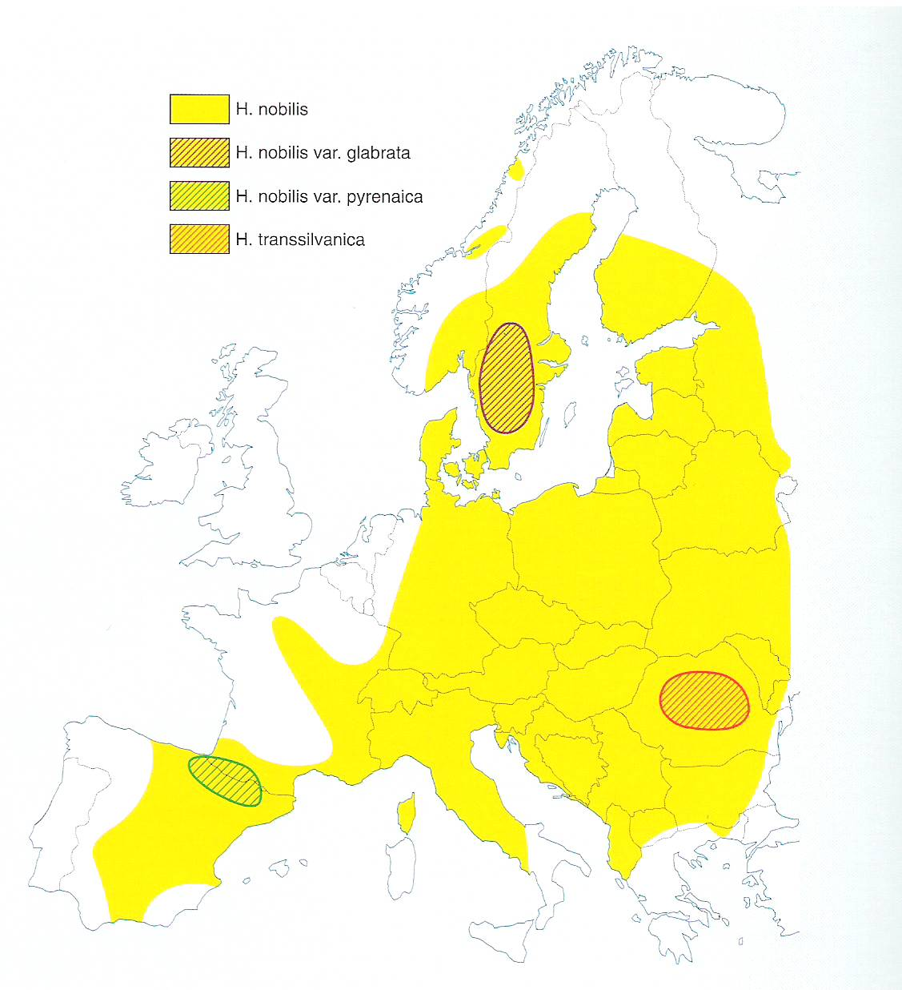
Notes:
The distribution of Hepatica nobilis and variations in flowers in Europe.

Slide 19
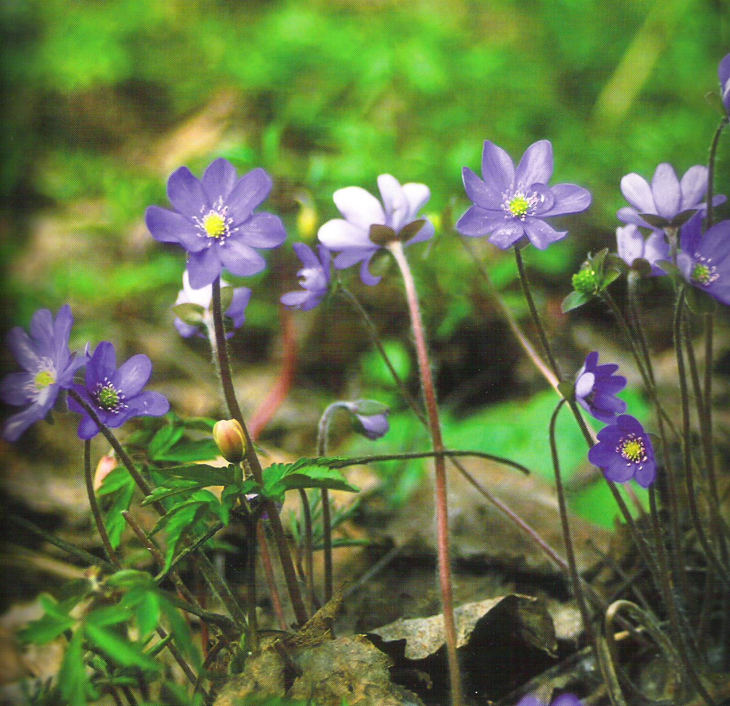
Notes:
Blue and white anemone with dry leaves from the fall on the ground.

Slide 20
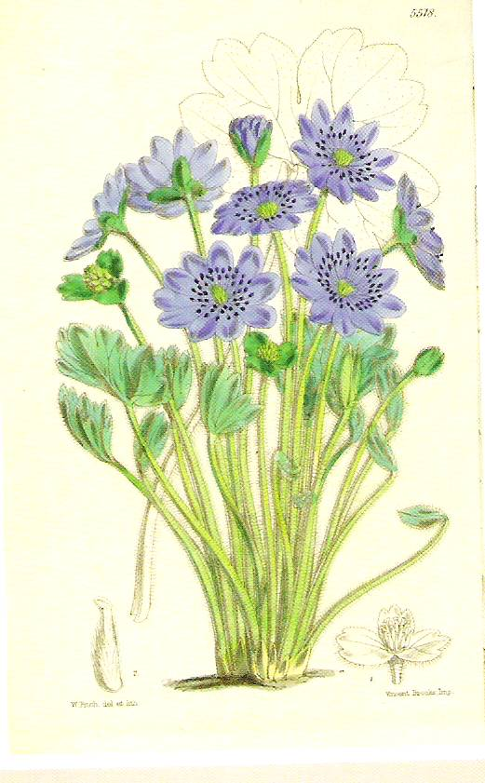
Notes:
An Himalay variety

Slide 21
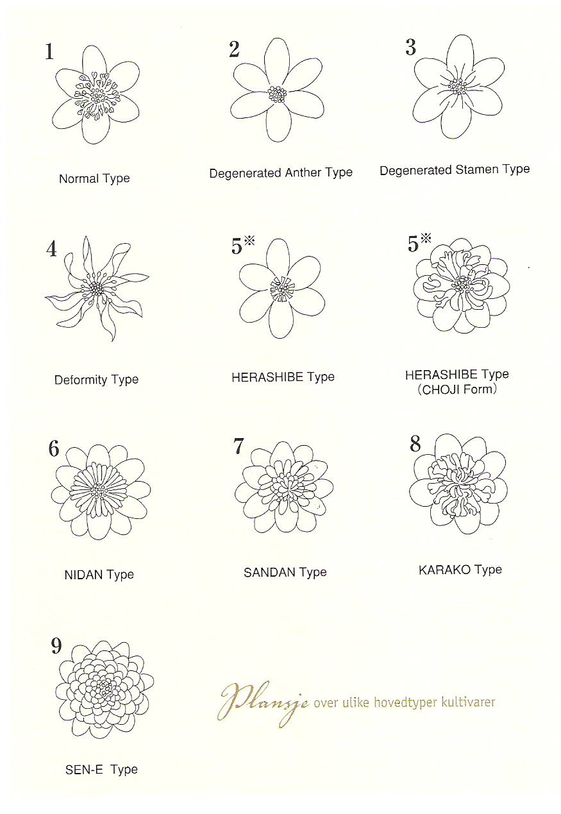
Notes:
Cultivated Japanese variations of Hepatica nobilis – other Asian variations exists in China, Korea, Pakistan and India

Slide 22
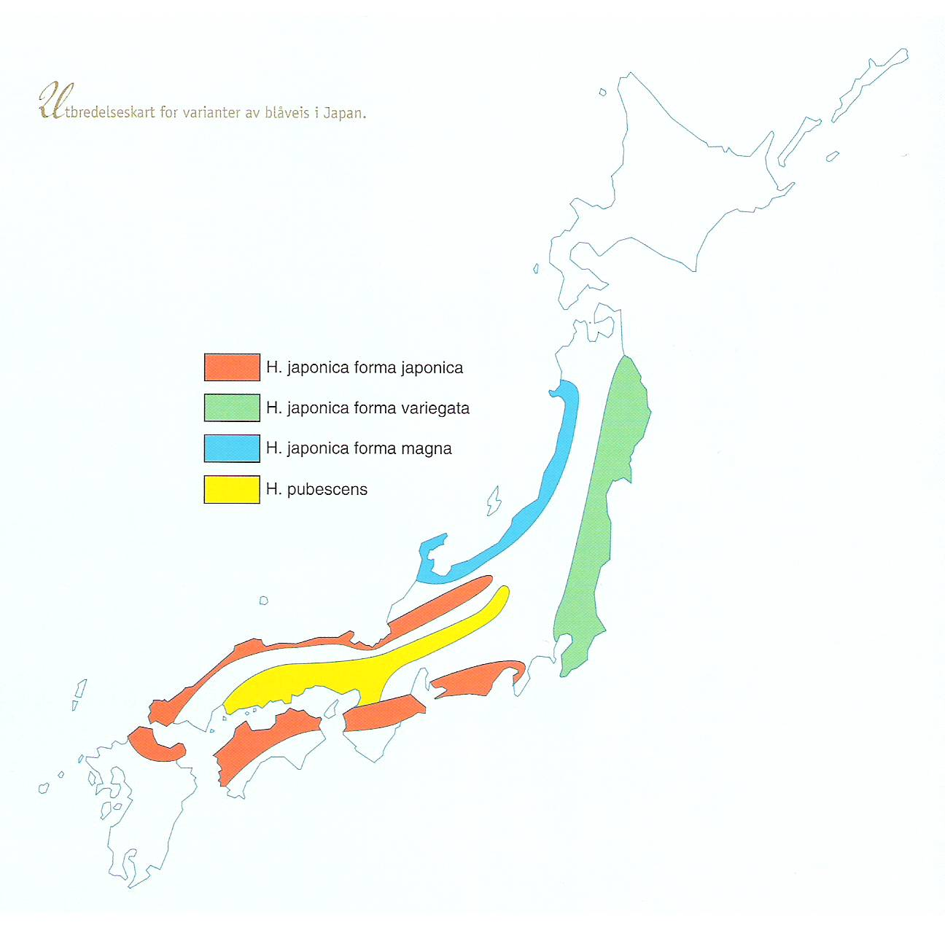
Notes:
The Japanese distribution of Hepatica nobilis

Slide 23
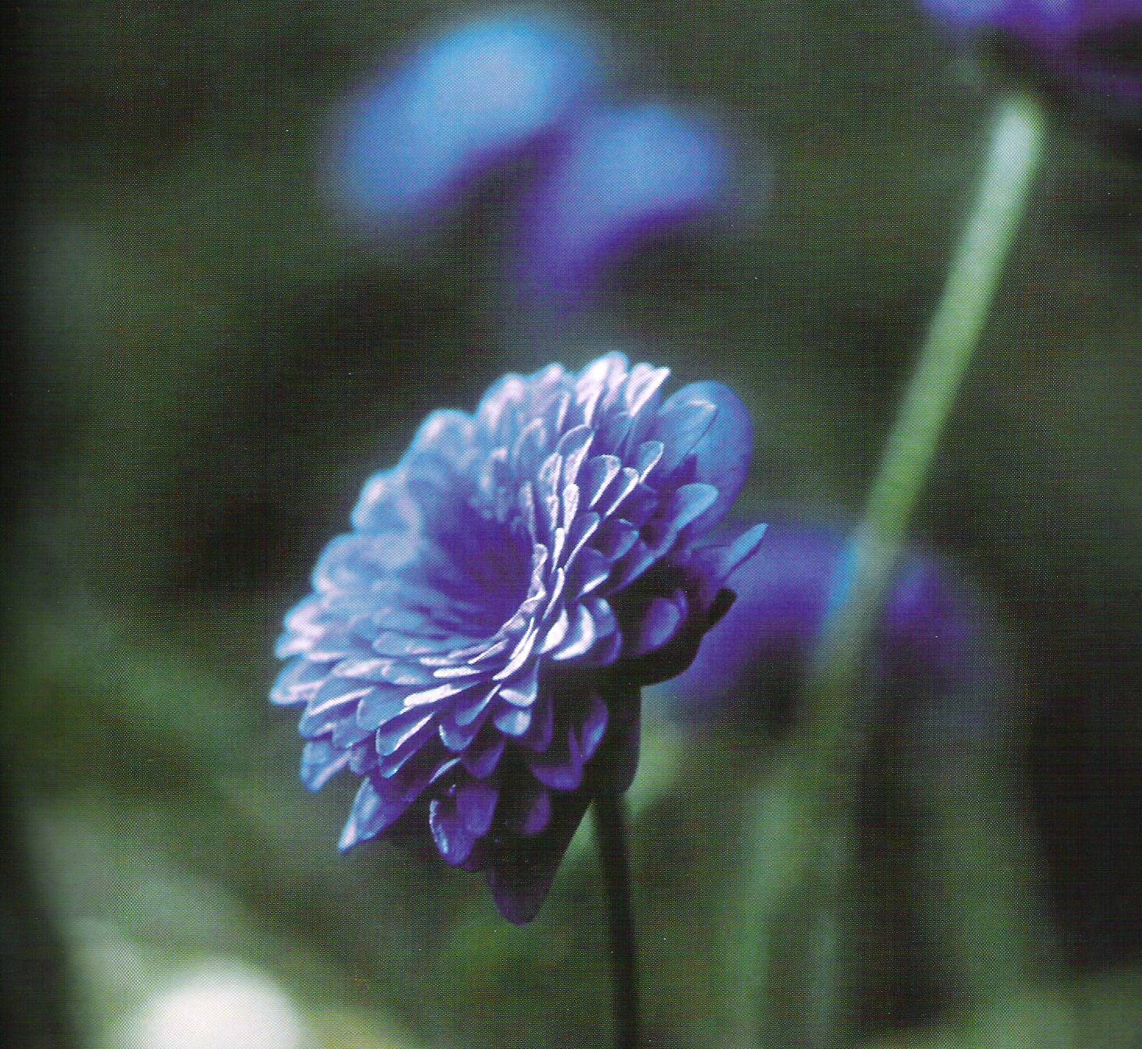
Notes:
A wild Norwegian variation of Hepatica nobilis

Slide 24
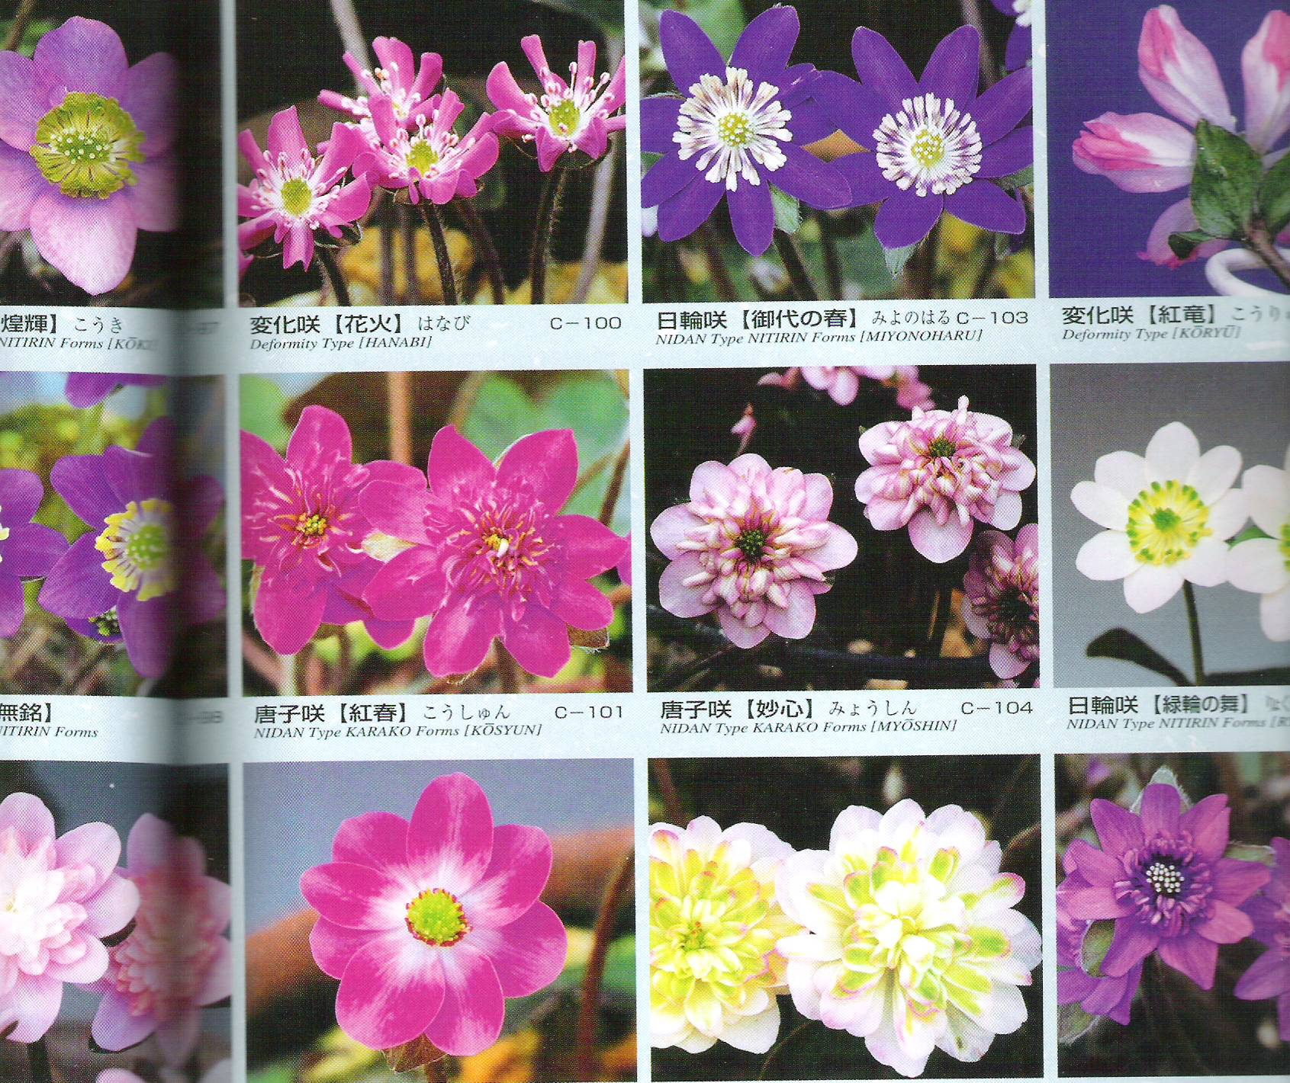

Slide 25
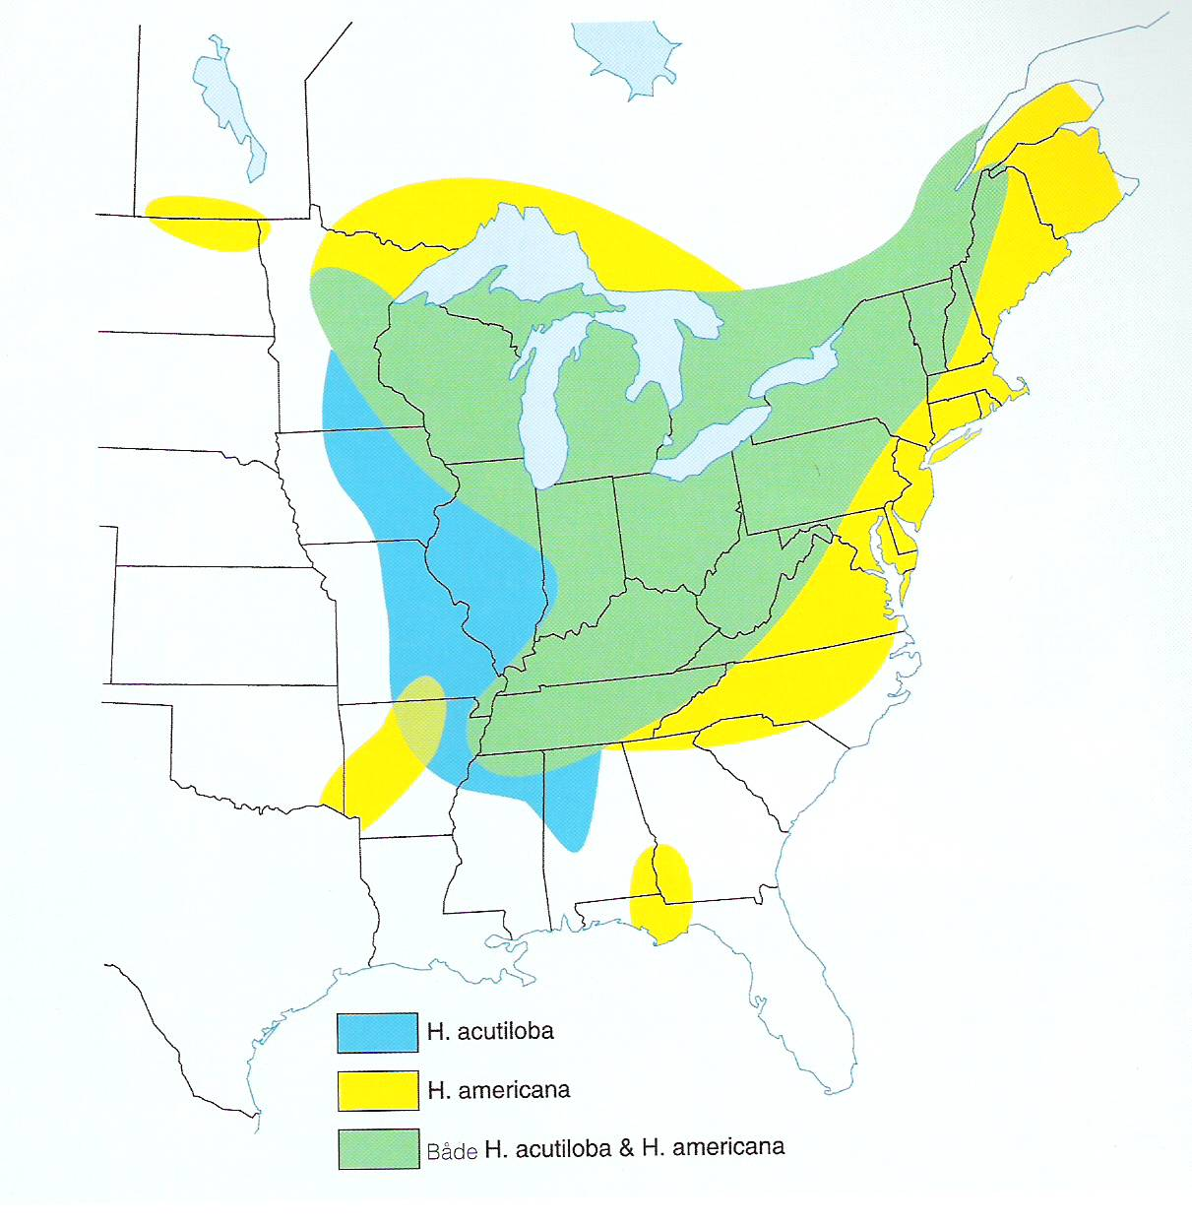

Slide 26
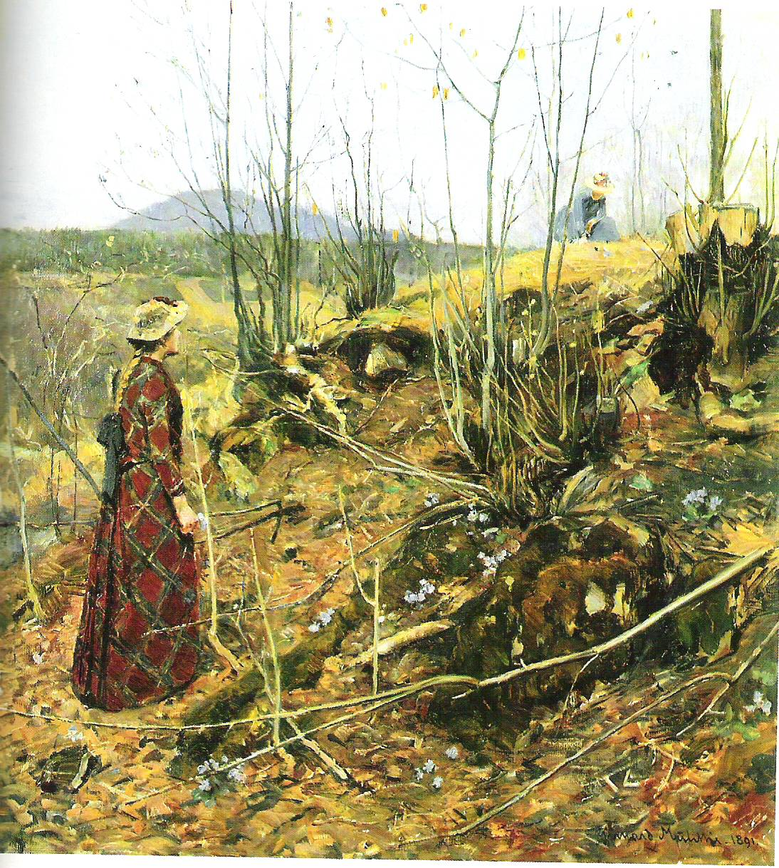

Slide 27
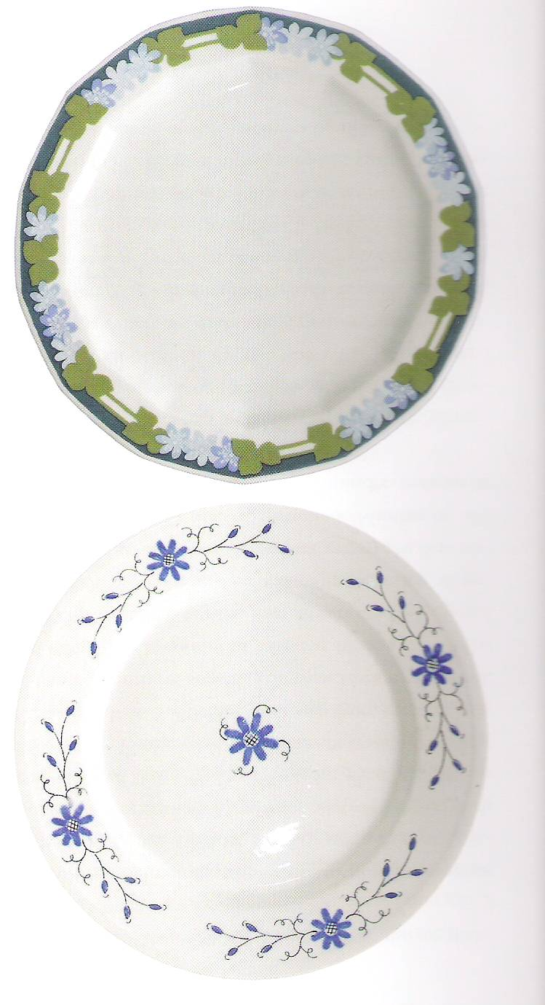

Slide 28
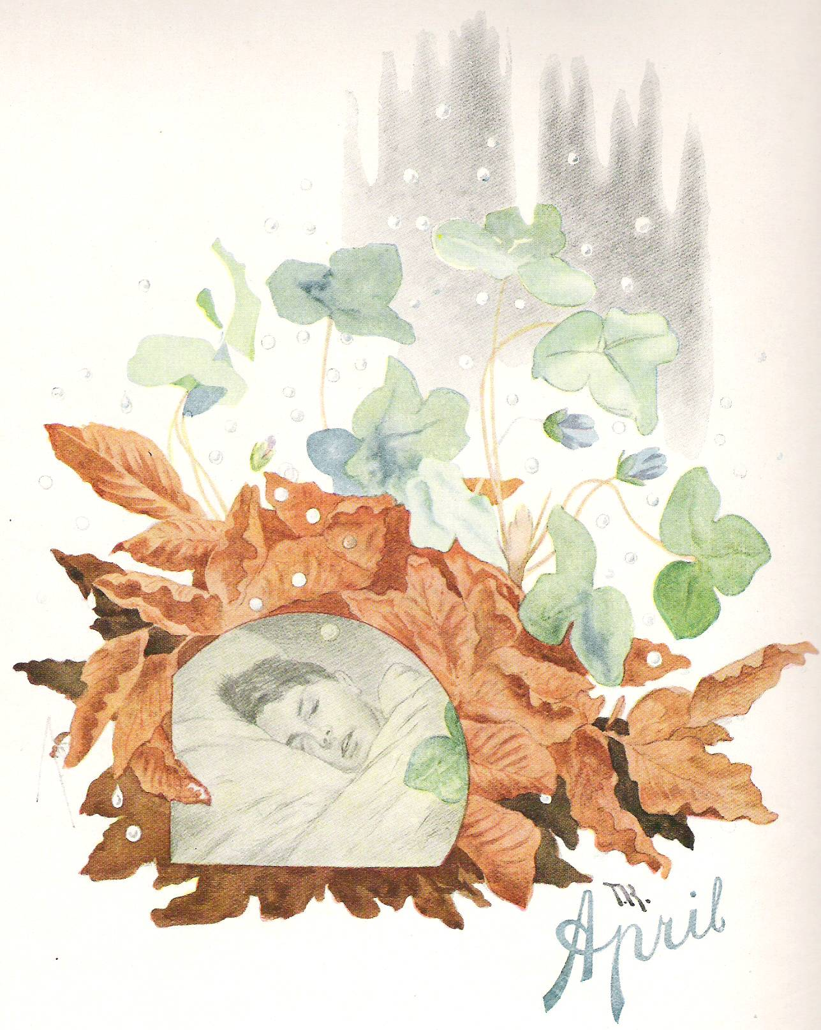

Slide 29
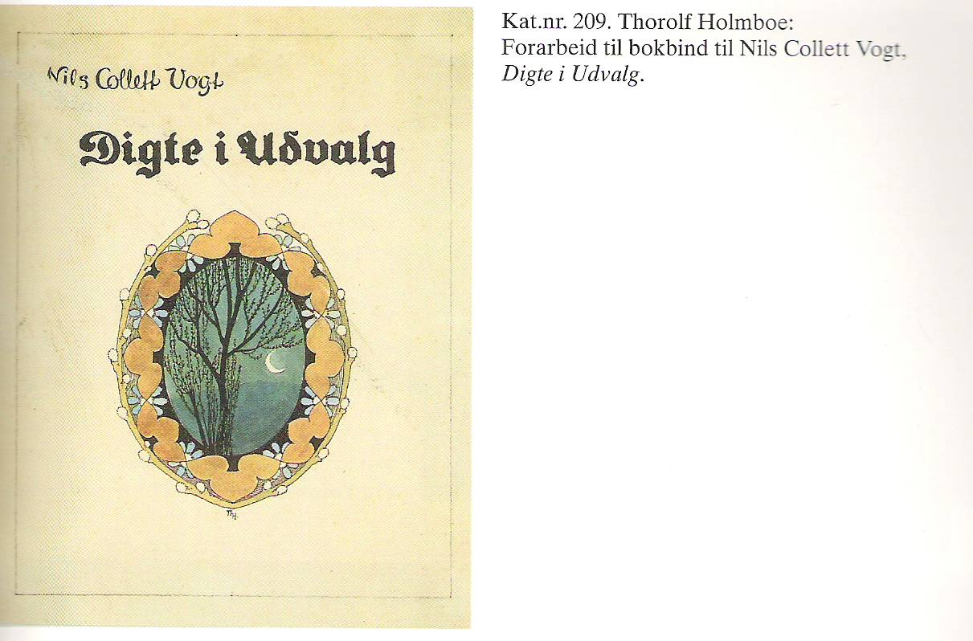

Slide 30
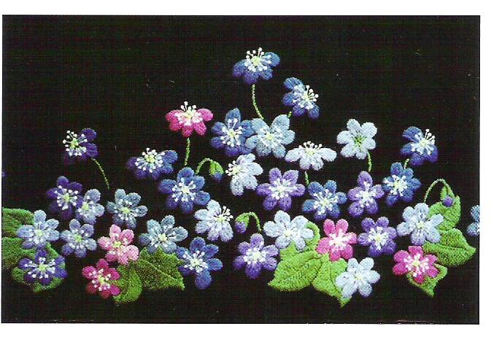

Slide 31
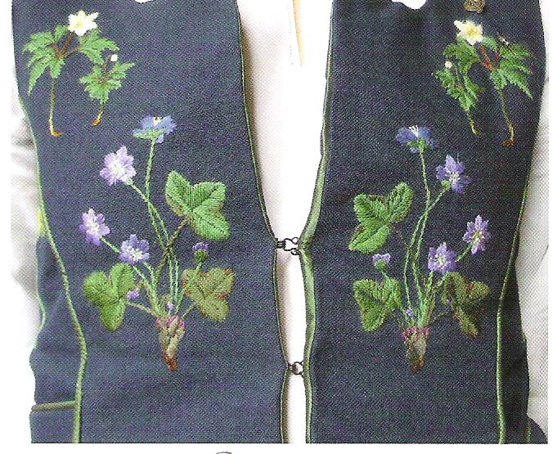

Slide 33
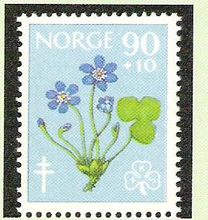
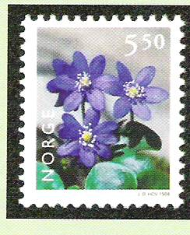

Slide 34
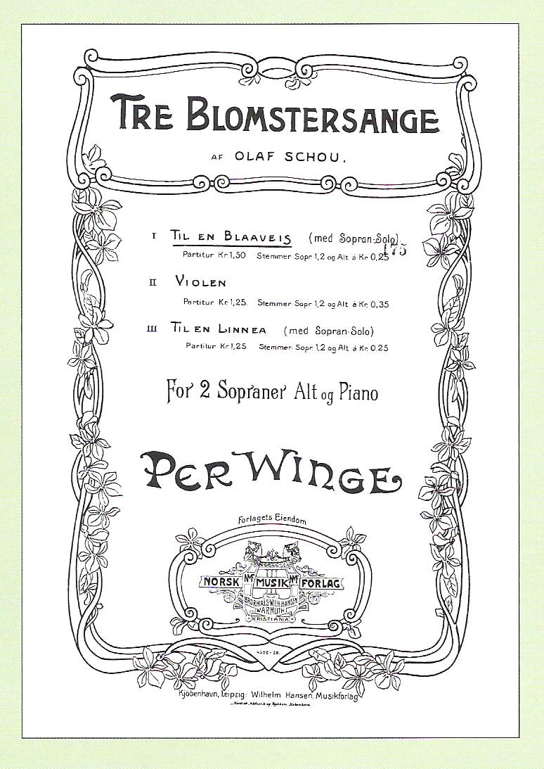

Slide 35
