Slide 1



Alternative and local food:
concepts and practices
Session 4 – Farmers’ markets: rural development or urban niche?
4th October 2013
Notes:
1

Slide 2
In this session we will
Look again at Britain, this time at examples of the emergence as farmers’ markets as a civil society response to concerns linked to modern industrialised agriculture.
Perceived benefits of FMs include:
Economic: farmers realise the retail price of the food they grow
Social: interacting with farmers to understand food qualities, farming methods, ‘food with a face’. Enjoying the shopping experience, which can include dining.
Environmental: farmers provide information in literature, discussion and certifications about their environmental credentials – arguably more than labels.
Notes:
2

Slide 3
In this session we will (2)
Use farmers’ markets as a way to briefly investigate a quantitative research tool used in local development.
What another short film which introduces a farmers’ market through the voices of the organisers and the farmers (remember our concerns about the transferability of consumer or producer-led CSA models yesterday.
Finally, another short discussion exercise.
Notes:
3

Slide 4
Reminder: policy and industry
Tensions between European adherence to family farming and production subsidy pre 2003
Insistence by politicians that food is safe despite a run of food safety scandals – salmonella in eggs, BSE in cattle, foot & mouth disease. Farmers blamed for some of these; but recast as victims after BSE.
Retailers become market ‘gatekeepers’ during BSE
Notes:
4

Slide 5
Why are FMs a civil society response?
Because they were instituted by an alliance of the mainstream farmers’union, the organic certification body and the farm retail association. These groups formed NAFM (now FARMA).
FARMA is an NGO which regulates FMs and helps provide training, legal advice and works closely with market authorities (councils).

Slide 6
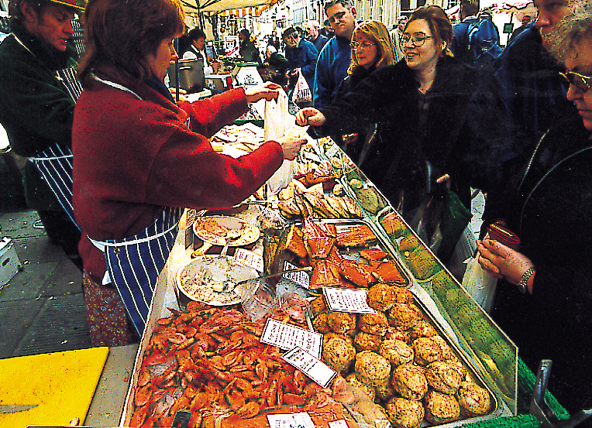
Notes:
6

Slide 7
Farmers’ market principles
Three basic principles:
retail relationship between producer and customer is direct
the distance between the farm and the market is prescribed
the producer must sell only what s/he makes
Notes:
7

Slide 8
Farmers’ Market models
…are varied:
Producer owned businesses or co-operatives (Somerset, Thames Valley, Hampshire)
Private companies (London, Stroud)
Council-run (Waverley Borough, North Lincolnshire District)
Community Voluntary Groups (Deddington, Moseley)
NGO – (Hadleigh Salvation Army, Maidenhead Friends of the Earth)
Notes:
8

Slide 9
Benefits for consumers and producers
Producers | Consumers
Low-cost operation and entry Full retail price return Contact (and possibly trade) with other local producers Face-to-face contact with customers Admin and marketing support from network/market manager | Attractive and convivial retail environment Seasonally changing produce Ability to question producers Unusual, high quality or rare breed foods Perception of ‘civic agriculture*’
(*Murdoch & Miele 1999, ‘Back to Nature’, Sociologia Ruralis 39, 4, 465-83.)
Notes:
9

Slide 10

The leaky bucket
NEF proposed that local investment often leaves the area via:
Central taxation
Multi-national corporations
Non-local services.
Notes:
10

Slide 11
LM3
Instead local businesses and services can recycle local investment, creating more local growth and preventing the leaking away of reinvestment opportunities.
LM3 is a way to calculate the local multiplier over 3 rounds of reinvestment: initial spend by consumers; the re-use of that money by companies buying supplies; and (in this case study) the spend of the wages of the workers of the company.
Research by nef and by Thatcher and Sharp (2008) using LM3 reveal a larger local mulitplier when using local goods and services in the public sector and in food shops.
Notes:
11

Slide 12
Bristol farmers’ market
Bristol was England’s second farmers’ market, opened in 1998 with 20 stall holders selling meat, fish, fruit and vegetables, bread. There are now 35 stalls. Stallholders must come from within 40 (c.75km) miles of Bristol.
In 2008, Bristol City council decided to carry out LM3 research in the farmers’ market.
The council wanted to know what contribution the farmers’ market made to the regional economy (ie. Bristol + 75km)
Notes:
12

Slide 13
For the market of 35 stalls
Income Spent locally Spent locally by stall holders/staff
£304,500 + £241,164 + £59,669
----------------------------------------------------------------------------------------- = 1.99 LM3
Income
£304,500
This can also be done per stall holder:
Income Spent locally Spent locally by stall holders/staff
£8,700 + £6,890.40 + £1,704.85
----------------------------------------------------------------------------------------- = 1.99 LM3
Income
£8,700

Slide 14
LM3 results
In other words, in the case of Bristol farmers’ market, the LM3 calculation showed that, at that time, every £1 (or Kr30) spent at the market by shoppers was worth almost £2 to the regional economy.

Slide 15
Other potentials for FMs
Urban regeneration: Southwark in London and St Nicholas in Bristol are promoted as ‘market quarters’ and have become very trendy.
From Growing Communities we heard how FMs can also support box schemes and other supply routes as part of a portfolio of retail arrangements.
FMs are their own supply chain – links to public and private catering are possible (South Moravia?)

Slide 16
Short film
Winchester Farmers’ Market
http://www.youtube.com/watch?v=A3NYMkN6Mbo

Slide 17
Discussion
In two groups discuss:
Walmart wants to open a new supermarket Zelny trh. The city council has asked the social studies faculty to evaluate the social and economic impacts of producer markets in Brno. What methods would you suggest? Qualitative, quantitative or mixed are fine.

