Slide 1
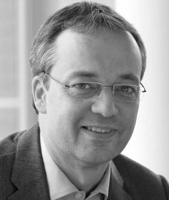
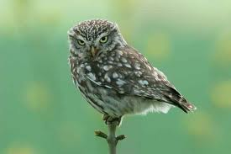
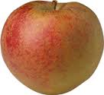
Beckert, boskop and biodiversity: facing the conceptual leap between social and environmental order in rural markets
Alternative and local food – concepts and practice
Session 5 – Environmental social enterprises
Brno, 3rd Oct 2013
Dan Keech, CCRI
University of Gloucestershire
dkeech@glos.ac.uk

Slide 2
Aims of this presentation
Part1: To present some of Prof Beckert’s ideas about the social order and coordinating ‘problems’ inherent in market exchange.
Ask: Can Beckert’s ideas be adapted so that they are useful for observing environmental outcomes from rural markets? In this case the environmental mission is orchard biosphere conservation?
Part 2: Explore that question with recourse to research on some German social enterprises, ie. I will attempt the leap.

Slide 3
Jens who?
Beckert is Director of the Max Planck Institute for the Study of Societies in Cologne.
Publications on market order and stability, social structures, Polanyi, value, inherited wealth, wine, empirical contributions to economic sociology.

Slide 4
Economic sociology (1)
Beckert follows a distinguished line from across the disciplines whose position is that rational actor theory is inadequate to explain market action.
Durkheim (1858-1917) studied the social implications of industrialisation.
Weber (1964-1920) traced protestant faith as a motivator in pursuit and accumulation of capital.
Parsons (1902-79) rejected idea that social stability comes a priori from pursuing self-interest. Norms and values also needed to integrate econ & society towards order.

Slide 5
Beckert adds…
Markets are social spheres where action is influenced by regulation, power, coercion, welfare, custom, place, acting like sheep…
Beckert acknowledges the hierarchy within capitalism – private, state, third sectors. But he is concerned that the tools used by the subsidiaries (redistribution and reciprocation) are not adequately recognised as resource allocation mechanisms.
Actors seek stability and social order so that they can make reliable predictions about the results of actions.

Slide 6
Beckert adds… (2)
Exchange can only work if actors manage to co-ordinate the trio of inherent ‘problems’ in the market: co-operation, competition and value.
The use of field theory allows insights into market dynamism, which has implications for market order.

Slide 7
Beckert and markets as fields
Cognition
Shape perception of network structures
Provide legitimation & shape perception of institutions
Shape and diffuse cognitive frames
Makes values socially relevant
Networks
Est. collective power to shape institutions
Institutions
Influence structure of social networks
Notes:
7

Slide 8
Field theory is, in this context
A way to examine how social/market dynamics work and what happens when market actors try to co-ordinate their ‘problems’.

Slide 9
Problems?
Beckert never mentions the environment.
Critics feel he misses a range of more conventional influences on market action, e.g. exchange and interest rates (Gemici 2011); or that historical and political developments define order more significantly than markets (e.g. Giddens).
Power is used by some market actors to consolidate their market position. How does this sit with my interest study in social enterprise?
Fligstein (2001) can be a helpful supplement (social skill in fields)… later.

Slide 10
Facing the leap
If analyses of market relationships (based on efforts to balance co-ordination problems) provide insights into opportunities for social outcomes…
…might the same techniques prove useful in working out how market interventions could lead to new relationships…
…which result in a different environmental ‘order’ – the revival of struggling economic landscapes?

Slide 11
Summary part 1
Beckert offers new ways to look at AFNs, rural social enterprises and the third sector. These have rich but sometimes highly normative literatures (esp SE – more shortly).
There are parallels between inherent market tensions and social enterprise operation (economic and social objectives).
Although I am proposing a conceptual adaptation, we can perhaps see that Beckert’s analysis techniques could help in devising practical interventions.

Slide 12
Part 2: SE, Beckert and orchards
SE is different from other types of business because SEs consciously juggle multiple goals (Keech, forthcoming).
For environmental SEs that list of things to juggle is even more complicated.
SE model and governance structures affect the juggling. I will now introduce 3 German SEs and look at two through the lens of field analysis.

Slide 13
Orchard social enterprises
Reciprocal model – co-operative run by producers
Networked market – registered association where SE facilitates changes within existing market structures
Market building model – limited and unlimited companies; SE as competitor.

Slide 14
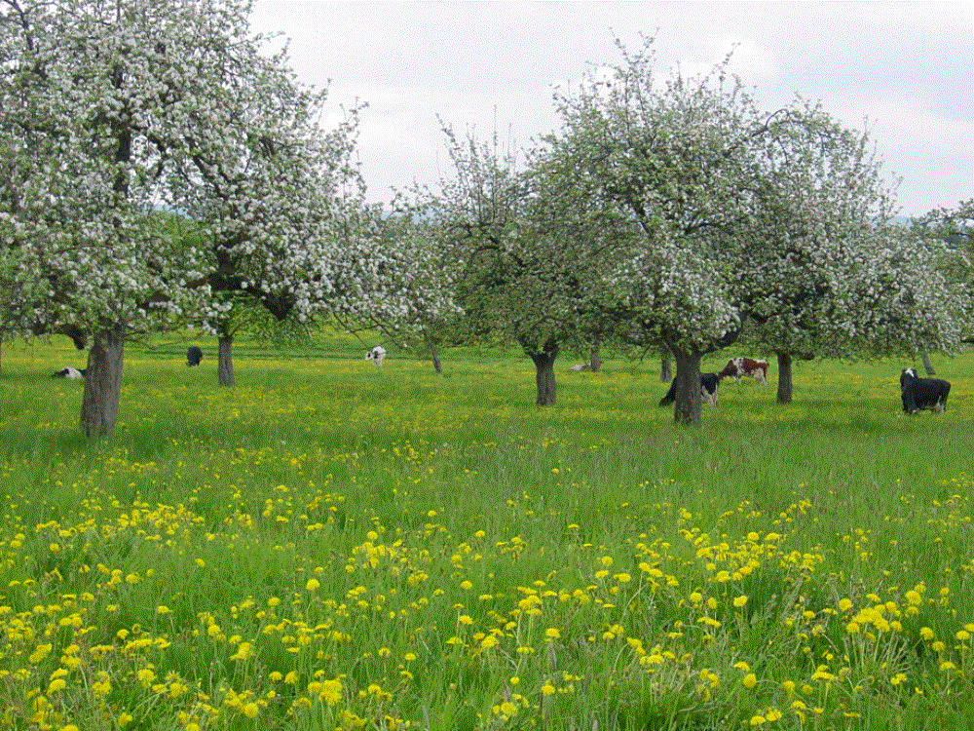
Bavarian Streuobstwiese
Picture: Buechele/Dagenbeck

Slide 15
What’s the problem?
These orchards may cost more to husband than they earn.
Payment to farmer may be delayed until juice sells (cash-flow).
Result: little incentive to manage orchards, which are neglected or grubbed out – ie. rich habitat is lost, biodiversity suffers. Economic and environmental logic clashes.
Solution: German SEs qualify juice, promote husbandry and redistribute money in the chain – ‘Aufpreis’

Slide 16
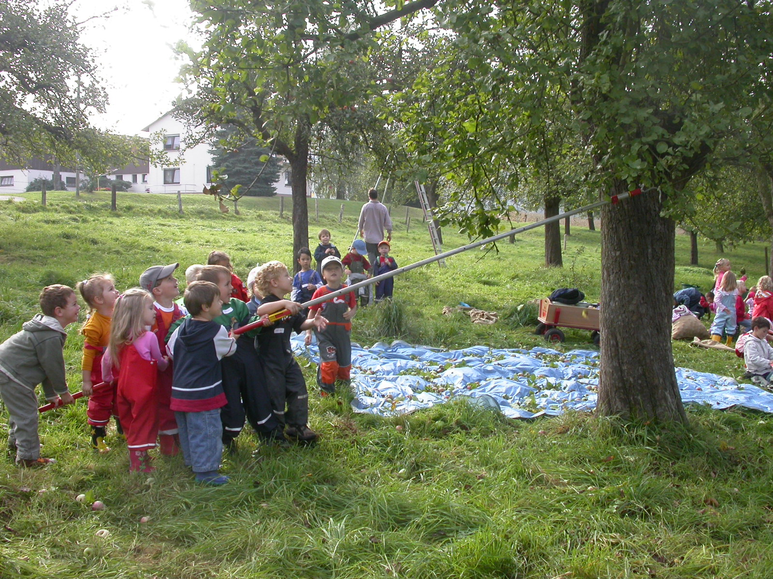
Child labour?
Special needs primary school buy/sell juice. Parents & corner shop
Helps with maths
Profits: school trips
Lots of other class work and field work
Pic: AV

Slide 17
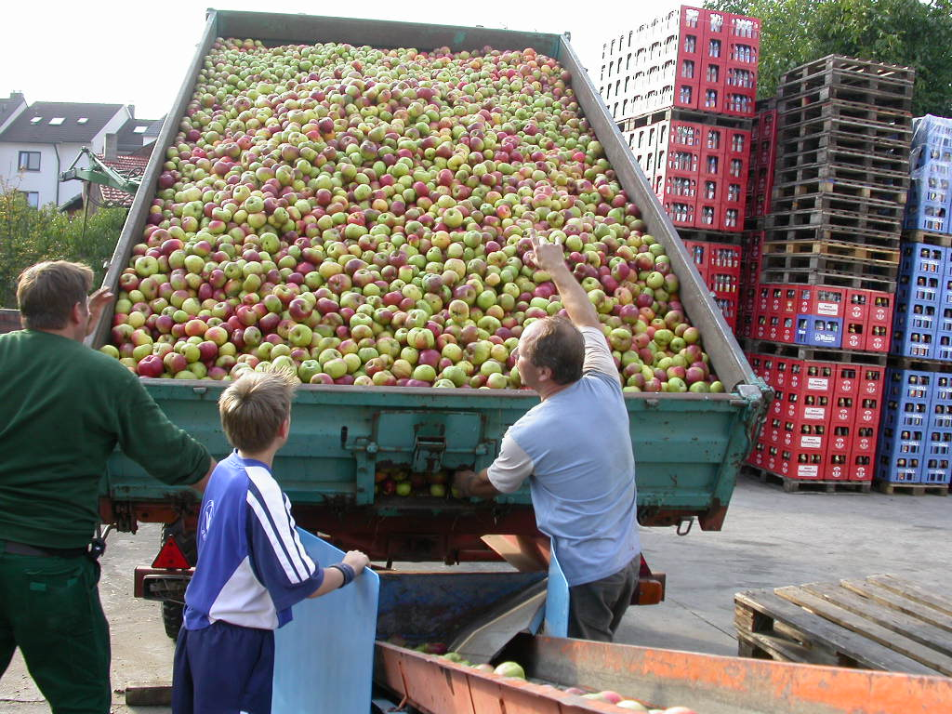
Farmers deliver to press
Deliveries by member farmers organised to keep fruit separate. This qualifies it.
Marketing remains with commercial players – press, wholesale, retail, catering trades.
Pic: AV

Slide 18
Disorder in the juice market
apples
Farmers
Commerc’l
press
Sales income
Wholesale
Retail
Juice products
££
logistics
Problem: inadequate

Slide 19
Networked market
Sales income
Civic
apples
Farmers
Juice
products
Press
Logistics, w’sale, retail
more ££
differentiation
Marketing, customers, grants
contract
3rd sector group
sets up
separate SE

Slide 20
Reciprocal model
Co-op members (265)
Capital €100 min per member
€0.60 sales: Home c’spn or home re-sale
Co-op owned
press.
Parish council
building
Wholesale
paid seasonal labour
Juices
Retail at press
Nursery school

Slide 21
Market building model
Civic
pubs
retailer
w’sale
civic
Sales income
capitalise
SE
warehouse
& labour
Press &
Specialist
processors
Product range
Buy services
contract
Collection points
for quality control
and payment
Shareholders, of which one is operational director
££
apples
farmers

Slide 22
Numbers…

Slide 23
Some summary points
Model | Output (litres) | Some key points
Reciprocal | 30,000 – 70,000 | Development of new infrastructure Overlap between consumers, producers, stakeholders Economic value of juice is multiple – w/sale, home-retail, public procurement, self-provisioning Environmental gain unclear
Network | 15,000 – 600,000 | Stimulation/negotiation of existing market relations Mobilisation of supporters to create demand Increased sales create higher supply price NGO link helps create civic support Expansion of commercial organic production
Market-building | 40,000 – 80,000 | Co-option of competitors Differentiation on basis of product range and fruit variety, client base and price ranges High level of market research Retention of traditional orchard management

Slide 24
Field analysis of networked market SE
Cognitive frames
Local identity
Juice qualities
Cultural landscape
Biological data
Knowledge transfer
Civil alliances
Shape perception of network structures
Provide legitimation & shape perception of institutions
Shape and diffuse cognitive frames
Makes values socially relevant
Networks
Social enterprises
NGO supporters
SE supporters
Commercial presses
Regional orchard networks
Est. collective power to shape institutions
Institutions
Federalism
Local councils
Self-provision
Registered associations
Contracts
Influence structure of social networks
Notes:
24

Slide 25
Field analysis of market-building SE
Cognitive frames
Self provision
Kulturlandschaft
Juice qualities
Risk esp. harvest
Shape perception of network structures
Provide legitimation & shape perception of institutions
Shape and diffuse cognitive frames
Makes values socially relevant
Networks
SE & inter-SE Alliances
Local councils
Presses
Est. collective power to shape institutions
Institutions
Federalism
Company/employ’t law
Aufpreis
Influence structure of social networks
Notes:
25

Slide 26
Discussion (1)
In a market building model, the risk associated with harvest failure is big. Alliances with networked models are a clever mitigation.
That alliance means that Aufpreis becomes an environmental institution not just a commercial technique.
Creating marketable qualities which stimulate ‘social skill’ (Fligstein 2001) in the local market (co-operation), ties customers and suppliers to environmental production (orchard conservation), whether they are interested or not.

Slide 27
Discussion (2)
By contrast, in the networked market, SEs intervene but seek no power and actively avoid competition, concentrating all their efforts on value (supply price and juice qualities).
Though they depend on existing market structures, they succeed in constructing ‘civil’ supply chains which support the conservation of orchards.

Slide 28
Conclusions
Despite the problems outlined, Beckert’s ideas can be usefully adapted to:
Explain the operations of different SE formats in rural markets.
Empirically unearth new arrangements of cognition, institutions and networks.
Expose the influence of third sector organisations in creating supply chain, civil, co-operative and civic alliances bound together by local and regional environmental concerns.
Potentially assist decision-making for those wishing to conserve orchard biospheres and their species.

Slide 29
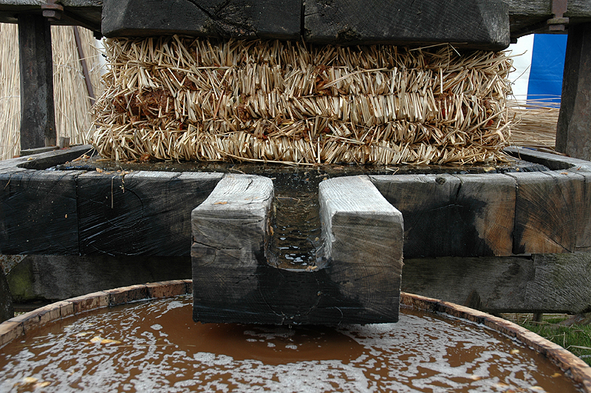
How d’ya like them apples?
Photo: Common Ground

Slide 30

Selected bibliography
Beckert, J. (2002) Transl. Harshav, B. Beyond the Market: The Social Foundations of Economic Efficiency. Princeton University Press.
- (2007) The Great Transformation of Embeddedness – Karl Polanyi and the New Economic Sociology. MPIfG Duscussion Paper 07/1.
- (2007) The Social Order of Markets. MPIfG Discussion Paper 07/15.
- (2010) How do fields change? The interrelations of institutions, networks and cognition in the dynamics of markets. Organisation Studies Vol. 31, pp.605-626.
- (2010) The Transcending Power of Goods – Imaginative Value in the Economy. MPIfG Discussion Paper 10/4.
- & Aspers, P. (2011) The Worth of Goods: Valuation and Pricing in the Economy. Oxford University Press.
- (2012) Capitalism as a system of Contingent Expectations. MPIfG Discussion Paper 12/4.
Fligstein, N. (2001) Social Skill and the Theory of Fields. Sociological Theory, Vol. 19, pp.105-125.
Gemici, K. (2012) Uncertainty, the problem of order, and markets: a critique of Beckert, Theory and Society, May 2009. Theory and Society, Vol. 41, pp. 107-118.
Rössel, J. & Beckert, J. (2012) Quality Classifications in Competition – Price Formation in the German Wine Market. MPIfG Discussion Paper 12/3.
White, H. & Godart, F. Märkte als soziale Formationen. In: Beckert, J., Diaz-Bone, R., & Gauβmann (eds.) (2002) Märkte als soziale Strukturen. Campus Verlag, Frankfurt am Main.

