Slide 1
SOC585/SOC585E
MIGRATION AND TRASNATIONALISM – MIGRATING PEOPLE, MIGRATING CULTURE: OPTICS, METHODS, AND IMPACTS
Fall 2013
Peggy Levitt (Wellesley College and Harvard University)
Radka Klvaňová (Faculty of Social Studies)
Office hours: by appointment
Contact person: Radka Klvaňová: radka.klvanova@gmail.com

Slide 2
Migration studies at FSS
Courses (Sociology and Social Anthropology)
Research: identities, ethnicization, ethnic economies, inclusion/exclusion, transnationalism, gender
Publications
  Transnational Migration (in Czech)
  Boundaries in Motion
  Social Studies – Transnationalism (in Czech)

Slide 3
Course sessions
Session 1 (26.9.) Introduction to the course (RK)
Session 2 (14.10.) Transnational Studies and Transnational Approaches to Migration/Studying Culture in Motion (PL)
Group project: Design a research methodology for studying culture in motion. Redesign your own research project using a transnational optic
Session 3 (15.10.) The Cultural Armature of Cities (PL)
Group Project: What is the nature of the cultural armature in the city where you live? What would you do to make it more conducive to immigration integration?
Session 4 (16.10.) Using Culture to Create Diverse Communities (PL)
Group Project: Curate your own museum exhibit on immigration and/or cosmopolitanism
Session 5 (17.10.) Global Social Protection Regimes (PL)
Group Project: Design a new kind of education, health, pension, or social welfare program that responds to transnational migration
Session 6 (18.10.) Lecture by Peggy Levitt at Identities in Conflict, Conflict in Identities conference
Session 7 (14.11.) Migration and Transnationalism in CEE (RK)
Session 8 (5.12.) Conclusion (RK)

Slide 4
Conditions for Passing the Course
1. Participation in class (discussions, group projects) (20%)
2. Peer-to-peer feedback on the outline of the final paper (20%)
3. Final paper (3,000 – 5,000 words) (35%)
4. Written final exam (25%)
Total: 100 points
90-100 = A; 80-89 = B; 70-79 = C; 60-69 = D; 50-59 = E; 0-49 = F

Slide 5
Study Materials and Instructions
IS Learning Materials – in electronic form
Instructions for the final essay as well as written final exam will be available in the IS Study Materials folder.
Please, check the study materials folder regularly for actual readings and study instructions.

Slide 6
Final paper
Length: 3,000 – 5,000 words
Group or individual
Based on group projects from class with PL or a topic of individual choice based on literature, interesting case study etc.
Form: academic paper
  more information will follow…
Draft of the paper will be discussed by colleagues on the last session (5.12.)
  to be delivered by 24.11. (to IS Homework Vaults)
Deadline: 12.1.2014

Slide 7
Written exam
Take-home exam
Orientation in the literature and main concepts
Date: to be specified

Slide 8
Introduction
Your background (where have you lived, studied, background in migration study)
Field of interest in social science/sociology
Motivation, hopes, expectations towards the course…

Slide 9
Brainstorming on transnationalism
What is transnationalism?
What social groups come to your mind?
Your life in a transnational perspective?
Plurality of definitions of transnationalism
Notes:
Today not lecturing but rather discussions and excercise to focus on the topic, make you think about migration and transnationalism before the week with PL.

Slide 10
Anthropologists‘ discovery of a new phenomena?
1990s – new form of migration: transnational migration
  Critical to conventional theories of immigration
  Focus on cross-border processes and identities
Basch, Glick Schiller, Szanton Blanc (1994):
  Nations Unbound: Transnational Projects, Postcolonial Predicaments, and Deterritorialized Nation-States
  -“By living their lives across borders, transmigrants find themselves confronted with and engaged in the nation building processes of two or more nation-states. Their identities and practices are configured by hegemonic categories, such as race and ethnicity, that are deeply embedded in the nation building processes of these nation states.“ (p. 22)
  Transnationalism as a form of resistance
Notes:
Since the nineties, critical anthropologists and sociologists (U.S., GB) proposed that a new form of migration has emerged – transnational migration, transmigrants.
These theories were from the beginning radically critical towards what they call conventional or hegemonic migration theories of immigration (next slide)
Theories of assimilation, acculturation etc. were based on an assumption of migration as unidirectional movement from the country of origin to the receiving country and focused on the problems migrants face in the so-called host societies, theories of transnational migration shifted attention to crossborder processes and organization of social life of migrants who live their lives in connection to more than one nation state, predominantly the country of origin and the country of immigration.
Nations Unbound – long term anthropological research of Carribean and Filipino migrants living in NY. (one of the first books, important in developing the project of transnational migration studies)
They link transnational migration to:
changing context of global capitalism – current mode of production (low pay, job insecurity) requires maintaing homeland ties, they are economically and politically vurnerable and it foster migrants‘ transnational links
processes of decolonization and nation-building processes in former colonies.
-“By living their lives across borders, transmigrants find themselves confronted with and engaged in the nation building processes of two or more nation-states. Their identities and practices are configured by hegemonic categories, such as race and ethnicity, that are deeply embedded in the nation building processes of these nation states.“ (p. 22)
- Deterritorialization and nationalization processes – a new form of nation state: deterritorialized nation state that encourages migrants‘ continuing relations to their homeland. Migrants are encouraged to work abroad and send remittances
- These authors conceptualized transnationalism of migrants as a form of resistance against their racial and class subordination in US.

Slide 11
Conventional immigration theories
The problem of assimilation (Americanization)
Chicago School of Sociology
  „Problem of maintaining political order…in a community that has no common culture“
  Migrants: „peoples who have abandoned the political allegiance of the old country, and are gradually acquiring the culture of the new (Park and Burgess 1969)
Melting pot, cultural pluralism (Glazer, Moynihan)
  ethnic groups and their culture (=roots, not vital links)
Critique: Social sciences participate in nation-building projects (lack of reflexivity)
Notes:
United States as a nation of immigrants have been concerned with the issues of loyalty and patriotism, fear of political commitments of immigrants towards their states of origin, emphasis on assimilation and creation of united American people.
U.S. Social science (Chicago school) has played an important role in shaping the manner in which immigrant populations were understood to relate to the U.S. nation. Social scientists took the social and political problem of assimilation (what was politically desirable) as description of processes immigrants were going through and this was described as an inevitable historical process.
Chicago school defined their problematic as „Problem of maintaining political order…in a community that has no common culture“
Migrants: „peoples who have abandoned the political allegiance of the old country, and are gradually acquiring the culture of the new (Park and Burgess 1969)
The later model of cultural pluralism – construction of immigrants as bounded ethnic groups with distinct cultures (competing, culture as a explanation fro inequality). Culture was viewed in terms of a metaphor of roots that were transplated rather than vital links.
Multiculturalism – efforts to incorporate the previously subaltern people into representation of the American nation – but the conception is still bounded by the image of American nation, do not look accross borders.
Nation-building social science – lack of reflexivity

Slide 12



Slide 13
Americanization project
“There can be no divided allegiance here. We have room for but one language here, and that is the English language, for we intend to see that the crucible turns our people out as Americans, of American nationality, and not as dwellers in a polyglot boarding-house; and we have room for but one soul loyalty, and that is loyalty to the American people.” (Theodore Roosevelt, 1919)

Slide 14
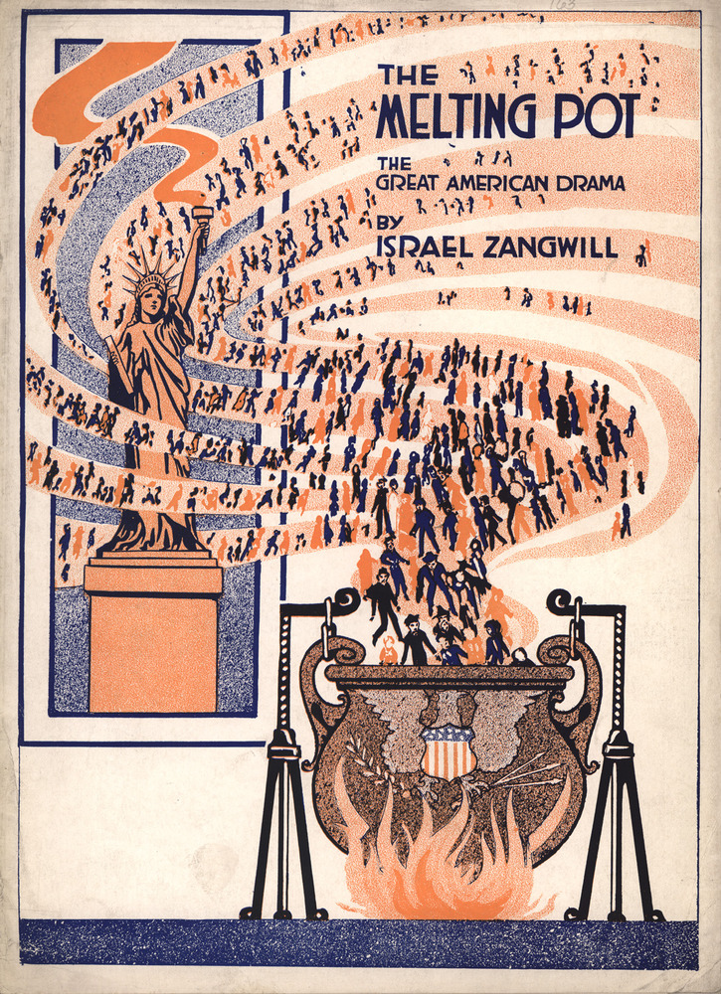

Slide 15
The critique of methodological nationalism
Methodological nationalism – the tendency to accept nation state as a given unit of social analysis, society = nation state
Critique of bounded concepts of ethnicity, race, culture – social constructs that reflect power relations
BOTH/AND instead of EITHER/OR logic
New phenomena requires new conceptual tools: transmigrant, transnational migration, deterritorialized nation state, transnational social field
Wimmer, Glick Schiller. 2002. Methodological nationalism and beyond: nation state building, migration and the social sciences.
Notes:
An important part of transnational theories is their critique of conventional anthropological categories of ethnicity, culture and identity that equate culture and nation-state society and limit the ability of researchers to perceive and analyze the phenomenon of transnationalism. This critique has been later elaborated as a critique of methodological nationalism so often found in social science: a tendency of social science to equate society with nation state.

Slide 16
A new phenomena or a new perspective?
Notes:
A returning question in debates on transnationalism is whether transnationalism is indeed a new phenomena?
The assumed novelty of the phenomenon was criticized by citing examples of transnational involvements dating back to the beginning of the twentieth century and even earlier (e.g. political initiatives of exiles after WWI participating in nation building in CEE)
Wimmer, Glick Schiller – the world in the end of 19th century was very transnational, intensive globalization produced dense labour migration that was not much constrained administratively (compared to postwar conditions).
During the period between two world wars intensive nation-building and national closure.

Slide 17

A new phenomena or a new perspective?
Transnationalism in History studies
David Gerber – transnational activity of personal correspondence of 19th century immigrants to America
  Letters as sites of construction of identity, reflection of in-betweenes
  Negotiation of personal relationships
  Exchange of social intelligence
Notes:
Gerber – Authors of their lives – immigrants and their close people were always interconnected (or their strived for it), they did not loose interest in their homeland – analysis of personal correspondence of European immigrants to America in late ninetieth century as a case of formation of transnational social field through exchange of letters: acts of reading, writing, and organization of the exchange of letters – all contributed to a formation of transnational social field.
Immigrants and those left behind used letters to reformulate their relationships, future separation or reunion, letter as a site for ongoing construction of identity, reflection of in-betweeness, exchange of information and images about distant parts of the world, discussion of remittances. In sum, mutual influence of the localities.
- The revision of the scholarship of the Chicago school has shown that they have collected lots of evidence about connections of migrants to America to their countries of origin, but they theorized this type of connections as transitional phenomena that will be lost in the natural process of assimilation.

Slide 18
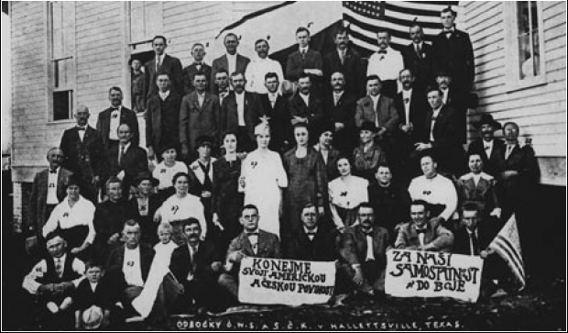
„Let us do our American and Czech duty.“
„Fight for our independence.“
(Branch of Czech National Society in Halletsville, Texas, around 1917)
Notes:
North-Moravian emigrants in America (Wallachian region)
Over the Sea exhibition about emigration from the Frenštát region in Moravia to America in the second half of the 19th century, museum of emigration, activities supported by Czech national societies in the United States, revival of links after the fall of iron curtain, evidence of long-term persistence of the social networks between places of origin and destination, but also a part of the transnational shift after the Cold War.

Slide 19
A transnational turn in migration studies
Critical perspective: critique of methodological nationalism
Shift in the focus on cross-border processes, flows, movement
Social networks, links btn. new homes and original homes
Formation of migrant identities, hybridity
Transnationalism vs. Globalization?
Notes:
Wimmer, Glick Schiller: In postwar migration studies migrants were perceived as:
potential security threat (the issue of loyalty)
Radically culturally different (disregard for other characteristics such as class)
Socially marginal
exception from normality of territorial sedentariness
- this conception of duality between migrants and host populations has driven the research on migration (selection of research topics, questions etc.)
Critical perspective – against hegemonic discourse in anthropology – methodological nationalism and dualism btn. „modern“ Us and „traditional“ Others – border zones that are the focus of transnational scholarship are opportunities to question these simple binaries
Transnationalism vs. Globalization studies: the continuing importance of nation state and nationalism in the age of globalization, nation state do not loose importance but they are transformed
Transnational migration studies extended their focus - not only on the working class transnational migrants but also on bussinessmen, high-skilled professionals who live their lives on move, religious transnational communities etc.

Slide 20


