Slide 1
Chapter 4: HISTORICAL CONTEXT
ZUR584 Theory and Methods of Genre Analysis
By Michal Solčiansky

Slide 2
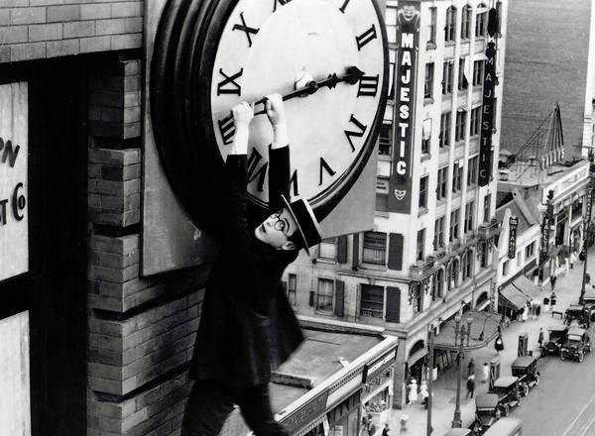
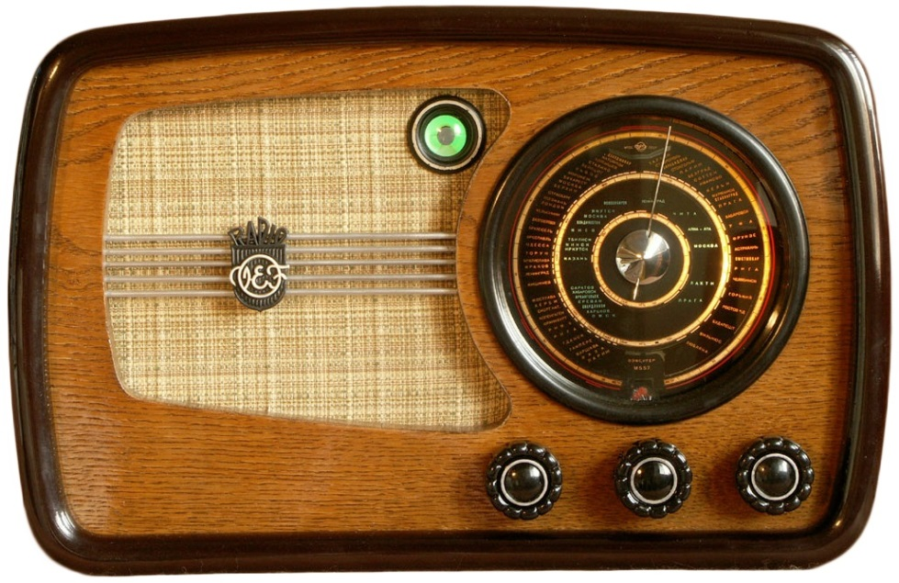
Pre World War II.

Slide 3
1950´s

Slide 4
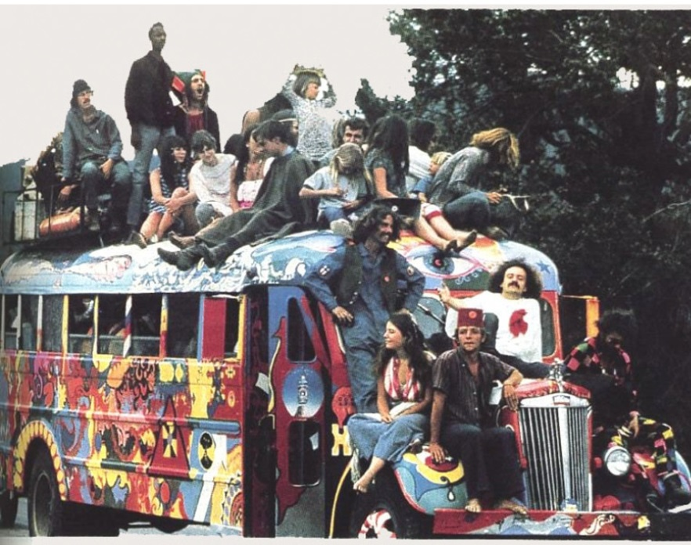
1960´s

Slide 5
1970´s 80´s

Slide 6
1990´s

Slide 7
New milenium

Slide 8
Thank you for your attention

