Slide 1
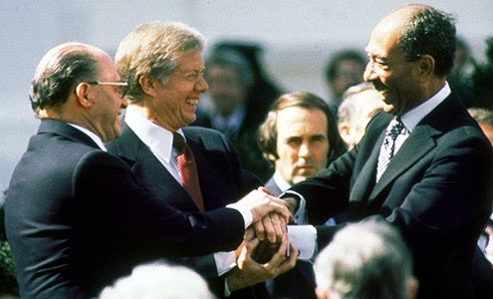
Camp David
The Arab-Israeli Miracle of 1979

Slide 2
Peace Treaty
"No more war, no more bloodshed, no more bereavement, peace unto you, shalom, saalam, forever."

Slide 3
Background
30 year war between Egypt and Israel
National security
  defensible borders (Israel)
  domestic control (Egypt)
neoclassical realism
  perception and personality

Slide 4
Israel
The May 1977 elections would prove to be a defining moment in Israeli history. For the first time since Israel’s independence in 1948 the government would not be in the hands of the Labor party—the party of the founding father of Israel David Ben Gurion and military hero Moshe Dayan. (Gilbert, Israel: a History, 477)
After 30 years under the Labor party’s guidance, the Israeli government had accomplished many goals set out in its early days. It survived many large waves of immigration from the Arab world, Eastern Europe, and the Soviet Union, four wars with its Arab neighbors, and constant attack in wars of attrition since 1956; but financial scandals and mismanagement during an hour of peril in 1973 forced Labor out and allowed the Likud party and its leader Menachem Begin to seize power and create a ruling coalition. (Gilbert, Israel: a History, 478)

Slide 5
Egypt
November, Sadat’s intentions were to become publicly known. In an address to the Egyptian Parliament on November 6th, Sadat announced his wish to speak to the Israeli Knesset, “I am willing to go to the ends of the earth for peace. Israel will be astonished to hear me say now, before you, that I am prepared to go to their own house, to the Knesset itself, to talk to them.” (Gilbert, Israel: a History, 482-83)
Sadat’s speech was met with utter disbelief in Israel. Many government leaders believed Sadat’s words were merely false piety, that he was using rhetoric to score political points with Washington and that he did not truly stand behind his words. In response, Menachem Begin announced that if Sadat truly desired a visit to the Knesset he would be welcomed. An official invitation was relayed via United States diplomatic cables to Sadat, who officially accepted the invitation and planned a visit for the 19th of November. (Gilbert, Israel: a History, 487; Sachar, A History of Israel, 46)

Slide 6
USA
In the months between the Egyptian President’s visit and the Camp David Accords, several attempts were made to take advantage of the groundbreaking initiative offered by Sadat; but each effort subsequently failed.
In order to save the peace process and to bring Egypt out of the Soviet sphere of influence during the Cold War, US President Jimmy Carter called upon the leaders of Egypt and Israel to join him at a Summit Conference in the US in order to design a framework for a comprehensive peace plan for the Middle East.

Slide 7
Secrecy
No members of the press were invited to the Accords process. Carter wanted the leaders of Israel and Egypt to feel comfortable expressing their true positions to one another without feeling obligated to stick to talking points for their audiences at home.
  (Gilbert, Israel: a History, 489)

Slide 8

Background
Time magazine august 1977; Jimmy carter president surrounded by cynical lions: Helmut Schmidt of Germany, Hua Guafeng of China, Anwar Sadat of Egypt, Menachem Begin of Israel and Brezhnev of the Soviet Union

Slide 9
Background
Contrasting styles of Sadat and Begin.
  While Sadat was emotional, a dreamer and an idealist, Begin was
  Colder and more analytical, grinding down proposals inch by inch “into the fine dry powder of details, legal clauses, and quotes from international law.” (Wright, 2014)
Despite mistrust, mistakes and miscalculations, they signed a peace treaty that has endured

Slide 10
Background
By end of the summer of 1978, almost a year after Egyptian President Anwar Sadat’s historic trip to Israel, negotiations between the two countries had stalled.
  In March, Palestinian terrorists killed 38 Israelis, the Israelis invaded Lebanon, inflaming the Arab world.
  Prime Minister Menachem Begin made clear that he was unwilling to stop Israeli settlements in or withdraw from the Sinai or the West Bank or grant Palestinians any real authority.
Despite these developments and against advice that he not invest political capital in an initiative that was doomed before it started President Jimmy Carter invited Sadat and Begin to come to Camp David.
“Close to nature, peaceful and isolated from the world,” the two leaders, he [Carter] wrote, with a characteristic combination of idealism, hubris and naiveté, might conclude the “First Egyptian-Jewish peace since the time of Jeremiah.”
  Lawrence Wright, Thirteen Days in September: Carter, Begin, and Sadat at Camp David, 49-50

Slide 11
Background
The agreement was due to the character, temperament, ideology and tactical and strategic calculations of both Sadat and Begin, the isolation of the participants and the dogged determination of Carter.
After the initial weekend, it became clear that neither Begin nor Sadat could leave without paying a terrible political price. Isolation became a stronger incentive, since both men couldn’t stand each other, or the idea of remaining in Camp David.

Slide 12
Process
Carter started the negotiations with a meeting between himself, Secretary of State Vance, President Sadat, and Prime Minister Begin. Each party was allowed time to lay out their positions on a host of issues uninterrupted by the others. Carter wanted to ensure that each leader had the opportunity to make their positions perfectly clear from the outset. Begin began the discussions. (Wright, Thirteen Days in September: Carter, Begin, and Sadat at Camp David, 49-50)
In no minced words, Begin assured the group that his positions had changed little since Sadat’s visit to Jerusalem the year prior. While Israel was ready and willing to return the Sinai Peninsula in return for an agreement of peace with the Egyptians the other territories captured in the Six Day War were to remain off limits in the negotiations at Camp David. The historic lands of Judea and Samaria, to Begin and his party, were historically integral to the Land of Israel.

Slide 13
Process
Like the issues in the West Bank, the Palestinian problem was to remain unaddressed at the Camp David summit. In Begin’s eyes, the accords process was an opportunity to build a bilateral peace agreement with Egypt, as facilitated by the US and President Carter; but not to settle disputes with the other Arab countries not represented at the summit.
Beyond these restrictions everything else was up for discussion: permanent non-aggression, the determination of final borders between Israel and Egypt, the status of Jerusalem which had been reunited in 1967, the passage of Israeli ships and cargo through the Suez Canal and Red Sea without problems.
Gilbert, Israel: a History, 493.

Slide 14
Process
President Sadat was of the same vein of reasoning as Begin. His negotiating positions had changed little since his visit to the Knesset in the previous November.
Sadat insisted upon the full military and civilian withdrawal from the Sinai Peninsula and the Gaza Strip, both of which had been under Egypt’s control from 1948 to 1967, as well as all other Arab territories including the Golan Heights and the West Bank. As Sadat had made perfectly clear, his intention at the accords was to both make peace with Israel bilaterally, but also to begin negotiating a final peace deal between Israel and her other neighbors—mainly with the Palestinians. Sadat’s main motivation behind peace with the Palestinian population was his view of himself as the leader of the Arab world. (Sachar, A History of Israel, pg. 61)
Though he was shunned by many of his Arab counterparts, and was kicked out of the Arab League, Sadat recognized the power and size of Egypt as a significant and influential force that could help bring about peace, with or without the help of the other Arab countries. Regardless, Sadat came to the peace conference in the mindset that he was representing each and every Arab state in the region. (Wright, Thirteen Days in September, pg. 57)

Slide 15
Problems
The President had invited Sadat and Begin to Camp David under the stipulation that both parties would arrive without preconditions for negotiations, ready to seriously discuss concessions both sides would be willing to take. On one hand, Sadat presented his proposal replete with stipulations that were sure to be rejected by the Israeli delegation; on the other hand, Begin offered areas in which he would be able to compromise—but laid out demands the Egyptians were to fulfill before the Israelis could agree to a settlement.

Slide 16
Resolution
By day eight, Carter had finally devised a strategy he hoped would save the talks and push the delegations towards real progress. Instead of creating one comprehensive peace deal to appease all parties in the Arab-Israeli conflict, Carter suggested two separate, but linked agreements.
  (Boyne, The Two O’clock War, 13-14; Moshe Dayan, Breakthrough: a Personal Account of the Egypt-Israeli Negotiations, pg. 49)
One agreement, “A Framework for Peace in Sinai,” would exclusively deal with Israel and Egypt’s disputes in the Sinai Peninsula. The other agreement, “A Framework for Peace in the Middle East,” would create a framework to finalize a comprehensive agreement between Israel and all of her Arab neighbors while establishing rights and autonomy for the Palestinians.
  (Wright, Thirteen Days in September, pg. 190-92)

Slide 17
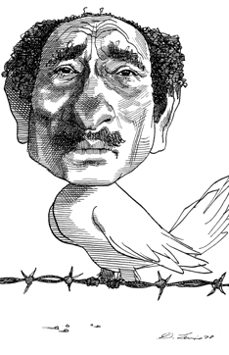
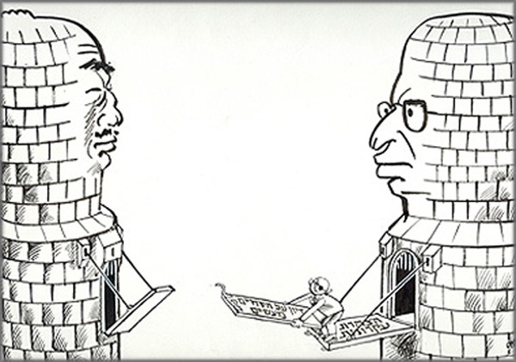
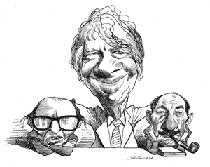

Slide 18
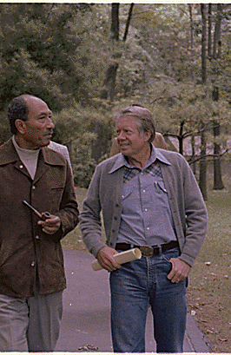

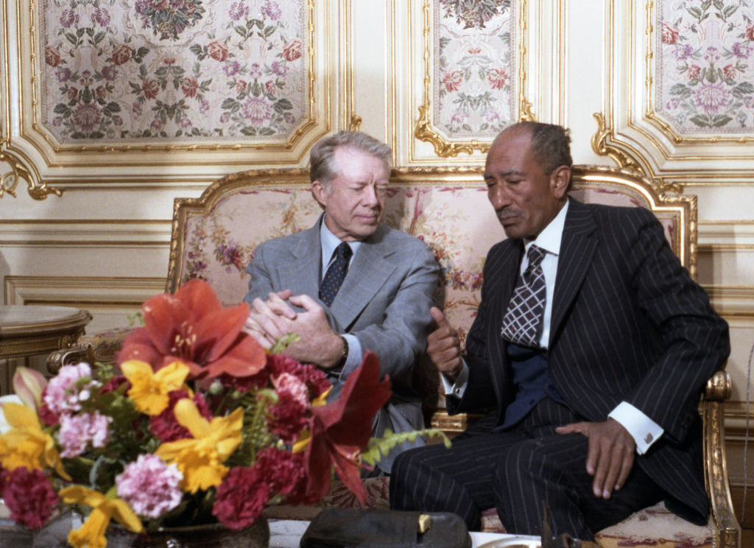

Slide 19
Result
The treaty was the result of months of grueling, often frustrating negotiations that finally were concluded early this morning when a final compromise was reached on the last remaining issue - a timetable for Israel to give up Sinai oil-fields.
Under the treaty, Israel will withdraw its military forces and civilians from the Sinai Peninsula in stages over three years.
  Two-thirds of the area will be returned within nine months, after formal ratification documents are exchanged.
  The ratification process began in two weeks.
In return for Israel's withdrawal, Egypt agreed to end the state of war and to establish peace. After the initial nine-month withdrawal was completed, Egypt and Israel will establish "normal and friendly relations" in many fields, including diplomatic, cultural and economic relations.

Slide 20
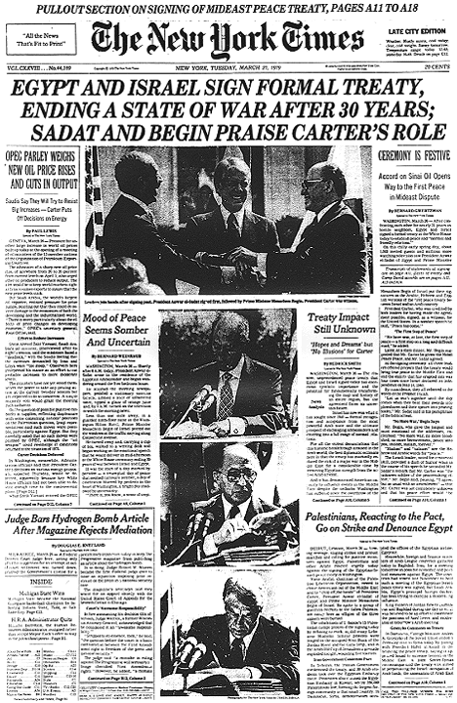
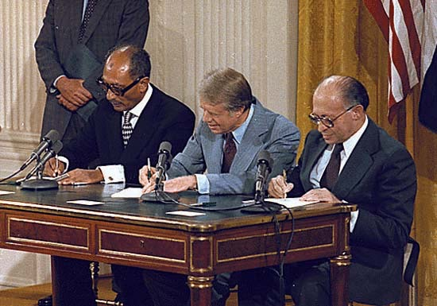
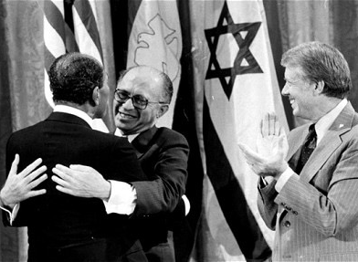

Slide 21
Arab opposition
The Camp David accords were opposed by most countries in the Arab world for two reasons.
  The Arabs regarded the decision by Mr. Sadat to sign a peace treaty with Israel as a betrayal of the Arab cause, since it suggested that Egypt would no longer be willing to go to war against Israel to help Syria, Jordan, and the Palestinians regain territory.
  Arabs also viewed the self-rule agreement for Palestinians as insufficient because it did not guarantee the creation of a Palestinian state.

Slide 22
"We must not minimize the obstacles that still lie ahead. Differences still separate the signatories to this treaty from each other and also from some of their neighbors who fear what they have just done.” —President Carter

Slide 23
Jerusalem
A major point of difference between Israel and the Arabs is the future of Jerusalem, with the Arabs, including Egypt, insisting that Israel must relinquish control over the eastern sector, and Israel's declarations that it will never yield it.

Slide 24
Palestinians
Left out. Rejected by Arab brethren, Dejected at oppression.
  Egypt
  Jordan
PLO radicalized further
  intifada (uprising)

Slide 25
Final Negotiations
The peace treaty negotiations went through a series of ups and downs and surprises.
They began in October in Washington with expectations of an early conclusion.
Although the basic treaty text was approved by both Egypt and Israel by early December, three months more were needed to obtain agreement on differing interpretations of the treaty -- the subject of a separate document of "agreed minutes" - and over issues such as when ambassadors would be exchanged and target dates for beginning and concluding the Palestinian self-rule negotiations.

Slide 26
Final Negotiations
President Carter resolved most of the questions during a week-long trip to the Middle East in September 1979.
Even though both Governments approved the treaty, it was not completed until late the previous night when Mr. Begin and Mr. Sadat agreed that the Sinai oilfield would be returned to Egypt seven months after the treaty was ratified, instead of the nine months Israel had preferred and the six months Egypt had earlier asked.
In addition, Mr. Begin agreed to turn over the El Arish area within two months instead of the three months originally proposed by Israel.
An arrangement was also made to insure Israel a right to buy oil from the fields without interruption.
Even the morning, in the final drafting, differences arose over whether to call a body of water the Gulf of Aqaba or the Gulf of Eilat. The Arabic and English texts refer to it as "Aqaba," the name of the Jordanian port by that name. The Hebrew version calls it Eilat, after the Israeli port adjacent to Aqaba.

Slide 27
Further reading
Lawrence Wright, Thirteen Days in September: Carter, Begin, and Sadat at Camp David (New York: Alfred A. Knopf, 2014)
William B. Quandt, Camp David: Israel and the Peacemaking Process (Washington DC: Brookings Institute Press, 1981)

Slide 28
Further Reading
Shlomo Avineri, "Beyond Camp David," Foreign Policy, no. 46 (1982)
Howard M. Sachar, A History of Israel, Volume II: from the Aftermath of the Yom Kippur War (New York: Oxford UP, 1987)

