Slide 1
Institutions for divided societies
Lesson 8

Slide 2
Nationalism and ethnicity

Slide 3
What is a nation?
Psychological bond that joins people
Self-identification based on shared ethnicity, language, culture, history, religion
Imagined community

Slide 4
Few Nation-States
Type of state | Percentage of all states
Nation-state: almost all citizens belong to one nation | 9%
One ethnic group > 90% of population | 19%
One ethnic group between 71% and 89% | 19%
Largest ethnic group between 50% and 74% | 24%
Largest ethnic group < 50% of population | 30%

Slide 5
Nations arise in 19th c.
Before people don’t feel themselves to be part of nation
Limited horizons
Lack of national language and culture
Society split vertically (upper versus lower classes)
Demands of industrial revolution
Mobile labor
Education and literacy
Creation of common culture
Print capitalism is key
Bottom Line: “Making Peasants into Frenchmen”

Slide 6
Invented traditions
Nationalists often borrow or adapt tradition and pass them off as age-old customs of entire group
Scottish kilt
Chinese traditional medicine
Japanese martial arts
Hungarians named Attila
Establish social cohesion through common history

Slide 7
Dangers of nationalist conflict
Nationalism = belief that nation should have its own state
If other nation living in your state, they must leave
If part of your nation living in other state, they must join you
Hard to compromise: all or nothing
Portray opposition as threat to state
They are traitors – allied with people from other countries
They want to change boundaries
Danger of “Nationalizing policies”
national language or religion have special privileges

Slide 8
Ethnic conflict and democracy
Can democratization cause ethnic conflict?
Elections are conflict
Nationalism effective in mobilizing masses
Who controls flow of information?
Democratizing states most conflict prone

Slide 9
Market-dominant minorities
Minority that controls large percentage of country’s resources
Chinese in the Philippines
Lebanese in Sierra Leone
When introduce democracy
small minority has economic but not political power
large majority has political but not economic power

Slide 11
Institutional solutions to ethnic conflict

Slide 12
Worries about majoritarian rule for divided societies
Potential for permanent exclusion of minority
No room for shifting coalitions
Ethnic outbidding
Elections very high stakes

Slide 13
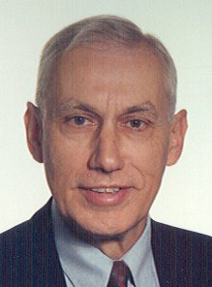
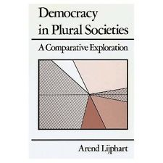
Consociational solution
An extreme version of consensus patterns
Based on broad agreement and powersharing among elites
Assumes that ethnic identity is permanent
Encourages cooperation among elites

Slide 14
Consociational institutions
Grand coalition: all groups included in cabinet
Also possible: surplus majority, council (Switzerland)
Can it work with presidentialism?
Government versus opposition depends on shifting coalitions and floating voters which may not exist
Mutual veto: all groups can veto legislation
How does it avoid immobilism?
Can be limited to certain policies
Proportionality: elections, civil service, and financial resources
Quotas for groups
Segmental autonomy and federalism
Each group has own territory and governs itself
Cultural and group rights

Slide 15
Problems with consociationalism
Not democratic – no opposition
Groups can be oppressive to own members
Requires organized elites and deferential non-elites
Immobilism, slow decisions
Creates large, non-merit-based bureaucracy
Reifies ethnic identity
Encourages secession
Requires cultural traditions of accommodation that may be foreign to developing countries

Slide 16
Where can consociationalism work?
Leaders committed to unity, cooperation
Leaders can control followers
Balance of power: 3-4 groups without single majority
Multiparty systems that represent segments
Better for small countries
External threat, personal relations, fewer decisions
Cross-cutting cleavages
Overarching loyalties
Clear boundaries
Traditions of elite accommodation

Slide 17
Overlapping vs Cross-Cutting Cleavages
 | Rich | Poor
Protestant | XX
Catholic |  | XX
 | Rich | Poor
Protestant | X | X
Catholic | X | X

Slide 18
Successful cases?
Belgium
Austria
Switzerland
Lebanon
Malaysia

Slide 19
Centripetal/integrative approach
Accommodation through position shifts
Tries to break down salience of ethnicity
Creates incentives for interethnic cooperation
Force parties to center
Encourage alternative alignments
Moderation
Contact => engagement

Slide 20
Integrative institutions
Vote pooling: alternative vote or mixed lists
Strong incentive for multiethnic coalitions and moderation
Presidential system
But require broad support for election
Federalism with heterogeneous units or unitary state
Local politics as training ground
Encourages party proliferation
Disperse conflict
Cooperation on low-stakes issues
Ethnicity-blind policies

Slide 21
Preference voting
Rank candidates in order of preference – first, second, third…
Forces parties to seek support from supporters of other parties
Plurality version: alternative vote (instant runoff)
If one candidate gets a majority of first preferences, then wins
If not, then eliminate candidate with fewest and redistribute their second preferences
Requires that districts don’t have a majority of one group
Proportional version: single transferable vote

Slide 22
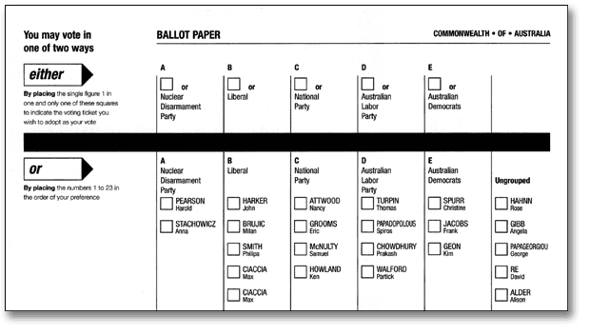
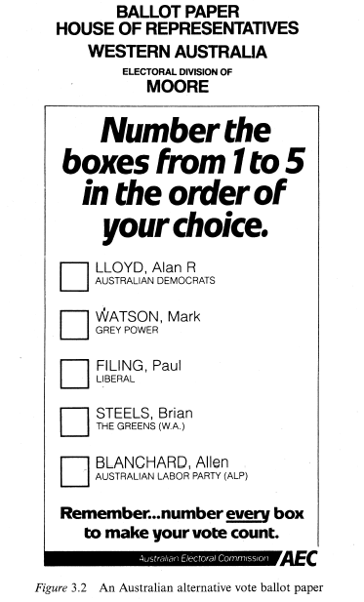
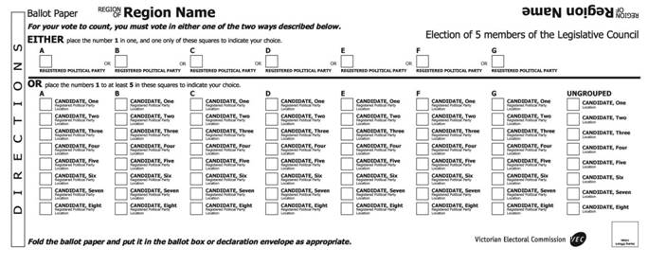

Slide 23
What does it achieve?
Political learning
Fairness
Mass not elite based
Broad, multiethnic parties
Centralism
Arenas of bargaining => civility, cooperation

Slide 24
Problems with integrative approach
Few empirical examples
Papua New Guinea? Fiji?
Will politicians respond to incentives
Do they gain or lose by being moderate
Will voters cross ethnic lines if advised by leaders
Minorities excluded
Will they accept being represented by others
Does contact => understanding and trust?
Assumes part of electorate moderate

Slide 25
Where might it work?
Party proliferation: as many as possible
Heterogeneous districts: groups dispersed and intermingled
Settler and immigrant societies
Can’t have genocidal hatred
Hard for illiterate
Ethnic divisions mutable
Groups internally fragmented

Slide 26
Comparison
Consociationalism
Integrative/Centripetal
Obstacles to conflict
Good fences make good neighbors
Everyone gets a piece of the pie
Elites are key
Incentives for cooperation
We can all get along
Everyone gets a fair opportunity
Citizens are key

Slide 28
Other options
Assimilation
“Making Peasants into Frenchmen”
Too illiberal for modern times
Partition/secession
Good fences make good neighbors
But hard to draw correct boundaries
Global norm against territorial changes

Slide 29
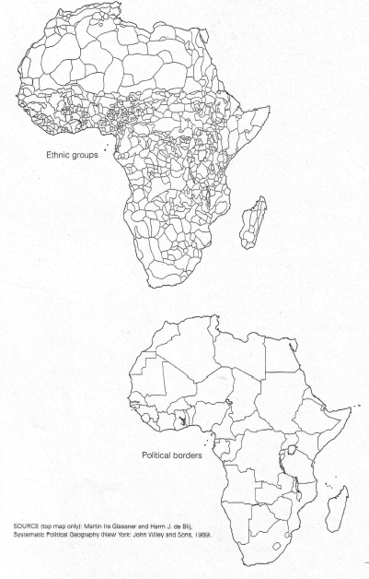

Slide 30
Can we design a constitution?
Often countries choose the opposite of what they need
Countries that need restrictions on executive power often choose powerful executives
Countries that need representation of minority group get majoritarian institutions
How to get a good solution adopted?
External pressure and advice?
Private drafting of constitution?
Wise leaders

