Slide 1
Critical Theory
Sam Kniknie

Slide 2
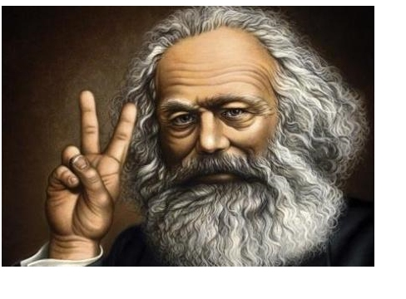
Beyond Marx
Marx’ predictions → not true
Revolution in Russia
Capitalism was/is not overthrown
Marx = useless?

Slide 3
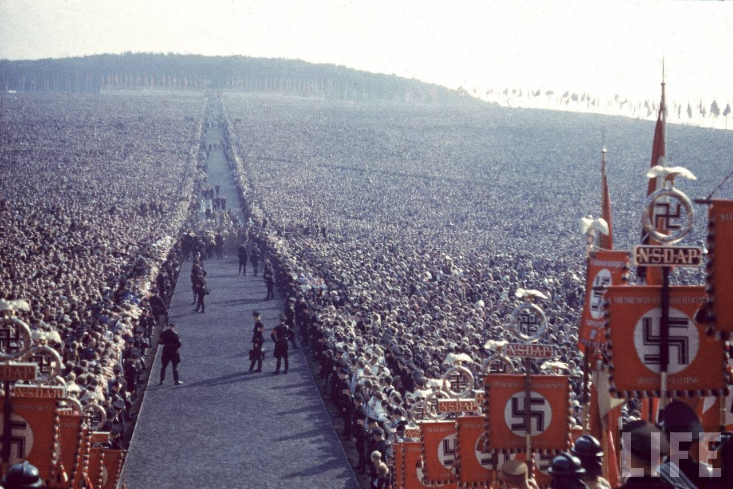
Frankfurter Schule
Founded in the 1930s in Frankfurt, Germany
Max Horkheimer, Theodor Wiesengrund Adorno, Walter Benjamin & Herbert Marcuse
Critique on Western, capitalist society
Enlightment did not result in human emancipation (Fascism, Stalinism)

Slide 4
Basics of Critical Theory
Combines the ideas of Marx, Weber and Hegel
Economic determinism → cultural determinism
Interdisciplinarity
4 critiques

Slide 5
Criticism of economic determinism
Economic determinism in Marx’s original work & followers
Not whole story
Interaction between ‘superstructure’ and ‘base’
Gramsci

Slide 6
Criticism of positivism
≈ critique on economic determinism
Human sciences ≠ natural sciences
Loses sight on human actors
Conservative: no attention for change

Slide 7
Criticism of sociology in general
Conservative science
Legitimates status quo of society
Should help creating a ‘just and humane society’
Sociology as a political instrument

Slide 8
Criticism of culture industry
Critique on mass media
Commodification of media
Driven by profit, money
Conformism
Stupifies people
False feeling of individualism

Slide 9
Criticism of culture industry
≈ knowledge industry
Commodification of knowledge
Universities become companies?

Slide 10
Critiques on Critical Theory
A-historical
Not enough attention for economy
Bourgeois idealism
Too ideological?

Slide 11
Questions
Can a university be objective and independent in its research when it goes to stock exchange?
Is sociology conservative and does it approve for the status quo of society? Should it take a progressive role and fight for emancipation?

