Slide 1
Structure-agency and micro-macro integration
Antonio Montalbán Espinosa, Anastasiia Volkova

Slide 2
The debate:
Social structure vs human agency
Social structure determines social life;
individual activities = outcome of structure.
Individuals (re)construct and give meaning to their world.
Social structure influences human actions and vice versa.

Slide 3
Theory of Structuration
Structuration theory aims to explain social practices across space and time by viewing action and social structure as linked by their interdependency
The duality of structure: human agency and social structure each act as an enabling condition of the other.
Human
agency
Social
structure

Slide 4
Key points
Action is not equated with individual human activity(Weber);
Structure is not identified with external constraint(Durkheim);
Men make their own history but not in circumstances of their own choosing (Marx).
AGENT is any social unit that is capable of making a difference.
AGENCY is the continuous flow of conduct.

Slide 5
The agent-structure integration
Anthony Giddens: Action and structure can not be isolated from each other.
Margaret Archer: agency and structure may and need to be isolated.
Pierre Bourdieu: the action-structure conflict is transformed into the relationship between habitus and field.
Jurgen Habermas: the framework of the problem of "colonization of the life-world."

Slide 6

Gidden’s theory
Structure is when the rules and resources are organized as properties of social systems.
Agency is when an individual is able to observe his/her own experience and then be able to give reasons for their action.
The relationship between structure and agency as
the duality of structure, whereby individuals reflexively produce and reproduce their social life.

Slide 7
Micro- Macro Integration
Classic sociologist view as either Macro-Micro extremist : Marx, Durkeheim, Weber, Simmel
Marx can be seen as being interested in the coercive and alienating effect of capitalist society on individual.
Weber may be viewed as being focally concerned with the plight of the individual within the iron cage of a formally rational society.
Simmel was interested primarily in the relationship between objective (macro) culture and subjective (or individual, micro) culture.
Durkheim : concerned with the effect of macrolevel social facts on individuals and individual behavior

Slide 8
Micro-Macro Integration movement
2 major strands of work on Micro-Macro Integration:
  Theorists focus on integrating micro and macro theories
  Others concerned with developing a theory that deals with the linkage between micro and macro levels

Slide 9
Examples of Micro and Macro Integration
All micro and macro social phenomena are also either objective or subjective. Focus on the interrelationship among these 4 levels.
  The macro-objective level involves large-scale material realities such as society, bureaucracy, and technology.
  The macro-subjective level encompasses large-scale nonmaterial phenomena such as norms and values.
  The micro objectivity involves small-scale objective entities such as patterns of action and interaction, whereas
  The micro subjectivity is concerned with the small-scale mental processes by which people construct social reality.

Slide 10
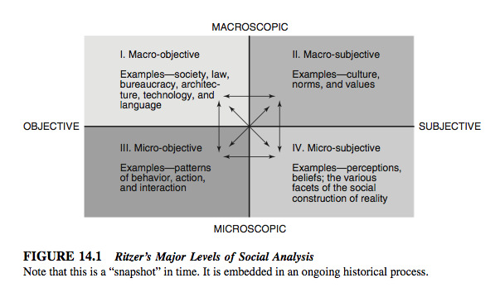

Slide 11

Microfoundations of macrosociology
Randall Collins->focus of radical microsociology, is what he calls “interaction ritual chains,” or bundles of “individual chains of interactional experience, crisscrossing each other in space as they flow along in time”
all macrophenomena” can be translated “into combinations of micro events”

Slide 12
Questions
It is possible to achieve an all unifiying theory for Micro-Macro Sociology?
Do you think that structure and agency are sources of each other?
References:
A History of Sociological Analysis / ed. by T. Bottomore, R. Nisbet. New York: Oxford University Press, 1978.
GIDDENS, A. 2001. Sociology. 4th. ed. Cambridge: Polity Press
RITZER, G. 2012. Sociological Theory. 8th ed.London:McGraw-Hill Education
Tucker K. H., Jr. Anthony Giddens and Modern Social Theory. London: Sage Publications, 1998. 224 p.

