Slide 1
EU Law
EGO402 EU Law and
European System of HR Protection
Hubert Smekal
(hsmekal@fss.muni.cz)
4 October 2016

Slide 2
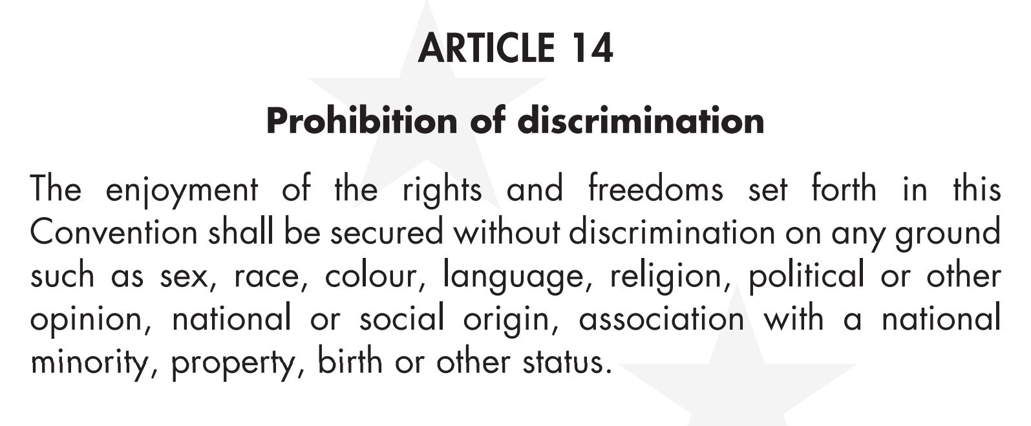
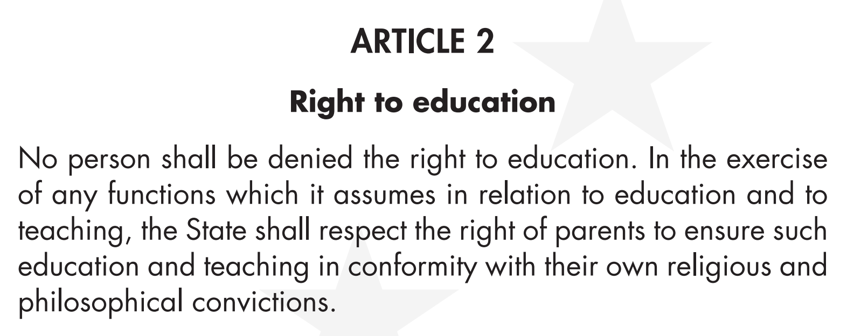
ECHR
ECHR – Prot. 1

Slide 3
ARTICLE 9
Freedom of thought, conscience and religion
1. Everyone has the right to freedom of thought, conscience
and religion; this right includes freedom to change his religion or
belief and freedom, either alone or in community with others and
in public or private, to manifest his religion or belief, in worship,
teaching, practice and observance.
2. Freedom to manifest one’s religion or beliefs shall be
subject only to such limitations as are prescribed by law and are
necessary in a democratic society in the interests of public safety,
for the protection of public order, health or morals, or for the
protection of the rights and freedoms of others.

Slide 4
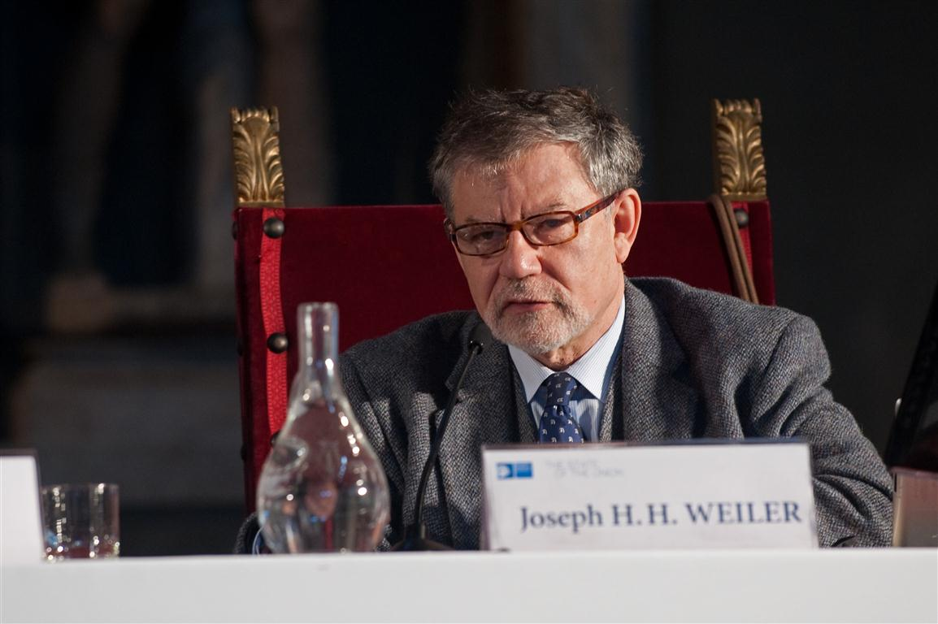
Jaqen, flickr

Slide 5
EU Law
Primary law
Treaties (IL)
Secondary law
Directives
Regulations
Decisions
Opinions
Recommendations

Slide 6
A court in a SN organization
infringement proceedings (enforcing the law)
actions for annulment (annulling EU legal acts)
actions for failure to act (ensuring the EU takes action)
preliminary rulings (interpreting the law)
actions for damages (sanctioning EU institutions)

Slide 7
Court of Justice
Direct effect – Van Gend en Loos
Supremacy – Costa v ENEL
Competences

Slide 8
Transposition of EU directives

Slide 9
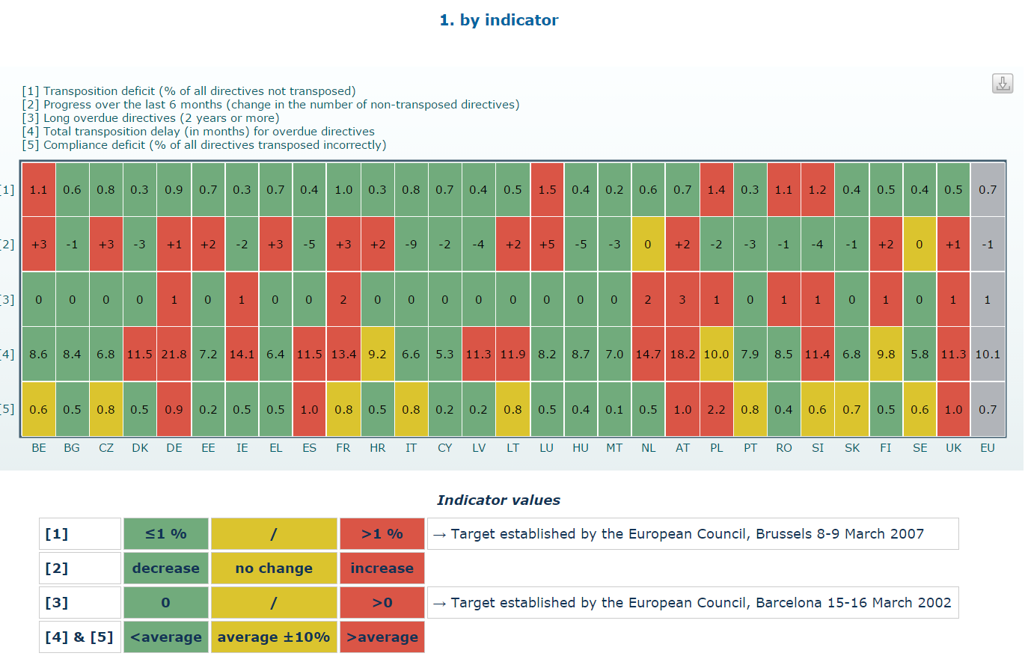
http://ec.europa.eu/internal_market/scoreboard/performance_by_governance_tool/transposition/index_en.htm

Slide 10
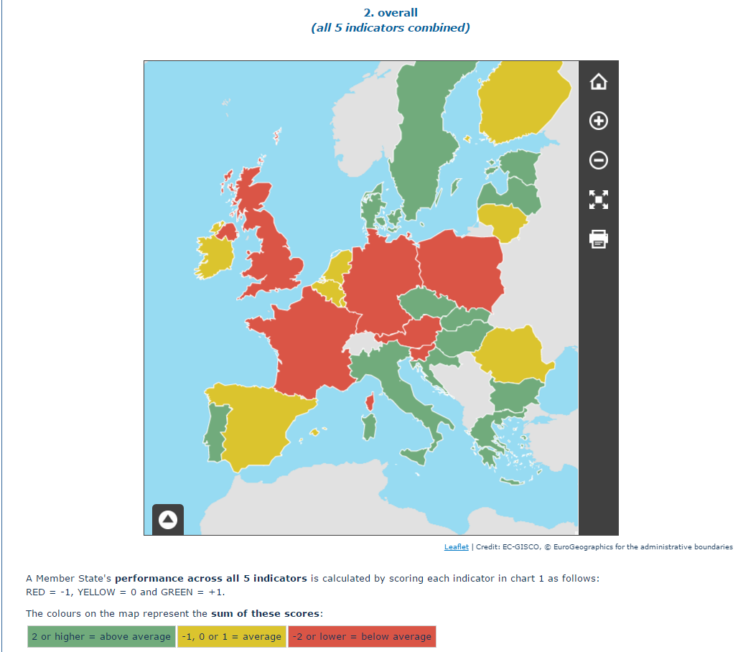

Slide 11
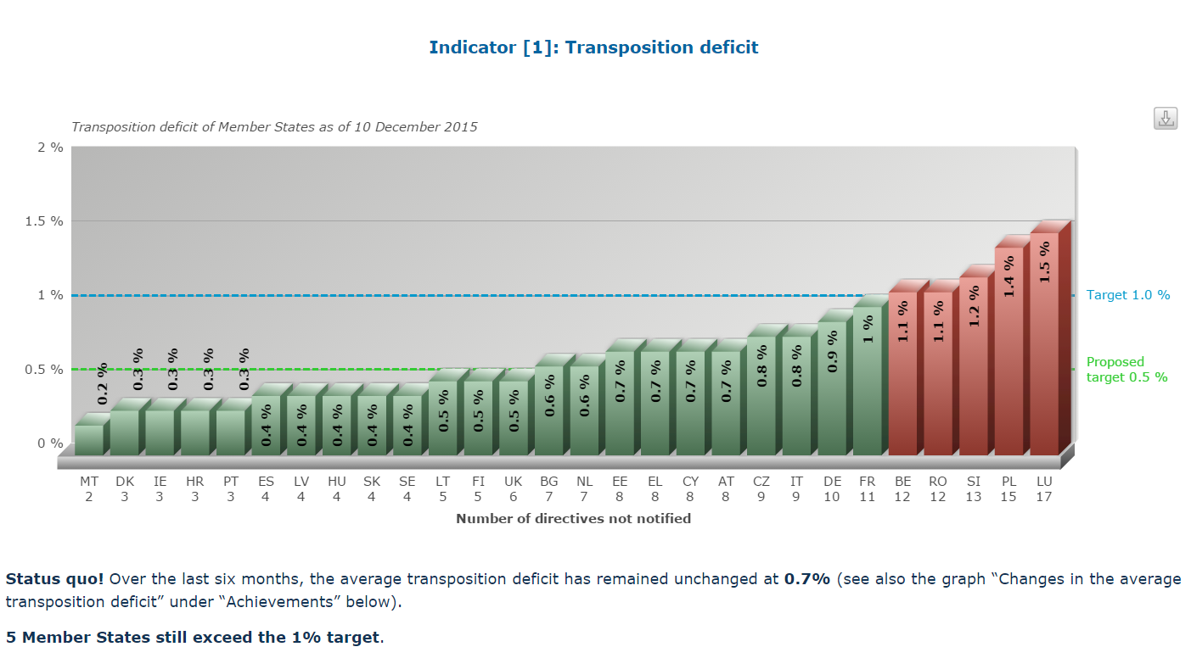

Slide 12
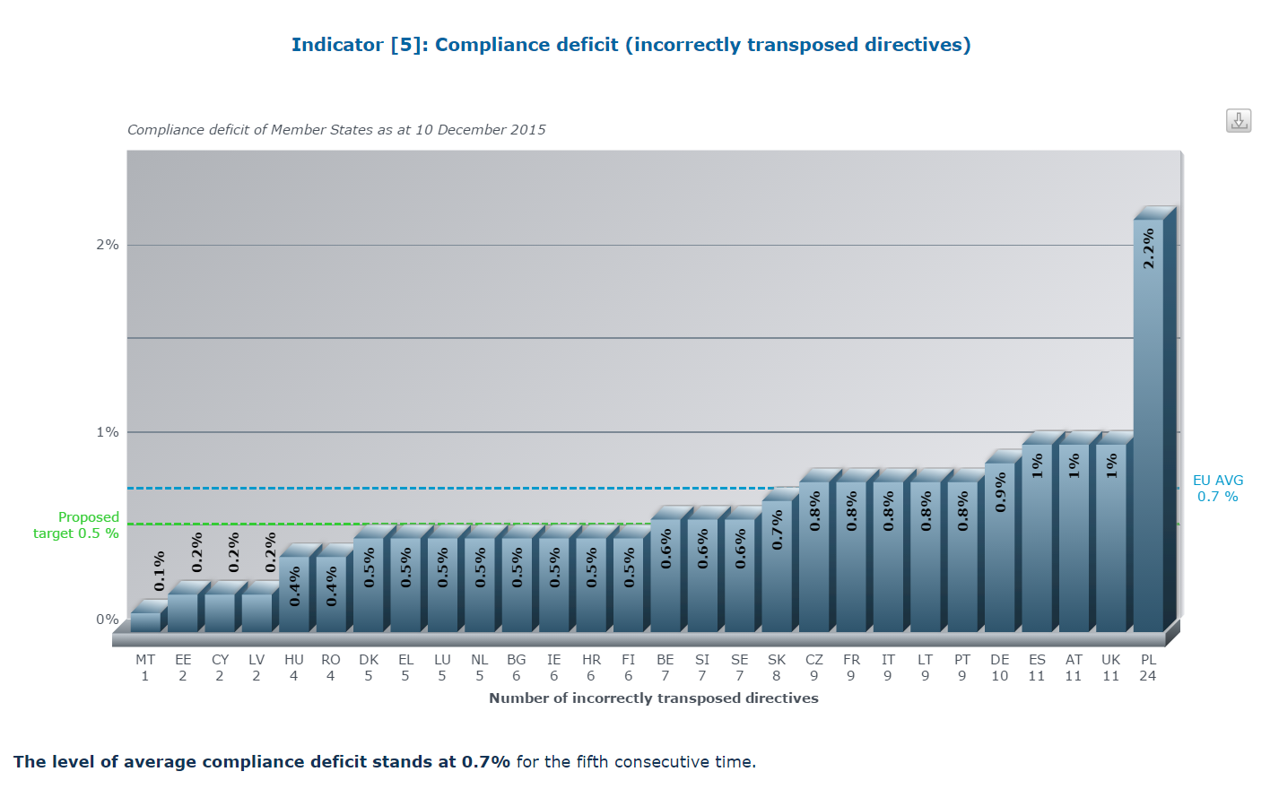

Slide 13
Compliance with EU law

Slide 14
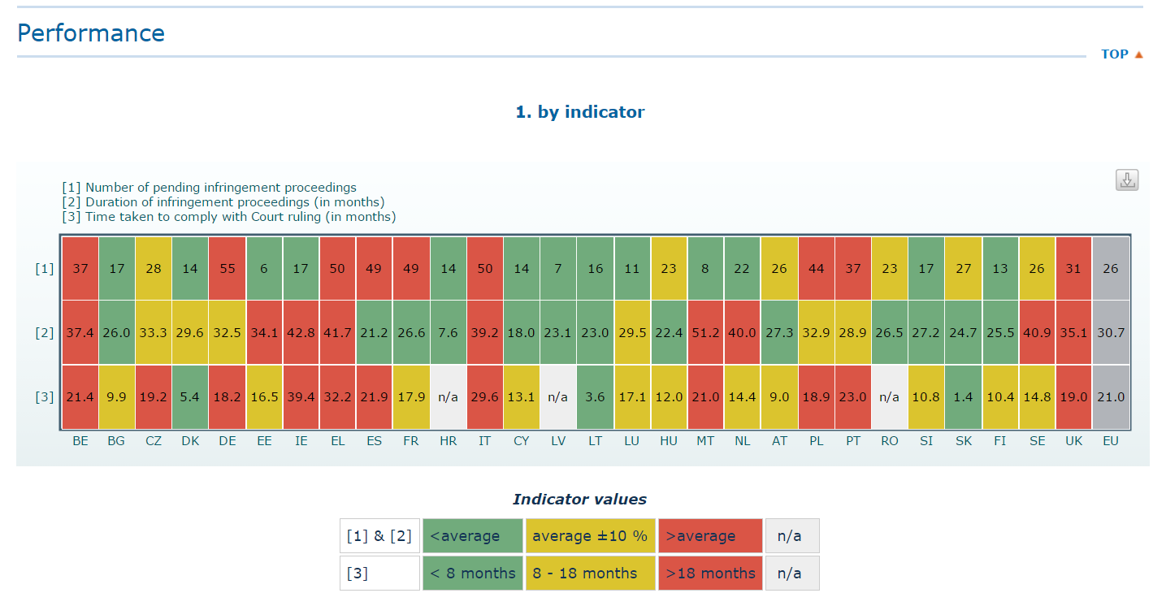
http://ec.europa.eu/internal_market/scoreboard/performance_by_governance_tool/infringements/index_en.htm

Slide 15
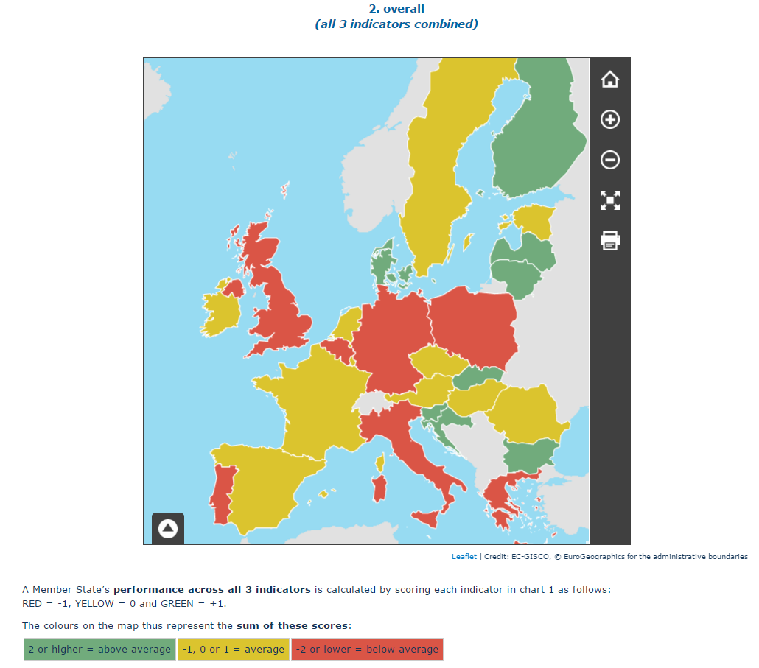
http://ec.europa.eu/internal_market/scoreboard/performance_by_governance_tool/infringements/index_en.htm

Slide 16
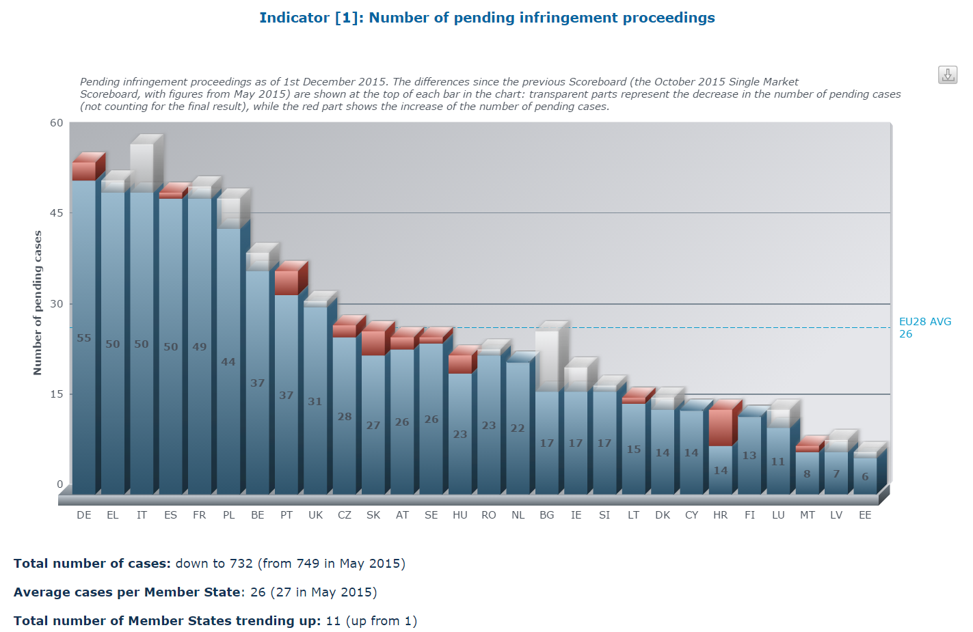
http://ec.europa.eu/internal_market/scoreboard/performance_by_governance_tool/infringements/index_en.htm

Slide 17
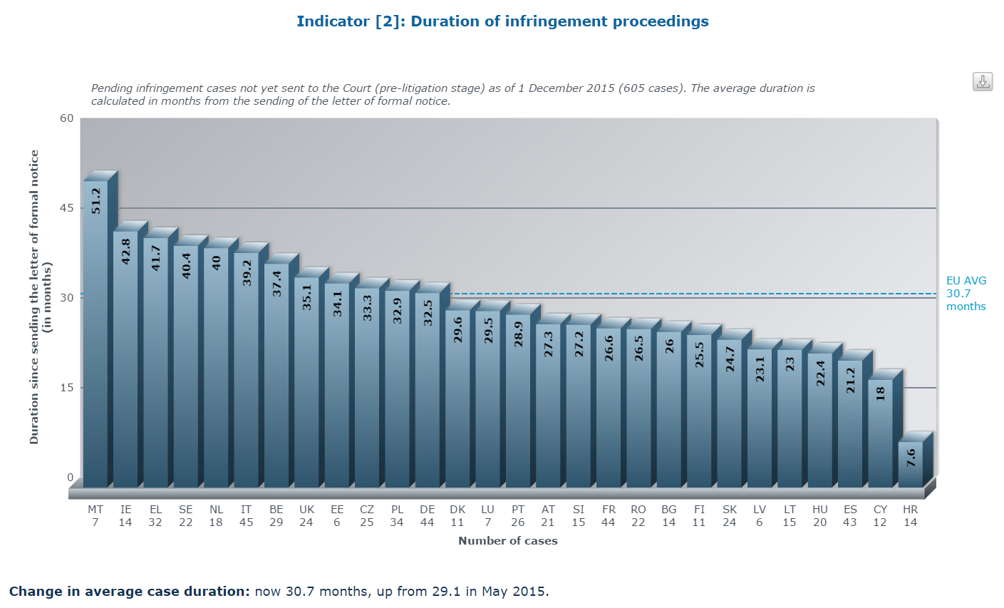
http://ec.europa.eu/internal_market/scoreboard/_docs/2014/07/infringements/2014-07-scoreboard-infringements_en.pdf

Slide 18
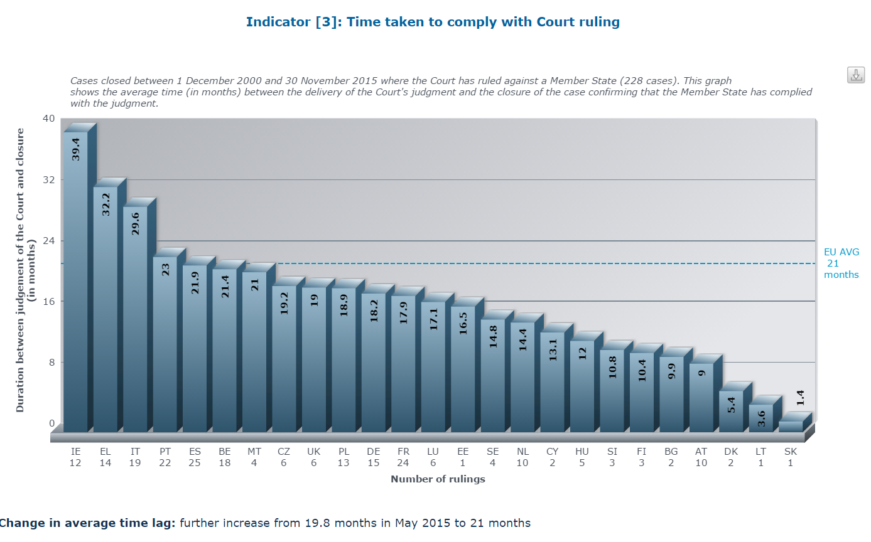
http://ec.europa.eu/internal_market/scoreboard/performance_by_governance_tool/infringements/index_en.htm

Slide 19
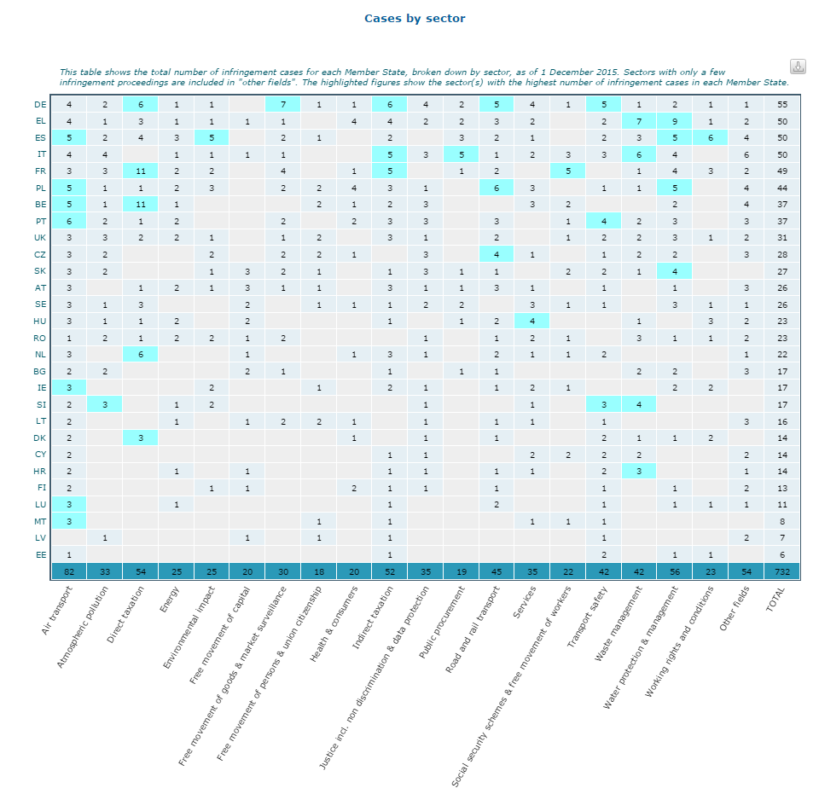
http://ec.europa.eu/internal_market/scoreboard/performance_by_governance_tool/infringements/index_en.htm

Slide 20
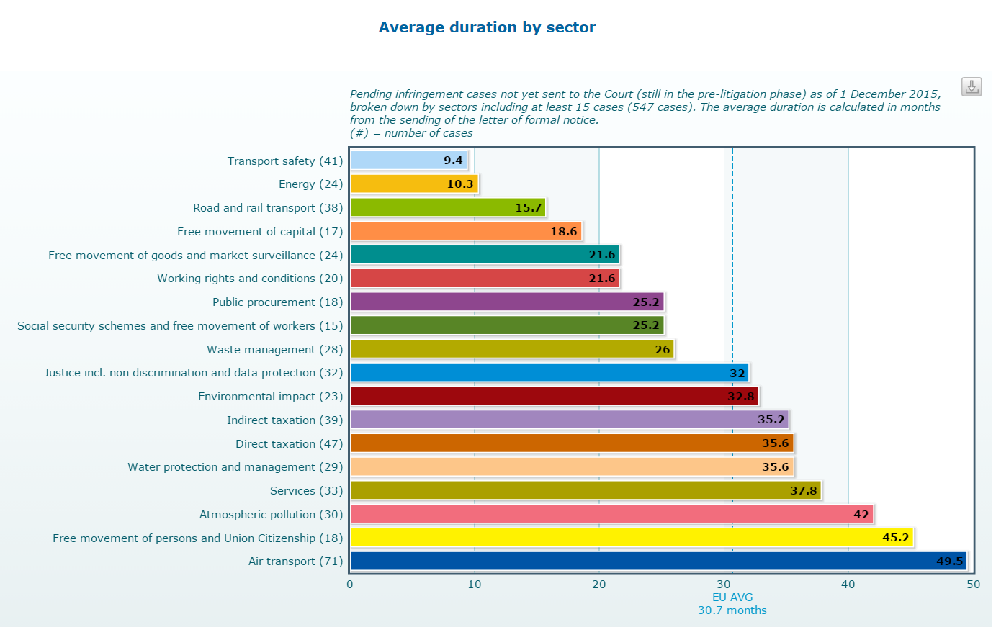
http://ec.europa.eu/internal_market/scoreboard/performance_by_governance_tool/infringements/index_en.htm

Slide 21
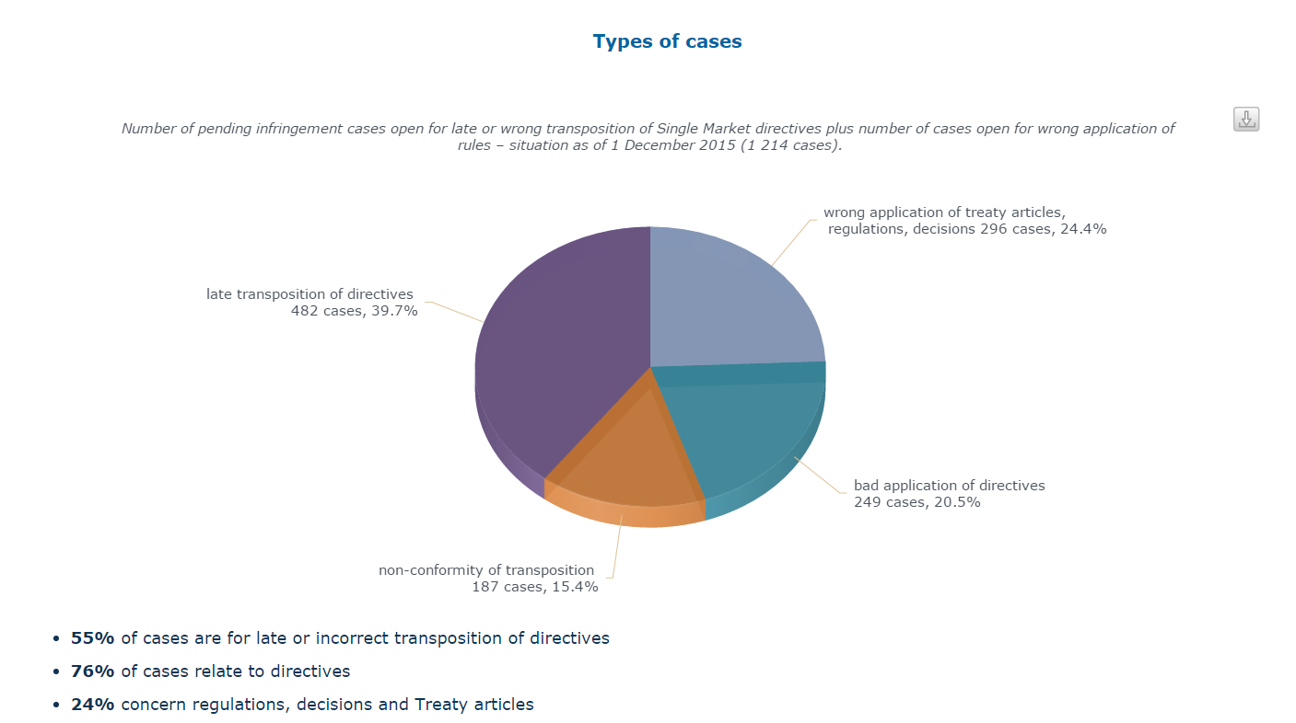
http://ec.europa.eu/internal_market/scoreboard/performance_by_governance_tool/infringements/index_en.htm

Slide 22
Article 352 (ex Article 308 TEC)
1. If action by the Union should prove necessary, within the framework of the policies defined in the Treaties, to attain one of the objectives set out in the Treaties, and the Treaties have not provided the necessary powers, the Council, acting unanimously on a proposal from the Commission and after obtaining the consent of the European Parliament, shall adopt the appropriate measures. Where the measures in question are adopted by the Council in accordance with a special legislative procedure, it shall also act unanimously on a proposal from the Commission and after obtaining the consent of the European Parliament.
2. Using the procedure for monitoring the subsidiarity principle referred to in Article 5(3) of the Treaty on European Union, the Commission shall draw national Parliaments' attention to proposals based on this Article.
3. Measures based on this Article shall not entail harmonisation of Member States' laws or regulations in cases where the Treaties exclude such harmonisation.
4. This Article cannot serve as a basis for attaining objectives pertaining to the common foreign and security policy and any acts adopted pursuant to this Article shall respect the limits set out in Article 40, second paragraph, of the Treaty on European Union.

