Slide 1
Court of Justice as Player in European Integration
EGO402 EU Law and
European System of HR Protection
Hubert Smekal
(hsmekal@fss.muni.cz)
11 October 2016

Slide 2
Courts

Slide 3
Conventional prototype of courts
Independent courts
Decide cases on the basis of preexisting rules
adversary procedure, dichotomous ruling (Winner x Loser)
Appeal
Triadic resolution of conflicts
Shapiro (1986): Courts.

Slide 4
Why independent judicial review?
Ginsburg – Versteeg 2013, JLEO
Theories
Ideational
Coordination and Commitment
Electoral Market
Diffusion

Slide 5
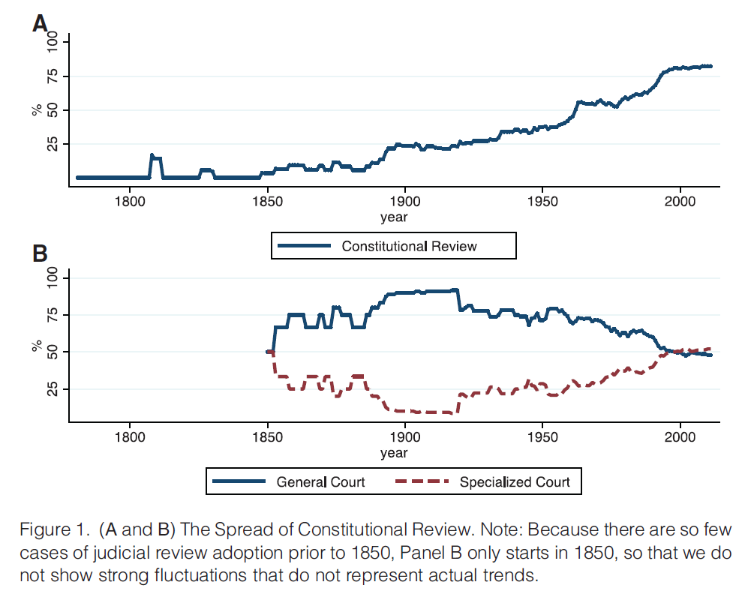
Ginsburg – Versteeg 2013, JLEO

Slide 6
Questions about courts
What influences their position in a political system
What influences courts in their decisions?
What influences judges in their decisions?

Slide 7
Strategic approach (Epstein – Knight)
Behavioural approach (Gillman)
Gibson: „Judge‘s decisions are a function of what they prefer to do, tempered by what they think they ought to do, but constrained by what they perceive is feasible to do.“

Slide 8
Critique of courts
Bickel: „non-majoritarian difficulty“
Bork: juristocracy
Dahl: Decision making in a democracy
Ely: protection of minorities
Checks and balances
Dworkin: rights as trumps

Slide 9
CJEU

Slide 10
CJ EU
CJ
General Court (CFI 1988)
Civil Service Tribunal (2004)
Why not Supreme Court, High Court etc?

Slide 11
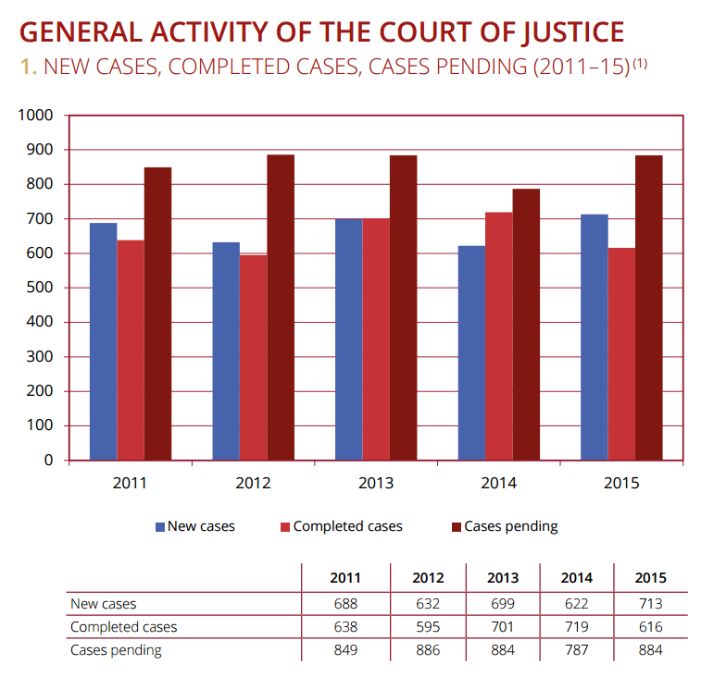
Annual Report 2015 – CJ

Slide 12
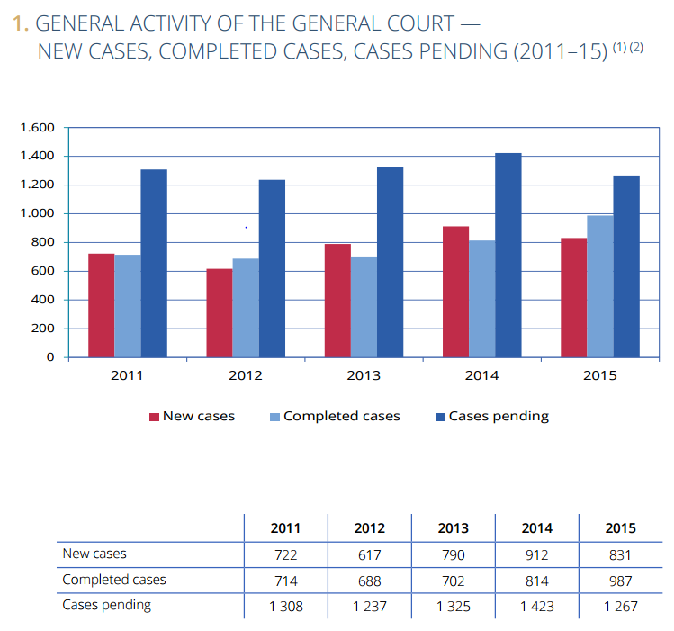
Annual Report 2015 – General Court

Slide 13
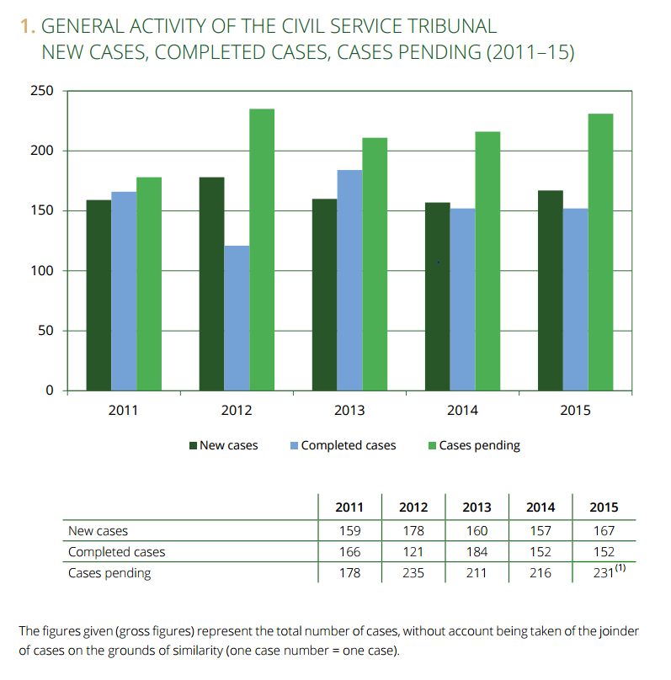
Annual Report 2015 – CST

Slide 14
CJ (Annual Report 2015)

Slide 15
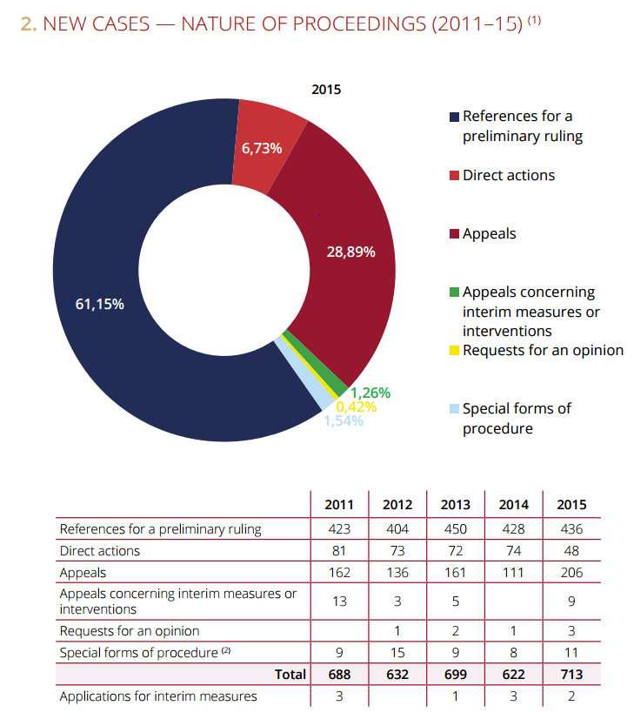

Slide 16
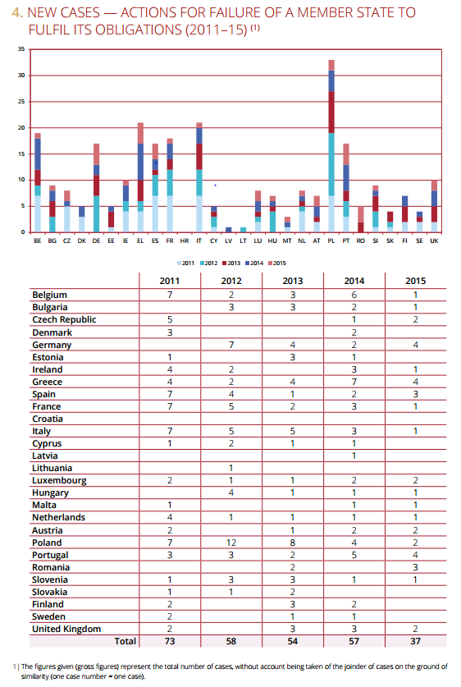

Slide 17
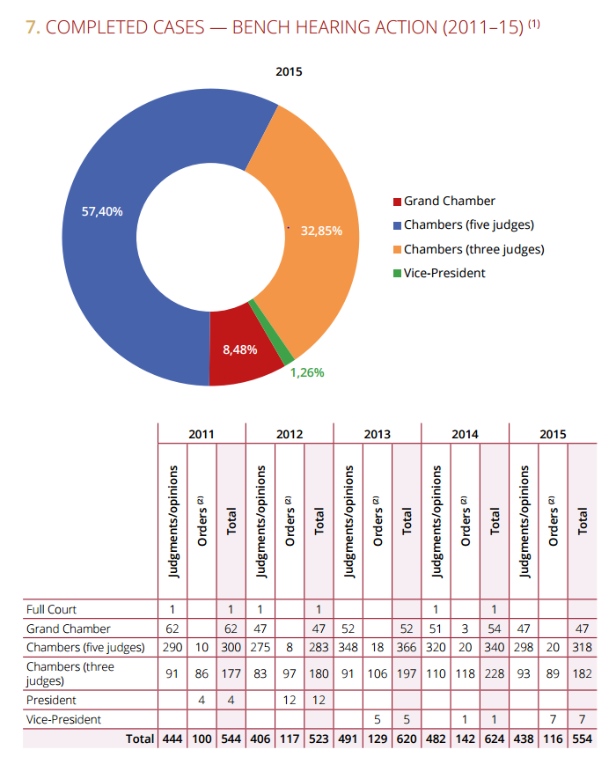

Slide 18
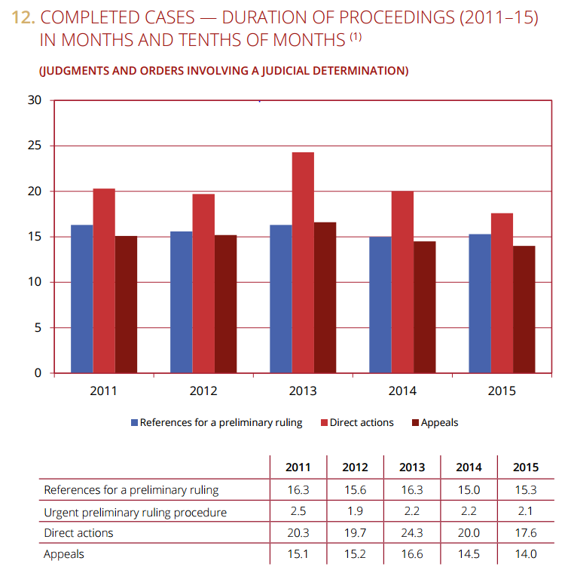

Slide 19
General Court (Annual Report 2015)

Slide 20
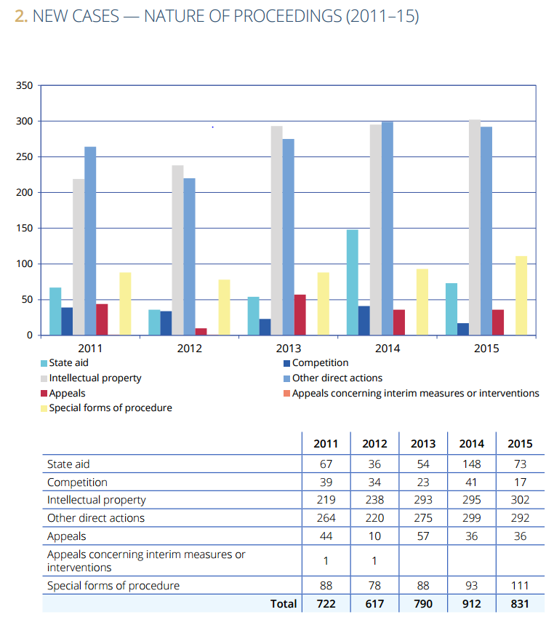

Slide 21
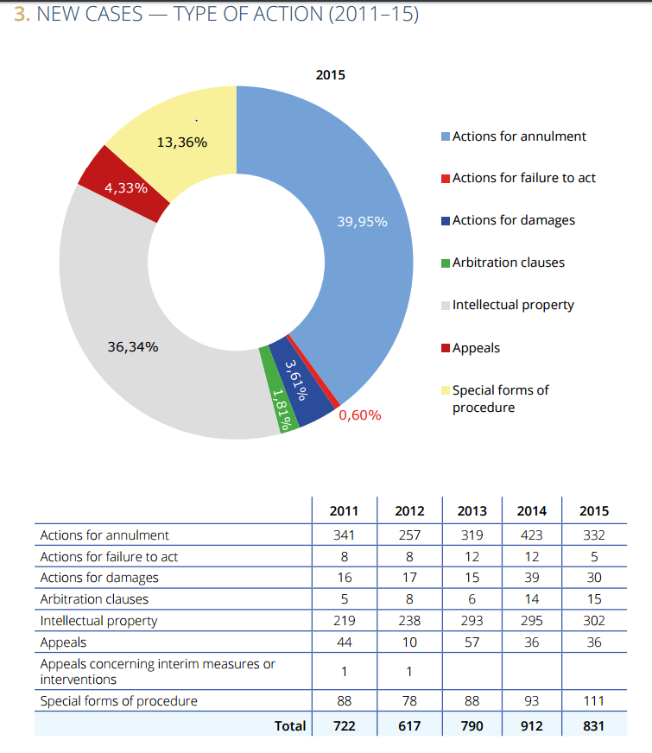

Slide 22
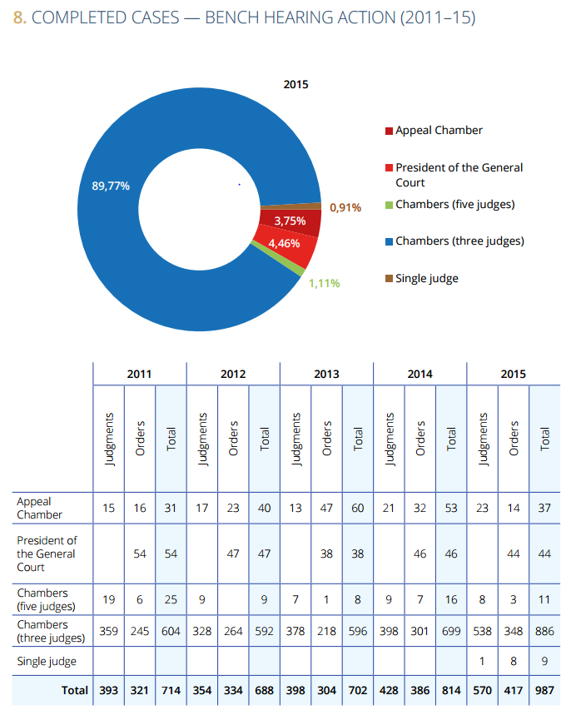

Slide 23
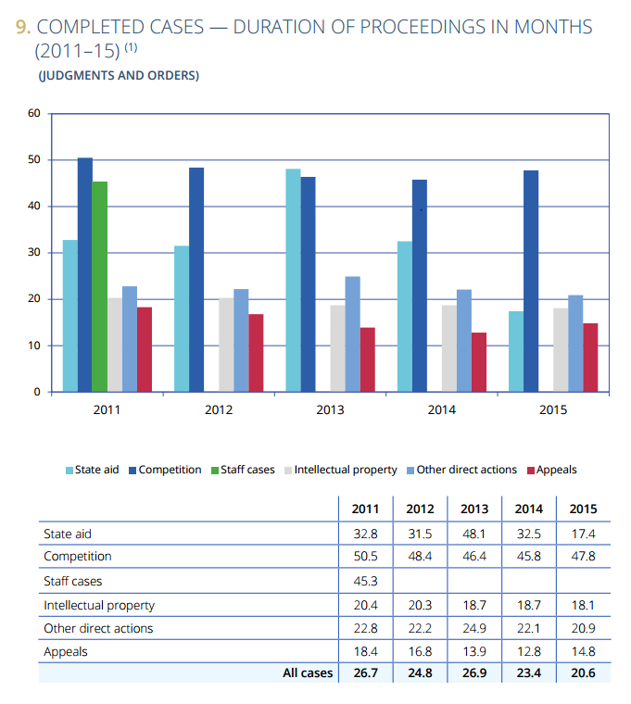

Slide 24
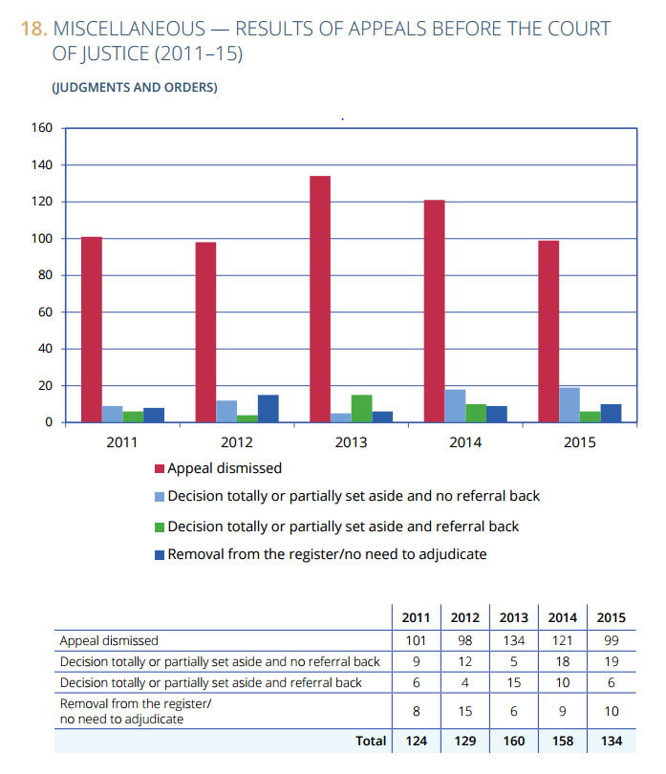

Slide 25
CST (Annual Report 2015)

Slide 26
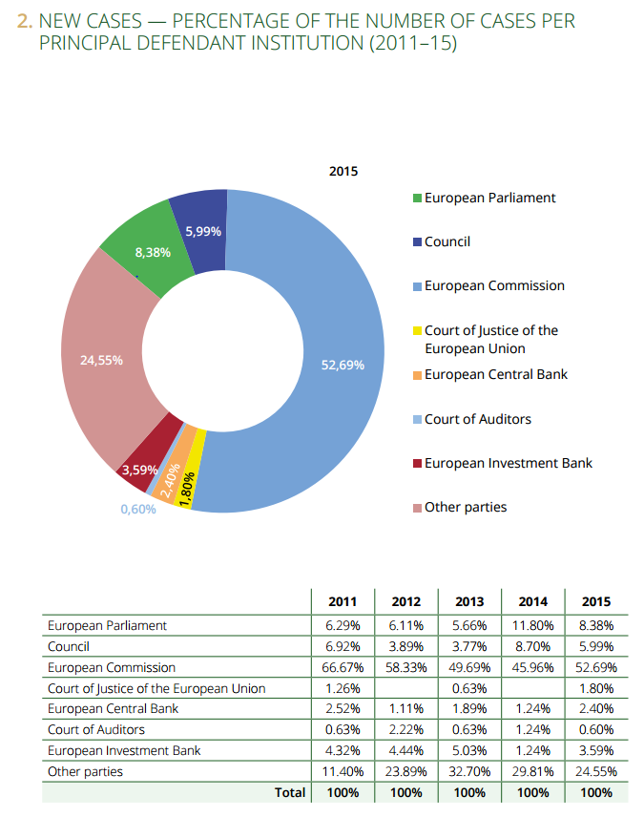

Slide 27
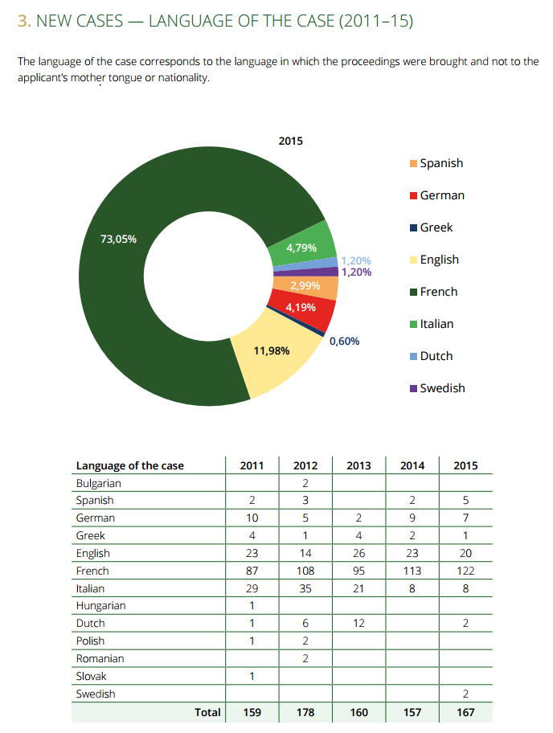

Slide 28
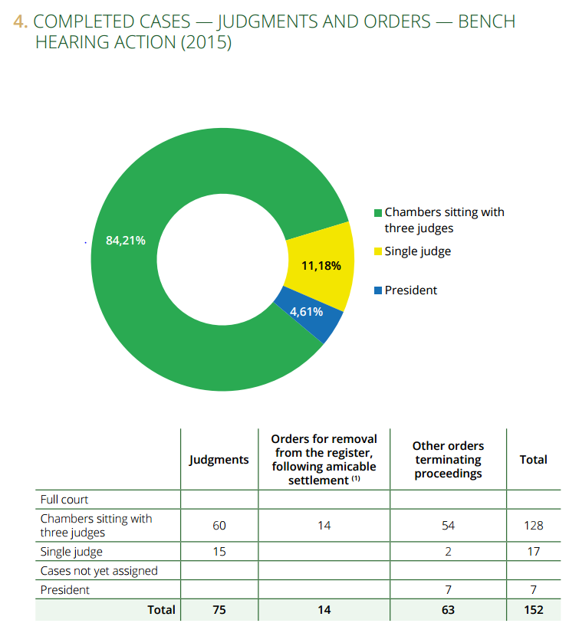

Slide 29
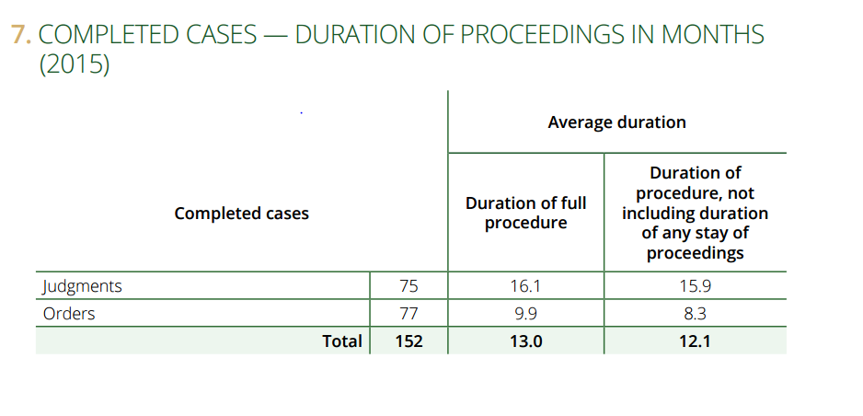

Slide 30
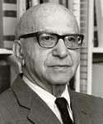
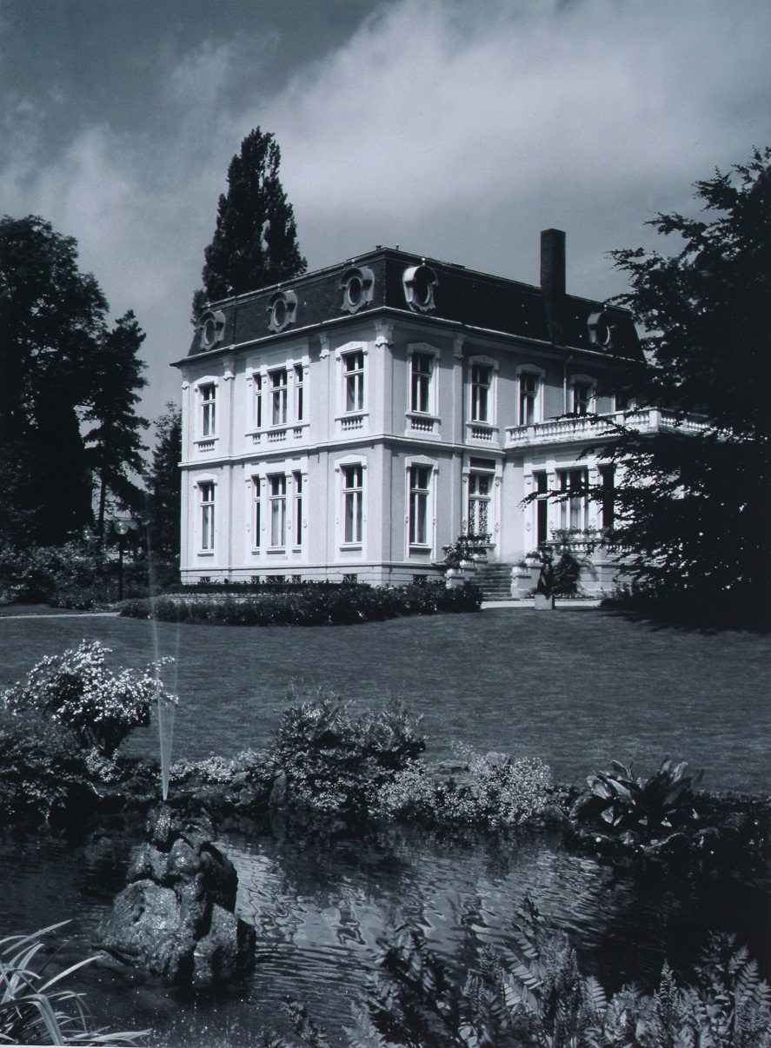
Eric Stein (1981) AJIL
“Tucked away in the fairyland Duchy of Luxemburg and blessed, until recently, with the benign neglect by the powers that be and the mass media, the Court of Justice of the European Communities has fashioned a constitutional framework for a federal-type structure in Europe.”

Slide 31
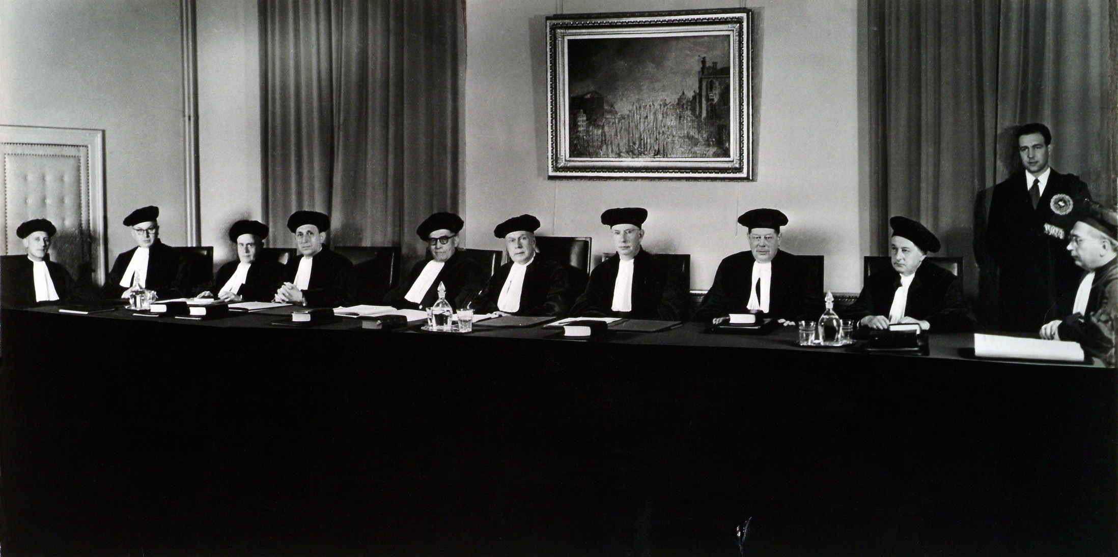
http://curia.europa.eu/jcms/upload/docs/image/jpeg/2012-11/1952-2high.jpg

Slide 32
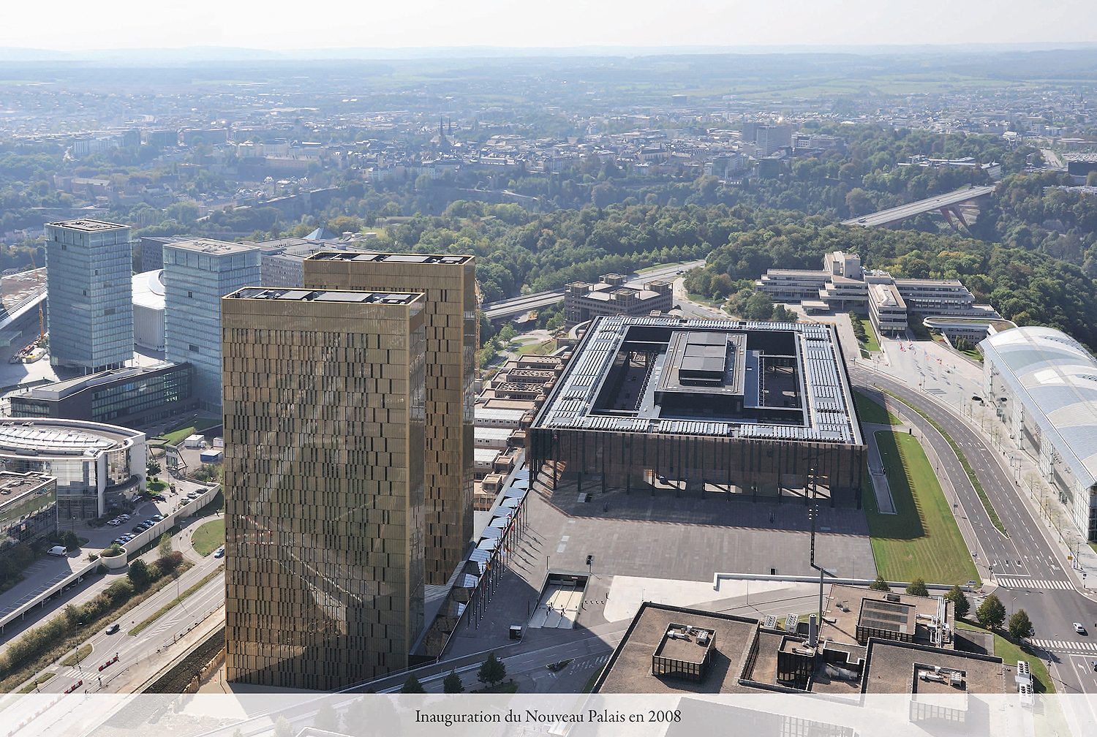
http://curia.europa.eu/jcms/upload/docs/image/jpeg/2012-11/2008-1high.jpg

Slide 33
Eric Stein (1981) AJIL

Slide 34
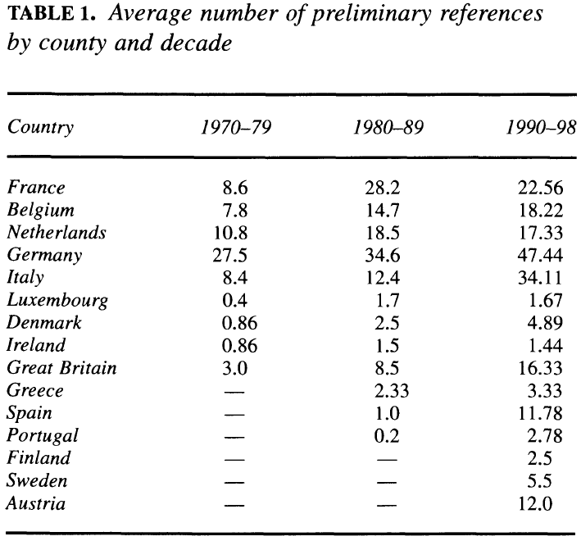
Carrubba - Murrah(2005) IO

Slide 35
Stone Sweet – Brunell (1998). APSR.

Slide 36
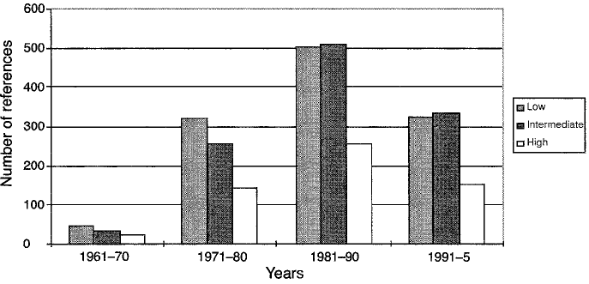
Stone Sweet – Brunell (1998) JEPP

Slide 37
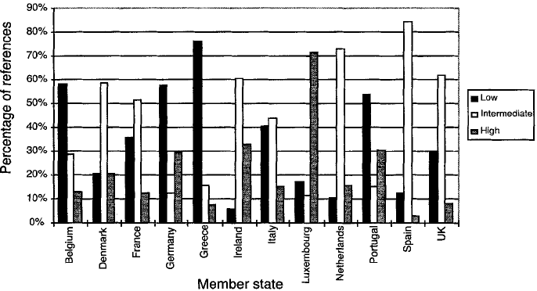
Stone Sweet – Brunell (1998) JEPP

Slide 38
Stone Sweet – Brunell (1998). APSR.

Slide 39
Court of Justice
Direct effect – Van Gend en Loos
Supremacy – Costa v ENEL
Competences

Slide 40
Article 352 (ex Article 308 TEC)
1. If action by the Union should prove necessary, within the framework of the policies defined in the Treaties, to attain one of the objectives set out in the Treaties, and the Treaties have not provided the necessary powers, the Council, acting unanimously on a proposal from the Commission and after obtaining the consent of the European Parliament, shall adopt the appropriate measures. Where the measures in question are adopted by the Council in accordance with a special legislative procedure, it shall also act unanimously on a proposal from the Commission and after obtaining the consent of the European Parliament.
2. Using the procedure for monitoring the subsidiarity principle referred to in Article 5(3) of the Treaty on European Union, the Commission shall draw national Parliaments' attention to proposals based on this Article.
3. Measures based on this Article shall not entail harmonisation of Member States' laws or regulations in cases where the Treaties exclude such harmonisation.
4. This Article cannot serve as a basis for attaining objectives pertaining to the common foreign and security policy and any acts adopted pursuant to this Article shall respect the limits set out in Article 40, second paragraph, of the Treaty on European Union.

