Slide 1
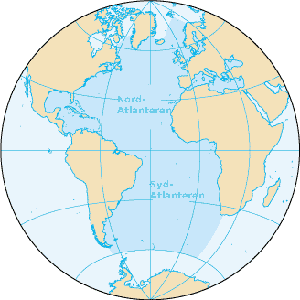
THE ATLANTIC LANDSCAPE

Slide 2
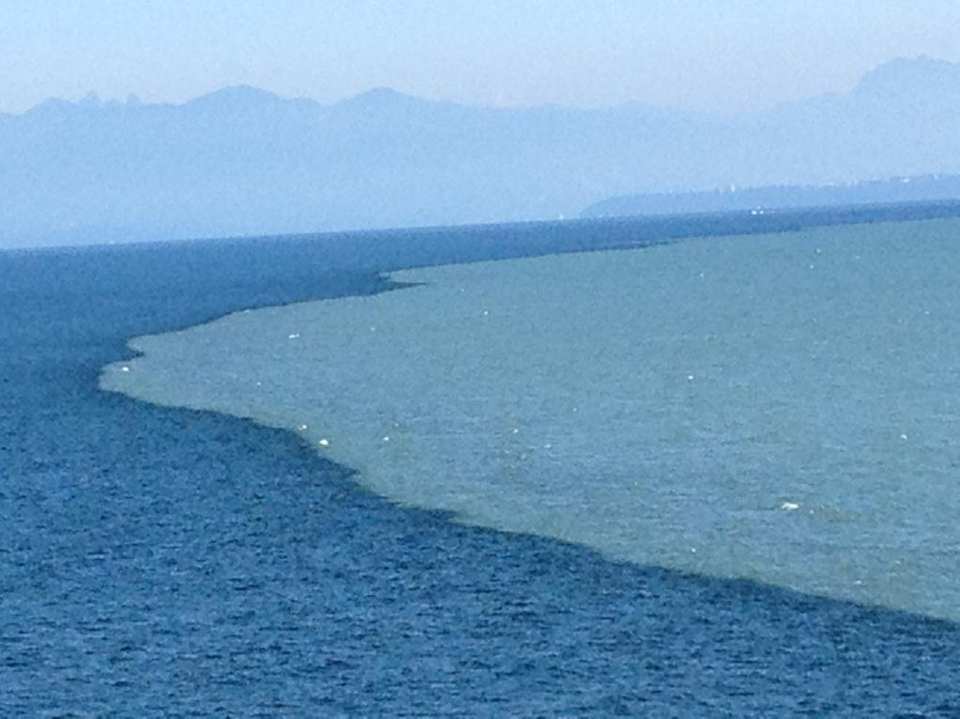
LARGE BODIES OF WATER NOT MIXING

Slide 3
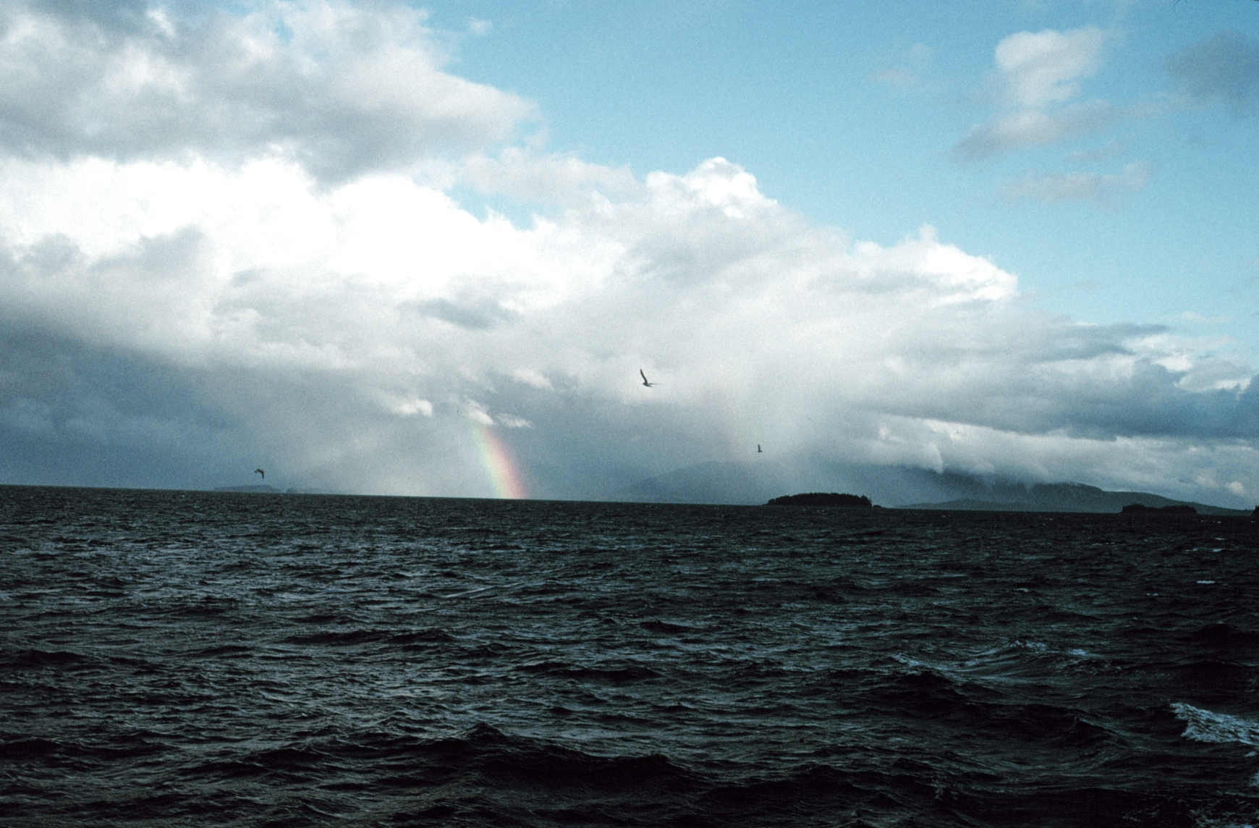
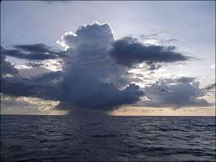
Tropical squalls

Slide 4
Tropical Squalls
Sharp increase of wind
Rain showers
Sustained wind over a short time interval

Slide 5
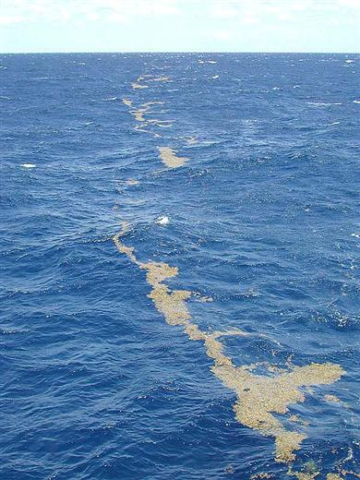
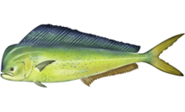
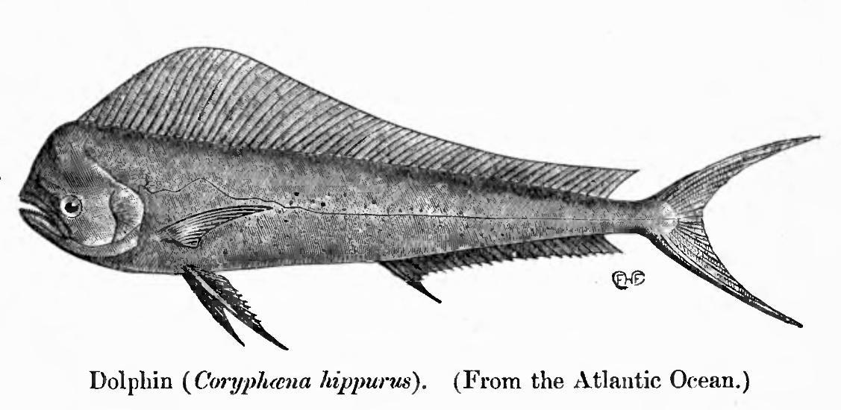
The Saragassum – sea weed in the Atlantic attracts fish like the Dorado (Coryphaena hippurus)

Slide 6
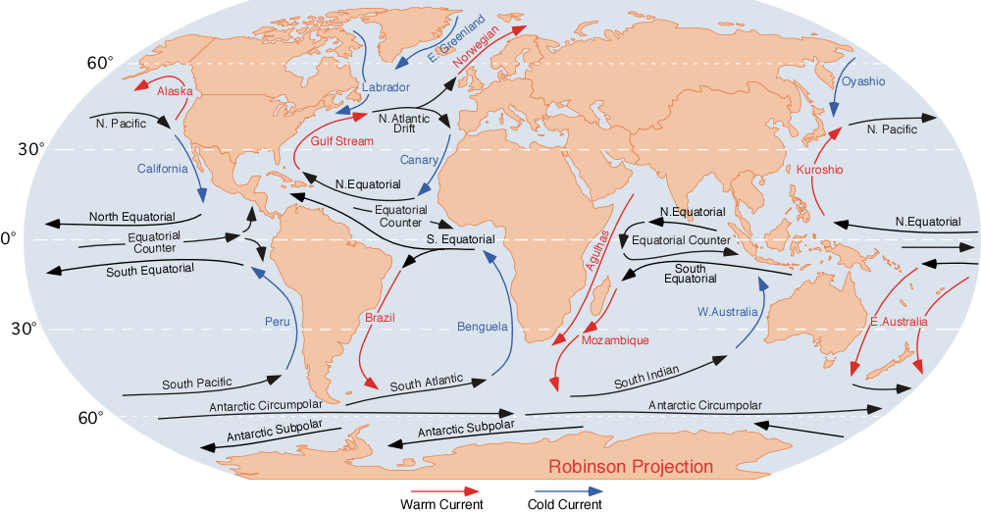
Ocean Currents – cold water in blue and warm water in red

Slide 7
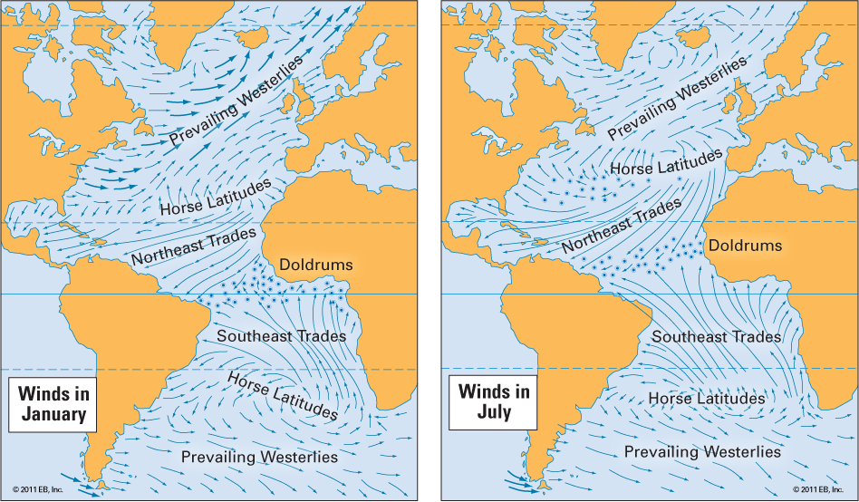
Atlantic Winds

Slide 8
Horse latitude (Explanations of the word)
1. Dead horse ritual Seamen were paid in advance and often had periods without income “dead horse time”. At the time of reaching Horse-latitudes they usually had worked off the dead horse and threw overboard a stuffed horse.
2. Alternative explanations is that ships transported horses becalmed at the latitude and due to lack of water and feed could not keep the animals alive.
3. A third explanation is the maritime expression of a ship being horsed in a certain direction by wind and currents

Slide 9
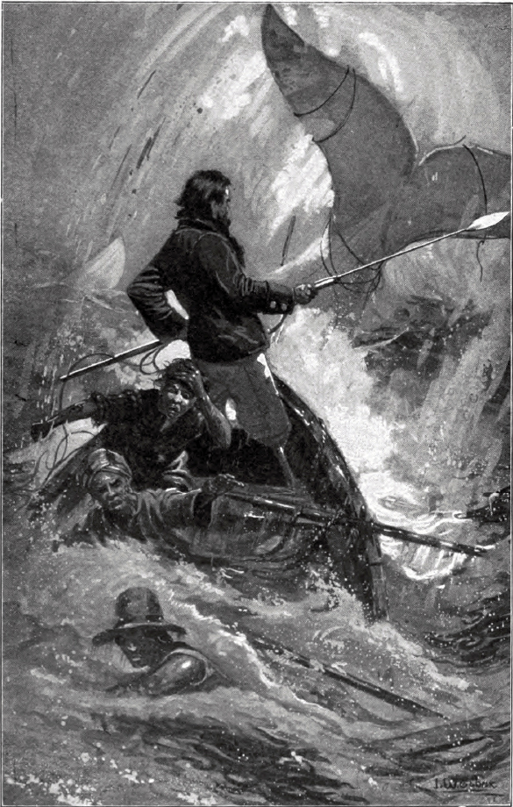
Moby Dick (Herman Melville 1819 – 1891) First Edition 1851

Slide 10
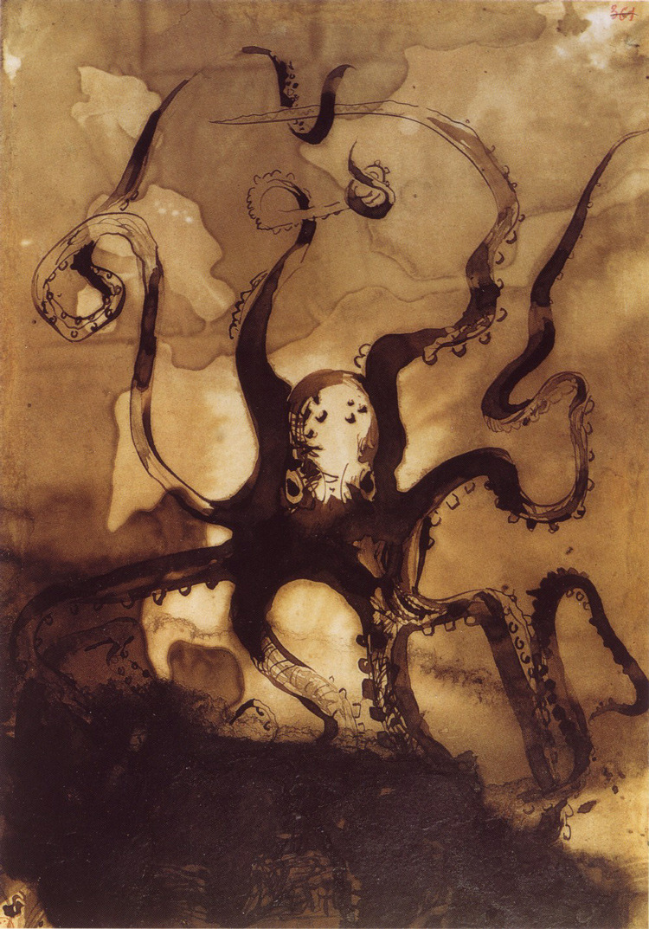
Toilers of the Sea – Les Travailleurs de la Mer (1866) Victor Hugo (1802 – 1885)

Slide 11
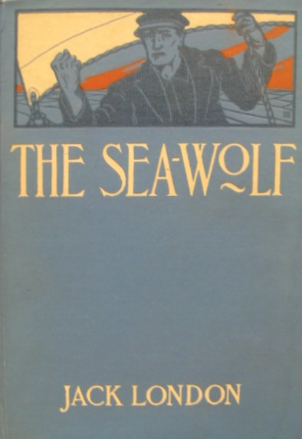
Sea Wolf (1904) Jack London (1876 -1916)

Slide 12
“Who hears the fishes when they cry?” asked Henry David Thoreau in 1839.
Henry Thoreau (1817 – 1862)
Walden (1854)
Cape Cod (1865)

Slide 13
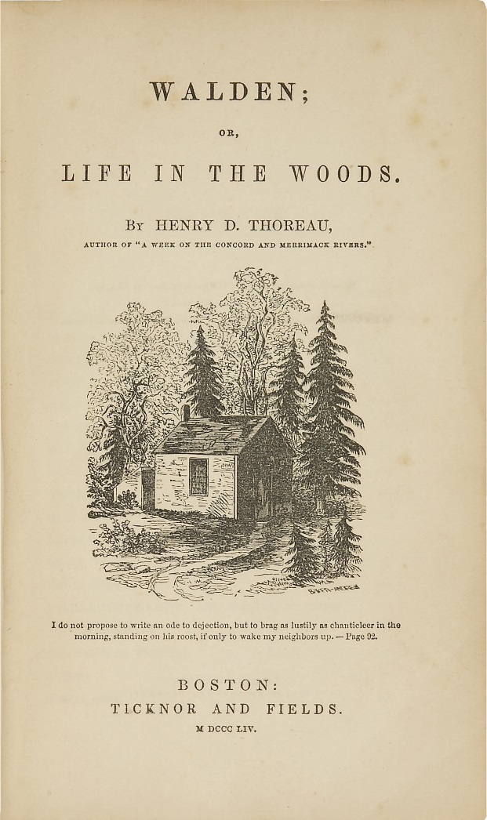
Klassikeren Walden (1854) skrevet etter at forfatteren levde alene ved sjøen Walden i ett år

Slide 14
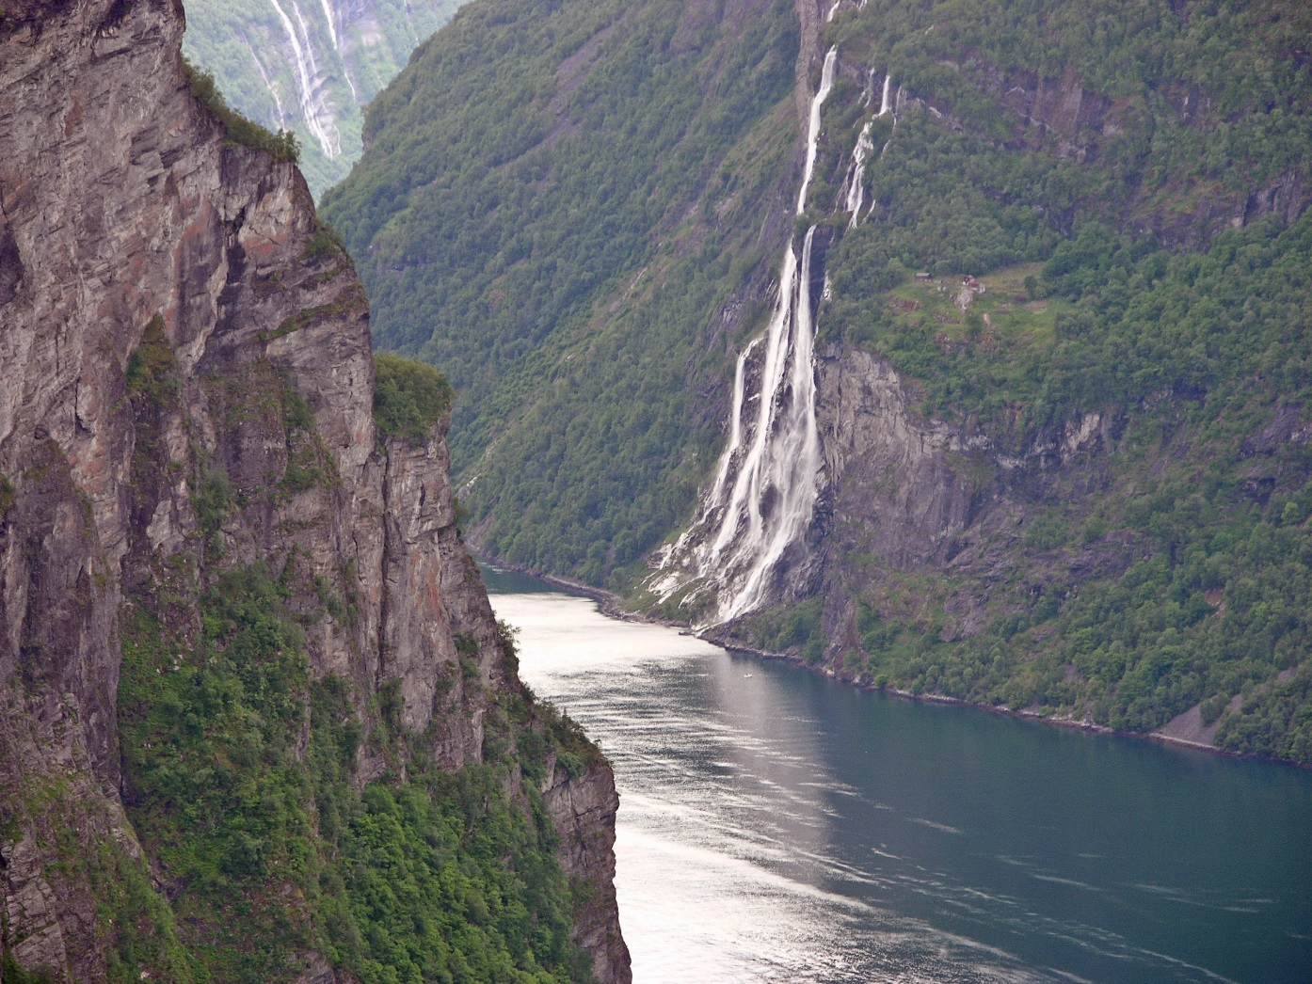
The Vikig tales – the Saga Stories

Slide 15
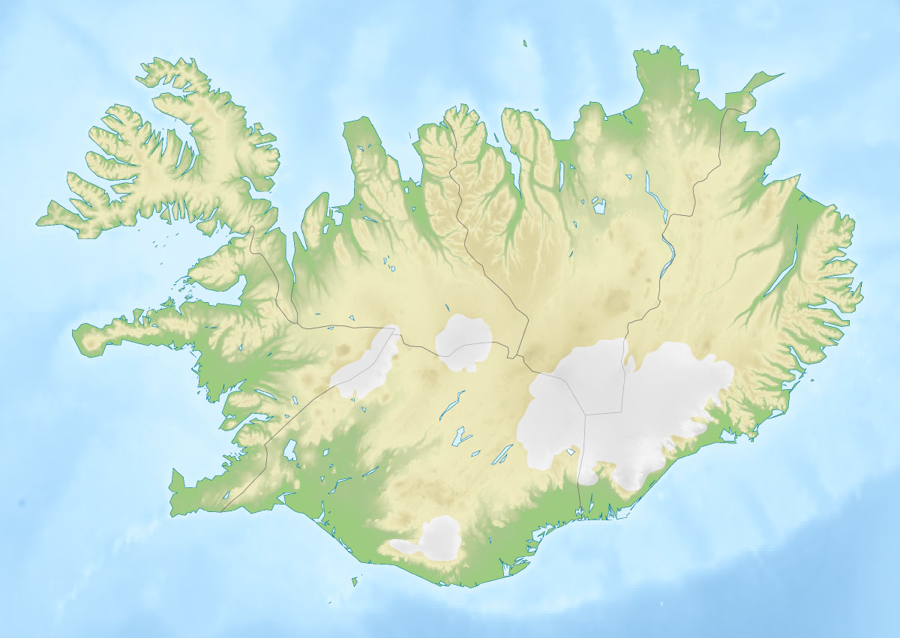
Snorre Sturlasson (1178/1179 – 1241)

Slide 16
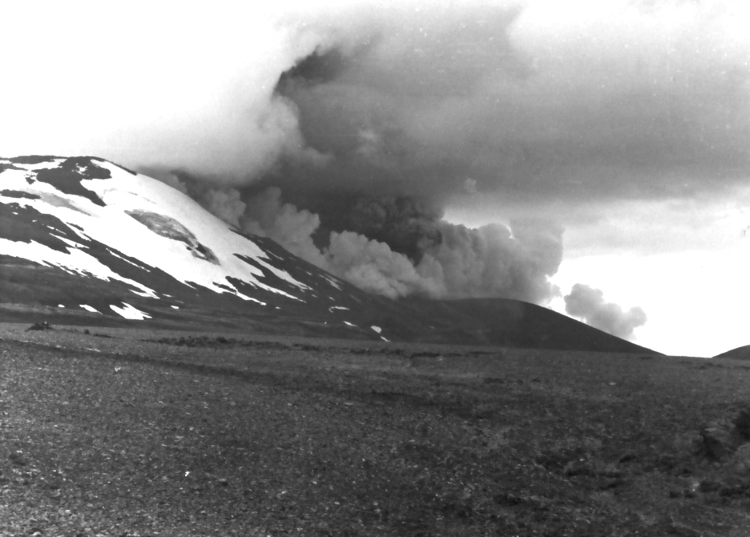
Hekla – the volcano erupting in 1980
«Gateway to Hell» «Lady with a hooded coat»

Slide 17
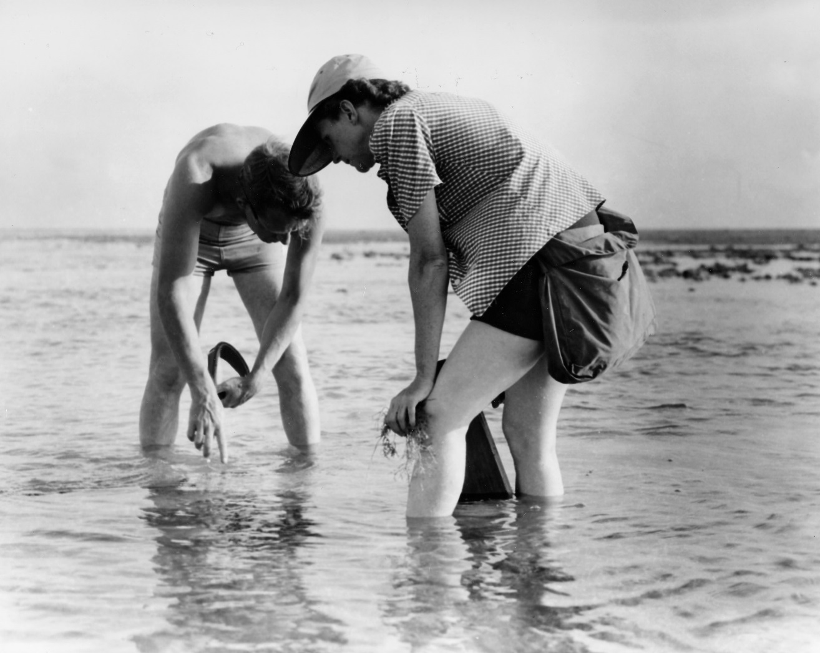
The Sea Around Us (1951) Rachel Carson (1907 – 1964)

Slide 18
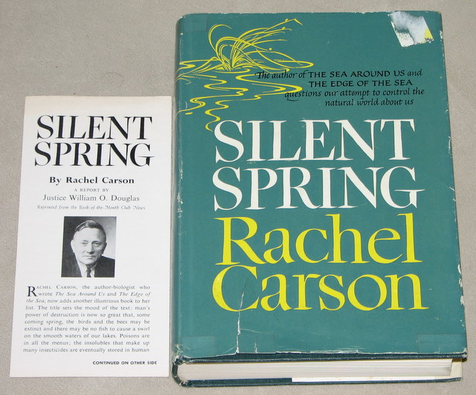
Silent Spring (1962) Rachel Carson (1907 – 1964)

Slide 19
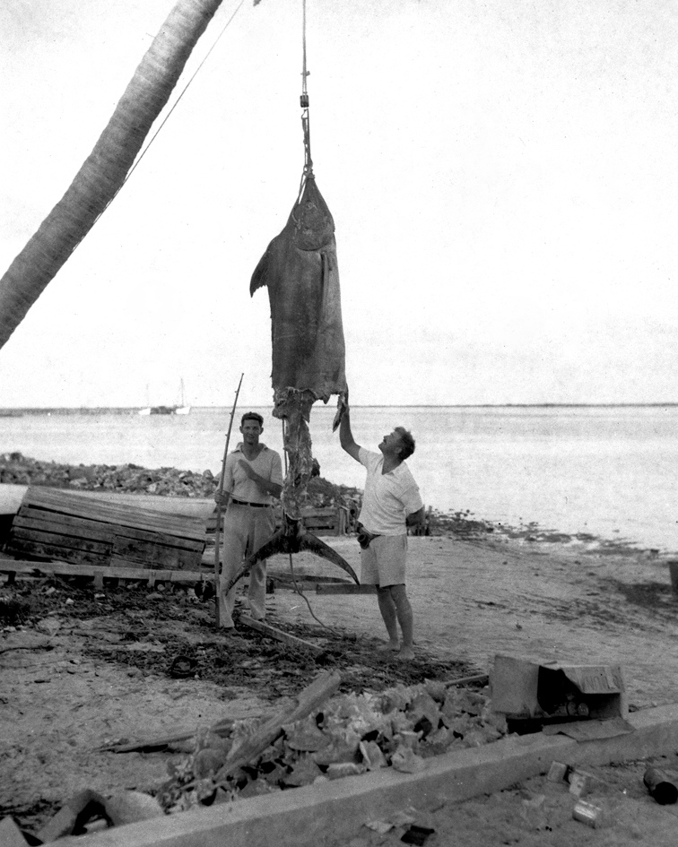
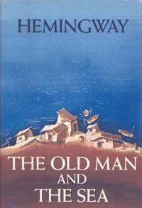
The Old man and the Sea (1952) Hemingway (1899 – 1961) Pulitzer Prize (1953) Nobel Prize 1954

Slide 20
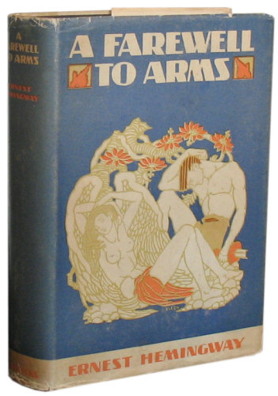
A Farewell to Arms (1929) Ernest Hemingway (1899 – 1961)

Slide 21
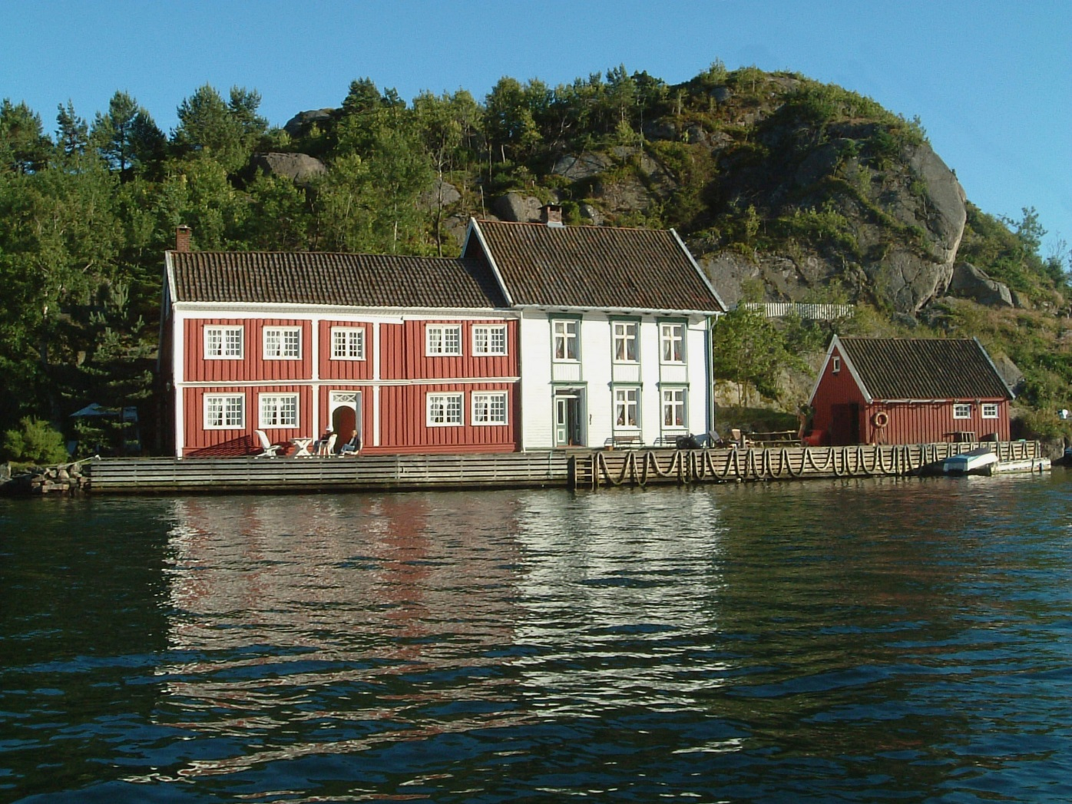
One of the Norwegian authors being part of the tradition of describing coastal life was Gabriel Scott (1874 – 1958) – The Fisherman Markus (1918). The picture is from the coastal settlment of Ny Hellesund.

Slide 22
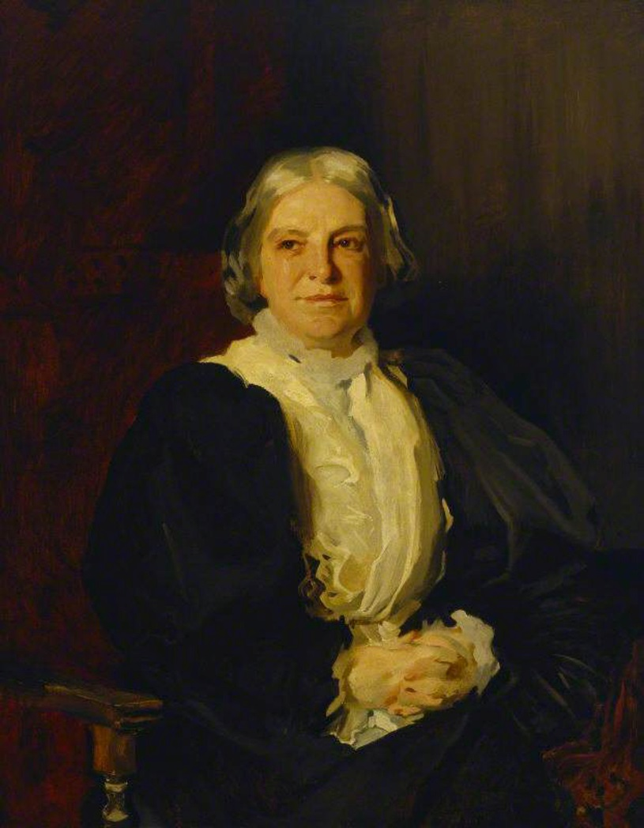
Octavia Hill (1838 – 1912)
National Trust
Open spaces

Slide 23
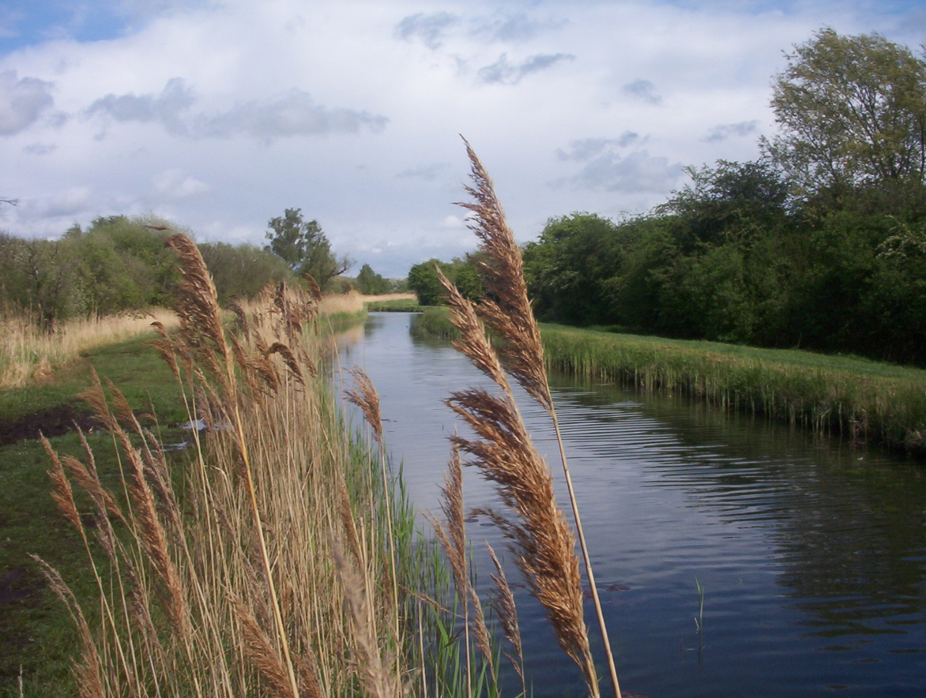
Wicken Fenn aquired by National Trust 1899

