Slide 1
The Lobby
U.S. Foreign Policy and an Interest Group

Slide 2
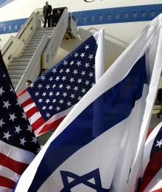
Influence?
Foreign aid
$3 billion to Israel
Democracy promotion
Support of Iraq war
Anti-Iranian nuclear deal
Peace process
inflamed Arab and Islamic opinion
jeopardized U.S. security

Slide 3
Balance?
Debate within academia
observe employment and prior published work
Arguments supported by ideological preference
neoClassical realism
Zakaria (1998: 42) “principal actors and their perceptions are crucial.”

Slide 4
Real-time
Paper from 2006.
Book published in 2007.
Sources from early 2000s or prior
Discussion on regional events since 2011

Slide 5
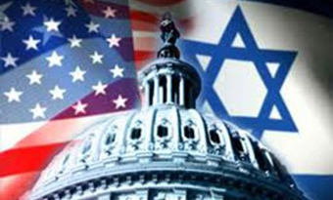
A real lobby?
Is argument sustainable when compared

Slide 6
