Slide 1
Populism in Western Europe
Contemporary Issues and Challenges

Slide 2
Questions
What kind of populists they are? Ideology.
Why do they emerge? Reasons.

Slide 3
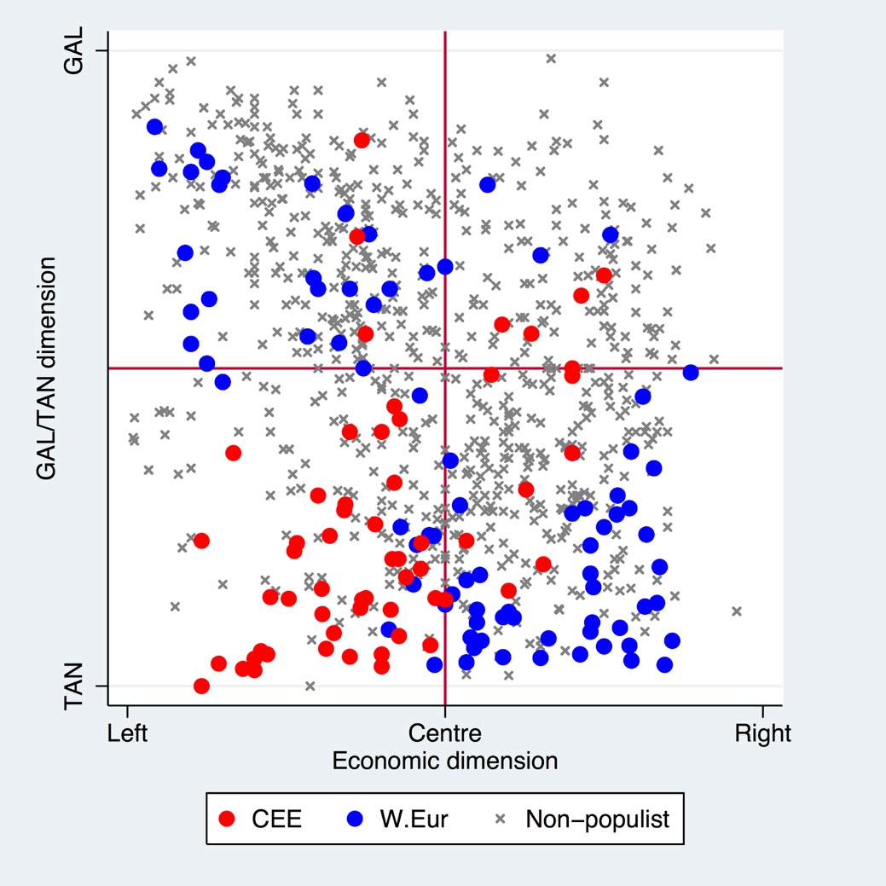
What kind of populist they are?
Striking differences between WE and CEE
Two groups of populist parties
GAL + econL / TAN + econR but…
…importance changes over the time
Source: Havlík, Stanley 2015, data: Bakker et al. 2015

Slide 4
A new winning formula?
Kitschelt, McGann (1995) – analysis of electoral appeals of (populist) radical right parties – authoritarianism and economic neoliberalism
Changes in the nature of PRR since the 1990s
Kitschelt (2004), De Lange (2007) – a new winning formula
Based on observed structural changes – new political opportunity structures (and constraints) for political parties as vote-maximizing actors
The authoritarian position retained but supplemented by a more centrist economic position

Slide 5
Defenders of the ‘losers’
Kriesi et al. (2006, 2008)
A thesis about emergence of a new conflict between winners and losers
Stemming from globalization characterized by more intensive economic, cultural, and political competition
Some people gain, some lose
Political potential for articulation of the divide at the national level
Lowering of national bounderies produces demand for their protection
INTEGRATION vs DEMARCATION divide
Intensification of the socio-economic conflict (more protectionist economy vs more open approach) and increased importance of the cultural conflict (defense of traditions, anti-immigration and Eurosceptic attitudes)
Uncertainty as a driver for populist radical right voting and to some extent also for populist left-wing voting

Slide 6
Issues - summary
Uncertainties caused by globalized world in the age of modernization
Immigration
European integration
Protectionist economy
Welfare state
Law and order
Identity-related issues (Christianity, nationality, culture)
Traditions – national integrity
Pro-Russian stances
A need for a strong leader

Slide 7
Thank you for your attention.

