Slide 1
The People`s Party in the USA Historical Roots of Populism

Slide 2
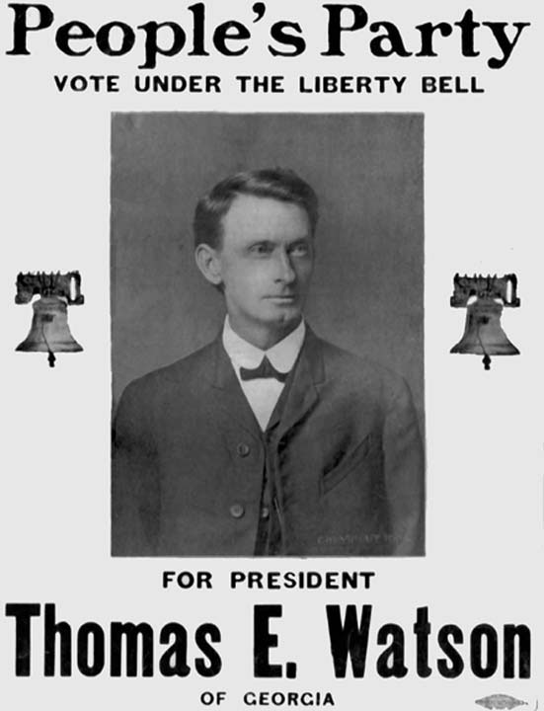
Outline
The history
The ideology
The impact

Slide 3
History of PP – socio-ecoomical context
The context:
Immigration to America and expansion to the West (1862 – Homestead Act)
the Civil War (1861-1865)
Result:
Division of the country
The urban North and the rural South
Financial centre vs agrarian periphery
Economic (monetary) policies (in details later)
The end of slavery – increasing number of small farmers

Slide 4
History of PP – socio-economical context
Rooted in regionally based agrarian radicalism X financial centre of the North
Two key issues:
Monetary policy
Crop lien system

Slide 5
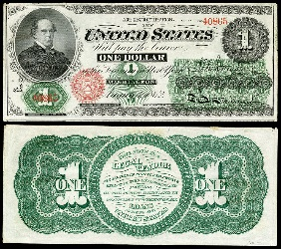
Monetary policy
Need for money during the Civil War – leaving the Gold standard
Congress agreed the issue of Greenbacks
(unbacked paper money) to cover war
expenses
Cheap money as the result (deflation)

Slide 6
Crop lien system
A credit system used in the South (X North, West – banks, land as collateral)
Farmers with no cash but in need of equipment and food
Supply and food on credit from „furnishing merchants“ with money from the North (high interest rates, double prices)
Credit based on expected crop production (collateral) – pushing into growing cotton – overproduction
Farmers dependent on the level of production (seasonal influences) in combination with the price of products + other expenses (transport)
Price influenced by production (higher effectivity + one sided production) + changes in monetary policy = „debt slavery“

Slide 7
Impact of monetary policy
Conflict between „Greenbackers“ and „Goldbugs“
Gradual return to the Gold Standard
Loans taken at times of cheap money (and high prices of crop) but needed to be paid back during the decline of prices caused both by production increase and monetary policy in the context of population growth - deflation
Worsening of economic situation of farmers - growing numbers of landless tenants in debts

Slide 8
From economic to political solution
self-reliance of farmers as the chief recipe
Farmers` Alliance (1877 – Texas Alliance) – a cooperative movement with political aspiration
Spreading in the South
Collaboration with labour movement (Knights of Labor – conflict between Dunlap and Lamb)
Establishment of their own (then unsuccessful) exchange system
1892 – the People`s Party established, the Omaha Platform

Slide 9
Omaha platform
A complex programme of economical and societal changes
Based on combination of farmers` priorities (self-reliance, acknowledgement of cooperative movement), greenbackism and labour movement
Social reforms (e.g. shortening of working days)
Nationalization of railways, telegraphs and telephones
More flexible currency (silver)
Graduated income tax
Direct elections to the Senate, a reform of the electoral system

Slide 10
Spotting populism
The People`s Party as expression of political discontent and economic deprivation of small farmers
the People – farmers (in the south), workers (secondary)
the Elites – politicians, bankers, „capitalists“, landowners, merchants exploiting the People
Restoration of the sovereingty of the poeple – empowerment of farmers (and workers), cooperative movement as a way to self-realiance, macroeconomical changes and reform of the political system

Slide 11
Electoral performance
1892 – James Weaver as the presidential candidate of the People`s Party (8.5% of votes)
Minor successes in Congress elections
1896 – support of the Democratic candidate William Jennings Bryan (vice-president candidate Thomas E. Watson)
Loss to William McKinley
Gradual fusion with the Democratic Party – the end of the Populist Party (1900 – partly supporting Bryan but separate candidate Wharton Barker)

Slide 12
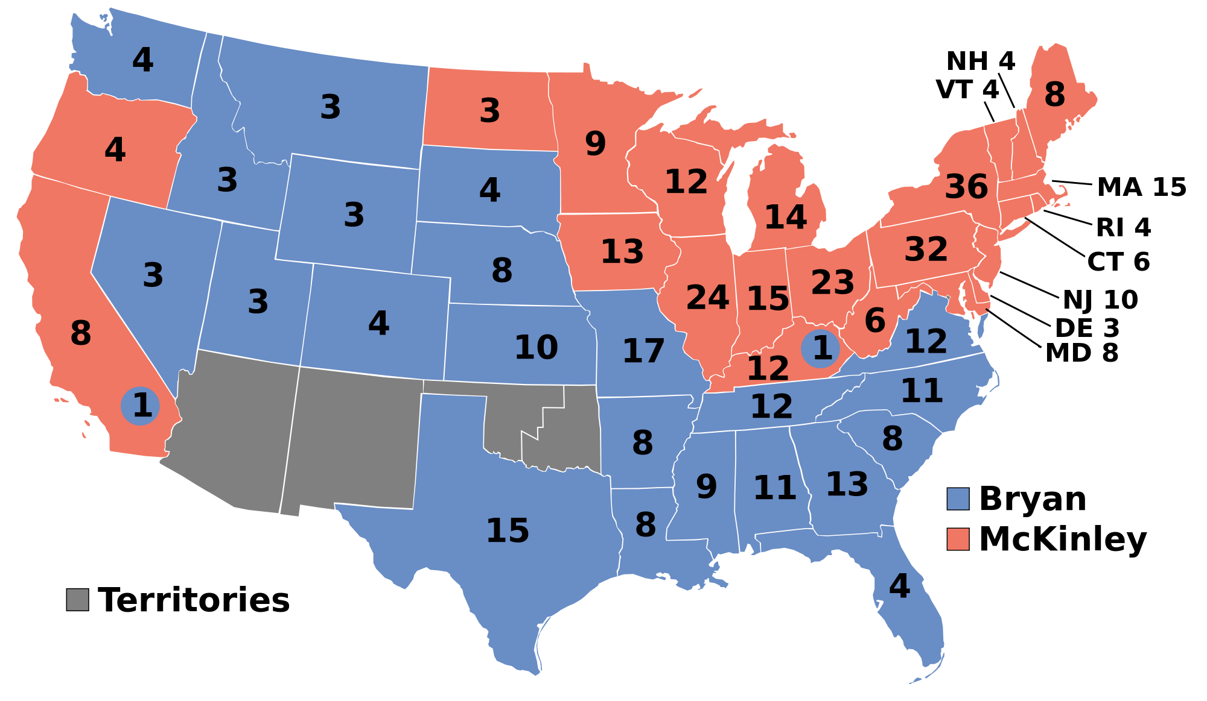

Slide 13
Conclusion
The People`s Party`s rise as an expression of political deprivation strongly rooted in economic conditions
An example of populist mobilization from the bottom
An alliance of farmers and workers – left-wing populism?
Long-term political alignments and institutional constrainst as the main reason of the flash performance of the People`s party

Slide 14
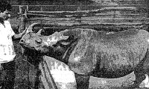
…and now for something completely different (Vol. 1)
Rhinoceros Party
Established 1963
Inspiration in Brazilian rhino Cacareco
who gained the biggest share of votes in Sao Paulo local election in 1959 („Better to elect a rhino than an ass“)
„Voto Cacareco“ as an expression of protest voting

Slide 15
…and now for something completely different (Vol. 1)
Leader of the party Cornelius I
Primal promise – „promise to keep none of our promises“
Jacques Ferron – „Éminence de la Grande Corne du parti Rhinocéros“
A rhino as a perfect symbol of politicians as they are „thick-skinned, slow-moving, dim-witted, can move fast as hell when in danger, and have large, hairy horns growing out of the middle of their faces.„
Joined by some maverick artists/politicians:
Ted „not too“ Sharp: “Once we have Antarctica, we'll control all of the world's cold. If another Cold War starts, we'll be unbeatable.“
Penny Hoar: „Politicians screw you — protect yourself.“

Slide 16
…and now for something completely different (Vol. 1)
Other party promises:
To repeal the law of gravity
Providing higher education by building taller schools
Instituting English, French and illiteracy as Canada's three official languages
Adopting the British system of driving on the left; gradually phased in over five years with large trucks and tractors first, then buses, eventually including small cars, and bicycles and wheelchairs last
1984 – the forth biggest political party (!)
Abstained in 1993 election and subsequently dissolved

Slide 17
…and now for something completely different (Vol. 2)
Lemon Party
Established in 1987
„For a Bitter Canada“
To centralize the Canadian economy around lemons
Support global warming to promote lemon growth in Canada
Abolish Toronto
Repeal the law of gravity

