Slide 1
vnitřní výpověď workshop pro HR i manažery
Projekt pro IBM Brno
Tereza Blažejovská, Veronika Klodnerová, Hana Psotková,
Tatiana Rumanovská, Tomáš Škrábal
PSY519 Psycholog v řízení lidských zdrojů, Fakulta sociálních studií, podzim 2016

Slide 2
Tým – jak jsme pracovali?
2x schůzka celého týmu pro tvorbu designu & průběžná práce online
Plán, design & návrh projektu pro IBM
INSIDE - Tereza – zajištění kontaktu s IBM, tvorba projektu, komunikace s HR a manažery, získání ústního feedbacku a úprava projektu dle firemních doporučení
OUTSIDE – celý tým - tvorba obsahu:
design workshopu, teorie, kazuistiky,
Veronika, Tatiana, Hana, Tereza, Tomáš teorerické zakotvení a specifikace VV, diferenciální popis, kazustiky

Slide 3
Proces – feedback byl nadšený a podporující
Referentka pro stáže – doporučení formulace projektu a business justification
Education team – info. o souvislosti se strategií udržování talentů
Communication team – info. o potřebě této aktivity na pracovišti
HR team members – info. o současných HR procesech a pokrytí tématu
HR manažer – feedback na projektový koncept, návrh pro realizaci formou pilotáže finálního školení, které bude dodáváno manažerům, teamleaderům
Finanční manažer – feedback na celou iniciativu, návrhy pro vytvoření dlouhodobého programu a strategie, která bude pracovat přímo se zaměstnanci (nejen cestou přes management)

Slide 4
Feedback
Nový návrh (top management):
vytvořit strategii (a následně ji realizovat) pro hlubší a dlouhodobější práci se zaměstnanci z hlediska podpory engagementu
  Bottom-up – přímá podpora zaměstnanců v nezávislosti
  Projekt workshopu by se tak stal prvním krokem v rámci vize pro dlouhodobou práci na engagementu v organizaci.
Nová otázka (HR): JAK můžeme efektivně měřit užitečnost školení?
Nový plán (HR): Ve školení pokračují IBMeři (Tereza + HR psycholožka)

Slide 5
Finální návrh projektu – vize (purpose)
„To create and establish a stable form of education covering the topic of psychological aspects of "inner withdrawal / disengagement / dismissal“ (vnitřní výpověď).“
The education will cover complexity of the topic and is meant to become part of body of education which is run on regular basis in IBM Brno.
It is also possible to keep the education content in e-learning form if this will be considered the best option after the pilot workshop with HR.

Slide 6
Dlouhodobý cíl X Krátkodobý cíl
Long-term goal of the education:
spread the knowledge about the topic
what are the causes and effects
how to prevent such state,
how to recognize it once it appears
how to treat it
Target group: Managers and team leaders who are most able to influence the situation and prevent / cause the occurrence of this state among employees in their team.
Short-term goal of the first event:
educate the professionals from HR first
run a pilot version of the education
gain feedback from professionals from HR
identify strong and weak parts
decide on the final form of the education
Target group: HR professionals; it is possible to include coaches and soft skills lectors.

Slide 7
Benefits
preventing talented employees from leaving the company
improving the way of dealing with crisis of employees, and related decision making of leaders
improving spontaneous branding of the company by employees (it is said that person shares negative experience from work with several times more people than a positive experience)
improving employees well-being and performance
improving leadership skills regarding soft skills in the field

Slide 8
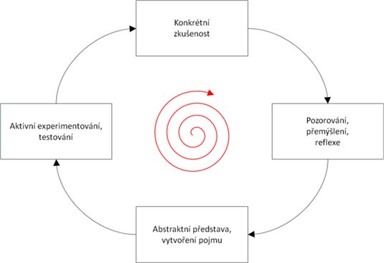
Design workshopu – Kolbův cyklus
90 minut v anglickém jazyce, přelom listopadu
a prosince (přesný den stále hledáme)
Max. 12 účastníků z HR, on site v IBM Brno
Lide se nejvíce naučí, pokud neco zažijí.
Jednotlivé faze musí navazovat dle daného
pořadí, idealní je celý cyklus opakovat.

Slide 9
Design workshopu – plán pilotního setkání
1] Reflection of the current knowledge of the participants
"What do you know/think about the inner disengagement? Do you have any experience with the topic?"
2] Presentation - "What the inner disengagement is"
What is it's essence and signs; how to recognize it; why we need to invest in treating & preventing it.
3] Casuistries - practice the knowledge on example stories; lectors' feedback on the suggested solutions během pilotáže s HR plánujeme získat reálné příběhy z praxe
4] Reflection on the point 1]: „What would you do now in the situation which you described in the beginning?"
5] Presentation - „How to fight inner disengagement and how to prevent it"
6] How to recognize own competencies in the given situation - When should I ask a psychologist for help?
7] Reflection on the point 1] again
„What would you do now in the situation which you described in the beginning? Which concrete steps would you take?"
8] Discussion, Q&A and the closing circle
"What I learned and what I am taking with me from this education."

Slide 10
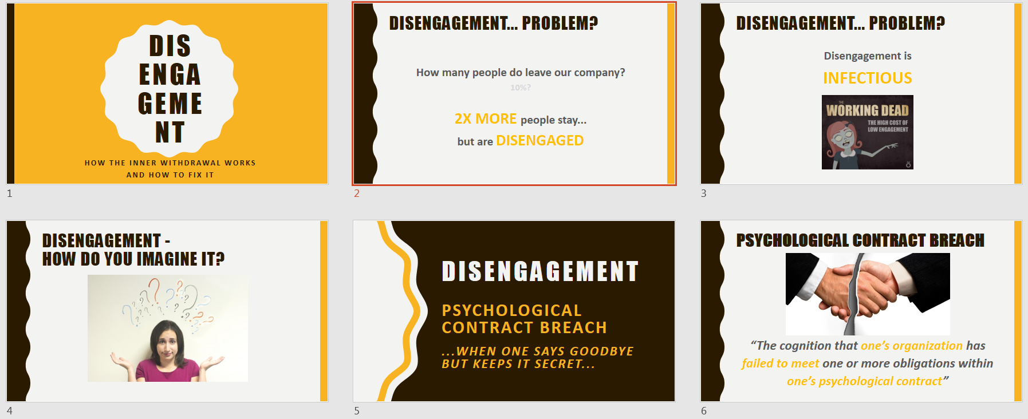
Design workshopu

Slide 11
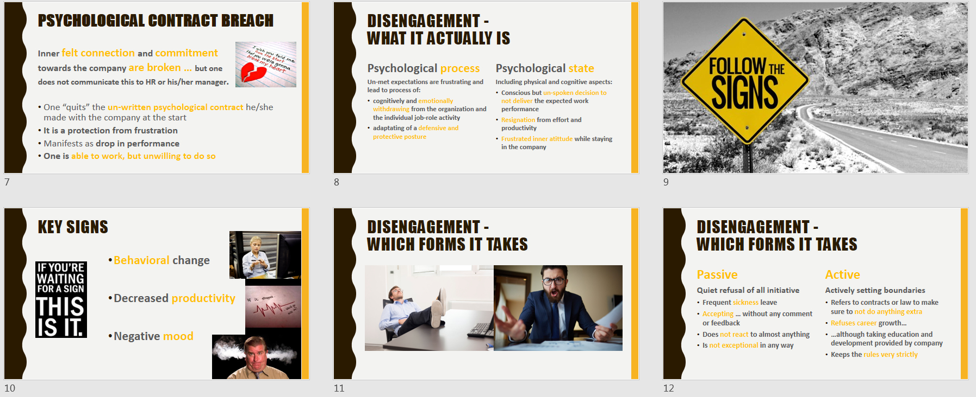
Design workshopu

Slide 12
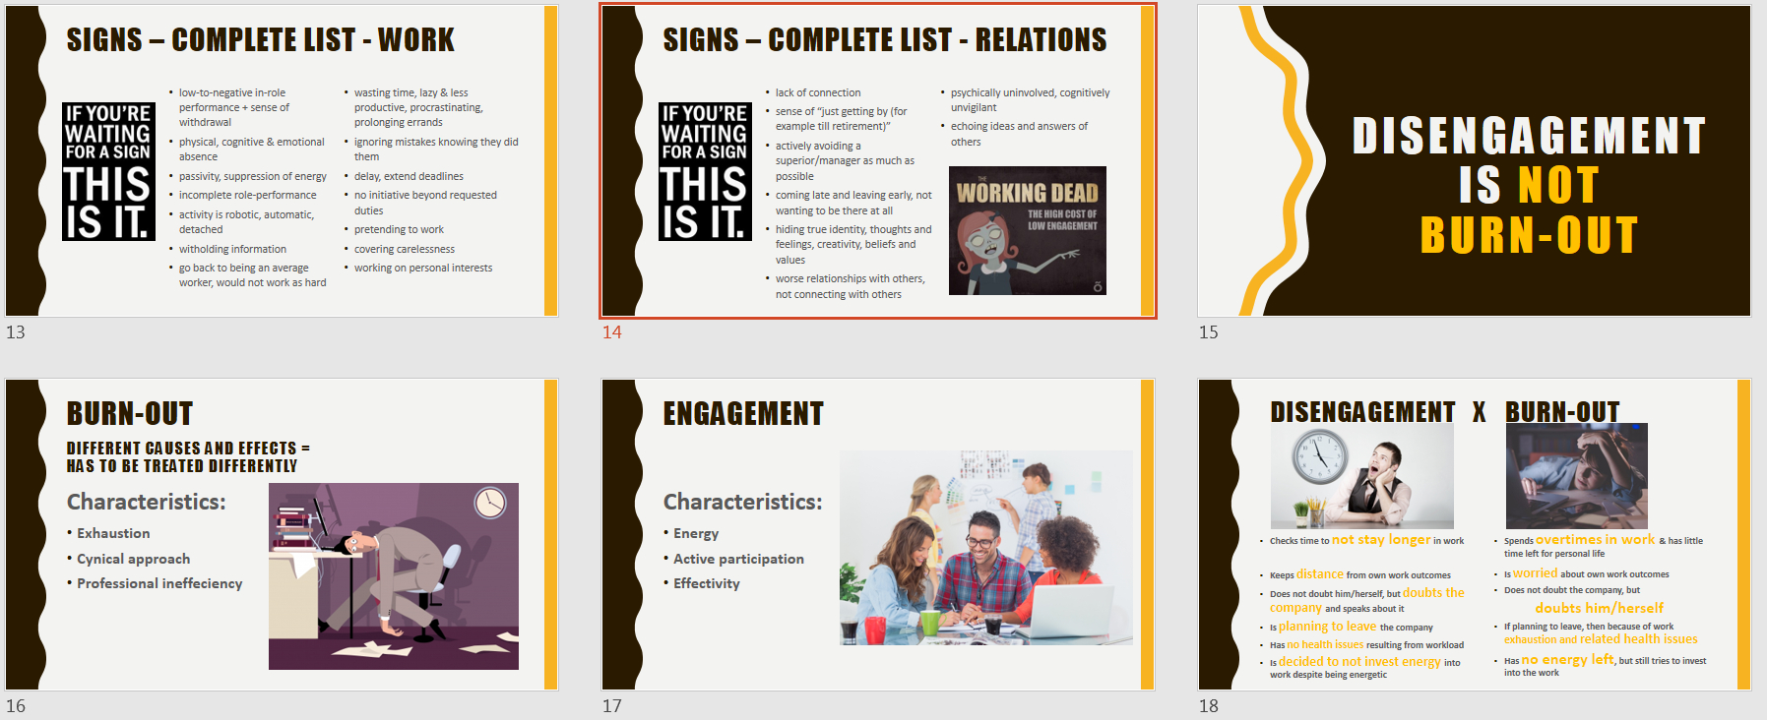
Design workshopu

Slide 13
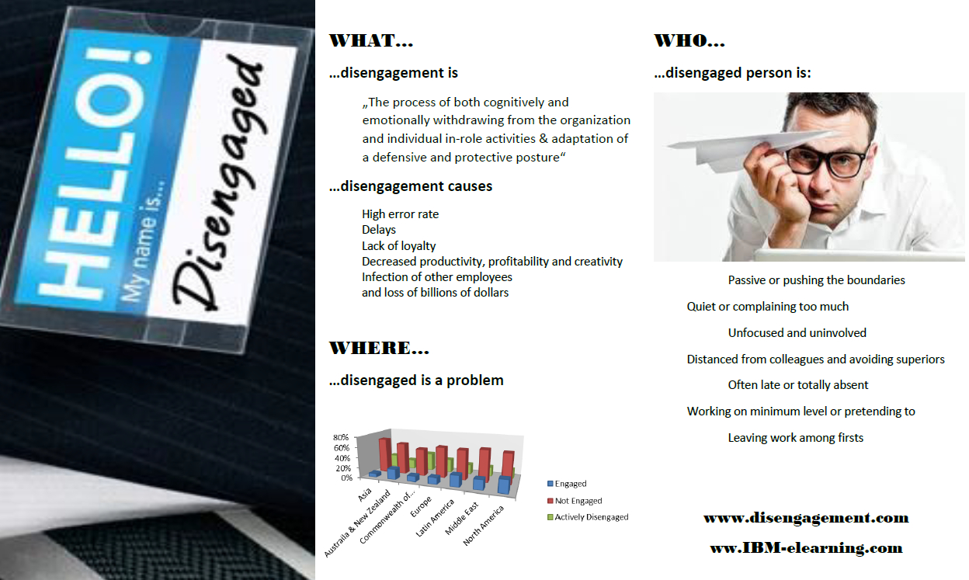
Hand-out

Slide 14
3 typy kazuistik
= normálni, disengagement VS burnout, problém jiného typu
Naším cílem je vhodné kazuisitky pro finální školení pro manažery získat od našich HR účasntíků během pilotáže
Pro účely pilotáže a jako back-up pro finální školení jsme připravili příběhy z jednotlivých okruhů

Slide 15
Hanka
Patrick (29 years old) has been a promising designer since the beginning. His first year in the company he was all about change and progress, blooming with new ideas. For a few months now you have been noticing him rushing in traditional Monday meetings the last second possible, unpacking his things and then staring out of the window for another hour in total silence. When asked for an opinion, he usually agrees with the last person speaking, rarely offering something beyond ´I agree with...´. You are never sure that he has been actually listening. He told you that it should not concern you as long as he got the work done, looking absentminded and grumpy. At the end of the working day he seldom checks out after 16:05.
Until approximately 6 moths ago Dana (40-year-old accountant) had been an upstanding worker. Her idea on file entering improvement saves the economic department employees considerable amount of time every day. She aspired to be the new head of economic department, which did not go as planned. Dana stayed on her initial position. She always seems to be working, staring at the PC screen, her desk covered with files. However, her coworkers noticed, that she does not type in a word for whole minutes, just regularly turning the files´ pages. When she sees her manager passing the department door, she tries to engage in activities that prevent talking to him (picking up the phone or slipping to the toilet).
You accidentally overheard Lucase´s (55-year-old analytic) conversation with his friends from another department during lunch-break. You heard him say, that the company´s security system project was “trash”. He would not entrust it with a single valuable information and could repeat it to anyone who would be wise enough to listen. Afterwards he informed them that he was just getting by there, waiting to retire. When you asked him to induct a new colleague last week, he refused, making one excuse or another. You realized he did not reject helping for the first time. When you confronted him about it he argued that it certainly is not a part of his working contract and he likes to be focused on the priorities entirely.

Slide 16
Tatiana
Kate (24y.o) works for prestigious firm at a receptionist position. However, she shows a great amount of dissatisfaction on her job : “The role I'm required to perform, sitting up here in front and smiling and typing and being friendly.. it's all bullshit, it's just a role, and there isn't any satisfaction in it for me. I'm more than that, and I want to be seen as a person apart from the work I do. This eight or nine hours is a waste, damaging, I think, to my own growth and what I think about myself.“
Tom (52 y.o) is a senior manager at well-known organization. Although he is a an acclaimed expert, his team member noticed that he somehow withdrew his energies by forming out non-management tasks to other. In addition to this, he adopted an automatic, perfunctory approach marked by not questioning others´ decisions and assumptions as well as he showed little empathy for confused assistants and upset clients.
Katie (39y.o) has been long-term and experienced sales manager. She used to work effectively, responsibly and there never was an unrealizable challenge for her, which brought her a positive appreciation from bosses and partners as well. During the last year, however her work commitment has decreased due to divisive office politics. No longer does she see a meaning in her duties. She neither feels appreciated, nor receives a valuable feedback on her performance. She is annoyed by meetings with colleagues, she doesn´t contribute to informal conversations and neither shows interest in bussiness trips abroad.

Slide 17
Tomáš
Peter (27, junior IT engineer) seems to be avoiding interaction with his colleagues lately. Unless its for something job related, he doesn´t initiate conversation with them at all and every attempt at small talk from his colleague is doomed from the beginning, since he is only using short, one worded answers like „good“, „hmm“ or his favorite one „sure“. He even missed last two company bowling games, which is really strange because he never missed them before, since he is really good at bowling and he likes to show it off.
Paul (39, PR specialist) seems to be really „out of juice“ at bussiness meetings as of late, he yawns often and looks bored. He is still paying attention to what others says and his additions to the discussion are usually still valuable, even they are not as frequent as they used to be. Its just his body language that puts you off. Its even more weird to you, because he was one of the most active looking employees out there not so long ago. Its not just a bussiness meetings, every time you walk past his cubicle, he looks tired and stares like a zombie into the computer screen while typing something. Not that its big problem to you, his performance is still quite the same, it takes him little bit longer to finish assignments though.
Last time you talked with Patricia (35, HR specialist) she told you how disappointed she is with the work she has done for the company so far, its even worse for her, because she feels like she is been giving it 110%. When you asked her why, she replied that its because she feels that she is making no difference at all. None of her new ideas has been accepted by the company manager, and what is worse, it seemed that he did not even thought them through, he only listened to them and said no immediately after. Its really frustrating because she is sure that her ideas for the new recruitment and development methods for the employees would benefit the company greatly.

Slide 18
Veronika
Every time you meet Adam (Project Manager, 45 years old) he would make your day. He is able to stay positive and encourage people even when things in work were not going the way they were supposed to. He always said, it’s his beautiful family who’s “recharging his batteries”. However, on recent meetings you couldn’t have recognized him. Adam became very anxious and passive concerning his work tasks. Moreover, his boss have had called him in the office as he noticed his reduced work performance, increased errors, lack of ideas and even lack of effort.
Sandra (Administrator, 26 years old) is very dynamic young lady, although very organised and punctual. Her Functional Manager never had any issue with her until last week, when she showed up late continuously for two days. When he confronted her the second day, she sincerely apologized and said that she simply overslept.
For Daniel (IT Engineer, 32 years old) you could say he is a very smart person. Even though, he’s always polite and has an answer for you any time you came to consult a problem with him, he doesn’t seem to be going on well with his co-workers. He never gets involved in any discussion nor shares any opinion until he’s asked to. Meanwhile, after work, his colleagues are frequently meeting in a bar/restaurant every Thursday, he only went once and seemed to be just listening and waiting for it to be over, so he could go home. On the other hand, he has never refused to help any of his colleagues as well as they would always help him.

