Slide 1
Modern Technologies and Conflicts
Space
4.10. 2017
Jakub Drmola

Slide 2
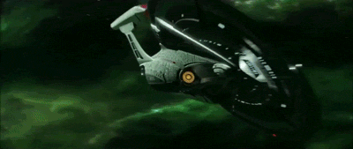
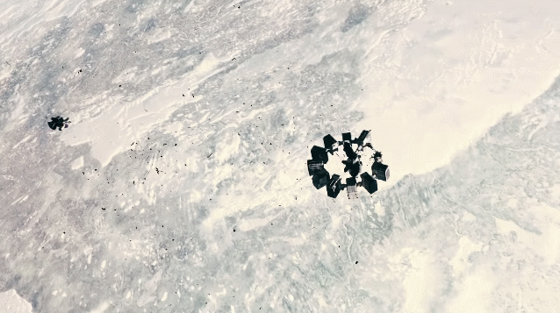
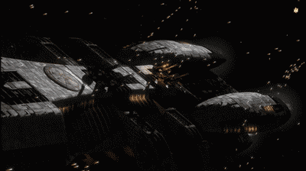
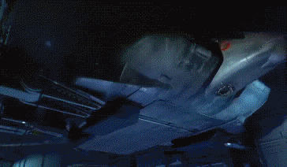

Slide 3
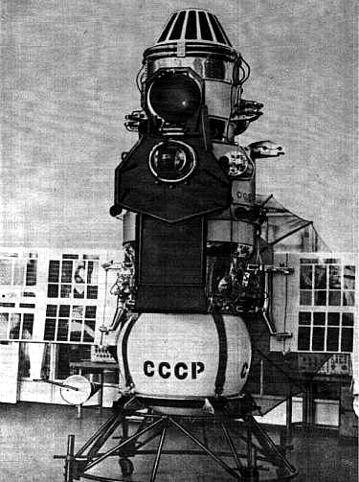
Brief history
1942 - V2
1957 - Sputnik 1
1961 - Gagarin
1966 - Luna 9
1969 - Apollo 11
1970 - Venera 7
1981 - STS
1997 - Pathfinder
1998 - ISS
2004 - Opportunity
2014 - Rosetta

Slide 4
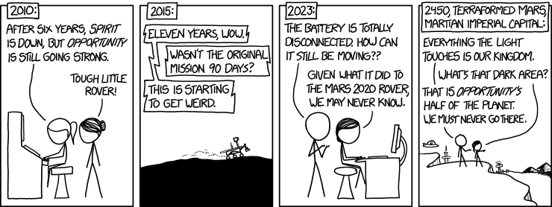

Slide 5
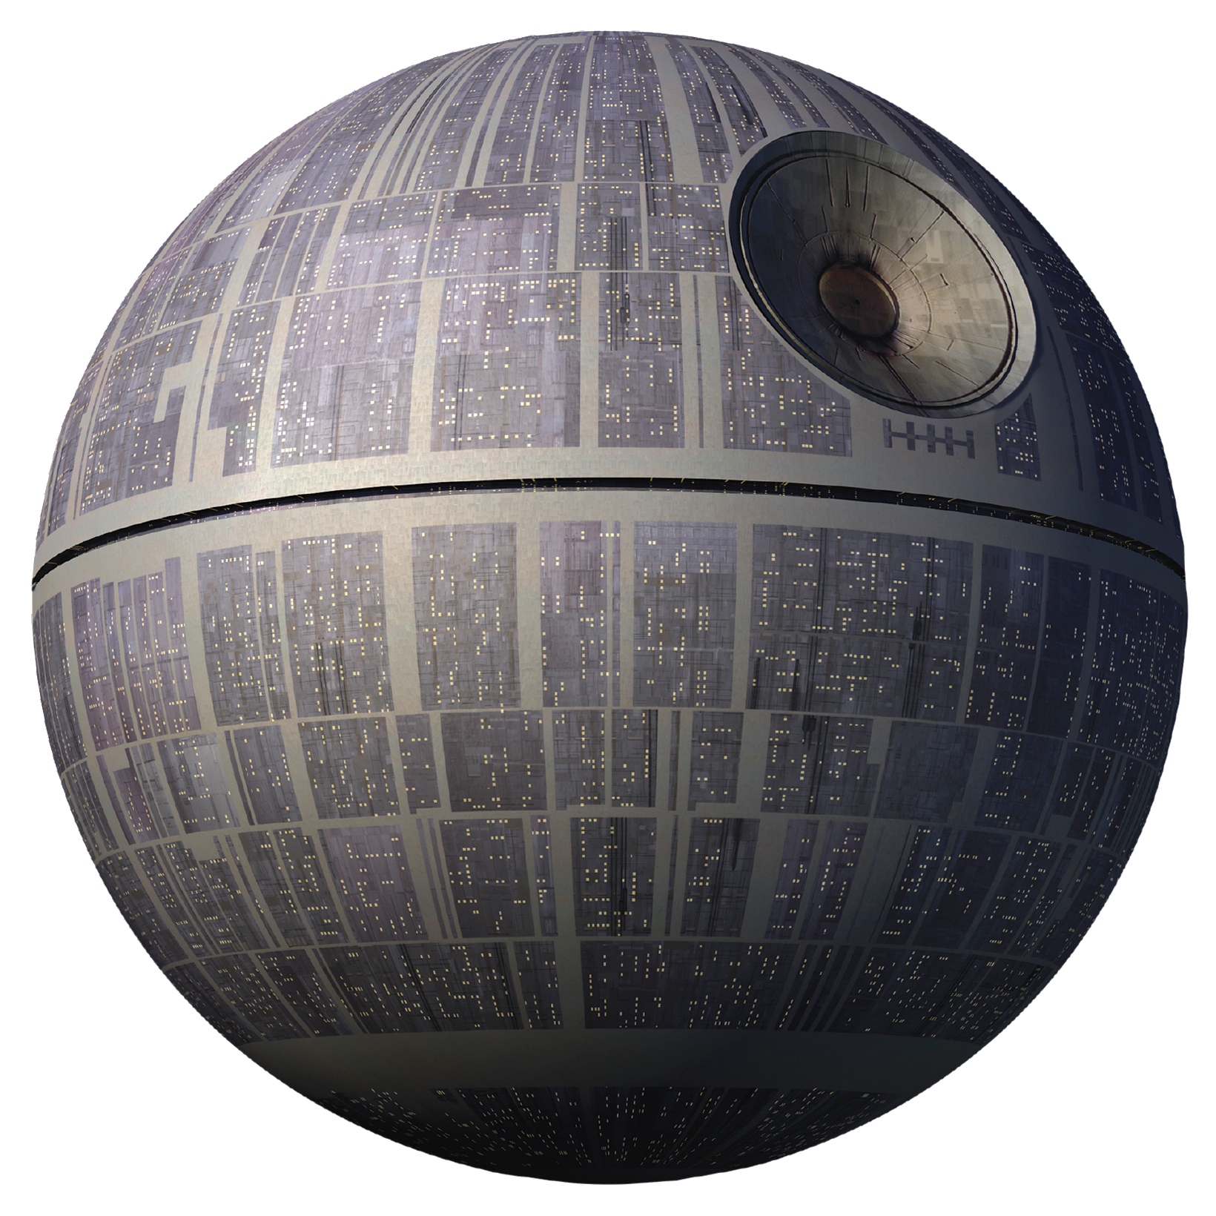
Militarization
information
espionage
communication
defense
SDI (1983)
offense
WMD/kinetic/EM
Outer Space Treaty (1967)
ASATs
advantages and disadvantages?

Slide 6
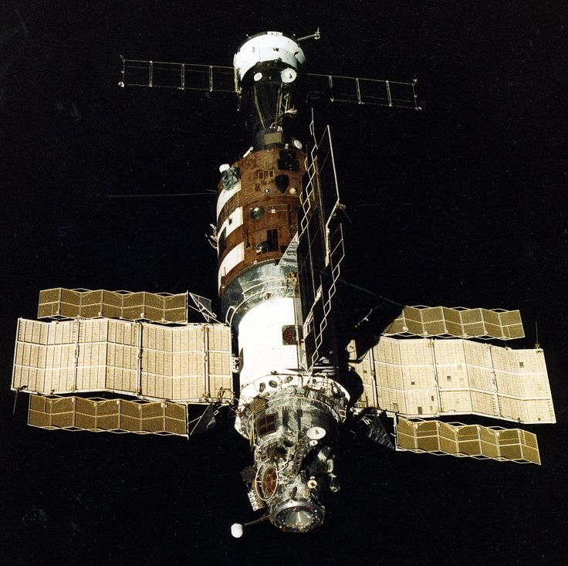
1970s
Salyut

Slide 7
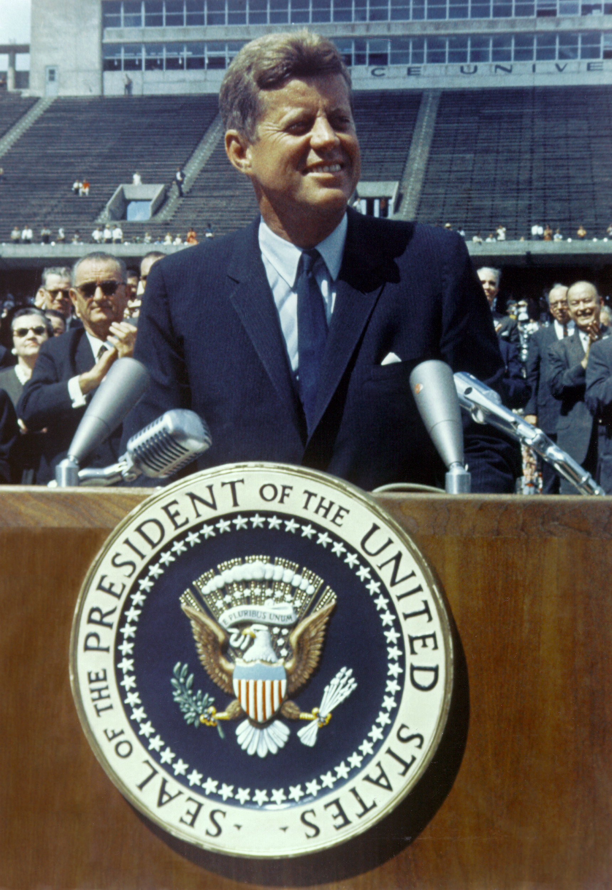
Impact
space race was part of the Cold War
for prestige and military application
spin-offs for civilian life and economy
1983 - GPS for public use
navigation, communication
boost for industry
inspirational

Slide 8
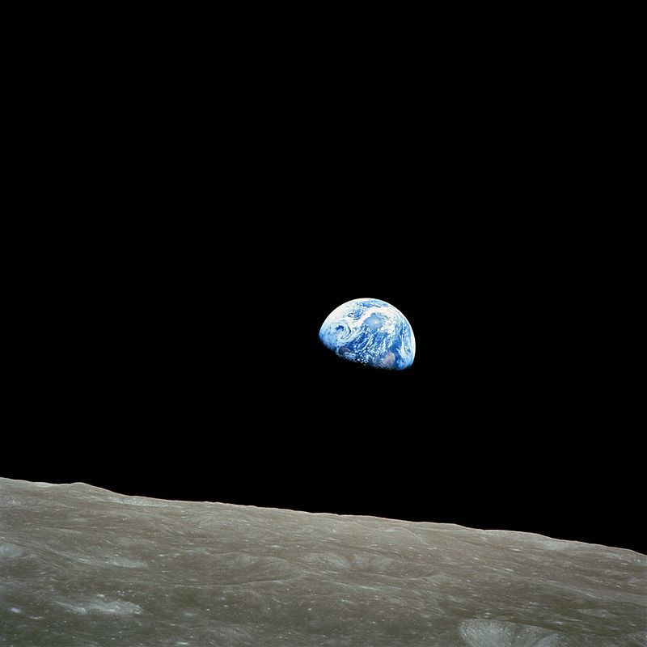
1968
Apollo 8

Slide 9
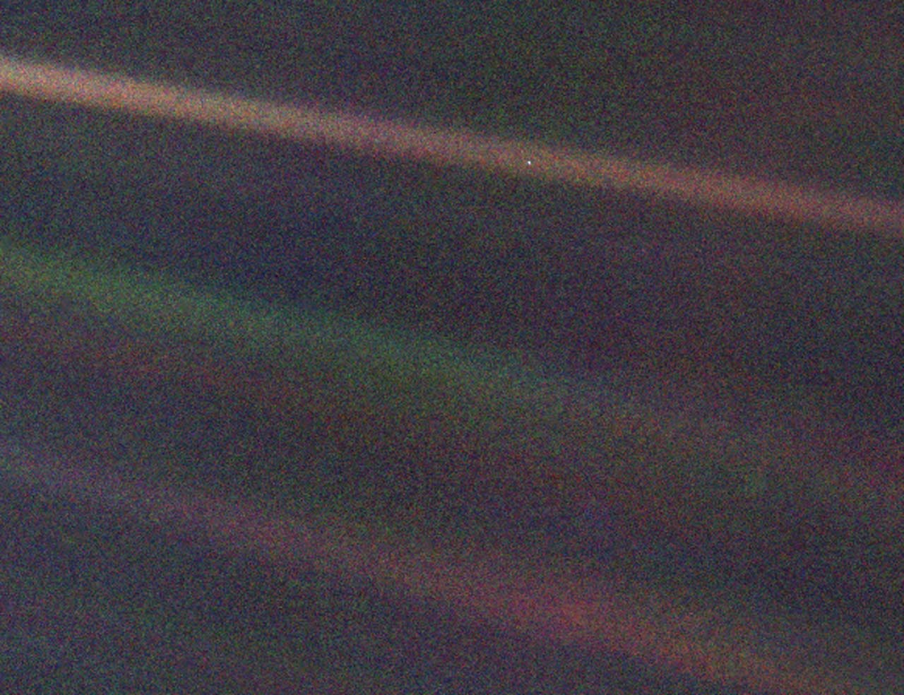
1990
Voyager 1

Slide 10
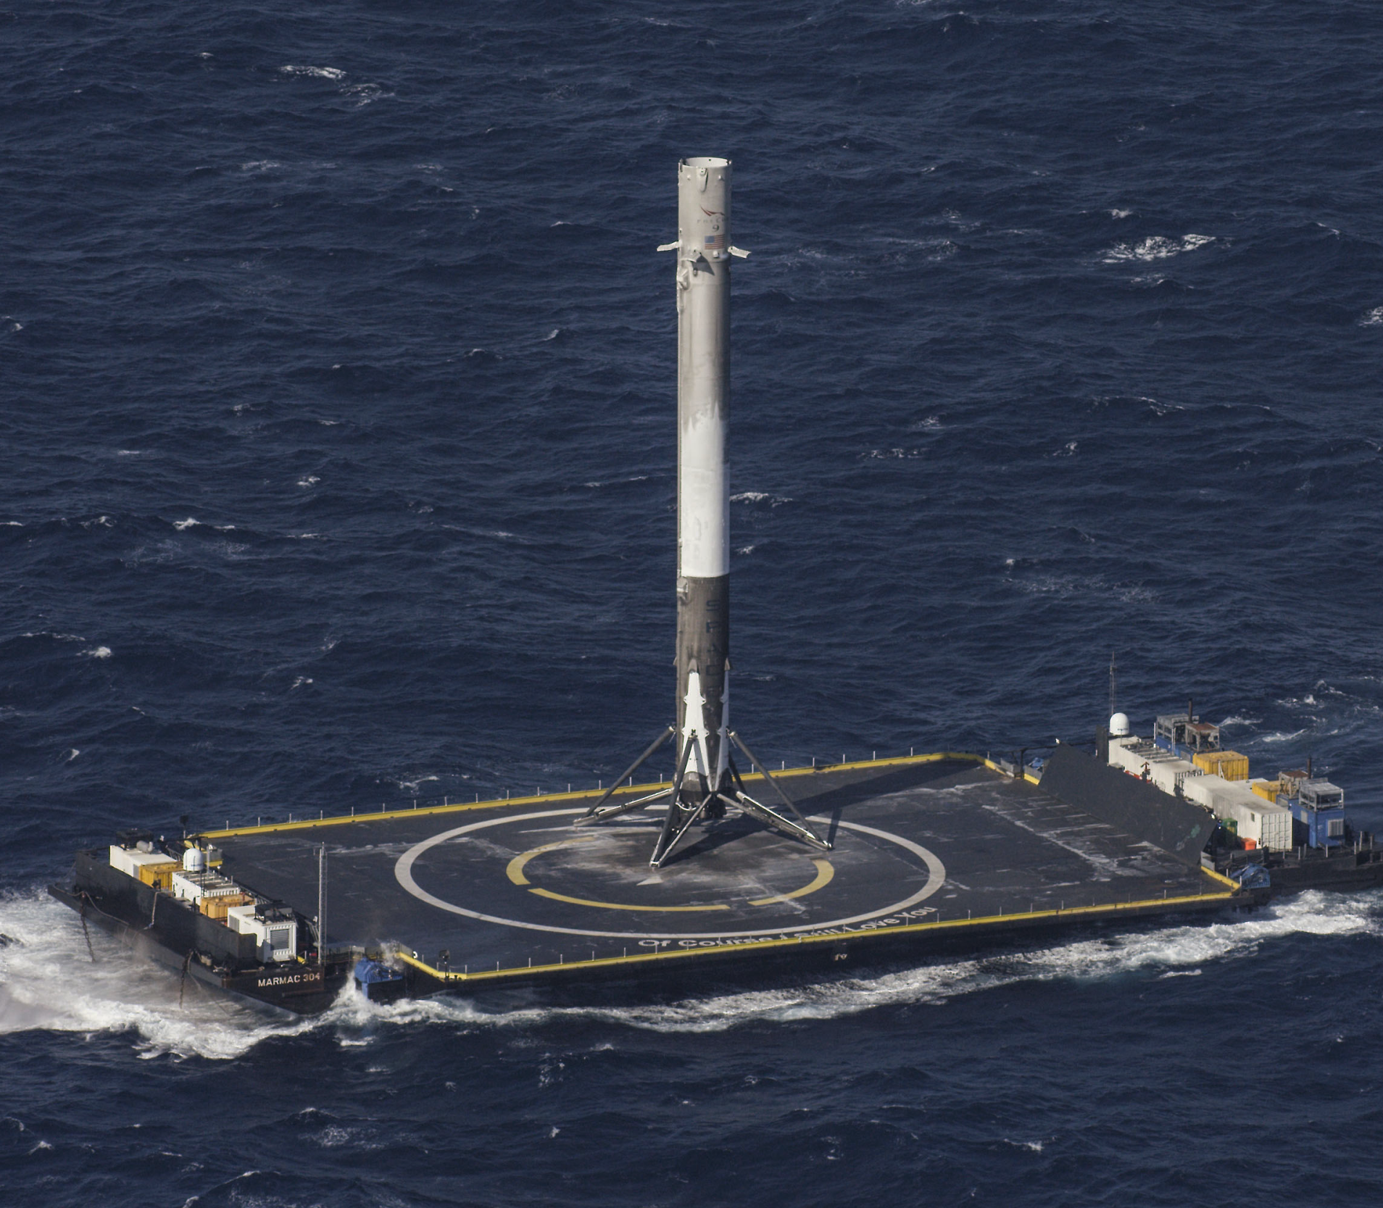
Privatization
1965 - IntelSat 1
2001 – first tourist
2008 - Falcon 1
2012 – Dragon
2017 – first reflight
around 40% of currently active satellites

Slide 11
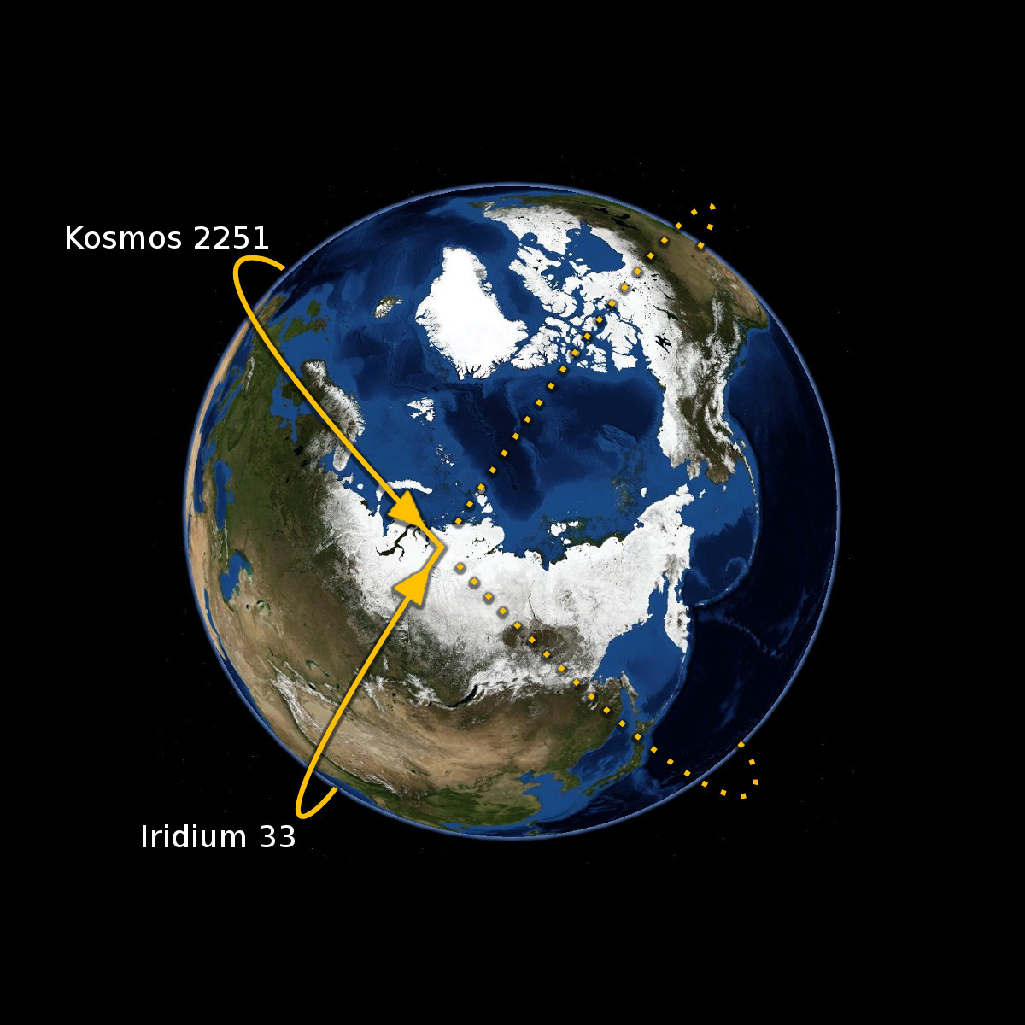
Orbital debris
http://stuffin.space/
- Kessler syndrome
chain reaction of collisions
- caused by:
launches
dead satellites
collisions
- it is getting worse…
- how to clean it up?

Slide 12
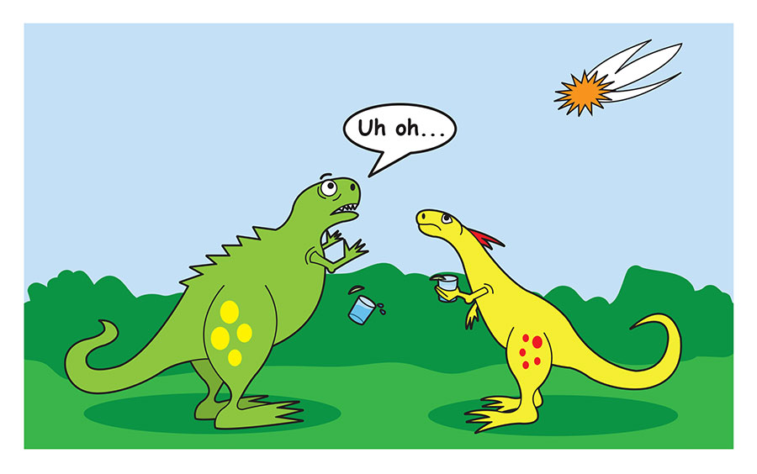

Slide 13
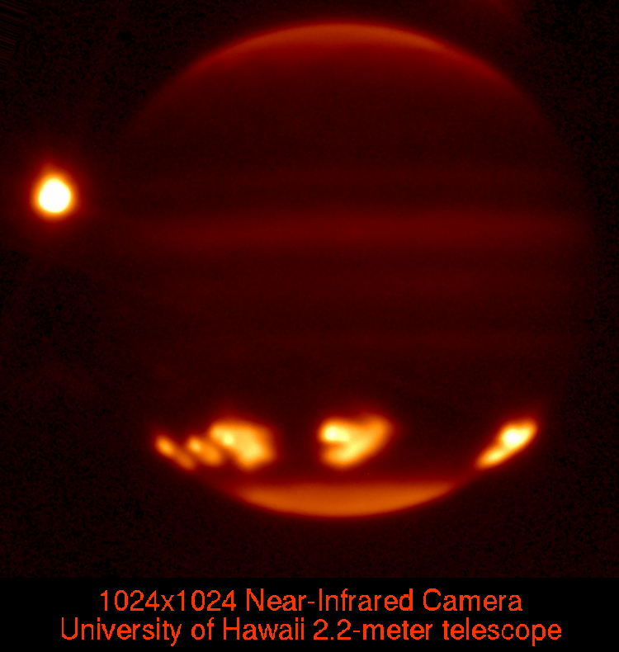
66 million years ago, K-Pg extinction
dinosaurs died out
(and 75% of all life)
1994, Shoemaker-Levy 9
comet hit Jupiter >>
2013, Chelyabinsk
over thousand injured
1908, Tunguska

Slide 14
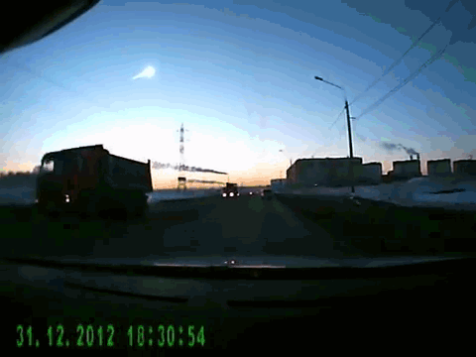
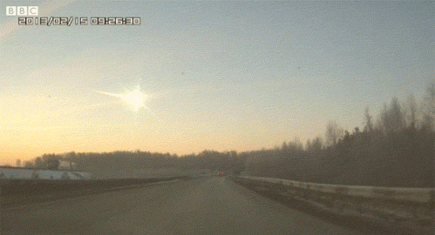
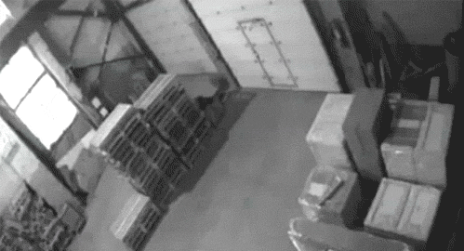
Notes:
Chelyabinsk, 2013

Slide 15
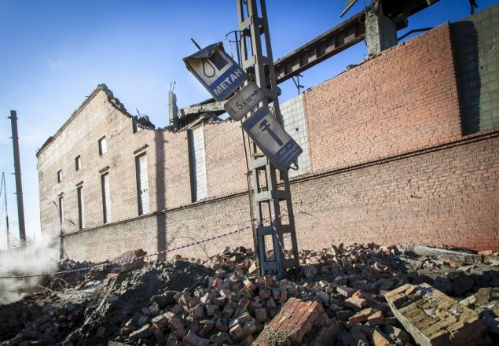

Slide 16
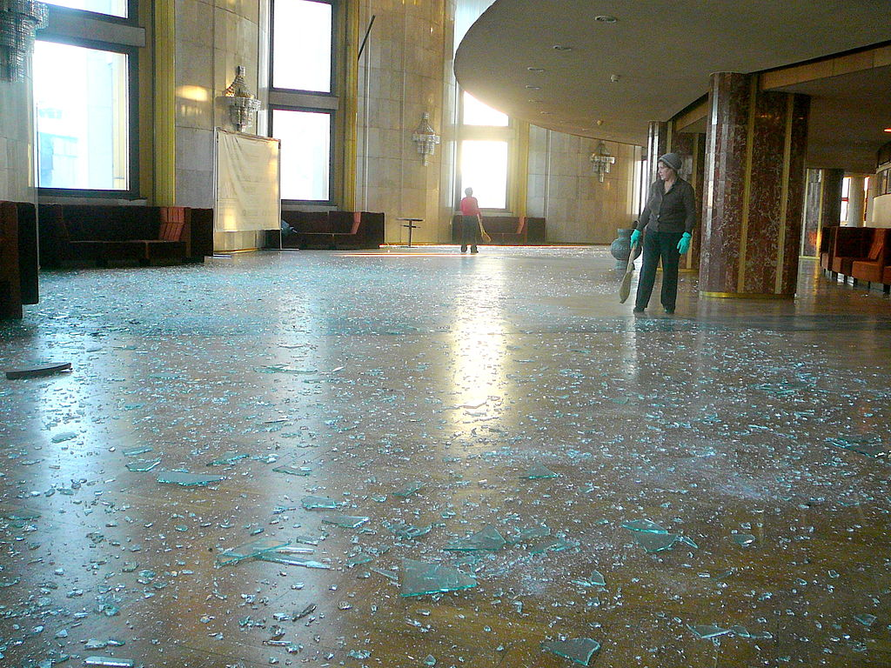

Slide 17
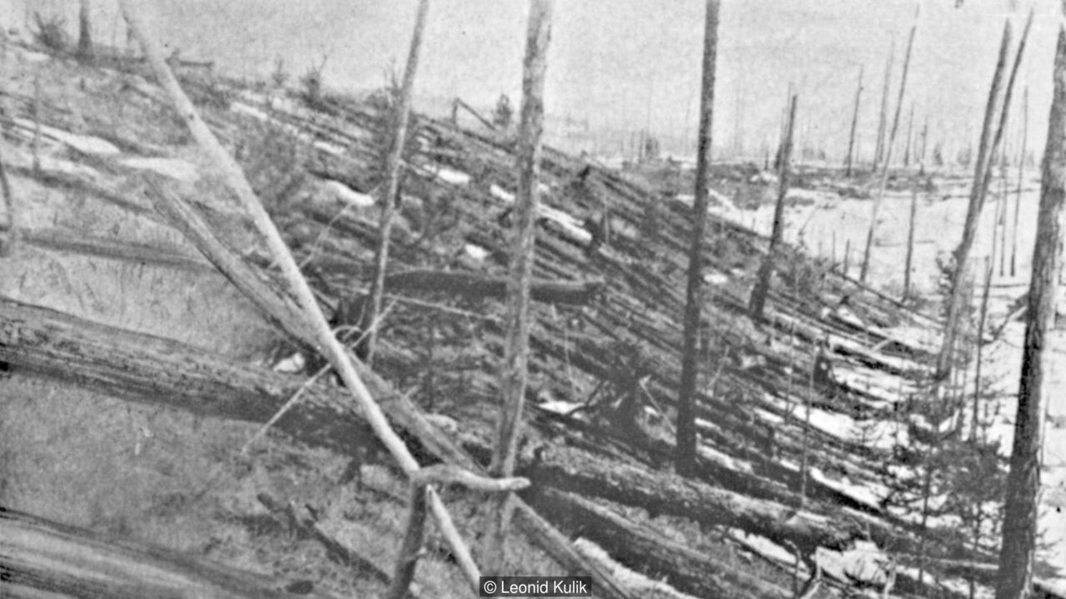
Notes:
Tunguska, 1908

Slide 18
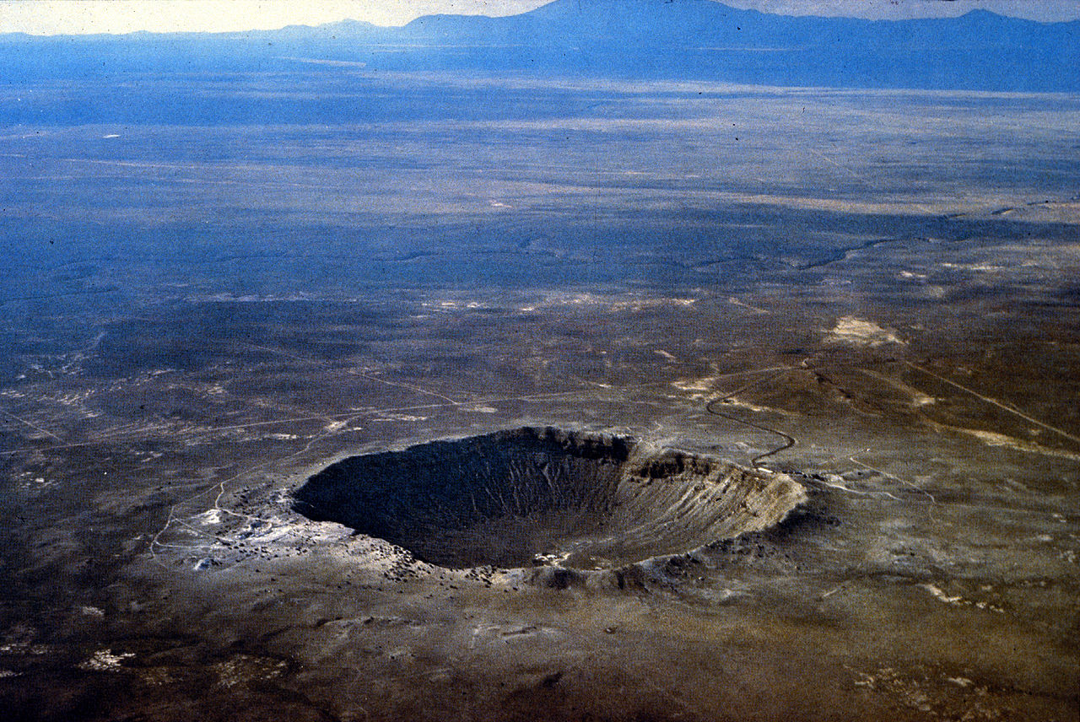

Slide 19
Some comparisons
Chicxulub 100 000 000 megatons TNT
Shoemaker-Levy 9 (G) 6 000 000 megatons TNT
Tsar nuclear bomb 50 megatons TNT
Tunguska 10-30 megatons TNT
Chelyabinsk 0.5 megaton TNT
Little Boy (Hiroshima) 0.015 megaton TNT

Slide 20
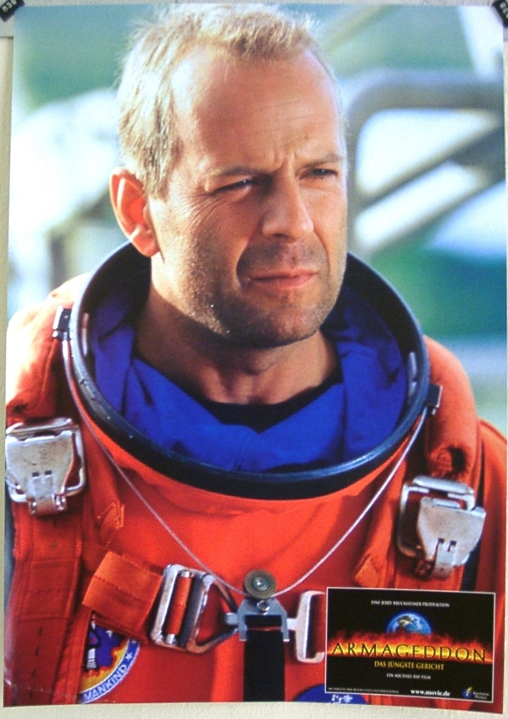
Solution?
- Or a new problem?
- If we can deflect an asteroid, we can also inflect it = “Deflection Dilemma”
Probability of getting hit by a massive asteroid in the near future is very low.
Probability of someone misusing it is … ?

Slide 21
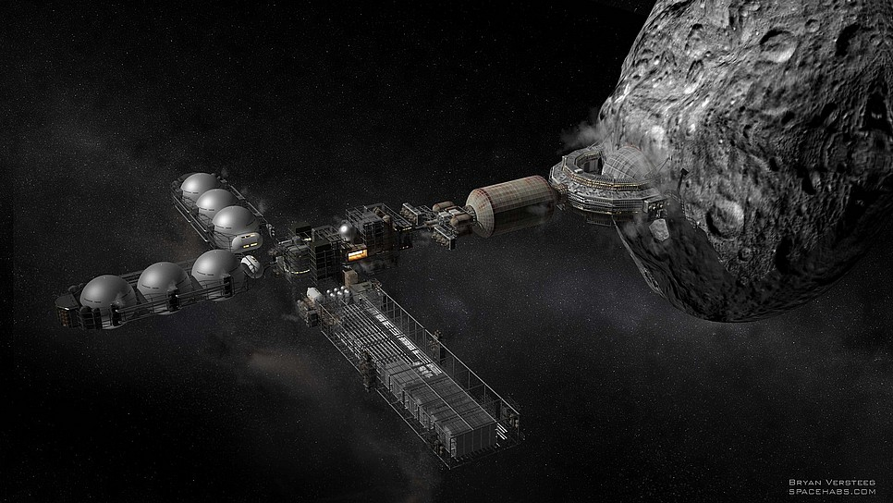
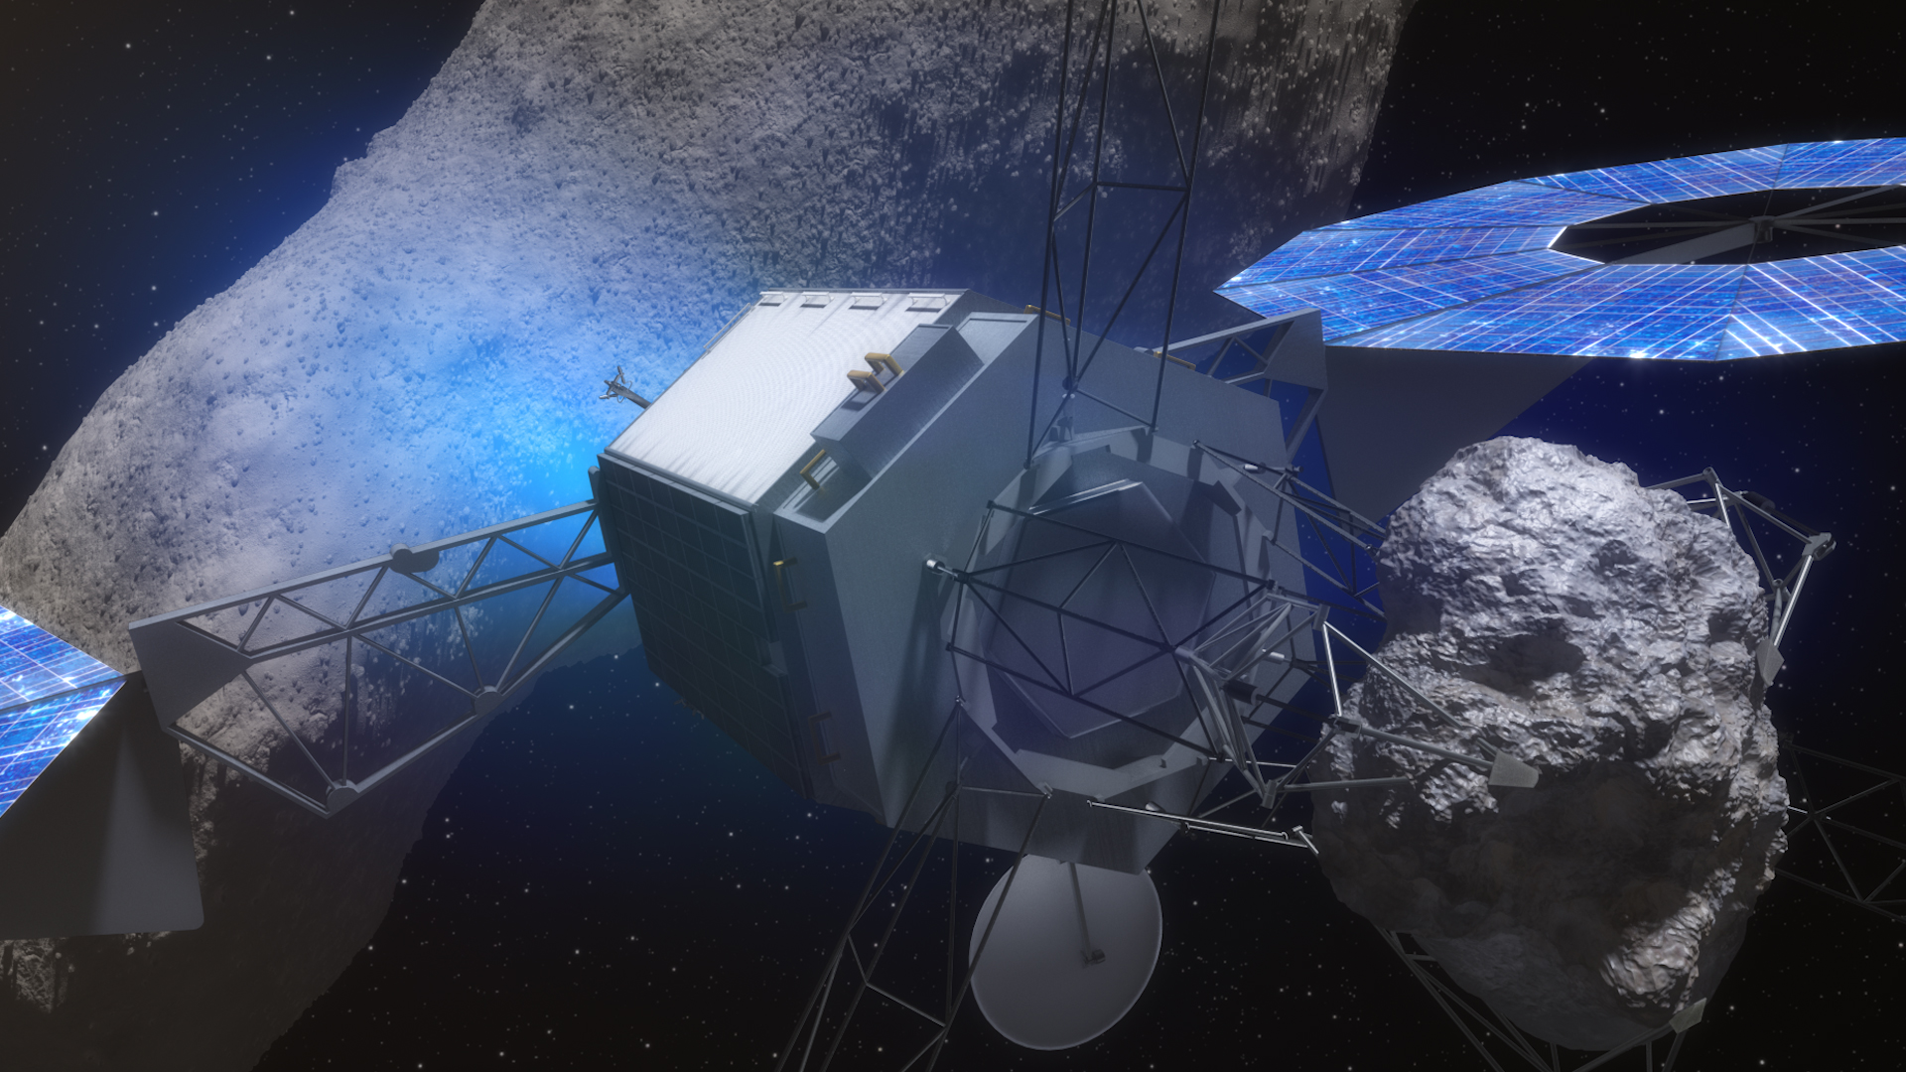
Space Industry
asteroid mining
water
precious metals (platinum, paladium, rhodium)
Planetary Resources Inc.
http://www.planetaryresources.com/
Deep Space Industries
https://deepspaceindustries.com/
H.R. 2262
Spurring Private Aerospace Competitiveness and Entrepreneurship Act of 2015
Asteroid Redirect Mission
canceled

