Slide 1
Biological weapons, and other bits
29.11. 2017
Jakub Drmola

Slide 2
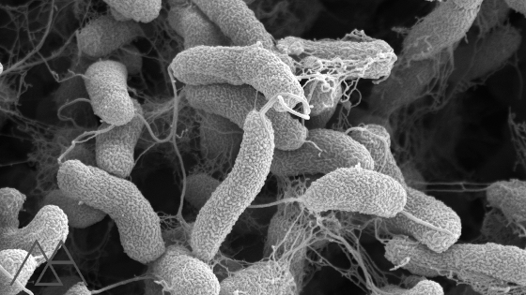
Types
bacteria
anthrax, cholera, salmonela, tetanus, tularemia, yersinia pestis, ricketsia, typhus, Q fever, glanders
viruses
encephalitis, smallpox, marburg virus, ebola
fungis
toxins
botulotoxin, ricin, enterotoxin
in some cases, animals can also be considered as biological weapons (dogs, dolphins, snakes, bees, …)

Slide 3
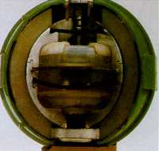
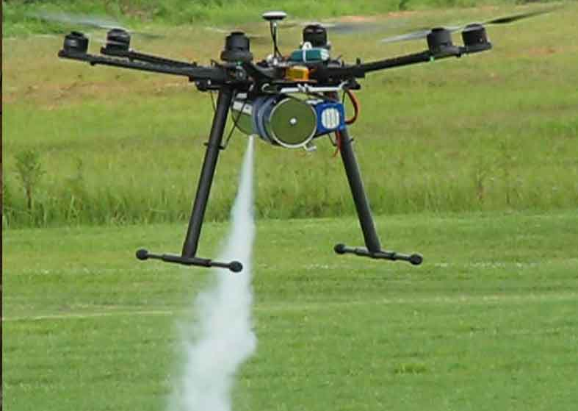
Vectors of infection
inhalation or consumption
through blood or skin
aerosol dispersal (trucks, planes, drones, missiles)
detonation (problematic)
infiltration (water, food, ventilation)
other organisms (humans, rats, flees, mosquitos, ...)

Slide 4
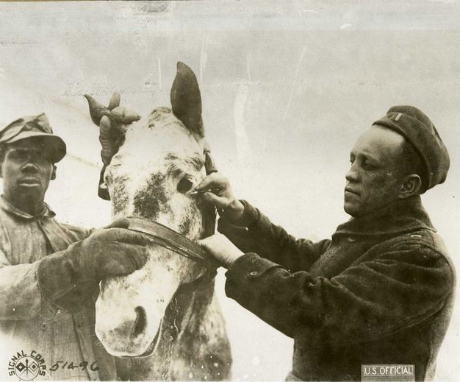
Targets
people
to kill
to incapacitate
animals
as food
as transport
plants
as food
against drugs

Slide 5
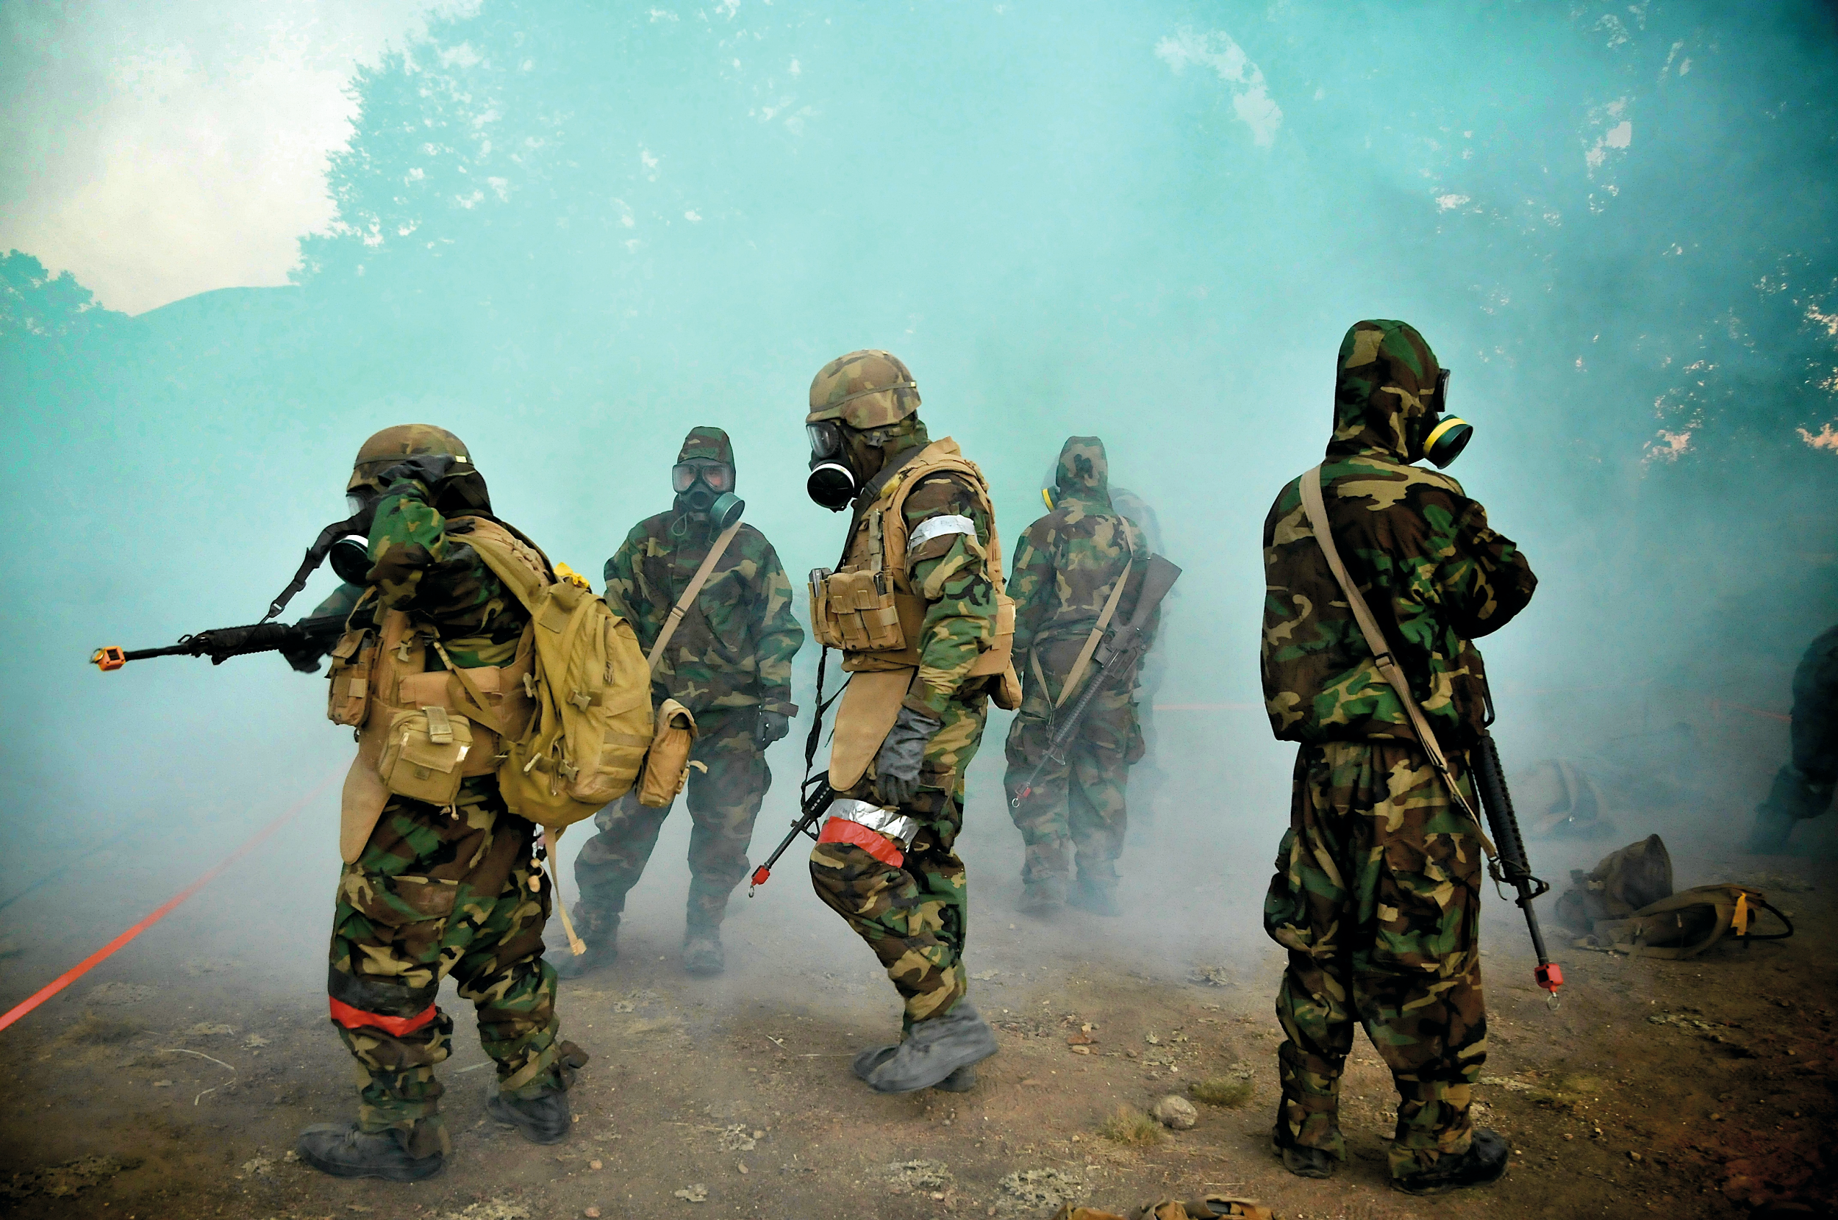
Strategic and tactical aspects
operational support
demoralize enemy
attack population
annihilation
highly dependent on weather and environmental conditions
quite unpredictable
friendly fire
latent and hard to detect

Slide 6
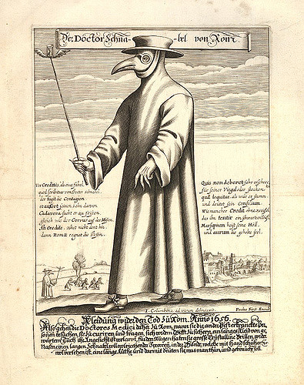
History
ancient history (poisoned arrows, wells, during sieges, use of snakes and wasps, and even plague?)
indians decimated by smallpox
vaccination discovered 1796
deployed during WW1
mostly against animals
deployed during WW2
esp. by Japan in China (around 500 000 dead)
plans to attack USA: “Cherry Blossoms at Night”
other powers quite behind, eager to “learn”
very active development during Cold War on both sides

Slide 7
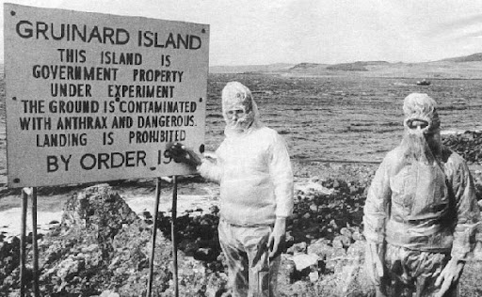

Slide 8
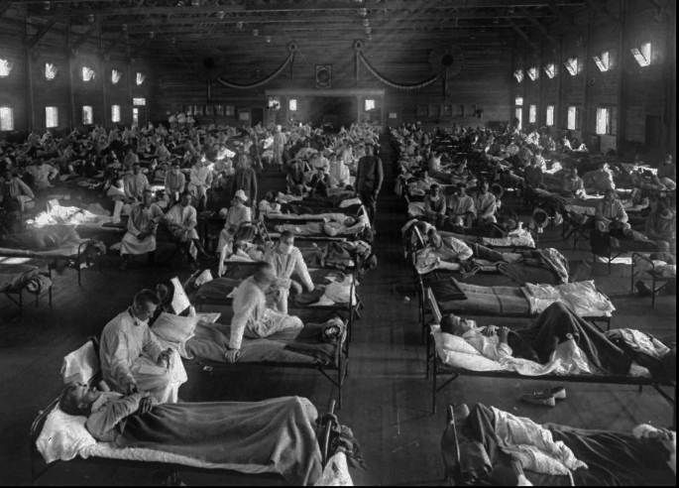
Spanish Flu
1918-1920
global population around 1,75 bil.
WW1 casualties:
15-20 mil.
WW2 casualties:
40-100 mil.
Spanish Flu:
50-100 mil.
Black Death:
75-200 mil.

Slide 9
Terrorism and assassinations and others
1978, Bulgarian dissident, Georgi Markov killed by ricin pellet
1984, Dalles, Rajneesh and salmonella
751 infected, 45 hospitalized
today known as Osho, still popular
1990-5, Aum Shinrikyo
unsuccessful attempts to deplot anthraxu, botulin and ebola
2001, Bruce Ivins, anthrax letters
22 infected, 5 dead
ended with suicide, still unclear motivation
many unfuliflled threats and plans from a number of organizations

Slide 10
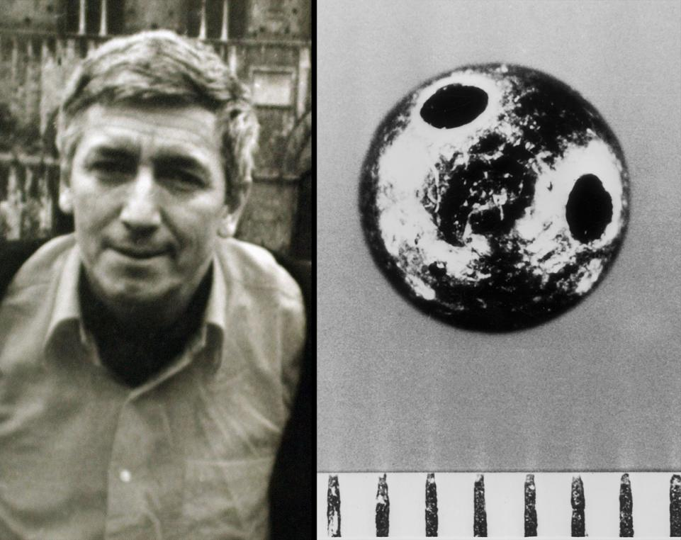

Slide 12
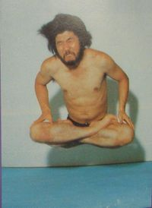

Slide 13
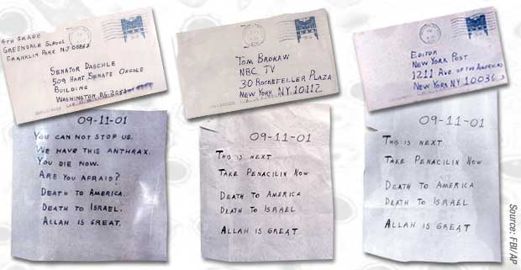

Slide 14
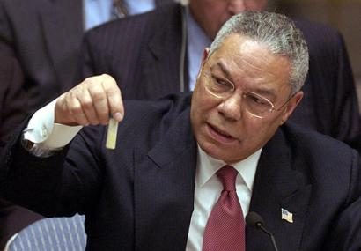

Slide 15
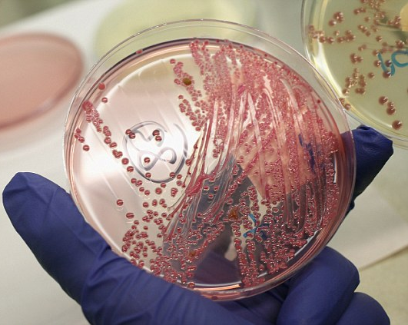
Current situation
development relatively cheap, but difficult
deployment very difficult
growing bacterial resistance
https://www.youtube.com/watch?v=plVk4NVIUh8
can be directly gentically modified now
chimeras, deimunization, genetic targeting
can accidentally leak or be acquired by terrorists
engineered anti-material bioweapons possible

Slide 16
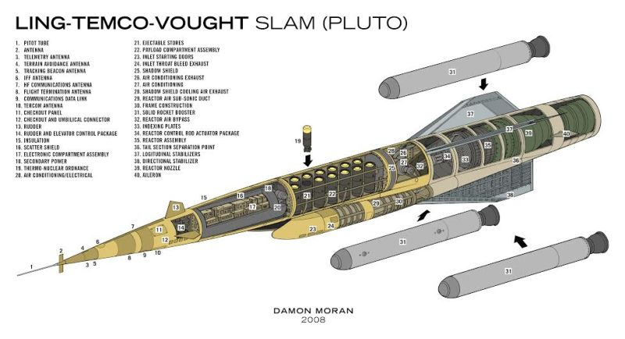
Some notable weapon systems
- SLAM (1955-1964)
doomsday weapon

Slide 17
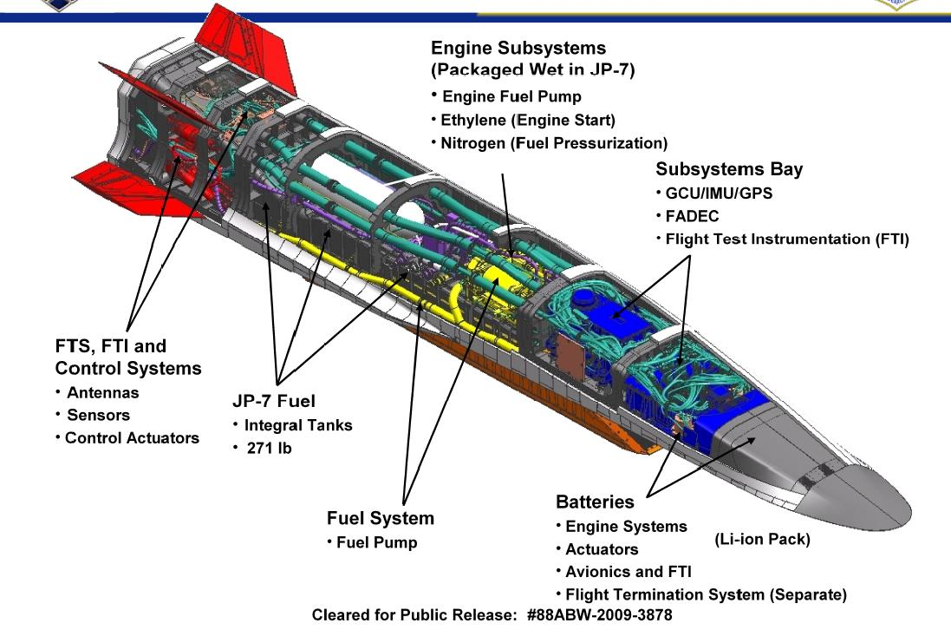
Some notable weapon systems
- scramjet
- goal is fastest possible reaction when ballistic missiles cannot be used and cruise missiles are too slow
- hypersonic (mach5+)
- flight across pacific in 1-2h
- theoretical basics known since WW2
- mixed success in tests

Slide 18
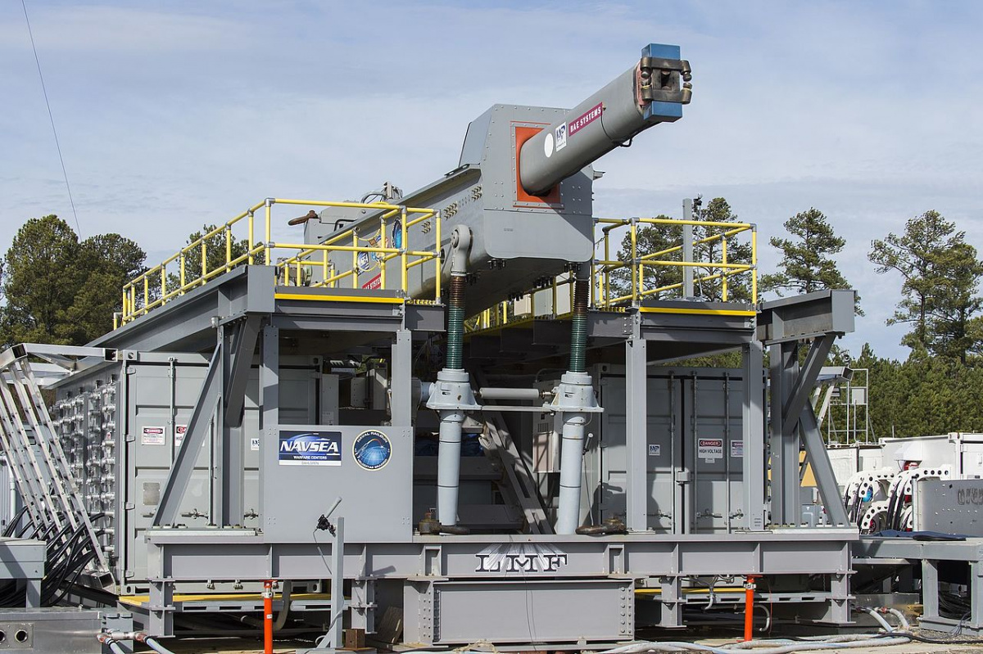
Some notable weapon systems
- Mach7+, range up to 200 km
- electromagnetic force instead of chemical combustion
- small “cheap” munition, less risky to store
- purely kinetic energy kill
- 11 kilograms @ Mach7 ≈ 87t @ 100 km/h (locomotive)
- targets at land, sea and air
- first deployments “soon”
https://www.youtube.com/watch?v=O2QqOvFMG_A&feature=youtu.be&t=8s
- problems:
gun wear and durability
power demands

