Slide 1
Evolution of EU crisis management
Jana Urbanovská, Ph.D.
Masaryk University
urbanovska@fss.muni.cz
21 & 28 November 2017

Slide 2
Content
EU as a security actor: what we are talking about?
Establishment of the European Security and Defence Policy: when & why?
European Security Strategy & the comprehensive approach to crisis management
EU crisis management: civilian & military dimension
EU crisis management operations: an overview
Added value of EU crisis management
Role of EU crisis management operations
EU’s performance in crisis management:
main features
Current developments

Slide 3
European Union as a security actor: any ideas?
Comprehensive approach
Mogherini
Security Sector Reform
ESDP/CSDP
Crisis management
European Security Strategy
Battlegroups
Petersberg Tasks
Balkans
EUFOR
Rule of law
Soft vs. hard power
Africa
EU Global Strategy
Police

Slide 4

EU as “an economic giant, a political dwarf and a military worm“?

Slide 5
Saint-Malo Declaration (1998)
  “The European Union needs to be in a position to play its full role on the international stage.”
  “…the Union must have the capacity for autonomous action, backed up by credible military forces, the means to decide to use them, and a readiness to do so, in order to respond to international crises.”
  “…Atlantic Alliance … is the foundation of the collective defence of its members.”
  “Europe needs… a strong and competitive European defence industry and technology.”

Slide 6
→ Establisment of European Security and Defence Policy (ESDP) in 1999
  = A new chapter in EU history
Crisis management as a core part of the ESDP/later CSDP
Start of a process of:
  Institutions building
  Capacities building
Two basic lines:
  Military crisis management
  Civilian crisis management

Slide 7

Previous attempts:
  Brussels Treaty (1948) and the Western European Union
  European Defence Community (1950s)
  Fouchet Plan (1962)
  European Political Cooperation (1970s)
→ Any idea why the EU has decided to establish its own security and defence policy?

Slide 8
Reasons for the establishment of ESDP:
1) logical outcome of the end of the Cold War
2) change of US attitude
3) desire of the EU to be a fully-fledged international actor
4) change of British and French attitudes (Blair + Chirac)
5) reappearance of military conflict in Europe (performance of the EU very weak)
6) high public support for EU action

Slide 9
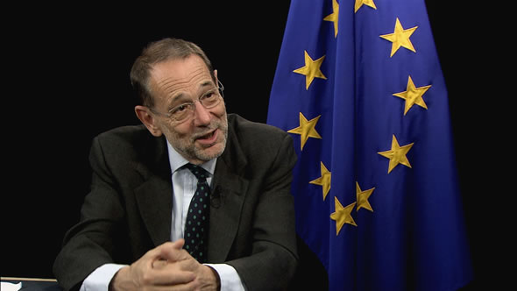
European Security Strategy
Javier Solana

Slide 10
European Security Strategy
“A Secure Europe in a Better World” (2003)
Expression of normative strategic thinking
Lack of any coherent strategy
Adoption considered politically unfeasible
High symbolic value but little real impact?
Tactical use of the strategy
To overcome the “Iraq divide” – acceptable for both Europeanists and Atlanticists

Slide 11
Introduction:
  “…the European Union is inevitably a global player.”
  „Europe should be ready to share in the responsibility for global security and in building a better world.“
Global Challenges & Key threats
Strategic objectives
Policy implications
Comprehensive approach to crisis managament! → EU as a special security actor

Slide 12
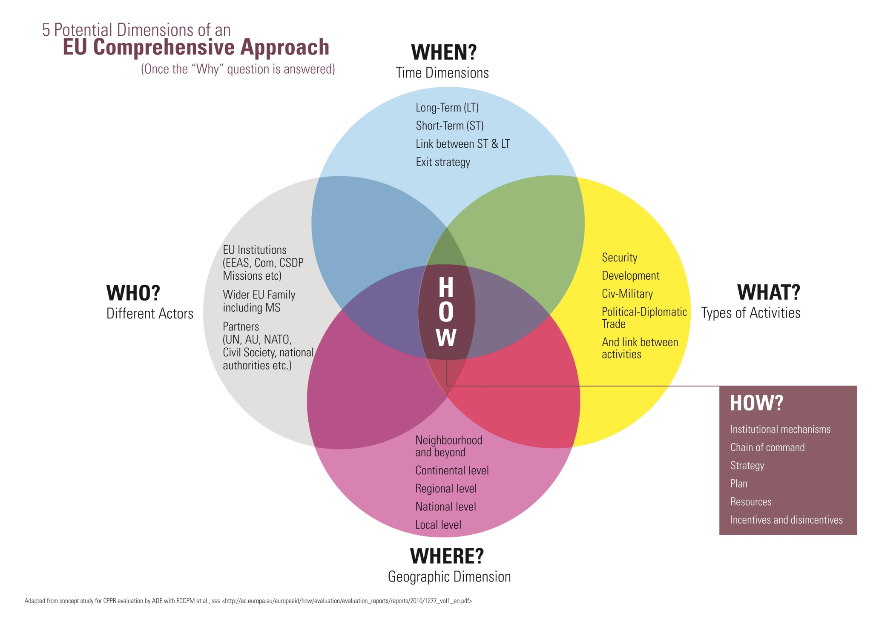

Slide 13
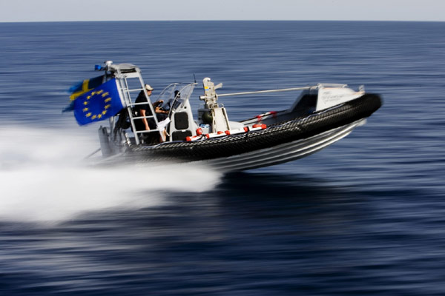
Comprehensive approach to EU crisis management
in practice:
“EU NAVFOR Atalanta”
https://www.youtube.com/watch?v=jMS-7mwuXgY

Slide 14
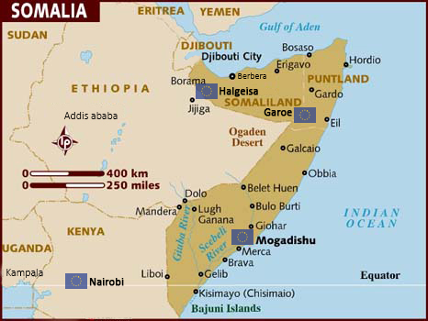
EU approach to the security in the Horn of Africa: What are the features of the EU’s comprehensive approach to crisis management?

Slide 15
EU crisis management as a flagship of CSDP
I. Civilian crisis management
police (fulfilling advisory, assistance and training tasks)
rule of law (capable of both strengthening and substituting local judiciary/legal system)
civilian administration (providing basic services that the national or local administration is unable to offer)
civil protection (offering assessment, coordination and intervention teams)
monitoring capabilities (i.e. border monitoring, human rights monitoring, observing political situation)
generic support capabilities (supporting the work of EU Special Representatives or forming part of an CSDP mission; include experts in the field of human rights, political affairs, security sector reform, mediation, border control, disarmament, media policy etc.)

Slide 16
II. Military crisis management
“Petersberg Tasks“ (1992):
  Humanitarian and rescue tasks
  Peacekeeping tasks
  Tasks of combat forces in crisis management, including peacemaking
“Berlin Plus” (2003):
  Agreement with NATO for the use of NATO structures, mechanisms, and assets to carry out military operations if NATO declines to act
Lisbon Treaty (2009):
  Expanding Petersberg Tasks to include:
    Joint disarmament operations
    Military advice and assistance tasks
    Tasks in post-conflict stabilization

Slide 17
EU Battlegroups:
  2004 UK, France and Germany
  A BG = cca 1 500 troops (+ combat support elements), high state of readiness, highly military effective
  Formed by one nation or a group of nations (a roster)
  2 BGs take responsibility for a six-month period
  No use so far → doubts
  “Costs lie where they fall” principle
  Reform of financing

Slide 18
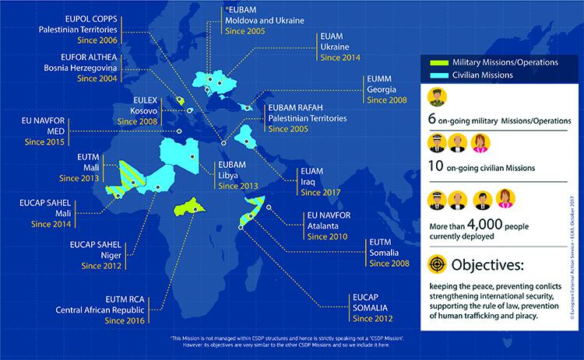
Overview of the current EU mission and operations
(October 2017)

Slide 19
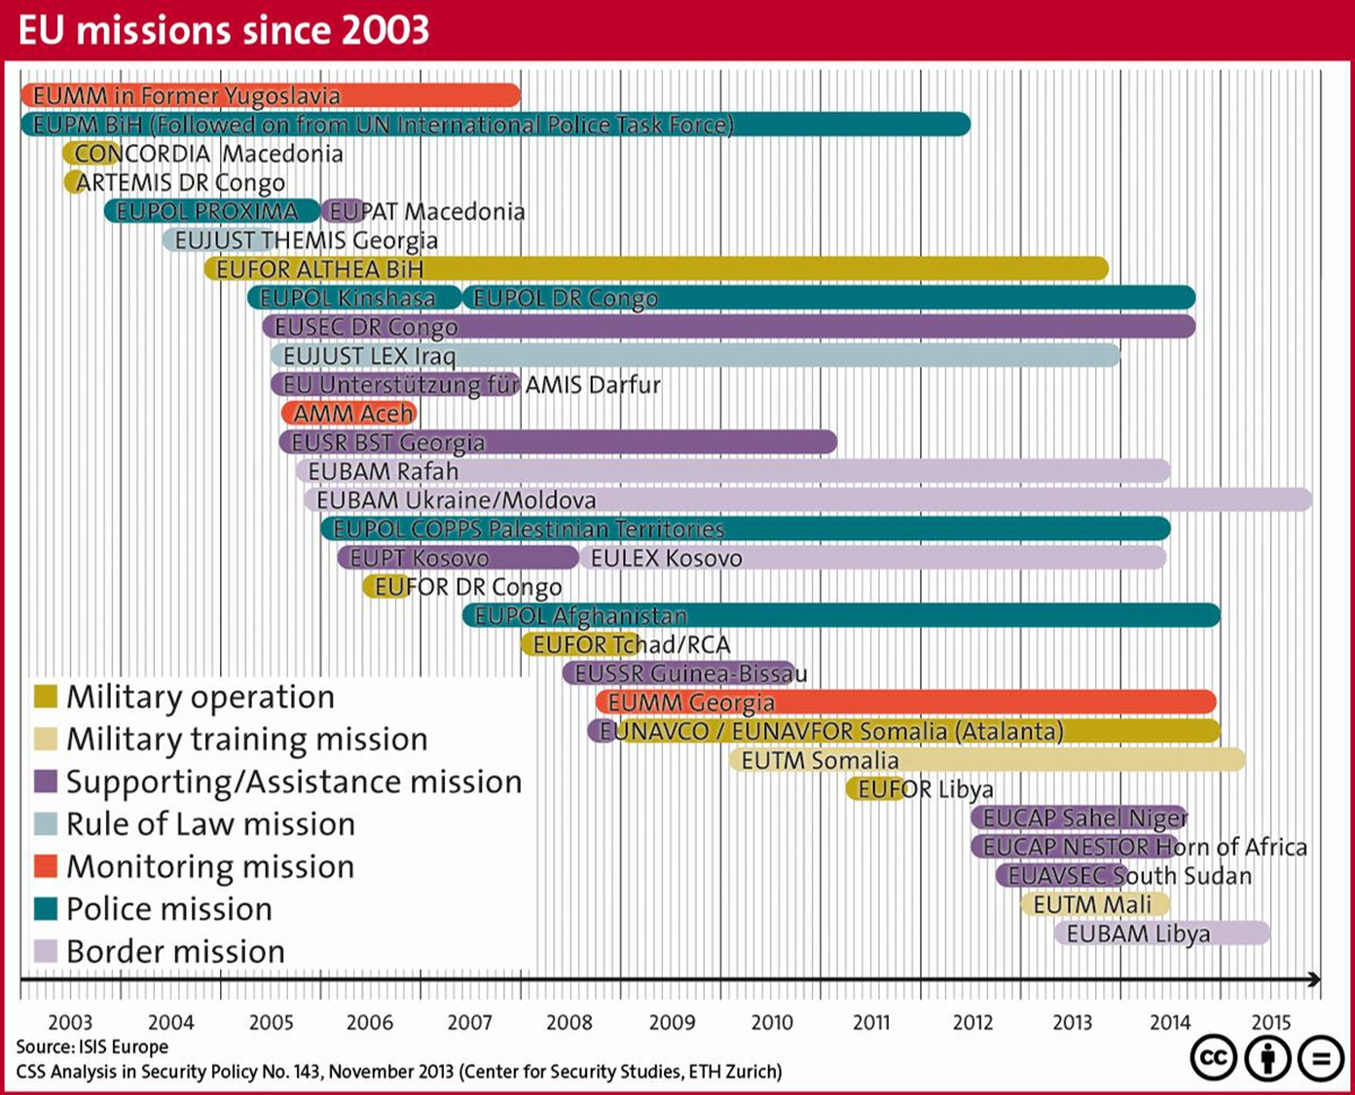

Slide 20
Types of EU CMO
Police missions
  E.g. EUPOL Afghanistan, EUPOL COPPS, EUPOL DR Congo
Rule of law missions
  E.g. EULEX Kosovo, EUJUST Lex, EUJUST Themis
Monitoring missions
  E.g. EUMM Georgia, Aceh Monitoring Mission
Capacity building missions
  E.g. EUCAP Sahel, EUCAP Nestor
Advisory missions
  E.g. EUAM Ukraine, EUAM Iraq
Security sector reform missions
  E.g. EU SSR Guinea Bissau, EUSEC RD Congo
Training missions
  E.g. EUTM Mali, EUTM Somalia, EUTM RCA
Stabilizations missions, incl. peace enforcement
  E.g. EUFOR Althea, EUFOR TCHAD, EUFOR RCA, EUFOR RD Congo
Naval oprations
  Atalanta (EUNAVFOR Somalia), Sophia (EUNAVFOR MED)

Slide 21
EU crisis management operations
More than 30 crisis management operations
Some in EU’s extended neighbourhood
Cooperation with other IOs on the ground
Quality X quantity
Limited size
Majority civilian missions, small support missions
Only few comparable to NATO/UN missions
Vast majority initiated before 2009

Slide 23
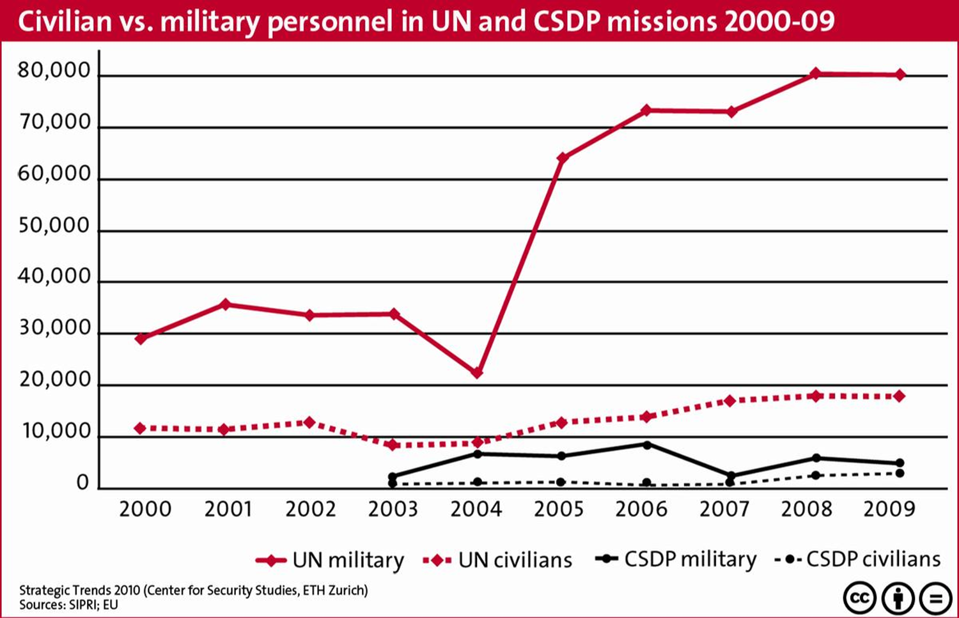

Slide 24
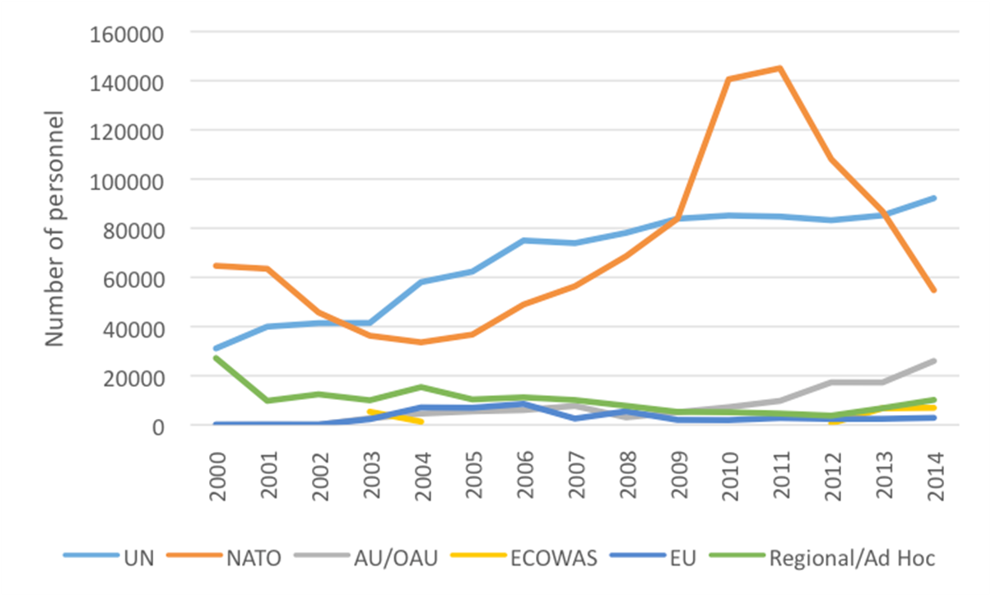
Numbers of personnel in EU missions in comparison to other IOs

Slide 25
Added value of EU crisis management
EU’s comparative advantage – decisive contribution in three types of situations:
The EU was willing and capable to act…
  1) where other organizations were not
    Others not willing / politically capable of acting (Kosovo, Georgia)
    Others could not deploy quickly enough to stabilize the situation (“bridging operations” Tchad, CAR, DR Congo)
    European presence → mitigating effects (EUFOR DRC)
    EU MSs offered specific capabilities (EUNAVFOR Atalanta)
    EU contribution linked to its geographical scope (Horn of Africa, Sahel, the Balkans)

Slide 26
  2) when there was a specific demand for the EU to intervene
    EU perceived as particularly legitimate to help solve a conflict in its neighbourhood (the Balkans, Georgia)
    EU perceived as more neutral (Aceh, Rafah)
    EU acting as a mediator in the conflict (Aceh, Georgia)
    EU covering specific needs which others did not address: security sector reform, rule of law, border management, airport security
    A broad range of diplomatic, civilian and military tools was needed to deal with the situation + presence of an EU Delegation on the ground

Slide 27
  3) in low- to medium-intensity conflict environments
    Mostly pre- or post-conflict situations
    NATO – high intensity conflicts
    UN – needs peace to keep before deploying
  Otherwise…
    EU serves as a clearing house for member states’ contributions (e.g. Lebanon, Haiti)
    EU contributes to UN PK or monitoring missions by other means
    EU builds the capacity of other regional organizations (e.g. AU, ECOWAS, Arab League of States)

Slide 28
Role of EU crisis management operations
EU crisis management missions & operations (CMO) = major vehicle for realizing EU security policy
  From an instrument at the service of the CFSP to a major driving force of the EU’s external policy
  ESDP as a boost of CFSP which lacked the tools to deliver
  ESDP relatively isolated; rapid development; British-French tandem
Serve the broader aim of positioning the EU on the international stage
  CMO as a symbol of the search for a niche on the world stage
  CMO as the most significant / defining feature of the ESDP

Slide 29
What EU CMO are?
  Formally = reactions to crisis on the ground
  X More than crisis management tools
  Provide important building blocks in the construction of an EU security policy
    Artemis (autonomous military operation)
    Aceh MM (“going global”)
    The Balkans/ME (commitment to the neighbourhood)
Deployment decisions as a strategic search for opportunities, directed towards the external as well as internal audience
EU CMO as a response to an international security issue & a political means to advance a particular agenda
EU looking for deployments that promise to generate maximum political capital & avoiding challenges that might end up in total disaster
= Strategic approach → EU CMO as a success story

Slide 30
EU’s performance in crisis management: main features
Civilian crisis management
Military crisis management
…
…
…
…
…
…

Slide 31
Current developments
EU Global Strategy (EUGS)
Unfortunate timing (June 2016)
Defines common ends of the EU´s external action and identifies means to achieve them
Presents a fairly realistic, pragmatic and cautious picture of what the EU does, and can do
Goes back to the basics and puts the immediate interests of European citizens first
While normative power Europe is perhaps dead, civilian power Europe is very much alive
Has created a momentum on EU security and defence
„Resilience“ as a new leitmotif of the EU´s external action
Broadens the understanding of the comprehensive approach to crisis management

Slide 32
Permanent Structured Cooperation (PESCO)
Treaty of the EU (Lisbon Treaty), Articles 42(6) and 46
A Treaty-based framework and process to deepen defence cooperation amongst EU MSs who are capable and willing to do so
Key requirements:
  To enhance coordination in defence affairs
  To increase investment in defence
  To increase cooperation in developing defence capabilities
Binding commitments undertaken by participating MSs
Participation voluntary
Decision-making in the hands of participating MSs (unanimity)
November 2017 – 23 MSs signed a common notification on the PESCO = the first formal step to set up the PESCO (now waiting for a Council decision establishing PESCO)

Slide 33
Sources
Biscop, Sven. 2008. “The European Security Strategy in Context”. In The EU and the European Security Strategy, edited by Sven Biscop and Jan Joel Andersson. Oxon: Routledge.
EU. 2003. “A Secure Europe in a Better World. European Security Strategy” (http://www.consilium.europa.eu/uedocs/cmsUpload/78367.pdf).
EU. 2016. Shared Vision, Common Action: A Stronger Europe. A Global Strategy for the European Union’s Foreign And Security Policy (http://europa.eu/globalstrategy/sites/globalstrategy/files/pages/files/eugs_review_web_13.pdf).
EU. 2017. “Overview of the current EU mission and operations“ (https://eeas.europa.eu/headquarters/headquarters-homepage_en/430/Military%20and%20civilian%20missions%20and%20operations).
Hazelzet, Hadewych. 2013. “The added value of CSDP operations.” ISS EU (http://www.iss.europa.eu/uploads/media/Brief_31.pdf).
Howorth, Jolyon. 2014. Security and Defence Policy in the European Union. Hampshire: Palgrave Macmillan.
“Joint Declaration on European Defence”, Franco-British Summit, Saint-Malo, 4 December 1998 (http://www.atlanticcommunity.org/Saint-Malo%20Declaration%20Text.html).
Kurowska, Xymena. 2008. “The Role of ESDP Operations.” In: European Security and Defence Policy. An implementation perspective. Eds. Michael Merlingen and Rasa Ostrauskaite. London – New York: Routledge, 25–42.
Sherriff, Andrew. 2013. Time to clear the confusion around the Comprehensive Approach. European Centre for Development Policy Management (http://ecdpm.org/talking-points/clear-confusion-around-the-comprehensive-approach/).

