Slide 1
Liberalism: markets and interdependencies
Petr Ocelík
MEB401 Teorie bezpečnosti a metodologie / MEB427 Bezpečnost: teorie a koncepty
12th October 2017

Slide 2
Outline
Liberalism in International Relations.
Liberalism: agency and structure.
A complex interdependence.

Slide 3
Liberalism in IR
International system (IS) is anarchically organized.
But, the effects of anarchy are mediated by institutions and interdependencies.
The IS consists of national states and non-state actors such as firms or NGOs.
Conflict is not an inherent feature of the IS.
The domestic level processes are important for our understanding of international politics (“bottom-up” perspective).

Slide 4
Economic theories’ influence
Liberalism has been heavily influenced by economic theory.
Neoclassical economy:
market mechanism
Neoinstitutional economy:
institutional context of market functioning (e.g. transaction costs)
direct influence on neoliberal institutionalism (Keohane & Nye)

Slide 5
Agency
Agency: concept of a social actor.
Actor: an entity that is able to make decisions.
Liberalism holds rather optimistic view of agency.
Two variants:
Classical Liberalism: assumption of an essential harmony of interests.
Neo-variants of Liberalism: agency based on rational actor model where actors maximize their utility.

Slide 6
Agency: methodological individualism
Neo-variants of Liberalism are based on methodological individualism (MI).
MI assumes that structures result from actors’ interactions and stresses the individual (actor) level of explanation.
→ The emergence of complex higher-level phenomena, such as a segregation or war, can be explained by actors’ interactions.

Slide 7
Structure: a market
Structure: a context that enables and constraints actions of actors.
Neoclassical economy: a market mechanism.
Aggregates actors’ interests.
Effectively distributes their resources.
Provides information (signals) about the environment.

Slide 8
Supply / demand

Slide 9
Structure: a complex interdependence
Structure: a context that enables and constraints actions of actors.
Neoliberal institutionalism: a complex of institutions and interdependencies.
Complex interdependence:
Weakened state-centrism: trans-/national and governmental relations.
Borders between international/domestic and high/low politics are eroding.
States’ behavior is influenced by international regimes and interdependencies.

Slide 10
Structure: an international regime
International regime: an intentionally created institution that establishes norms and principles according to which actors’ expectations about a particular issue converge.
Regimes are often “complemented” by international organizations.
International regimes have a (semi)autonomous status.
Functions of regimes (Keohane 1982):
Convergence of expectations.
Reduction of uncertainties.
Reduction of transaction costs.

Slide 11
Structure: interdependence

Slide 12
Structure: interdependence

Slide 13
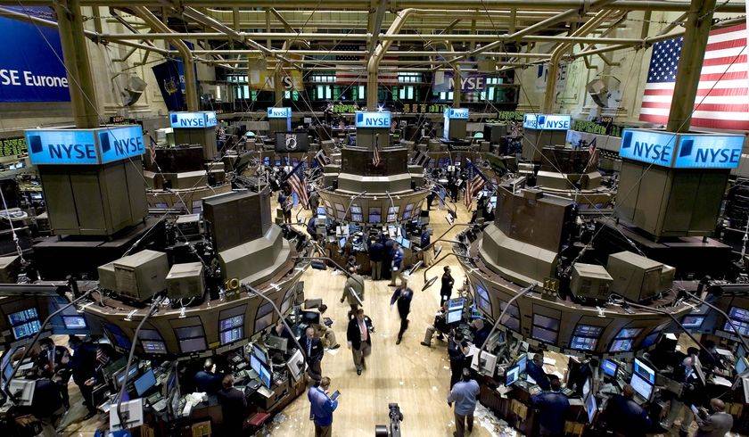
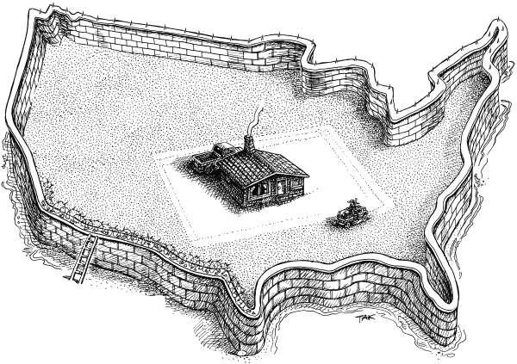
Structure: interdependence

Slide 14
(inter)dependence vs. (inter)dependency
(inter)dependence ~ (mutual) bilaterally defined relation.
E.g.: import dependence, security dependence, capital dependence etc.
→ issue specific, narrowly defined relations
dependency ~ structurally defined relation.
A complex relationship between center and (semi)periphery.
→ a broad pattern of relations that maintains underdevelopment of periphery.

Slide 15
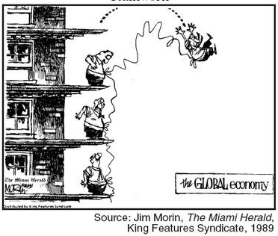
Structure: an interdependence
Interdependence: a relation of mutual, typically,
asymmetrical dependence that, when disrupted,
brings significant costs and constraints to both
parties.
→ It is not possible to a priori say whether the
costs of disruption overweight the benefits.
→ The “strategic commodity” does not exist;
its importance is given by the cost/benefit calculation.

Slide 16
Interdependence: sensitivity
Sensitivity: given by an (in)ability to decrease externally imposed costs before (or without) adaptation measures are implemented.
(1) How high are the costs?
(2) How quickly the costs come?
What could be examples of regulation or policy responses that decrease sensitivity?

Slide 17
Interdependence: sensitivity
Sensitivity: given by an (in)ability to decrease externally imposed costs before (or without) adaptation measures are implemented.
(1) How high are the costs?
(2) How quickly the costs come?
E.g.: utilization of storage capacities, spot market trade, activation of diversification contracts etc.

Slide 18
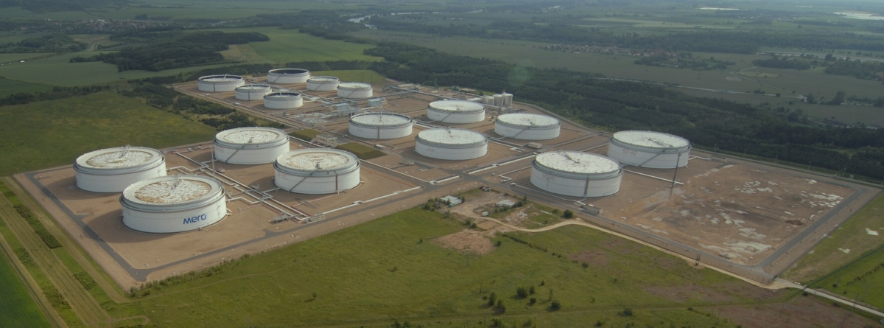
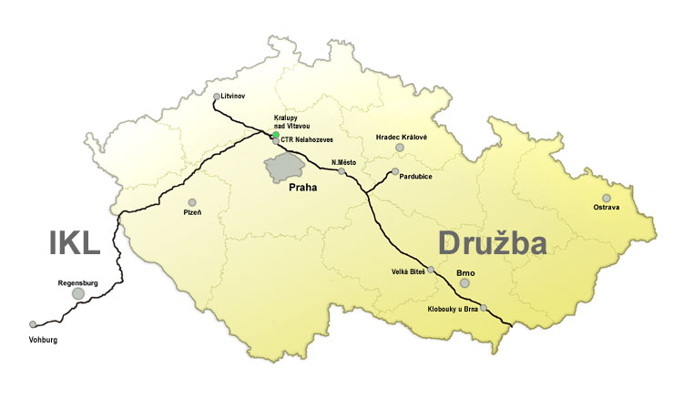
Interdependence: sensitivity

Slide 19
Interdependence: vulnerability
Vulnerability: given by an (in)ability to decrease externally imposed costs after adaptation measures (AM) are implemented.
(1) How high are the costs after the AM are implemented?
(2) How quickly the costs decrease after the AM are implemented?
What could be examples of regulation or policy responses that decrease vulnerability?

Slide 20
Interdependence: vulnerability
Vulnerability: given by an (in)ability to decrease externally imposed costs after adaptation measures (AM) are implemented.
(1) How high are the costs after the AM are implemented?
(2) How quickly the costs decrease after the AM are implemented?
E.g.: restrictions of energy consumption, investments in diversification and alternative sources of energy, restructuring of economy etc.

Slide 21
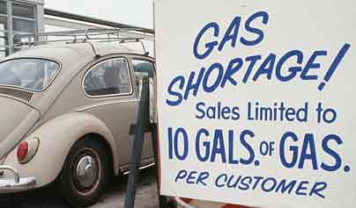
Interdependence: vulnerability

Slide 22
