Slide 1
Social constructivism
Petr Ocelík
MEB401 Teorie bezpečnosti a metodologie / MEB427 Bezpečnost: teorie a koncepty
26th October 2017

Slide 2
Outline
Constructivism as a social theory
The construction of social reality (John Searle)
Discourse
Frame
Mini-case study

Slide 3
Constructivism as a social theory
Idealism: social world is primarily created and driven by ideas
Interpretativism: social phenomena do not exist independently of our interpretations of them
Thus: social world is being constructed
Social constructivism is not an IR theory
It is a social theory that provides an explanation or understanding of social organization as such

Slide 4
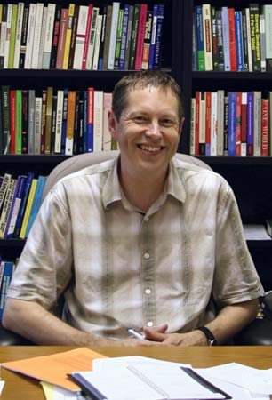
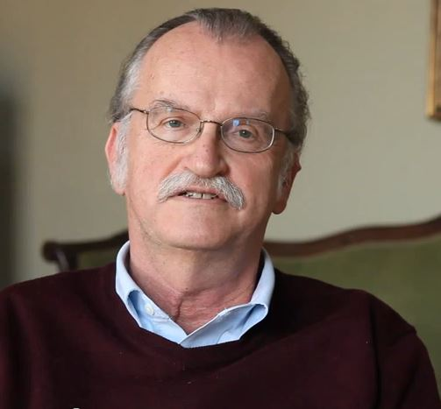
Strong vs. weak constructivism
Weak constructivism:
Allows causal explanations
Allows objective knowledge
(Differentiates between brute and social facts)
Strong constructivism:
Rejects the concept of causality
Rejects the possibility of objective knowledge
(There are only social facts)

Slide 5
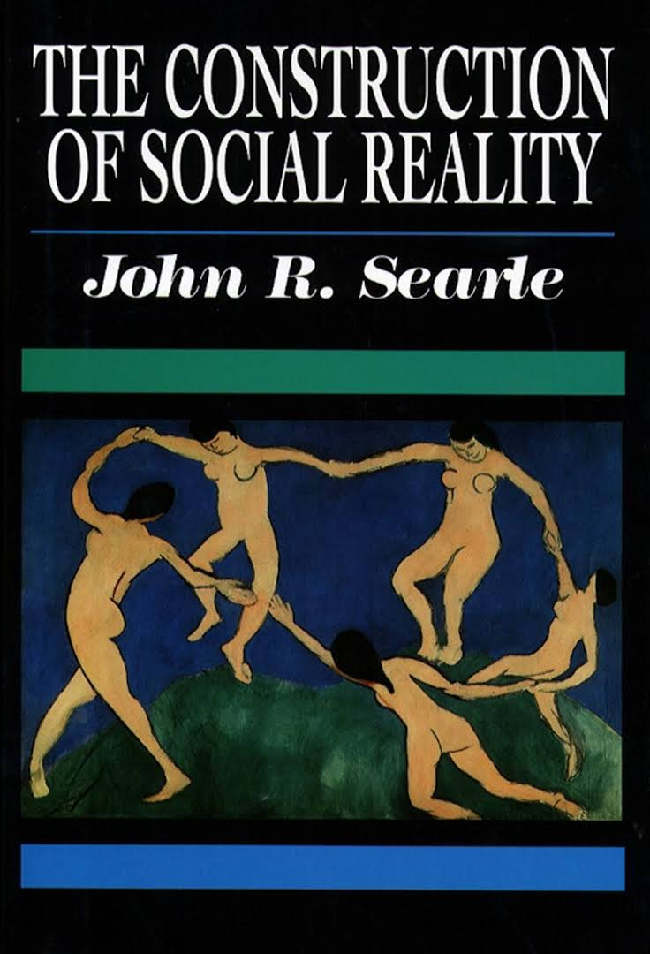
John Searle: The Construction of Social Reality
Brute vs. social/institutional facts
Function assignment
Individual vs. collective intentionality (~ subjectivity vs. intersubjectivity)
Regulatory vs. constitutive rules

Slide 6
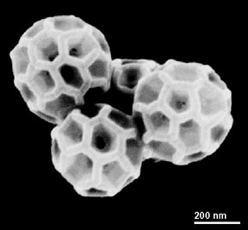
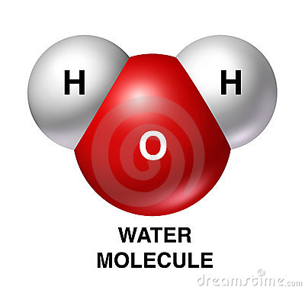
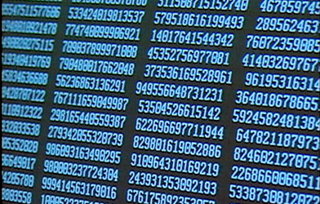
Brute vs. social facts
Brute facts:
Mind-independent
Independent on other facts
Social facts:
Mind-dependent
Dependent on social context, i.e. language, actions etc.

Slide 7
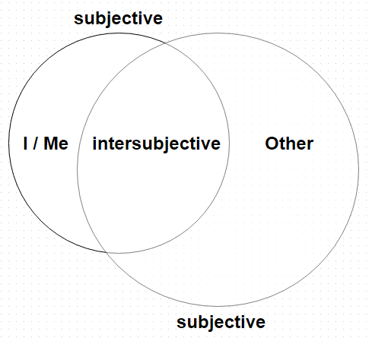
Collective intentionality / intersubjectivity
The intersubjectivity is established through convergence of expectations about self and Others
→ social facts always exceed individual level
→ social facts are always intersubjective
E.g.: I can really play ice hockey (I) only if
we have shared understandings (intersubjectivity)
of my role (Me) as well as of role of others (Other)
in the game and about what constitutes the game

Slide 9
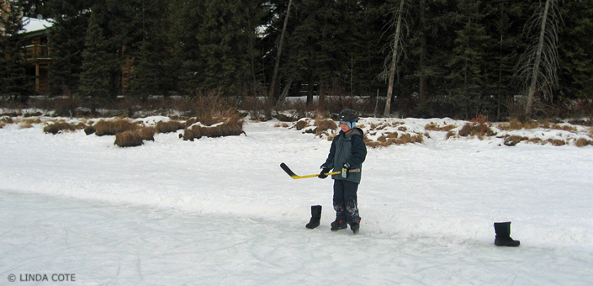
Function assignment
The function of a given object is not inherent, it is assigned to the object by its use
A parallel with Wittgenstein’s “tool theory of meaning”
General form of a status function:
X counts as Y in context of Z
E.g.: boots (X) count as goal posts (Y)
while playing ice hockey at a pond (Z)

Slide 10
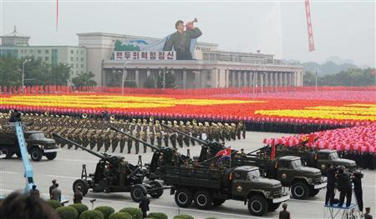
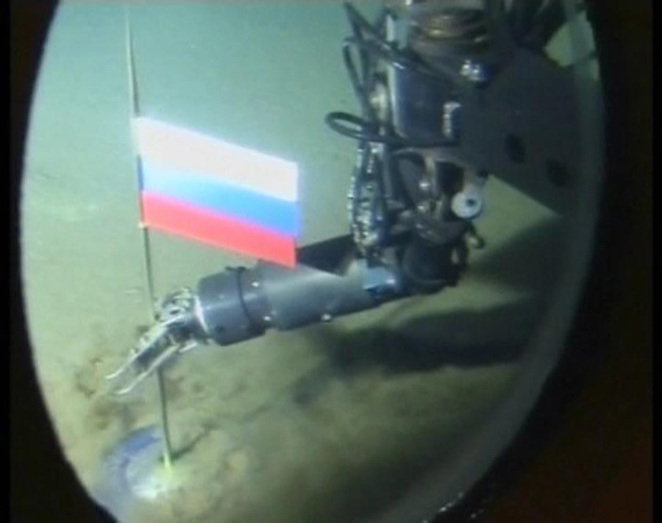

Slide 11
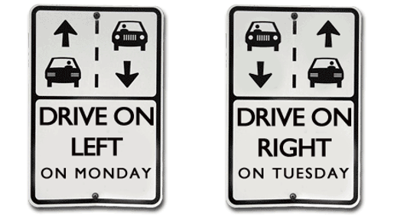
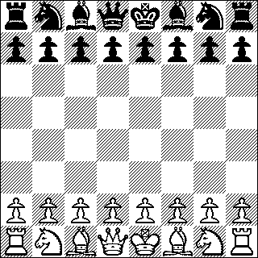
Regulatory vs. constitutive rules
Regulatory rules govern existing activities
→ activities do not depend on them
Constitutive rules not only regulate, but also create/constitute given activities
→ activities do depend on (are made of) them
Any examples of constitutive rules in international politics?

Slide 12
Social construction

Slide 13
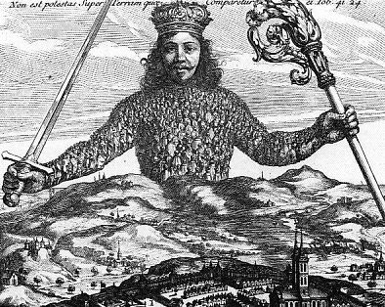
Sovereignty as a social construction

Slide 14
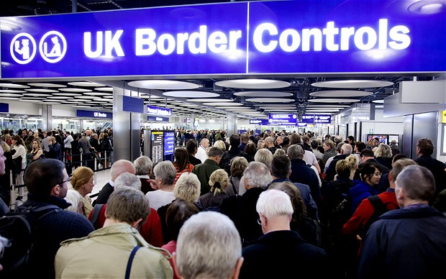
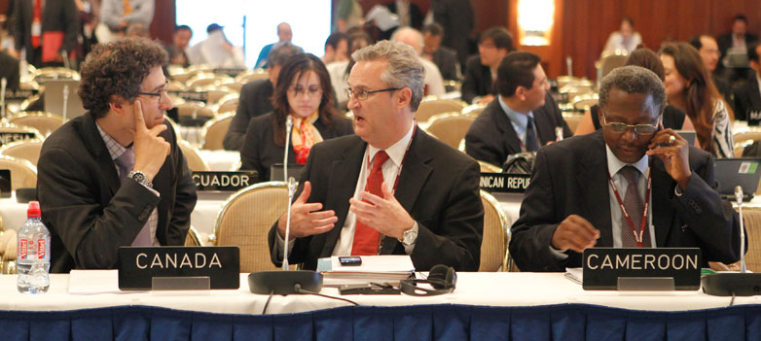
Sovereignty as a social construction

Slide 15
Discourse
Discourse: an institutionalized use of language and other meaning systems (images, gestures etc.)
Discourse provides, more or less, coherent account of some issue
It shapes how we speak and think about the issue
→ power is exerted and maintained through discursive operations
We are embedded in a plurality of overlapping discourses

Slide 16
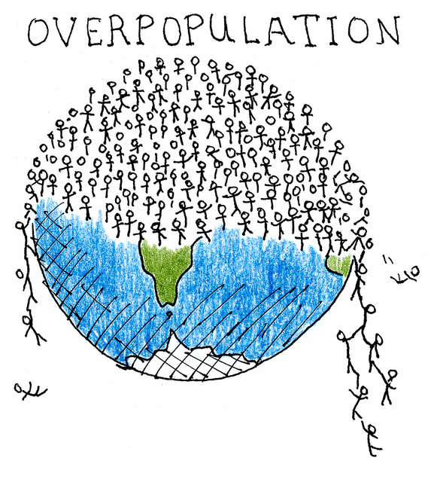
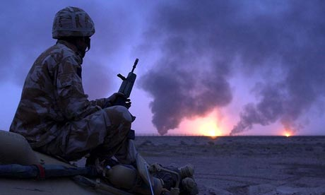
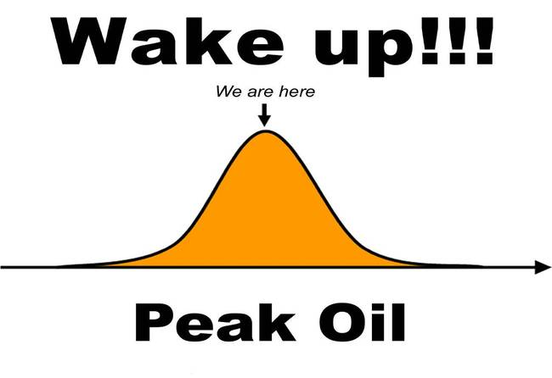
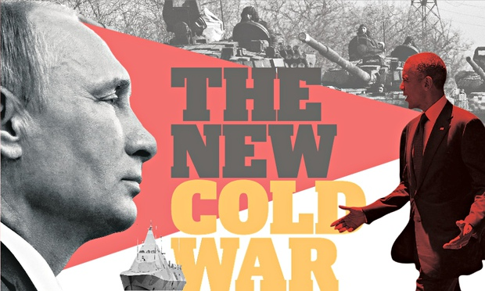
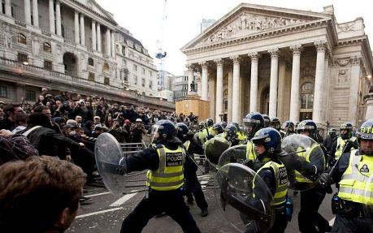
Malthusian discourse

Slide 17
Frame / framing
Frame: a shared interpretative scheme through which actors understand and promote certain version of reality
Actors – via framing – strategically emphasize or suppress certain aspects of a given issue
The purpose of framing: promote own interpretation of the issue → make it hegemonic (critically unquestioned)

Slide 18
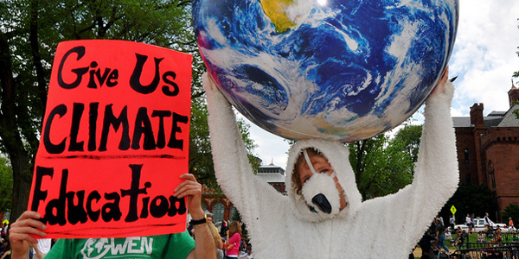
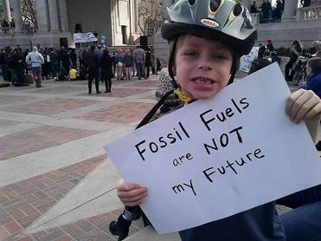
Framing: climate change

Slide 19
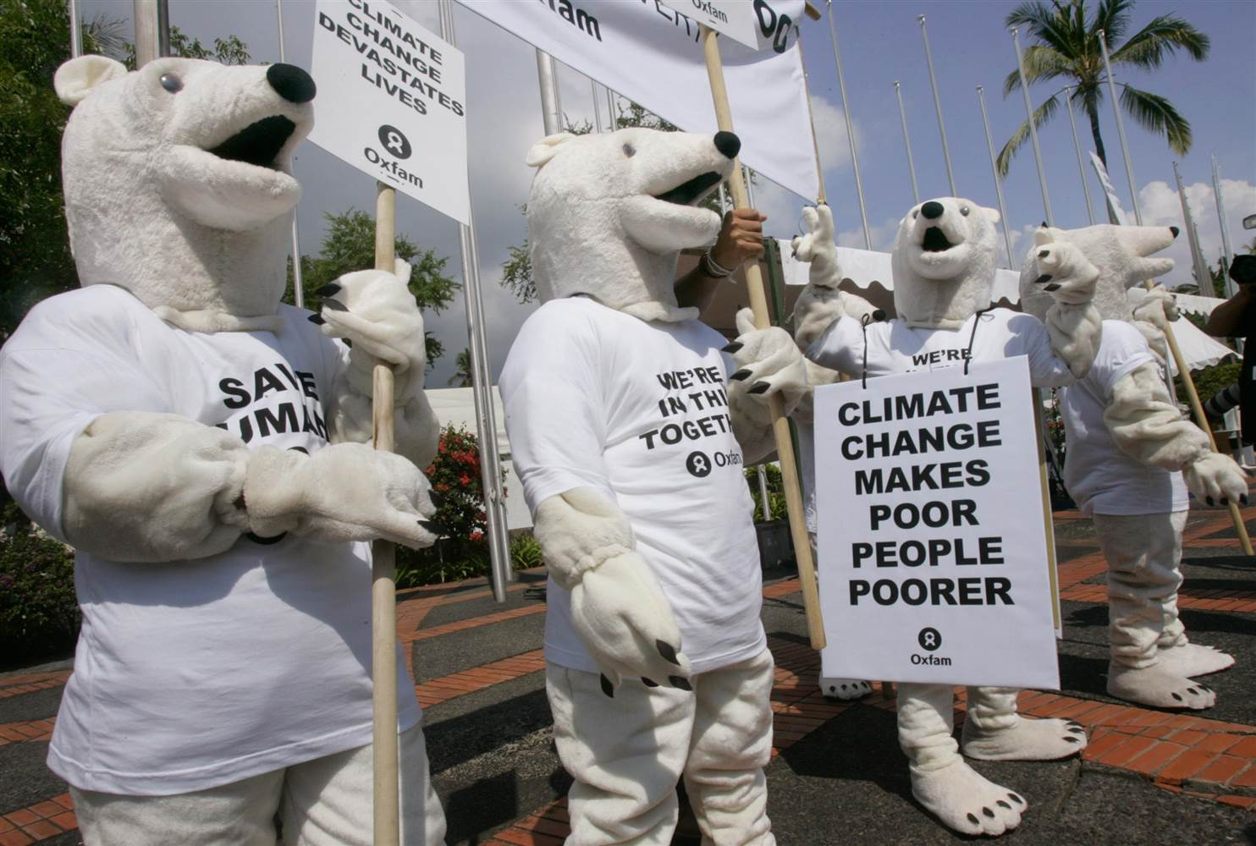
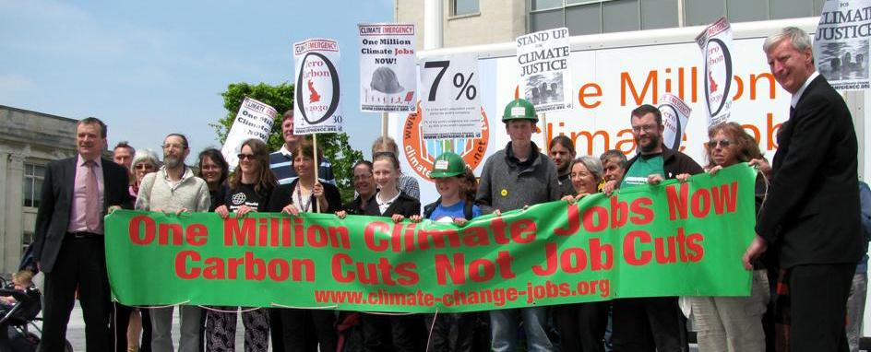
Framing: climate change

Slide 20
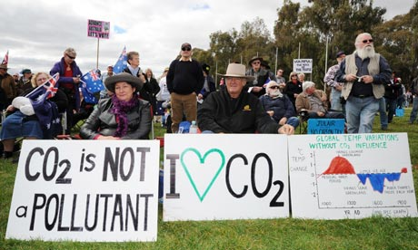
(Contra)framing: climate change

Slide 21
Constructivist analysis: mini-case
Framing of unconventional natural gas resources (UNG) in Russian foreign policy in 2009 - 2011
RQ: how is the meaning of UNG constructed? Through which frames it is promoted?
For details: http://www.sciencedirect.com/science/article/pii/S0301421514002171

Slide 22
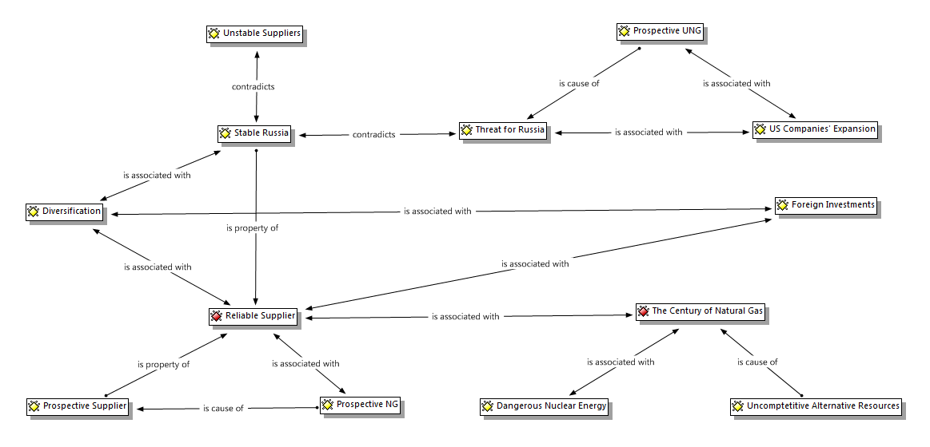

Slide 23
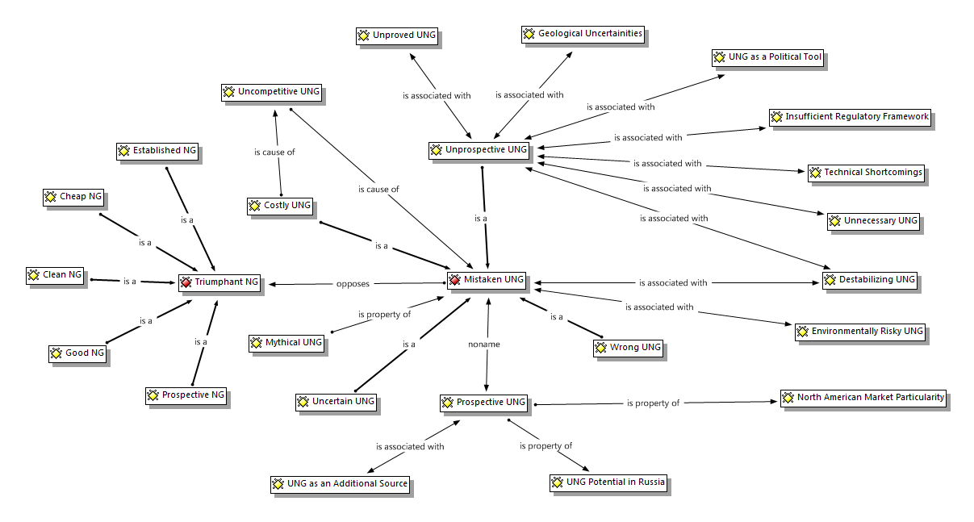

Slide 24
Concluding remarks
Constructivism challenges materialism and essentialism
Every institution is historically and socially conditioned → subversive potential
Constructivism links the use of language with power relationships → emancipatory potential
Constructivism accepted as a (mainly) ontological framework by many post-rationalist approaches (critical approaches, post-structuralism, to some extent New materialism)

