Slide 1
Copenhagen School: Revisions
Petr Ocelík
MEB401 Teorie bezpečnosti a metodologie / MEB427 Bezpečnost: teorie a koncepty
9th November 2017

Slide 2
Outline
Securitization: assumptions
Internal inconsistencies (Balzacq 2005):
  speech act vs. pragmatist act
  speaker-audience relationship
External insufficiencies (Stritzel 2007):
  discursive context
  threat-texts
  power positions: embedded agency

Slide 3
Security as a social construct
There is no “essence”, no universal feature of security.
But: according to CS follows logic of survival (Ciuta 2009)
Security is socially constructed and intersubjectively shared.
Security is a self-referential practice: an issue becomes a security issue only by being labeled (via appellative act) as one.
→ Focus on discursive construction of security issues.
Notes:
Different logics of security possible? (Ciuta 2009)

Slide 4
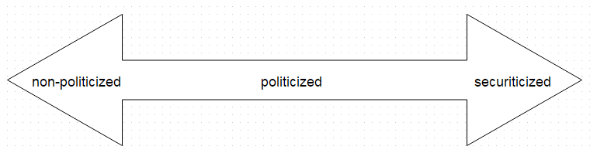
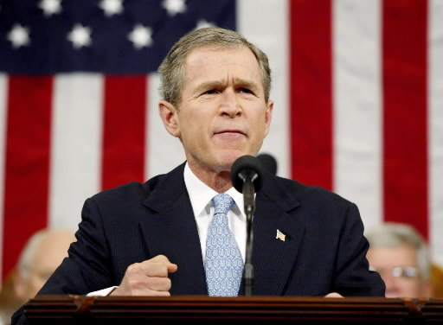
Securitization
Framing
  standard (depoliticized)
  politicized
  securitized
Securitization actors: ones that declare – via illocutionary speech act – existential threat towards a particular referent object.
Functional actors: ones that significantly affect the dynamic of the security environment (sector).
Audience acceptance
Exceptional measures
Linkages

Slide 5
Speech acts
Constative act: the literal meaning of the utterance.
Appellative act: the social function of the utterance, for what purpose it is used in a given context.
Performative act: the effect of the utterance in a given context.
“I warn you, the oil is running out!”
Constative act: made vocal sounds, said that with a Czech accent.
Appellative act: making a warning about (an existential) threat.
Performative act: made you (audience) feel insecure (or amused).

Slide 6
Facilitating (felicity) conditions
The speech act is following the grammar of security (i.e.: existential threat to referent object requires extraordinary measures)
The relationship between speaker and audience (i.e.: the speaker has a privileged/authoritative position in relation the audience)
Features of the alleged threats that either facilitate or impede securitization (i.e. information about the alleged threat outside of the speech act)
Buzan et al. 1998 in Stritzel 2007: 364

Slide 7
Balzacq’s revision
  Distinguishes between brute and institutional threats.
    Institutional threats: depend on social construction / intersubjectivity
    Brute threats: do not depend on social construction (natural catastrophes)
  Reduction of speech acts to appellative acts is misleading.
  → does not allow interaction with the audience (performative effects)
  Solution: broader concept of a pragmatic act
    strategic use of language centered at a specific audience
    cultural embeddedness (“clues from ‘the real world’”)

Slide 8
Balzacq’s revision: pragmatic act
  The processes of securitization – a pragmatic act – consist of:
  A relatively stable system of discursive resources (metaphors, images, stereotypes, etc.),
  mobilized by an agent (securitization actor), who
  strategically targets the audience to build
  a coherent network of implications that convene with actor’s actions, by
  portraying the referent subject (entity that threatens) in a way that
  a customized political act must be taken to block its development
  within a specific social and space-time context

Slide 9
Balzacq’s revision: situated interactive activity
  The speaker and the audience need to engage in responsive activity → the speech act is just “a blueprint” based on which audience flesh out missing meanings/details.
  Thus, the speaker’s argument has to employ terms that resonate with understandings (by speeches, gestures, images, etc.) of audience.
  → relation to external reality (external to securitization process)
  The success of securitization is here given by mutual (intersubjective) understanding and the speaker’s ability to identify audience’s feelings, needs and interests.

Slide 10
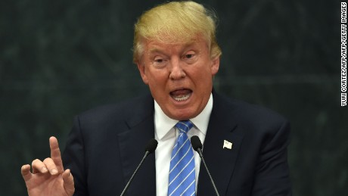
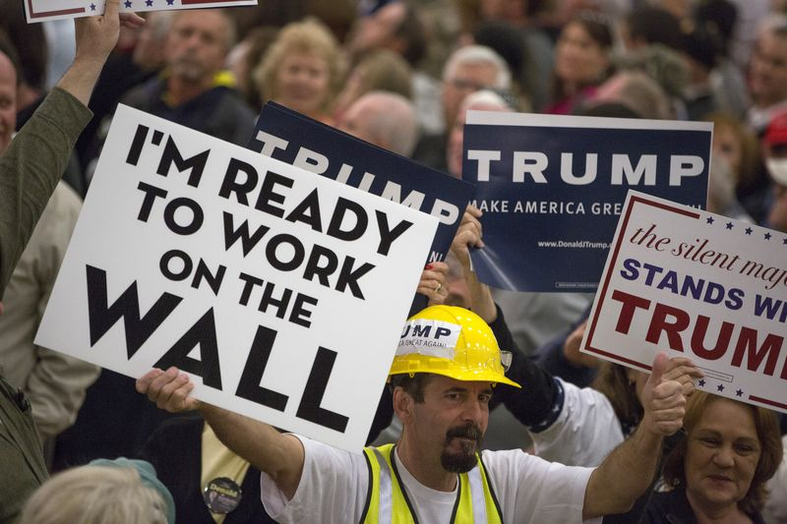
Balzacq’s revision: situated interactive activity

Slide 11
Stritzel’s revision
  Distinguishes between internalist and externalist position (compare with Balzacq 2005).
  Internalist position: speech acts are capable to transform understanding of a certain issue (if the felicity conditions are fulfilled): “By saying the words, something is done.” (Buzan et al. 1997: 26)
  Externalist position: securitization is a process – not just a particular speech act - that takes place in concrete socio-temporal context.
    Broader discursive environment
    Production of “threat-texts”
    Power positions (field)

Slide 12
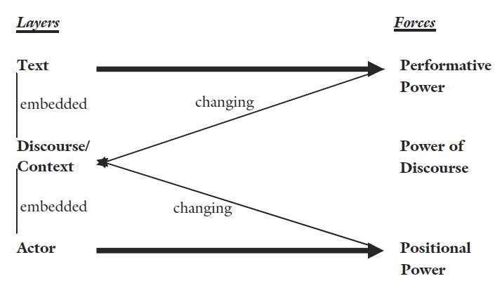
Stritzel’s revision

Slide 13
Discursive context / embeddedness
  The speech acts and texts (“threat-texts”) are embedded within a network of constitutive rules and narratives that surround them. (Stritzel 2006: 369)
  The (security-related) meanings do not come “out of nowhere” or just from securitization actors’ heads.
  → involved actors/audiences need to understand a speech act (or a threat-text)
  Actors exploit discursive contexts as stocks of ideas, images, analogies, metaphors or – historical/cultural traumas (Sztompka 2000).

Slide 14
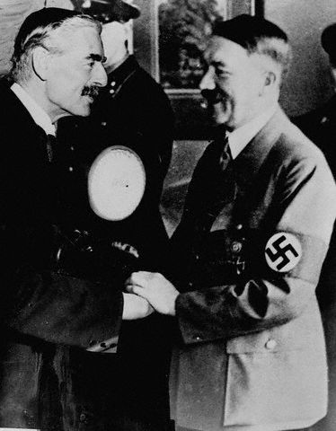

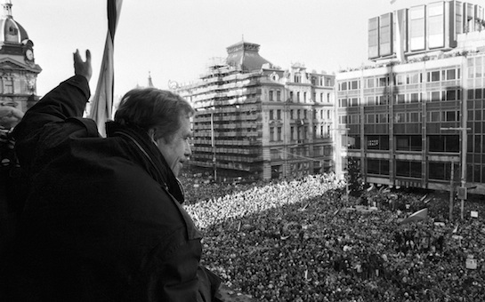
Historical/cultural trauma (Sztompka 2000)

Slide 15
Stritzel’s revision

Slide 16
“Threat-texts” (Stritzel 2007)
  In contrast to exceptional speech acts, threat-texts evolve over longer periods of time and have performative force that shapes discourse as well as (consequently) power-relations.
  Again, “fit” of the threat-text with the existing discourse (its resonance) is crucial for its influence.
  → localization (Stritzel 2011): re-interpretation of a threat-text in a particular context where it meets a new (local) audience.
  Thus: what counts as a security practice in one period or locale, does not necessarily count in the same way in other periods/locales (ibid.).

Slide 17
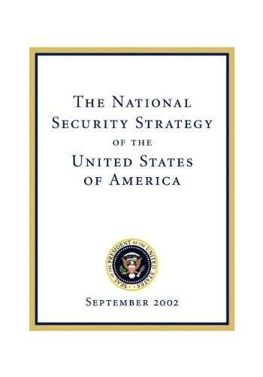
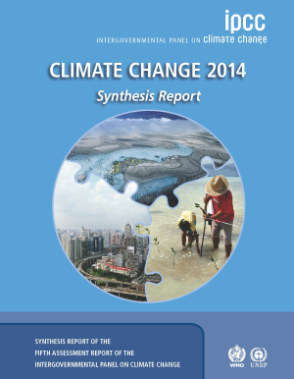

Threat-texts

Slide 18
Stritzel’s revision

Slide 19
Power positions: embedded agency
  Agency is embedded sociopolitical context where actors occupy different power positions defined by access to cultural (knowledge), moral (legitimacy), and formal (capability to make decisions) resources.
  → There is an uneven distribution of opportunities and constraints to the actors.
  → This embeddedness poses objective (in sense actor-independent) limitations (objective context according to Balzacq) to securitization moves.

Slide 20
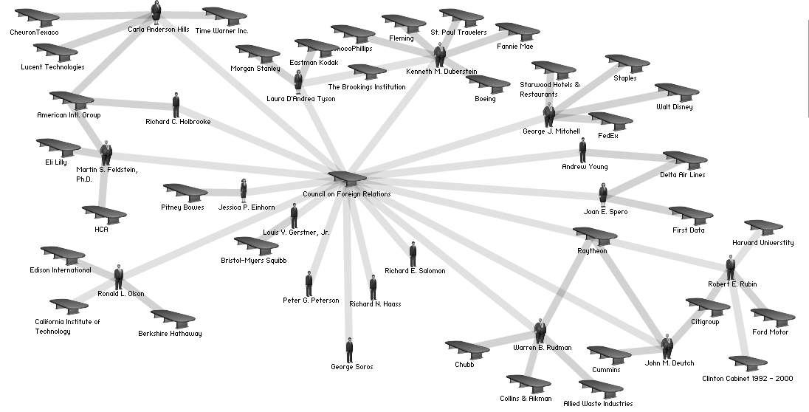
Power positions: embedded agency
https://en.wikipedia.org/wiki/Council_on_Foreign_Relations

Slide 21
Conclusions
  Internal inconsistencies:
    speech act vs. intersubjectivity (securitization actor – audience)
    what is the position of securitization theory within the whole framework? (Eclecticism of the Copenhagen School)
  External insufficiencies:
    is contextual understanding of securitization necessary?
    is there added value of the introduced concepts in comparison to facilitating conditions?
  Your thoughts? What to do with the CS? How does this influence our understating of security?

