Slide 1
International political sociology (Paris school)
Petr Ocelík
MEB401 Teorie bezpečnosti a metodologie / MEB427 Bezpečnost: teorie a koncepty
16th November 2017

Slide 2
Outline
International political sociology (IPS): assumptions
The “practice turn”
Sociology of Pierre Bourdieu: field, capital, and habitus

Slide 3
IPS: assumptions
IPS shares constructivist background with Copenhagen school and CSS
Both security and insecurity are products of an (in)securitization which consists both of discursive and non-discursive processes
Non-discursive processes: technologies, routines and practices etc.
→ The central questions of the IPS: who does securitize what, under what conditions, against whom, and with what consequences?

Slide 4
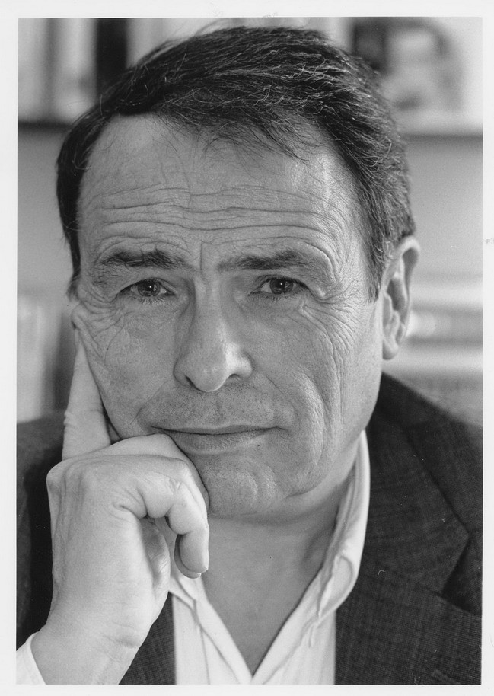
IPS: background
The IPS emerged during 1990s; often related to “Paris school” which draws on sociology of Pierre Bourdieu (1930 - 2002)
Bourdieu attempted to overcome distinction between individualism and structuralism

Slide 5
IPS: the “practice turn”
The IPS is a part of the “practice turn” in IR → focus on what actors do and why (Emmanuel Adler and Vincent Pouliot)
Investigates practical, common-sense knowledge rather than theoretical knowledge
Conceptual differentiation: behavior, action, practice
Behavior: material dimension of “doing”
Action: adds meaning to the behavior
Practice: embeds action within social organized context

Slide 6
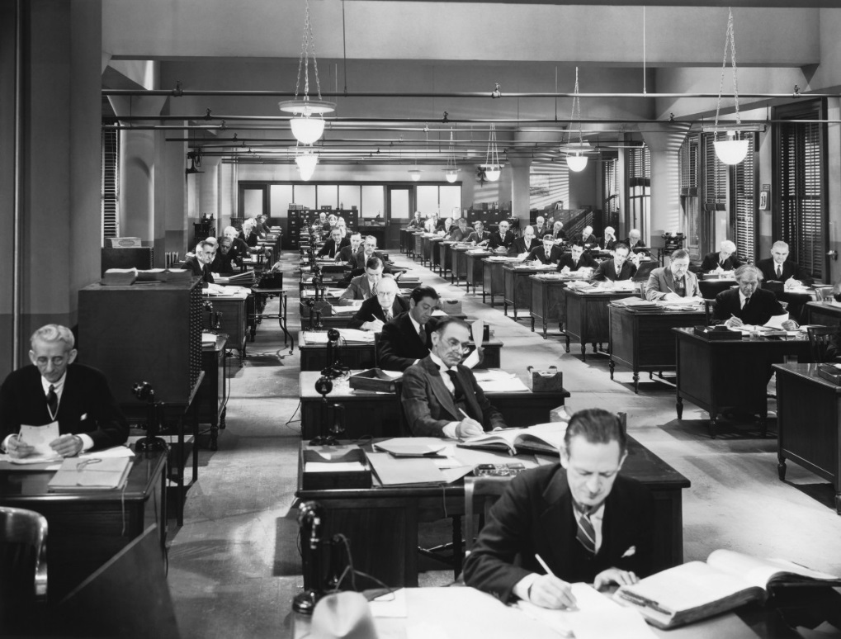
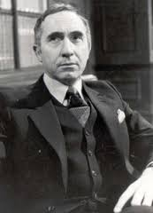
IPS: the “practice turn”

Slide 7
Bourdieu: field
Field: a relatively autonomous, hierarchically organized social space within which transactions, interactions, events etc. in a particular sphere of social life take place
Analogy: a “sports field” or a chess board
There are different kinds of fields: political, military, organized crime, academia, art, medical, bureaucratic, security experts etc.
Each field operates according to its own logic (nomos)

Slide 8
Bourdieu: field
Actors compete among themselves according the field’s rules for specific benefits associated with the field
There are social positions given by power-differentials of actors within the field
The movement of actors between the positions is called (life) trajectory
There is a hierarchy of fields: most fields subordinated to the field of power and class relations (sometimes called field of the fields)

Slide 9
Bourdieu: capital
The structure of the social world is conditioned by the distribution of various forms of capital
Capital: an accumulated labor that enables actors to influence their position and position of others within a given field
Economic capital: an accumulation of money, assets, property rights
Cultural capital: an accumulation of knowledge, abilities, qualifications etc.
Social capital: an accumulation of social ties to potential resources
Symbolic capital: an accumulation of prestige, honor, recognition etc.

Slide 10
Bourdieu: capital
There are various types of capital – anything that differentiates individuals/stratifies society can be seen as a form of capital
E.g. in sport (or bouncers) field, a physical capital crucially stratifies the field
Also, any form of capital can be transformed into a symbolic capital (capital that does not appear as capital)
Symbolic capital is capital of “a different order”

Slide 11
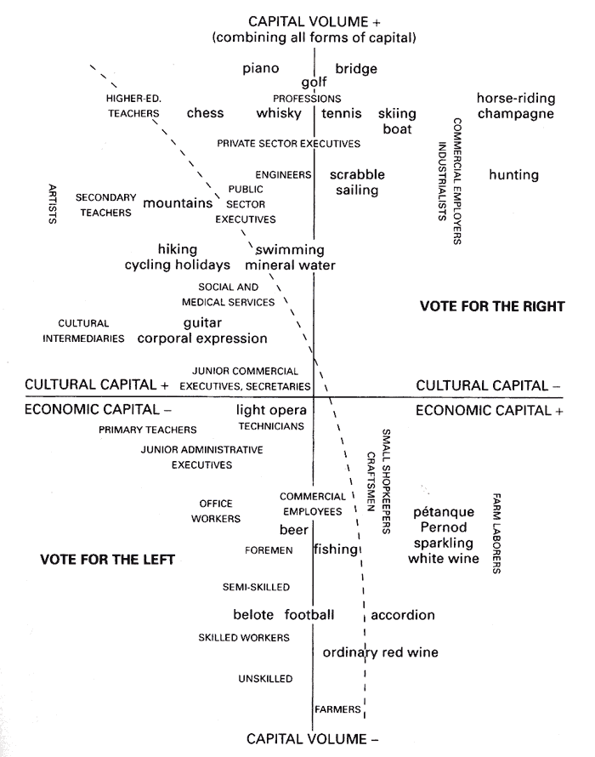

Slide 12
Bourdieu: habitus
Habitus: an embodiment and internalization of the social world which structures how the social world is perceived and experienced and is structured by objective structures of the social world which are not controlled by the actor
Habitus is the link between the private experience of the world (subjective) and the social world itself (objective)
Habitus consists of dispositions that define habitual state, tendencies, and inclinations of an actor
Dispositions (and consequently habitus) are formed by the actor’s encounters of the objective conditions of the social world

Slide 13
Bourdieu: habitus
Preference vs. dispositions: “real” preferences might be hidden vs. dispositions (do not have to correspond with preferences) are performed
The continuous performance of dispositions, often in form of practices, situates actor within a field
Field, capital, and habitus are interdependent
→ Bourdieu: we should research both subjective (habitus) as well as objective (field); see Pouliot “sobjectivism”

Slide 14
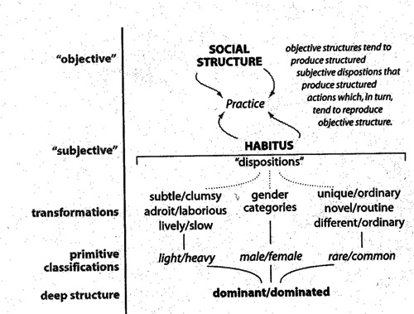

Slide 15
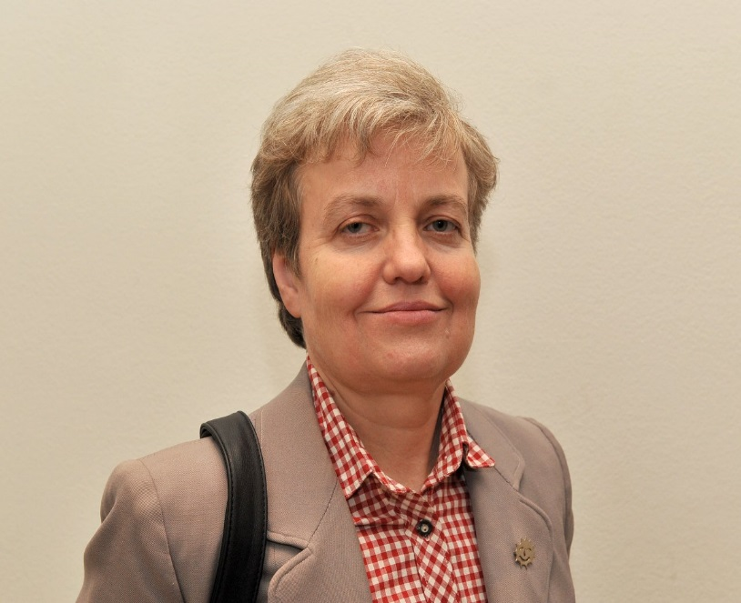
(Security) knowledge re/production
Science influences what can be said and what not:
the non-politicized has no language; it is what we know without knowing that we know it (Berling 2011: 391)
Scientific or expert knowledge: a privileged form (Berling 2011)
Objectification: issue defined as a matter of scientific inquiry or necessity
Legitimation: scientific field influences status of a securitizing actor
Mobilization: securitization claims backed (or even driven) by scientific evidence

Slide 16
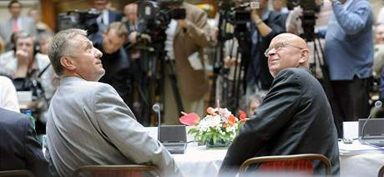
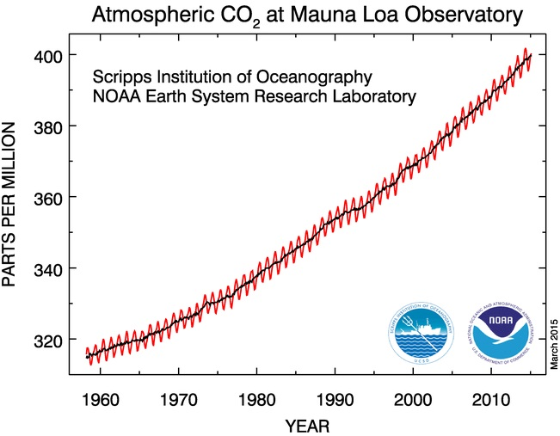

Slide 17
Conclusions
IPS shares constructivist background with Copenhagen and Aberystwyth schools (CSS)
Transdisciplinary
Blurs borders between international and domestic, strategic and everyday...
Many actors compete for their definition of (in)security within various fields
(In)securitization moves have roots in the practices and routines → goal is to uncover and disrupt those “regimes of truth”

