Slide 1
Marxism and its modern interpretations
Nikita Minin
KMVES FSS MUNI

Slide 2
origins
Karl Marx and friedrich engels
1848 - The Communist Manifesto
3 volumes of “capital” (1867-1883)

Slide 3
Basic assumptions
Ontology
Foundationalism
Epistemology
Realism

Slide 4
Key features
Economism
Economic relations are the cornerstone
Materialism
Material relations shape ideas
Structuralism
Economic structures determine the actions of agents
Determinism
Political sphere and state are determined by class relations and mode of production
Dominant ideas promote interests of the ruling class

Slide 5
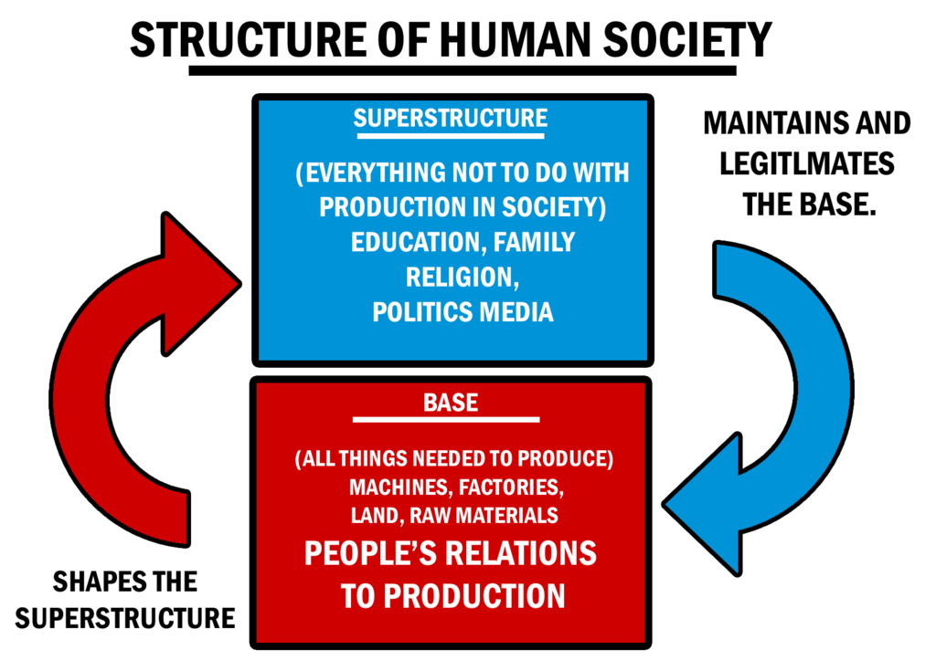
Structure of human society
Source: Deviant Art

Slide 6
Dialectism
Thesis
Contradictions within
Antithesis
Synthesis

Slide 7
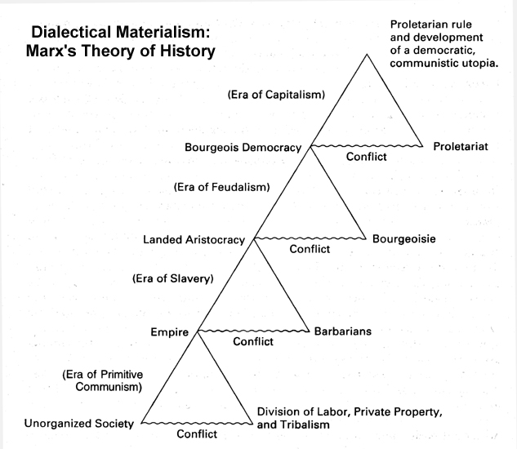
Historical/dialectical materialism
Progress
Emancipatory potential – critical theory
Source: Quora

Slide 8
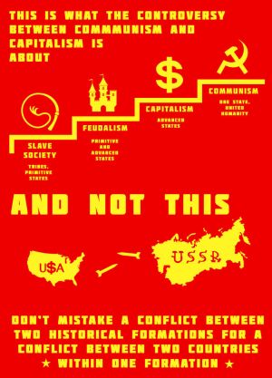
Theory vs. reality
Evolutionary (Kautsky) vs. Revolutionary (Lenin) strains
Scandinavia/Northern Europe vs. USSR and China
Global system vs. Particular Country
Socialism vs. Communism
Source: Deviant Art

Slide 9
3 laws of capitalism (Marx)
Law of Disproportionality
Law of Accumulation
Law of the Falling Rate of Return

Slide 10
Lenin’s 4th law
1917 – “Imperialism, the Highest Stage of Capitalism”
Financial Capital Controls the Industrial One
Law of Uneven Development
Theory of International Relations
Trotsky: World Revolution
Political reasons of capitalism’s demise

Slide 11
Towards Neomarxism
Ontology
More Idealist
Epistemology
More Interpretative
Interpretation Affects Outcomes
Ideas Are Independent; Actors Are Reflexive
The majority of the authors:
Rejects rigid economism, determinism, structuralism, materialism
Acknowledges various factors of structural inequality other than class (e.g. gender, race, etc.)

Slide 12
Some variants
Marxist Feminism
Gender as a factor of structural inequality
Men’s politics are aggressive
Cultural Hegemony of Gramsci
Hegemony is control/leadership/authority
Hegemony is complex: cultural component is crucial
Obsolete distinction between public and private spheres (productive vs. reproductive labor)
Key role of ideology and institutions

Slide 13
neomarxism of I. Wallerstein: world-Systems Analysis
Economic factors dominate global politics
Rejects dialectical materialism
Capital/labor dichotomy

Slide 14
world-Systems theory: threshold concepts
Historical systems: mini-systems, World-Empires, World-Economy
Nowadays – Capitalist World-System or World-Economy
Complex network of economic exchange relationships
Core, semi-periphery, and periphery
Absence of the unified political center or system

Slide 15
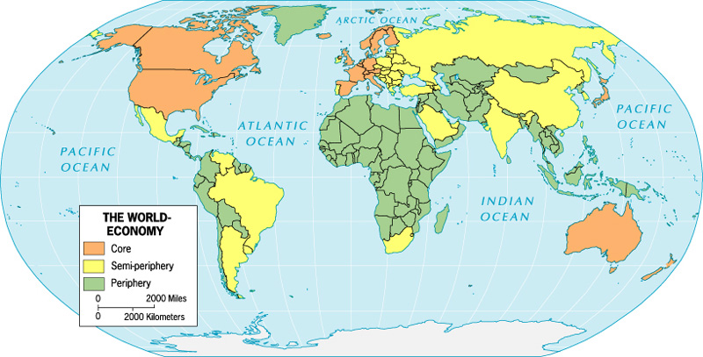
world-Systems Map
Source: Elwell, F. W.

Slide 16
world-Systems theory: practical implications
North/South Divide
“End of liberalism”: Crisis
New System to Resolve the Issues

Slide 17
Afterward: (F)utility?
contradictions within capitalism persist
Capitalism is exploitative
Massive inequalities domestically and internationally vs. division of labor

